Slide 1
Preventing and Responding to Challenging Behavior in a PBIS framework
Everett School District
Maggie Schulze, Ph.D., BCBA-D

Slide 2
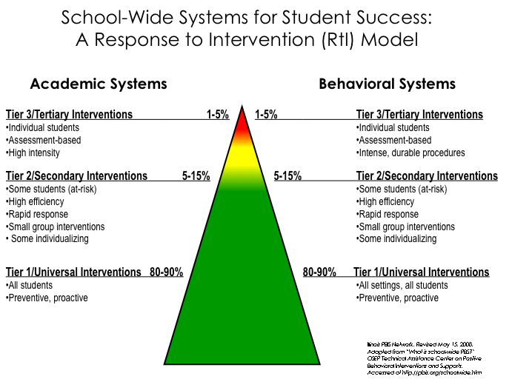
Notes:
2

Slide 3
PBIS Prompts A Shift in Thinking
What about the interaction of the curriculum, instruction, learners, and learning environment should be altered so that the student(s) will learn?
What about the student is causing a problem?
Instead
This shift alters everything else!
Adapted from Batsche and Elliott materials (citing Ken Howell)
Notes:
A major conceptual shift. This puts the problem in the context of alterable variables and moves it outside of the student. When the focus of team meetings is on the discovery of instructional changes that will enable learning, the content of the meeting is quite different from one focused on the discovery of a disability.
(*Sometimes allowing time for discussion of this slide can bring about significant “aha”s.)
Remember our MTSS approach where we are focusing on what we can do or what supports (i.e. instructional changes) we can put in place to help the student be successful. This is a major conceptual shift. This puts the problem in the context of alterable variables and moves it outside of the student
FSCP Ideas:
Use of out-of-school time is considered a major factor in the achievement gap; and can be altered with family and community partnering; coordinated before and after-school programs, summer learning, homework support, technology access – and their interaction with the other variables can be influential

Slide 4
In PBIS We Strive to:
Make Behaviors Ineffective and Inefficient by:
  Restructuring the Environment
  Our Procedures
  Our Responses
It is generally about environmental and adult behavior change and making small changes for big gains.

Slide 5
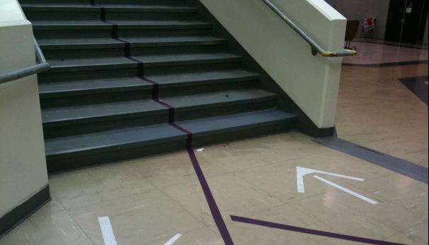
Prevention is Critical
Expectations are clearly defined
  Taught and re-taught
  Visual cues to support
  Pre-correction used
Environment is predictable and consistent
Rules, routines, procedures established
Environment is positive
  Positive reinforcement is used
  5:1 ratio

Slide 8
Fosters positive connections and a positive environment
Focuses attention on positive behaviors and effort
Fosters a positive school/classroom climate
Positive reinforcement increases the occurrence of desired behaviors
It’s not about the “stuff,” it’s about the connection
Positive Reinforcement and Relationships
You get more of what you pay attention to!!!!
Notes:
Emphasize relationships there. Piggy bank.

Slide 9


How Do We Deliver Reinforcement?
Always pair with behavior specific praise
  Gives specific feedback to the student about why he/she is receiving the reinforcer
Ensure all kids receive positive reinforcement
  This might mean rewarding approximations of behavior for some students
    We are SHAPING behavior for these kids!

Slide 10

Turn and Talk
Are your expectations and routines clearly defined and taught and do you refer to them consistently?
Are there visual cues to support your expectations?
How do you currently reinforce your students for following expectations? Do you use the school-wide acknowledgement system?
Notes:
Until 2:20

Slide 11
Understanding Student (Mis)Behavior
From the student’s point of view…
Notes:
2:10

Slide 12
The Secret About Problem Behavior…
Problem behavior is not a “problem” for students!
In fact it is a “solution” for them!
• Behavior happens in contexts, not a vacuum
• Many factors influence problem behaviors
The most important factors are in the IMMEDIATE
context or environment (Simonsen, 2012)

Slide 13
Quick Error Corrections
Your error corrections should be…
  …contingent: occur closely after the undesired behavior
  …specific: tell learner exactly what they are doing incorrectly and what they should do differently in the future
  …brief: after redirecting back to appropriate behavior, move on

Slide 14
Basic Intervention Steps For
Minor Problem Behaviors
First Focus on Keeping Instruction Going and Assign a Task to Students if Needed
Praise/Acknowledge Students Who Are On-Task
Use Proximity
Clearly Restate the Expectation
Provide Choices to Get on Track
Have Plan for Ongoing Non-compliance
Do Not Make Mountains of Molehills
Remember: You Will Get More of the Behaviors You Pay Attention to…
Notes:
This is an area that it might really be beneficial to model implementation. It is the area teachers have least training and confidence in doing and then end up in power struggles.

Slide 15
For Repeated Challenging Behaviors, Ask Yourself…
Do they understand the expectations?
Are they aware that they are exhibiting the challenging behavior?
Are they able to engage in the expected behavior?
Do they want attention (from you? From peers?)
Do they want to escape a task (because it is too challenging)?
IS THIS A CASE OF WON’T DO OR CAN’T DO?

Slide 16
Functions of Behavior
(Won’t Do)

Slide 17
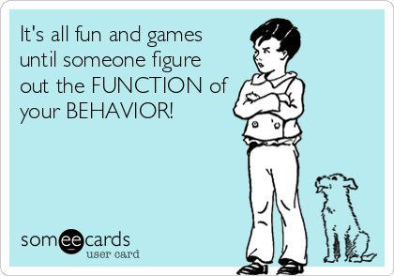
Is Behavior Functional?
Notes:
https://www.youtube.com/watch?v=lXP5rFAJQek

Slide 18
How Do We Determine Function?
We look at the ABCs!
A-Antecedent (what happens before the behavior)
B-Behavior (What the individual does)
C-Consequence (What happens directly after the behavior)

Slide 19
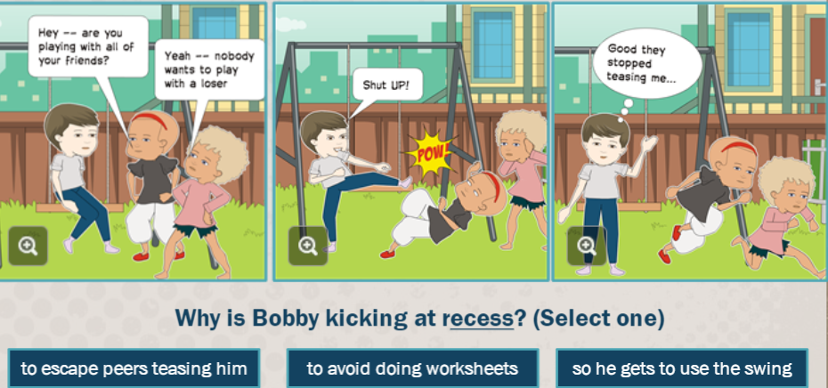

Slide 20
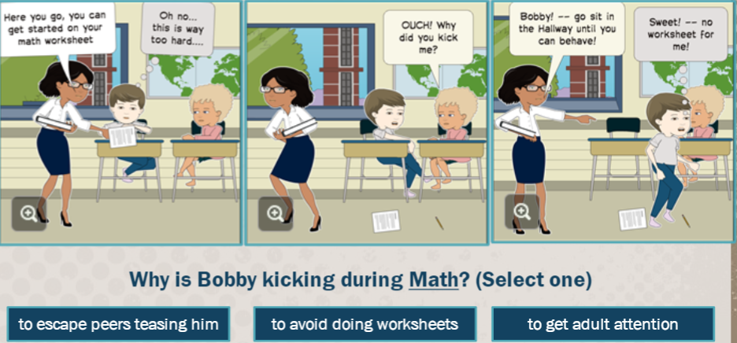

Slide 21
Sometimes obvious – runs out of the classroom
Less obvious – argues or talk outs aboutassignments
Often accessing time-outs or ISS or OSS
Function of the Behavior
Escape Motivated Behavior
Attempt to avoid a task, demand, or person
Obtain Tangible Thing Behavior
Attempt to get a tangible object or a specific agenda
Engaging in Sensory Stimulation Behavior
Student is motivated by looks good, sounds good, taste good, or feels good behaviors.
Attention Seeking Behaviors
Student is trying to gain attention from adults or peers
Often belligerent
Loud
Interrupts adults
Also can be a positive – being a teacher helper
Wants what he wants when he wants it
Inflexible, self-centered
Some history of abuse and neglect
Low frustration tolerance
Operates with the assumption that must take to get needs met
Humming loudly
Must stand up and walk around
Chewing on things
Sensory behaviors often become disruptive
Peers occasionally see these behaviors as weird
Rappaport, N. & Minahan, J. (2013)
Durand, V.M. (1990)

Slide 22
Functions of Behavior
Antecedent | Behavior | Consequence
1. Teacher asks student to complete the assignment | 1. Student rips up paper | 1. Teacher sends student to “Time Out”
2. Phone rings, parent puts child down to answer the phone. | 2. Child starts crying | 2. Parent puts phone down, and cradles child saying, “shhhh”
3. Teacher tells student he/she has to wait | 3. Student hits his/her teacher | 3. Teacher brings student outside classroom and explains hitting is wrong.
4. Teacher walks away from one student to help another. | 4. Student makes disruptive noises. | 4. Teacher returns to student to reprimand him.
5. Parent tells child that they can’t have the item he/she requested. | 5. Child screams and jumps up and down. | 5. Parent gives the item to calm them down.
Escape:
Task or activity
Obtain:
Attention
Obtain:
Attention
Obtain:
Attention
Obtain: tangible
Notes:
So why does this matter? If we all understand the purpose of a behavior, we understand why and how to intervene. If a student blurts out repeatedly in class and we know the function is attention, that helps us figure out what we need to do to stop the behavior. Stop giving him attention and helping him find another behavior to get attention that is more acceptable.

Slide 23
Why Do We Care About Functions of Behavior?
Helps us understand the behavior (the WHY behind it)
Helps us collect data on the behavior for students who are approaching Tiers 2 and 3
Helps us respond to the behavior more effectively
Helps us avoid taking the behavior personally
Become curious rather than furious!

Slide 24
Strategies For Addressing Functions Of Behavior: Attention Seeking
For students seeking attention:
Planned ignoring for off-task behaviors (but providing attention as soon as students are on-task)
Provide more positive attention before challenging behaviors occur
Teach the student how to get attention in a positive way (e.g., raising her hand)
Verbiage:
Praise a nearby peer who is on-task while ignoring target student: “I like how Julie is focused on her math with a quiet mouth and safe body.”
“If you want my attention, Sara, you can raise a quiet hand.” Provide praise and attention when you see that.
“Johnny, I will give you attention when I see you focused on your math assignment.”

Slide 25
Strategies For Addressing Functions Of Behavior: Escape
For students seeking escape:
Don’t kick them out/send them to time-out
Use a break system (Teach them it explicitly)
Expectation is to re-engage after break is over
Reinforce appropriate breaks
Verbiage:
“This might be a good time to take a break. I see you are in the Yellow Zone (frustrated)”
“Great work taking a break to self-manage”
Consider how task demand is presented

Slide 26
Strategies For Addressing Functions Of Behavior: Obtain own Agenda
For students seeking to obtain their own agenda:
Provide choices whenever possible
Support use of self-regulation strategies to increase frustration tolerance
Be mindful of conflict cycles/power struggles
Verbiage:
“You have the choice to sit at your desk or on the carpet. When I see you in the group you will be earning tickets again.”
“You sound frustrated. Let’s use your lazy 8 breathing strategy”

Slide 27
Strategies for Addressing Functions of Behavior: Sensory
For students seeking sensory
  Provide short movement breaks
    Delivering something to the office
    Getting a drink of water
    Moving supplies
    Cleaning the classroom
  Seating supports
    Wiggle seats
    Stools

Slide 28
Related, Respectful, Logical Consequences
Name-calling: Have the student create a book of positive affirmations for the class, or have them create a list of “kind words” and teach them to a younger class.
Low-level physical aggression (pushing, kicking, hitting): Some consequences could include giving the student a new learning space in the room or a new spot in line, or they could be tasked with performing an act of kindness or service for the hurt person.
Inappropriate language: An older student could research the words they used and report to you on why they’re not school words; younger students could try to write out what they were trying to convey using school-friendly language or drawings.
Incomplete assignments: Have a one-on-one discussion to convey what this behavior communicates to you. Ask if something has changed at home or school, or if the student doesn’t understand what is required. Make a plan with the student and possibly a parent for making up the work that has been missed. And consider assigning a student mentor to help the student.
From: Aiming for Discipline Instead of Punishment by Lori Desautels

Slide 29
Turn and Talk
Think about the challenging behaviors you encounter consistently
Consider if they are “Can’t Do” or “Won’t Do”
Consider functions of behavior
How can you address these behaviors?
How might you set up logical consequences in your classroom to address challenging behavior?

Slide 30
Final Thoughts
When a child misbehaves there is a reason for it!
We can help students by:
  Focusing on prevention
  Building solid relationships
  Taking time to figure out the “why” behind the behavior
  Teaching (and re-teaching)

Slide 31
Thank you!
Maggie Schulze
Maggie.Schulze@gmail.com

