Slide 1

INSTRUCTIONAL REVIEW
H.M. Jackson High School
Debrief from December 11, 2019

Slide 2

Instructional review outline
12:15-12:20
Welcome and Introductions
12:20-12:45
School background, demographics
Data analysis: Strengths & Challenges
Attendance & discipline
12:50-2:05 -- Classroom Visits
2:15-3:00
School improvement planning
Goals, barriers, strategies, rationale & needs
Notes:
This is an introductory slide which serves as a “table of contents” for subsequent areas of analysis

Slide 3

Articulating our work for the year
GOAL: we will be able to be able to communicate our focus simply and clearly to others
The WHY: We have identified demographic groups of students at our school who are struggling at disproportional rates.
The WHAT: We will break through barriers for our Low-SES students to increase achievement, engagement, and connection at JHS!
The HOW: We will accomplish this through 1) improving student-teacher relationships, 2) increasing clarity within academics and behaviors, and 3) leveraging our PLC’s to improve instruction for ALL students.

Slide 4
Part II
Classroom Walkthroughs
Notes:
This concludes the school’s presentation.

Slide 5
Part III
Glows & Grows
Notes:
This concludes the school’s presentation.

Slide 6
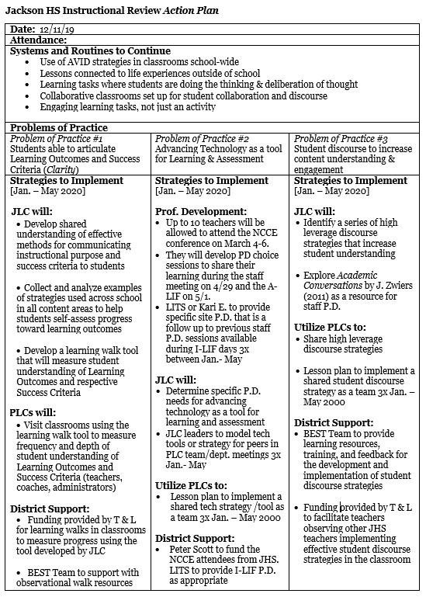
Action Plan
Notes:
This concludes the school’s presentation.

Slide 7
Systems & Routines to Continue
Use of AVID strategies in classrooms school-wide
Lessons connected to life experiences outside of school
Learning tasks where students are doing the thinking & deliberation of thought
Collaborative classrooms set up for student collaboration and discourse
Engaging learning tasks, not just an activity

Slide 8

Problem of Practice #1
Students able to articulate Learning Outcomes and
Success Criteria (Clarity)

Slide 9

Problem of Practice #2
Advancing Technology as a tool for Learning & Assessment

Slide 10

Problem of Practice #3
Student Discourse to increase Student Understanding and Engagement

Slide 11
Stakeholders
JLC
PLC’s
Professional Development
District Support

Slide 12
Problem of Practice #1
Students able to articulate Learning Outcomes and Success Criteria (Clarity)
JLC will:
Develop shared understanding of effective methods for communicating instructional purpose and success criteria to students
Collect and analyze examples of strategies used across school in all content areas to help students self-assess progress toward learning outcomes
Develop a learning walk tool that will measure student understanding of Learning Outcomes and respective Success Criteria.

Slide 13
Problem of Practice #1
Students able to articulate Learning Outcomes and Success Criteria (Clarity)
PLC’s will:
Visit classrooms using the learning walk tool to measure frequency and depth of student understanding of Learning Outcomes and Success Criteria (teachers, coaches, administrators)

Slide 14
Problem of Practice #1
Students able to articulate Learning Outcomes and Success Criteria (Clarity)
District Support:
Funding provided by T & L for learning walks in classrooms to measure progress using the tool developed by JLC
BEST Team to support with observational walk resources

Slide 15
Problem of Practice #2
Advancing Technology as a tool for
Learning & Assessment
Professional Development:
Up to 10 teachers will be allowed to attend the NCCE conference on March 4-6.
They will develop PD choice sessions to share their learning during the staff meeting on 4/29 and the Admin- LIF on 5/1.
LITS or Kari E. to provide specific site P.D. that is a follow up to previous staff P.D. sessions available during Individual-LIF days 3x between Jan.- May

Slide 16
Problem of Practice #2
Advancing Technology as a tool for
Learning & Assessment
JLC will:
Determine specific P.D. needs for advancing technology as a tool for learning and assessment
JLC leaders to model tech tools or strategy for peers in PLC team/dept. meetings 3x Jan.- May

Slide 17
Problem of Practice #2
Advancing Technology as a tool for
Learning & Assessment
PLC’s will:
Lesson plan to implement a shared tech strategy /tool as a team 3x Jan. – May 2000

Slide 18
Problem of Practice #2
Advancing Technology as a tool for
Learning & Assessment
District Support:
Peter Scott to fund the NCCE attendees from JHS. LITS to provide teacher LIF PD as appropriate

Slide 19
Problem of Practice #3
Student discourse to increase student understanding and engagement
JLC will:
Identify a series of high leverage discourse strategies that increase student understanding and engagement
Explore Academic Conversations by J. Zwiers (2011) as a resource for staff P.D.

Slide 20
Problem of Practice #3
Student discourse to increase student understanding and engagement
PLC’s will:
Share high leverage discourse strategies
Lesson plan to implement a shared student discourse strategy as a team 3x Jan. – May 2000

Slide 21
Problem of Practice #3
Student discourse to increase student understanding and engagement
District Support:
BEST Team will provide learning resources, training, and feedback for the development and implementation of student discourse strategies
Funding will be provided to facilitate teachers observing other teachers implementing effective student discourse strategies in the classroom

