Slide 1




Negotiations Update
August 27, 2020
Notes:
.

Slide 2
Agenda
  Classified Furloughs
  EPS EEA MOU
    Health and Safety
    Conference Days
    Attendance
    Grading
    Teacher evaluation
    Special Education
    Assessments
    Schedules

Slide 3
Classified Furloughs
Discussion with all classified associations are underway regarding impacts of 100% remote learning
Immediately impacted groups
  Paraeducators – HRA, MS supervision, crossing guards
  SEIU – swing custodians, movers and floaters
  Teamsters – Bus/Van Drivers
  Non-rep – Elementary Music Program Assistants, AV Tech
Ongoing communication and monitoring of staffing needs based on enrollment

Slide 4
Communications and Timelines
9/8 - 12/31/20 – Furlough period
8/27/20 – Joint communication from Superintendent and classified association leaders
8/28 - 31/20 – personal notifications with impacted employees
9/2-3/20 – written notice to impacted employees
Human resources will be partnering with association on supports available to those furloughed

Slide 5
Health and Safety
Everyone, including students, parents, and staff will be treated with patience, grace and flexibility.
Provide a physically and emotionally safe environment for staff and students.
Strict compliance with all relevant District safety and health rules will be an essential function of each employee's job.
Employee's family members will not be allowed on school campus during work hours but will be allowed after hours and on weekends as long as the family member remains under the director supervision of the staff member.

Slide 6
Work location
During remote instruction, staff may choose to work either on- or off-site.
In making this decision staff should consider such factors as safety, access to materials, internet availability, childcare, and health.
It is expected staff will maintain an effective level of instruction in their chosen work location.
If a staff member works off-site, they will work with their principal or supervisor so they can communicate and serve the needs of students.

Slide 7
Conference Days - Elementary
There will be five (5) days of elementary conferencing during the first five (5) days of school to connect with students and families to prepare for distance learning. With respect to these parent-teacher conferences, the following shall apply:
The conferences shall serve as time to connect and engage with students/families to prepare and support them for distance learning.
Such conferences shall be held after lunch and scheduled at the classroom teacher’s discretion.
Such conferences shall not be held outside of the workday without the consent of the teacher, and if held, shall be traded for employee release time during the non-instructional portion of another reduced student day during the same conference week.
No modified student day schedule necessary

Slide 8
Conference Days – Secondary
For the first three (3) days of secondary instruction, periods in the Appendix C schedule shall be reduced to provide two and one-half (2½) hours of non-instructional time to conduct opportunities for teachers to connect with students and parents regarding distance learning.
Such opportunities shall not be held outside of the workday without the consent of the teacher, and if held, shall be traded for employee release time during the non-instructional portion of another reduced student day during the same conference week.
School leadership teams will provide suggested opportunities for conferences.
Modified student day schedule is necessary

Slide 9
Attendance
OSPI defines an absence as a student not participating in planned instructional activities on a scheduled remote learning day.
Evidence of student participation in remote learning may include, but is not limited to:
Daily logins to the learning management system (e.g., Canvas), or
Daily interaction with the teacher, or
Evidence of participation in a task or assignment
New WAC language: Tiered Response System
Monitoring daily attendance data
Process to contact families and log multiple attempts in parent's home language
Daily notification of absences
Absences from Sept. 9 - Oct. 4 called "nontruancy remote learning absence." It's neither excused nor unexcused
  No unexcused absences until October 5
  New reasons for excusing absences due to COVID circumstances

Slide 10
Grading
Elementary: Standards-based grading
Secondary: A-F scale; plus/minus continues
  Considerations:
    The grading floor of “zero” will be eliminated and replaced with a floor of fifty percent (50%). This includes missing assignments.
    To support a system focused on the evaluation of student learning and one of providing meaningful feedback to students and families, grades as an assessment of learning will not include students’ attendance or behaviors.
    With specific criteria designed by teachers, students will be allowed to retake exams and revise assignments.
With input from the Association, the District shall appoint a “Grading Committee” to determine the most appropriate grading policy for distance teaching

Slide 11
Teacher Evaluation
Teachers scheduled for Focused evaluation
  Scored at prior comprehensive score, or better
For teachers in years two and beyond who are scheduled for a Comprehensive evaluation, and for teachers with two or more years of successful performance in another Washington state district who are in their first year of teaching in a new district, the teacher and evaluator will decide on two criteria to be formally scored using evidence provided during the 2020–21 school year.
  The remaining six criteria will be scored by assigning the score received in the most recent Comprehensive evaluation.
  The teacher can be moved to a regular Comprehensive cycle (all 8 criteria) if the evaluator or teacher provides notice in writing by December 15.

Slide 12
Teacher Evaluation
For teachers in their first year of teaching in the District on a Comprehensive evaluation, the teacher and evaluator shall
  (a) use the traditional Comprehensive process (all 8 criteria); or
  (b) determine at least two criteria to be formally scored using evidence provided during the 2020–21 school year, and the remaining criteria will be scored “Basic” as default scores.
  Evaluators will use the language “default scores due to the circumstances of the COVID-19 pandemic” where applicable.
Those employees who received an Unsatisfactory or below Proficient score in the 2019-20 school year shall be mutually addressed with the District and Association to determine an appropriate, fair, and supportive evaluation process.
For teachers on a plan of improvement, the District and Association shall determine modifications, if any, to the evaluation process on a case-by-case basis.

Slide 13
Teacher Evaluation
For certificated employees not eligible for the TPEP evaluation, employees on the long-form model shall be evaluated in accordance with Section 10.02
Employees on short-form or PGO shall be given the same summative rating as their last completed evaluation.
  The employee can be moved to a regular long-form cycle (all 6 criteria) if the evaluator or employee provides notice in writing by December 15.

Slide 14
Special Education
During Stage One: Special education staff whose duties may include in-person evaluations (OT/ PT/ SLP/ Psychologist/Vision) will schedule those individual services at their discretion at any of three centralized schools.
If remote evaluations are not possible because staff are in a high risk group as defined by the governor’s proclamation, have family members who are high risk, have a documented medical condition preventing them from wearing appropriate PPE/mask, or have child care challenges due to the COVID-19 pandemic shall not be required to provide services in person while this MOU is in effect. Job assignments will be adjusted to allow for those in the above criteria.
Staff shall have the option to schedule all conferences, meetings and service online via Zoom. The expectation is to serve the IEP.
Schedules shall be designed to include adequate time for special education staff to support students and families, hold IEP meetings, evaluations, and coordinate with staff members.

Slide 15
Assessments
K-2 Developmental Reading Assessment (DRA)
  Release time to administer
    Kindergarten: one day
    Grades 1-2: four days
i-Ready diagnostic
  Grades 1-5 math
  Grades 3-5 reading
    Administer using instructional time, monitored by classroom teachers; Fall, Winter
    Data analysis meetings
      One half-day release after first diagnostic assessment window
        Team choice of one half-day release or per diem after second diagnostic assessment

Slide 16
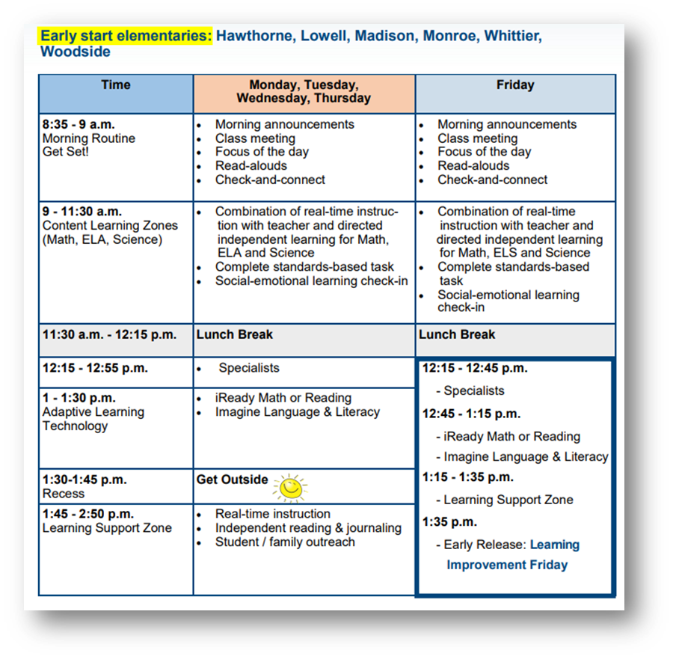
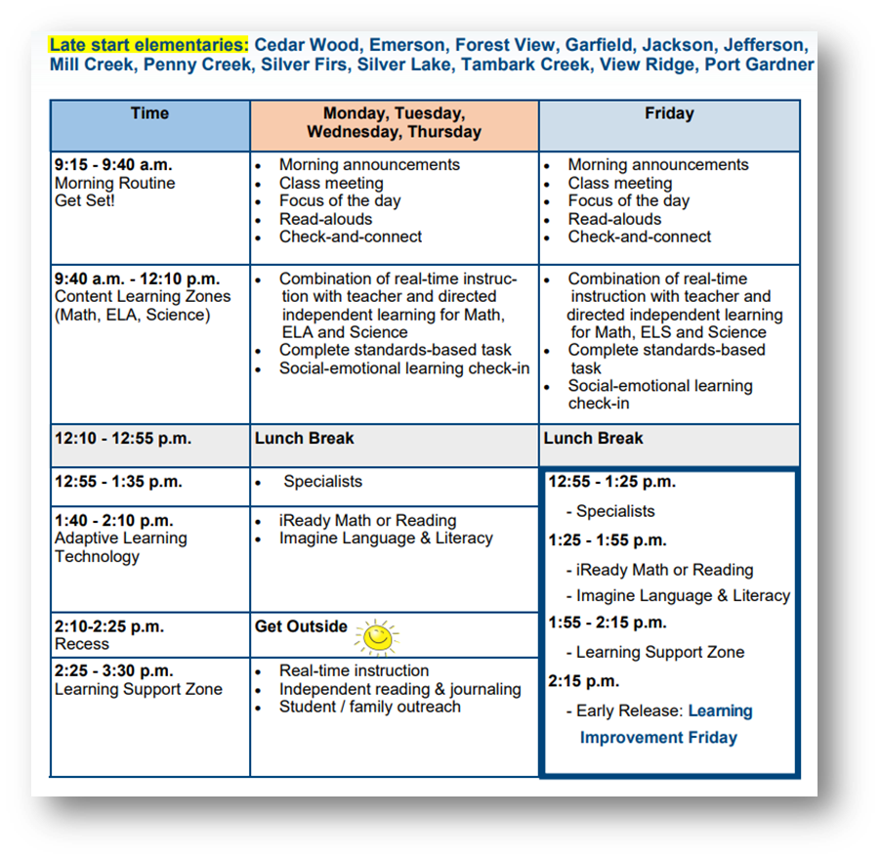
Schedules – Elementary School
[2]

Slide 17
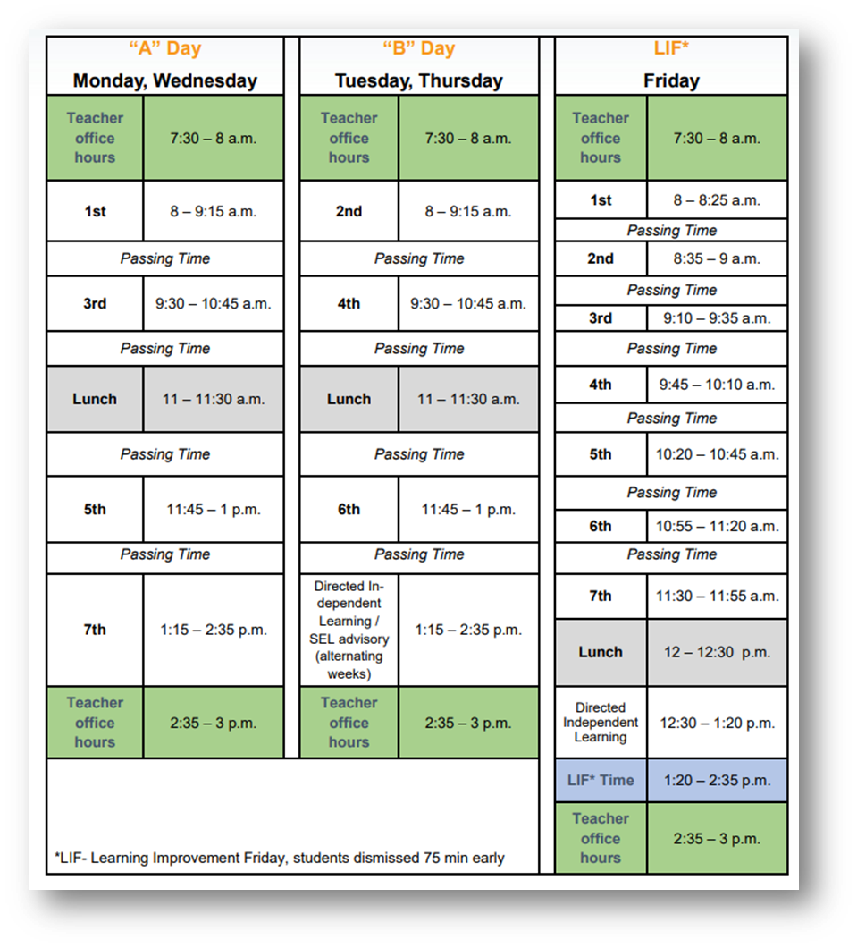
Schedules – Middle School

Slide 18
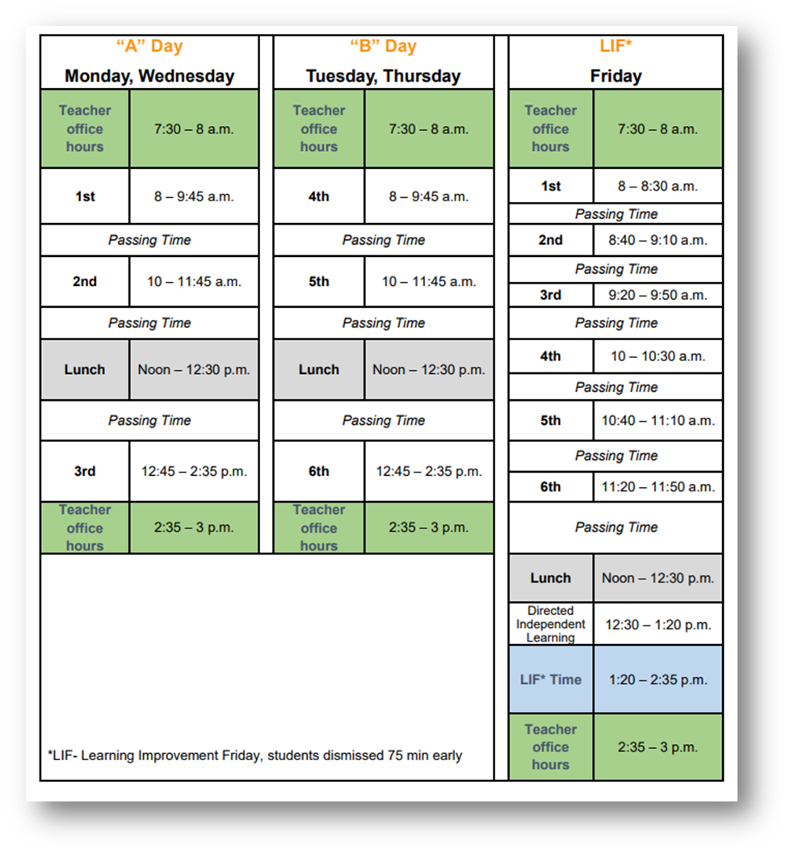
Schedules – High School

