Slide 1
State Testing Tools, Supports, and Accommodations
Tools, supports, and accommodations are provided to students to help them show what they know and are able to do.
Some tools, supports, and accommodations can be coded to show up embedded in the SBA Secure Browser, we call these Embedded. Some cannot be embedded in the Secure Browser (i.e. abacus, Read Aloud), they still must be coded. We call them Non-Embedded.
Universal Tools
Automatically available to every student
Designated Supports
Available to any student for whom the need has been identified by an educator.
Must be in IEP if you want them uploaded by Special Services.
Accommodations
Changes in materials or procedures that increase equitable access to state assessments for Special Education/504 students.
Legally required to be documented in an IEP or 504 plan.
Notes:
Align the colors based on the colored graphic organizer

Slide 2
Choosing Accommodations Thoughtfully
  Some accommodations (marked with a lightning bolt) fundamentally change the assessment. For example, a reading test you listen to is now a listening test, preventing the student from demonstrating some skills.
Criteria 1: Documented Disability via IEP or 504
Does the student have a documented disability that pertains to the accommodation?
If yes, continue. If no, do not choose accommodation.
Criteria 2: Familiarity with Recommended Accommodation
Is the support utilized regularly as a classroom accommodation and during class assessment?
If yes, continue. If no, do not choose accommodation.
Criteria 3: Equitable Access to the State Assessment
Does the student need the accommodation to access the assessment?
Will the accommodation provide equitable access to the assessment, comparable to students without the specific disability noted in Criteria 1?
If yes, proceed with the accommodation.
If no, do not choose accommodation.
Notes:
Notes:
Left Column – any student can have this
Right column – only for IEP/504 students

Slide 3


ATTENTION ISSUES
Noise Buffers
SBA; EPLA21; WCAS
Non-Embedded Designated Support
Description: Students use noise buffers (i.e. headphones)to block external sounds.
Recommended for Students with:
attention difficulties (distracted by external noises)
Separate Setting (Small Group)
SBA; WCAS
Non-Embedded Designated Support
Description: Any alteration of test setting
Note:
Separate Setting is not required to be coded for ELPA21.
Recommended for Students with:
attention difficulties (easily distracted or may distract others)
Scribe
Read Aloud (human reader)
Read Aloud- Student (whisper phone)
Simplified Directions
Frequent breaks

Slide 4
Streamline
SBA; WCAS
Embedded Designated Support
ATTENTION ISSUES
Description: Displays the items below the stimuli instead of side by side. Video clip
Note:
Students often find Streamline Interface challenging to use– students must be given an opportunity to practice using this accommodation extensively.
Recommended for Students with:
specific learning and/or reading disabilities
zoom of x5 or greater coded
Spanish stacked translation coded
Regular Screen: Streamline:
Passage
Question 1
Passage
Question 2
Question 1
Question 2
Question 3
Question 3

Slide 5
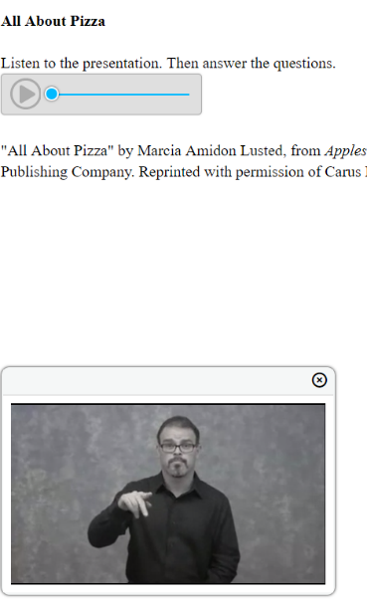
HEARING IMPAIRMENT
ASL Video
SBA
Embedded Accommodation
Description: Test content is translated into ASL displayed in a video. ASL human signer and the signed test content are viewed on the same screen. Video clip
Recommended for Students with:
hearing impairments, who use ASL as their primary form of communication
ASL (Human Signer)
WCAS
Non-Embedded Accommodation
Description: Test content is translated into ASL by a human signer.
Recommended for Students with:
hearing impairments, who use ASL as their primary form of communication

Slide 6
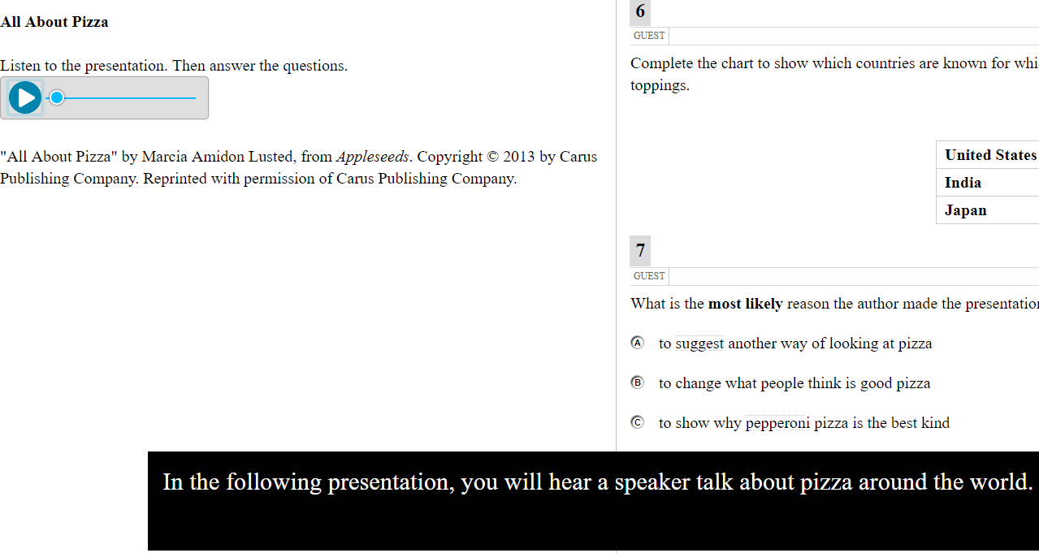
HEARING IMPAIREMENT
Closed Captioning
Math and ELA CAT (Listening)
Embedded Accommodation
Description: Printed text that appears on the computer screen as audio materials are presented. Video clip
Note:
If you choose closed captioning and ASL video, the closed captioning will appear and may block the ASL video.
Recommended for Students with: hearing impairments.

Slide 7
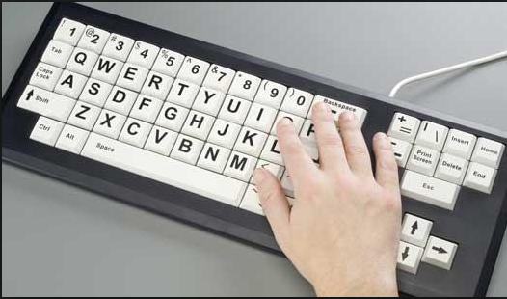
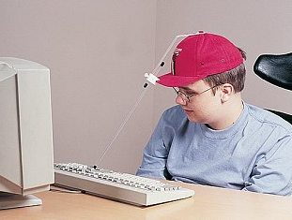
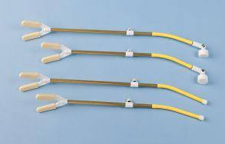
Alternate Response Options
SBA; WCAS; ELPA21
Non-Embedded Accommodation
PHYSICAL
Description: Alternate response options include but are not limited to adapted keyboards, large keyboards, StickyKeys, MouseKeys, FilterKeys, adapted mouse, touch screen, head wand, and switches.
Recommended for Students with:
physical disabilities (including both fine motor and gross motor skills)

Slide 8
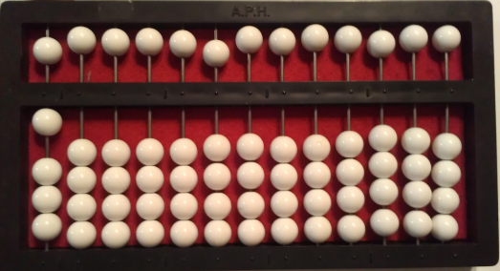
VISUAL IMPAIRMENT
Abacus
SBA
Non-Embedded Accommodation
Description: This tool may be used in place of scratch paper for students who typically use an abacus.
Note:
Rekenrek are also permitted.
Student must be familiar with an abacus and use it regularly.
Recommended for Students with:
visual impairments
Braille
SBA; WCAS
Non-Embedded Accommodation
Description: Test provided in braille format.
Note:
Paper braille as well as online test braille options, and braille tools available.
Recommended for Students with:
visual impairments (who can read text via braille well)

Slide 9
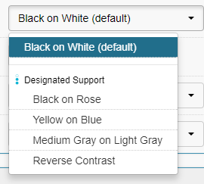
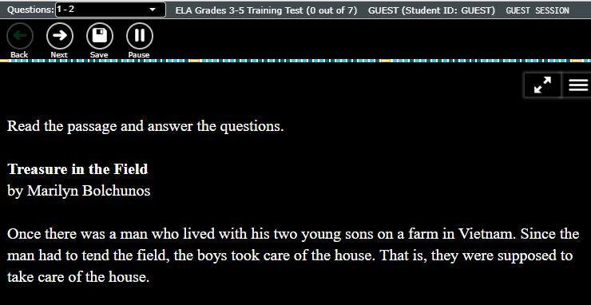
Color Contrast
SBA; WCAS; ELPA21;
Embedded Designated Support
VISUAL IMPAIRMENT
Description: Enables staff to select alternate background and font color, based on student need. Student cannot adjust the color scheme. Video clip
Note:
  Staff member must sit with student to select desired color scheme.
  When box is checked in IEP/504, the color scheme will be changed to medium grey on dark grey (see below). If the student needs a different color scheme you must have a school coordinator code it manually in TIDE.
  Color options differ between SBA/WCAS and ELPA 21.
Recommended for Students with:
  attention difficulties
  visual impairments or other print disabilities (including learning disabilities)
Sample:
Notes:
Notes:
Staff member must sit with student to select desired color contrast before the testing.

Slide 10
VISUAL IMPAIRMENT
Magnification Assistive Tech
SBA; EPLA21; WCAS
Non-Embedded Designated Support
Description: Non-embedded magnification software, or physical magnifier.
Note:
Special Services will also code for Permissive Mode, which is required for outside software to work when the Secure Browser is open.
Recommended for Students with:
visual impairments or other print disabilities (including learning disabilities)
Print on Demand
ELA CAT
Embedded Accommodation
Description: Students can push the print on demand button to request to print everything on their screen at any given time.
Note:
Students must have a specific need for viewing part of the test in print.
Only students coded with this accommodation have a print on demand button.
Teacher must approve request and have access to a printer in the room.
A very small percentage of students should need this accommodation.
Recommended for Students with:
visual impairments
Notes:
Notes:
A5: Zoom – This is embedded support . The images and font size is magnified but not the other button.
B1: Magnification Assistive Tech – Non-embedded support. The entire screen can be magnified.

Slide 11

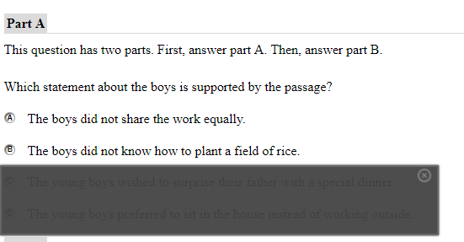
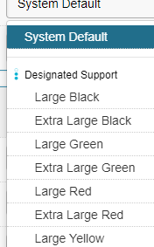
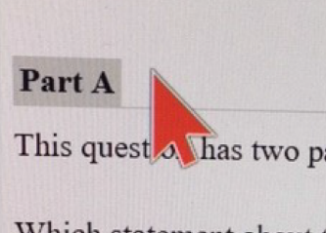
VISUAL IMPAIRMENT
Masking
SBA; WCAS; ELPA21
Embedded Designated Support
Description: Masking allows students to draw boxes over the screen to cover an reveal content as needed. Video clip
Recommended for Students with:
attention difficulties
print disabilities (including learning disabilities)
visual impairments
Mouse Pointer
SBA; WCAS; ELPA21
Embedded Designated Support
Description: Staff can change the mouse pointer size or color based on student need. Video clip
Note:
Staff member must sit with student to select desired color scheme.
When box is checked in IEP, the moue will be extra large black. If the student needs a different color scheme you must have a school coordinator code it manually.
Recommended for Students with:
visual impairments

Slide 12
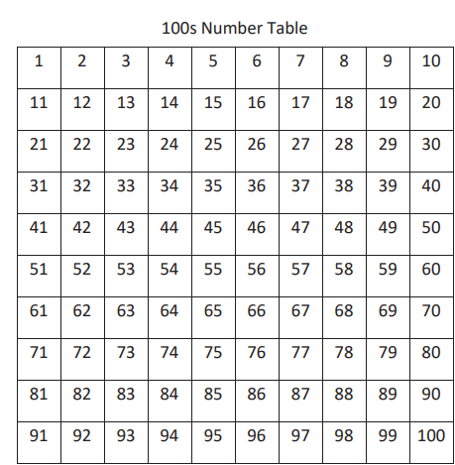
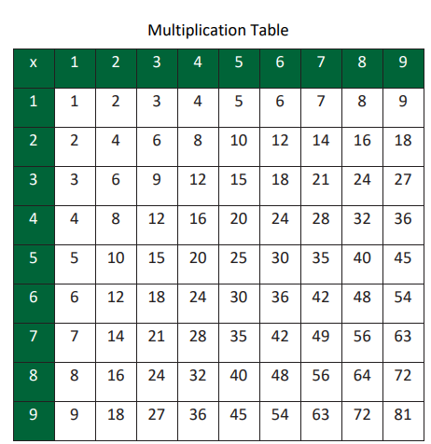
OTHER
100s Table
Math SBA
Non-Embedded Accommodation
Description: A table listing numbers from 1–100 from WCAP Portal.
Note:
Must be the Smarter Balanced provided table.
Not available for Grade 3/Off-Grade at Grade 3 level.
Recommended for Students with:
visual processing difficulties
spatial perception difficulties
Multiplication table
Math SBA
Non-Embedded Accommodation
Description: A single digit (1–9) multiplication table from WCAP Portal.
Note:
Must be the Smarter Balanced provided table.
Not available for Grade 3/Off-Grade at Grade 3 level.
Recommended for Students with:
documented and persistent calculation disability (i.e., dyscalculia).

Slide 13
Word Prediction
ELPA21; SBA; WCAS
Non-Embedded Accommodation
OTHER
Description: Student uses separate software to allow students to begin writing a word and choose from a list of words that have been predicted from word frequency and syntax rules.
Note:
Examples: CoWriter or Clicker 7
Special Services will also code for Permissive Mode, which is required for outside software to work when the Secure Browser is open.
Recommended for Students with:
significant documented motor or orthopedic impairments
moderate to severe learning disabilities that prevent students from recalling, processing, or expressing written language

Slide 14
Simplified Test Directions
SBA; WCAS; ELPA21
Non-Embedded Designated Support
OTHER
Description: A student’s normal 1:1 support ( must be proctor trained and Simplified Test Direction trained) paraphrases the test directions read from the Test Administrator Script.
Note:
All students may receive Technical Assistance from their proctors on how to use the Secure Browser– including logging in.
Requires special permission.
Simplified Test Directions:
  Applies only to the “say” instructions in the TA Script
  Teachers must be trained on State Guidelines
  1:1 only-- a single proctor with a single student for the duration of the test.
  Cannot include defining words or concepts.
  Cannot include anything from the student screen.
  Cannot prompt or influence student responses.
  Cannot be made up at the moment; proctors must be familiar with and practiced in reading and simplifying the “say” instructions. Writing down the simplified directions ahead of time is encouraged.
Recommended for Students with:
regular classroom accommodation: read aloud test instructions

Slide 15
What is covered by Text-to-Speech and
Read Aloud (Human Reader)
OTHER
Sections Covered by Text-to-Speech (TTS) or Read-Aloud (Oral)
Test | Any coded student (Designated Support) | Only if written in IEP (Accommodation)
Math | Items and/or Stimuli
ELPA21 | Items and/or Stimuli (Read-Aloud Only)
WCAS | Items and/or Stimuli, and/or Scenarios
ELA CAT | Items only | Passages and/or Stimuli
ELA PT | Items and/or Stimuli, and/or Passages
Passages & Stimuli = reading passages, charts, diagrams.
Items = Questions and response options.
Can the student understand computer speech? If yes, select TTS.
Remember Read Aloud is a 1:1 support.
Notes:
Notes:
Left Column – any student can have this
Right column – only for IEP/504 students

Slide 16
Read Aloud at Two Levels
OTHER
Read-Aloud Designated Support
All subjects except reading
Description: Trained and qualified human reader reads aloud appropriate sections of the assessment to the student.
Note:
Does not include ELA CAT reading passages/stimuli.
Must be provided in 1:1 setting.
Recommended for Students with:
visual impairments
reading struggles that impact accessing the assessment
Read-Aloud Accommodation
All subjects including reading
Description: Trained and qualified human reader reads aloud all sections of the assessment to the student.
Note:
Must be provided in 1:1 setting.
Requires an IEP.
Only 1-2% of IEP/504 students should be using this accommodation.
Recommended for Students with:
Physical or visual impairments that prevent students from being able to access reading passages in any other way (i.e. a blind student who does not read braille)
Notes:
Notes:
B3: Read-Aloud (Oral) - Non-Embedded Designated Support = Reading skill is not being assessed.
D9: Read-Aloud (Oral) ELA CAT Passages/Stimuli -Non-Embedded Accommodation = Reading skill is being assessed. The student has no means of reading the text because of his/her impairment i.e. blind

Slide 17
Text-to-Speech at Two Levels
OTHER
Text-to-Speech Designated Support
All subjects except reading
Description: Computer reader reads aloud appropriate sections of the assessment to the student.
Note:
Does not include ELA CAT reading passages/stimuli.
Requires headphones.
Students can control speed and volume.
Recommended for Students with:
visual impairments
reading struggles that impact accessing the assessment
Text-to-Speech Accommodation
All subjects including reading
Description: Computer reader reads aloud all sections of the assessment to the student.
Note:
Requires an IEP.
Requires headphones.
Students can control speed and volume.
Only 1-2% of IEP/504 students should be using this accommodation.
Recommended for Students with:
Physical or visual impairments that prevent students from being able to access reading passages in any other way (i.e. a blind student who does not read braille)
Notes:
Notes:
A4: Text-to-Speech - Embedded Designated Support = Reading skill is not being assessed.
C4: Text-to-Speech ELA CAT Passages/Stimuli - Embedded Accommodation = Reading skill is being assessed. The student has no means of reading the text because of his/her impairment i.e. blind

Slide 18
Scribe at Two Levels
OTHER
Scribe Designated Support
All subjects except the full write
Description: Students dictate responses to appropriate items to a trained and qualified Scribe who records responses verbatim.
Note:
Requires 1:1 proctoring
Recommended for Students with:
motor or processing difficulties (i.e. dyslexia)
Scribe Accommodation
All subjects including the full write
Description: Students dictate responses to any or all items to a trained and qualified Scribe who records responses verbatim.
Note:
Requires 1:1 proctoring
Recommended for Students with:
significant documented motor or processing difficulties (i.e. dyslexia) and use a scribe regularly in the classroom, because it is the only way to demonstrate composition skills.
Recent injury that prevents typing or writing comfortably. Must submit an Incident Report and hand code in TIDE for students with temporary injuries.
Notes:
Notes:
B4: Scribe - Non-Embedded Designated Support: Student has difficulty writing responses and in this assessment he is not being tested/assessed for his writing skill for example for composing an essay.
D10: Scribe - ELA PT Segment 2 (Full Write) - Non-Embedded Accommodation: = The student is being assessed for his writing skills. It is impossible for student to write or compose an essay.

Slide 19
Speech-to-Text (Voice Recognition)
ELPA21; SBA; WCAS
Non-Embedded Accommodation
OTHER
Description: Student uses separate voice recognition software to allow students to use their voices as input devices to the computer, to dictate responses or give commands.
Note:
Special Services will also code for Permissive Mode, which is required for outside software to work when the Secure Browser is open.
Recommended for Students with:
significant documented motor or processing difficulties (i.e. dyslexia), use it regularly in the classroom, because it is the only way to demonstrate composition skills

