Slide 1

2008-2013
5 Year Overview

Slide 2
Questions to Ask and Answers to Seek
Does the ESEBT want to continue to offer an employee Wellness Program?
If so..
  What are the goals of the wellness program moving forward (knowing what we know now)?
    Examples
      A Benefit the Trust offers employees of the district
      Cultivate a culture of wellness in the district (how do we measure this?)
      Decrease Substitute Utilization (is this a function of the Trust OR the district?)
      Increase the number of employees who state they are physically active 150 minutes per week
      Increase the number of employees who state that they eat 5 fruits and vegetables a day 5 days a week
      Weight Loss – district tally of over XXXX pounds
      Increase participation in seasonal campaigns to at least 50% participation
      Other Goals?
  What level of employee participation would you associate with a successful program?
  How can we engage administrators and leadership in the wellness program?
    What is a reasonable expectation/goal for leadership engagement/participation?
    What ideas does the Trust have for HOW we can get leadership more engaged in the program?
  What is the budget for the wellness program for the next 1, 3, 5 years?
    What if the Trust dissolves? Do you envision the district absorbing the cost of the wellness program?

Slide 3
Testimonials
Our wellness program got me to exercise. I used to say "I hate to sweat!" Now I love to sweat and lost weight! I appreciate you for allowing me to discover something that I enjoy so much.
I seem to need these games to keep me motivated so I appreciate the campaigns!
The 45 for 45 Campaign helped me to increase the amount of TIME I spend being physically active each day. I was more consistent (daily activity) with my physical activity and I was more physically active BECAUSE I was participating.
I've lost 40 lbs and become more physically active. That's great for someone who is 60!
I started with the first group of Weight Watchers at Work, made goal in 6 months by losing 55 pounds and have been on maintenance for over 3 years. Thanks to you!
I feel supported in my quest to become more balanced with lifestyle, exercise, stress, and eating. The Wellness Challenge is motivating to me to help offset costly programs. I feel the support and believe that if we are healthier, we will be better people, learners, and better able to teach effectively

Slide 4
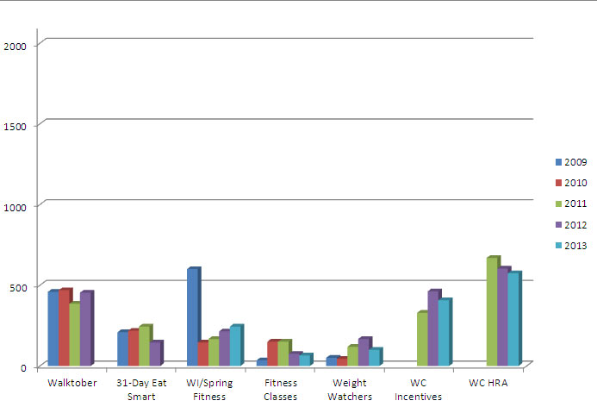
5 Year Overview
Wellness Program Participation
Wellness Challenge

Slide 5
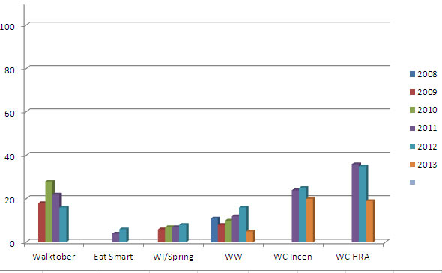
Senior Leadership Participation
Wellness Challenge

Slide 6
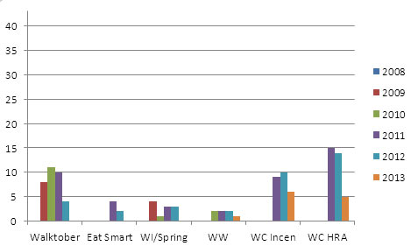
School Principal & Assistant Principal Participation
Wellness Challenge

Slide 7
What staffs says about leadership & the Wellness Program
I didn't see administrators or leadership team involved in Wellness activities (although they might have been) and the program was NOT talked up (that I'm aware of) around our school, so there hasn't been much feeling of camaraderie around it (for me).
It would be nice to know how many people in my building are participating. How many Administrators are participating? I've never heard an Administrator talk about the program.
I would like to see more administrators leading wellness initiatives at school.
You do wonderful work. However, I see no evidence that there is administrator involvement. Your program is the only evidence that there is an interest in the health of the district employees.
You asked about Administrators influence on my Wellness. I can't figure out how they fit other than rolling out the program. I would be interested to know by name how many of them actively participate in the program.
I would like to see those in leadership positions more actively involved in wellness activities.

Slide 8
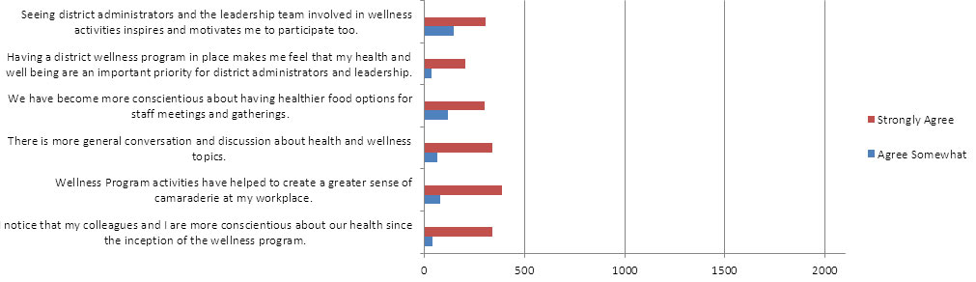
Culture Change
Wellness Program
End of Year Survey (averages) from 2010-2012

Slide 9
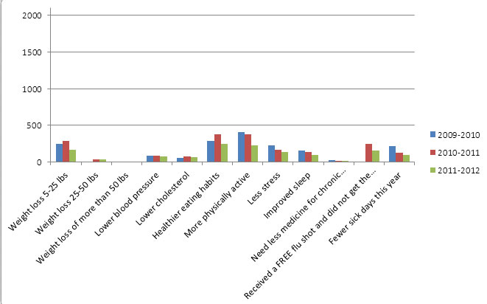
2009-2012
End of Year Survey
Self Reporting Risk Reduction

Slide 10
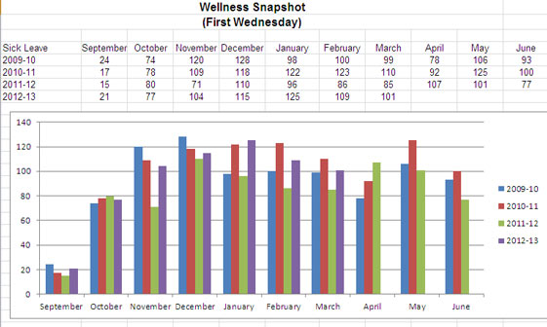
Absenteeism

Slide 11

Post Program Survey Results
2011 2012
The Wellness Challenge ® was very important in Strongly Agree 77 92 helping me make positive lifestyle changes Agree 167 197
Neutral 32 34
Having a structured program was valuable in Strongly Agree 94 135
keeping me on track and leading a Agree 159 167
healthy lifestyle. Neutral 25 22
The Wellness Challenge is a great way to Strongly Agree 92 135
motivate me to change my poor health habits. Agree 152 144
Neutral 32 41
The emphasis on eating fruits and vegetables Strongly Agree 96 155
has been very helpful to my health. Agree 128 139
Neutral 53 27

Slide 12
Post Program Survey Results
2011 2012
The Wellness Challenge ® helped me to better Strongly Agree 37 55 cope with stress. Agree 121 154 Neutral 111 107
The Wellness Challenge® helped me be more
aware of my blood pressure. Yes 150 232
No 135 97
I have reduced one or more health risks since
I have been participating. Yes 229 275
No 56 54
I have taken fewer sick days since I have
been participating in the EPS Wellness
Challenge. Yes 184 221 No 101 108

Slide 13
Post Program Survey Results
2011 2012
I have used my health insurance less since I have
been participating in the Wellness Challenge ®. Yes 164 210 No 121 119
The Wellness Challenge® helped me feel more
positive about the organization. Yes 256 296 No 29 33
I believe participating in the Wellness
Challenge has made me a healthier person. Yes 259 310
No 26 19
I believe EPS cares about my well being by
offering the Wellness Challenge®.
Strongly Agree 163 186 Agree 104 130
Neutral 17 11

Slide 14
(+) Feedback
I like money. It motivates me more to write things down, which helps me not miss a work out.
Thanks to the Wellness Challenge, I am reaching for the carrot sticks and fresh vegies instead of the chips and crackers.
I am so pleased and fortunate to have had the opportunity to participate in The Wellness Challenge. It has worked wonderfully to challenge me to increase my health and self-care and encourage appropriate choices for my students. This program has influenced me positively in several ways; increased health (as documented objectively and subjectively), socially, psychologically and professionally. I have done so well with The Wellness Challenge that I now brag about it to education colleagues in other districts. No one in other school districts that I have talked to seems to have a program that is anything like this. Ours seems to be unique and we are all better for it.
I didn't think the "challenge" would motivate me. Actually it did -- I was in competition with myself to complete those challenges. It made me more aware and more committed to myself.
Having the daily reminder from Wellness to enter my activities really motivates me to do something. When I miss a day of physical activity and cannot enter my data into my Wellness Challenge, I am disappointed in myself.

Slide 15
(-) Feedback
Cut the program and use the money for something else. In other words, stay out of my private life.
It is a waste of time and resources.
I participated in the challenge last year but found I actually was LESS physically active than I would have been without the challenge because I sort of resented that someone was paying me to be healthy and as a result I felt that some outside entity felt it/they had the right to tell me how to behave. So, this year I didn't sign up for the challenge and my physical activity, healthy eating, and reduced stress has VASTLY improved. Not being in the health challenge actually made me healthier.

Slide 16
Comments about WHY staff does not participate
Tracking over the computer is cumbersome. I spend enough time on the computer at school, spending time on the computer at home to be healthy just doesn't seem correct. I have been riding my bike as many days a week all school year long for the past 9 years... How about a credit for those of us that have already chosen to lead a healthy life style - Don't Drink, Smoke .....
I have been exercising consistently 5 times/week over the last two years. However, I have forgotten to log my entries several times by the end of the month, and I am not allowed to go back to enter them now. I keep records of my workouts, but the incentive to utilize the Wellness Challenge feels a bit futile now that I'm a couple months behind on my entries.
It's difficult to have the time to make entries your personal online wellness page. Sometimes the end of the month is too full and I don't have time to make entries. So I just quit making entries. If you were able to go back to previous months, then I would enter my data.
Wellness is very important. Personally I am not willing to record and track my behaviors. I find that "just one more thing" to do that adds to stress.

Slide 17
Theories
Participation Levels
Wellness Challenge®
  Lack of leadership engagement with the Wellness Challenge® majority of leadership does not endorse or promote it
  Employees perceive it takes too much effort to log activities
  Employees struggle with technology or do not want to learn how to use the program
  Employees are suspicious about what is being recorded and who is viewing their scorecard
  Negative association with cash incentive
  Not enough of a cash incentive to drive participation levels higher
Wellness Program-General
  Majority of administrators and senior leadership team do not actively promote or participate in wellness program activities
  Majority of administrators and senior leadership team do not actively encourage their staff to participate in wellness program activities
  Employees do not believe their employer should be trying to influence their health in any way “my health is none of your business” mentality
  Number of employees who ARE healthy who do not feel they need to participate or engage in wellness program activities
  Need more grassroots efforts at the sites i.e. wellness champions and teams to promote wellness program activities
  Wellness Coordinator…..minimal FACE TIME with employees i.e. SLT Meetings, Principal Meetings, Staff Meetings.

Slide 18
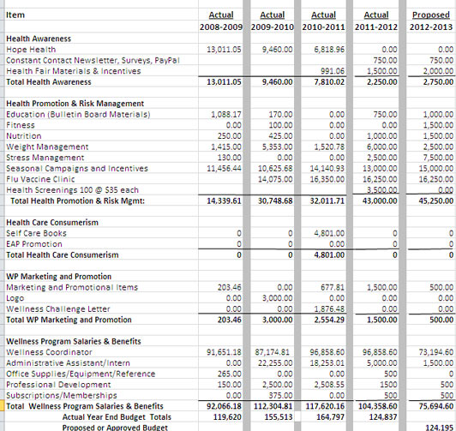
Wellness Program Budget Internal
2008-2013

Slide 19
Good News
National and Local Recognition
  Conferences and Presentations representing Everett Public Schools
    ASHA Conference in San Antonio, TX October 2012
    OSPI Inter-agency School Health Committee Fall 2012
    Oregon Education Association Trust School Employee Wellness Conference in Bend, OR March 2013
    Puget Sound Healthy Worksite Summit panel member October 2012 and presenter October 2013
    King 5 National Walking Day on April 3rd
    WWU Presentation to students on our program and worksite health promotion May 2013
    Invitation to present: Washington State Joint Conference on Health October 2013
Awards
  AHA Gold Level Fit Friendly Award 2011 and 2012
  DHPE School Employee Wellness 2011-2012 Gold Level Award

Slide 20
Testimonial
This year I have participated in the exercise classes offered and the Weight Watchers at Work program. I also took advantage of the waived enrollment fee through the YMCA. Because of these opportunities, I have begun a journey to a healthier lifestyle. I have lost nearly 15 pounds so far and have increased my activity and healthy eating significantly. I don't believe I would have accomplished this much without the support and opportunities provided by the EPS Wellness Program.
I am so thankful that the district values the health of their employees and is taking steps to make the Everett School District a healthier place!

Slide 21
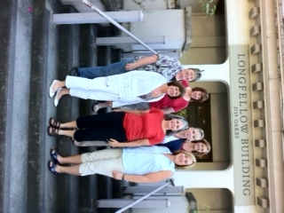
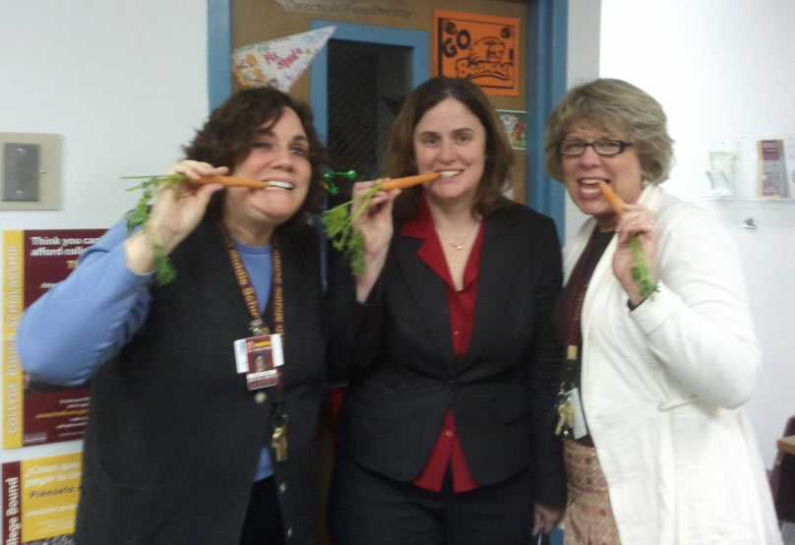
Successes
Wellness Champions
Wellness Team Champions
Kelly Shepherd
Sequoia HS Principal
Enrolled in the Wellness Challenge
January1st 2011…as a result
Logs her healthy behaviors regularly
Goes to the gym every morning at 4:30 am
Weight Loss (over 65 pounds to date)
Started a “Veggie Club” at her school
Training for her first ½ marathon, ran her first 5K last spring
Says she’s a better principal because she FEELS better!
Turkey Trot
Women with Weights
Weight Watchers at Work
Healthy Pot Luck Building Social
Veggie Snack Club Founders
Longfellow Wellness Team

Slide 22
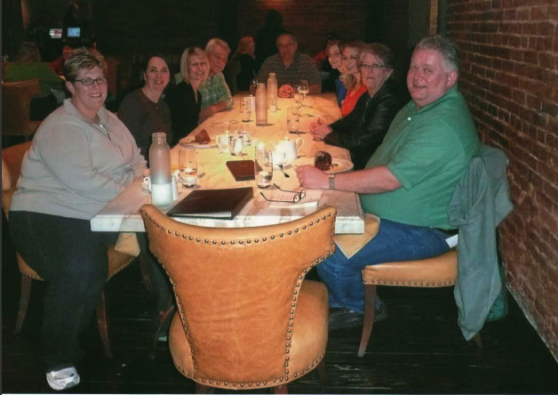
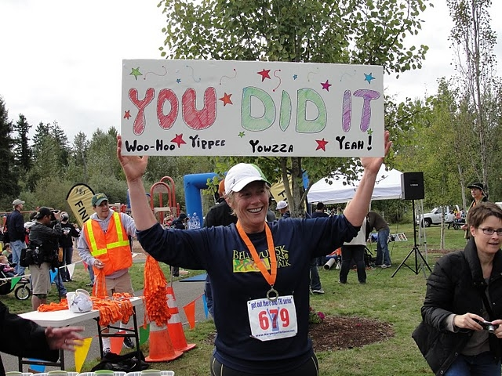
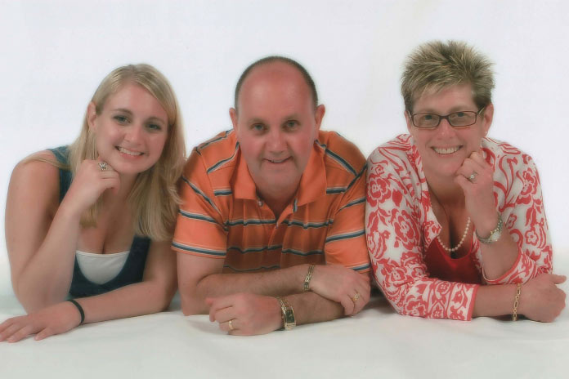
Success
Darcie Cooper
Cascade High School
Journey began with….
Eight Weeks to Wellness in January 2009
To date, she has lost over 125 lb weight loss
Lower cholesterol, blood pressure and fasting blood sugar.
Completed the STP Bike Race this summer and the Danskin Triathlon.
Currently training for her first ½ marathon.
Awarded a Lifestyle Change Award by the American Heart Association
"I can definitely say the Wellness Program not only changed my life but has truly saved it!
I know it is all the work I have put in, but having the path to follow and the people who have guided and supported me have made changing my life possible"!

Slide 23
Questions to Ask and Answers to Seek
Does the ESEBT want to continue to offer an employee Wellness Program?
If so..
  What are the goals of the wellness program moving forward (knowing what we know now)?
    Examples
      A Benefit the Trust offers employees of the district
      Cultivate a culture of wellness in the district (how do we measure this?)
      Decrease Substitute Utilization (is this a function of the Trust OR the district?)
      Increase the number of employees who state they are physically active 150 minutes per week
      Increase the number of employees who state that they eat 5 fruits and vegetables a day 5 days a week
      Weight Loss – district tally of over XXXX pounds
      Increase participation in seasonal campaigns to at least 50% participation
      Other Goals?
  What level of employee participation would you associate with a successful program?
  How can we engage administrators and leadership in the wellness program?
    What is a reasonable expectation/goal for leadership engagement/participation?
    What ideas does the Trust have for HOW we can get leadership more engaged in the program?
  What is the budget for the wellness program for the next 1, 3, 5 years?
    What if the Trust dissolves? Do you envision the district absorbing the cost of the wellness program?

