Slide 1


Slide 2

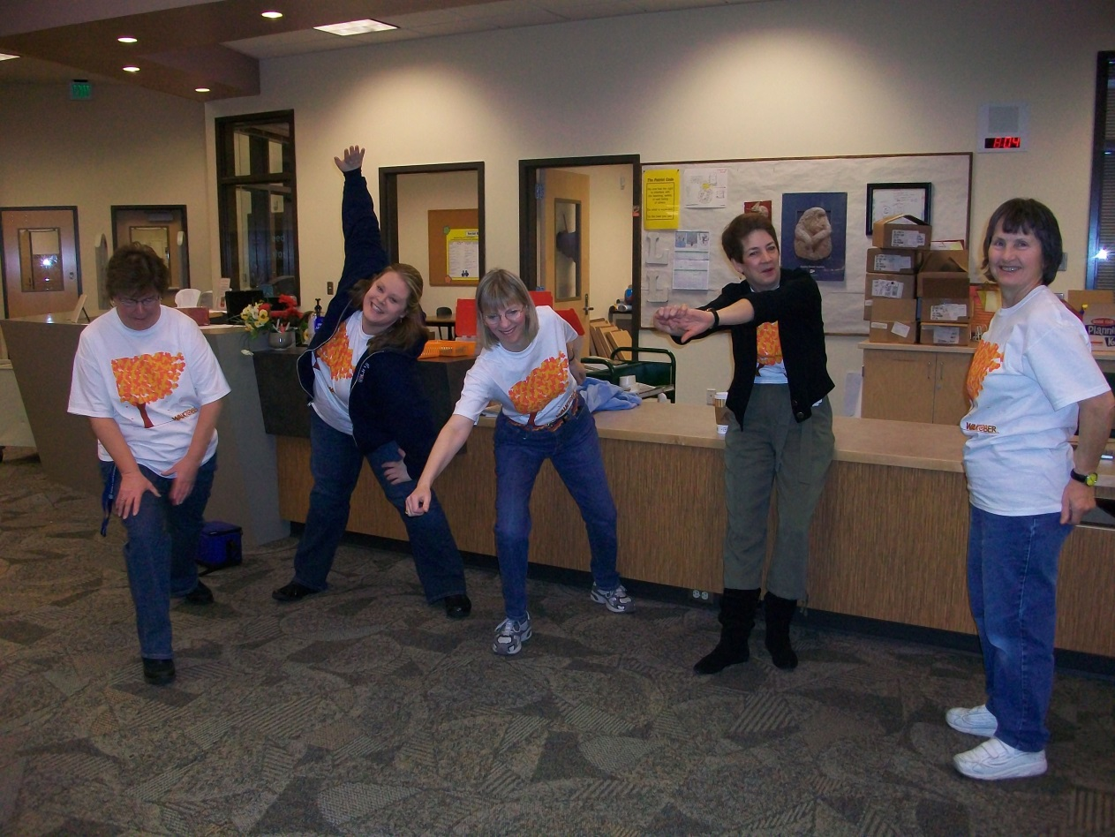

Slide 3
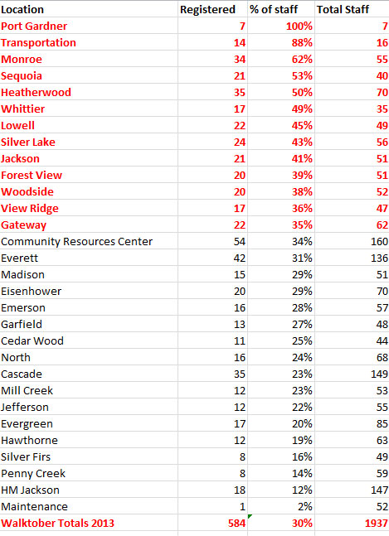
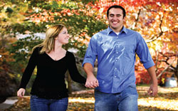

Slide 4
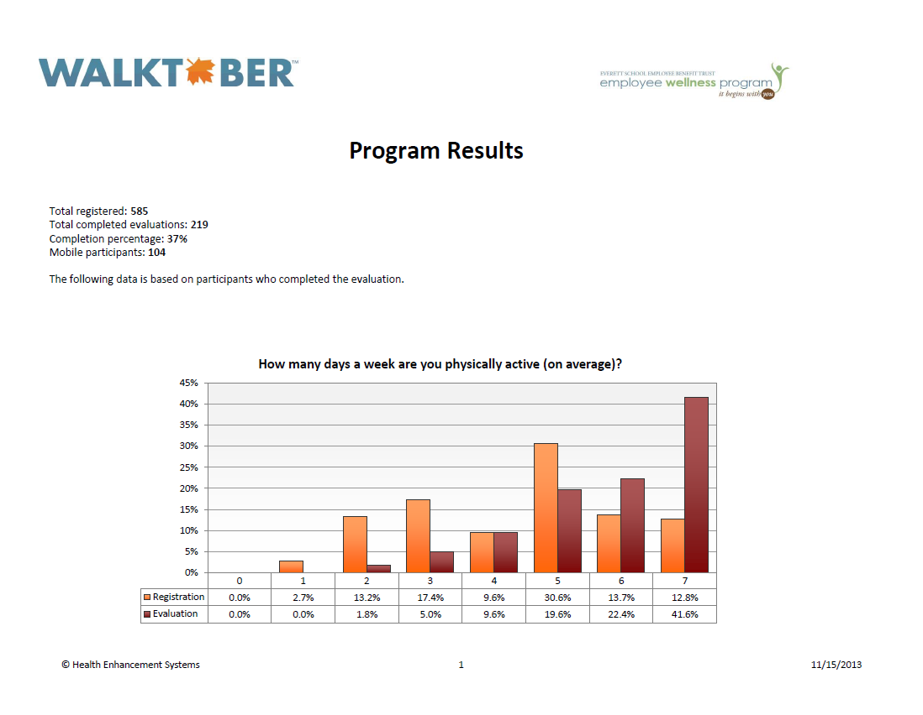

Slide 5
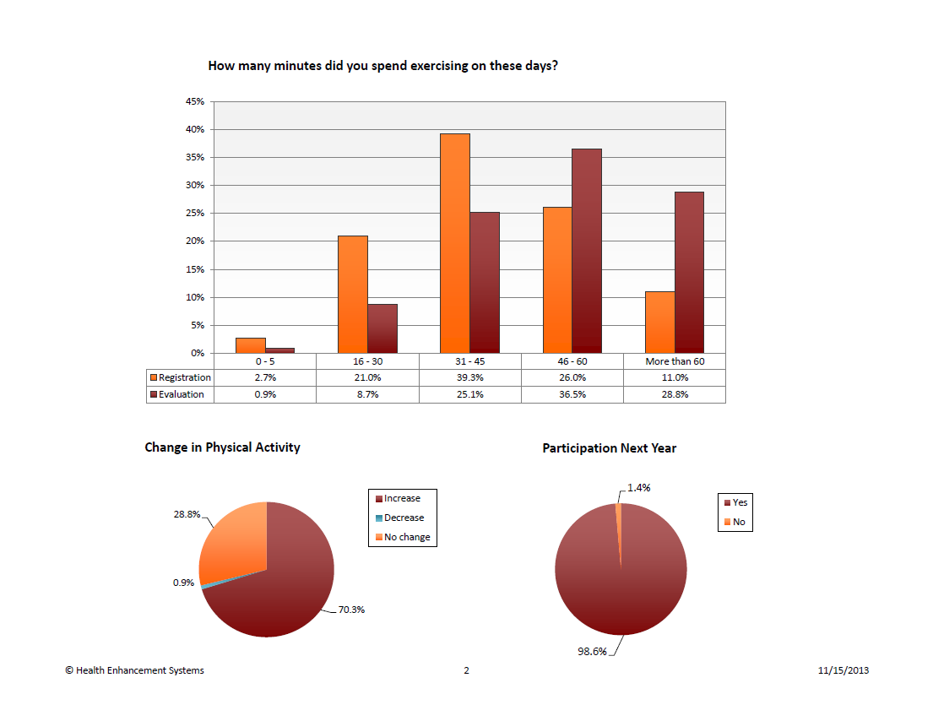

Slide 6
Feedback
It gave me something other then professional work to join and work with my colleagues, it was all about walking and being active!
It forced me to work in exercise every day.
I was motivated to exercise even when I didn't feel like it because I wanted to earn my leaf!
Motivated me to walk each night knowing that other people were doing it. I also met up with others doing Walktober so I had walking buddies.

Slide 7
Success Stories
"Walking more has helped me to be more successful with my workout program. I feel better physically. It has helped to distress me. I would definitely recommend everyone do this. It is not that difficult. Dianne Hanson
"Exercising every day keeps me energized. Walking is my favorite form of exercise. when I regularly exercise I stick to a healthy eating routine. I do less unhealthy snacking. The Walktober program was great. Karen Stolworthy
"I have been walking over a year now. I've lost 60 pounds and feel really healthy. I am a grandma and wanted to get on the floor with my babies and play. Thanks for this program, it's fun!“ Kathy Bogart
"Walktober was a perfect program to train for my fourth 1/2 marathon on October 27th. I dropped 21 minutes and got my best time. Thank you Walktober.
Thet Thet Win
"I noticed an increase in my energy level, which made me feel positive an happy!“
Torri McEntire
Over 370 WALKTOBER participants (63%) earned T-shirts for logging 30 minutes or more of exercise 24/31 days in October. This was a RECORD!

Slide 8
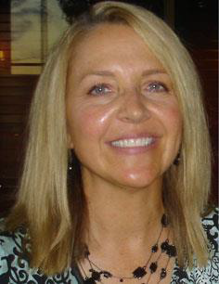
Walktober Wellness Champion
Chris organized 3-4 Walktober teams and met with them to inform them of the program.
She sent encouraging emails to get everyone going.
She made a chart for students to see that exhibited the Wellness Team’s walking steps to inspire students.

Slide 9
Wellness Updates
Flu Vaccine Clinics: Success. 575 (still an estimate) participated.
Wellness Challenge®: 270 people actively logging in at this time. All NEW Wellness Challenge® 2014 begins January 6th. Next year? On to something new?
November EAT SMART-Maintain Don’t Gain Campaign. 154 registered.
Weight Watchers at Work: Garfield and Silver Lake began early November. Collectively the groups have lost over 100 pounds already. January 2014 new meetings to begin at CRC and Forest View.
  Their leader says: “The members at Siverlake are "on fire"! No joke! They are simply amazing. Thirteen members joined for our 12 week session. We've had 4 meetings. They have lost a TOTAL OF 56.8 pounds! That represents 1.09/per member! They have created an email where they share ideas and recipes. They encourage each other during, and between meetings. They talk proudly of what they are accomplishing”.
CRC Wellness: Wellness Wednesday-healthy pot luck and cookie contest. Free yoga/stretch classes. Fitness room to be ready to go January 2014! Lunch and Learns….and so much more☺.
Fitness Classes: 10 classes at various district sites.

