Slide 1

Program Overview
2008-2015

Slide 2

Beginnings
Goal: Create a Culture of Wellness

Slide 3

Creating a
Culture of Wellness
Action: Establish Residence.
Put the wellness program on the Everett Public Schools map.
Steps:
Crafted a mission statement
Designed a brand/logo for the program
Wellness page on district website
“Our mission is to create a culture of wellness by promoting opportunities that enhance the overall health and quality of life for all district staff”.

Slide 4
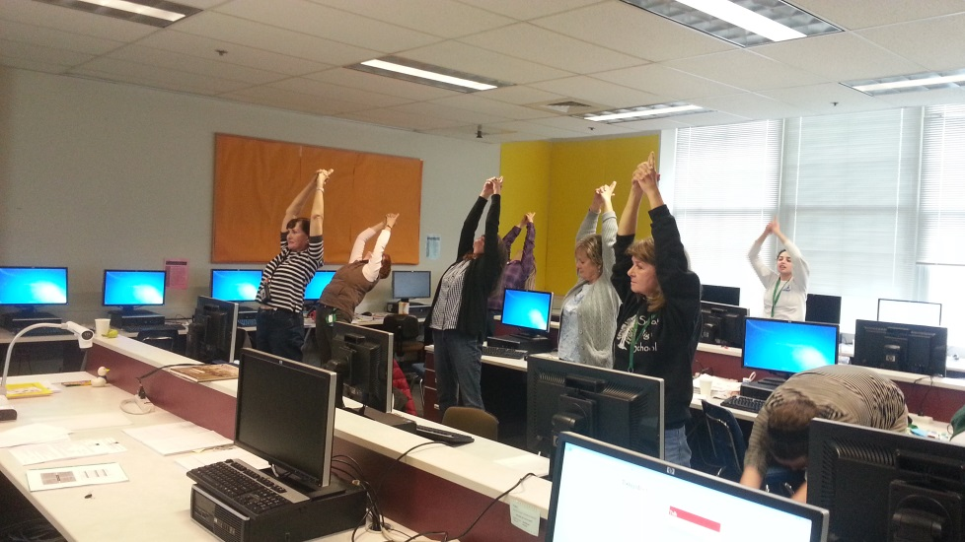
Creating a Culture of Wellness
    Action: Build Bridges
    Establish Trust-Cultivate Image Equity
    for the Program
Steps:
  Introductions-Staff Meetings, SLT
  Employee Interest Survey
  Wellness Council
  Establish Wellness Teams
  Addition of positive benefit changes
    Tobacco Cessation Program-Free and Clear
    Weight Management Program-Sound Health Solutions
    EAP-Expanded Coverage
    Alternative Medicine inclusion in benefits coverage
  Free Flu Vaccine Clinics
  Athletics Weight Room and Track open to employees
  Seated Chair Massage
  Gym Discounts for Employees
  Weight Watchers at Work
LID Day at Sequoia
“Thank you for the Free and Clear program. I am happy to say I am three years without a cigarette”. Cynthia; Maintenance

Slide 5
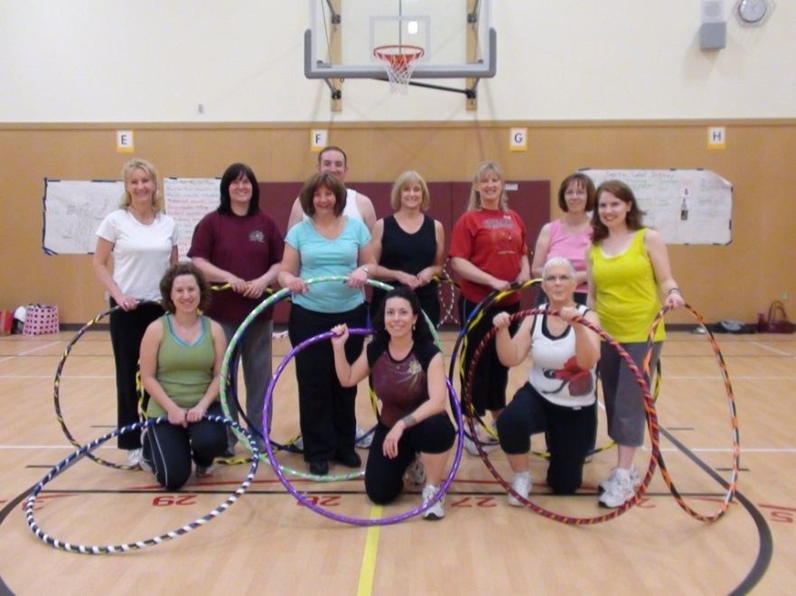
Creating a Culture of Wellness
Action: Infusion of Wellness
Raise awareness, Educate, Encourage
Steps:
  Hope Health Letter
  Newsletters-HR Payroll
  and Newslinks
    National Health Observances
  Fitness Classes at District Sites
  Wellness Classes
    Be Well-Teach Well
    Eight Weeks to Wellness
    Cultivating Calm
    Cooking Classes
    Quick and Healthy Meals
“Our wellness program got me to exercise.
I used to say "I hate to sweat!" Now I love to sweat and lost weight! I appreciate you for allowing me to discover something that I enjoy so much”.

Slide 6

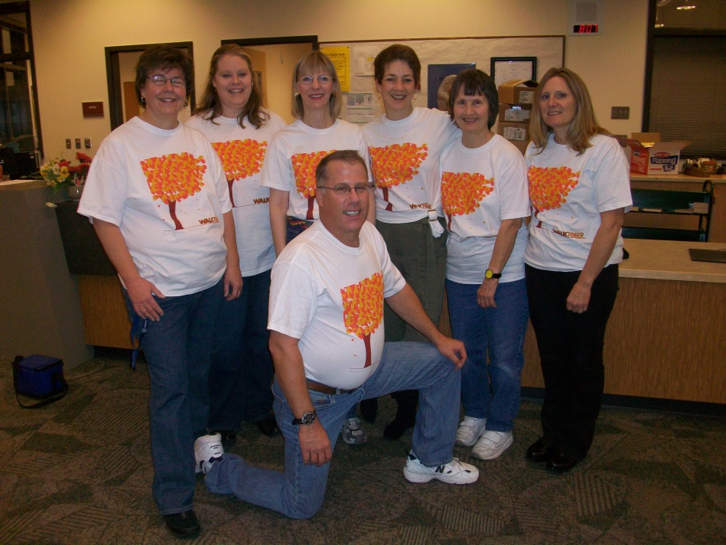
Creating a
Culture of Wellness
Action: Inspire, Motivate, Nudge
Steps: Challenges and Campaigns
Bike to Work
Trails Challenge
WALKTOBER
Turkey Trot
Maintain Don’t Gain
Health for the Holidays
Passport to Health
“Thanks to WALKTOBER I have been walking for over a year now. I've lost 60 pounds and feel really healthy. I am a grandma and wanted to get on the floor with my babies and play. Thanks for this program, it's fun!“

Slide 7
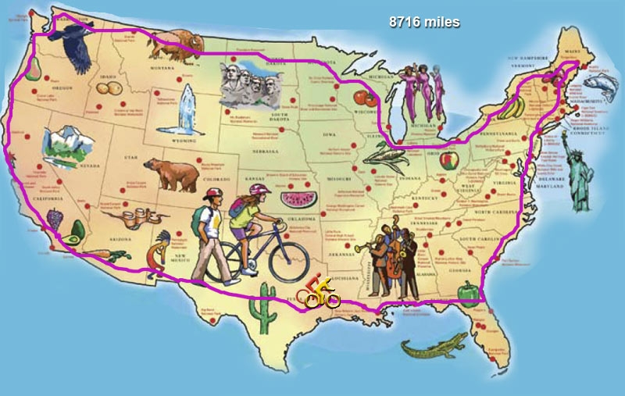
Bike to Work Campaign
150 participants biked over 9,500 miles and 2,000 trips
“Lets do it again next year!
Could we do something similar to this at the start of school and keep healthy year-round?”

Slide 8
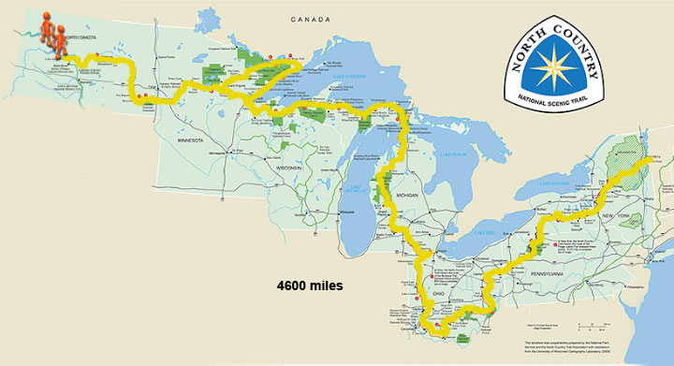
EPS Trails Challenge
600 participants walked 40,197 miles and 80 million steps
“I think this challenge was a great idea, it created a lot of camaraderie and a sense of team spirit at our school.”
Notes:
Slide 9
Additional Quotes:
I really enjoy that the district has this program in place. It really helps people that don't know what to do (when they need help changing their lifestyle) by taking us by the hand and showing various paths to get there. Also, camaraderie between co-workers has increased. It is really great when we have these challenges, we all work for the common cause-health to happiness

Slide 9
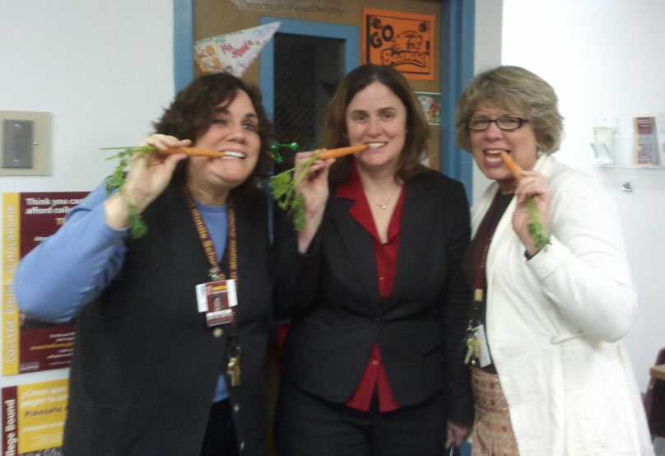
Creating a Culture of Wellness
Action: Inspire, Motivate, Nudge
Steps: Challenges and Campaigns (Cont.)
Know your Numbers
31-Day Eat Smart Challenge
National Parks Tour
Daily Fitness Challenge
Ironman Challenge
Triathlon Challenge
Winter Break Bingo
Sit Less Move More
Path to Health
Summer Fitness and Nutrition Challenge
Heart Month Challenge
Healthy Heart Tick-Tack-Toe

Slide 10


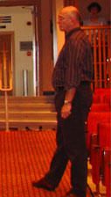
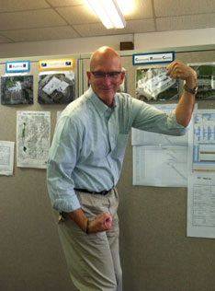
Creating a
Culture of Wellness
Action: Motivate-Change
The Wellness Challenge®
Weight Watchers at Work
Chuck Booth, Facilities and Planning; CRC

Slide 11
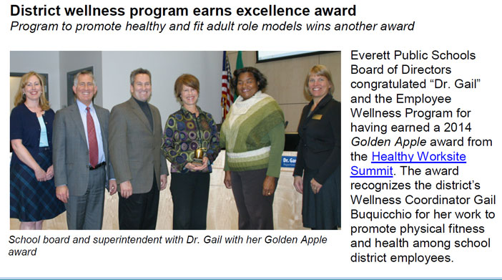



Awards/Recognition
American Heart Association
  Gold Fit Friendly Worksite Award
  4 years in a row.
School Employee Wellness-Gold Level National Award 2011-2012 from the Directors of Health Promotion and Education
Puget Sound Healthy Worksite Summit
Golden Apple Award 2014

Slide 12
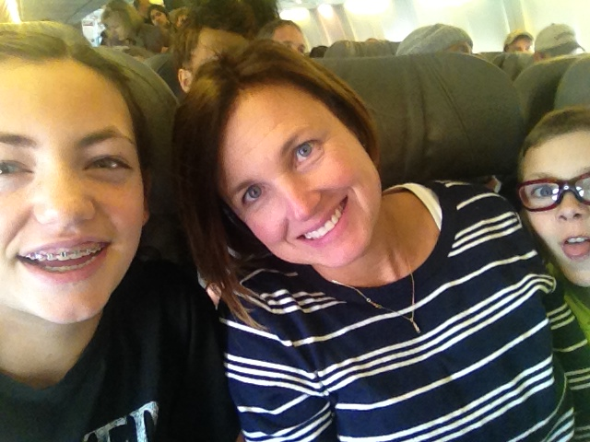
Testimonials
“I don’t even think I can begin to explain how much I looked forward to your Wednesday Wellness Newsletters. It was the most challenging year I have had teaching, and the newsletters were bits of wisdom and sunshine that I could glean and apply to my world”.
Maggie Doud, Teacher; Port Gardner

Slide 13
Testimonials

Slide 14
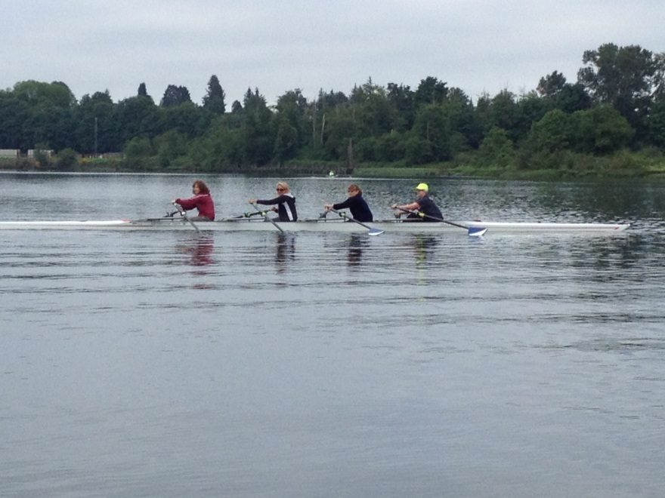
Testimonials
When the fitness classes were first offered, I decided it would be a good start to trying to be healthier. I think there was even a chance to try out the first class for free! Gail was teaching yoga and even though I had never practiced yoga before, she made me feel so welcome. I started to remember how good it feels to get moving! Then I tried Zumba, and it was so much fun that I just had to go two days a week. Around this time I started wondering, Why not get back into rowing? So I did! I’m healthier now than I had been for a very long time. I am so grateful that the Wellness Program provided a way for me to focus on my health”
Janet Erickson, Teacher; Jackson Elementary

Slide 15
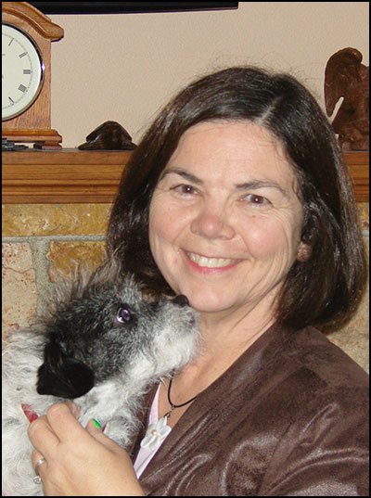

WW is a very supportive program that has helped me lose over 100 pounds. Our leader is very inspirational and helps us see the “whole” picture and process of losing weight. Small changes can make a big difference. A big thank you to the Trust for supporting the Weight Watcher program in the school district!
Pat Jones, LMS; CRC

Slide 16
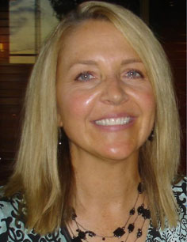
Chris Hulteng, Teacher at Monroe, organized 3-4 Walktober teams and met with them to inform them of the program. She sent encouraging emails to get everyone going. She made a chart for students to see that exhibited the Wellness Team’s walking steps to inspire our students. She also coordinates monthly Wellness lunches where the Wellness walking teams provide a healthy lunch for the entire staff each month. Oh yes! In partnership with Debi Doyle, she tries to get staff to exercise after school. Thanks Chris! You are truly an inspiration to us all!

Slide 17
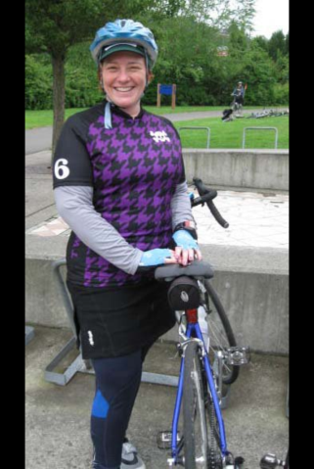
Cynthia Gaub has been a wellness leader in our school. She participates in our weekly veggie/healthy snack club; helps keep the staff informed about wellness opportunities. She walks, runs, swims, rides her road bike, and always takes on several of the wellness challenges herself.

Slide 18
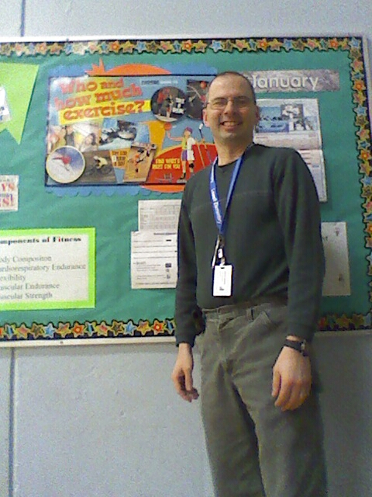
John Preston is a perfect example of someone who has incorporated health and wellness into every aspect of his life. John starts almost each day by riding his bike to work, rain or shine. John also uses his pedometer faithfully. John brings in his healthy lunch each day and makes sure his fruits and veggies are represented. He has participated in Walktober many years in a row and is a huge part of our Wellness Team at Lowell.

Slide 19
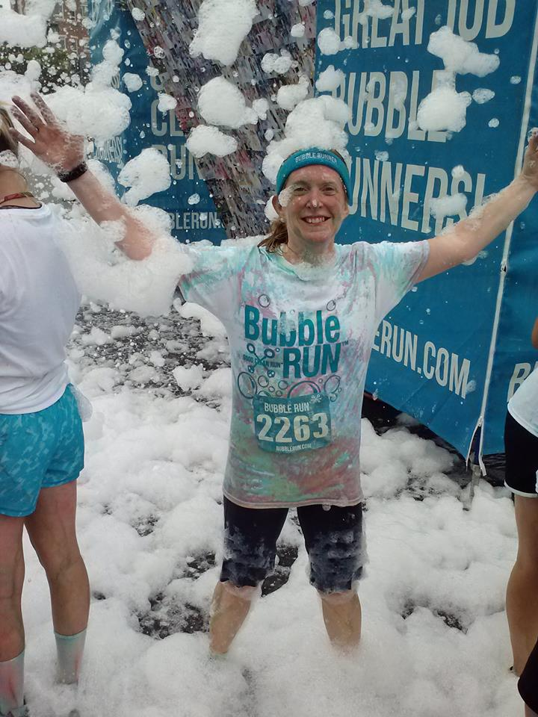
Cathy Woods, Principal; Cascade High

Slide 20
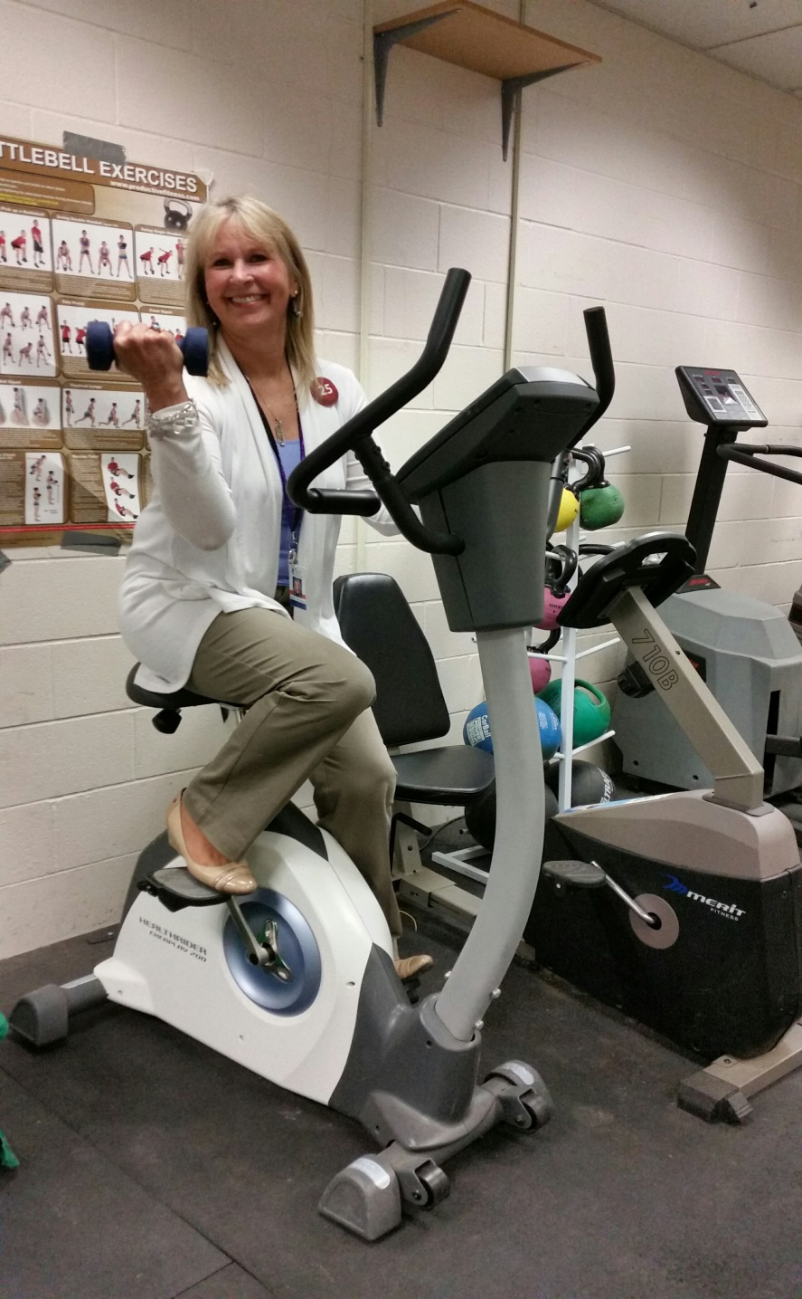
Janet Gillingham, Principal; Heatherwood

Slide 21
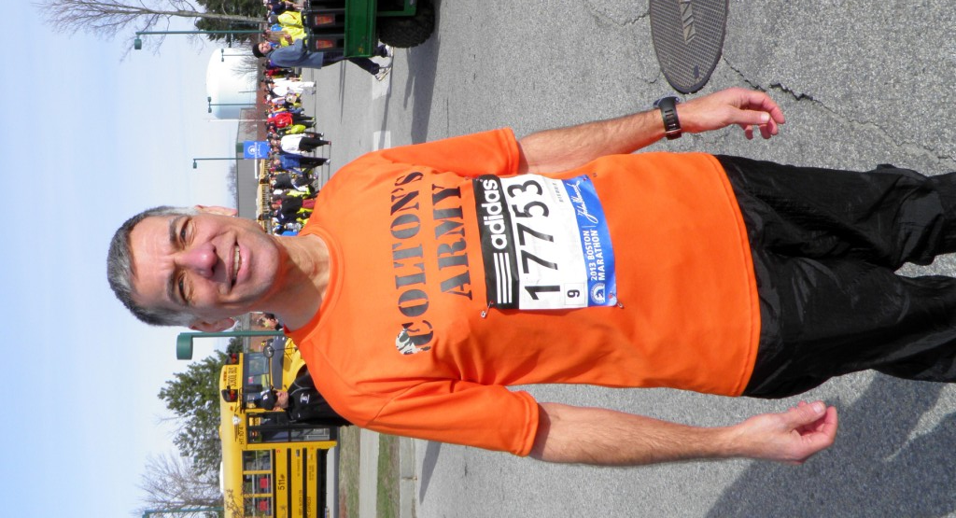
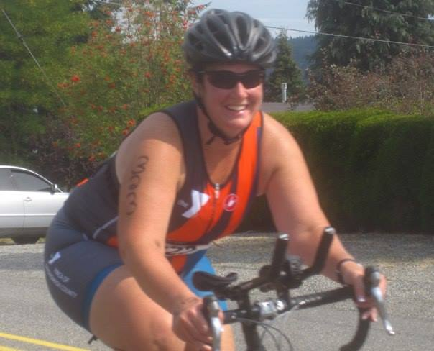
Kelly Shepherd,
Principal; Sequoia
David Jones,
Principal; Cedar Wood

Slide 22
Measuring Culture Change
Survey Question: One of the main goals of the EPS Wellness Program is to "create a culture" of Wellness.
 | 2013/2014 | Agree somewhat | Strongly agree | Total Survey Respondents | 2012/2013 | Agree somewhat | Strongly agree | Total Survey Respondents | 2011/2012 | Agree somewhat | Strongly agree | Total Survey Respondents | 2010/2011 | Agree somewhat | Strongly agree | Total Survey Respondents | 2009/2010 | Agree somewhat | Strongly agree | Total Survey Respondents
I notice that my colleagues and I are more conscientious about our health since the inception of the wellness program. |  | 51% | 42% | 350 |  | 55% | 39% | 707 |  | 50% | 47% | 328 |  | 49% | 45% | 688 |  | 51% | 43% | 733
Wellness Program activities have helped to create a greater sense of camaraderie at my workplace. |  | 51% | 35% | 350 |  | 56% | 26% | 707 |  | 51% | 40% | 328 |  | 56% | 33% | 688 |  | 51% | 39% | 733
There is more general conversation and discussion about health and wellness topics. |  | 46% | 42% | 350 |  | 46% | 39% | 707 |  | 40% | 52% | 328 |  | 49% | 41% | 688 |  | 47% | 42% | 733
We have become more conscientious about having healthier food options for staff meetings and gatherings. |  | 47% | 33% | 350 |  | 53% | 29% | 707 |  | 39% | 46% | 328 |  | 43% | 40% | 688 |  | 48% | 34% | 733
Having a district wellness program in place makes me feel that my health and well being are an important priority for district administrators and leadership. |  | 32% | 61% | 350 |  | 31% | 63% | 707 |  | 26% | 70% | 328 |  | 29% | 65% | 688 |  | 32% | 62% | 733
Seeing district administrators and the leadership team involved in wellness activities inspires and motivates me to participate too. |  | 47% | 43% | 350 |  | 44% | 36% | 707 |  | 44% | 38% | 328 |  | 45% | 33% | 688 |  | 41% | 31% | 733
Do you feel the Wellness Program is fully meeting it's vision of creating a culutre of wellness in our district? |  | 45% | 53% | 350

Slide 23

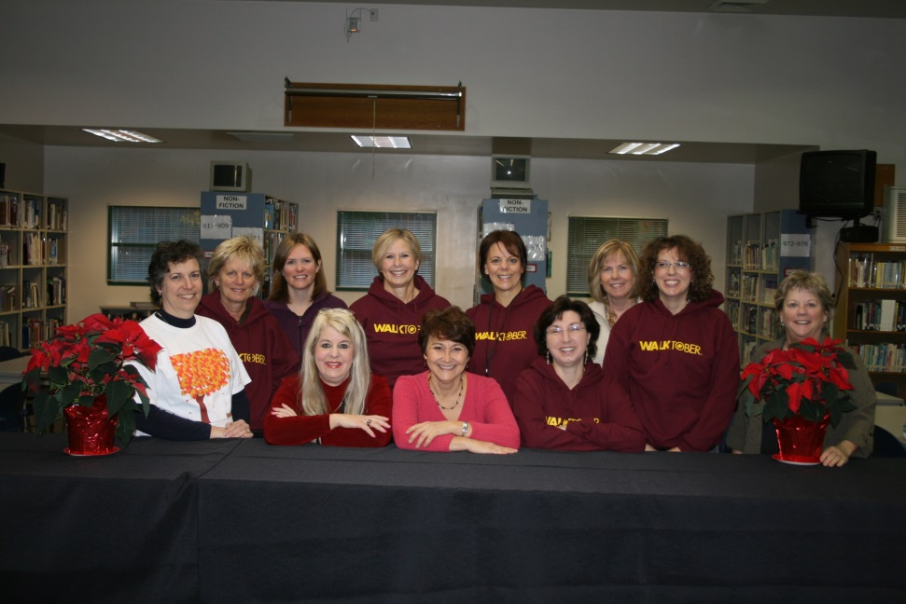
Goal:
Create a
Culture of Wellness
“Thank you for all that you do.
This is an outstanding part of EPS culture, as it says loudly and clearly to everyone:
You matter.
We care about you.
We care about one another”.

Slide 24
Future of Wellness at
Everett Public Schools
Continue to infuse wellness in to the culture
Incorporate staff wellness in to district policies and strategic plan
Engage more of the population by programing for individual groups i.e. maintenance, food services, custodians etc.
Keep the healthy people healthy
Engage leadership in the wellness program

Slide 25
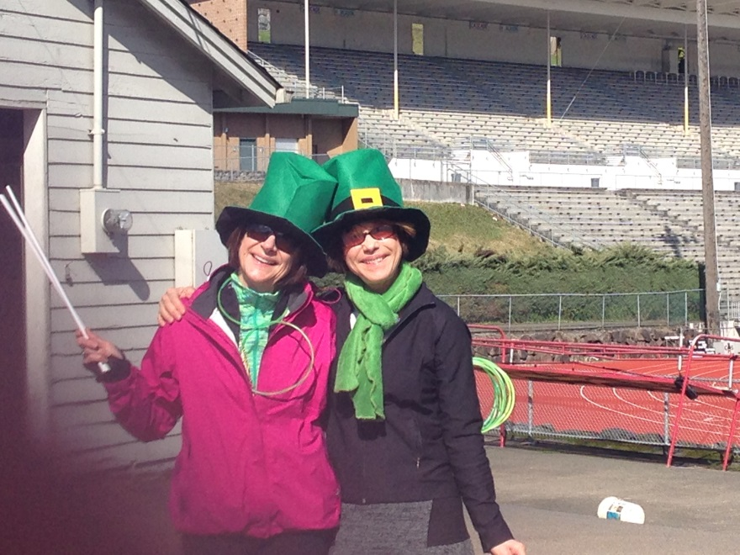
Thank You Trustees, for giving me the opportunity to create a program that makes a difference in peoples lives.
May you be well☺

