Slide 1
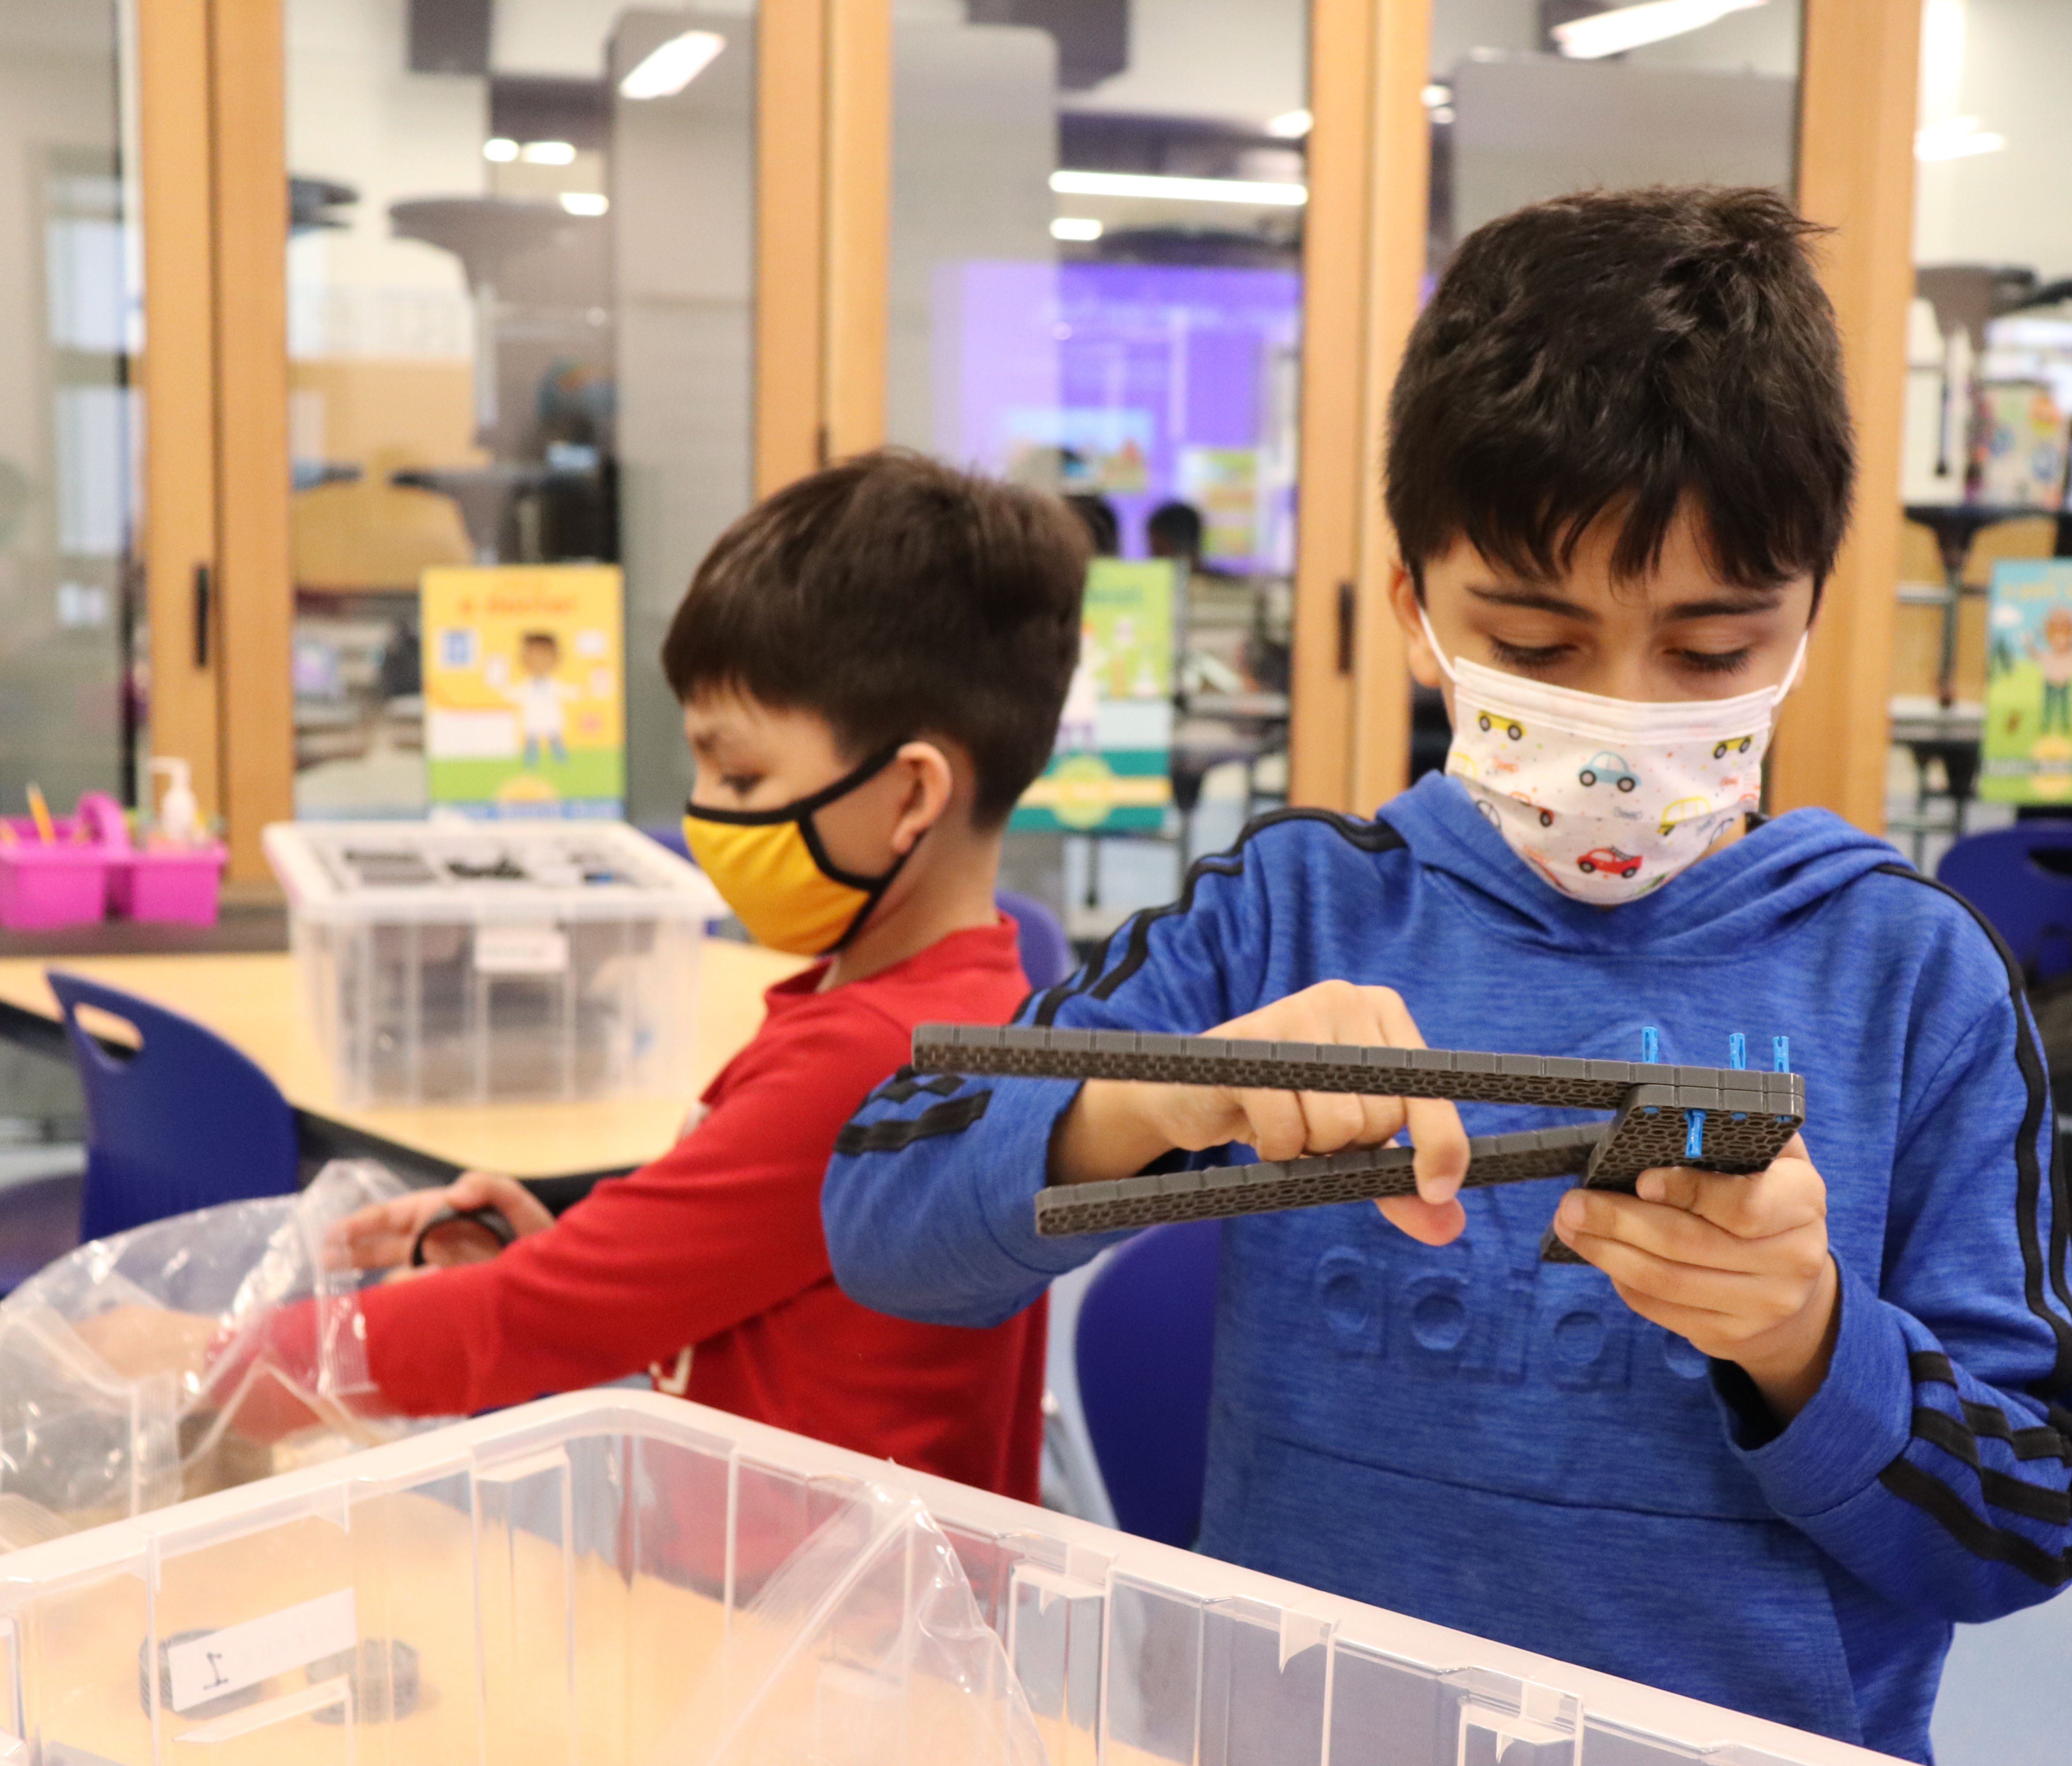

Replacement Capital and EP&O Levies
February 8, 2022
Notes:
Welcome comments
In November the board of directors voted to put two replacement levies on the February 8, 2022 ballot – a replacement capital levy and a replacement Educational Programs and Operations, or EP&O levy.

Slide 2

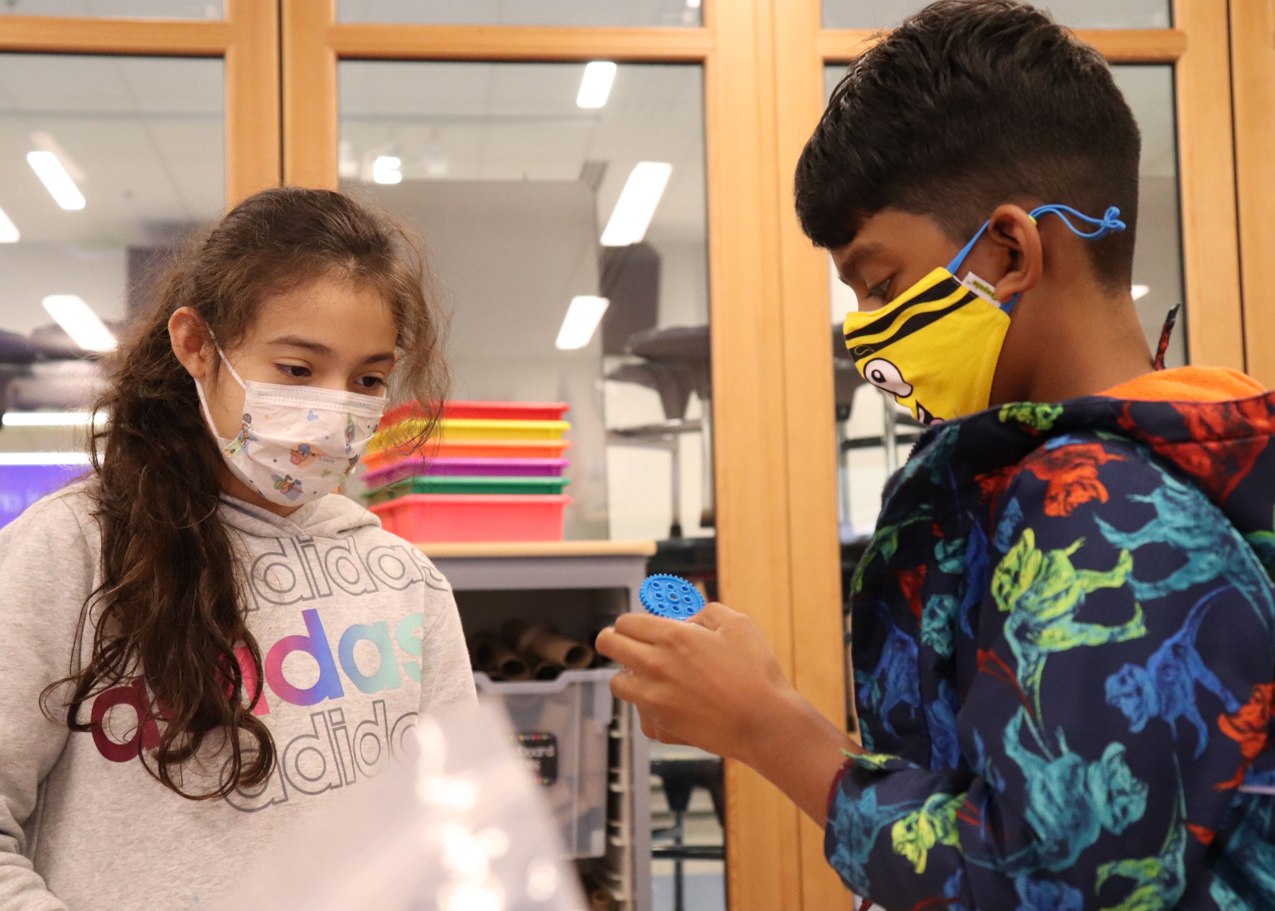
2022 Replacement Levies
We will review:
  The difference between and EP&O and Capital Levy
  What each levy pays for, and projects included
  The tax rate implications of passing the levies
Notes:
We will review:
The difference between and EP&O and Capital Levy
What each levy pays for, and projects included
The tax rate implications of passing the levies

Slide 3

2022 Replacement Levies
Educational Programs and Operations Levy (EP&O)
  Covers basic educational and operational costs not covered by the state
  Essential for day-to-day functioning of schools
  Includes special education, nurses, counselors and salaries.
Capital Levy
  Covers highest priority technology and facility needs
  Includes safety and security upgrades, facility maintenance and equal access to educational programs
Notes:
The EP&O levy covers basic educational and operational costs expected of the school district that is not covered by the state. It is a four-year levy that is deposited into the General Fund (Operating)and is essential for day to day functioning of schools. It includes special education, nurses, counselors and salaries.
The capital levy funds will be deposited into the Capital Projects Fund over six years and funds the highest priority technology and facility needs of the district not funded by the state. This includes computers, equipment and support to maintain one device/computer per student; health, safety and security upgrades district-wide; ensuring equal access to programs and facilities for all students; and maintaining our facilities in good working order.

Slide 4
2022 Replacement Levies
PROPOSITION 1:
Replacement Educational Programs and Operations Levy (EP&O)
4-year levy; funds collected 2023-2027
Accounts for approximately 14% of Everett Public School’s general fund revenue
PROPOSITION 2:
Replacement Capital Levy
6-year levy; funds collected 2023-2029
Accounts for approximately 92% of Everett Public School’s capital fund revenue
Notes:
The EP&O Levy will be Proposition 1 on the voter’s ballot, and the replacement capital levy will be proposition 2.
You can see here the EP&O is a 4-year levy while the capital levy is 6-year. They both start collecting in 2023.
The EP&O, which covers everyday expenses, accounts for 14% of the general fund revenue, while the capital level accounts for over 90%. You can see they both contribute significant amounts funding our schools.
- for the EP&O
- for the Capital levy, the levy itself contributes 92%, and the levy would result in an additional 7% funding from the state in SCAP – (or school construction assistance program) funding. So really, those two together result in 99% of the capital funding.

Slide 5

2022 Replacement Levies
EP&O
The state provides funding, but it does not fully cover the expense.
State pays for:
District must pay for:
3 Nurses
9 Nurses
$35 million
Special Education costs
$10 million
Special Education costs
$400,000
Student & Staff safety costs
$4.4 million
Student & Staff safety costs
$4.3 million
Counselor costs
$3.6 million
Counselor costs
Notes:
Let’s talk a little more about EP&O (read slide – pieces come in individually, need to click them on)

Slide 6
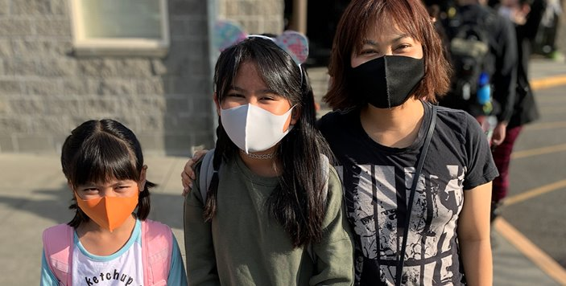
2022 Replacement Levies
EP&O Rates if Passed
    2023 - $65,500,000 at a rate of $2.20 per $1,000 AV
    2024 - $67,000,000 at a rate of $2.15 per $1,000 AV
    2025 - $69,000,000 at a rate of $2.14 per $1,000 AV
    2026 - $71,000,000 at a rate of $2.14 per $1,000 AV
Notes:
Here you can see what it will mean if the EP&O levy passes.
In years 2023 – 2026 you can see the total amount collected and what that would mean as a tax rate per $1,000 of assessed value of your home
Below you can see what the tax rate has been over the last 10 years for the EP&O levy. If this passes it will remain in the low $2 range for four years.

Slide 7



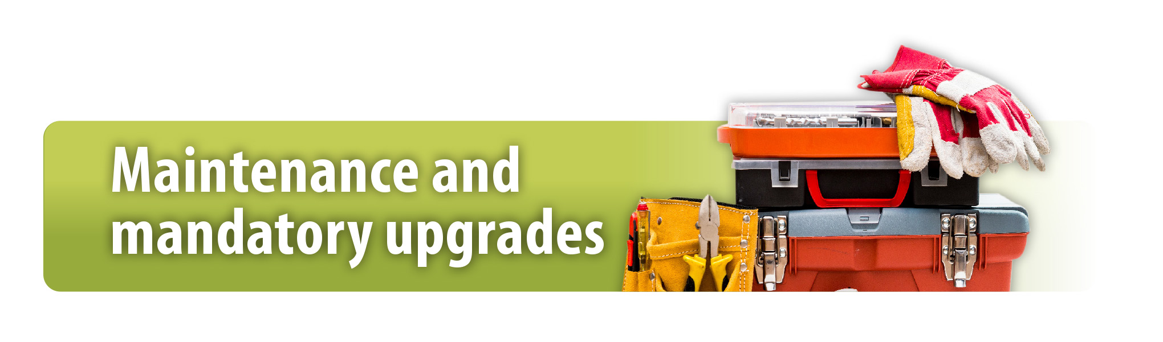
2022 Replacement Levies
Capital Levy
Total: $325.5 million
Our students benefit from ongoing integration of technology into their learning.
$ 96 million
Our students will learn in buildings that are made to be safer and more secure.
$ 2 million
Every student will have the same opportunity to learn in well-functioning, safe and modern spaces.
$ 172 million
Our facilities are valuable community assets and must be maintained to increase their life expectancy and comply with state mandated upgrades.
$ 54 million
Notes:
Now the Capital Levy
There are 4 major components of the capital levy:
Technology –
Increased safety and security
Equal access, same experience
Maintenance and mandatory upgrades
Read the bullets – total cost is $325.5 million
We will dive a little deeper into each of these

Slide 8
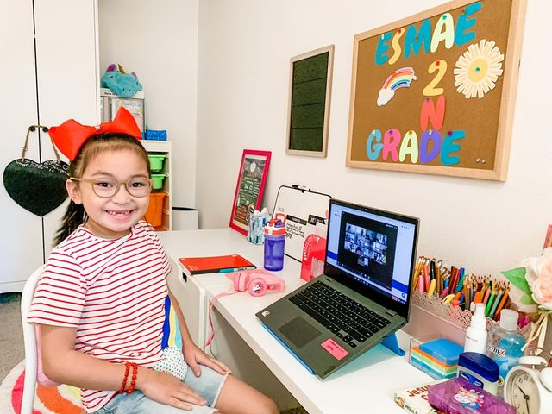
2022 Replacement Levies
• Maintain 1:1 program by ensuring devices stay updated, supported and properly maintained.
• Ensure classroom, building and district technology stays updated and capable of current and future needs.
• Ensure staff have the resources, skills, and support to enhance instructional design and engage students as creators and collaborators.
• Ensure families have adequate home internet access and Wi-Fi.
• Maintain district systems and online subscriptions
Notes:
Technology is a big part of this levy. As you know, the 2016 capital levy funded 1:1 devices for our district which set us up well when we had to pivot to online learning in the spring of 2020. This levy will continue that good work and more. It is preparing us not to just meet the needs of today, but to look into the future as well
• Maintain 1:1 program by ensuring student and teacher devices stay updated, supported and properly maintained.
• Ensure classroom, building, and district technology stays updated and capable of current and future needs.
• Our teachers need to be trained on new technology and platforms, so this also pays for professional development
• Ensure families have adequate home internet access and Wi-Fi.
• Also pays for ongoing updates, online subscriptions and maintenance

Slide 9

2022 Replacement Levies
• Install security fencing at Everett High School and Cascade High School
• Upgrade security systems at 11 sites
• Upgrade fire alarm systems at Mill Creek and Silver Firs elementaries and Everett High Science Building
Notes:
Increased safety and security
Read bullets
The fencing at Everett High and Cascade High is not a big fence around both campuses. They both have places that act as a public thoroughfare and are easy entrances for the public to be on campus. This will pay for those areas to be closed off during school hours
These are all about keeping our students and staff safe

Slide 10
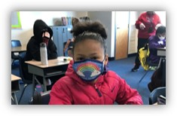
2022 Replacement Levies
• Replace Madison and Jackson elementary schools
• Replace Cascade High Science Building for science classrooms and Aerospace & Advanced Manufacturing Pathway
• Upgrade two classrooms at Jackson High for science programs and Information and Communication Pathway
• Modernize classrooms and cafeteria at Everett High Auditorium Building
• Upgrade cafeteria and kitchen at Cascade High
Notes:
Equal access, same experience – we believe that every student should have the same educational opportunities and experiences no matter what school in the district they attend.
• Replace Madison and Jackson elementary schools
- Madison and Jackson elementaries are desperately in need of replacement. They are not up to seismic code, are not ADA compliant, and are costing a lot to maintain while at the same time not providing the right kinds of environment for the best learning.
• Replace Cascade High Science Building for science classrooms and Aerospace & Advanced Manufacturing Pathway
• Upgrade two classrooms at Jackson High for science programs and Information and Communication Pathway
- The science rooms at Jackson and Cascade are not able to support the new teaching standards for science and also need new space for the STEM career pathways at those schools.
• Modernize classrooms and cafeteria at Everett High Auditorium Building
• Upgrade cafeteria and kitchen at Cascade High
- These schools have so little room in the cafeteria, students often skip lunch because they can’t get through the line in time or find a place to site
All of these things need to be addressed.

Slide 11
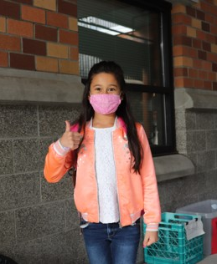
2022 Replacement Levies
• Upgrade HVAC controls at four sites
• Clean Buildings Act upgrades district-wide
• Replace roofing at six schools
• Replace flooring at Emerson and Silver Firs elementary schools
• Replace aging playground equipment at eight elementary schools
• New Reader boards at 19 schools
• Replace freezers and coolers at Jackson and Cascade high schools
• Replace bleachers at Jackson and Cascade high schools
Notes:
Maintenance and mandatory upgrades – just like you need to maintain your home to prevent more costly repairs down the road, we need to maintain our schools
• Upgrade HVAC controls at four sites
• Clean Buildings Act upgrades district-wide – new law in 2019, accounts for $30 million
• Replace roofing at six schools – about $2M per roof, need replaced every 20-3- years
• Replace flooring at Emerson and Silver Firs elementary schools
• Replace aging playground equipment at eight elementary schools
• Replace freezers and coolers at Jackson and Cascade high schools
• Replace bleachers at Jackson and Cascade high schools
• New Reader boards at 19 schools
- keep our community and families informed

Slide 12
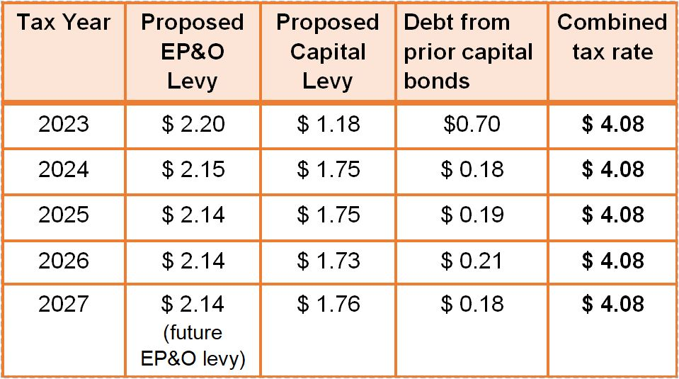
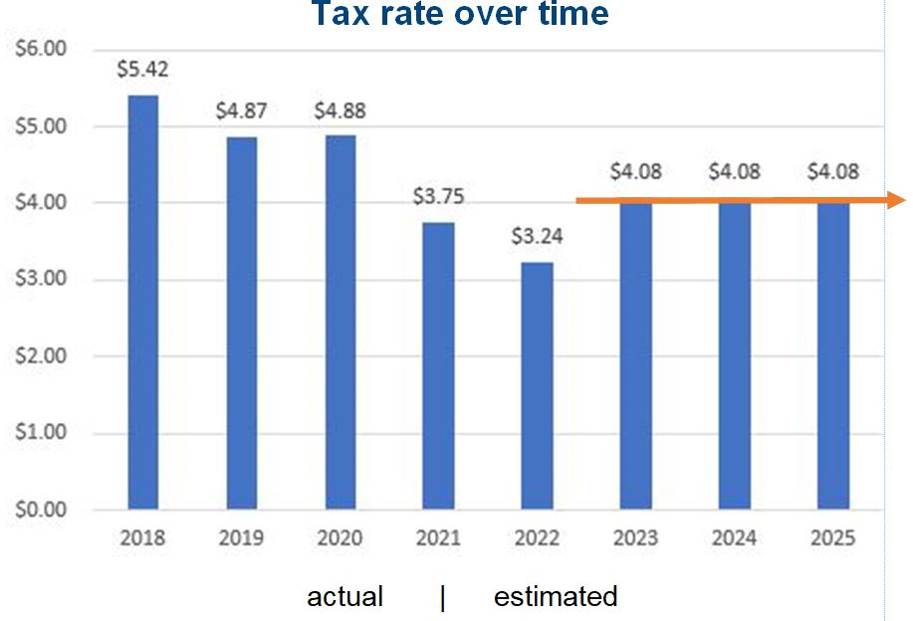
2022 Replacement Levies
How much will the levies cost?
Notes:
How much will these levies cost me?
You can see on the left the rate per $100,000 assessed value for the EP&O levy in the second column and the capital levy in the third column. The fourth column is debt from prior bonds we are paying off. The total shows, if both levies pass, the combined tax rate will be stable at $4.08 per $100,000 assessed value. This will mean your Everett Public Schools-related property tax rates would increase by an estimated $0.84 per $1,000 assessed property value (AV), when compared to 2022 and an estimated $0.33 when compared to 2021. However, the new tax rates will still be substantially lower than rates paid by district property owners prior to 2021. The rates in 2021 and 2022 were quite a bit lower and that is because we did not pass the 2020 Bond.
So what does that mean for you as a home owner?

Slide 13
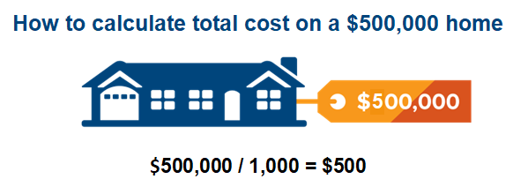
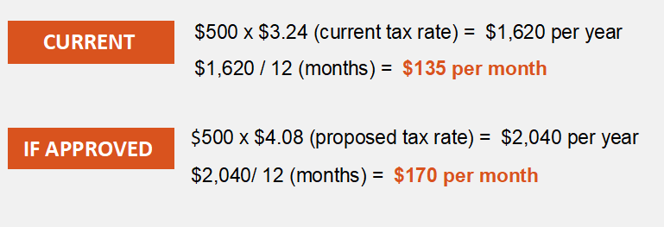
2022 Replacement Levies
How much will the levies cost?
Notes:
Let’s take an example and say your house is valued at $500,000
If you have a house that is assessed at $500,000
You take that value divided by 1,000 and get 500
Currently the tax rate is $3.24 so if you take that rate times your $500 – you currently would be paying $1,620 per year, or $135 per month.
If both levies pass you take the 500 times the new rate of $4.08 and get $2040 a year, which is $170 per month.
You can do the same calculation substituting your house value in where we put $500,000.

Slide 14
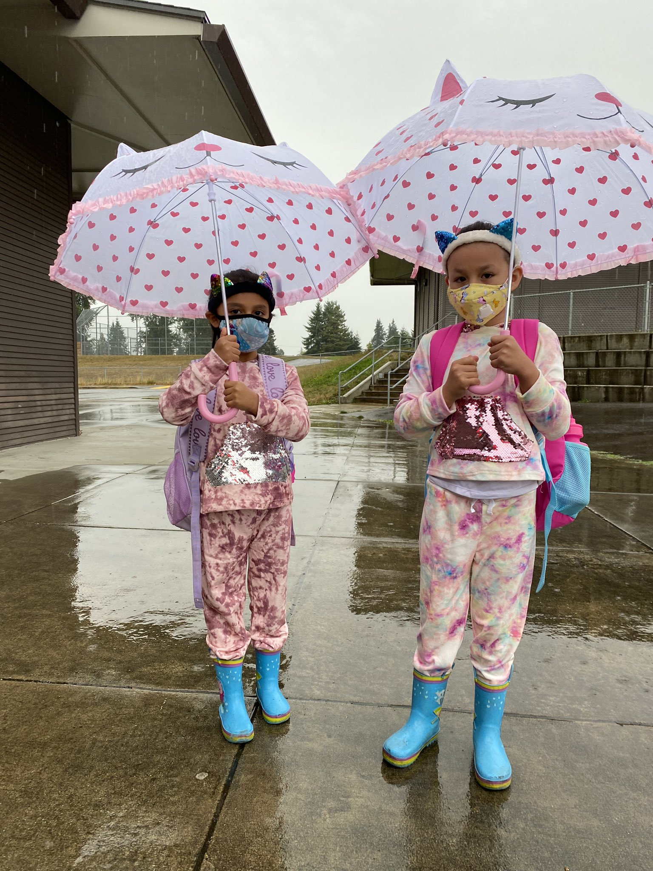
2022 Replacement Levies
Summary
Replacement EP&O Levy and Replacement Capital Levy will be on the ballot February 8
Ballots will be mailed to homes on January 20
Both levies are covering costs of projects and expenses that are needed to have safe, equitable and appropriately sized spaces for our students to learn.
If both levies pass your school district tax rate will be $4.08 per $1,000 AV starting in January 2023.
Notes:
In Summary
Replacement EP&O Levy and Replacement Capital Levy will be on the ballot February 8
Ballots will be mailed to homes on January 20
Both levies are covering costs of projects and expenses that are needed to have safe, equitable and appropriately sized spaces for our students to learn.
If both levies pass your school district tax rate will be $4.08 per $1,000 AV starting in January 2023.

Slide 15
2022 Replacement Levies
Questions?

