Slide 1
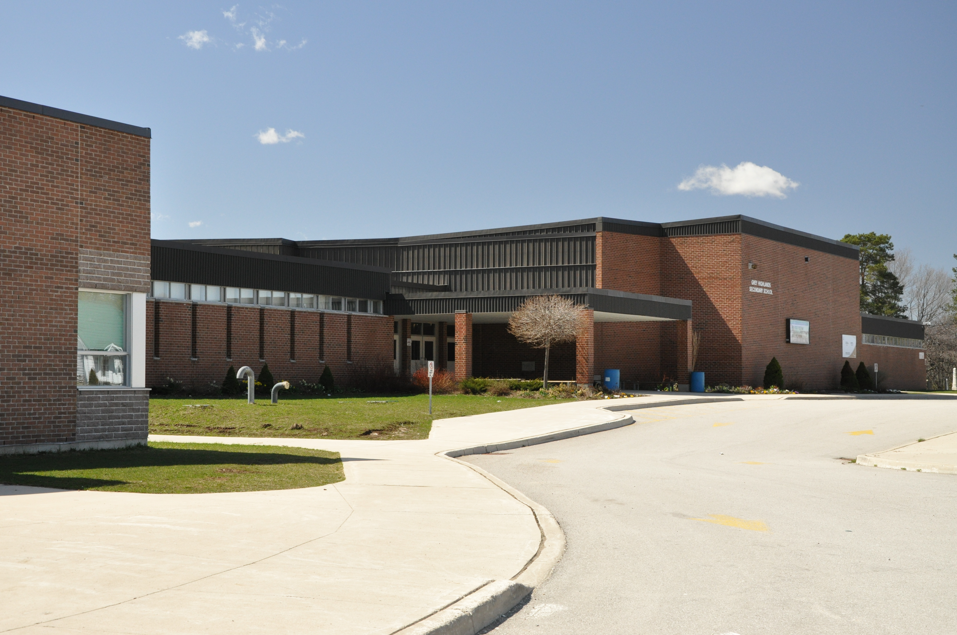



Policy and Legal Updates
Summer Leadership Institute August 2021

Slide 2

Purpose
Review how to access our school district policies, procedures & forms online
Know the most important policy and procedure updates for the 2021-22 school year
Identify the actions and key communicators in your building/department you will need to inform on an August LID Day of these important policy & procedure updates

Slide 3
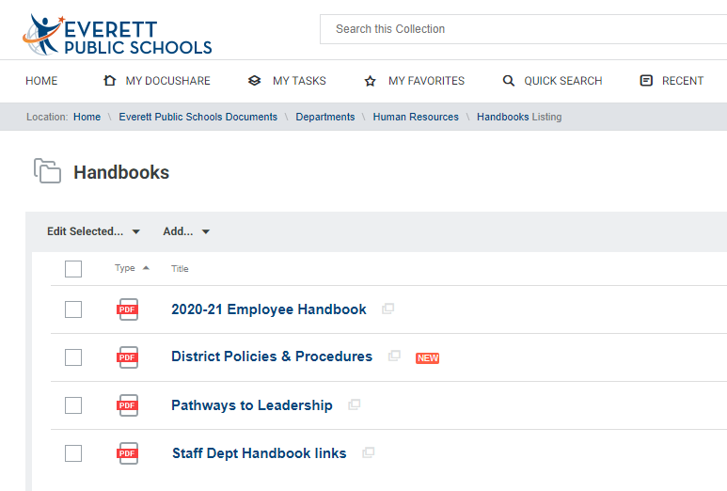
Policy and procedure for staff handbooks
Ingrid Stafford in HR sent directions for on 7/30- be on-time for the safe-schools upload for your LID days! Need the Word version? email Kelly N.
https://docushare.everett.k12.wa.us/docushare/dsweb/View/Collection-12851

Slide 4
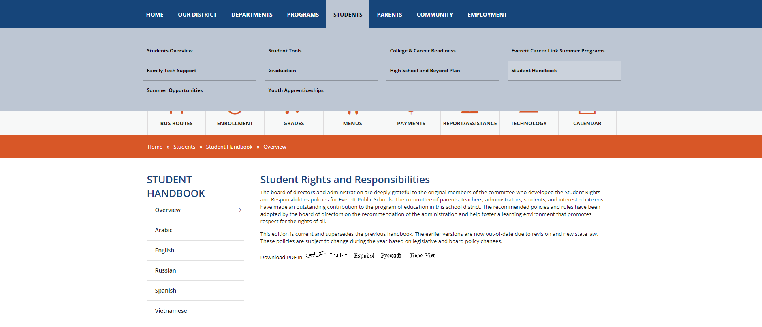
Student Rights & Responsibilities updates
Student rights & responsibilities are 100% electronic this year (no printed copies)
Like last year, annual info. updates (contact info. & FERPA, etc). will be sent to families electronically; the student rights & responsibilities will be sent with it
Accessible 24/7 on all student devices (desktop) and online (below)- on web by Friday

Slide 5
Policy and procedure updates
Policy: 3300/3300P – Student Discipline
What is New:
3240/3240P Student Conduct (deleted); now incorporated into 3300/3300P
Required to use proactive, instructional, and restorative approaches to behavior while keeping students in the classroom to the maximum extent possible
  “Best practices and strategies” refer to other forms of discipline the district has identified that school personnel should administer to support students in meeting behavioral expectations (WAC 392-400-110)
  HB 1541 eliminated the legal foundation for zero-tolerance discipline policies
Student discipline matrix created with community & staff feedback (WAC 392-400-010(3)); incorporated into 3300P to clarify responses to offenses that may merit exclusion
LID Day Action: Share these updates with your staff on an August LID day so they are aware that exclusion is not our first response to address student behavior, what “best practices & strategies” we use as other forms of discipline, and

Slide 6
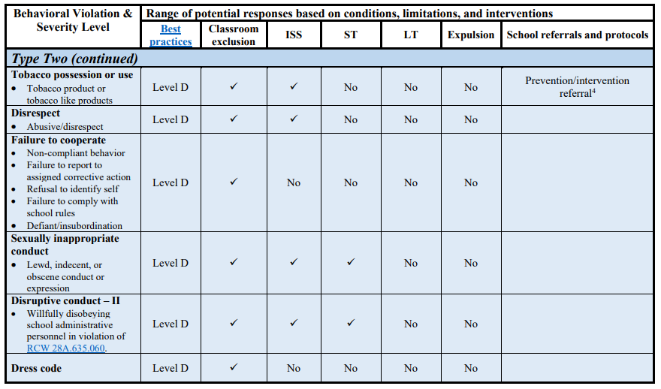
Student discipline best practices
https://docushare.everett.k12.wa.us/docushare/dsweb/View/Collection-576

Slide 7
Student discipline matrix
https://docushare.everett.k12.wa.us/docushare/dsweb/Get/Document-120035/3300P%20District%20Discipline%20Matrix.pdf

Slide 8
Policy and procedure updates
Policy: 3520 – Student Fees, Fines, and Charges
What is New:
HB 1176 has amended RCW 28A.635.060. Districts may no longer hold the grades or transcripts of a student with an unpaid fee or fine. Only the student’s physical diploma may be withheld until the student or the student’s parent, or guardian has paid for the damage or restitution has been completed per 3520P.
LID Day Action: Inform all staff of this change as they may issue a fee (course, athletics); review with office staff who serve parents/students regarding placing or resolving student fines on student accounts; ensure your office staff messaging/response with parents is consistent and aligned.

Slide 9
Policy and procedure updates
Policy: 3122P – Attendance
What is New:
Districts must not file truancy petitions earlier than 7 unexcused absences in a month (as opposed to the previous 5) and no later than 15 unexcused absences in a school year (as opposed to the previous 10).
Community Truancy Board is renamed to Community Engagement Board.
Action: Inform office staff who serve parents/students regarding attendance, filing truancy petitions, & review your truancy letters for updated language prior to use.

Slide 10

Policy and procedure updates
Questions or clarifications?

Slide 11


HIB, Sexual Harassment, Discrimination – District Policies

Slide 12






Student Reports of HIB, Sexual Harassment and/or Discrimination
No
Complaint
Send to counselor
???
No Follow-up
Parents Angry and they Call the District
Nobody Cares About Me!
Yes
Hand out complaint form and copy of the policy & procedure
YAY!!
Complaint
Send to administrator
Investigate Complaint & Resolve
Call the office
&
Call parent. Let parent know their student confided in me and wanted them to know
Administrator
Thank you!
Notes:
Many of the reasons we see complaints escalate is the failure to follow an appropriate complaint process. In my time here, I have heard the following [discuss flow chart].
Need training on investigation? Our Risk Pool offers free training, live via Zoom, with one of the investigators we use frequently. You can register through the link in Smack Talk or I can send it to you.

Slide 13

Complaints and Inclusivity
Nitty-Gritty
“You matter, we hear you, and we take this seriously”
Mindset of every staff member: “I need to protect and support all students”
Remember, they are reporting to you because they trust you – don’t break that trust
Training staff to approach complaints in this manner is important
Taking action = “We care”
Notes:
If we are going to tout our schools as inclusive environments for all students, when we receive complaints from our most vulnerable students – students of color, LGTBQ students, students with disabilities – we need to respond in a way that says “you matter, we hear you and we take this seriously!” Your staff should all be trained in responding in this manner.

Slide 14

District Policies
Policy 3204/Procedure 3204P – HIB
Defines Harassment, Intimidation and Bullying
Requires any staff who observe, overhear, or otherwise witness HIB, or to whom such actions have been reported, must take prompt and appropriate action to stop the HIB and to prevent its reoccurrence
Minor incidents that can be resolved immediately or do
not meet the definition of HIB, require no further action
Read with 3210/3210P
Notes:
As noted earlier, it is important that all staff know what to do if they receive a complaint of HIB. Policy 3204 and Procedure 3204P . . .
It is important to note that while some student misconduct may fall under the district’s HIB policy, the behavior may also trigger responsibilities under nondiscrimination laws and the district’s policies relating to those laws. Therefore, you should not limit your response to a complaint to the district’s HIB policy. If harassment, intimidation, or bullying is based on any protected class, such as gender or race, you must assess the behavior for civil rights implications.
*Note – District AD Dani Mundell is creating a step by step system for tracking and responding to complaints in compliance with Policy and Procedure – watch for templates in future Principal Packet.

Slide 15

District Policies
Policy 3205/Procedure 3205P – Sexual Harassment
Sets forth the investigatory procedure for complaints
of sexual harassment
Be aware of new Title IX requirements
Attempt to resolve at building level, but requires the principal or designee to provide complainant with a copy of the policy and the
procedure for formal complaints
Notes:
New Title IX Officer is Kevin Allen
Policy 3205 and its accompanying procedure 3205P focuses on sexual harassment and sets forth the investigatory procedure for student complaints of sexual harassment. You should attempt to resolve such complaints at the building level, but you should know that this policy and procedure requires the principal or the principal’s designee to provide and person making a complaint of sexual harassment with a hard copy of this policy and procedure, which will guide them in making informal or formal complaints.

Slide 16

District Policies
Policy 3210/Procedure 3210P – Nondiscrimination
Sets forth the investigatory procedure for complaints of discrimination
Attempt to resolve at building level, but requires the principal or designee to provide complainant with a copy of the policy and the procedure for formal complaints
Read with 3204 or 3205
Notes:
Policy 3210 and its accompanying procedure 3210P addresses claims of discrimination and sets forth the investigatory procedure for such student complaints.
Harassment may be discrimination when it is:
1. Based on sex, race, creed, religion, color, national origin, sexual orientation, gender expression or identity, veteran or military status, disability, or the use of a trained dog guide or service animal;
2. Sufficiently serious to create a hostile environment; and
3. Encouraged, tolerated, ignored, or not adequately addressed by school employees.
Harassing conduct may include verbal acts and name-calling, graphic and written statements, or other conduct that may be physically threatening, harmful or humiliating. Harassment does not have to include intent to harm, be directed at a specific target, or involve repeated incidents.
As with claims of harassment, you should attempt to resolve such complaints at the building level, but you should know that this policy and procedure requires the principal or the principal’s designee to provide and person making a complaint of discrimination (i.e., being excluded from a school activity because of the person’s race or disability) with a hard copy of this policy and procedure, which will guide them in making informal or formal complaints. This policy and procedure are to be read in conjunction with policies 3204 and 3205. If these complaints are not resolved at the school level, the complainant may ask district administrators to investigate. Student complaints will be addressed through the District’s Title IX officer, and staff complaints will be addressed by the Executive Director of Human Resources.

Slide 17


New Legislation
Notes:
Next, I want to highlight some important legislation from this most recent term.

Slide 18
New Legislation
HB 1214 – SROs and CSOs
New Policy and Procedure 4410 and 4410P
Requires enhanced training and accountability for both school resource officers and classified safety and security staff in schools;
Adds to training requirements and new requirements for safety and security staff contracts, data collection and reporting to OSPI
At beginning of year, each school must present to and discuss with students the roles and responsibilities of safety and security staff (in new policy and procedure) and distribute the same information to families
Notes:
HR 1214 has made significant changes to our existing policy and procedure regarding campus security officers – applies to both SROs and CSOs.
Molly Ringo and new Safety and Security Supervisor Topher Ferreira will be training CSOs and DSOs (District Security Officers) in compliance with the new requirements.

Slide 19
New Legislation
SB 5044 – Racial Equity Trainings
WSSDA must develop cultural competency, diversity, equity, and inclusion standards for school director governance, and must identify or develop governance training for Directors that align with those standards;
Already mandate that beginning in the 2020-21 school year, and every other school year thereafter, school districts must use one of the professional learning days funded under RCW 28A.150.415 to train school district staff in one or more of the following topics: SEL, trauma-informed practices, using the model plan developed under RCW 28A.320.1271 related to recognition and response to emotional or behavioral distress, consideration of adverse childhood experiences, mental health literacy, antibullying strategies, or culturally sustaining practices.
Notes:
Another new piece of significant legislation is SB 5044 requiring all staff to have racial equity trainings. This new legislation requires . . .

Slide 20
New Legislation
SB 5044 – Racial Equity Trainings cont’d.
Now, in the 2021-22 school year, school districts must use one of the professional learning days funded under RCW 28A.150.415 to train school district staff in one or more of the following topics: Cultural competency, diversity, equity, or inclusion.
Beginning in the 2023-24 school year, and every other school year thereafter, school districts must use one of the professional learning days funded under RCW 28A.150.415 to provide to school district staff a variety of opportunities for training, professional development, and professional learning aligned with the cultural competency, equity, diversity, and inclusion standards of practice developed by the Washington professional educator standards board under RCW 28A.410.260.

Slide 21

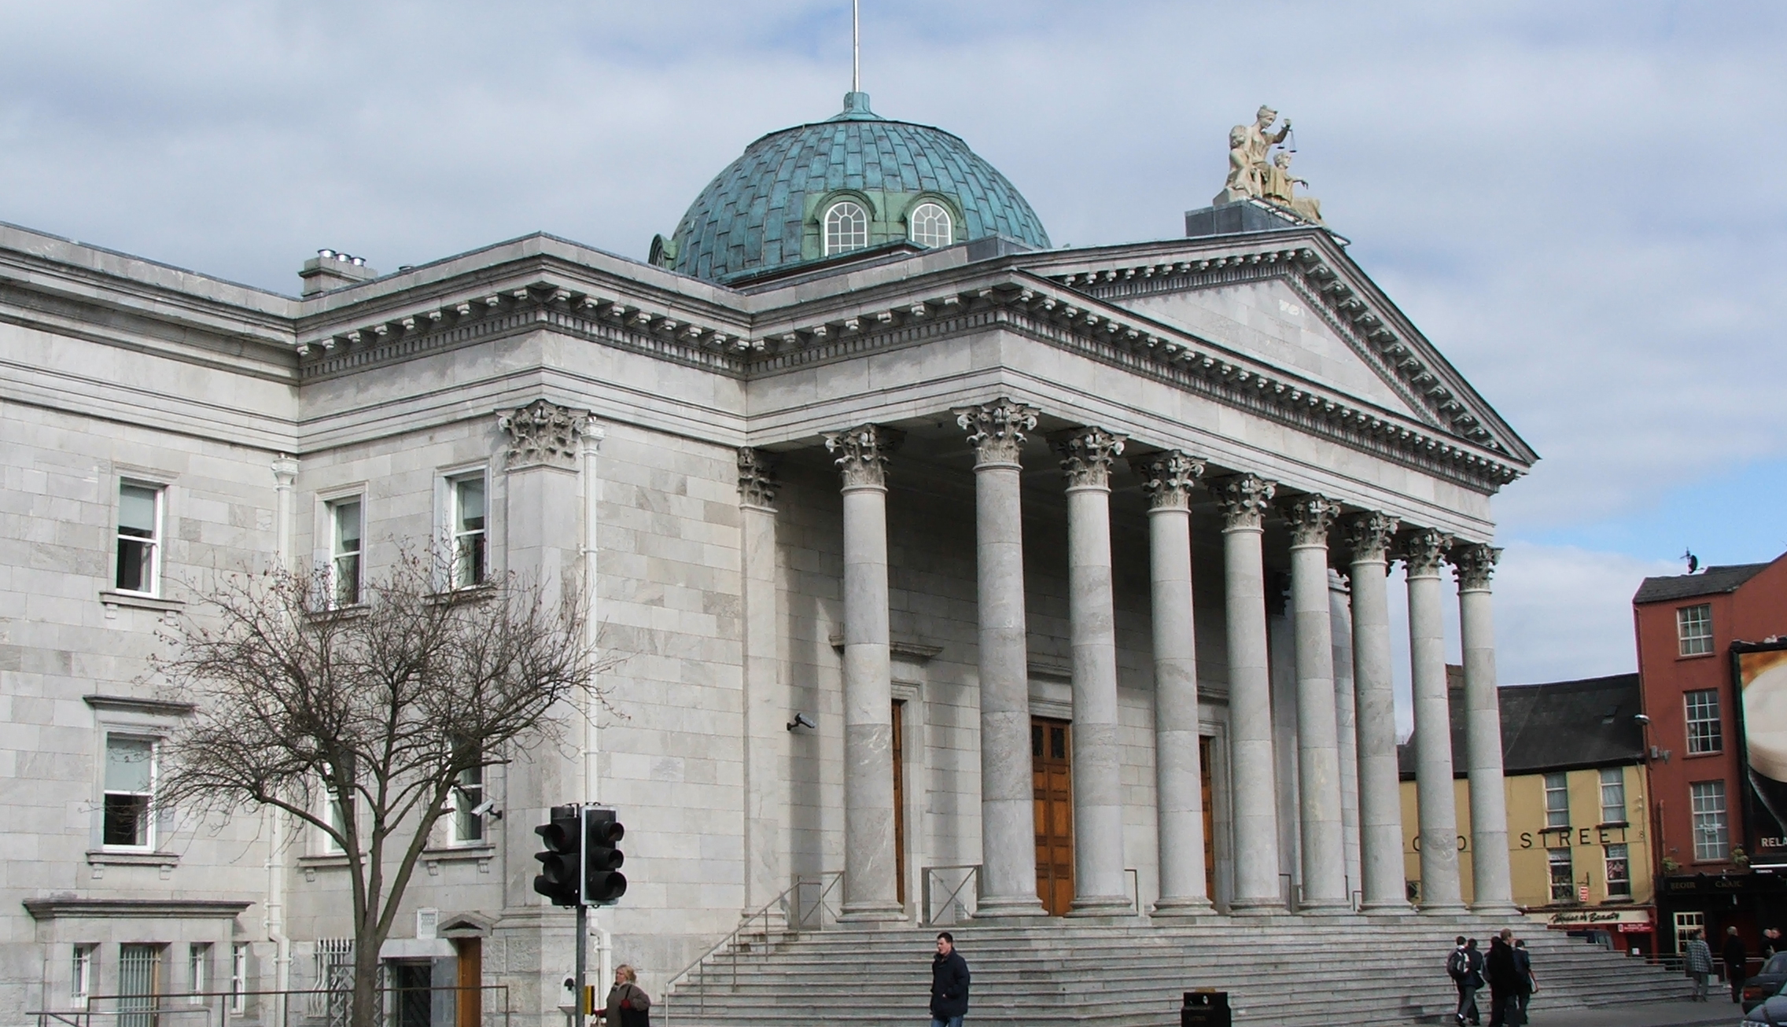
New Case Law
This Photo by Unknown Author is licensed under CC BY-SA
This Photo by Unknown Author is licensed under CC BY-SA

Slide 22

New Case Law
First Amendment Speech - Levy
On 6/23/2021 the US Supreme Court issued its decision;
The First Amend­ment permits public schools to regulate some student speech that does not occur on school premises during the regular school day;
This authority is more limited than the authority that schools exercise with respect to on-premises speech;
Courts should be “skeptical” about the constitution­ality of the regulation of off-premises speech;
The doctrine of in loco parentis “rarely”
applies to off-premises speech;
Notes:
Mahanoy Area School District v. B.L.
In April, the United States Supreme Court heard oral arguments in a case examining whether the seminal case of Tinker v. Des Moines Independent Community School District, which holds that public school officials may regulate speech that would materially and substantially disrupt the work and discipline of the school, applies to student speech that occurs off campus. This case is poised to determine how the First Amendment’s protection of free speech applies to the off-campus activities of the nation’s 50 million public school students.
The case originated in Pennsylvania. It involves a former high school cheerleader that had been on the JV cheer squad her freshman year and had been relegated to the JV squad for her sophomore year. Upon learning of her placement over a weekend, she responded with frustration by posting a photo of her upraised middle finger and (using the complete expletive) “F--- school, f--- softball, f--- cheer, f--- everything,” on her Snapchat account. It was sent to about 250 “friends” and was to disappear within 24 hours, before everyone returned to Pennsylvania’s Mahanoy Area High School on Monday.
Levy was at a convenience store – off the school campus – on a Saturday when she posted the message. Several students who saw the captioned photo approached the coach and expressed concern that the snap was inappropriate. The coaches decided Levy’s snap violated team and school rules, which she had acknowledged before joining the team, and she was suspended from the junior varsity team for a year.
Levy sued under the First Amendment’s guarantee of free speech. She was reinstated to the cheerleading team in the short run, and two lower courts ruled in her favor. The U.S. Court of Appeals for the 3rd Circuit held that Tinker generally does not give school officials the authority to discipline off-campus speech by students.
The Mahanoy Area School District asked the Supreme Court to take up its appeal of the 3rd Circuit’s decision, arguing that schools have long regulated off-campus behavior by students, and that remote learning during the pandemic had further blurred lines between campus and off-campus conduct. The district’s position was that Levy’s Snapchat message was directed at her school friends and fellow cheerleaders and disrupted that community.
Lawyers for Levy argued that applying the Tinker case outside of school would seriously undermine the speech rights of students. They pointed out that under Supreme Court precedent and traditional First Amendment principles, Levy could not be punished outside of school for using the four-letter word she repeated in her Snapchat post, and they proposed a test in which school officials would still have authority over the “school environment,” including the campus or its immediate environs during school hours, at a school-sponsored or -supervised event, on a school-sponsored website, while en route to or from school, or even from students’ own homes if they are engaged in school-sponsored remote learning or using a school laptop issued for school work.

Slide 23
New Case Law
First Amendment Speech - Levy
Public school students, like all other Americans, have the right to express “unpopular” ideas on public issues, even when those ideas are expressed in language that some find “‘inappropriate’” or “‘hurtful’”;
Public schools have the duty to teach students that freedom of speech, including un­popular speech, is essential to our form of self-government; and
The Court declined to set forth a broad, highly general First Amendment rule governing all off-premises speech at this time.
As Justice Alito wrote in his concurrence with the decision “the regulation of many types of off-premises student speech raises serious First Amendment concerns, and school offi­cials should proceed cautiously before venturing into this territory.”

Slide 24


Questions?
This Photo by Unknown Author is licensed under CC BY-SA-NC

