Slide 1

^{Our School Wellness Policy:}
^{What School Staff Need to Know}

Slide 2

Helping Kids Learn, Grow, and Be Healthy

Slide 3

Creating a Healthy School Environment

Slide 4

Making It a Team Effort

Slide 5

Wellness Committee

Slide 6
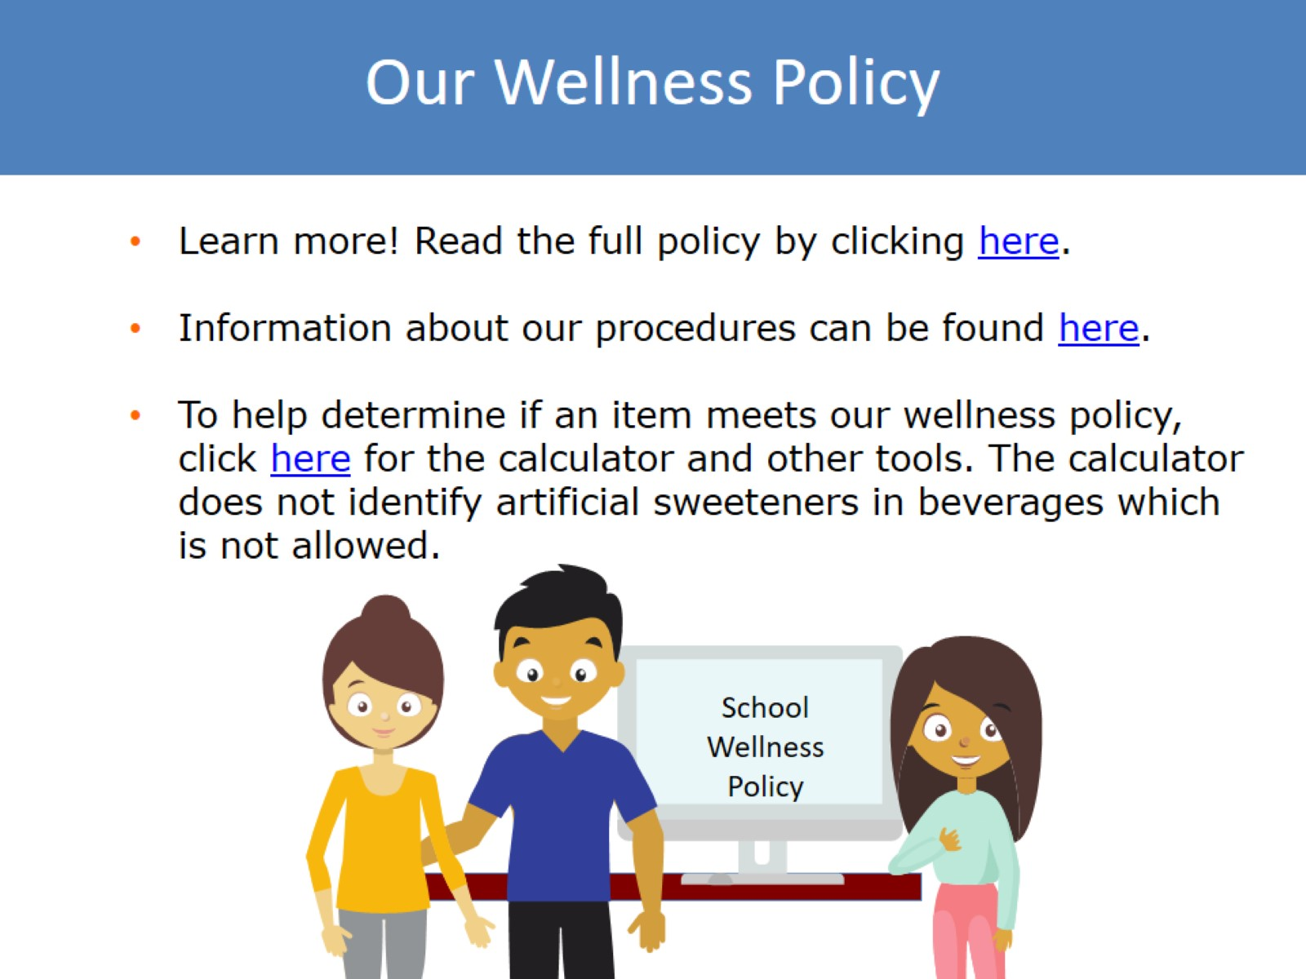
Our Wellness Policy

Slide 7

^{Foods Sold to Students}

Slide 8

Keeping Fundraisers Healthy

Slide 9

^{Food and Beverages Provided}
^{(Not Sold) to Students}

Slide 10

Importance of Nutrition Education

Slide 11

Team Nutrition Resources

Slide 12

Nutrition Promotion

Slide 13

Physical Activity & Physical Education

Slide 14

Understanding Food and
Beverage Marketing

Slide 15

Other School-Based Activities

Slide 16

Finding Our Wellness Policy

Slide 17

Connecting with our Wellness Coordinator

Slide 18
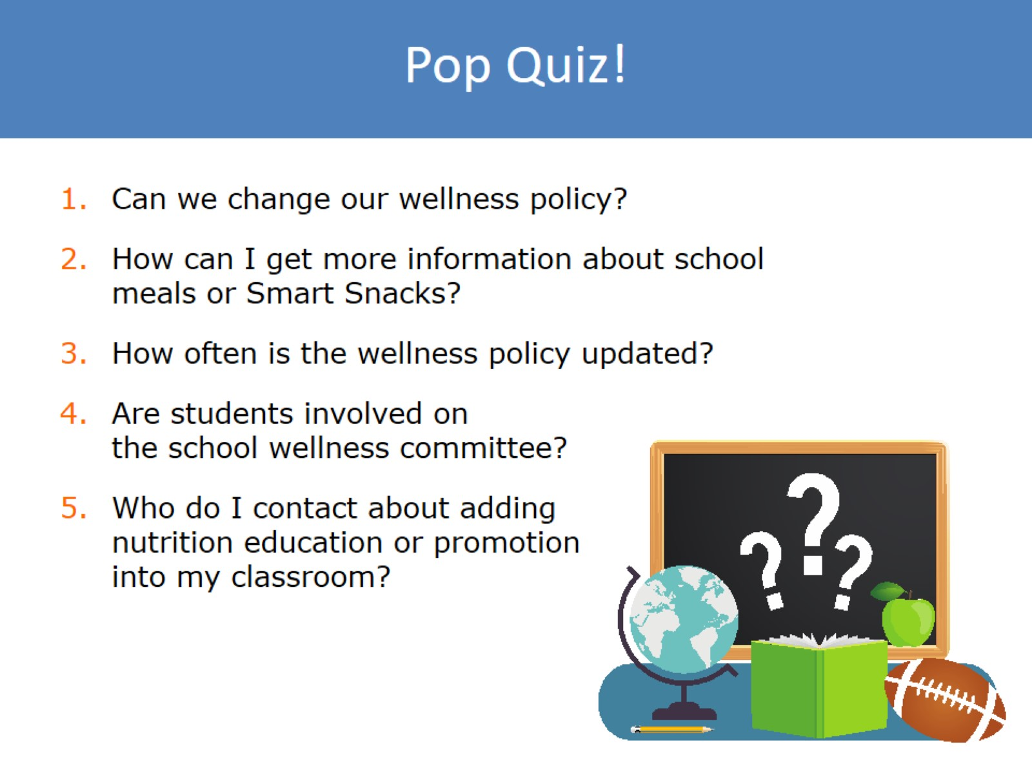
Pop Quiz!

Slide 19
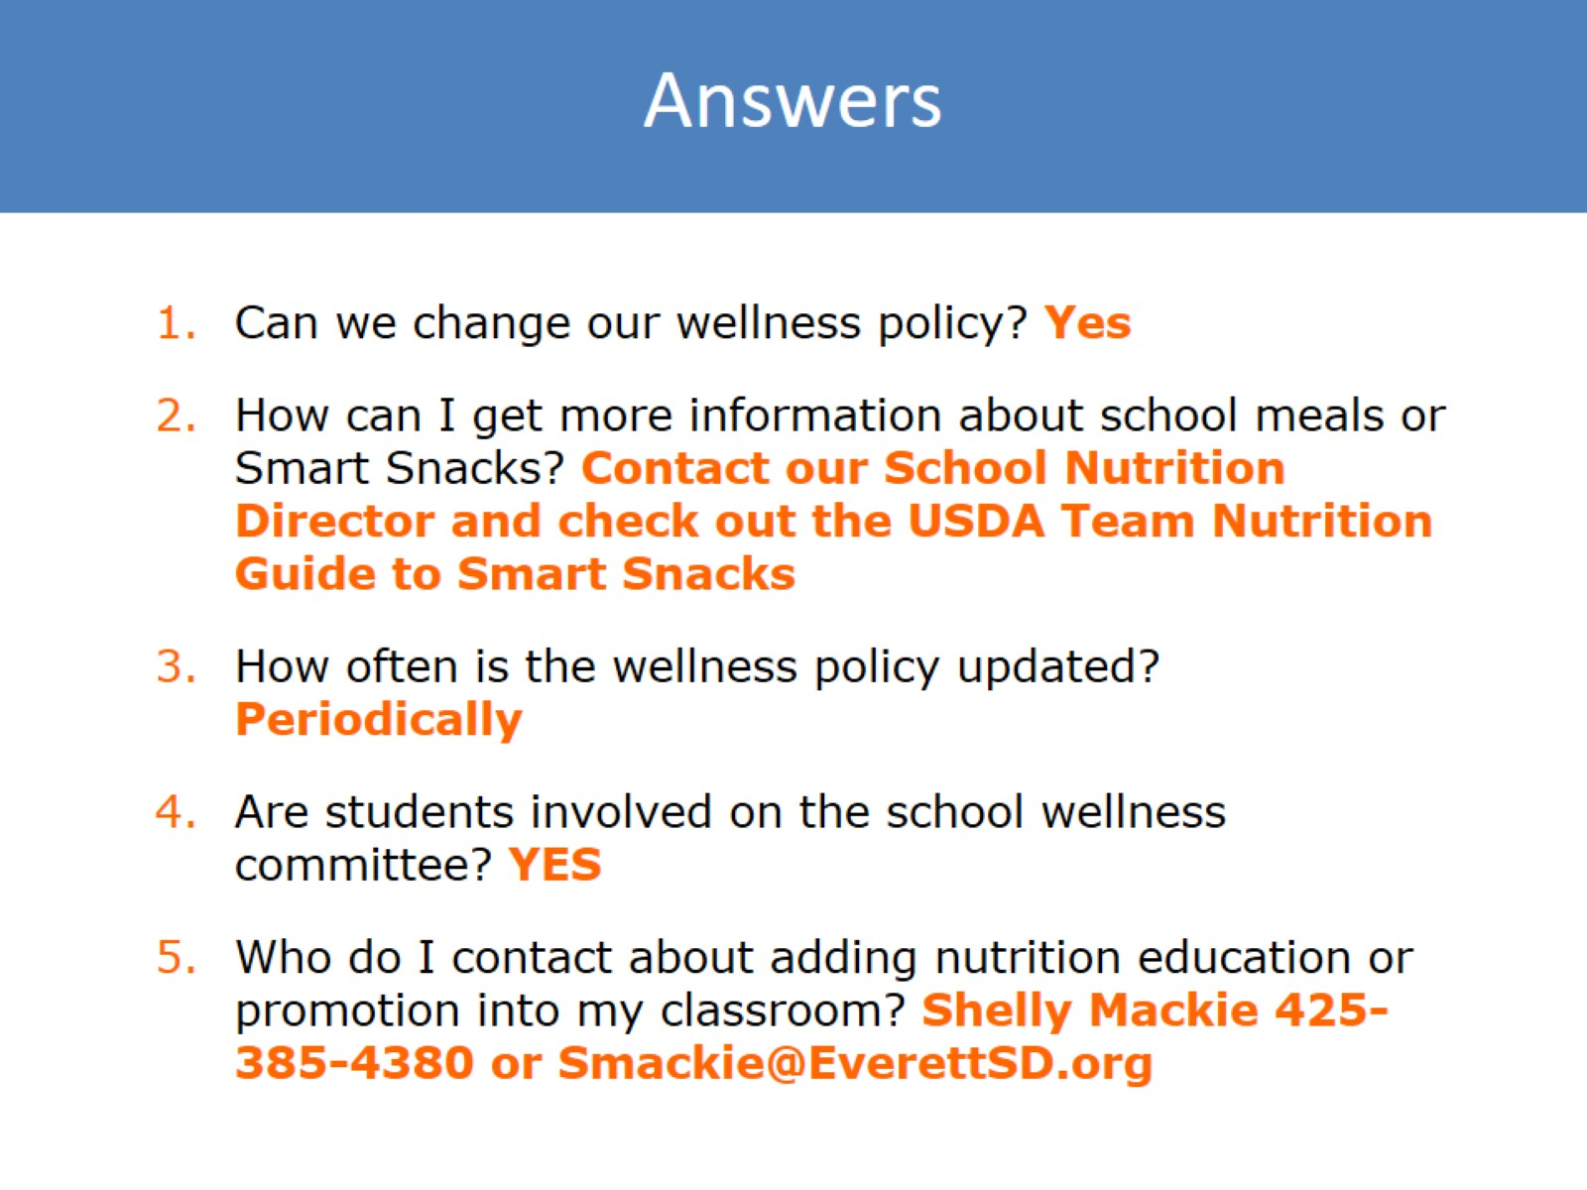
Answers

Slide 20

Thank you

