Slide 1

101: Emotional Intelligence Skills & Anchor Tools
Summer 2023

Slide 2
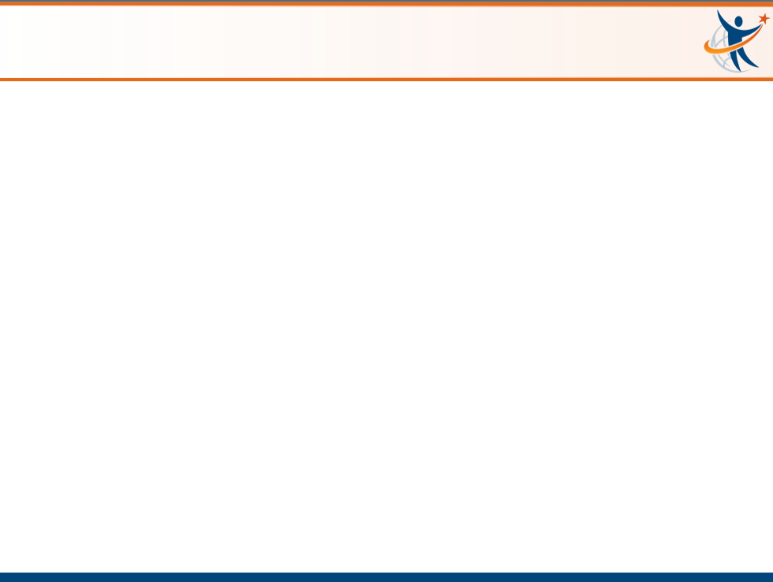
Intended Outcomes
By end of this session,
You will gain an understanding of:
  Emotions Matter Mindset
  RULER Skills
  Anchor Tools
You will be better equipped to:
  Contribute to an environment that will help students…

Slide 3

ROLL-OUT PHASES
Readiness & Planning Phase | Winter 2021 (secondary), Spring 2022 (elementary)
During this phase, district and school leaders will be learning about the benefits of emotional intelligence and the time and resources RULER requires.
A structured a plan for allocating resources helps meet these needs over time.
Staff Personal & Professional Learning | 2022-2023
School faculty and staff are introduced to RULER principles and tools. They have the opportunity to practice with skill-building activities in preparation for use with students. This way, the adults in the school are practicing the tools and skills before teaching them to students.
Classroom Implementation & Family Engagement | 2023-2024
Students and their families are formally introduced to RULER principles and tools, including skill-building activities for school and home.
Sustainability & Innovation | 2024 → beyond
RULER principles and tools are embedded into school and district policies and practices, including mission statements, curricula, staff/faculty professional development, and behavioral support plans.

Slide 4
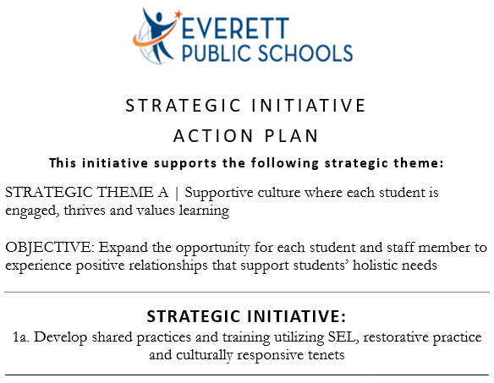
Eps Strategic plan

Slide 5

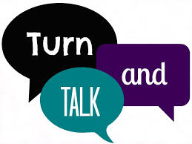
EMOTIONS MATTER MINDSET
How have your emotions influenced your performance or relationships at work
(positively or negatively)?
Take 30 seconds to think of an example
… then…
Share briefly with those in your breakout group if/as you feel comfortable

Slide 6

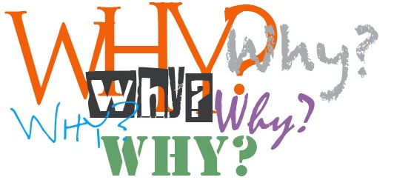
EMOTIONS MATTER MINDSET
After they answer, ask layers of...
...and you’ll likely drill down to an emotion they’re seeking

Slide 7
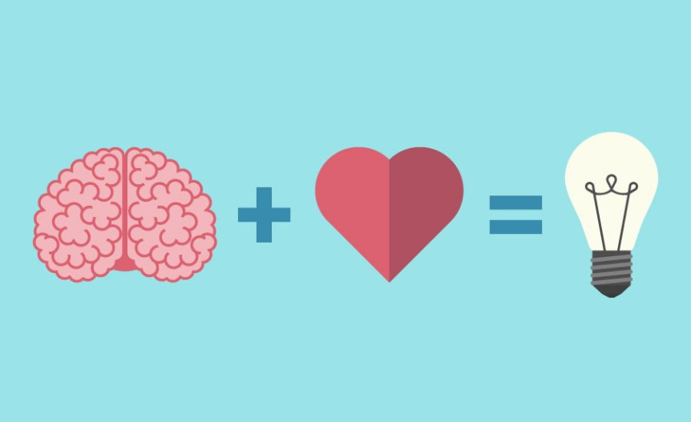
WHAT do emotions IMPACT?
Social Interactions
Memory Formation
Creativity
Performance
Motivation
Attention
Engagement
Relationships
Physical & Mental Health
Decision Making
Critical Thinking
Interest
Focus
Notes:
Here's why emotions matter for learning:
Attention and Focus: Emotions can impact your level of attention and focus. When you are emotionally engaged, your brain tends to prioritize the information and experiences associated with those emotions. This can lead to better concentration and improved comprehension of the material.
Memory Formation: Emotions can enhance memory formation. Information that is emotionally charged or connected to personal experiences is more likely to be stored in long-term memory. Emotions create a "memory marker" that helps your brain remember and retrieve information later.
Motivation and Interest: Positive emotions like curiosity, excitement, and interest can motivate you to learn. When you find a subject emotionally appealing, you're more likely to invest time and effort in understanding and retaining the material.
Emotional Context: Emotions provide a context for learning. They help you connect new information to your existing knowledge and experiences, making it easier to understand and remember. For example, if you associate a certain word with a strong emotion, you're more likely to recall that word when needed.
Neurological Connections: Emotions can stimulate the release of neurotransmitters such as dopamine, which can enhance the brain's ability to form new connections between neurons. These connections facilitate the transfer of information, making it easier for you to learn and remember new words.
Reduced Stress: Positive emotions can reduce stress and anxiety, which are known to impede the learning process. When you're in a positive emotional state, your brain is more receptive to new information and is better equipped to process and remember it.
Application and Real-World Use: Emotions can help you understand the practical applications of the words you're learning. Connecting words to real-life scenarios and emotions can make them more meaningful and easier to remember in context.
Personalization: Emotions personalize the learning experience. When you relate emotionally to the material, it becomes a part of your own story and identity, increasing the likelihood of long-term retention.
Creativity and Critical Thinking: Emotions can enhance your creative thinking and critical analysis skills. An emotionally engaged mind is more likely to explore different perspectives, ask questions, and make connections between concepts.
Social Learning: Emotions play a crucial role in social interactions. Learning often involves communication and sharing, and emotions can help you connect with others, leading to discussions, debates, and a deeper understanding of the words you're learning.
In essence, emotions serve as a bridge between cognitive processes and personal experiences, helping to make learning more effective, enjoyable, and memorable. Even when dealing with a relatively small number of words, the emotional context can significantly impact your ability to learn and retain them.

Slide 8

EMOTIONAL INTELLIGENCE: Why?
Educators and leaders with higher emotional intelligence:
Demonstrate more empathy and greater sensitivity to others’ needs
Develop higher performing teams and build a warmer and more supportive emotional school climate
Receive higher performance
ratings and experience less
stress and burnout

Slide 9

EMOTIONAL INTELLIGENCE: Why?
Students who are skilled in emotional intelligence:
Experience fewer problems with attention, hyperactivity, substance abuse, anxiety, and depression
Engage less in aggressive or socially deviant behavior
Achieve more academically, and experience better relationships, more satisfaction with school, and better wellbeing overall
Participate frequently in classroom
activities, cope in healthier ways
with stress, and behave in more
empathic and prosocial ways

Slide 10
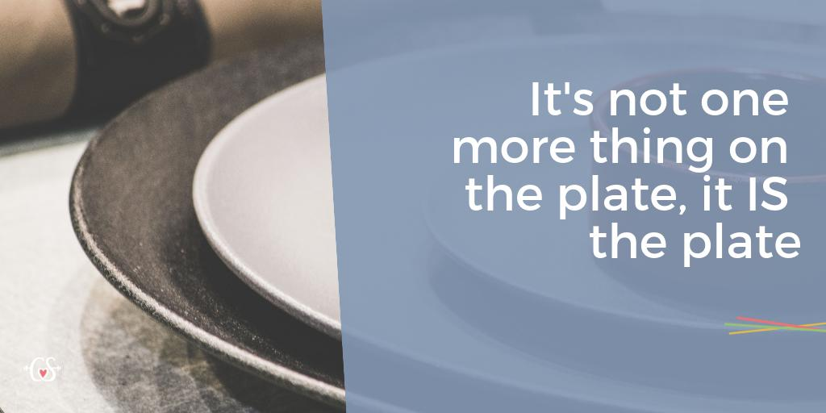
Emotions Matter Mindset
SEL

Slide 11
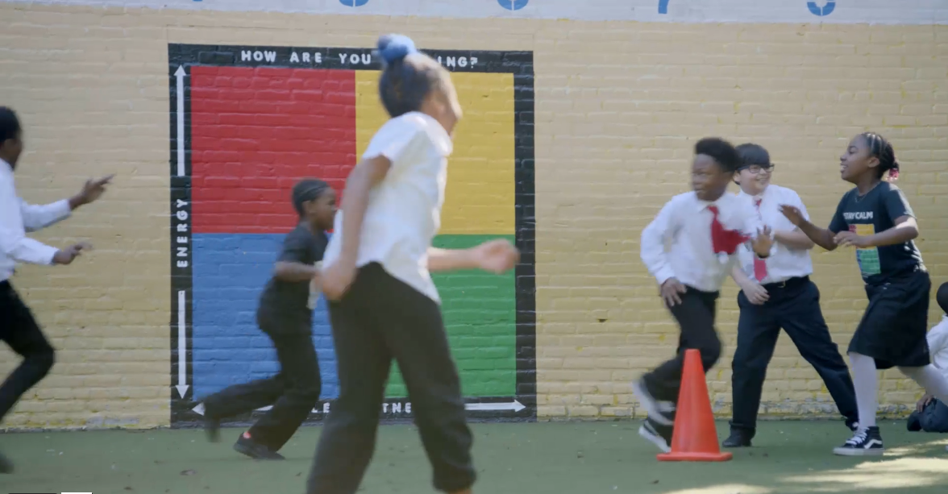
THE RULER APPROACH
https://www.rulerapproach.org/

Slide 12
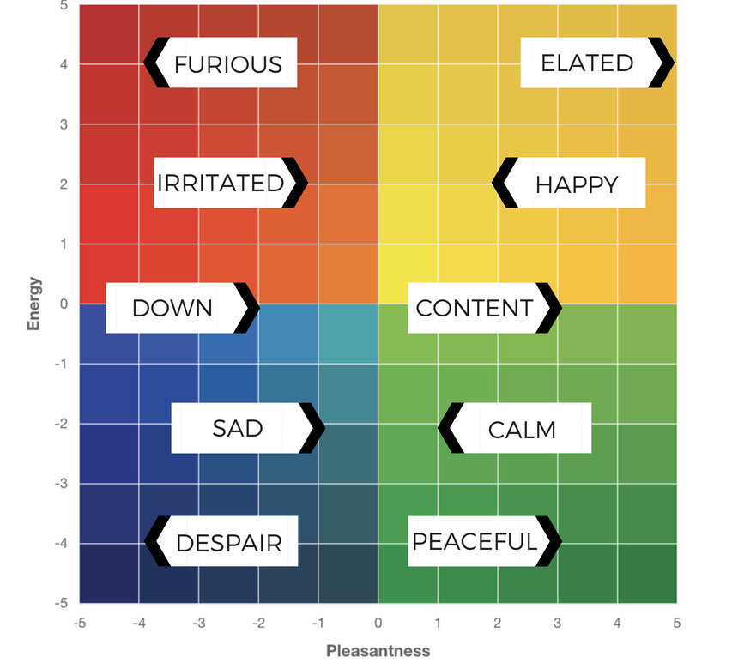
THE MOOD METER
The Mood Meter is a tool that can help us build all five of the RULER skills. We can use the Mood Meter to recognize, understand, and label emotions, which builds our self- and social-awareness.
Once we are aware of what we and others are feeling, we can use this as a starting point for expressing and regulating our emotions.

Slide 13
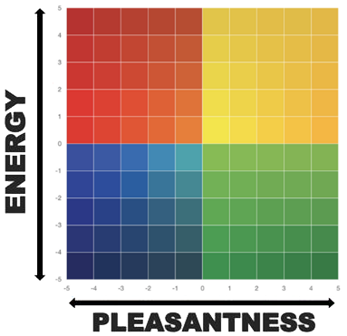
PLOTTING YOUR EMOTION
The Mood Meter allows us to plot our emotions along the two axes of pleasantness and energy.
The horizontal x-axis measures pleasantness, ranging from -5 (the most unpleasant you’ve ever felt) to +5 (the most pleasant you’ve ever felt).
The vertical y-axis measures energy, from -5 (the least energetic you’ve ever felt) to +5 (the most energetic you’ve ever felt).

Slide 14
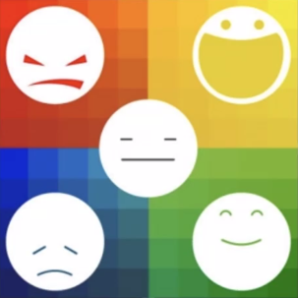
THE MOOD METER: Quadrants
The x- and y-axes intersect to form four quadrants.
Unpleasant, high energy (red) emotions are found in the upper left quadrant. Emotions like anxiety, frustration, anger, and fear reside in this quadrant.
Unpleasant, low energy (blue) emotions are found in the lower left quadrant. Disappointment, sadness, discouragement, and loneliness can be found in the blue quadrant.
Pleasant, high energy (yellow) emotions are found in the upper right quadrant. Joy, excitement, enthusiasm,
and empowerment reside in the yellow quadrant.
Pleasant, low energy (green) emotions are
found in the lower right quadrant. Emotions
like calm, relaxed, serene, and balanced
reside in this quadrant.

Slide 15
HOW ARE YOU FEELING?
Everett Learns
August 23, 2023
Please go to:
moodmeter.online
...and enter the group plot code:
7wqy2g

Slide 16
HOW ARE YOU FEELING?
Everett Learns
August 24, 2023
Please go to:
moodmeter.online
...and enter the group plot code:
7wqy2s

Slide 17
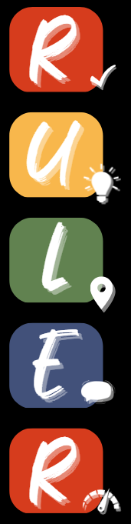
The RULER Skills
Recognizing emotions in ourselves and others
Understanding the causes and consequences of emotions
Labeling emotions accurately
Expressing emotions appropriately
Regulating emotions effectively

Slide 18
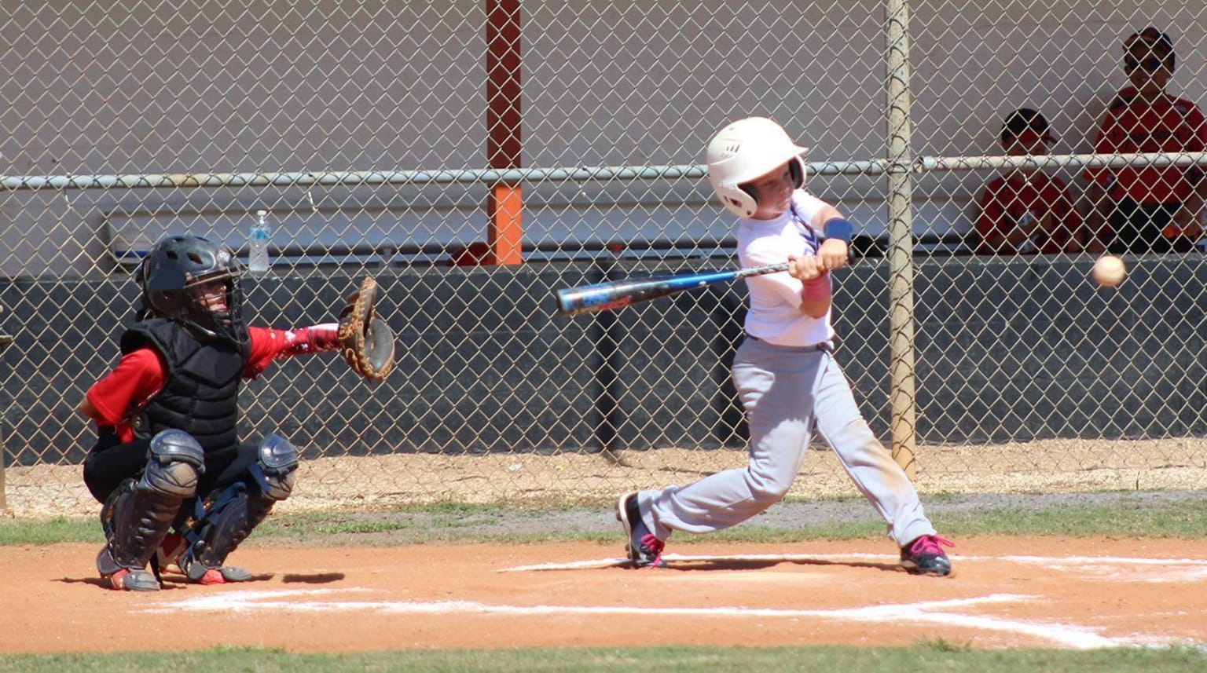

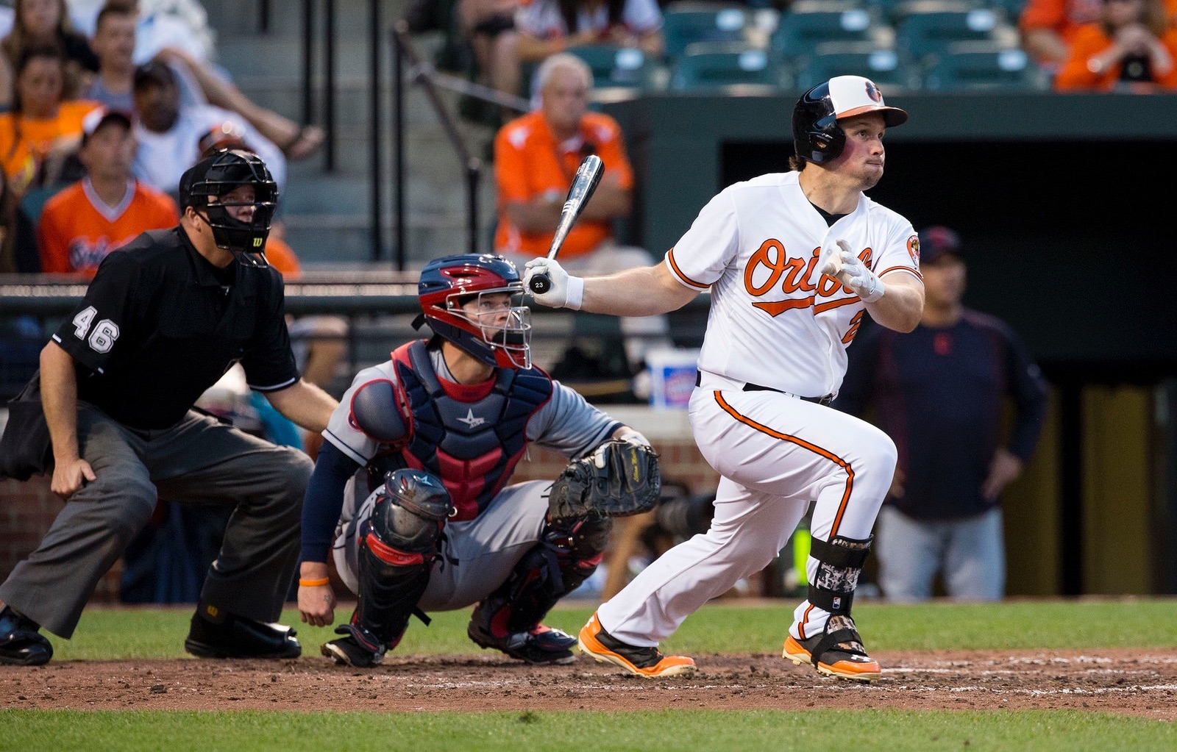
Skill-building considerations
Major League hitters have about 0.40 seconds reaction time to:
determine the type of pitch
determine if it's a strike or a ball
determine the speed of the pitched ball
finish the stride and get their foot down
get the bat to the ball
Must become automatic

Slide 19
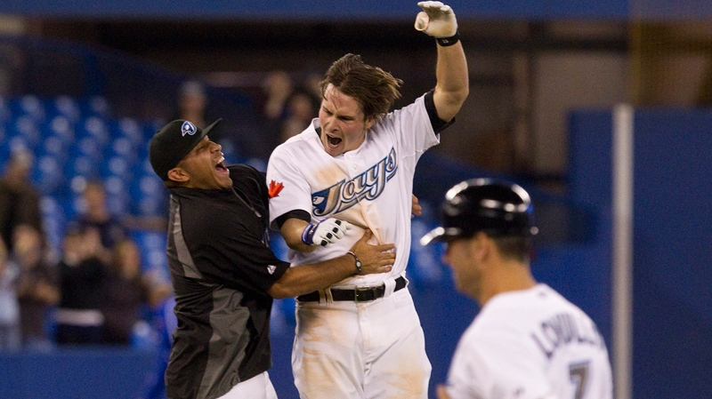


Skill-building considerations
If a batter fails to get on base 7 out of 10 times, he’s considered to be phenomenal!
(that’s a batting average of .300)
Perhaps we should evaluate our RULER success somewhere in between
If a person is successful 97% of the time at crossing the street, that would be considered a horrible rate!

Slide 20
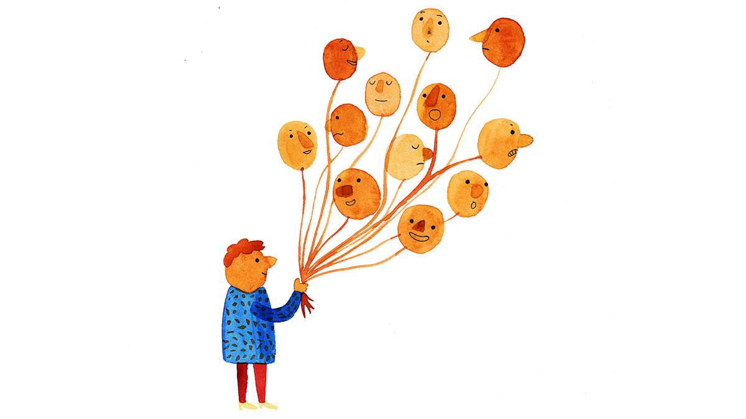
The first R of RULER is for Recognizing emotion
Recognizing emotion refers to identifying emotions by interpreting:
Our own thoughts and physiology (heart rate, body temperature, etc.)
Cues in ourselves and others, including:
  Facial expressions
  Vocal tones
  Body language
  Words and behavior
Practicing this skill builds our self-awareness. When we pay attention to our own thoughts and behavior, we begin to know and understand ourselves better.
Recognizing emotions also enhances our social awareness. When we look for clues in others’ faces, voices, bodies, and behavior, we can better understand how they may be feeling. We can use this information to guide how we respond to them.

Slide 21
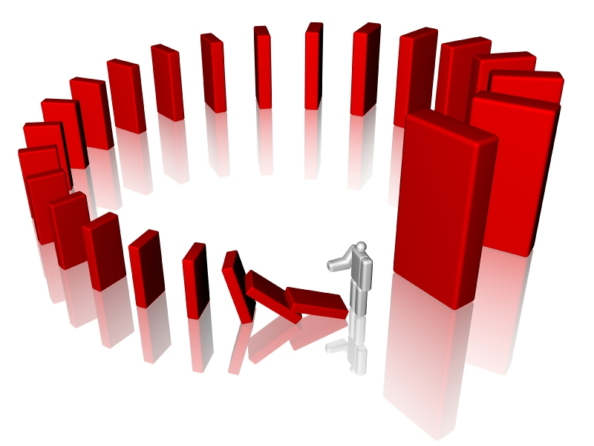
The U of RULER is understanding emotions
This skill involves understanding both the causes and consequences of emotions, including their effects on:
      Thinking
      Learning
      Decisions
      Behavior
In other words, understanding emotion involves
asking ourselves why we feel the way we do and
what happens when we feel different emotions.

Slide 22

The L in RULER is for Labeling emotion
Labeling emotion involves having and using a nuanced vocabulary to describe the full range of emotions.
Angry? Sad? Disappointed? Embarrassed? Frustrated? Fatigued? Stunned? Discouraged?
When we give our feelings a specific label, we create a mental picture of what each emotion looks like so that we can identify it in ourselves and others.
Labeling also helps us to effectively communicate our needs and to identify the best ways to manage our emotions.

Slide 23
Nuances of Labeling
Anxiety = Uncertainty about the future
Fear = Feeling as if there is impending danger
Stress = Too many demands, not enough resources
Pressure = Something at stake is dependent upon your behavior
Frustration = Feeling like you can't overcome an obstacle
Overwhelm = Overcome by emotion
Anxiety
Fear
Stress
Pressure
Frustration
Overwhelm

Slide 24
Nuances of Labeling
Happiness = a blanket term for a high-energy positive emotion often associated with success or the attainment of something (often future oriented)
Joy = An inner feeling connected to meaning and purpose in life
Contentment = A feeling of completeness in the present moment / feeling at ease in life

Slide 25
Nuances of Labeling
Envy = wanting something that someone else has
Jealousy = feeling threatened about the possible loss of a relationship or affection/attention to someone else
Where jealousy takes three parties to happen, envy only takes two.
Envy
Jealousy
Notes:
I give an example in my book from my own childhood. After coming home from my karate test where I had failed to get my yellow belt, I started screaming and yelling at my mother. She told me, “Stop being so angry, go to your room, and wait ’til your father gets home.” But what she didn’t know was the underlying story, which was that when I was getting ready to come home after failing the test, I wasn’t just disappointed by my failure, but I was also made fun of in the locker room by some kids who were the bullies at school. They were threatening me and making me feel bad about myself. So, I was really feeling a combination of fear and shame, but I looked like I was angry because I was yelling and screaming.

Slide 26


Nuances of Labeling
Embarrassment & Humiliation
Both involve discomfort when an aspect of
ourselves is observed/revealed that we think is likely to undermine the image of ourselves that we seek to project to others
We typically bring embarrassment upon ourselves
(and can often be humorous), but humiliation is
something that is brought upon us by others
(and is perceived as unjustified).

Slide 27
Nuances of Labeling
Emba= feeling remorse or responsible for something you've done wrong or perceived you did wrong
Shame = Feeling that you are bad, worthy of contempt, or inadequate as a person
Guilt says, “I did something bad.” Shame says, “I am bad.”
Guilt
Shame
Notes:
I give an example in my book from my own childhood. After coming home from my karate test where I had failed to get my yellow belt, I started screaming and yelling at my mother. She told me, “Stop being so angry, go to your room, and wait ’til your father gets home.” But what she didn’t know was the underlying story, which was that when I was getting ready to come home after failing the test, I wasn’t just disappointed by my failure, but I was also made fun of in the locker room by some kids who were the bullies at school. They were threatening me and making me feel bad about myself. So, I was really feeling a combination of fear and shame, but I looked like I was angry because I was yelling and screaming.

Slide 28
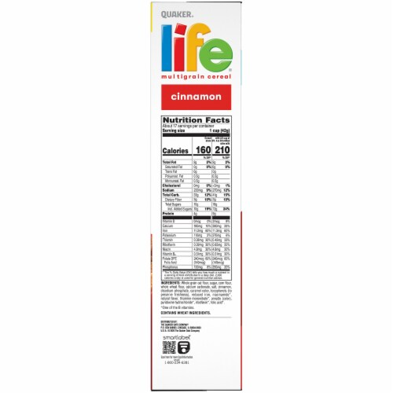
The Power of Labeling
Labeling our emotions with precise words does four main things:
It legitimizes and organizes our experiences
It helps others to meet our needs
Similarly, it helps us meet the needs of others
Finally, it connects us to the rest of the world
The words give us each a story to tell.

Slide 29

The E of RULER is for Expressing emotion
The skill of expressing emotion involves knowing how to show our emotions in ways that take into consideration norms and context. In other words, it’s really about the “how” and the “when” we express our emotions.
Three areas to consider when we think about
expressing emotions are:
  Individual differences
  Culture
  Social norms

Slide 30
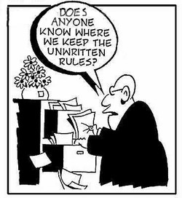
The E of RULER is for Expressing emotion
We may mask our expressions to fit the “norms” of our environments. These norms are known as display rules.

Slide 31
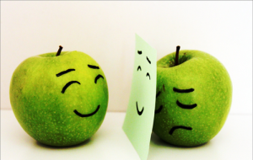
The E of RULER is for Expressing emotion
There often is a discrepancy between how we feel and what we display.
The work we do to conform how we express our emotions to the norms of our environments is called emotional labor.
  Emotional labor is unavoidable. However, it can be helpful in many situations, like expending effort to remain calm and cooperative when speaking with someone who is angry.
  Still, too much emotional labor can result in burnout, decreased job and life satisfaction, and health problems. This is why it’s important to keep it in check!

Slide 32

The last R of RULER is for Regulating emotion
Regulating emotion is managing our emotions.
Our emotional goals generally fall into the following areas, which we can remember with the acronym, PRIME:
  Prevent an unwanted emotion–like anxiety before a test
  Reduce an unwanted emotion–like anger when we are interacting with others
  Initiate a new emotion–like inspiration to be creative
  Maintain an existing emotion–like remaining calm in a stressful situation
  Enhance or increase a desirable emotion–like joy while at a party

Slide 33
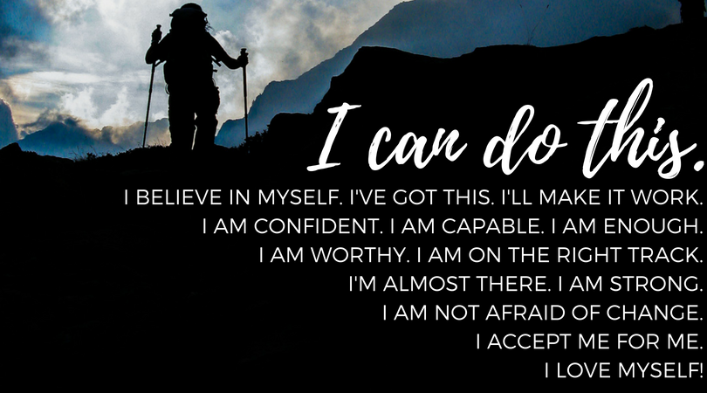
The last R of RULER is for Regulating emotion
Once we have selected a PRIME goal, we can choose strategies that will help us reach that goal.
Strategies include things we think about (thought strategies) and things we can do (action strategies) to regulate our emotions.
  Reframing the situation by thinking about it from a new perspective
  Breathing techniques
  Engaging in positive self-talk

Slide 34
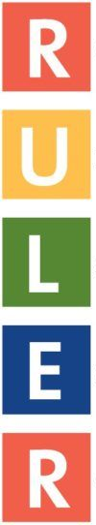


Slide 35
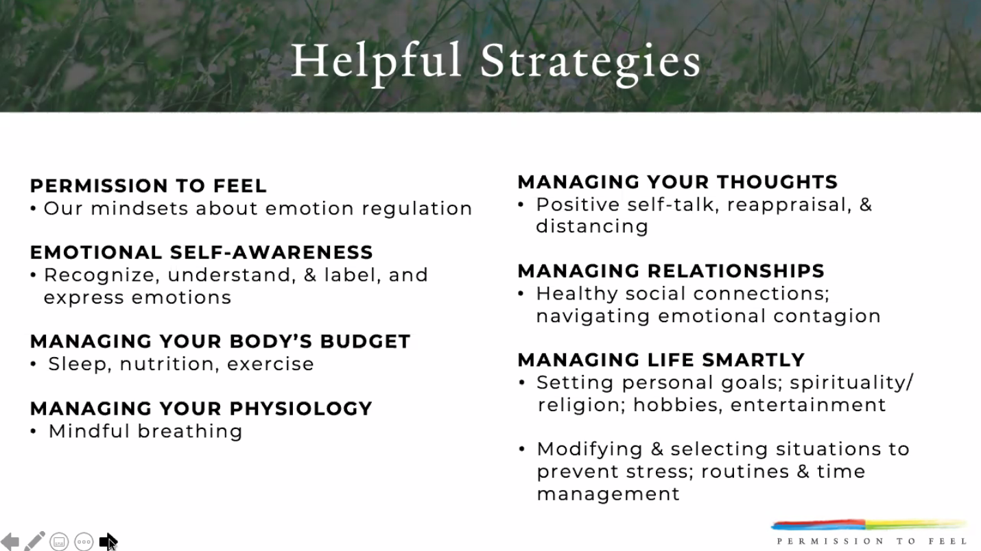

Slide 36

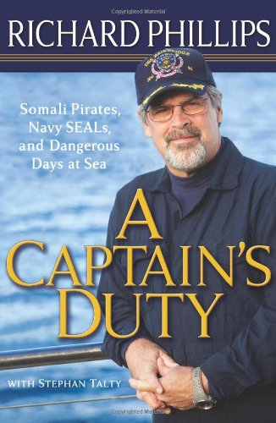

ADDRESSING MISCONCEPTIONS

Slide 37
WHAT GETS IN THE WAY?
Relational
Other's impatience (with me)
Other's negativity
Lack of support from others
Feeling disrespected
Personal
Fatigue (e.g., emotional labor)
Stress (about everything)
High expectations of others
A lack of trust
Need for control
Prior baggage
No education in
emotional intelligence
Environmental
Work/home demands & struggles
Economics
Unpredictability (COVID)
Societal division/War
Feeling confined
Time in the day
Cultural
Differences in display rules
Family expectations
Unwritten rules for expression
The values connected to certain emotions

Slide 38
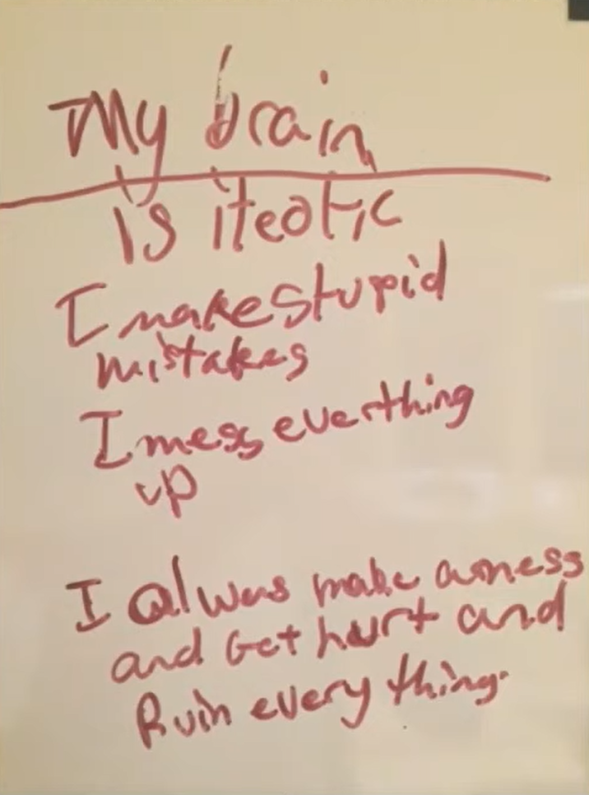
UNHEALTHY EMOTIONAL REGULATION

Slide 39
HEALTHY EMOTIONAL REGULATION
Positive Self-Talk: Saying encouraging words in your head about yourself & the world around you. It helps to refer to yourself in the 3rd person.
  From ... "l'm going to lose it." To ... “Dave, you’ve done hard things before. You can get through this."
Positive Re-appraisal: Looking at the situation through a different lens; a new spin.
  From ... "l'm never going to make it through this."
  To ... “Dave, this is an opportunity to learn and grow."
Psychological Distance: Jump in the hot air balloon! Will this matter in a month?
  From ... "My life is a mess." To ... “Dave, will this really matter in a month from now?"

Slide 40
MANAGING YOUR BODY’S BUDGET
Nutrition
Dehydration causes headaches, concentration problems, anxiety, and irritability
• Glucose (from carbs/sugar) is the only fuel used by brain (but not produced by it)
  −Drink water and eat healthy snacks
• When stressed, we are more likely to turn to high-fat, high-sugar foods
Sleep
• Poor sleep= poor restoration = poor cognitive functioning, anxiety, hostility
  − Try no devices 1-hour before sleep
  − Try some light stretching or take a shower/bath before bed
Physical Exercise
• Regular exercises leads to less anxiety, stress, and depression and greater concentration
  − It also leads to less negative emotions during difficult interactions
  − Build in some kind of movement throughout the day

Slide 41

EMOTION SCIENTIST vs EMOTION JUDGE
Emotion scientists are empathic, inquisitive, active listeners, contemplative, and focus on the facts.
Emotion judges are critical, reactionary, inflexible, and make assumptions.
How does this play into:
Recognizing? (The emotion judge makes quicks assumptions and may misdiagnose emotion by observing behavior)
Understanding? (The emotion scientist asks good questions)
Labeling? (The emotion judge just labels what others are feeling or even attributes emotions to people’s personalities)
Expressing? (The emotion judge makes assumptions
about why people are expressing emotions the way
they do, e.g., “She’s not sharing because she’s
antagonistic”)
Regulating? (The emotion scientist explores new
regulation strategies through trial and error)

Slide 42
The RULER Skills
Recognizing emotions in ourselves and others
Understanding the causes and consequences of emotions
Labeling emotions accurately
Expressing emotions appropriately
Regulating emotions effectively

Slide 43

THE RULER ANCHOR TOOLS
The RULER approach can be put into practice by using the four foundational RULER anchor tools, which focus on developing emotional intelligence and creating positive emotional climates at home and at school.

Slide 44


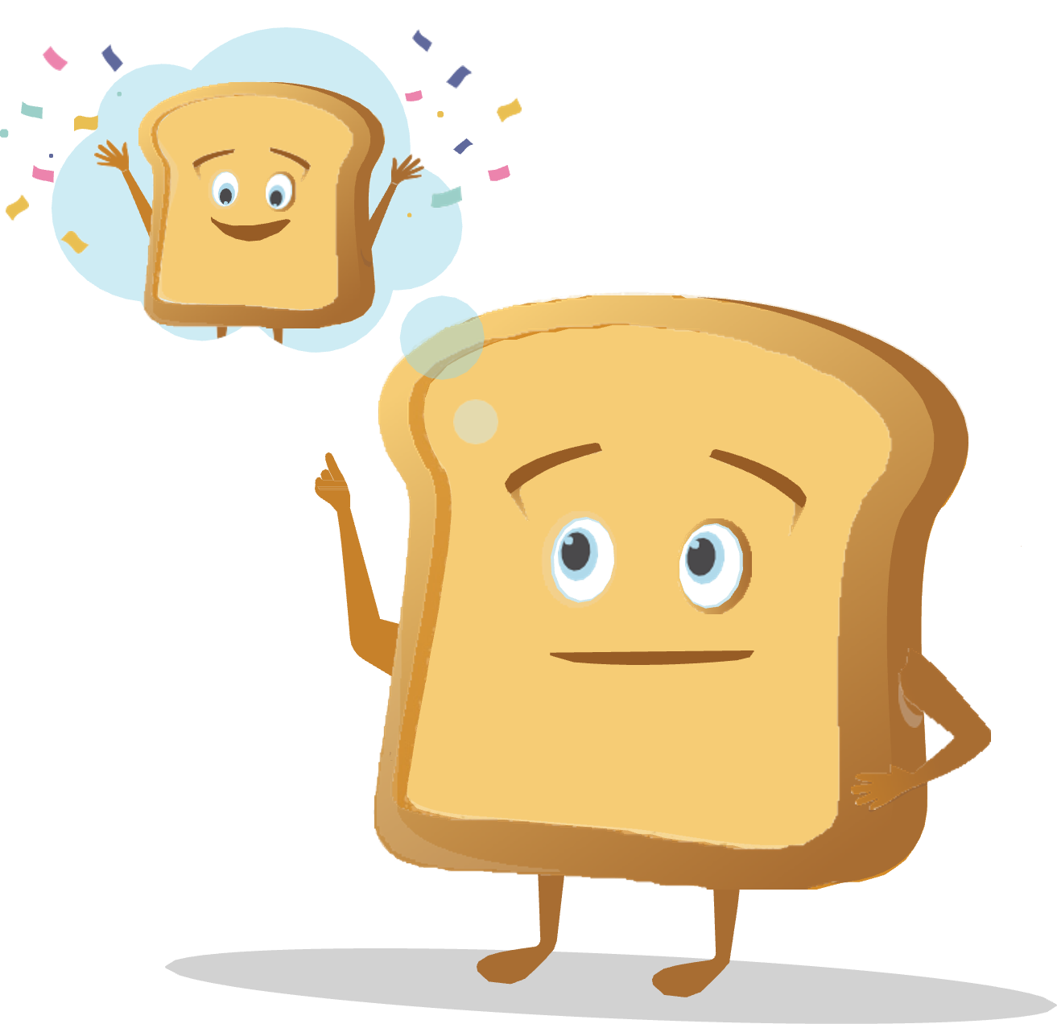
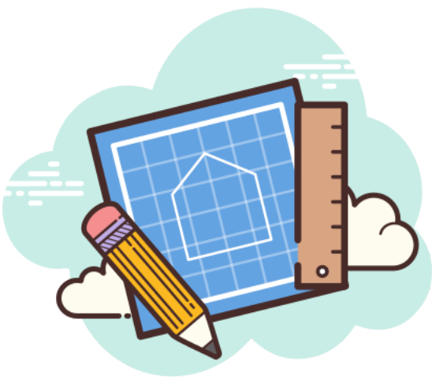
THE RULER ANCHOR TOOLS
The Charter represents agreed-upon norms for how everyone in a school, classroom, or other environment wants to feel. The Charter also explains what needs to happen or change to build and sustain positive emotional climates.
The Mood Meter is a visual guide to help individuals accurately analyze and “plot” their feelings. The Mood Meter develops skills in recognizing and labeling emotions, which can be further developed into understanding, expressing, and regulating emotions.
The Meta-Moment is a process for responding to emotional triggers in ways that align with one’s best self. The goal is to shift from automatic, unhelpful reactions to strategic, effective responses.
The Blueprint is a problem-solving tool for working with interpersonal conflicts. The Blueprint can be used independently or collaboratively to enhance empathy and identify effective solutions for past, real-time, or anticipated conflicts.

Slide 45
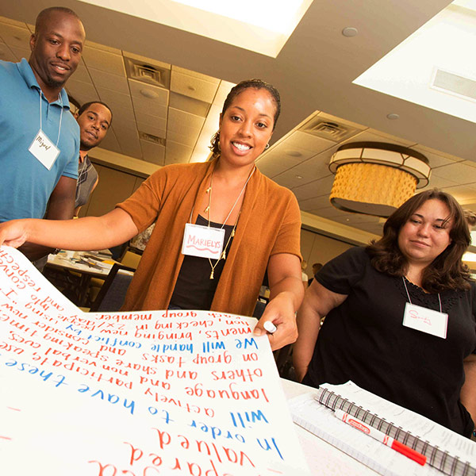
THE CHARTER
There is a clear gap between how school community members feel and how they want to feel. This presents us with an opportunity–a call to action to develop plans for enhancing emotional climates.
This is where the Charter comes in. The Charter allows everyone in a school community the chance to articulate how they want to feel at school, then work together to agree upon behaviors that support those feelings. As a group, the school community members decide on what needs to happen or change for those feelings to be consistently present.
All Charters are structured around two primary
questions:
  How do we want to feel?
  How will we help each other to
  experience these feelings?

Slide 46
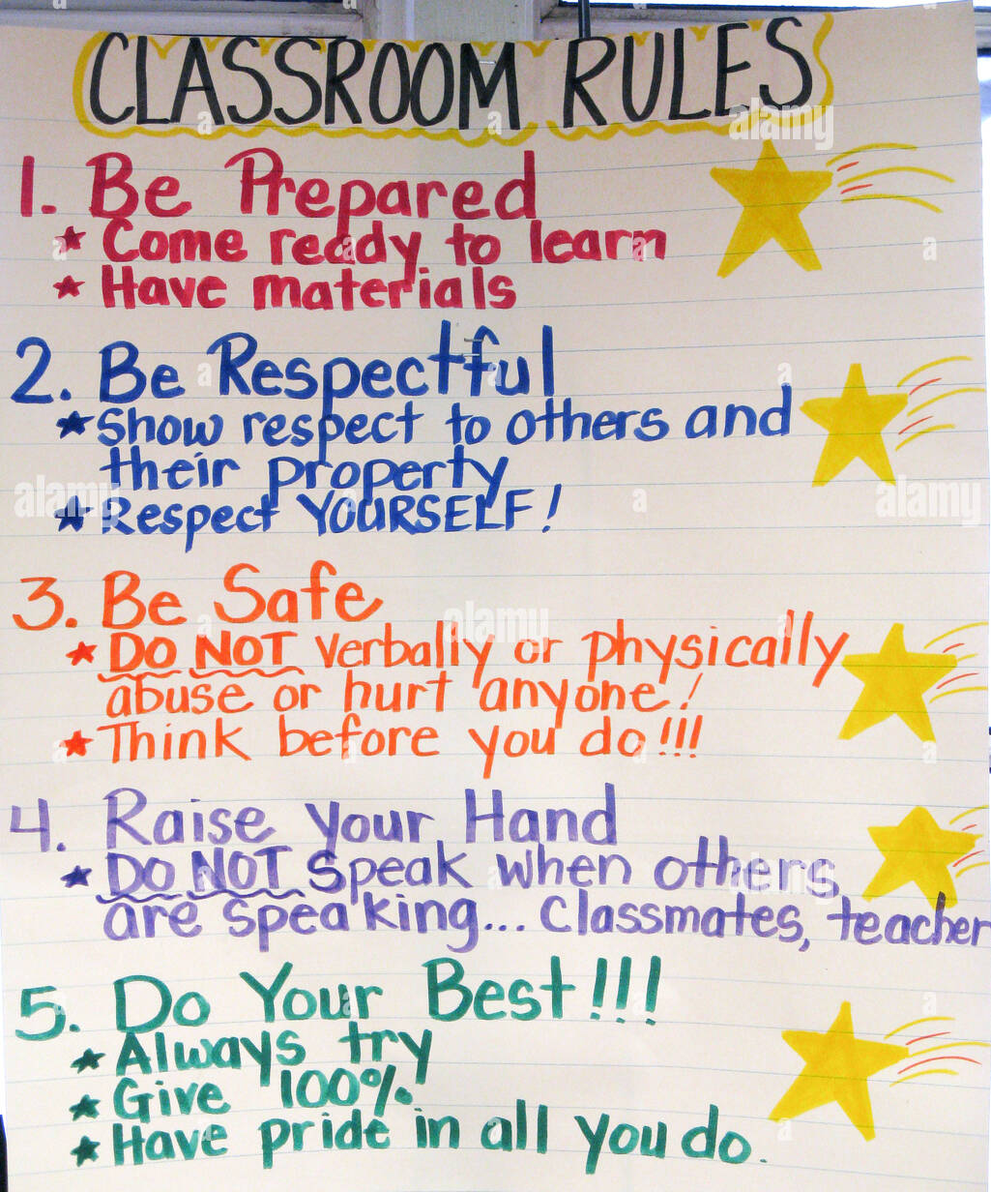
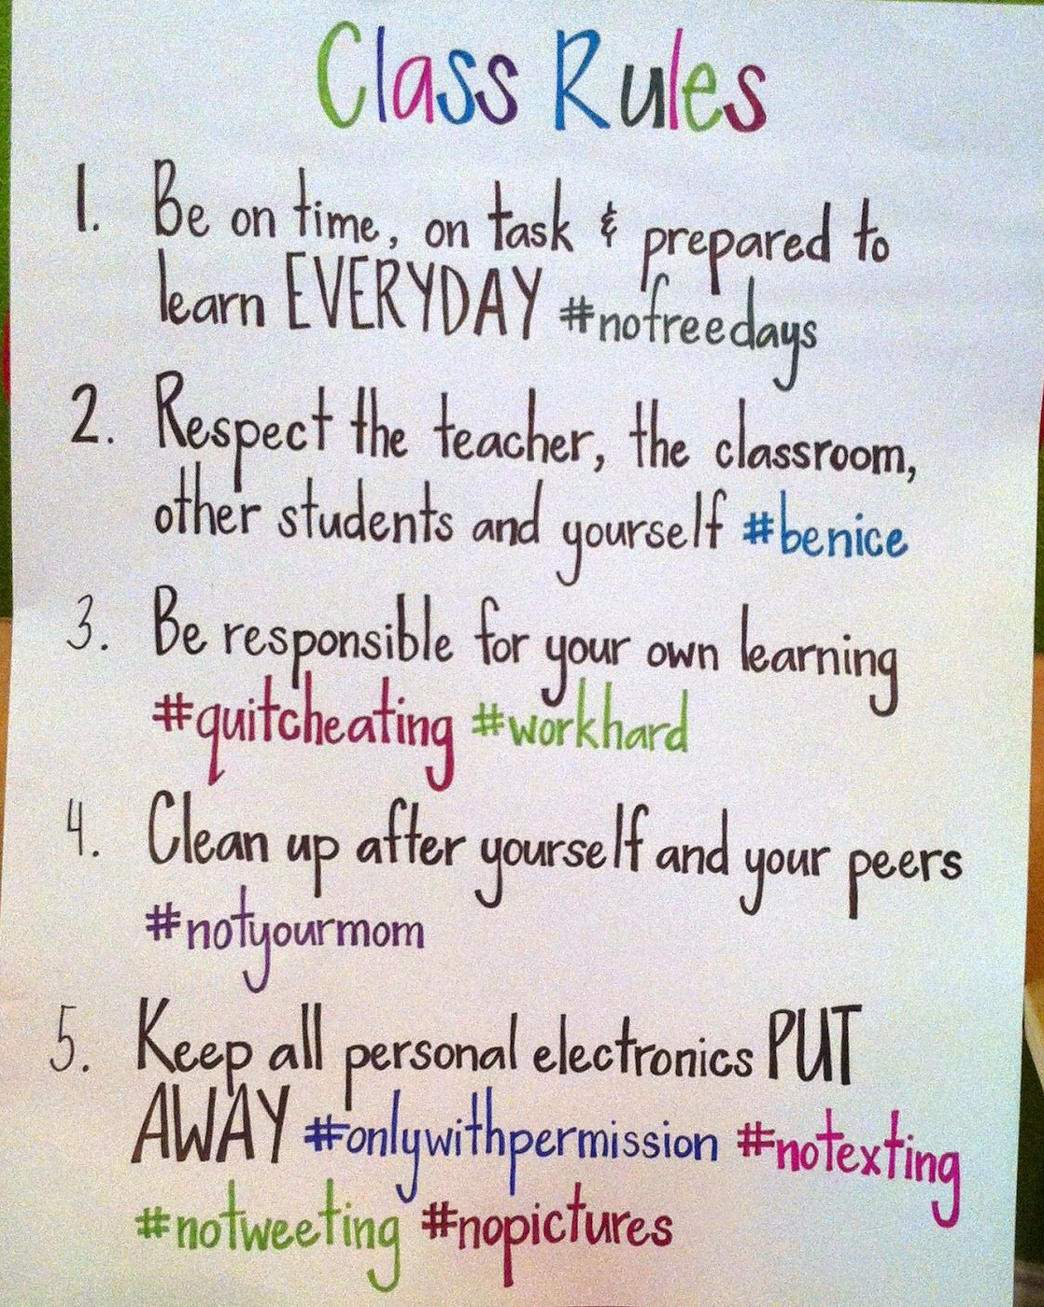
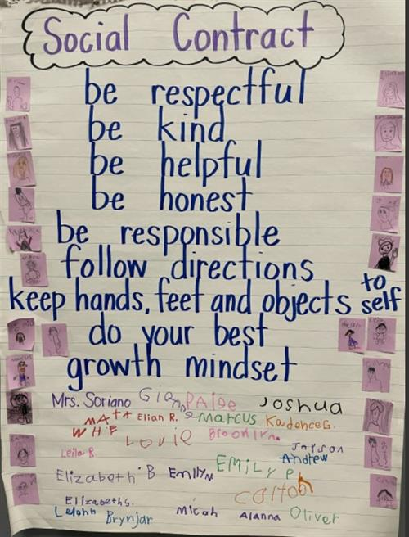
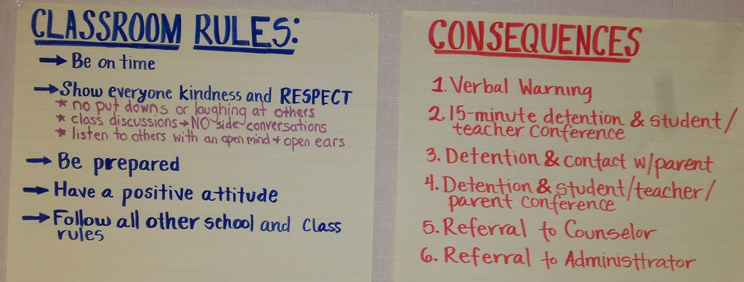
CHARTER vs rules

Slide 47
THE VALUE OF A CHARTER
The Charter creates the WHY for the classroom rules or social contract. How we want to feel will lead into strategies that will foster and maintain them. The “rules” naturally follow – but rather than for basic compliance, they will have a deeper level of meaning and purpose.

Slide 48
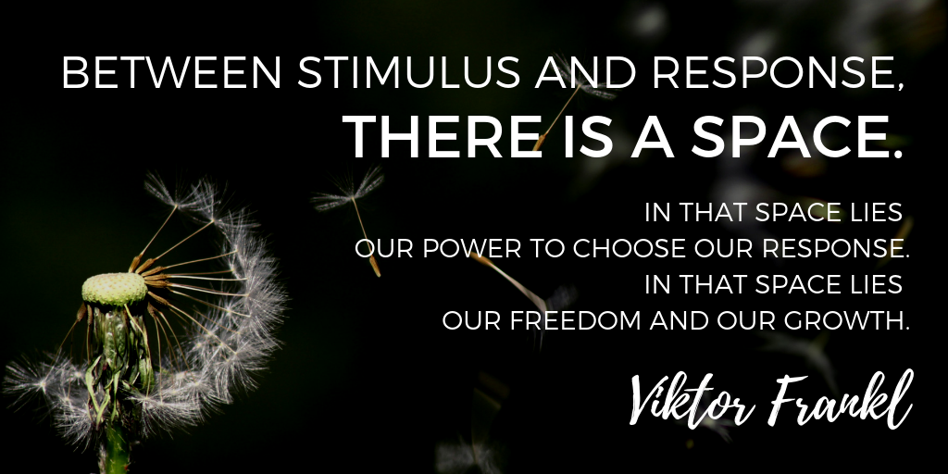
META-MOMENT

Slide 49
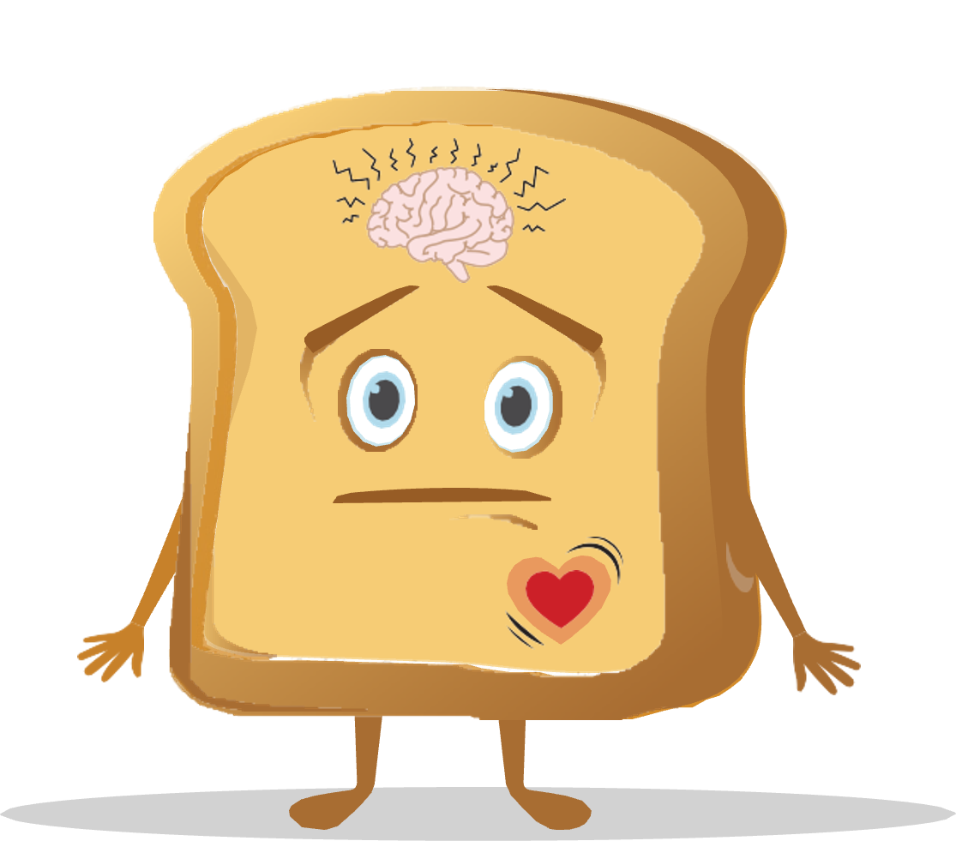
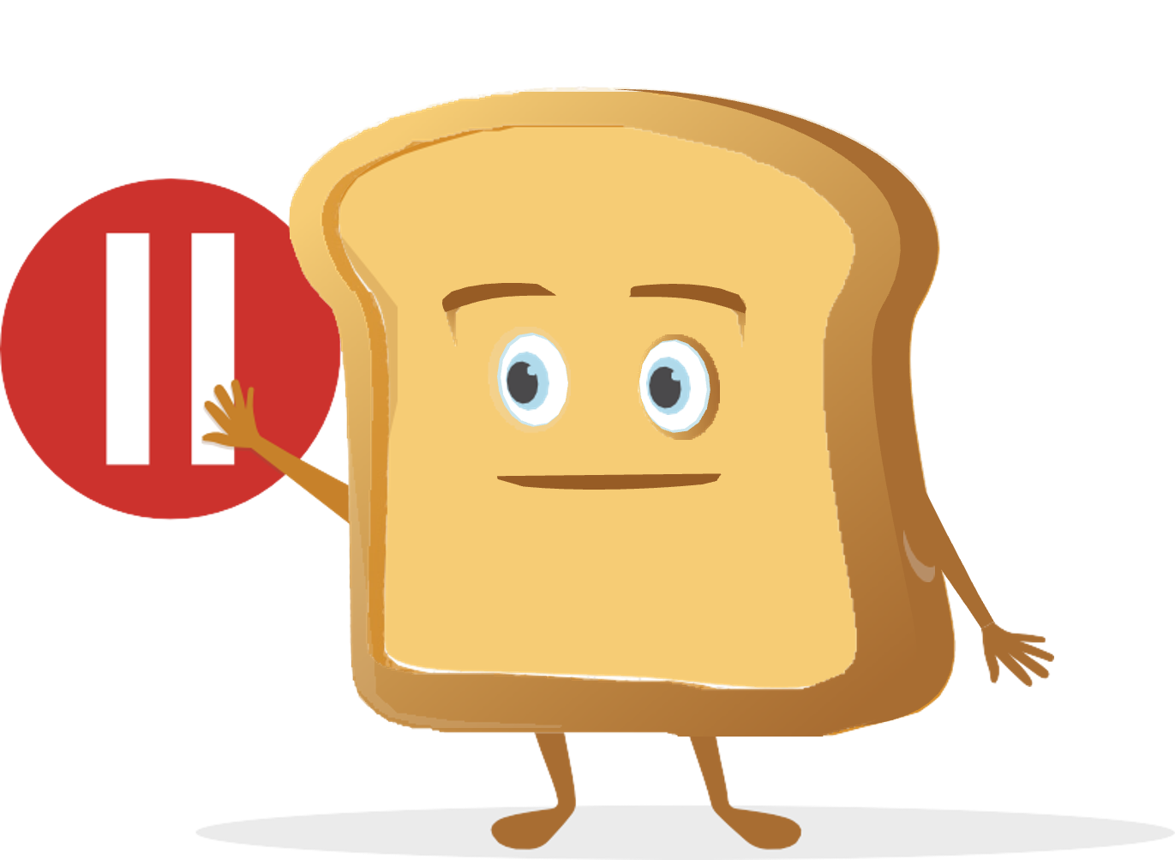
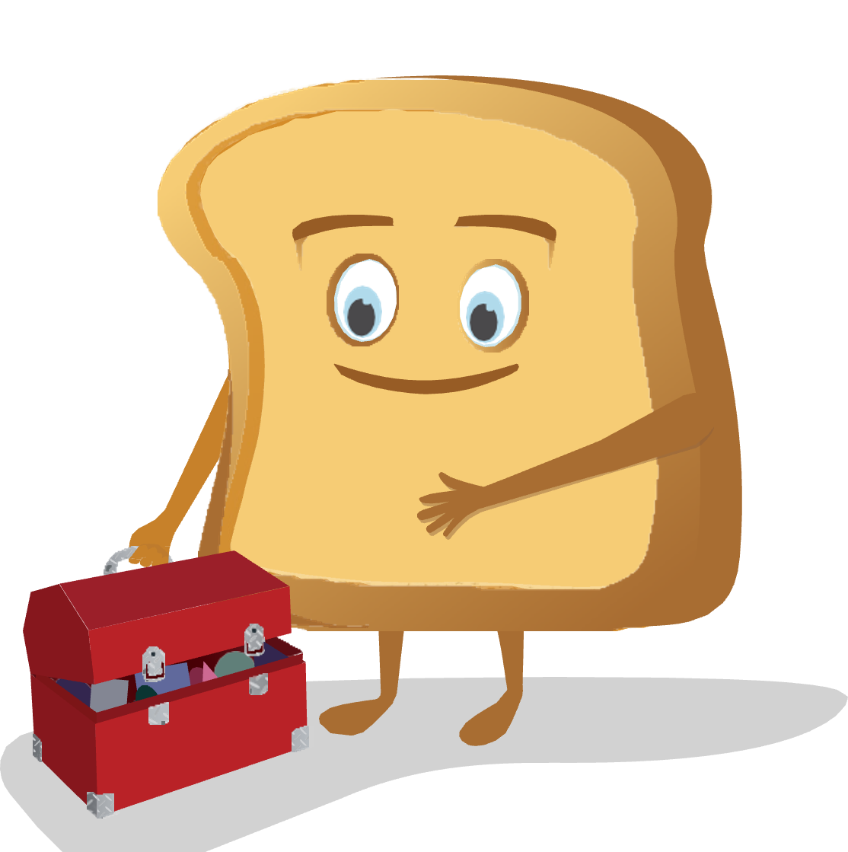
META-MOMENT
The Meta-Moment is a tool for building the space between stimulus and response, allowing us to leverage our best self to move from automatic, unhelpful reactions to thoughtful, helpful responses.
The Meta-Moment consists of four steps:
  Sense that something has happened or changed in your environment
  Pause to de-escalate and avoid responding in an unhelpful manner
  See your best self, or visualize a positive image of yourself
  Strategize and act in a more helpful manner
Notes:
The Meta-Moment teaches both children and adults to prolong the space between that trigger that we all have and our reaction or our healthy response. And it's a process during an interaction that helps people first recognize a strong emotion that just occurred, how does it affect your body, and the way you think about the person, or yourself in the situation.
The second piece of the Meta-Moment says let's pause. Let's not react; let's take that breath; let's build that space.
The third part of the Meta-Moment is called your best self, and what they have found in their research is that when you can teach children and adults to think about their best self - meaning I am a teacher who is caring and compassionate; I am a parent who is loving and kind - that activation of your best self helps you to choose more effective strategies…
…to then move to step 4, which is the regulation of emotion or strategizing. That instead of using negative self-talk, you use positive self-talk. Instead of blaming you'll start reframing. Instead of yelling and screaming, you'll do problem solving.
The goal is that successful interaction in that process. So it's this process to really help people manage emotions more effectively and build relationships as opposed to destroy them.

Slide 50
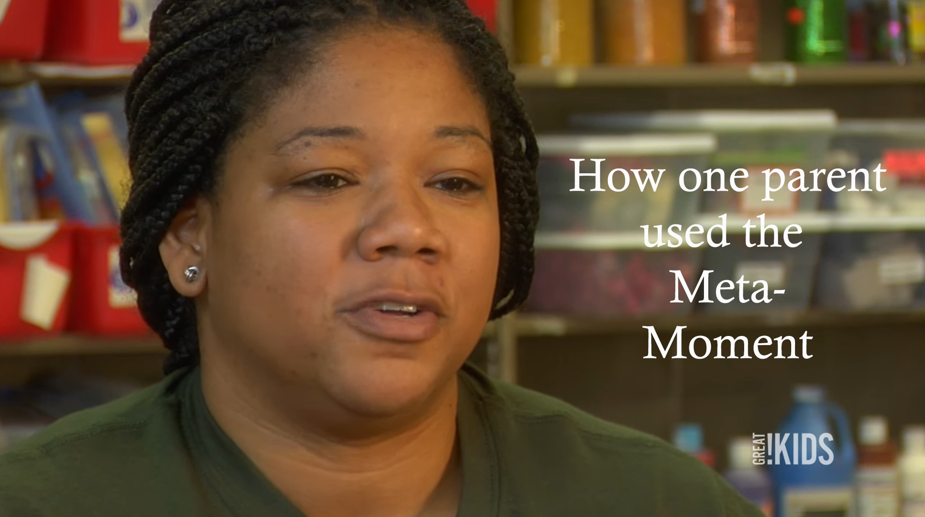
META-MOMENT
https://youtu.be/L12b5JoRT6I

Slide 51

THE BLUEPRINT
We can tap into the restorative potential of conflict by using the fourth RULER tool: the Blueprint.
The Blueprint as a tool for reflecting on conflict and guiding conferences to resolve conflict and help to restore communities
Through answering questions about the conflict, we learn to empathize and consider the situation from the other person’s perspective.
The benefits of empathy and strategies for cultivating empathy, including active listening and paraphrasing

Slide 52
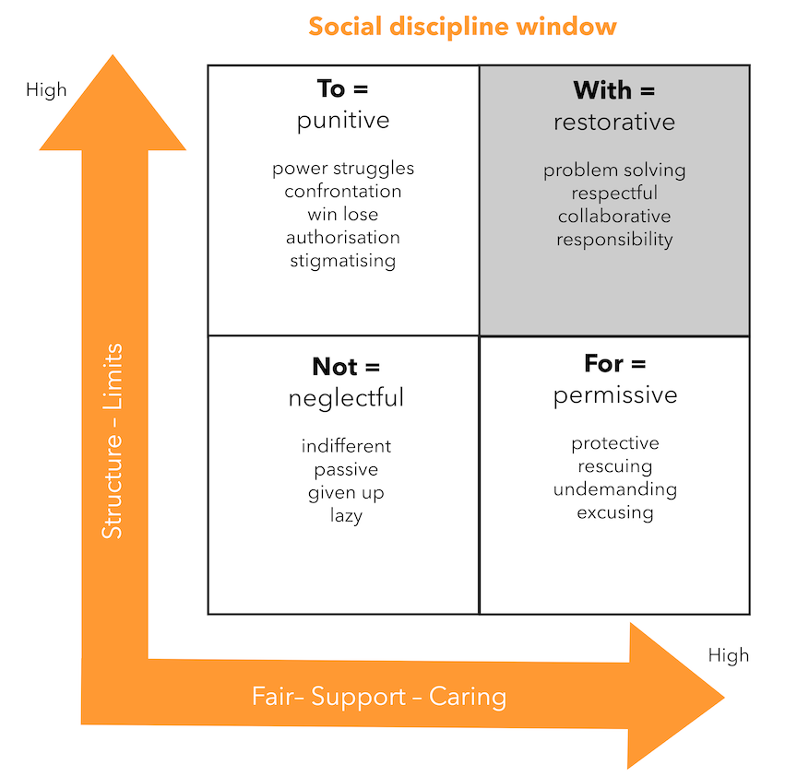
Restorative Practices
Notes:
Crucial conversations about feedback

Slide 53
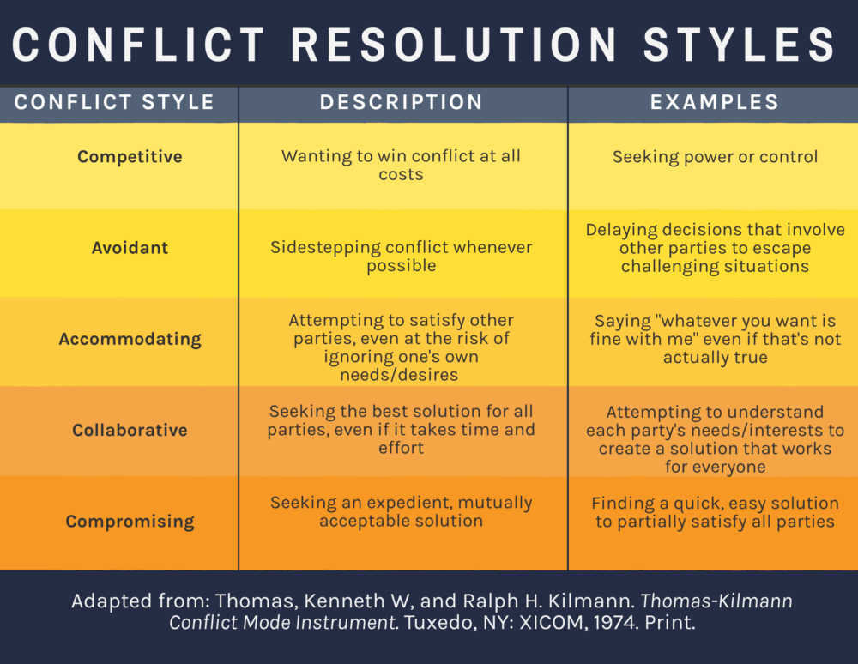
THE BLUEPRINT

Slide 54
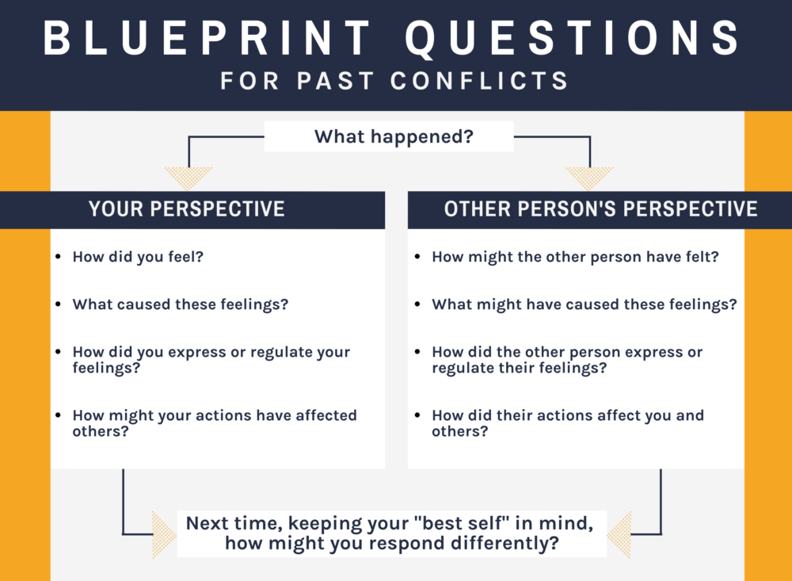
THE BLUEPRINT

Slide 55
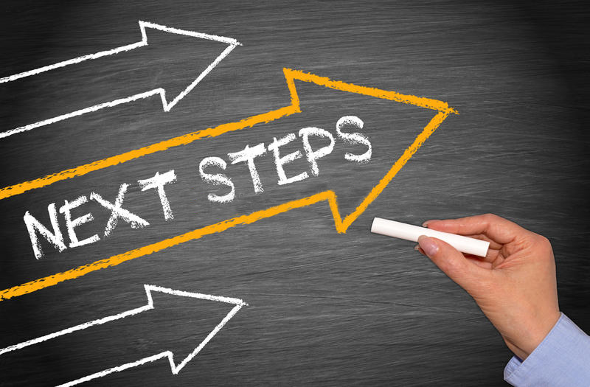
RULER | Staff Implementation

Slide 56


RULER
Dashboard
Staff Training Clock Hours

Slide 57
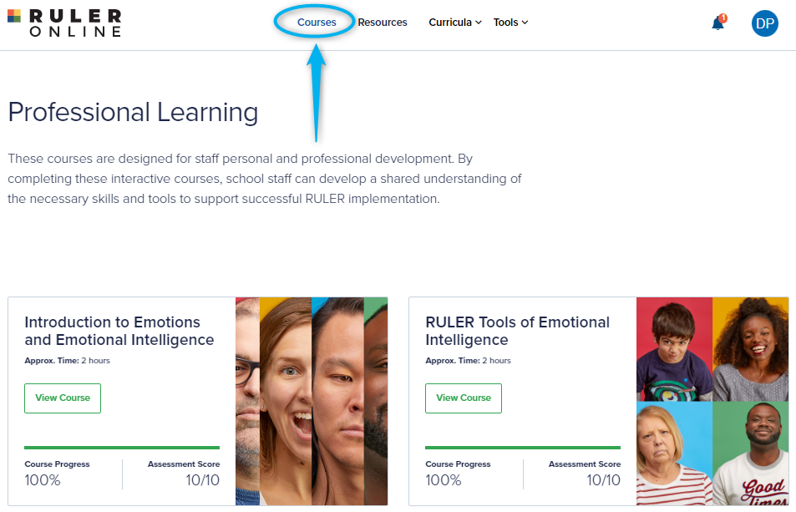
STAFF TRAINING MODULES

Slide 58
Addressing Misconceptions
Activity
LAYUP DRILL: With your table teams in a “line,” the 1st & 2nd person will face each other. 1st person will ask the question, 2nd person will respond (30 seconds). Next, the 2nd person will ask the question and the 3rd person will respond. Continue until everyone has been in both roles.
What would you say to someone who says,
I don’t have time to teach both SEL and [content type].
To survive in this world, kids need to learn toughness. Teaching them SEL will just make them soft.

Slide 59
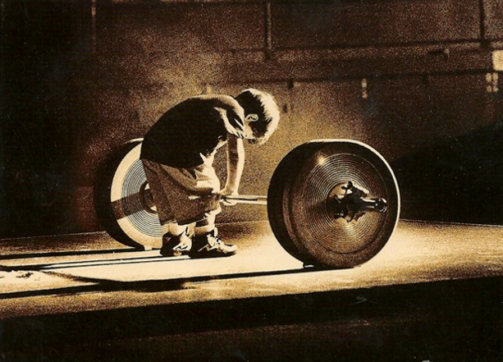
Emotions Matter Mindset
This is important, you can do it, I will help you!

Slide 60
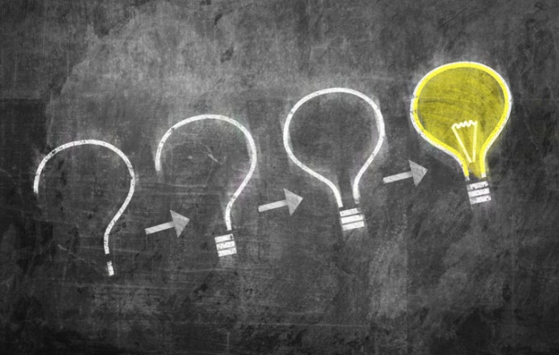
ARE YOU FEELING IT?
...Thank you!

