Slide 1

Student SEL Survey
Vocabulary Mini-Lesson for younger students

Slide 2
Overview for Teachers
The purpose of these slides is to support students in practicing and understanding the language that they will see on the student survey.
Slides 3-10 walk students through common language they’ll see in the answer choices.
Slides 11-31 highlight specific words that will be in the survey questions.
Throughout the deck you’ll see some “Let’s Practice” sections to give students a chance to answer a question using these new words. Use these to gauge understanding and reteach as needed.

Slide 3
Understanding
Answer Choices

Slide 4
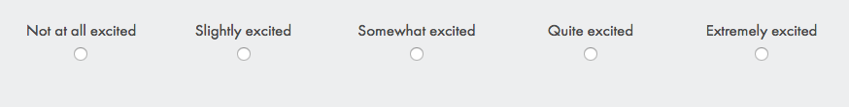
Questions about your feelings
Not
A bit
In the middle
Very
Super

Slide 5
Not at all excited → Not excited
Example:
“I am not at all excited to go to school today.”
Let’s practice:
What’s something you are not at all excited to do?

Slide 6
Slightly → A bit
Example:
“I am a bit excited to go to school today.”
Let’s practice:
What’s something you are a bit excited to do?

Slide 7
Somewhat → In the middle
Example:
“I am somewhat excited to go to school today.”
Let’s practice:
What’s something you are somewhat excited to do?

Slide 8
Quite → Very
Example:
“I am very excited to go to school today.”
Let’s practice:
What’s something you are very excited to do?

Slide 9
Extremely → Super
Example:
“I am extremely excited to go to school today.”
Let’s practice:
What’s something you are extremely excited to do?

Slide 10
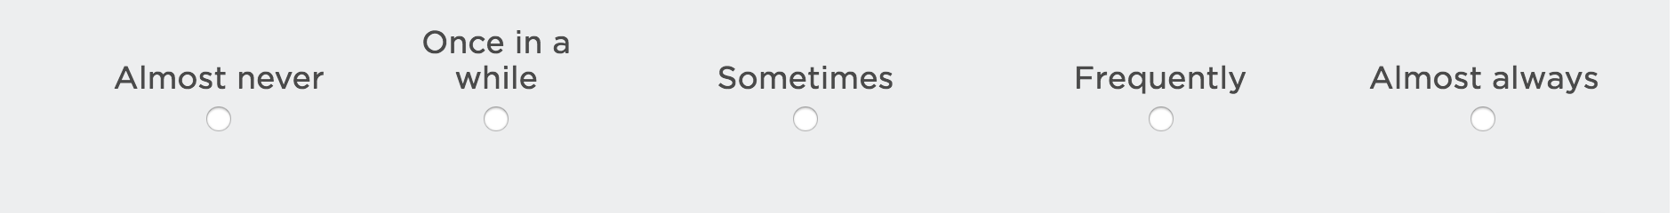
Questions about how often something happens
Does not happen
A few times
Sometimes
A lot of the time
Almost all the time

Slide 11
Understanding
Survey Questions

Slide 12
What do positive and negative energy mean?
Meanings:
Positive: good, happy :)
Negative: bad, sad :(
Energy: feeling, mood
Let’s practice:
When do you feel positive?
Who has good energy?

Slide 13

What does participate mean?
Meaning:
Participate: take part in, be a part of
Let’s practice:
How do you participate in class?

Slide 14
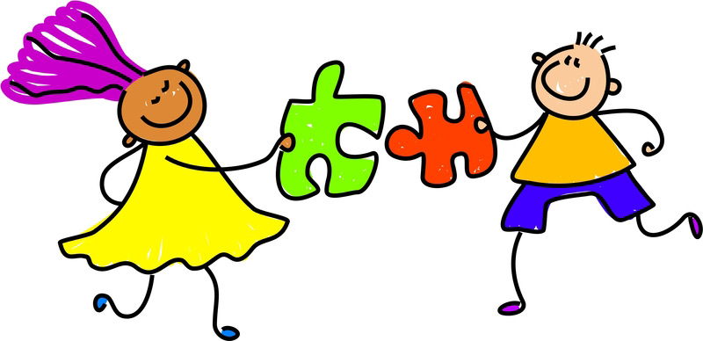
What does behavior mean?
Meaning:
Behavior: how someone is acting
Help, helpful: make easier
Hurt, hurtful: make harder
Let’s practice:
What’s an example of a helpful behavior?

Slide 15
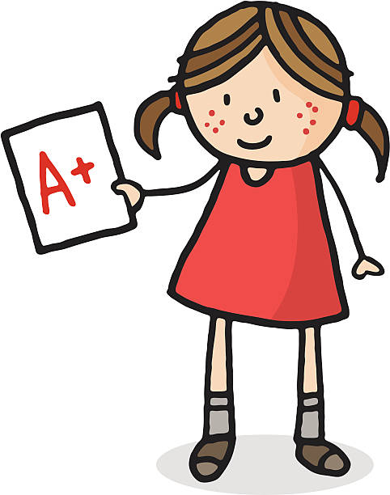
What does expectations mean?
Meaning:
Expectations: how someone thinks you can do
High expectations: someone thinks you can do great
Let’s practice:
Do you have high expectations for
yourself this year?

Slide 16

What does focus mean?
Meaning:
Focus: pay attention
Let’s practice:
What helps you
focus in class?

Slide 17
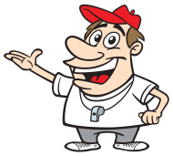
What do encourage and support mean?
Meaning:
Encourage: help you
Support: help you
Let’s practice:
Who encourages you
to work hard?

Slide 18

What does bully mean?
Meaning:
Bully, bullied: being picked on

Slide 19
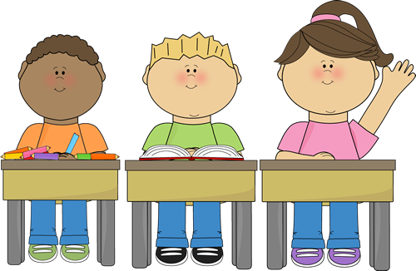
What does respect mean?
Meaning:
Respect, respectful: being nice
Disrespect, disrespectful: not being nice
Let’s practice:
How are you respectful
to your teacher?

Slide 20
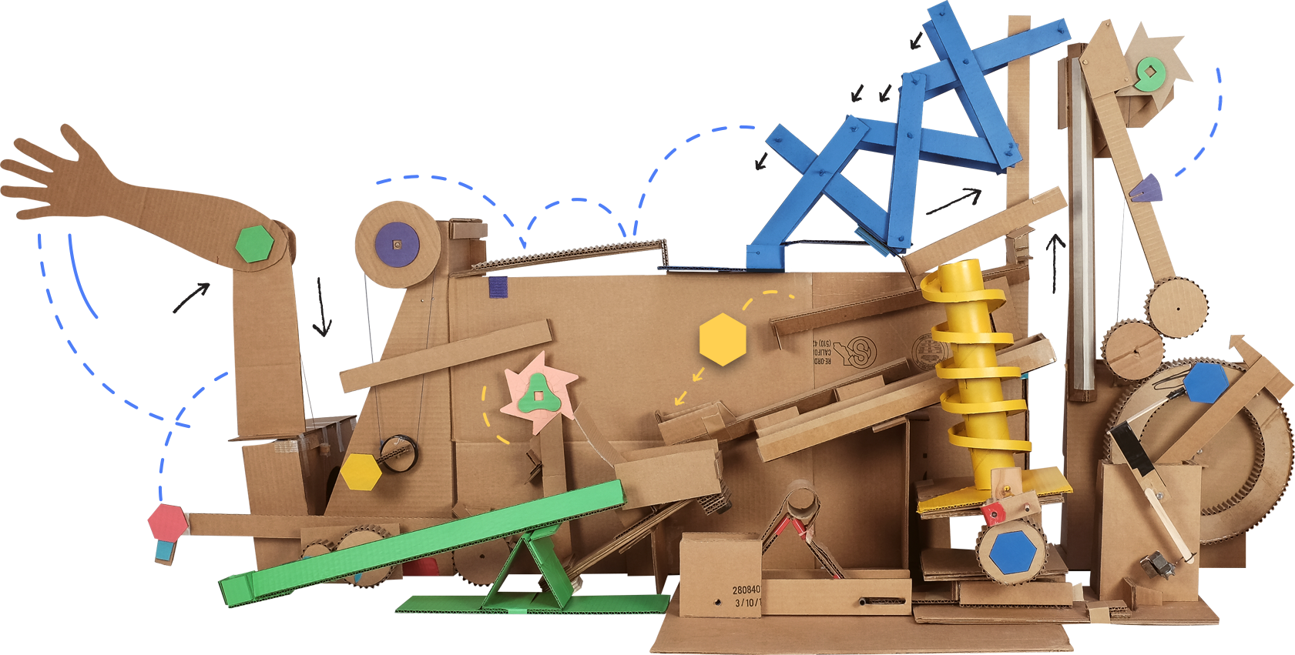
What does complicated mean?
Meaning:
Complicated:
Tricky to know what something means

Slide 21

What does talented mean?
Meaning:
Talent, talented:
having the ability to do something well
Let’s practice:
What is something you are talented at?

Slide 22

What are topics?
Meaning:
Topics: the new knowledge you learn during class
Let’s practice:
What is a topic you like to learn about?

Slide 23

What does effort mean?
Meaning:
Effort:
work put in to do something
Let’s practice:
What is something that takes a lot of effort?

Slide 24
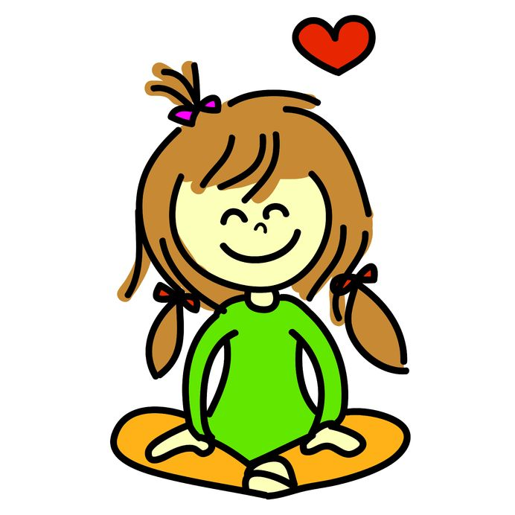
What does it mean to be relaxed?
Meaning:
Relaxed: feeling happy and comfortable because nothing is worrying you

Slide 25

What does it mean to be confident?
Meaning:
Confident: feeling that you can do something well

Slide 26
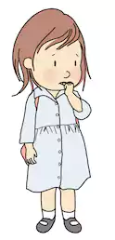
What does it mean to feel pressured?
Meaning:
Pressure: feeling that you must do something

Slide 27
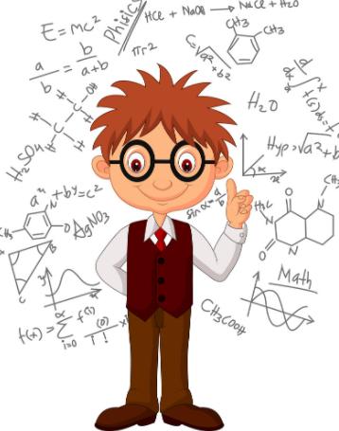
What does intelligence mean?
Meaning:
Intelligence: how smart you are

Slide 28
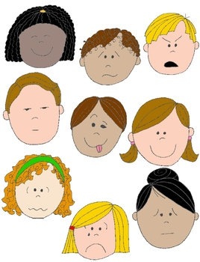
What are emotions?
Meaning:
Emotions: how you feel (happy, sad, angry, tired)

Slide 29
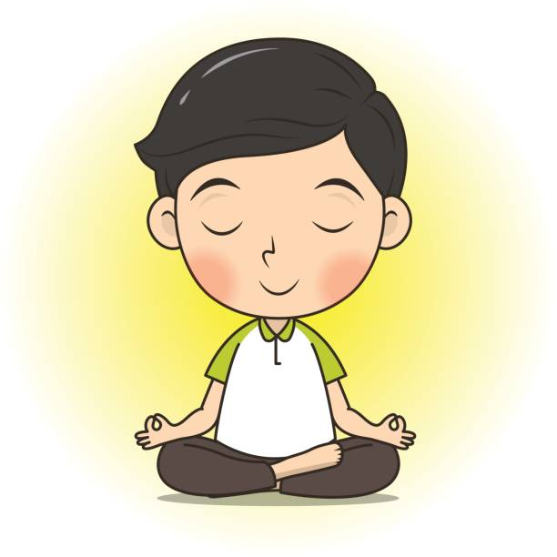
What does it mean to control your emotions?
Meaning:
Control: to be in charge Emotions: how you feel

Slide 30
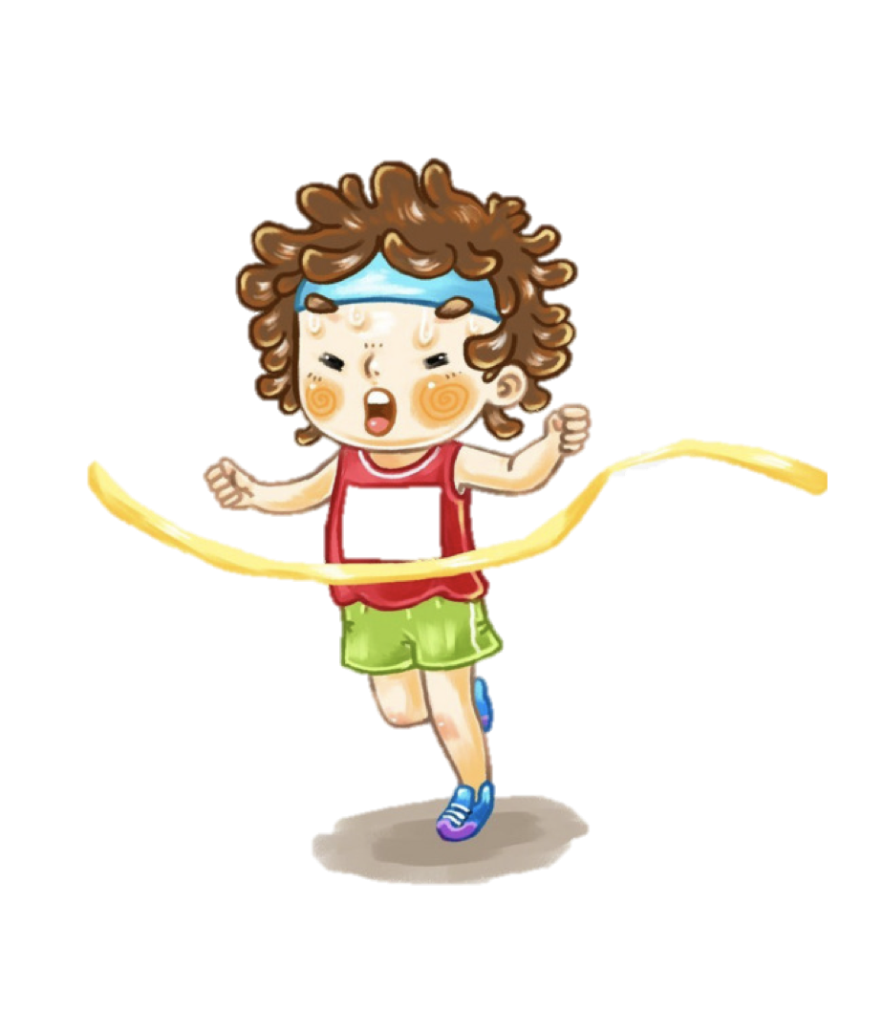
What does it mean to pursue a goal?
Meaning:
Pursue: to keep trying to reach
Goal: something you want

Slide 31
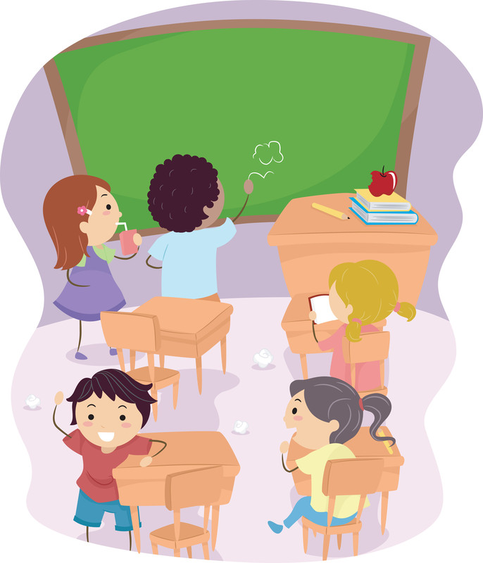
What are distractions?
Meaning:
Distraction: something that stops you from paying attention

