Slide 1

The Charter
Summer 2023

Slide 2

Intended Outcomes
By end of this session,
You will gain an understanding of:
  The value of a Charter
  How to set up a Charter
  The importance of revising your Charter
You will be better equipped to:
  Contribute to an environment that will help students…

Slide 3


Let’s Review: The RULER Skills
Recognizing emotions in ourselves and others
Understanding the causes and consequences of emotions
Labeling emotions accurately
Expressing emotions appropriately
Regulating emotions effectively

Slide 4




THE RULER ANCHOR TOOLS
The Charter represents agreed-upon norms for how everyone in a school, classroom, or other environment wants to feel. The Charter also explains what needs to happen or change to build and sustain positive emotional climates.
The Mood Meter is a visual guide to help individuals accurately analyze and “plot” their feelings. The Mood Meter develops skills in recognizing and labeling emotions, which can be further developed into understanding, expressing, and regulating emotions.
The Meta-Moment is a process for responding to emotional triggers in ways that align with one’s best self. The goal is to shift from automatic, unhelpful reactions to strategic, effective responses.
The Blueprint is a problem-solving tool for working with interpersonal conflicts. The Blueprint can be used independently or collaboratively to enhance empathy and identify effective solutions for past, real-time, or anticipated conflicts.

Slide 5
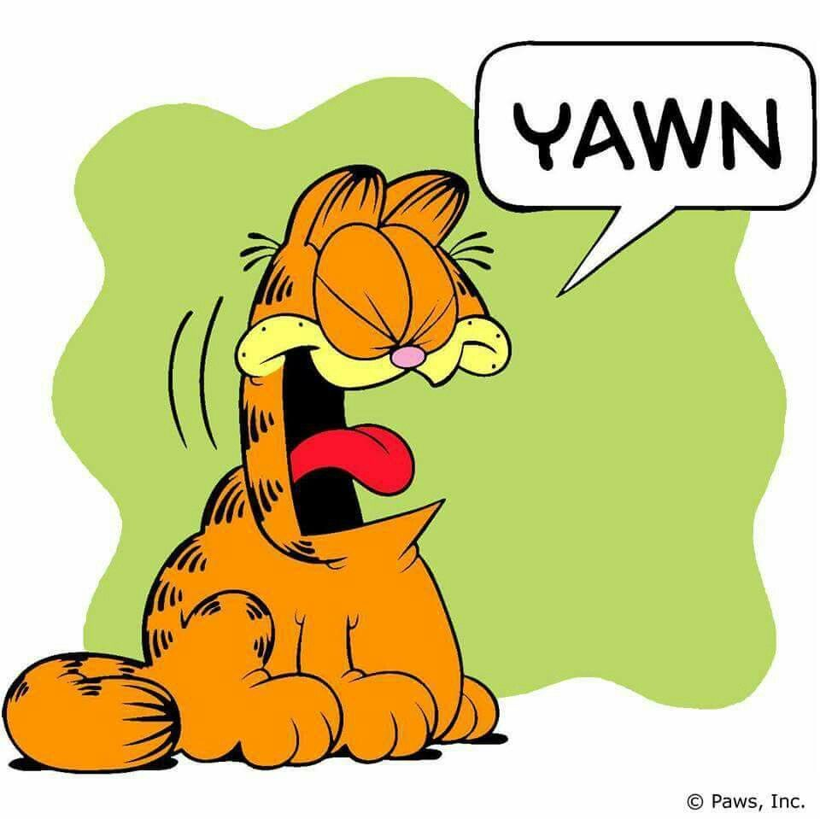
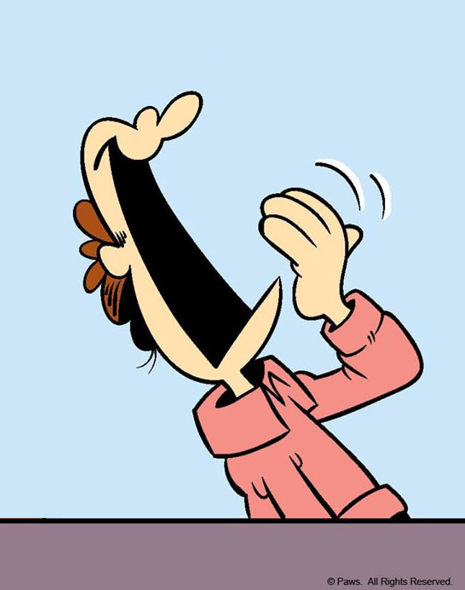
LET’S PLAY A GAME
Choose a starting person.
The first person will say the word “yawn.”
The next person will fake a yawn.
Then, the next person will say “yawn,” then the next person will fake a yawn, and on and on around the room.

Slide 6
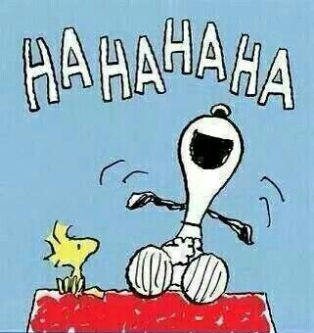
LET’S PLAY A GAME
This time, the first person will say “ha.”
The next person will say, “ha ha.”
The next person will say it three times, and on and on around the room.

Slide 7
REFLECTION
After playing both games:
Who believes that emotions can be contagious?
What were some ways that emotions were contagious during the game?
What other kinds of emotions are contagious?

Slide 8

EMOTION CO-REGULATION
https://youtu.be/YTTSXc6sARg

Slide 9

EMOTION CO-REGULATION
Co-regulation plays an important role in how we help each other to feel the words listed on our Charter.
When two people interact, they are constantly influencing, responding, and adjusting to each others’ behaviors.
Our individual emotions are constantly changing, depending on others’ emotions and behaviors.
Co-regulation can be between a
parent and child, two friends, or
between a teacher and student.

Slide 10

EMOTION CO-REGULATION
When co-regulation works well, both people experience less distress.
For example, if you were running a long race with a friend, you might adjust to each other’s speeds. If either of you felt like giving up, your might persist longer because you have each other’s support.

Slide 11
EMOTION CO-REGULATION
Example 1: Someone accidentally bumps into you in line, and you can tell that they are in a down mood.
You let them go in front of you. This causes the person to say “thank you” and smile, which makes you feel gratified.
Example 2: You see that a classmate who is giving a presentation is very nervous and struggling to speak in front of the class.
You choose to be extra cooperative, quiet, and attentive to help them feel better, which calms them down and makes you feel satisfied.

Slide 12
EMOTION CO-REGULATION
Remember…
We aren’t only responsible for regulating our own emotions and behaviors at school. We all play an important role in helping each other to manage our feelings.
…This is where the Charter comes in.

Slide 13
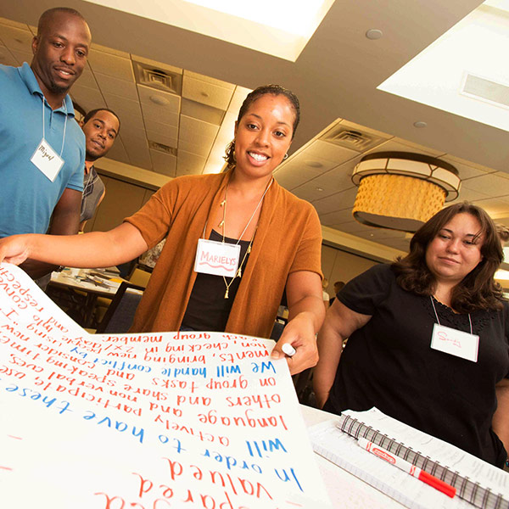
THE CHARTER
There is a clear gap between how school community members feel and how they want to feel. This presents us with an opportunity–a call to action to develop plans for enhancing emotional climates.
This is where the Charter comes in. The Charter allows everyone in a school community the chance to articulate how they want to feel at school, then work together to agree upon behaviors that support those feelings. As a group, the school community members decide on what needs to happen or change for those feelings to be consistently present.
All Charters are structured around two primary
questions:
  How do we want to feel?
  How will we help each other to
  experience these feelings?

Slide 14
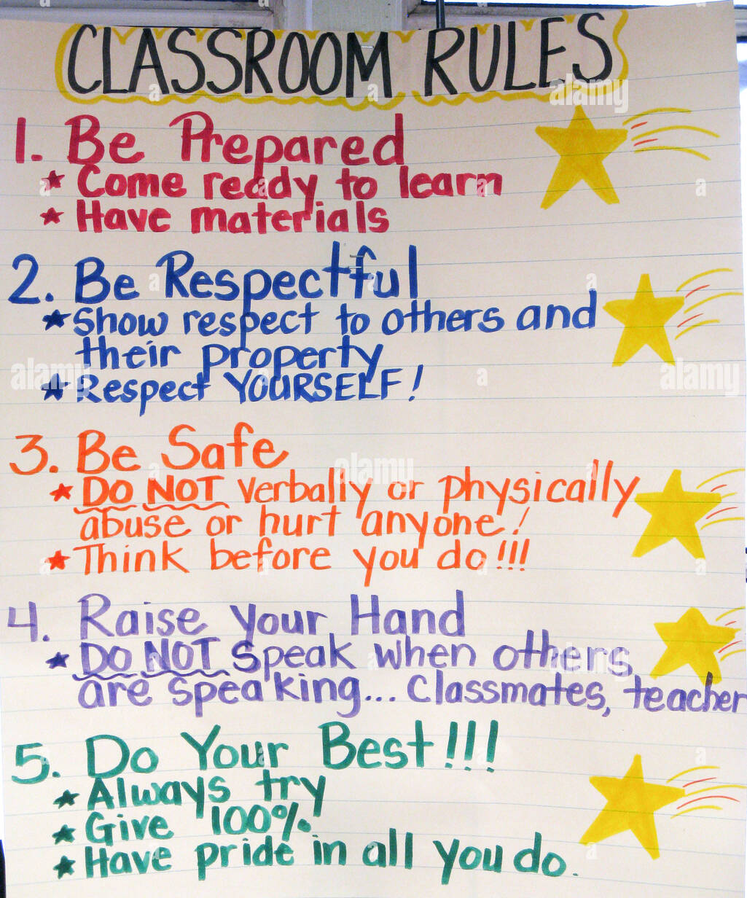
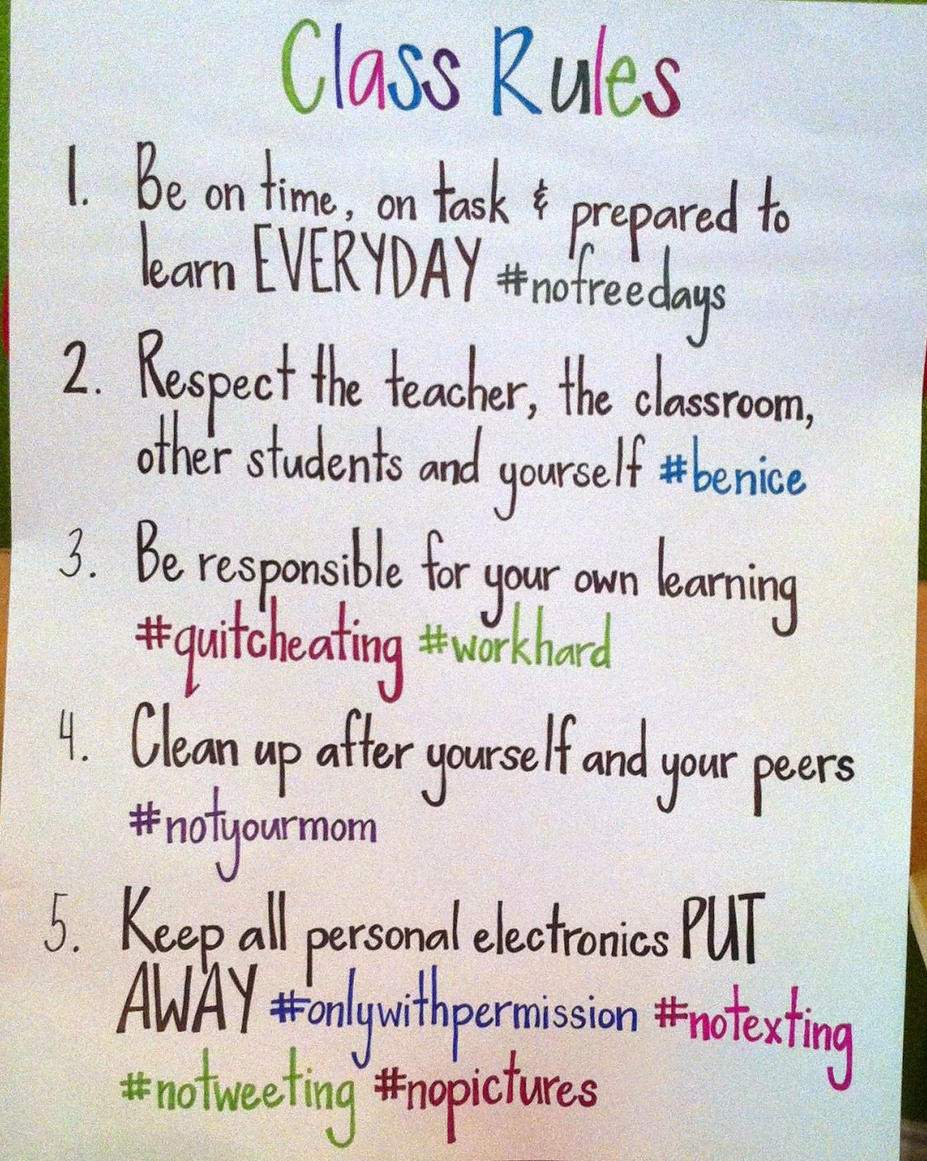
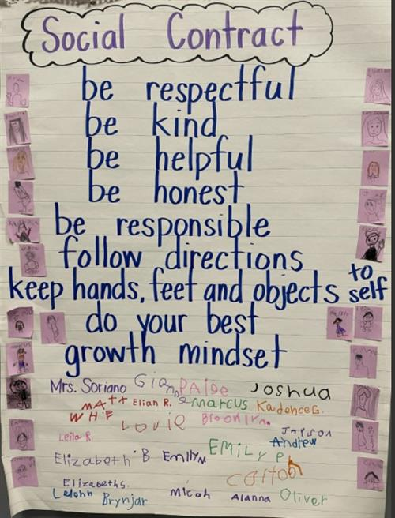
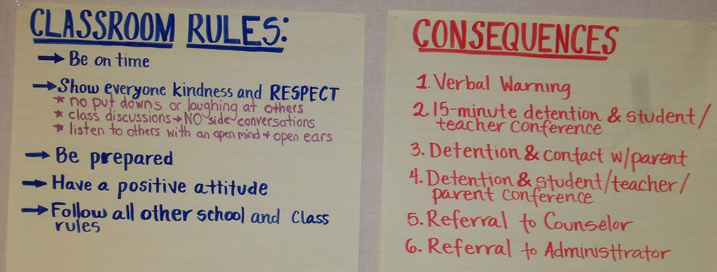
CHARTER vs rules

Slide 15
THE VALUE OF A CHARTER
The Charter creates the WHY for the classroom rules or social contract. How we want to feel will lead into strategies that will foster and maintain them. The “rules” naturally follow – but rather than for basic compliance, they will have a deeper level of meaning and purpose.

Slide 16
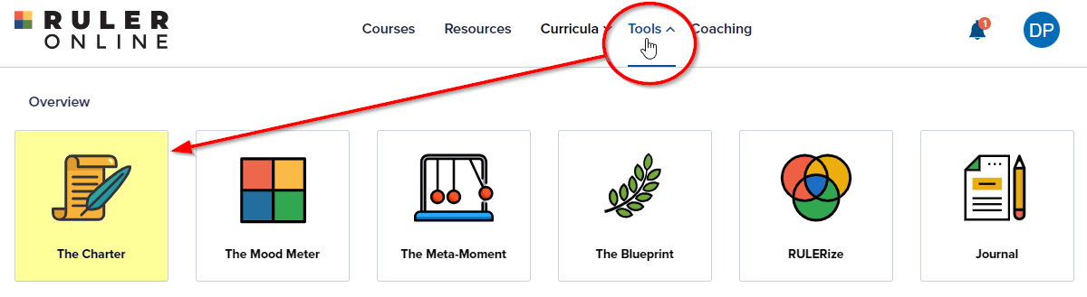
CREATING A CHARTER

Slide 17
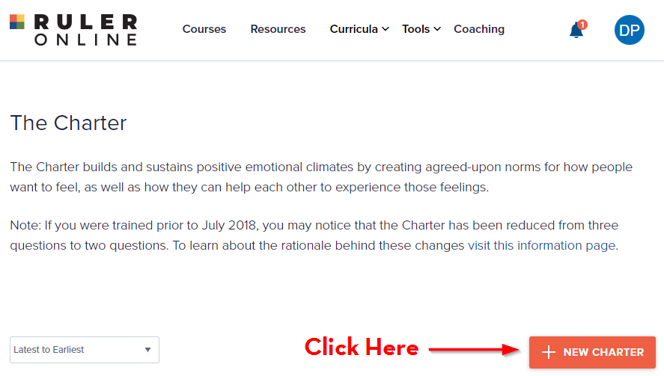
CREATING A CHARTER

Slide 18
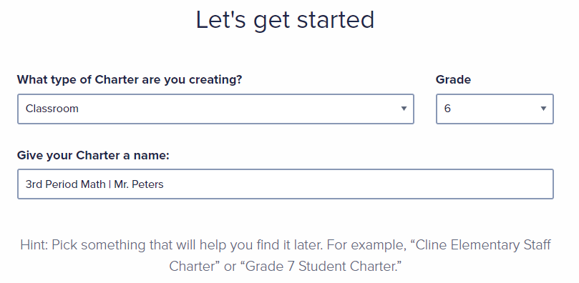
CREATING A CHARTER

Slide 19
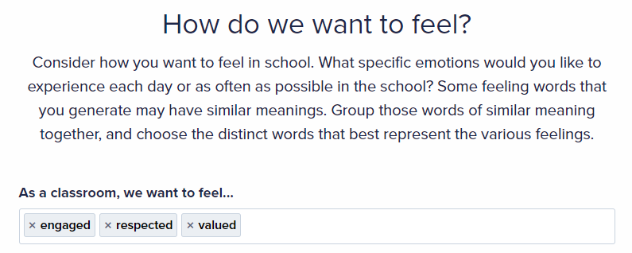
CREATING A CHARTER

Slide 20
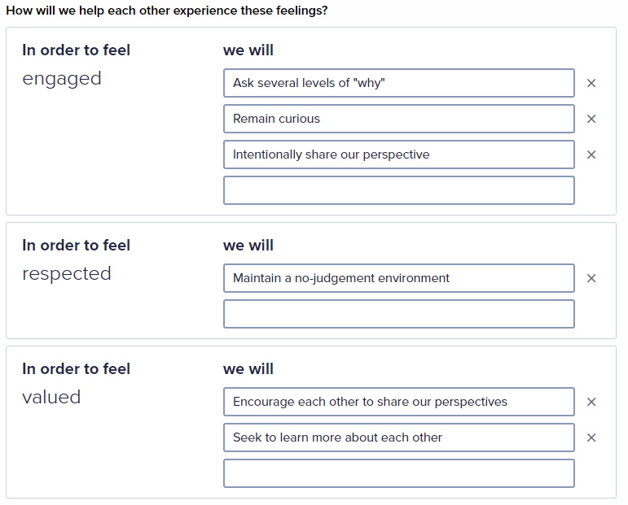
CREATING A CHARTER

Slide 21
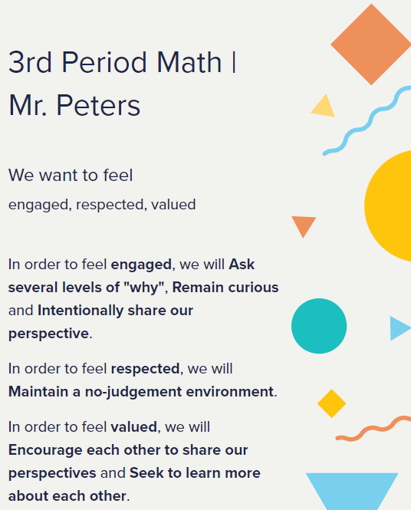

CREATING A CHARTER

Slide 22

Keeping the charter alive

Slide 23

ARE YOU FEELING IT?
...Thank you for your participation today!

