Slide 1

Get Ready
to Take the Diagnostic

Slide 2

“Why are we
taking the i-Ready Diagnostic?”

Slide 3
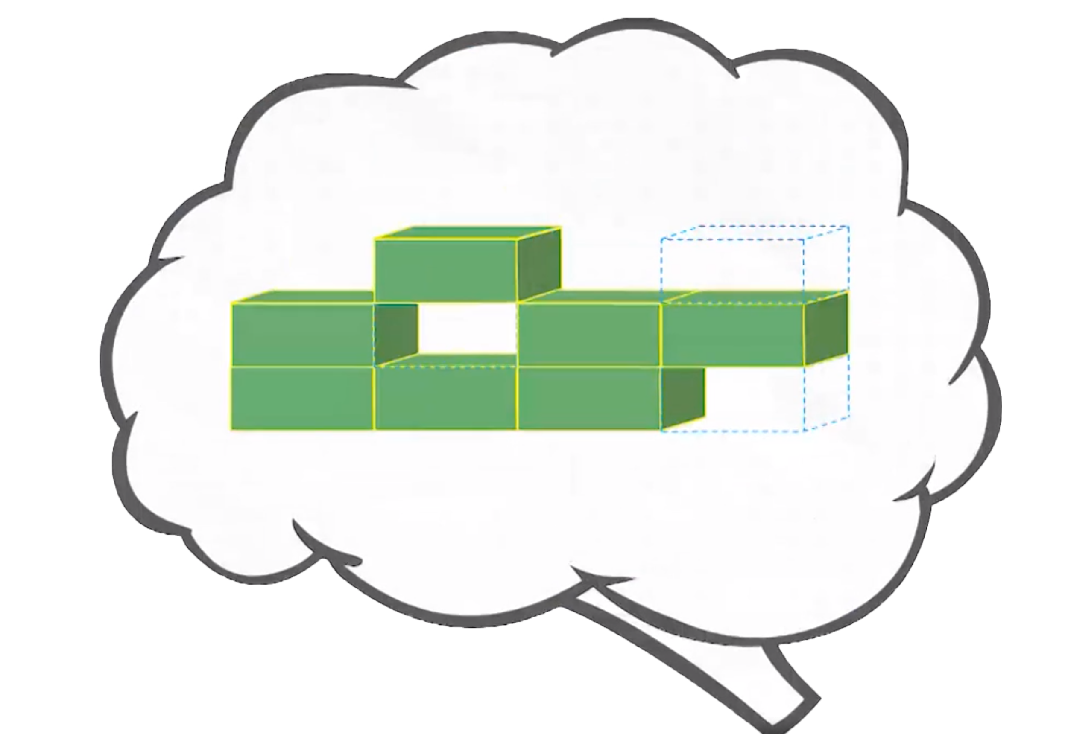
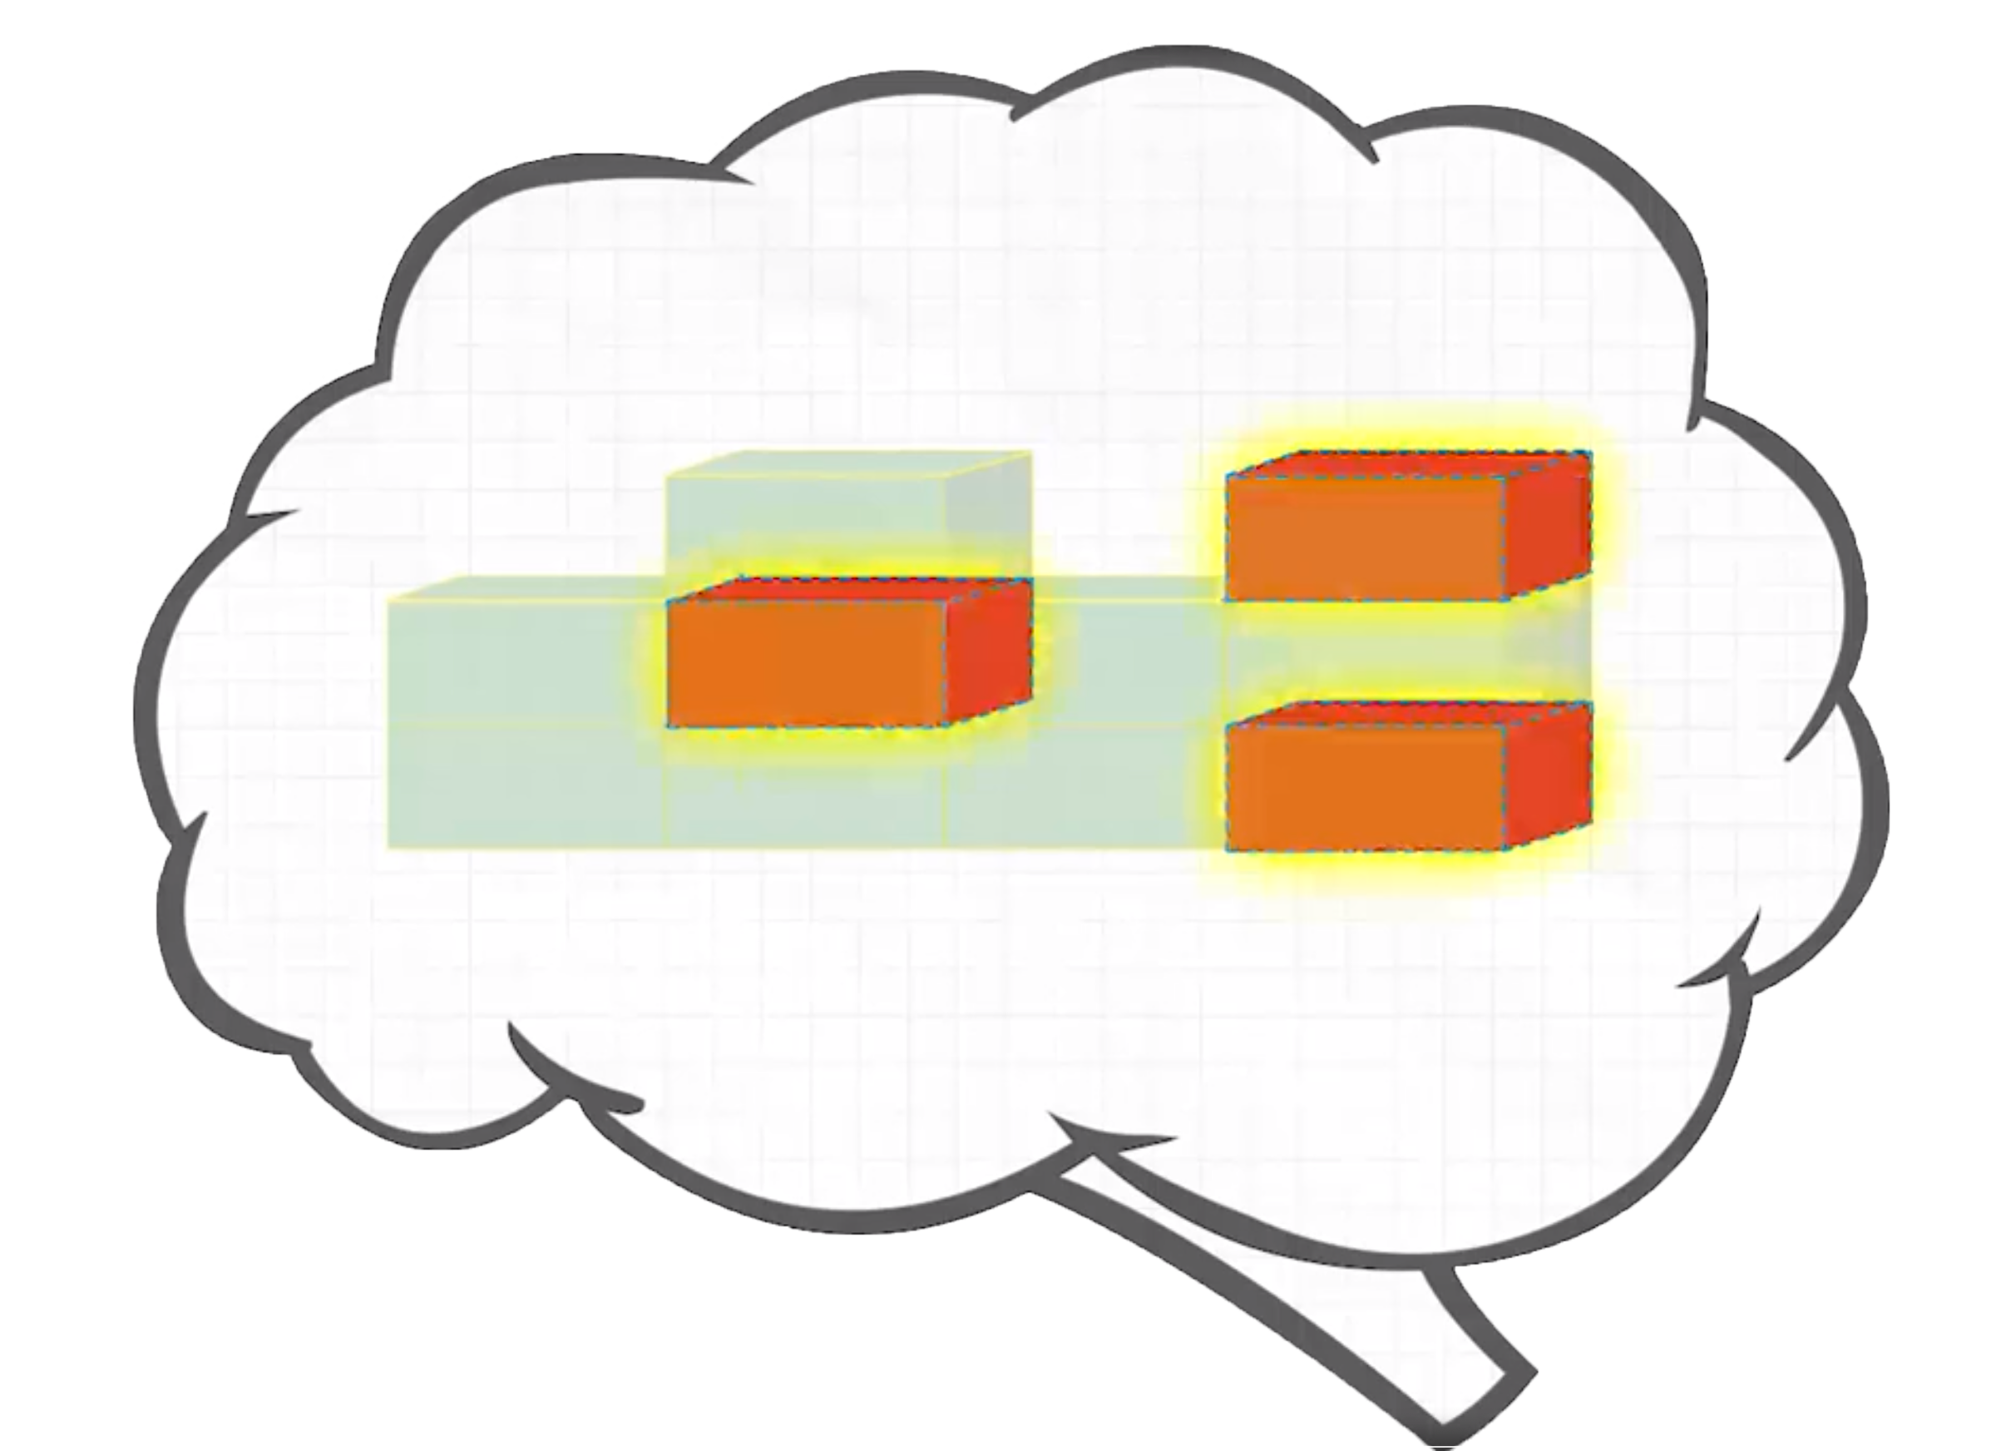
Remember, the Diagnostic is important because it helps you
and your teachers . . .
Understand what you
already know . . .
. . . and what you
need to learn.
Notes:
Today, when you complete your Diagnostic, you will see a score pop up on your screen. This score is one of many that you will see on your Diagnostic report. Your Diagnostic report will help us see the areas where you have strengths and the areas where we can help you grow. We will talk about your Diagnostic report and your personal learning goals when we meet for our data chat.

Slide 4

Remember, the Diagnostic is important because it helps you
and your teachers . . .
Make the best use of your learning time.
Notes:
Today, when you complete your Diagnostic, you will see a score pop up on your screen. This score is one of many that you will see on your Diagnostic report. Your Diagnostic report will help us see the areas where you have strengths and the areas where we can help you grow. We will talk about your Diagnostic report and your personal learning goals when we meet for our data chat.

Slide 5

Remember, the Diagnostic is important because it helps you
and your teachers . . .
  Show what you know!
  Try your best so you can show what you’ve learned.
Notes:
Today, when you complete your Diagnostic, you will see a score pop up on your screen. This score is one of many that you will see on your Diagnostic report. Your Diagnostic report will help us see the areas where you have strengths and the areas where we can help you grow. We will talk about your Diagnostic report and your personal learning goals when we meet for our data chat.

Slide 6



How does the Diagnostic work?
i-Ready is an adaptive test. This means the questions change based on your answers.
Some questions will be . . .
HARD
EASY
JUST RIGHT

Slide 7

What should you do?
Remember this test is adaptive! You should try your best, but know that you'll get questions you don't know how to answer.

Slide 8

What should you do?
Try your best.
Do not rush, but do not spend too much time on any one question.

Slide 9



What should you do?
You will see questions you won’t know how to answer because you haven’t learned them yet.
That is okay! Choose the best answer and move on.
Too Hard
Too Easy
Just Right

Slide 10
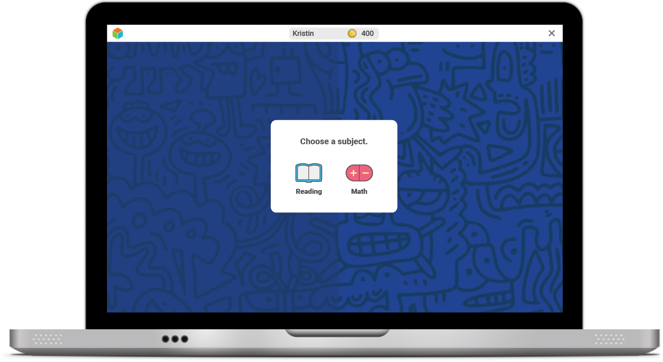
Once you log in, you will see this:

Slide 11
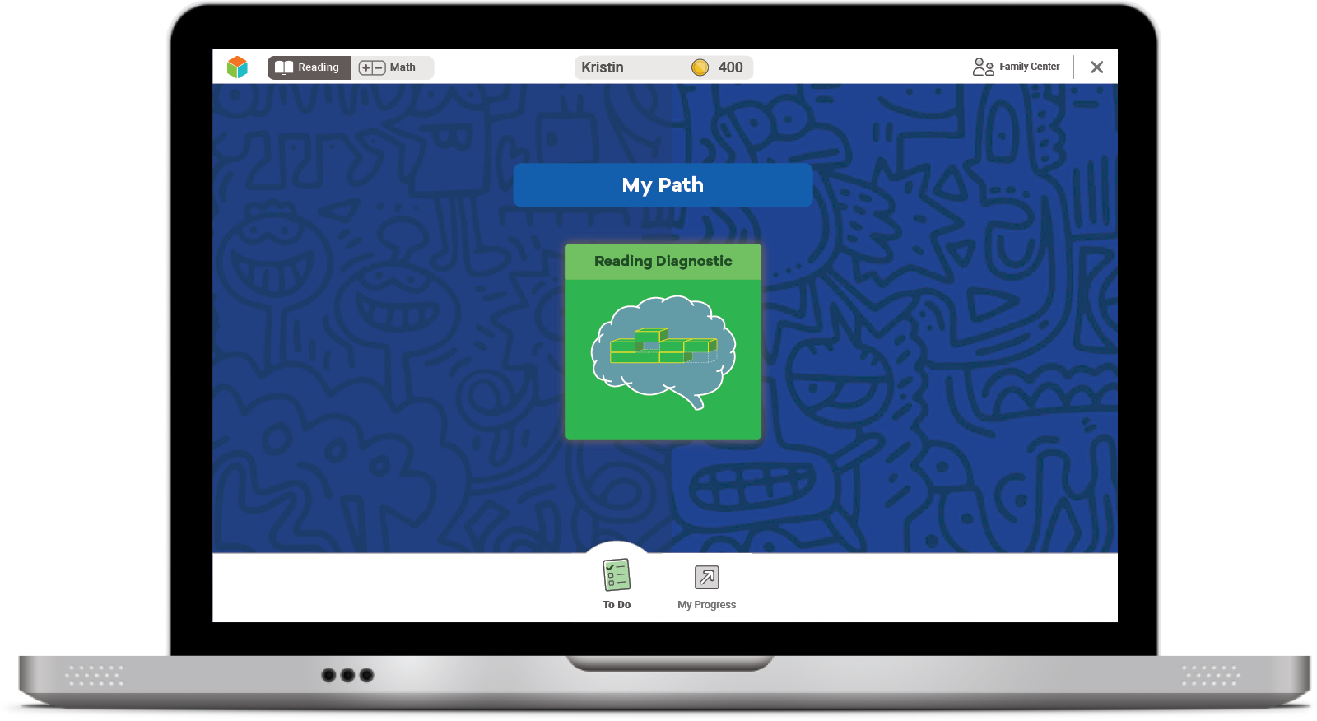
Next, you will see a page like this:
Select the green button
to start your Diagnostic.

Slide 12
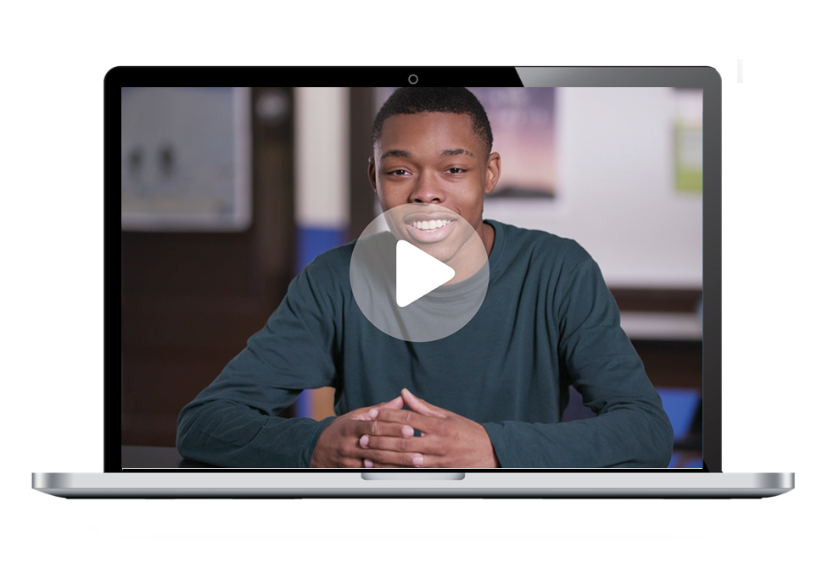
Next, you will:
Watch a video.

Slide 13
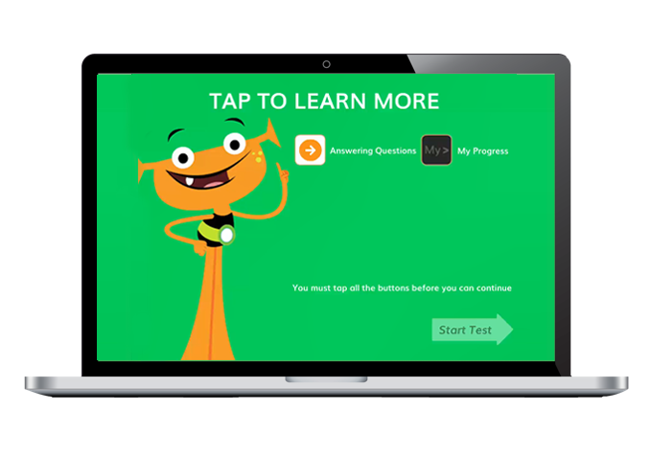
Next, you will:
Watch a video.
Click on each button
to watch a video
about each tool.

Slide 14
Next, you will:
Watch a video.
You must click on all of them before you can start.

Slide 15
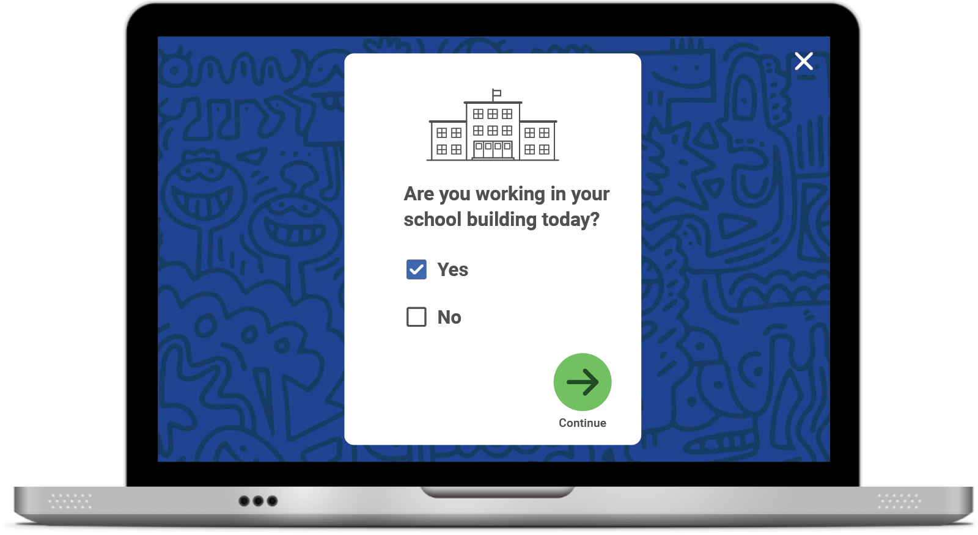
Student Survey
Once you START or RESUME your Diagnostic, you will see this question pop up on your screen:
Click No if you are taking the Diagnostic REMOTELY.
Click Yes if you are taking the Diagnostic at SCHOOL.
Click the green arrow to move on.

Slide 16






Helpful Tips
Take your time and do not rush.
Read each question and answer choice carefully.
If you get a question you have not learned yet, try your best. Like school, your teacher and family cannot help!
For Math—Show your work on paper for every problem.
For Reading—Read each passage carefully, and
reread the passage when necessary.
Check your work before going to the next question.

Slide 17
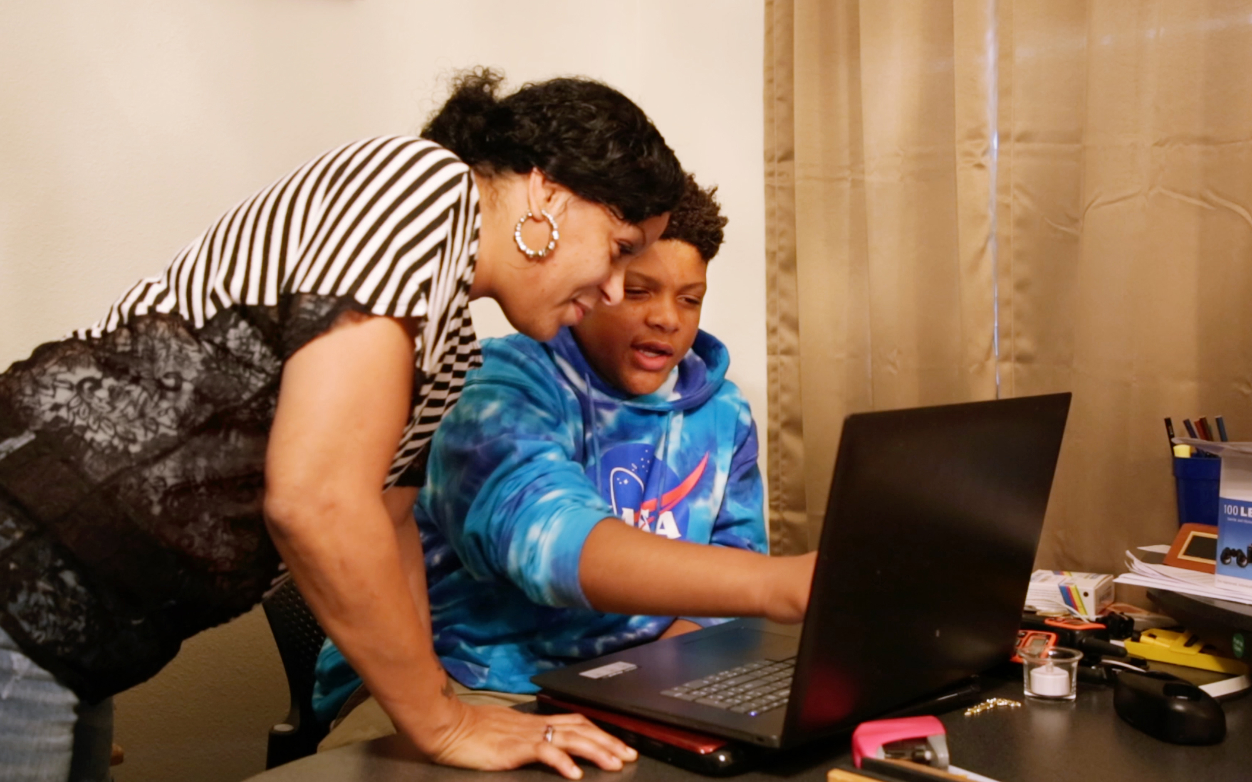
Our Plan
After the Diagnostic, i-Ready creates a special report for you and your family.

Slide 18
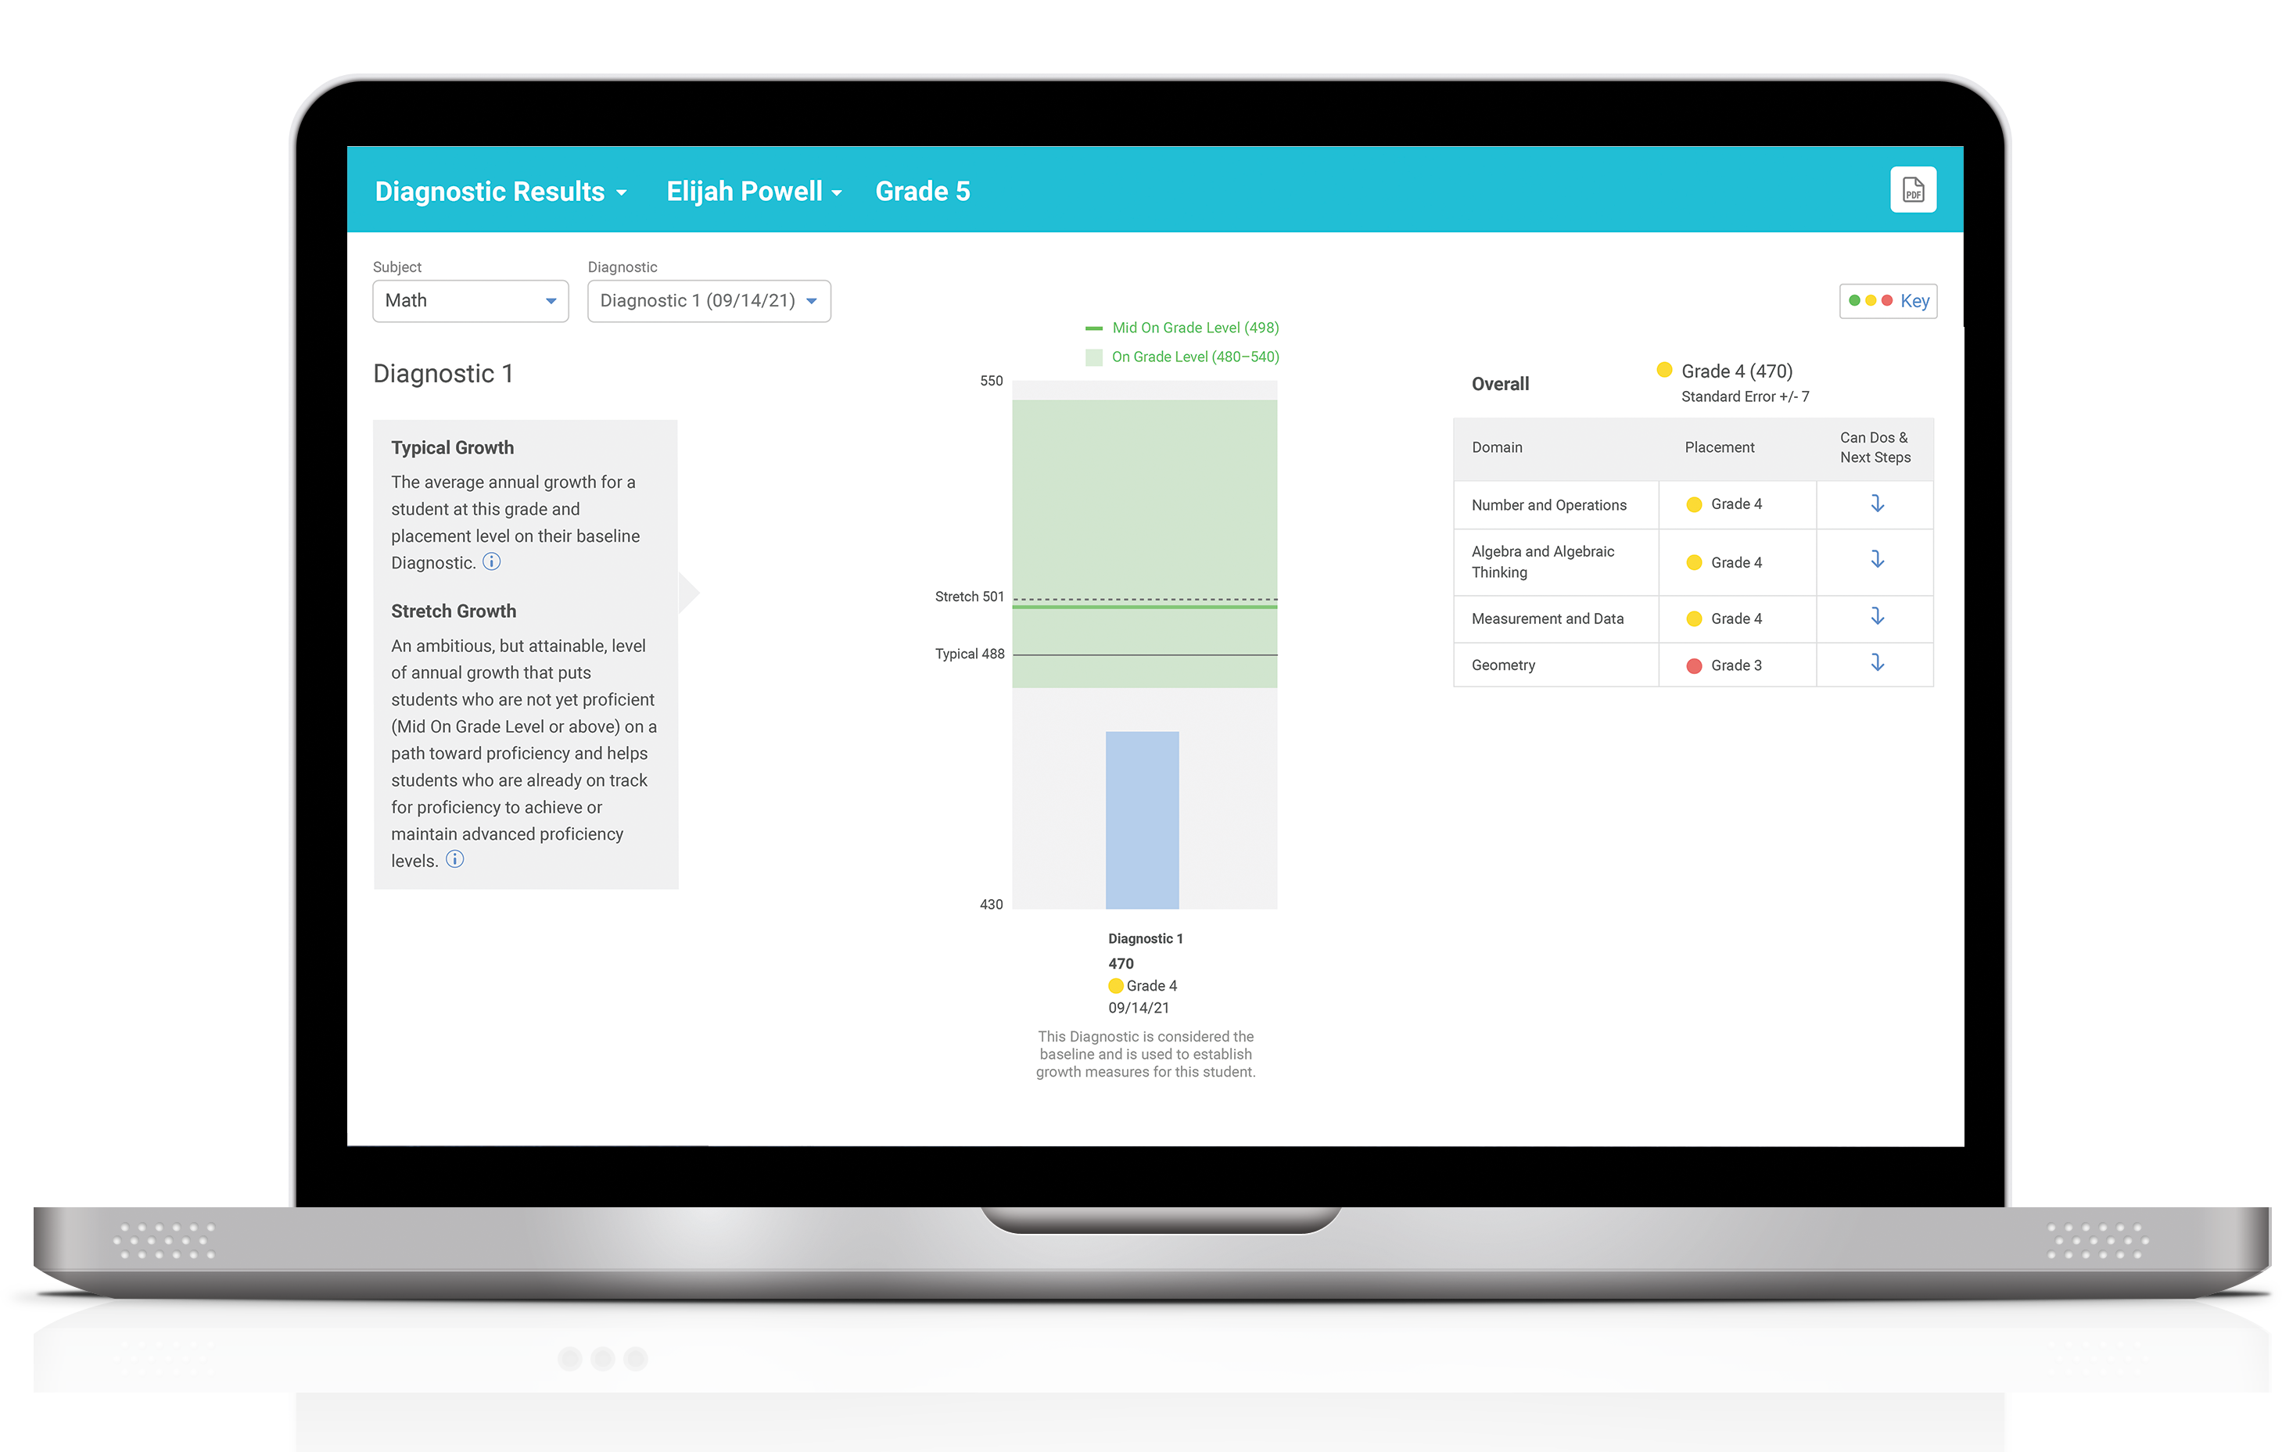
Our Plan
We can talk about:
Progress toward your growth goals
Your strengths and areas for growth
How you did
After the Diagnostic, we can
review your results and goals.

