Slide 1


How to Take the Diagnostic in i-Ready
Assessment & Research
CLIMATE | CULTURE | SYSTEMS | INSTRUCTION

Slide 2
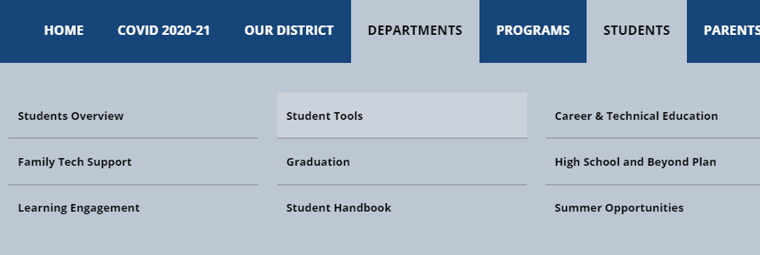

Open i-Ready from Student Tools

Slide 3
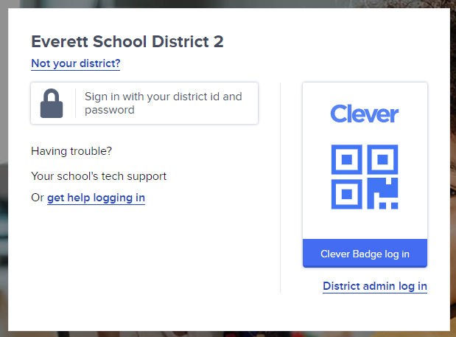
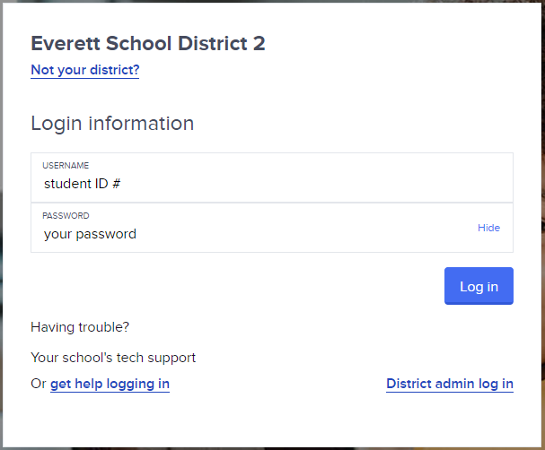
Log in!
Log in using your Student ID # and the password you use to sign in to a district computer.

Slide 4
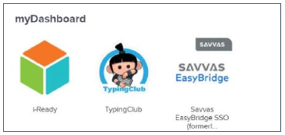
Clever Dashboard
Select i-Ready from your Dashboard

Slide 5
Choose Reading or Math

Slide 6
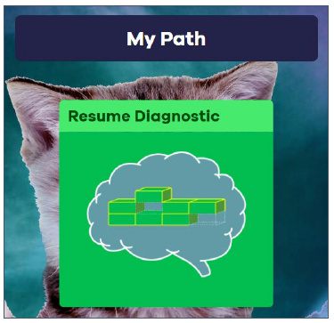
Take the Diagnostic
Click on the diagnostic to begin or continue!

