Slide 1

Exploring Interim Assessment Blocks as a Team
Quiana Hennigan
Assessment & Research Department
Everett Public Schools
Updated 3/2/2023

Slide 2
Objectives
Understand:
the role of Interim Assessment Blocks (IAB) in the Smarter Balanced Assessment (SBA) system
how to explore the IAB blueprints and item specifications as collegial work and to select an appropriate IAB
how to prepare students for and administer IABs
how to review IAB scores and use them to inform instruction

Slide 3
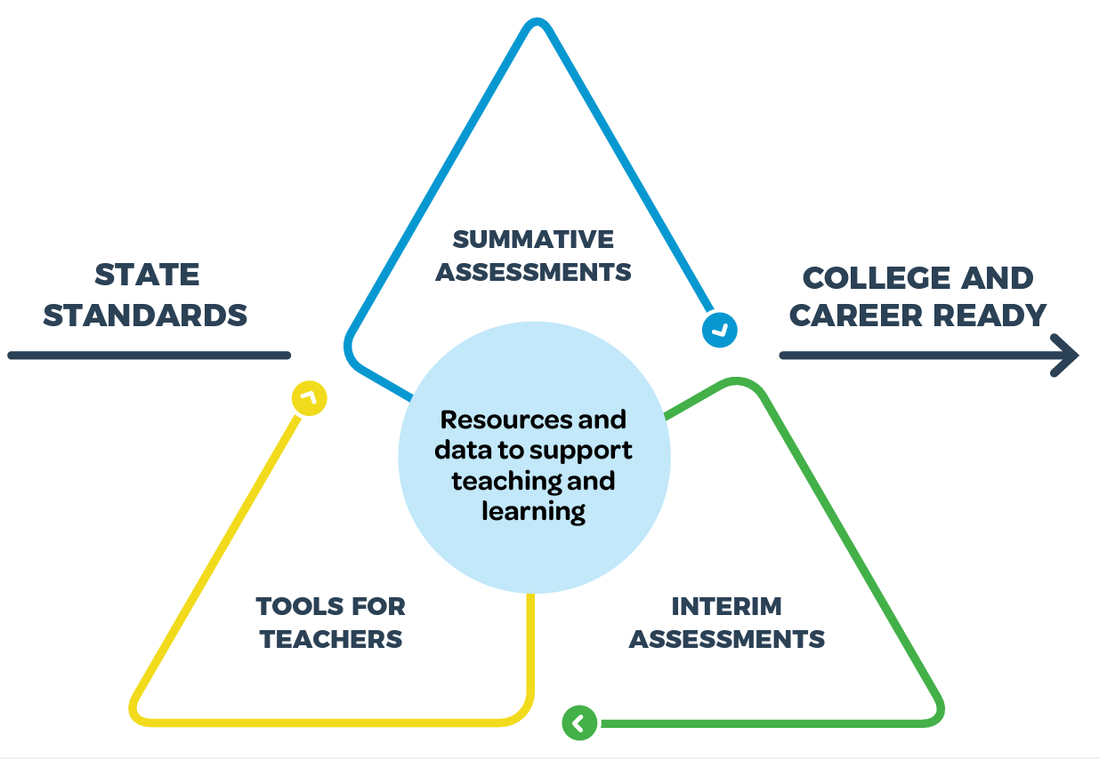
Smarter Balanced Assessment System

Slide 4
Interim Assessment Types
x
Interim Smarter Balanced Assessment
Interim Comprehensive Assessment (ICA)
Interim Assessment Blocks (IAB)
Focused Interim Assessment Blocks (Focused IAB)
Mirrors full blueprint summative SBA in structure, content and time for a grade level and content area.
Assessment focused on 3-8 targets for a grade level and content area. 6 available in ELA and 3-5 in math at grades 3-8 & HS.
Assessment focused on 1-3 targets. 9 available in ELA and 7-9 in math at grades 3-8 & HS.
Notes:
There are two components to the Interim Assessments Comprehensive and Blocks.
Comprehensive, mirrors summative Smarter Balanced Assessments.
Whereas, Blocks are smaller assessments focused on a more narrow set of standards.
Interims are voluntary to administer. They can be used to guide instruction or inform about student learning.
Last year you didn’t know what was on the interims or what the scores meant: below, at or near, above.
This year, there is a process that we will be discussing that allows you to view the assessments and determine which assessments will better aid current curriculum lessons and also allow you to see the structure of questions.

Slide 5
Why should I use an IAB?
Assess student learning against a set of standards
Get actionable data to inform instruction
Evaluate growth in a unit of study
Provide students experience in the online assessment environment in preparation for the summative assessment
Provide students experience with questions and tasks using structures aligned with the summative assessment

Slide 6
Selecting an IAB
Collaborate with team and specialists to select an IAB:
Consider the purpose: what do you hope to learn?
What fits the instructional map?
Review the Test Blueprints
  Consider content, structure and DOK
Take the IAB using the Assessment Viewing Application (AVA)
  Consider content, item format, ease of use of tools/items to prepare students

Slide 7
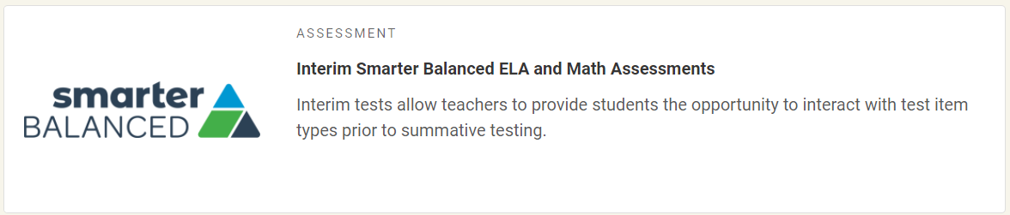
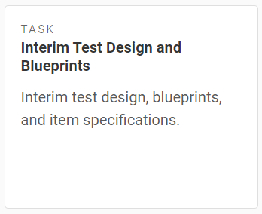
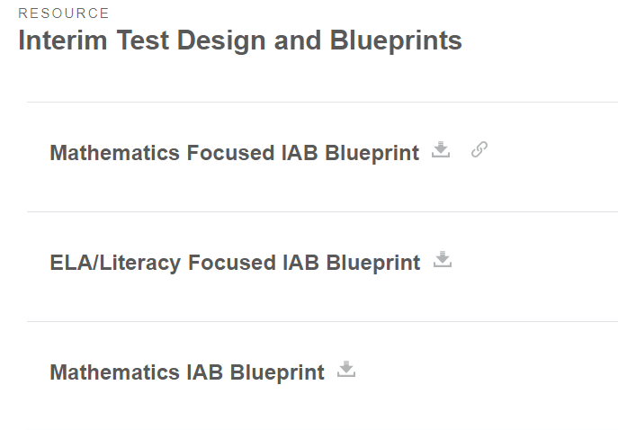
Finding Blueprints in WCAP Portal
1. Go to WCAP Portal through Managed Bookmarks and click the Interim tile.
2. Click on the blueprints task tile.
3. Click to download the relevant blueprint.

Slide 8
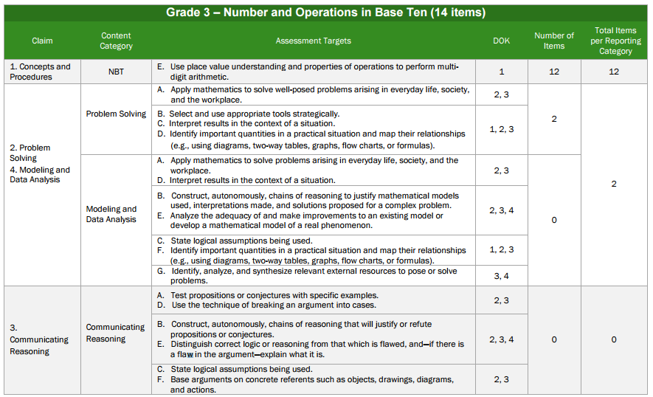
IAB Blueprints

Slide 9
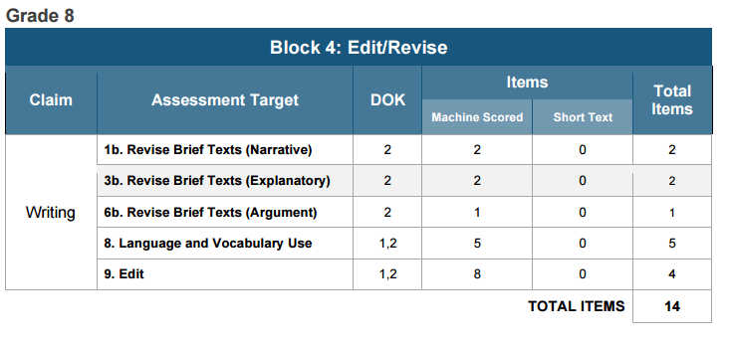
IAB Blueprints

Slide 10
IAB Blueprints
G3_
1E_
NBT_

Slide 11
IAB Blueprints
G08
C 2_
T1.b
Claim 1: Reading
Claim 2: Writing
Claim 3: Speaking and Listening
Claim4: Research

Slide 12
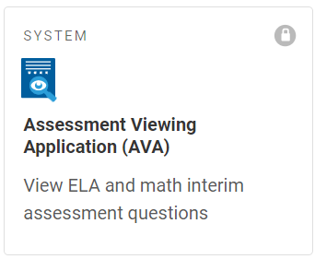
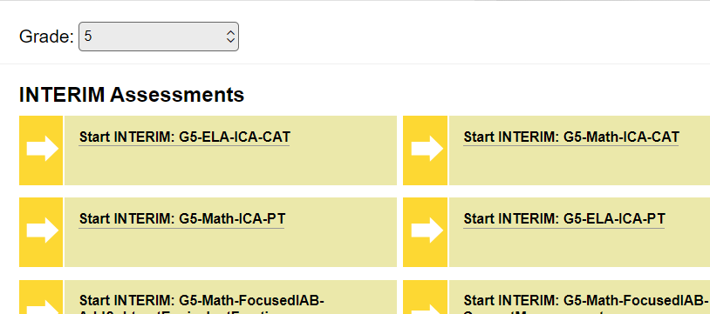
Assessment Viewing Application (AVA)
1. Go to WCAP Portal through Managed Bookmarks and click the Interim tile.
2. Scroll down and click on the AVA system tile. Log in.
3. Select the grade level and click on the interim you want to view.

Slide 13
How do I prepare for an IAB?
Check your roster and accommodations.
  Contact your TIDE manager for help if:
    you are missing students or have extras
    you think a student’s accommodations are wrong in any way
    You need guidance on providing an accommodation or support
Provide a *guided* training/practice test:
  Provides opportunities for students to:
    practice logging in
    be trained in the use of their tools, supports, and accommodations
    be trained in the use of the item types they will see in interim and summative testing

Slide 14
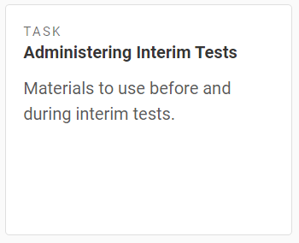
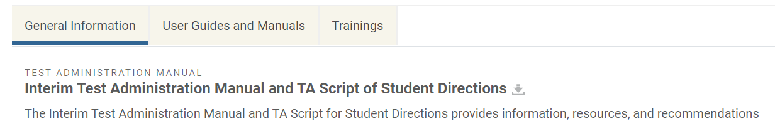
How do I administer an IAB?
Use Interim Administration Manual. It contains step by step student and teacher instructions.
Gather:
  Test tickets
  Support/accommodation materials
  Scratch paper if required
Use the instructions in the Manual to lead students into the Secure Portal to take the assessment.

Slide 15
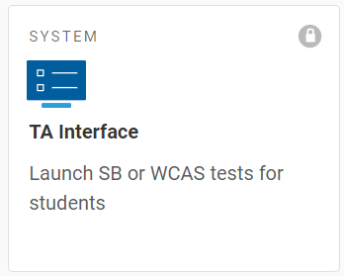
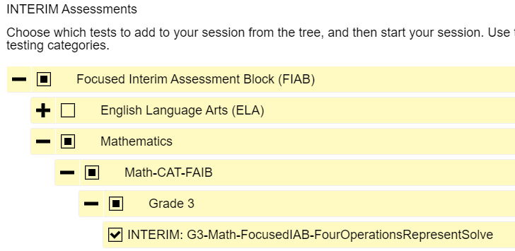
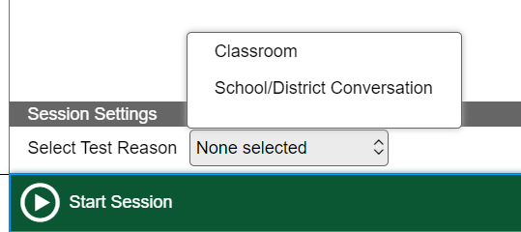
TA Interface: launching a session
WCAP Portal>Interim tile> TA Interface system tile
Select test by clicking +/- to only offer the one test
Pick a Test Reason in advance with your team and select it before clicking start.

Slide 16
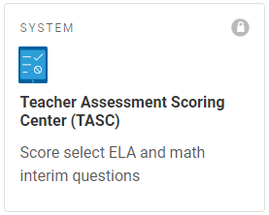
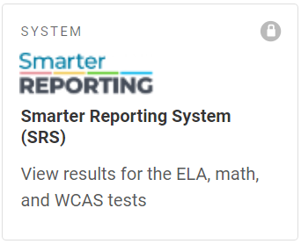
How do I get my student scores?
If IAB includes constructed response
requires hand scoring prior to final score appearing in Smarter Reporting.
Tentative scores will be generated for full writes but are not equivalent to teacher hand scoring.
If IAB doesn’t include constructed response
scores in shortly after submission.

Slide 17
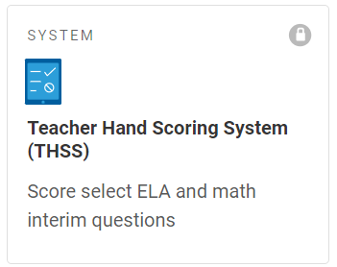
Teacher Assessment Scoring Center (TASC)
WCAP Portal>Interim assessment tile>TASC system tile (scroll down)
Instructions are in the back of the Interim Manual.
  For more help, see the state’s TASC training slideshow.
TIP: make sure to mark your students complete when you are done scoring or their scores will not show up in Smarter Reporting.

Slide 18
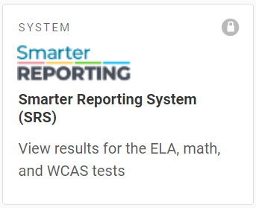
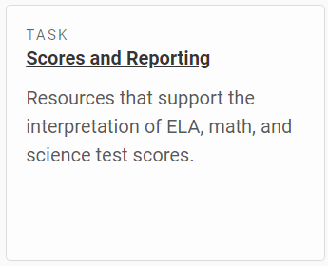
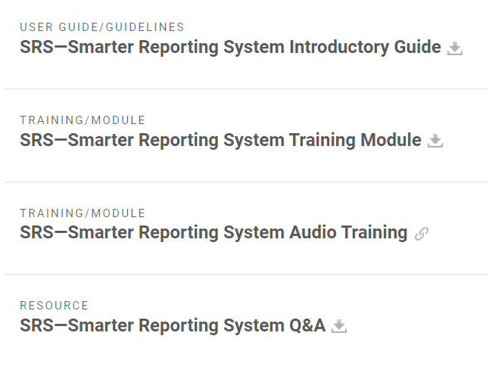
Smarter Reporting System (SRS)
WCAP Portal>Interim assessment tile>SRS system tile (scroll down)
Extensive instructions are available here: WCAP Portal>Interim assessment tile>Scores and Reporting task tile>scroll down to resources

Slide 19


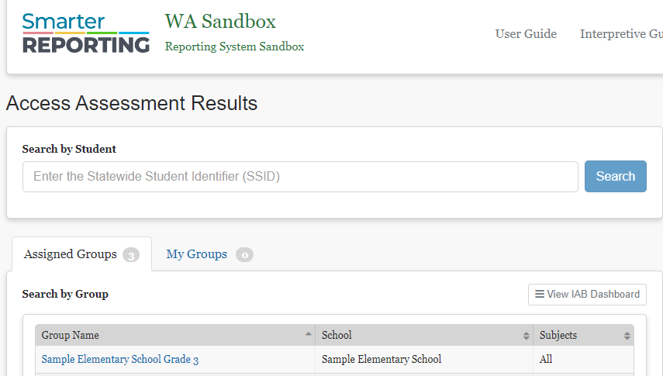

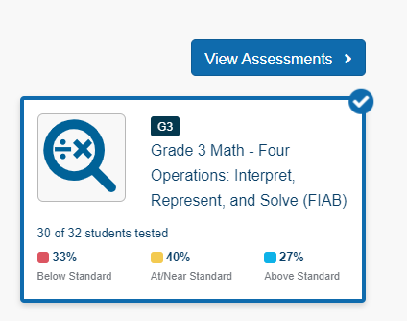


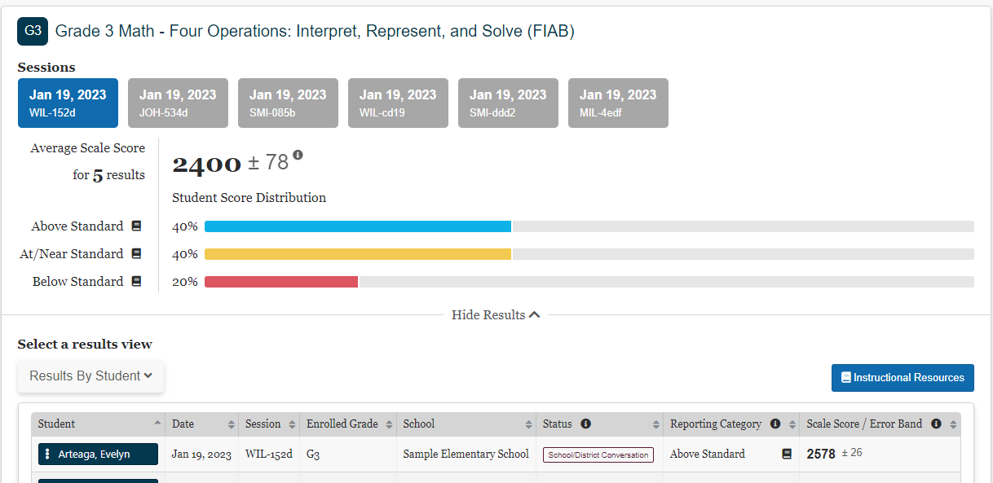
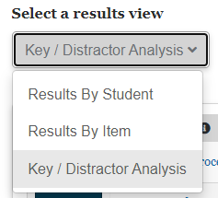


Smarter Reporting System (SRS)
Use Key/Distractor Analysis to see each question response by % selected.

Slide 20
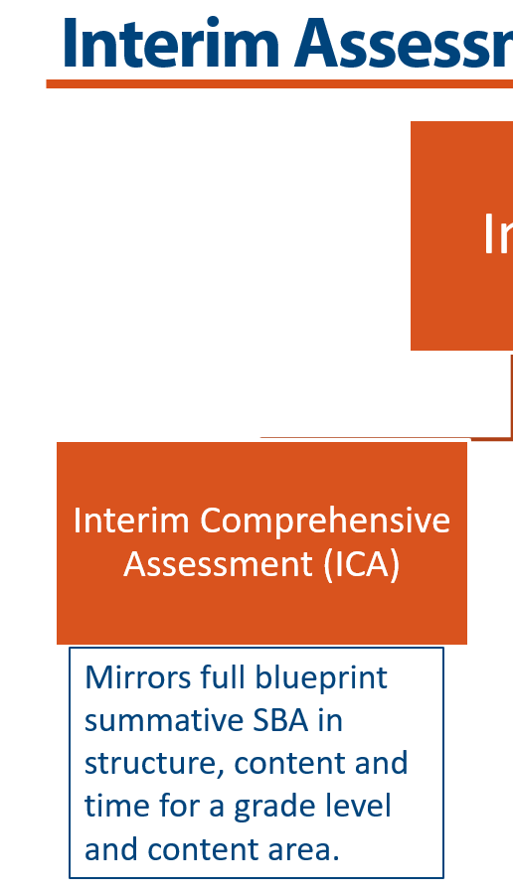
Interim Comprehensive Assessment Fun Facts
ICAs are longer than our current summative test blueprint
ICAs are not adaptive
Students must complete both CAT and PT for that subject
Must complete hand scoring to get a score
Interim Comprehensive Assessments are turned off
School principals who would like to offer ICAs at their school must email Quiana Hennigan in Assessment & Research to request activation.

Slide 21
Understanding your scores
Work with content specialists and your team
Review student data as a team
Score hand scoring collaboratively
Why?
  Calibration
  Learning more deeply about standards
  Learning about the structure of questions and tasks
Analyze the results keeping in mind:
  Learning targets students have been exposed to
  Depth of knowledge
  Instructional map
  Question or task construction
  Results of other assessments
  Distractors

Slide 22
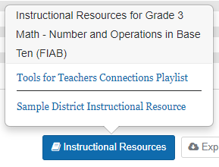
Apply the data to instruction
Click Instructional Resources for Tools for Teachers Resources like Connections Playlists
Work with coaches/facilitators on next steps.
    Protect the Reliability of the Exam
      Think about how you and your colleagues will be using the test before reviewing questions with students.
      Consider developing similar questions if your colleagues will use the same interims for pre/post or determine remediation.

Slide 23
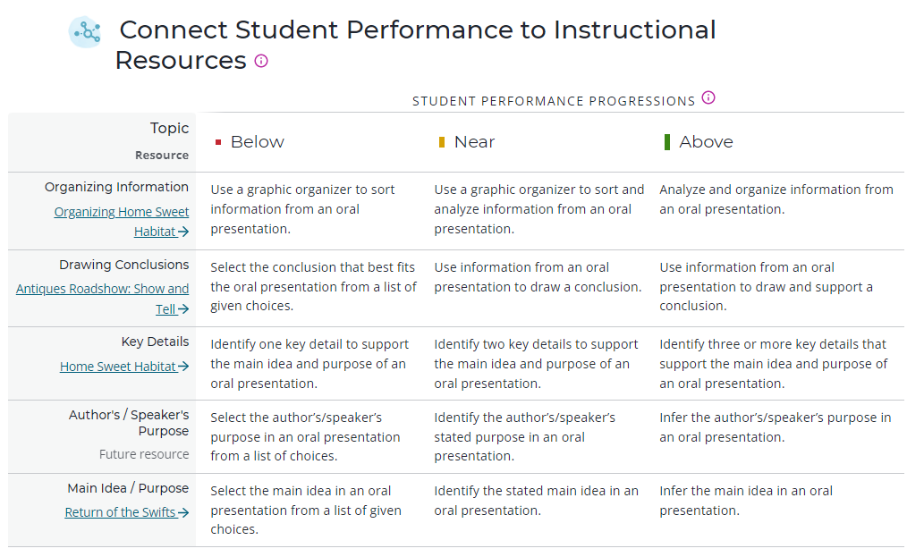
Using a Connections Playlist
Playlist suggests instructional next steps with links to example materials by performance level.

Slide 24
Questions?
If you have questions or would like to schedule a classroom demonstration:
Quiana Hennigan
    qhennigan@everettsd.org
    extension 4057

