Slide 1
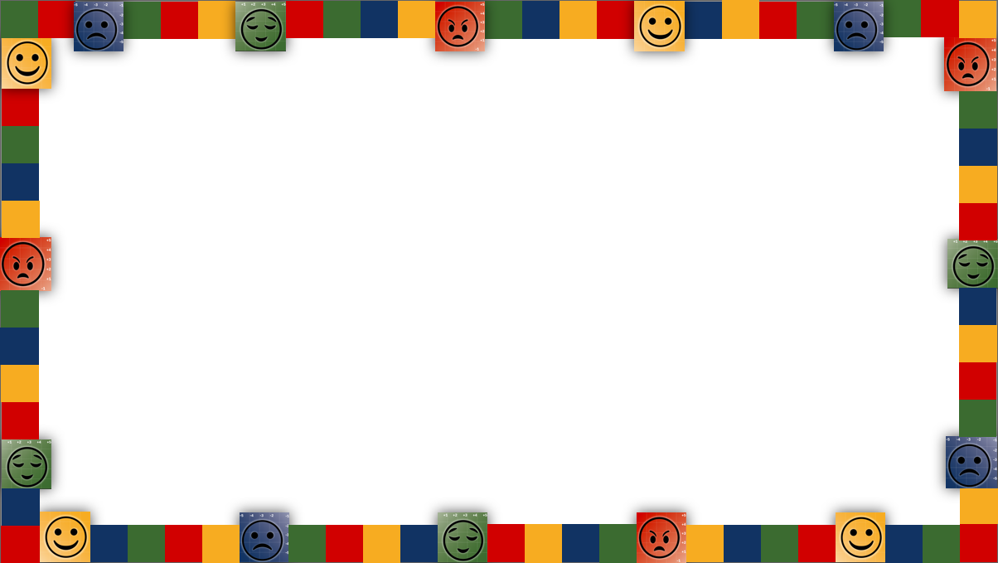


Roundtable for Spotlights & Next Steps
Elementary Schools | March 4, 2024

Slide 2

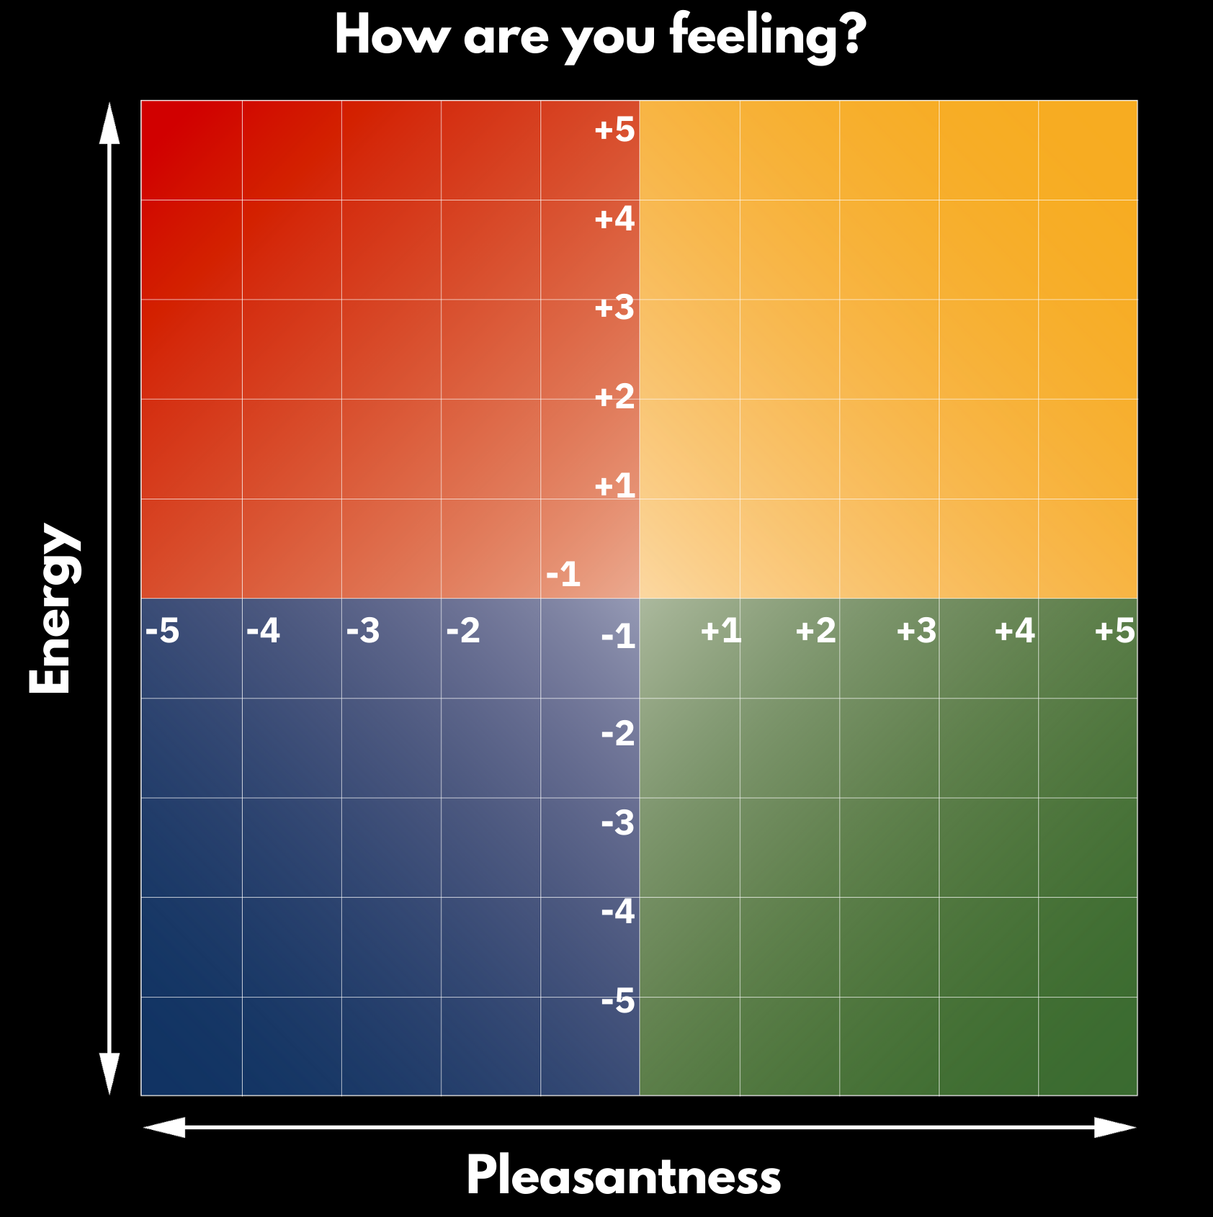




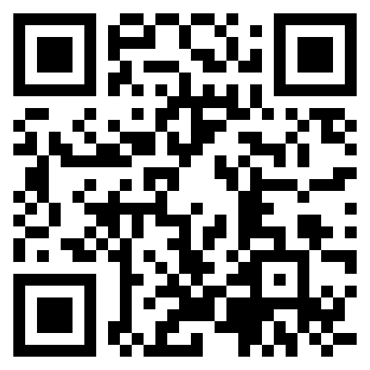
How are you feeling today?
RULER Roundtable
March 4, 2024
Please go to:
moodmeter.online
...and enter the group plot code:
7wxwv3
Or access the QR code

Slide 3
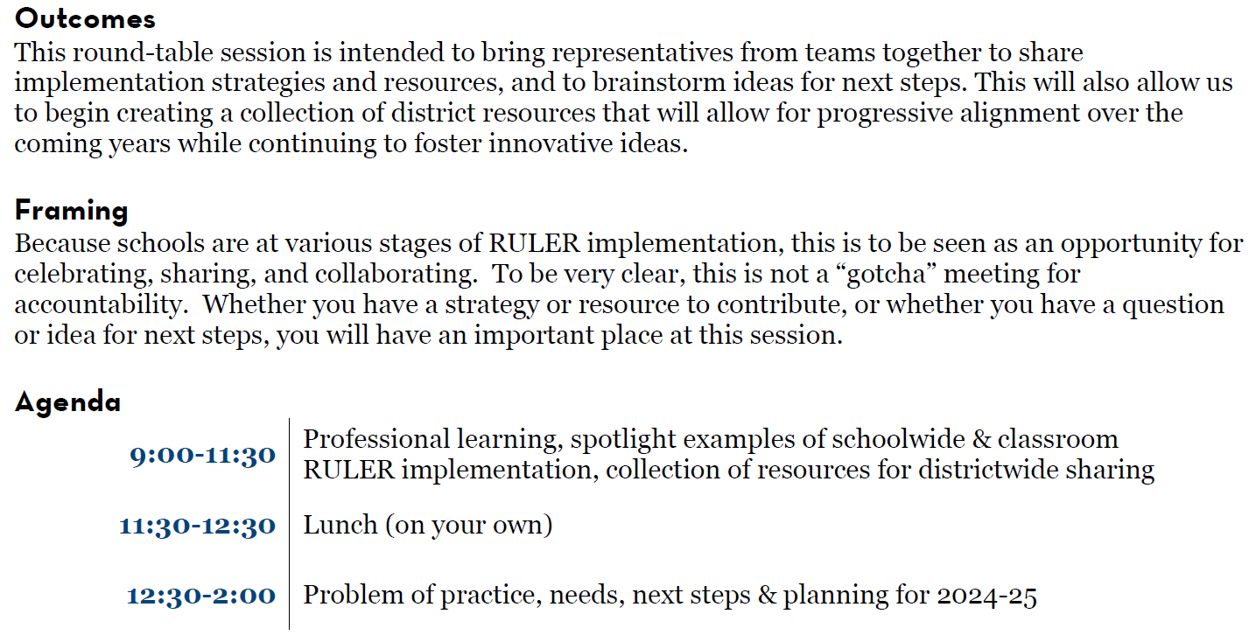
Outcomes & Agenda

Slide 4
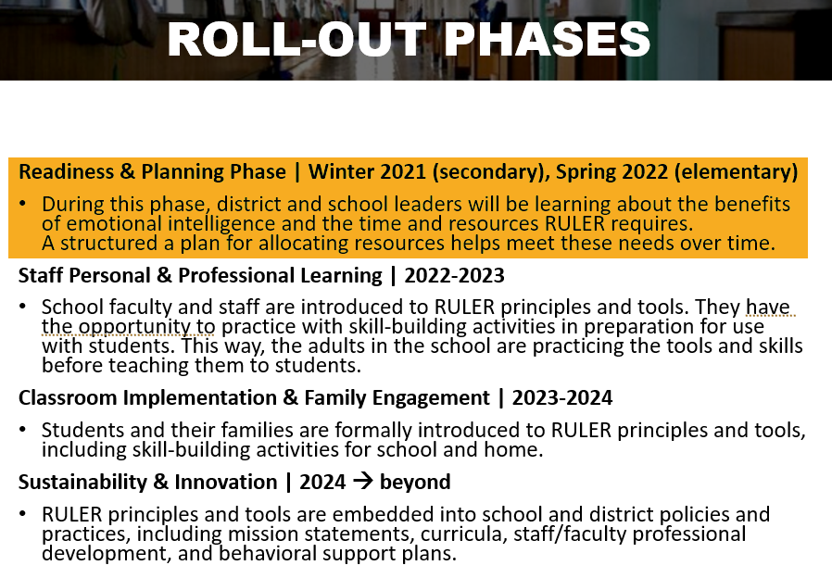
Our RULER Journey in EPS

Slide 5
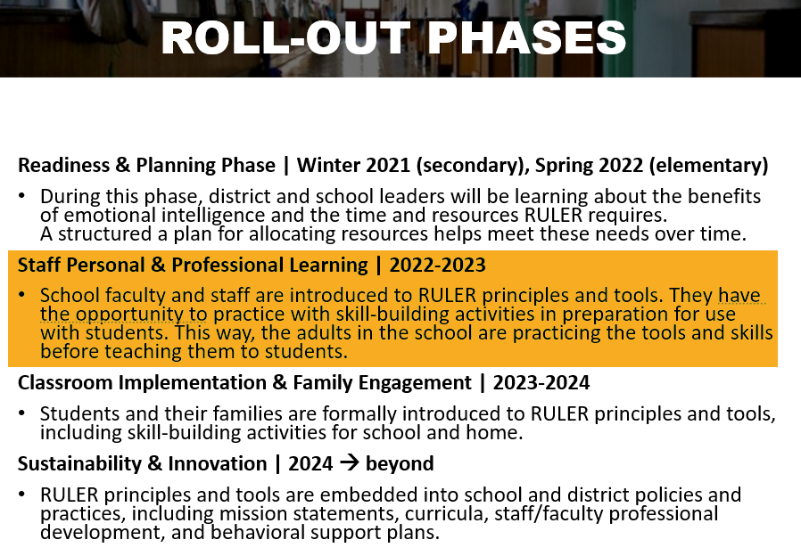
Our RULER Journey in EPS

Slide 6
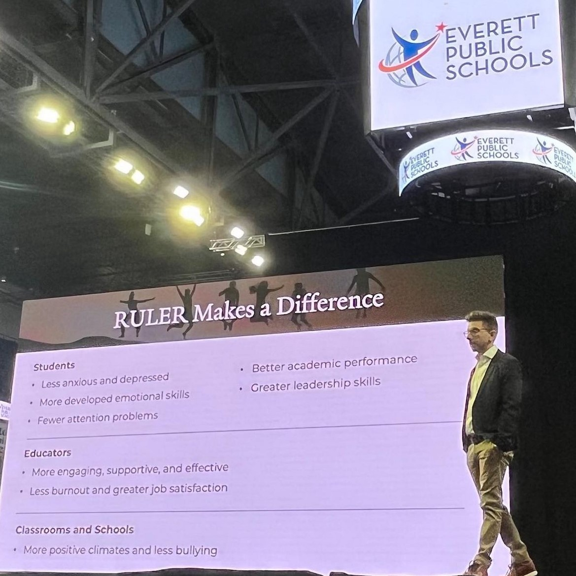
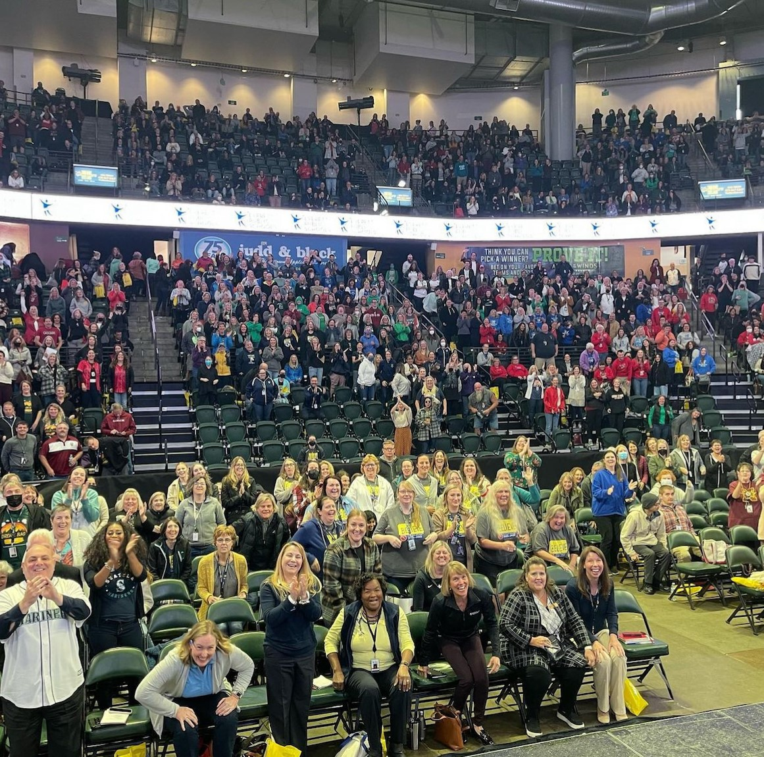
Learning Improvement Day | October 14, 2022

Slide 7
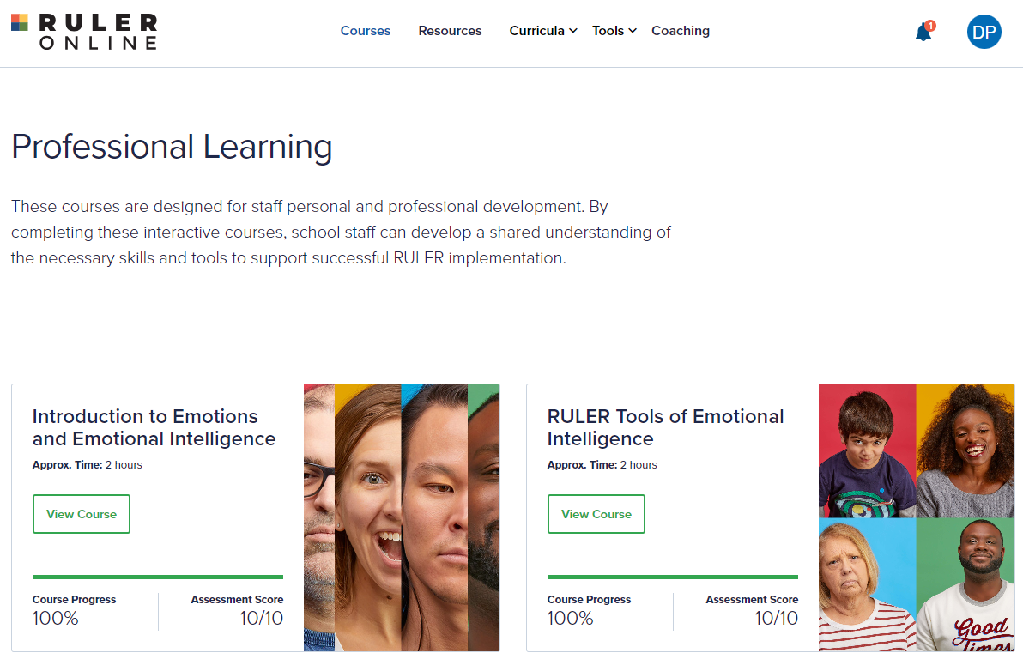
RULER Online Training

Slide 8
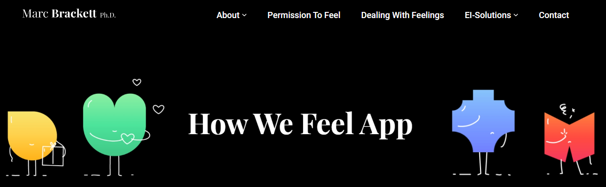

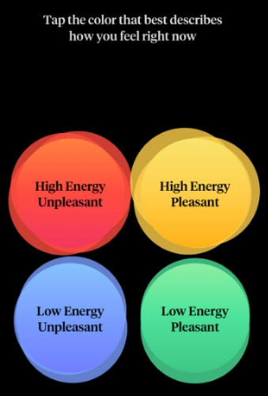
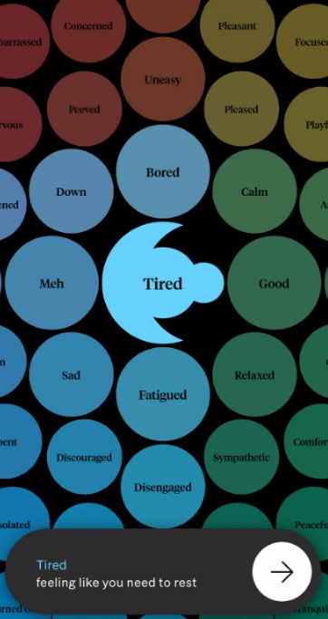
Additional Resources

Slide 9
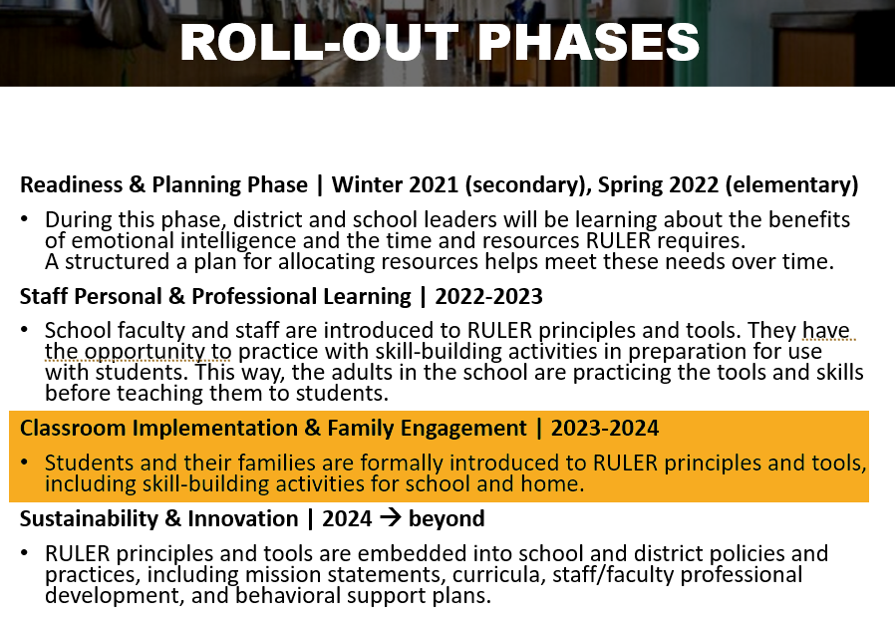
Our RULER Journey in EPS

Slide 10
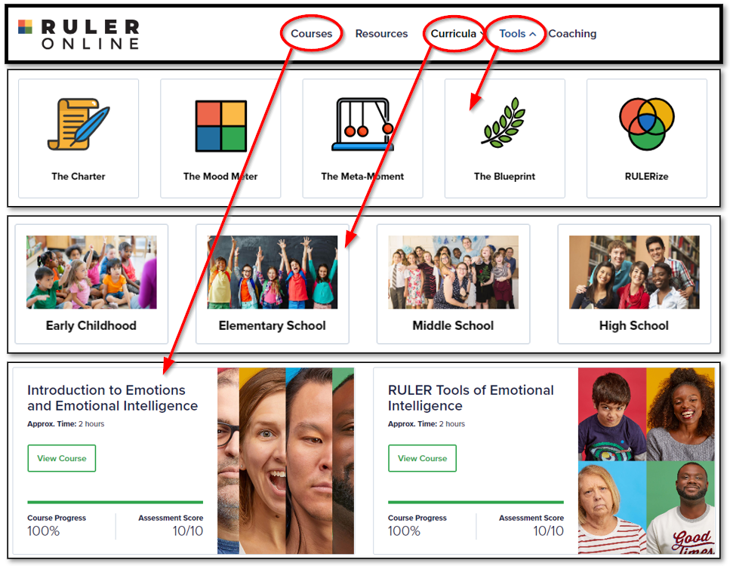
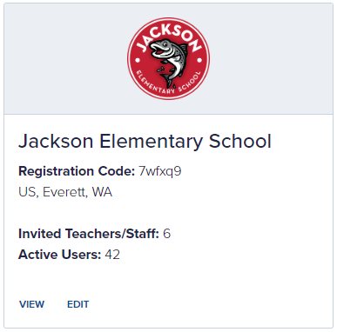
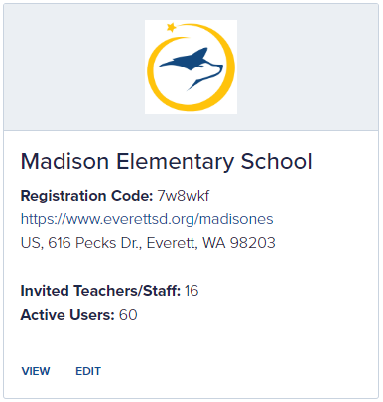
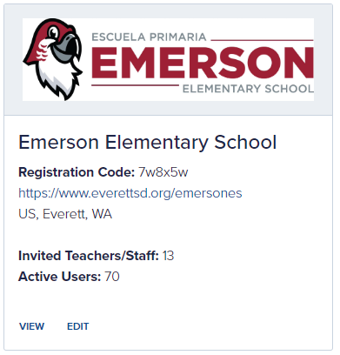
RULER Online Dashboard

Slide 11
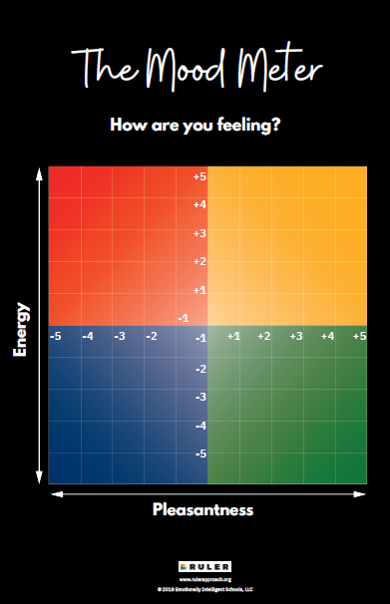
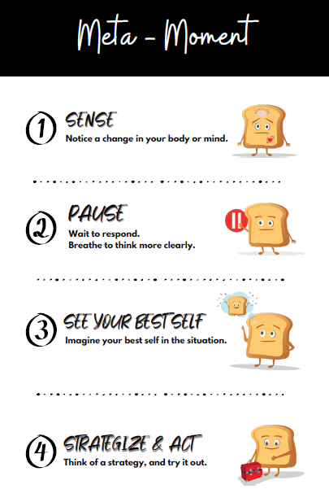
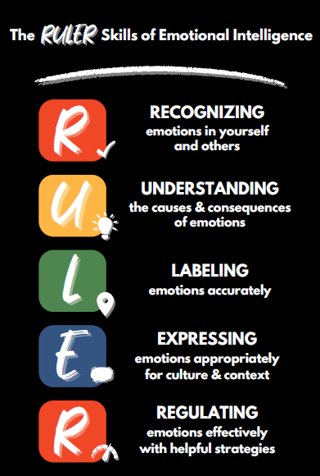
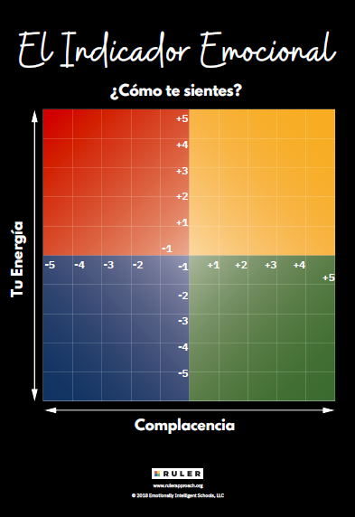
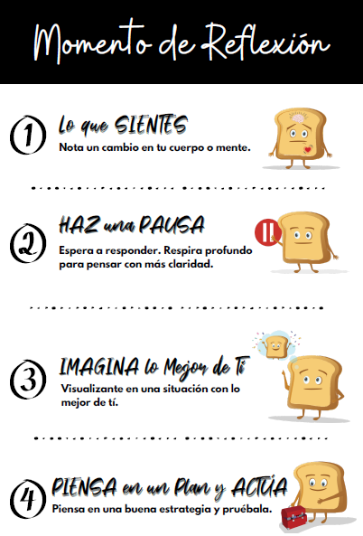
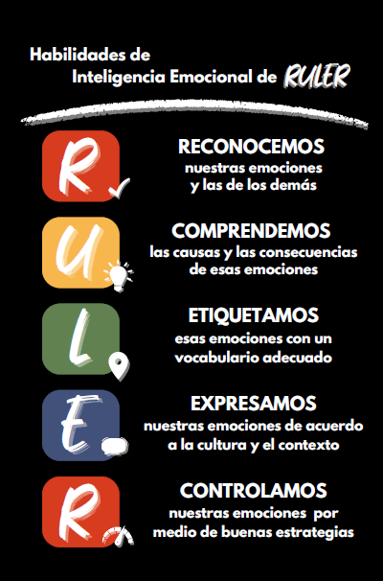
Posters

Slide 12
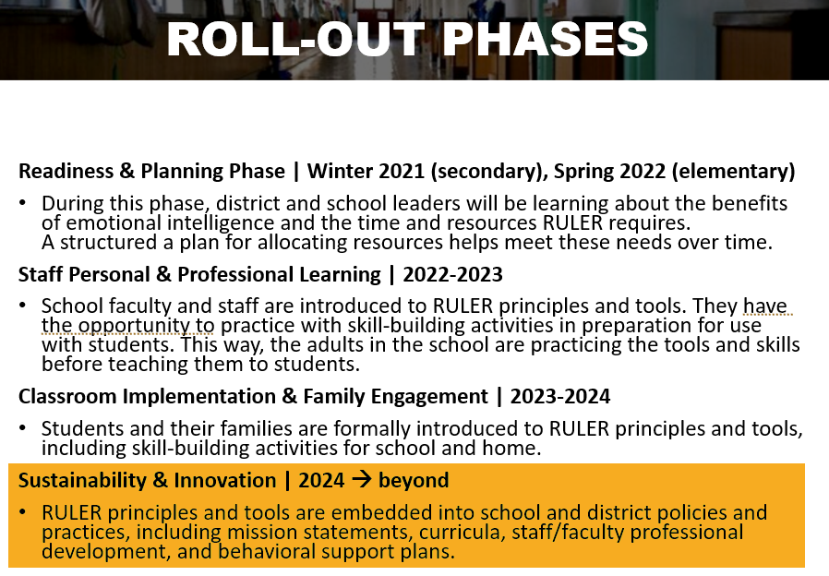
Our RULER Journey in EPS

Slide 13
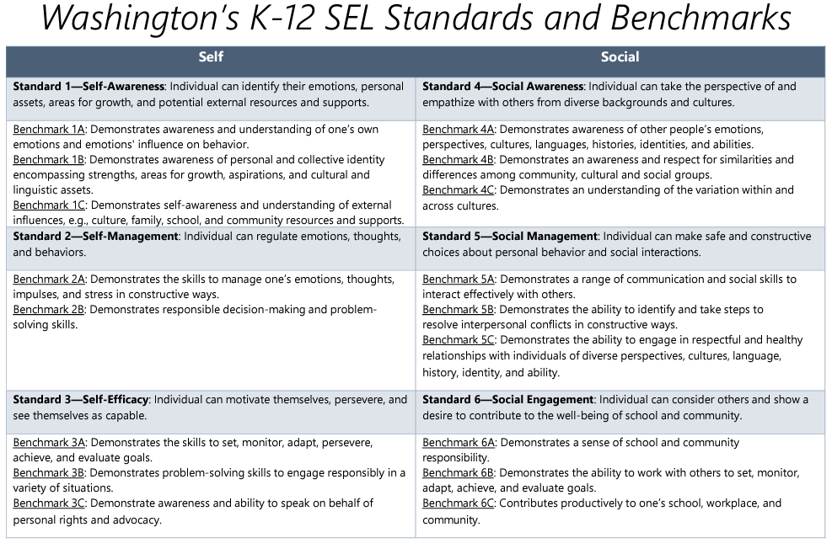
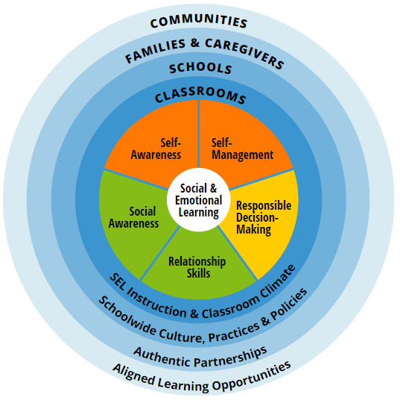


SEL Standards

Slide 14
SEL Standards

Slide 15
SEL Standards

Slide 16
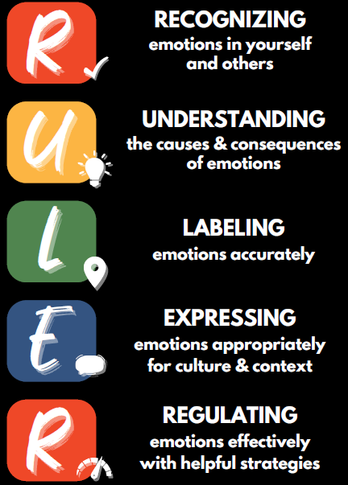

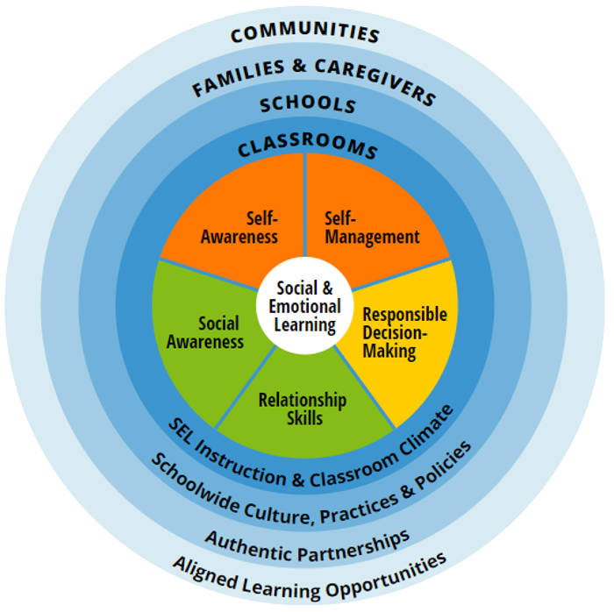
Connections to RULER
At your tables…
Identify which RULER Skills and Anchor Tools are associated with each of the:
WA SEL standards
The CASEL 5

Slide 17


The SEL Approach in EPS
Notes:
Behavior improves w/ common RULER vocabulary – recess paras won’t know which Second Step lesson you taught today

Slide 18
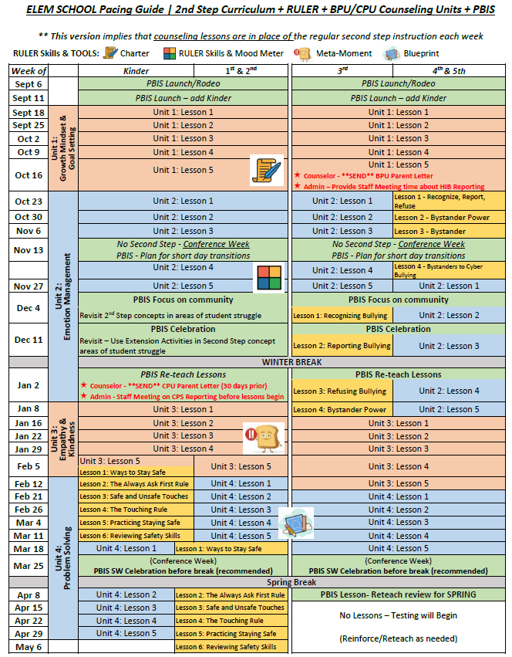
The SEL Approach in EPS
Notes:
Behavior improves w/ common RULER vocabulary – recess paras won’t know which Second Step lesson you taught today

Slide 19

Spotlights & Celebrations
Part I (40 minutes)
Arrange yourselves so that:
  There are 5 people at your table
  There is no more than one person from a school at your table
Introduce yourselves:
  Your name, school, role, how long you’ve been there
  A positive impact that you’ve seen from RULER (professionally or personally)
Share examples from your school where RULER has been implemented
  As part of schoolwide-efforts
  Within classrooms
Part II (20 minutes)
Large-group sharing of RULER implementation | Spotlights & Celebrations
  What is your school most proud of?
  What did you hear from another school that stood out to you that was creative and/or effective?
  What would you like to hear more about?

Slide 20






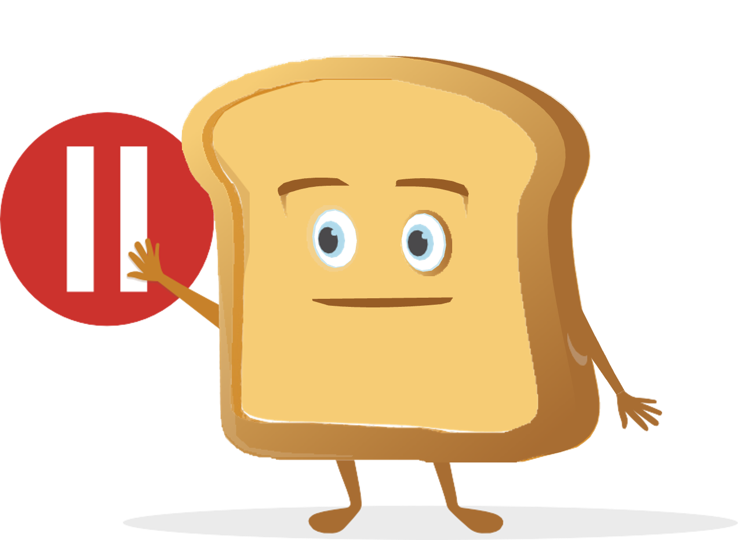
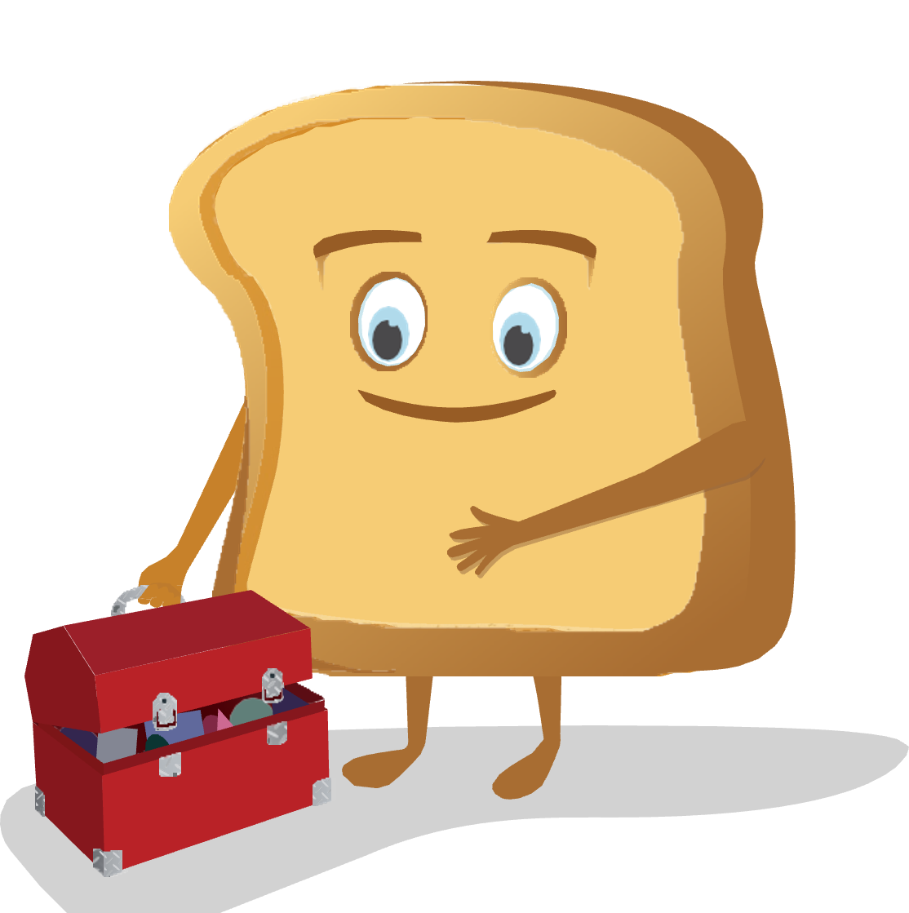
Meta Moment
The Meta-Moment consists of four steps:
  Sense that something has happened or changed in your environment
  Pause to de-escalate and avoid responding in an unhelpful manner
  See your best self, or visualize a positive image of yourself
  Strategize and act in a more helpful manner

Slide 21
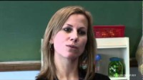
Meta Moment Story | In the Classroom
https://youtu.be/yKXLEJqxUxw?t=7

Slide 22

Meta Moment as a Habit
Habits are the compound interest of self-improvement. Getting 1% better every day counts for a lot in the long-​run.
Habits are a double-​edged sword. They can work for you or against you, which is why understanding the details is essential.
Small changes often appear to make no difference until you cross a critical threshold. The most powerful outcomes of any compounding process are delayed. You need to be patient.
If you want better results, then forget about setting goals. Focus on your system instead.
It’s not about what you want to do as much as who you want to be!

Slide 23
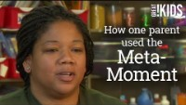
Meta Moment Story | At Home
https://youtu.be/L12b5JoRT6I

Slide 24
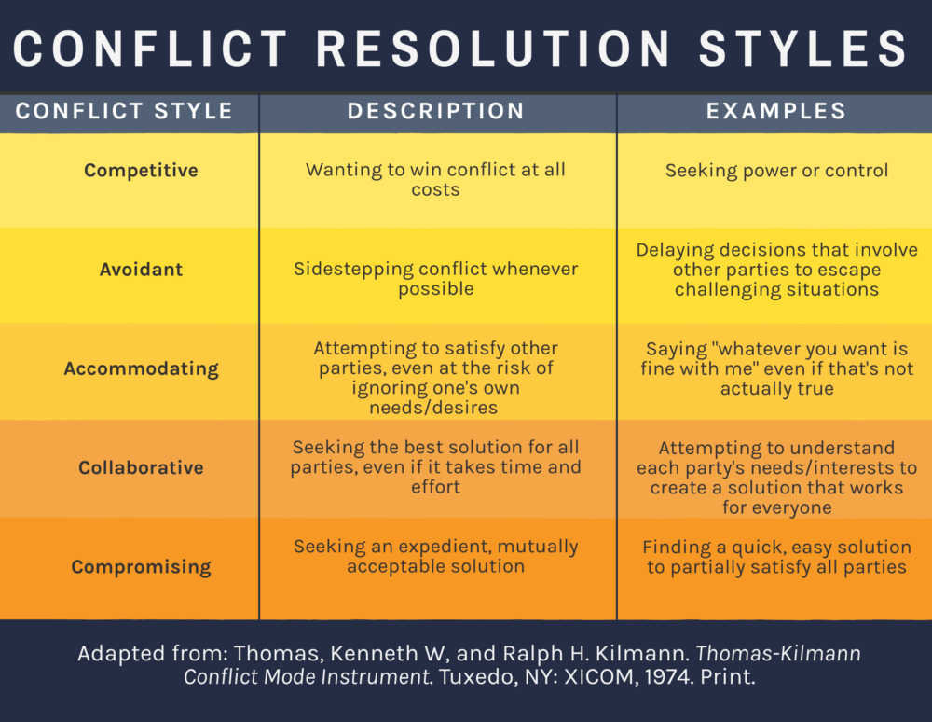
The Blueprint

Slide 25
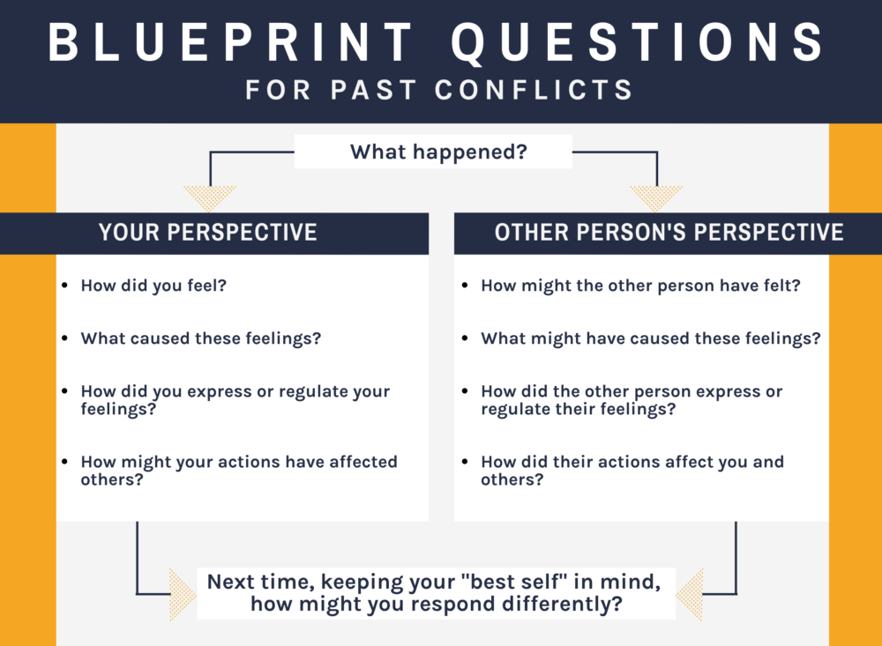
The Blueprint

Slide 26
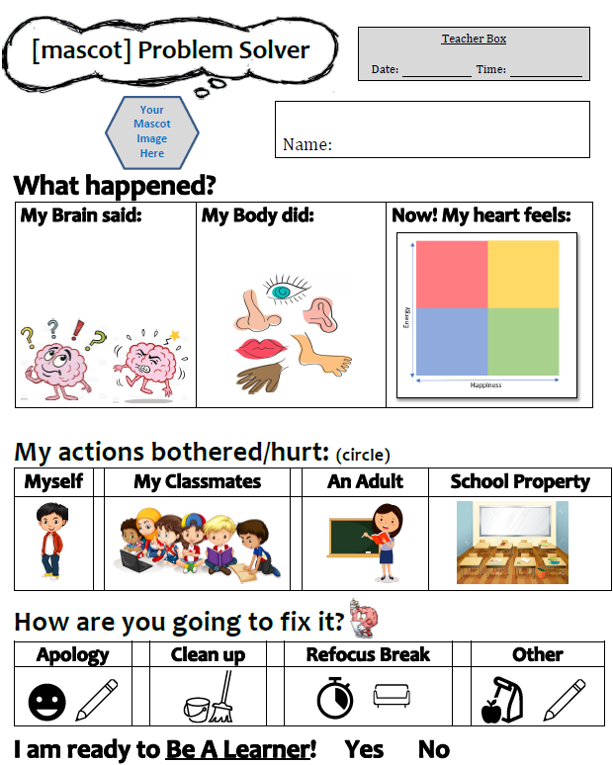
The Blueprint

Slide 27

The RULER Skills | Co-Regulation
https://youtu.be/QT6FdhKriB8?t=6

Slide 28

✰ Lunch today is on your own
✰ We will start again at 12:30

Slide 29
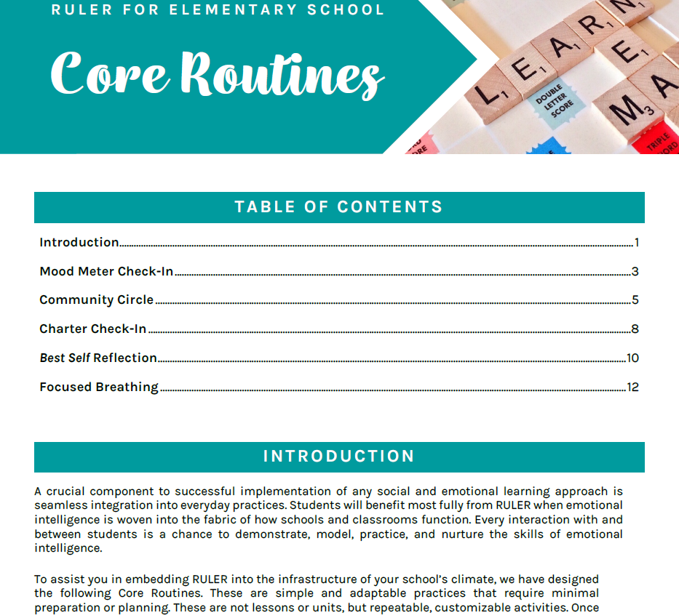
Resources | Core Routines & Vocab Development

Slide 30
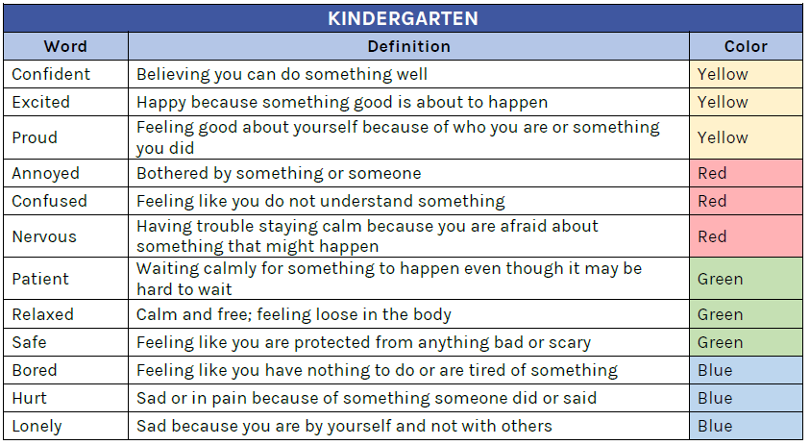

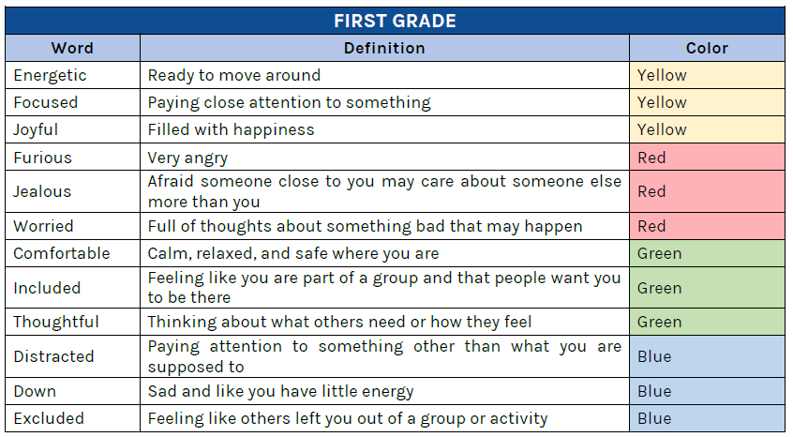
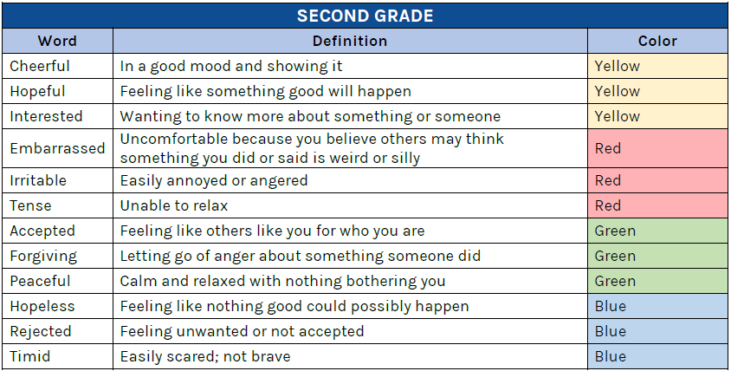
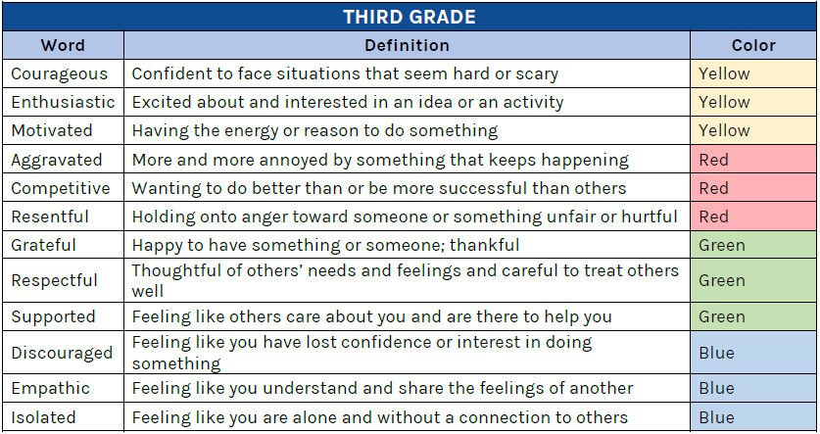
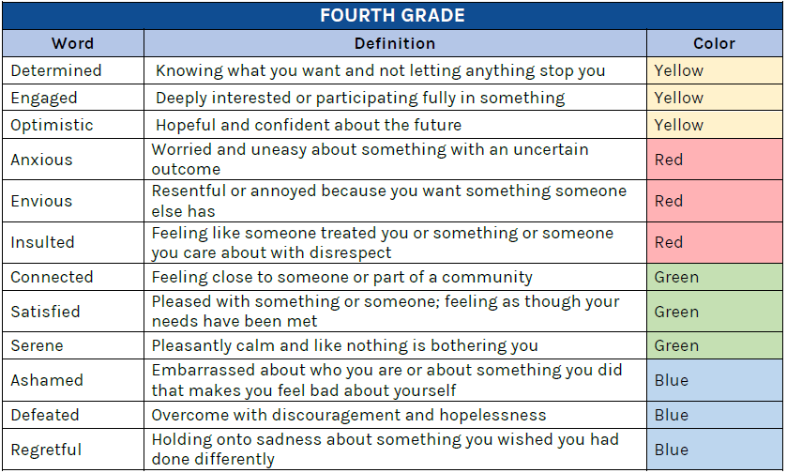
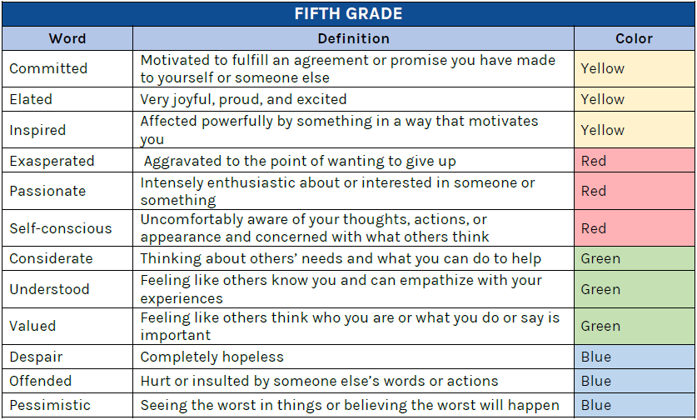
Resources | Core Routines & Vocab Development

Slide 31

Next Steps | School Needs?
Part I (40 minutes)
Arrange yourselves so that:
  Representatives from your school are at a table with two other schools
Introduce yourselves:
  Your school, role, how long you’ve been there
Through table discussion, consider what your school needs for next steps to:
  Strengthen the connections between the Second Step lessons and the RULER framework
  Expand/deepen the use of the RULER anchor tools (Charter, Mood Meter, Meta-Moment, Blueprint)
  Teach feeling word vocabulary at each elementary grade level
  Share RULER education with families
Part II (20 minutes)
Large-group sharing of school needs for next steps
  Each table will share a summary of their collective school discussion
  Several “Big Rocks” will be identified for district support for 2024-25

Slide 32


Access to Resources
A RULER Canvas portal is being designed for:
  Shared school-created resources
  District-created resources
  Frequently accessed resources from RULER Online

Slide 33
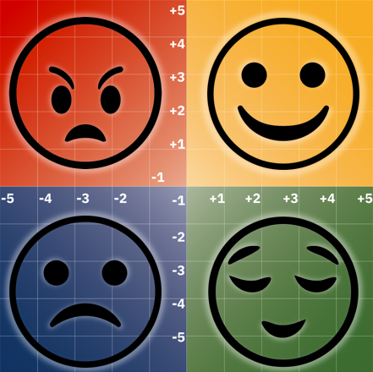




Slide 34
xxxx

