Slide 1
Choosing Middle School Classes
6th Grade

Slide 2
Required courses for all 6th grade students:
2 semesters of English 2 semesters of Mathematics 2 semesters of Science 1 semester of Social Studies 1 semester of Health 1 semester of Physical Education 1 semester of Visual and/or Performing arts 2 semesters of other electives (total of 3 total elective semesters)

Slide 3
BUILDING MODIFICATION NEEDED
Slides 4 and 5 are from the course catalog, please remove any classes that are not offered in your building before sharing with students.
This is a hidden slide.
It does not show when doing a slideshow.

Slide 4
Required - Core Classes
You have choices in English and Math
Subject | Semesters | Course Choices
Required Courses
English | Year long | English 6
 |  | Honors English 7*
Mathematics | Year long | Math 6
 |  | Accelerated Math 6*
 |  | Accelerated Math 7 *
Science | Year long | Science 6
Social Studies | One semester | History 6
Physical Education | One semester | Physical Education – Foundational 6
Health | One semester | Health 6

Slide 5
Elective Classes
Subject |  | Semesters |  | Course Choices
Elective Courses
Performing Arts | Year long | Year long | Band I Band II Band III* | Band I Band II Band III*
 |  |  | Choir I Choir II Choir III* | Choir I Choir II Choir III*
 |  |  | Chamber Orchestra Intermezzo Orchestra* Prelude Orchestra* | Chamber Orchestra Intermezzo Orchestra* Prelude Orchestra*
 | One semester | One semester | General Music | General Music
Visual Arts | One semester | One semester | Art 6 | Art 6
Physical Education Electives | One semester | One semester | Lifetime PE | Lifetime Individual Sports and Fitness
STEM Electives | One semester | One semester | Exploring Robotics Exploring Industrial Technology 6 Integrated Technology I | Exploring Graphic Arts* Exploring Industrial Tech 7 Digital Manufacturing (CAD)* Integrated Technology I Integrated Technology II Robotics I* Robotics II*
Other Electives | Year long | Year long | AVID 6 | AVID 7
One semester of Performing or Visual Arts is required
Three total semesters of Electives
Year long courses are two semesters.
Notes:
Buildings, Please plan to personalize this slide based on the course offerings in your school. There may be courses reflected on this slide that you do not have available in your school. Please feel free to delete. The table is from the Course Catalog in Docushare (https://docushare.everett.k12.wa.us/docushare/dsweb/Get/Document-127921/Course%20Catalogue%20MS%207th%20grade%20updated%202.24.23.docx)

Slide 6
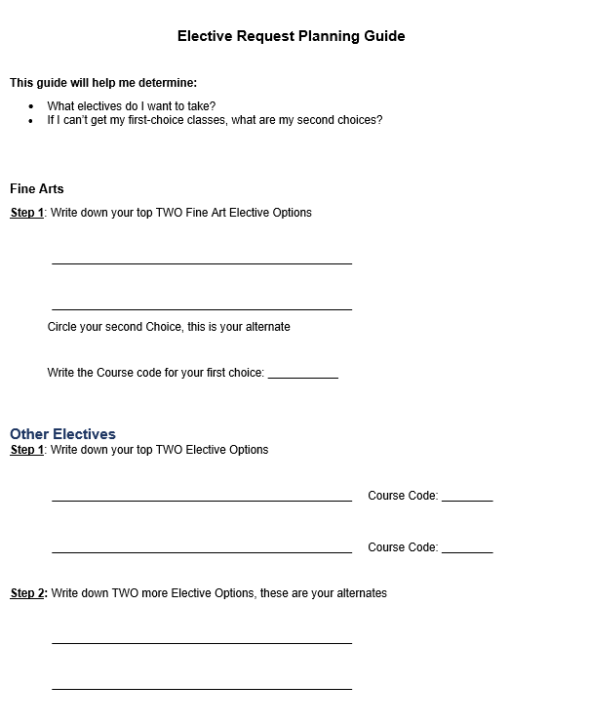
Before we put our choices into HAC
We need to pick out course we want to take
What Electives do I want to take?
Complete the Elective Request Planning Guide
  Use the Course catalog to help with your selection

Slide 7
What Core Classes Do I want to Take?
Core classes are Required but you do have choice for the following courses
  English
  Math
We highly recommend taking Honors English
If you are hardworking and enjoy math, Accelerated Math is a great choice

Slide 8
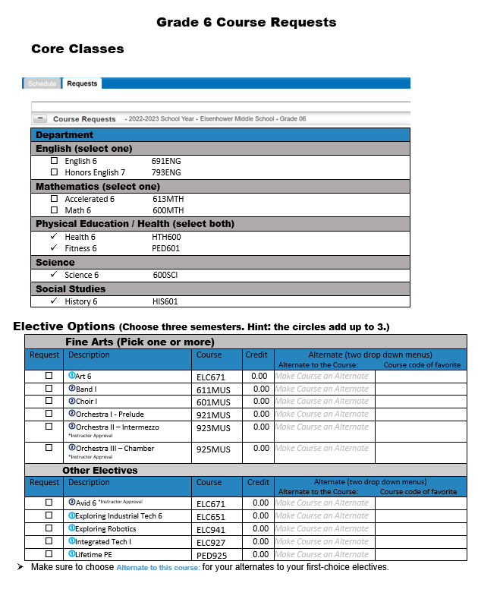
Check your English and Math Choices

Slide 9
Check your TOP 2 Fine Art Electives
Check your TOP 4 Elective Options

Slide 10
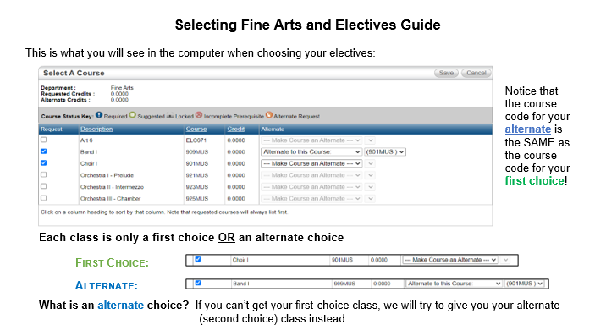
What is the difference between First Choice and Alternate Elective Options?

Slide 11
Circle your Alternate options
Write the course code of your first-choice electives next to each alternate, in the last column
Use your elective request planning guide to help

Slide 12
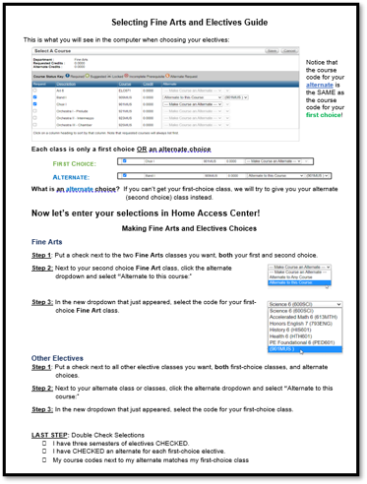
When you get into the Home Access Center,
Use this handout to help with the steps

Slide 13

How to log into HAC from Chromebooks
6th Grade

Slide 14
Now Let's Enter our Requests into the Home Access Center...

Slide 15
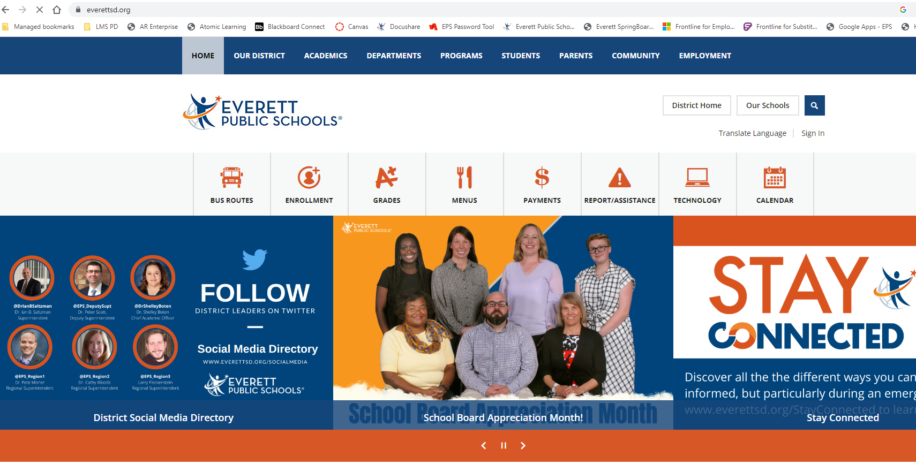
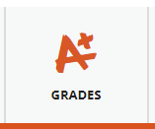
How to login to Home Access Center (HAC)?
Go to: Everettsd.org
Click on: Grades & more

Slide 16
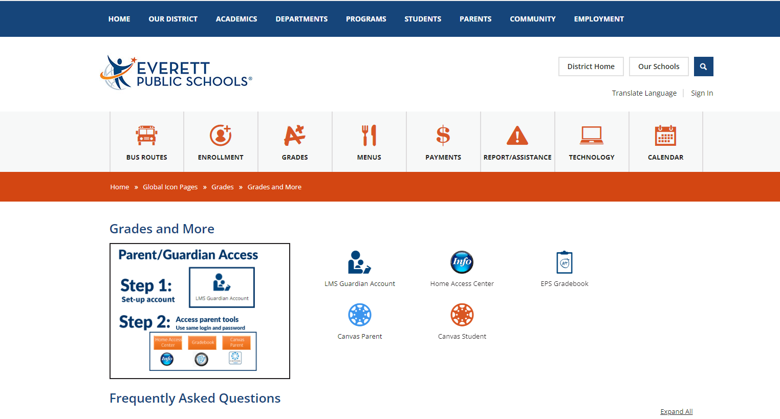
Click on Home Access Center

Slide 17
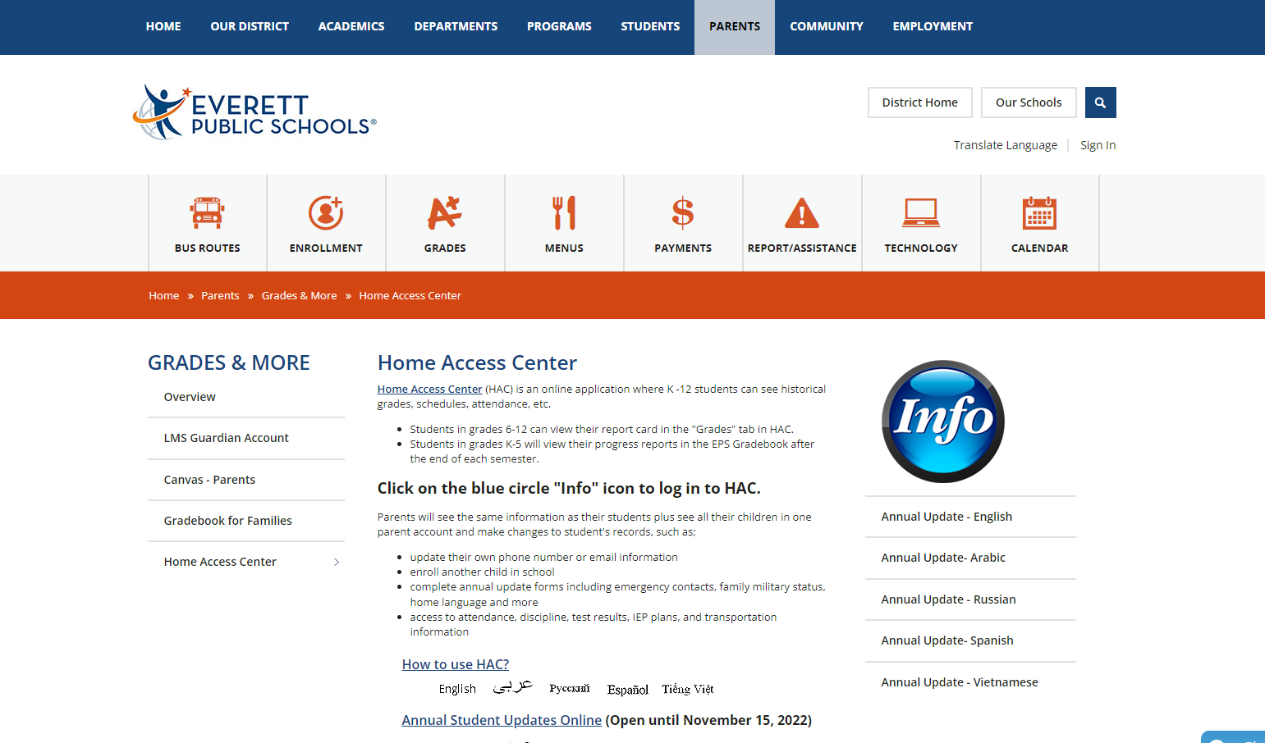
Click the large blue circle titled "Info"

Slide 18
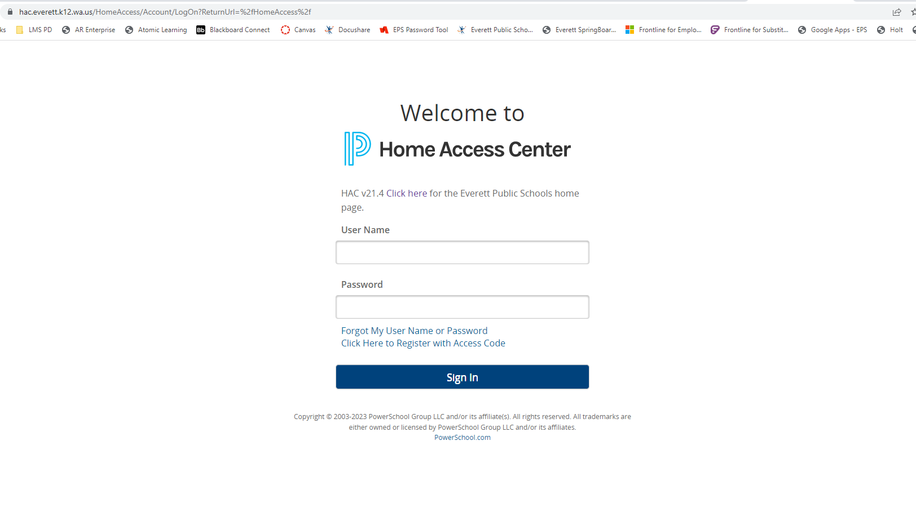
Login Using Your Computer Login and Password

Slide 19
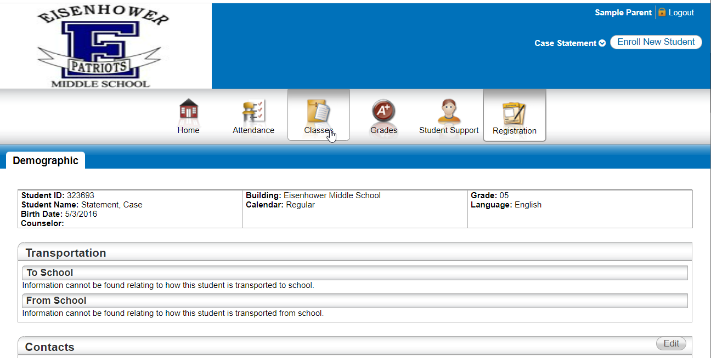
Click "Classes"

Slide 20
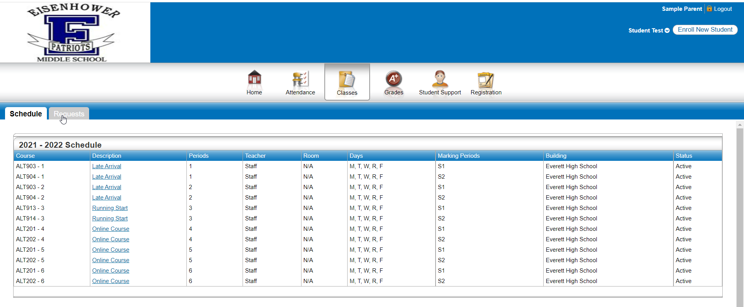
Click "Requests"

Slide 21
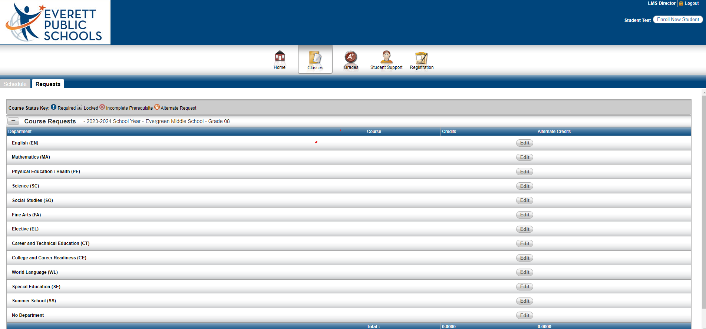
Click "Edit" to Add or Edit your English Course Requests
English (EN)

Slide 22
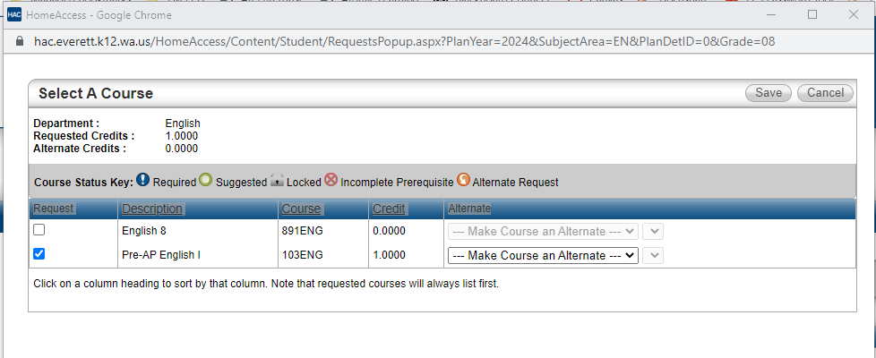
Check the BOX to the left of your English Course Request
Then Click Save.

Slide 23
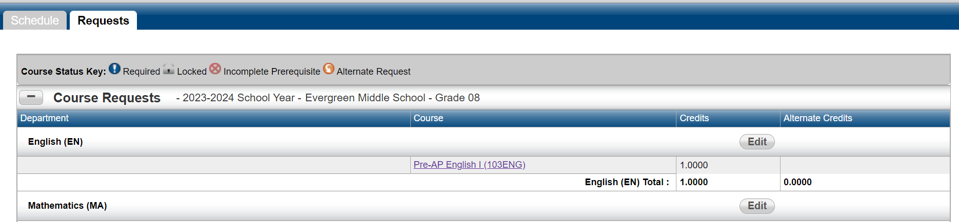
Click "Edit" to Select your Math Course Request
Mathematics (MA)

Slide 24
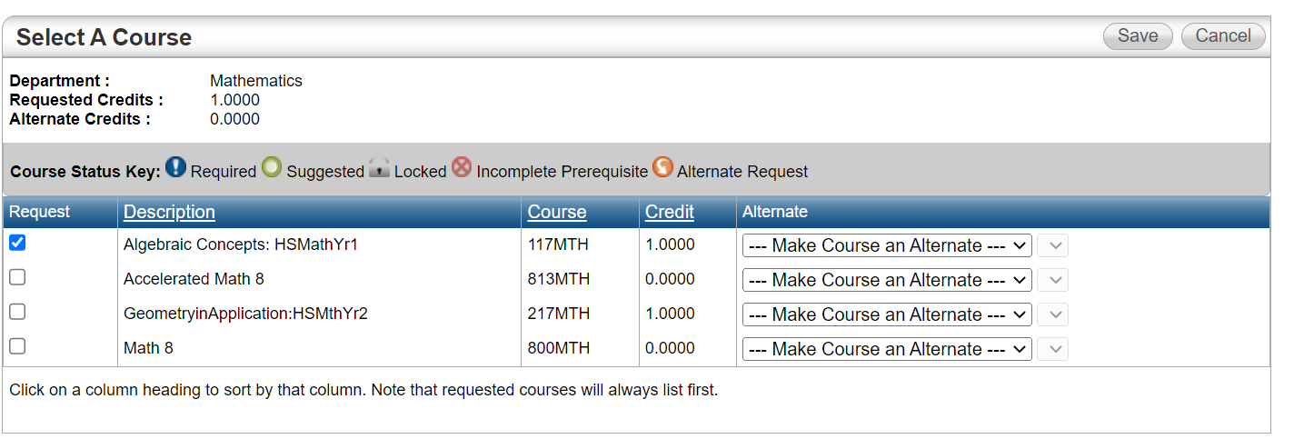
Check the BOX to the left of your Math Course Request
Then Click Save.

Slide 25
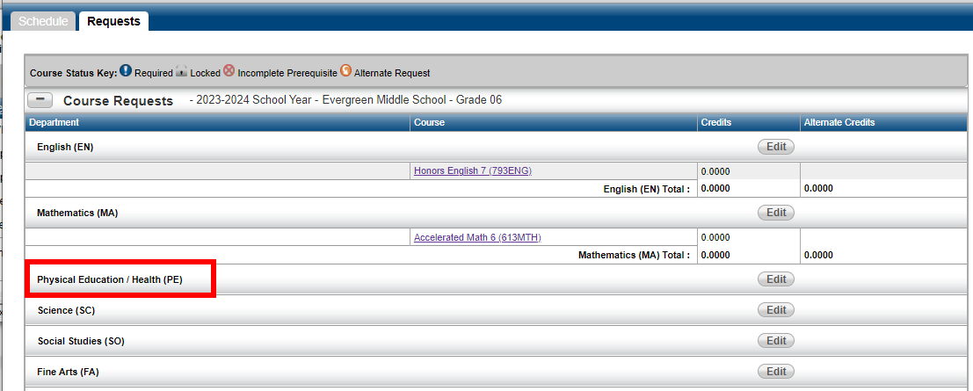
Click "Edit" to Select your Physical
Education/Health (PE)
Course Requests
Physical Education/Health (PE)

Slide 26
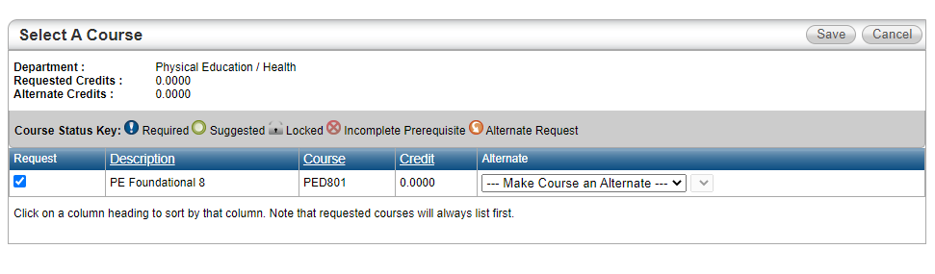
Check (PE Foundational 8)
Then Click Save.

Slide 27
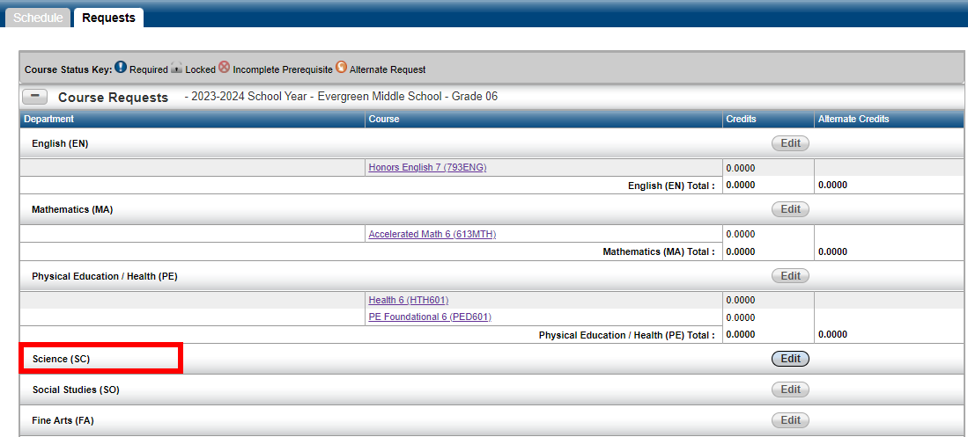
Click "Edit" to Select your Science
Course Request
Science (SC)

Slide 28
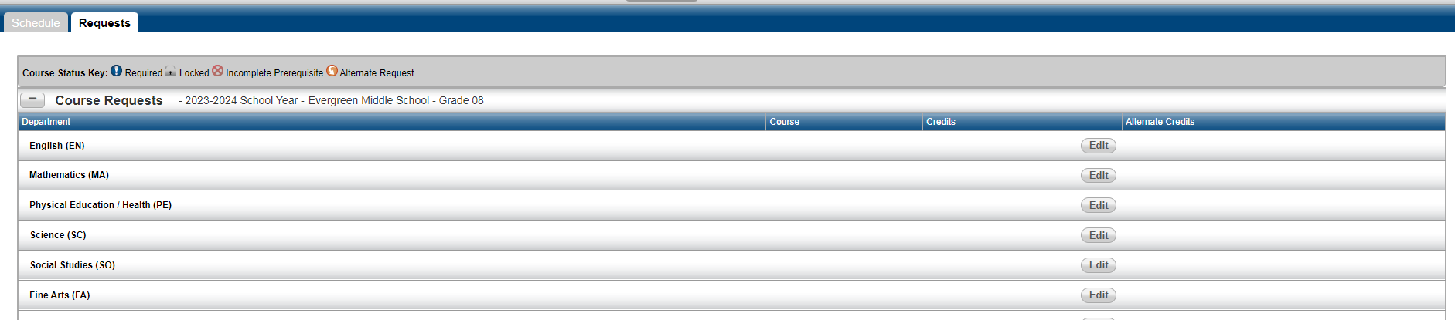
Click "Edit" to Select your Physical
Education/Health (PE)
Course Requests
Physical Education/Health (PE)

Slide 29
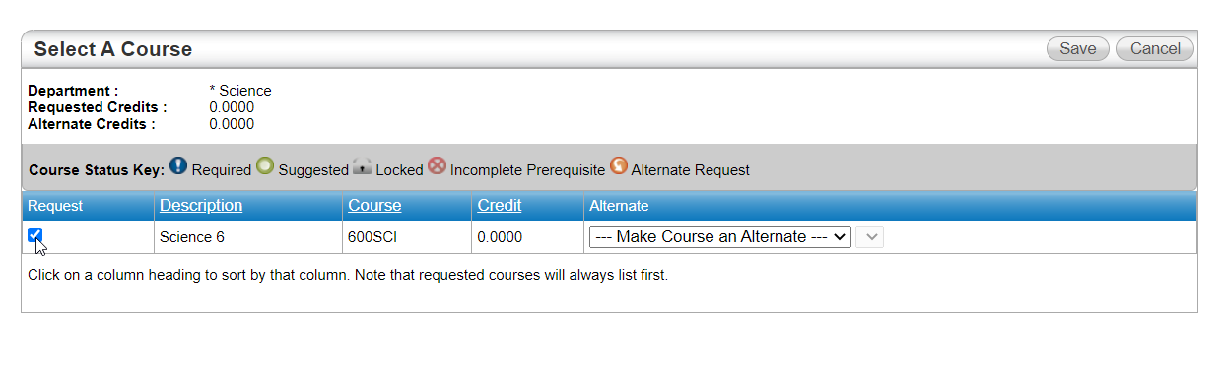
Check the BOX to the left of your Science Course Request
Then Click Save.

Slide 30
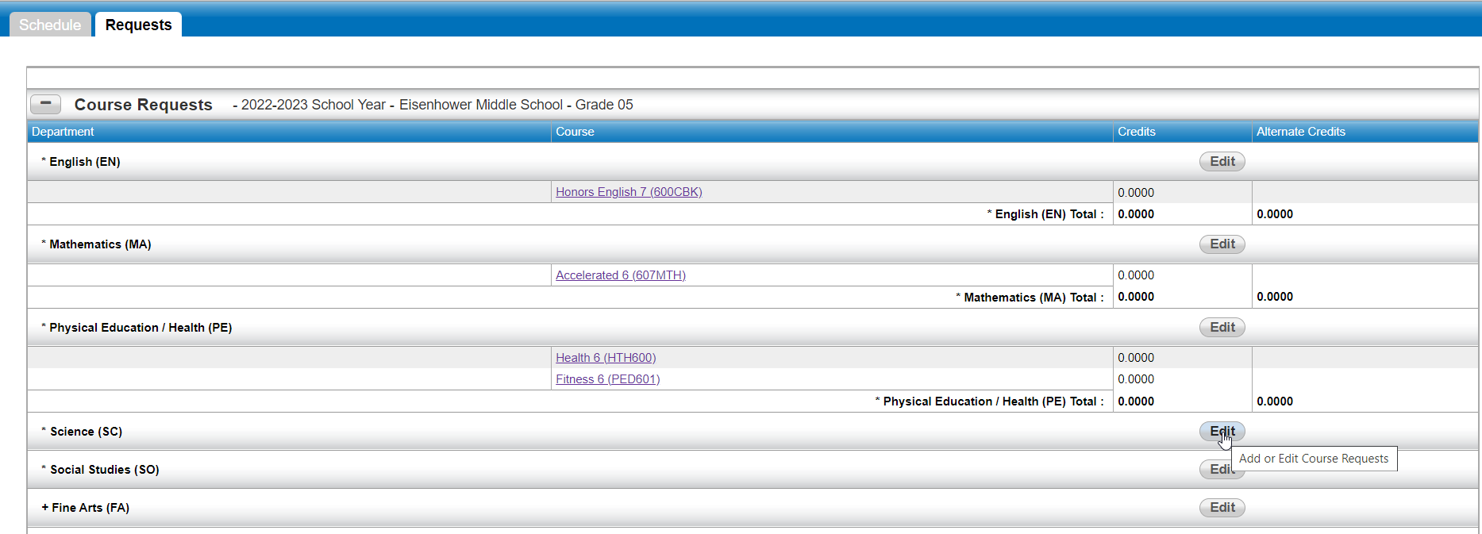
Click "Edit" to Select your Science
Course Request
Science (SC)

Slide 31
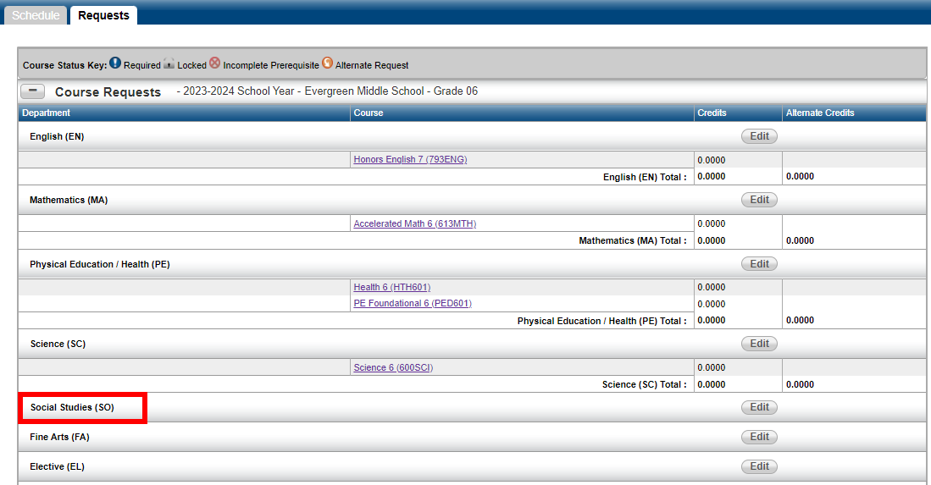
Click "Edit" to Select your Social Studies
Course Request
Social Studies (SO)

Slide 32
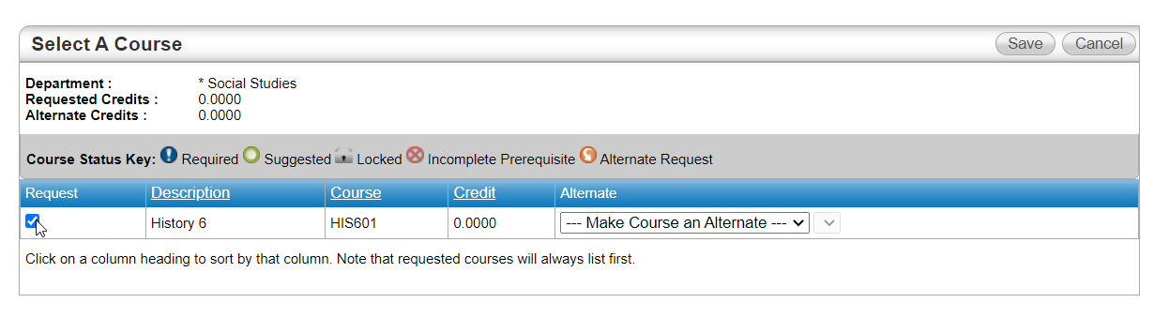
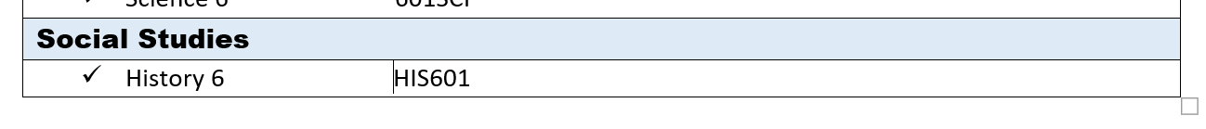
Check the BOX to the left of your Social Studies Course Request
Then Click Save.

Slide 33
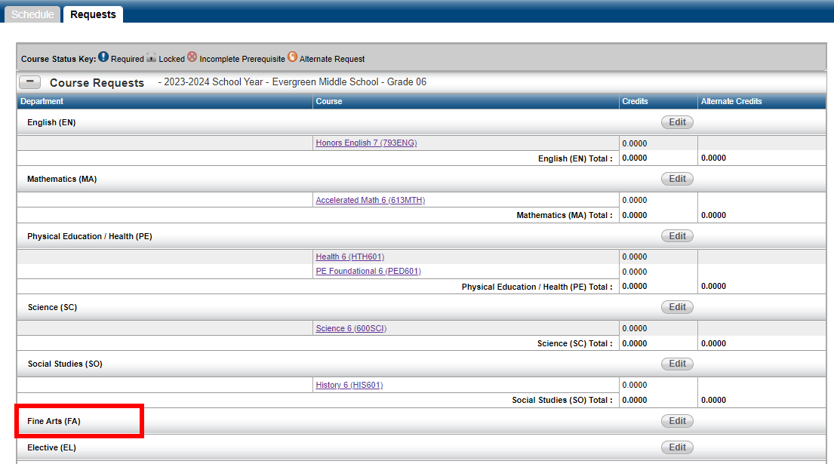
Click "Edit" to Select your Fine Arts
Course Requests
Fine Arts (FA)

Slide 34
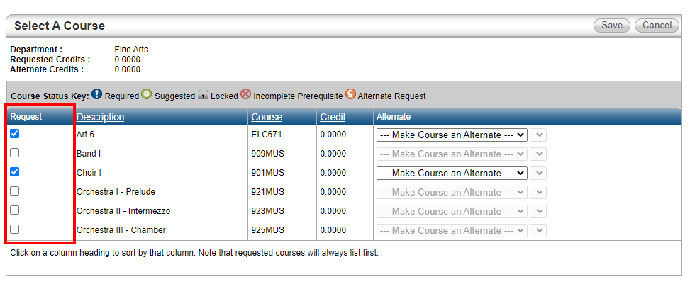
How to Select Fine Arts Classes
Place a check next to BOTH Fine arts classes you want:
First choice and Alternate

Slide 35
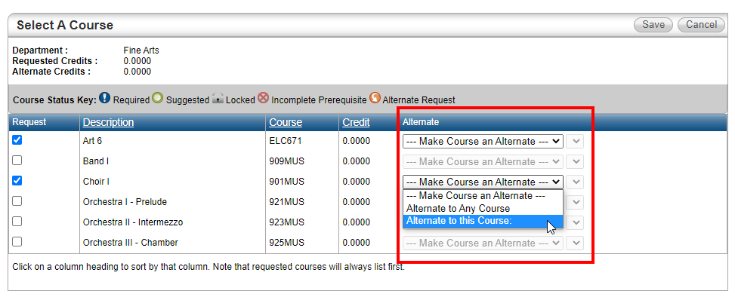
How to Select Fine Arts Classes
Go to the Alternate column and change drop-down to:
“Alternate to this course:”
for your Second Choice

Slide 36
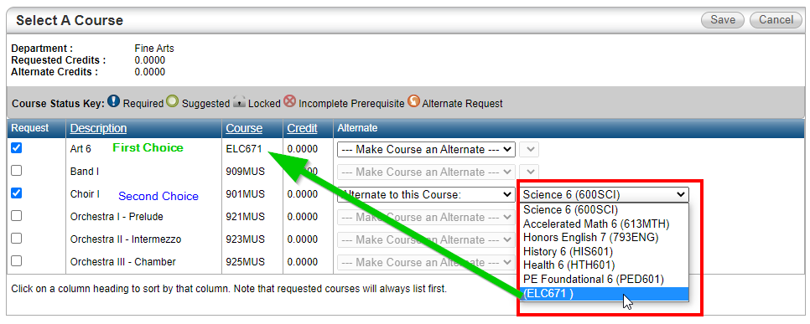
How to Select Fine Arts Classes
Then Click Save.
In the new dropdown, choose the course code for your first choice Fine Arts class.
Click save.

Slide 37
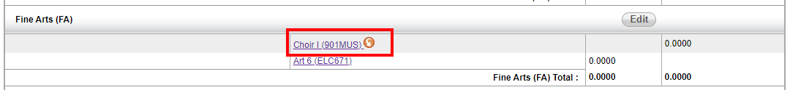
How to Select Fine Arts Classes
Check your work!
Do you have a first-choice fine arts AND an alternate?
Does your alternate have an ORANGE circle with an arrow?

Slide 38
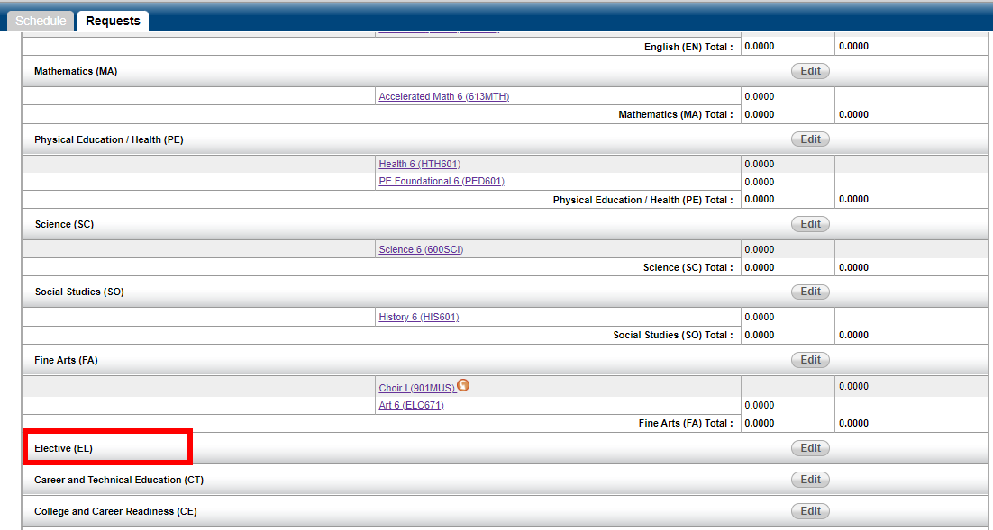
Click "Edit" to Select your Elective
Course Requests
Elective (EL)

Slide 39
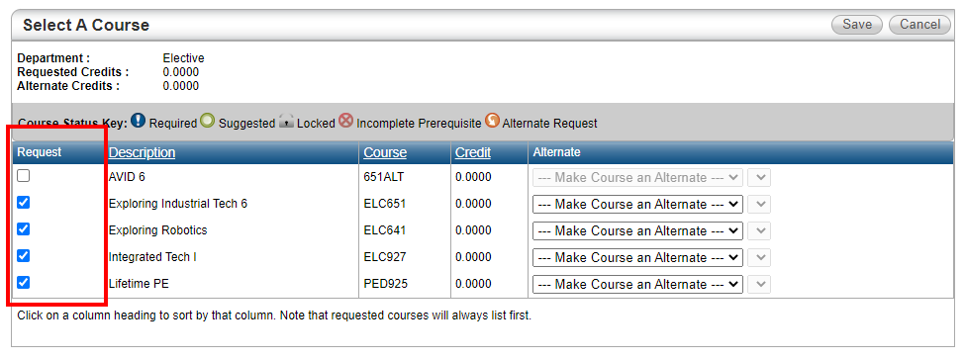
How to Select Elective Classes
Place a check next to ALL Elective classes you want:
First choice and Alternate choices

Slide 40
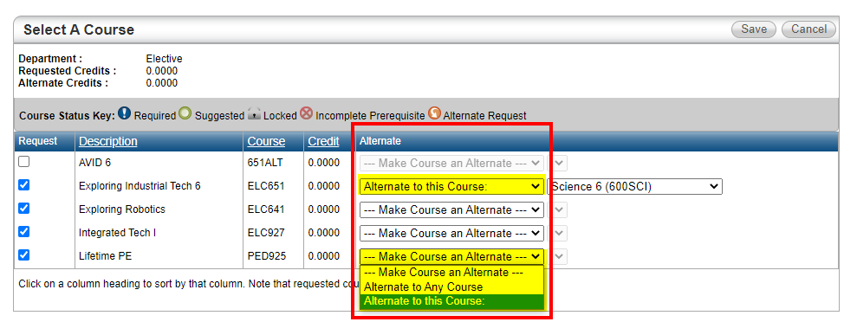
How to Select Elective Classes
Go to the Alternate column and change drop-down to:
“Alternate to this course:”
for ALL your Second Choices

Slide 41
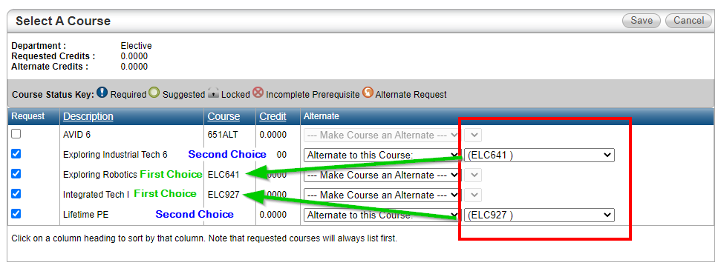

How to Select Elective Classes
Then Click Save.
In the new dropdown, choose the course code for each first-choice Elective class.
Click save.
DO NOT LEAVE A CORE CLASS IN YOUR ALTERNATE DROPDOWN

Slide 42
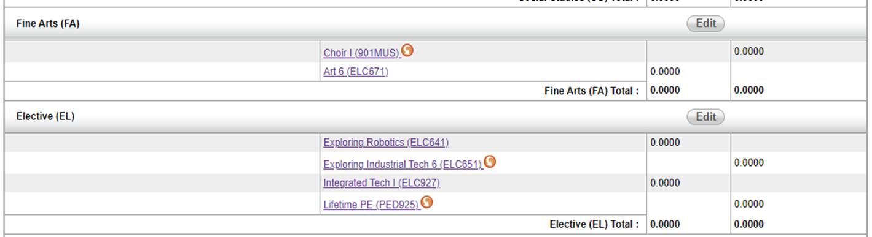
How to Select Elective Classes
First Choice was single semester fine arts
Check your work!
Do you have two first-choice Electives AND and two alternates?
Do your alternates have ORANGE circles with an arrow?

Slide 43
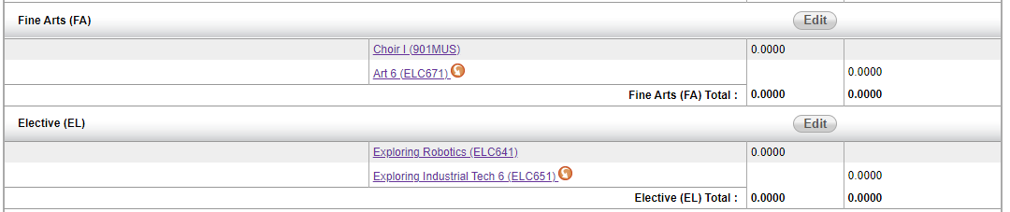
How to Select Elective Classes
First Choice was Full Year Fine Arts (Band, Choir, Orchestra), or AVID
Check your work!
Do you have a first-choice Elective AND an alternate?
Does your alternate have an ORANGE circle with an arrow?

Slide 44
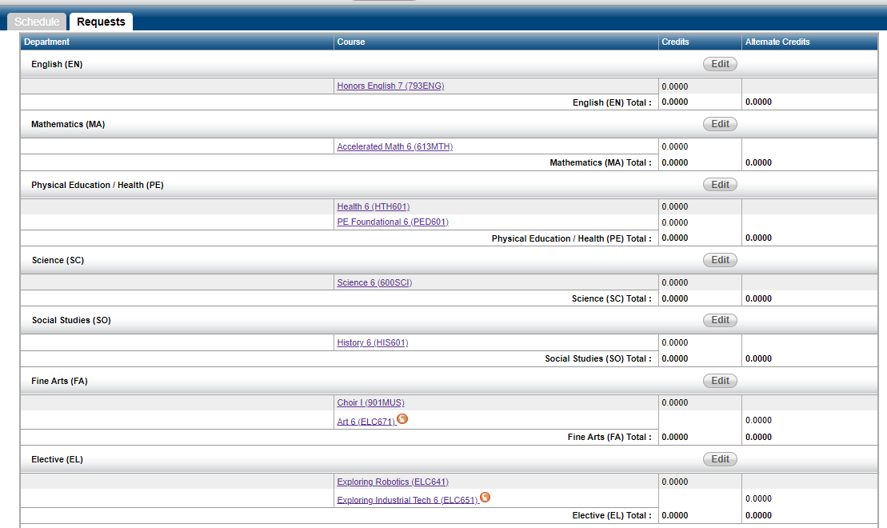
You’re Done!
Look your class requests
Do you have requests in ALL these areas?

Slide 45

How To VIDEO:
https://youtu.be/qLUEX4t_IVY
Notes:
https://youtu.be/qLUEX4t_IVY

Slide 46
Resources for School Staff using this PowerPoint
6th Grade Course Request Sheet with Worksheets – Word format
6th Grade Course Catalog – Word Format
6th Grade Walkthrough Video
Parent HAC Course Review Video
What if I want a Fine Art as an alternate to an Other Elective?
  Instructions – Word format
If links don’t work – contact your principal for the newest resources.
This is a hidden slide.
It does not show when doing a slideshow.

