Slide 1
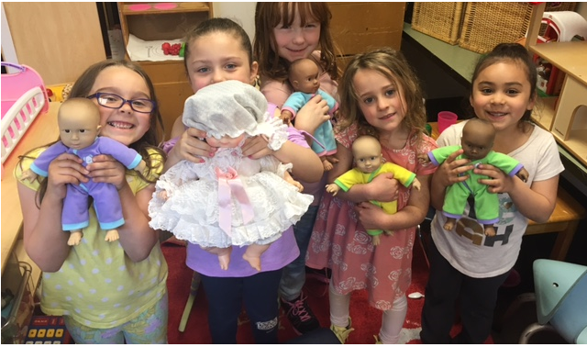
Welcome to Kindergarten!
Everett Public Schools
2021
Notes:
Welcome to Everett Public Schools.
This presentation is written for a parent audience – if children are present during presentation, be sure to adjust your presentation audience focus to tell children about what kindergarten will be like, rather than the parent.

Slide 2
Welcome to Jackson Elementary
Thank you for joining us today!
  Presenters:
  Insert name
  Principal
  Insert name
  Teacher
Notes:
Insert names of presenters, and a picture of your choosing. This is your welcome page.

Slide 3
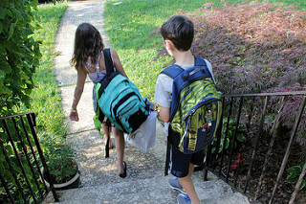
First day of school
Kindergarten students’ first day of school will be September 13, 2021.
Notes:
Welcome to Kindergarten in Everett Public Schools! We’re so glad you’ll be joining us in the fall 20__. It will be a wonderful and exciting new school year with lots of new things to do and learn. Kindergarten begins with our families.
Speak to the slide – may want to highlight:
State Funded Kindergarten
Recognizing a smooth transition
Instead of starting the very first day with other 1-5th grade students,
Families are invited to an individualize/personal meeting with your child’s teacher
First day 9/13/21

Slide 4

Families First
September 8th, 9th and 10th – Family Connection Meetings
Appointments will be scheduled with families in August
Notes:
Welcome to Kindergarten in Everett Public Schools! We’re so glad you’ll be joining us in the fall 20__. It will be a wonderful and exciting new school year with lots of new things to do and learn. Kindergarten begins with our families.
Speak to the slide – may want to highlight:
State Funded Kindergarten
Recognizing a smooth transition
Instead of starting the very first day with other 1-5th grade students, families are invited to an individualize/personal meeting with your child’s teacher

Slide 5


Purpose of Family
Connection meetings:
To welcome families
To begin building strong relationships
To learn from families about children
Notes:
Family Connection Meetings are one component of WaKIDS.
The purpose is to begin building a strong relationship between your child’s teacher and your family.

Slide 6
Pathway to Success:
Families and teachers partnering to get to know you and your child
Family
connection
Teachers identifying children’s strengths to target support where it’s needed most
Whole
child assessment
Kindergarten teachers and early learning providers sharing information to help children succeed
Early learning
Collaboration
Creating a pathway toward your child’s success in school
The
Result
Notes:
While family connections is one of the important components of kindergarten, through WaKIDS there are two other components: Whole child assessment and collaboration between kindergarten and preschool teachers. WaKIDS ensures that children in Washington get a great start in kindergarten. All three components serve as a transition process that result in creating a pathway toward your child’s success in school.

Slide 7
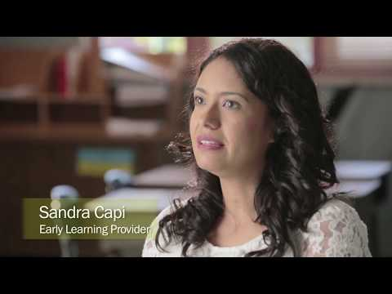
Notes:
Optional WaKIDS 4min Video: https://www.youtube.com/watch?time_continue=29&v=zO7JAHpqLyU

Slide 8
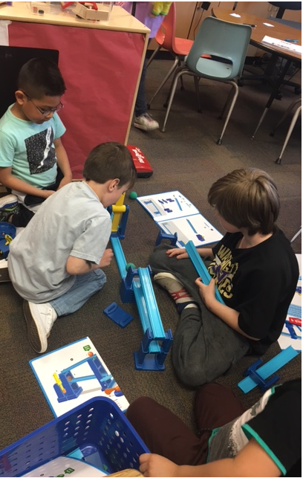
21st Century Skills
Citizenship
Collaboration
Communication
Creativity
Critical Thinking
Growth Mindset
Notes:
These six over arching skills are embedded into all content areas.
Individual schools add own information

Slide 9
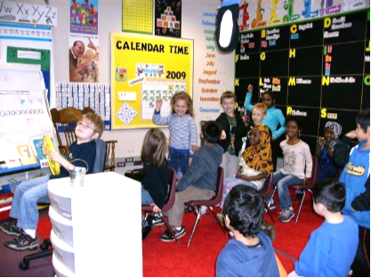
Social skills
Following routines
Sharing
Helping others
Recognizing feelings
Understanding emotions
Managing self
Problem solving
Interacting with children and adults
Taking on challenging tasks
Notes:
Kindergarten is more than just academics. It’s also about learning how to get along with others and how to manage oneself in a group setting.
Individual schools add own information

Slide 10
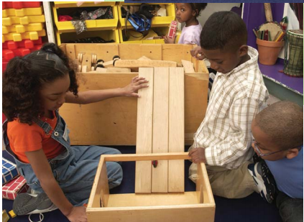
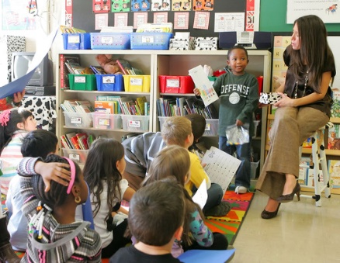
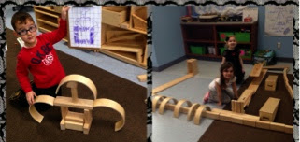
Plan-Do-Reflect
Learning through intentional choice, action and reflection
Students
Teachers
Plan a self-selected project based on interests
Construct meaning
Interact with peers
Process new information
Evaluate own learning
Managing self
Inspire others to try new ideas
Become an expert
Provide a rich learning environment
Observe and support students
Ensure students do the hard work
Coach for risk taking
Listen, interact and question to extend students’ thinking
Validate students as experts
Notes:
The full day allows time for kindergarten children to learn through intentional choice action and reflection. We call this part of the day Plan – Do – Reflect. This is a learning time that allow students the time to (read from slide)
It is often student’s favorite time of the day.

Slide 11
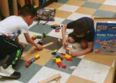
Illustrative Mathematics
The big ideas in kindergarten include; representing and comparing whole numbers, initially with sets of objects; understanding and applying addition and subtraction; and describing shapes and space. More time in kindergarten is devoted to numbers than to other topics.
The mathematical work for kindergarten is partitioned into 8 units:
Math in Our World
Numbers 1–10
Flat Shapes All Around Us
Understanding Addition and Subtraction
Composing and Decomposing Numbers to 10
Numbers 0-20
Solid Shapes All Around Us
Putting It All Together
Notes:
Excited to launch a new math curriculum this fall.
Everyday children will spend time learning math through whole group, small group and math workshop stations. Throughout the year they’ll learn about shapes, numbers, counting, beginning addition and subtraction, measuring and problem solving.
Possible addition to slide: show examples of fun, hands-on student math work such as manipulatives, graphs made as a class, consumables, subitizing and counting collections materials, etc.

Slide 12
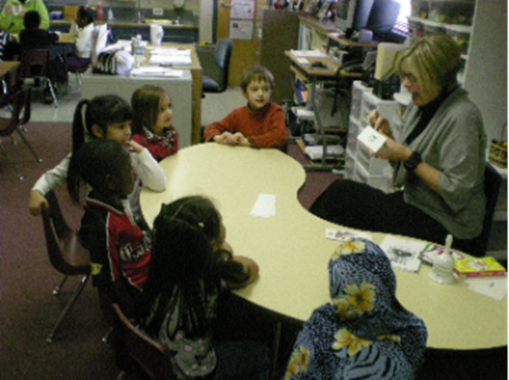
Literacy: Oral language
Listening and understanding
Expressing thoughts, feelings and ideas
Learning and using new words
Retelling familiar stories
Taking turns in classroom conversations
Notes:
Communication skills begin before birth. Language is an important part of one’s identity and is the precursor to literacy development.
In kindergarten children will be learning about listening and taking turns to share what they know and think.

Slide 13
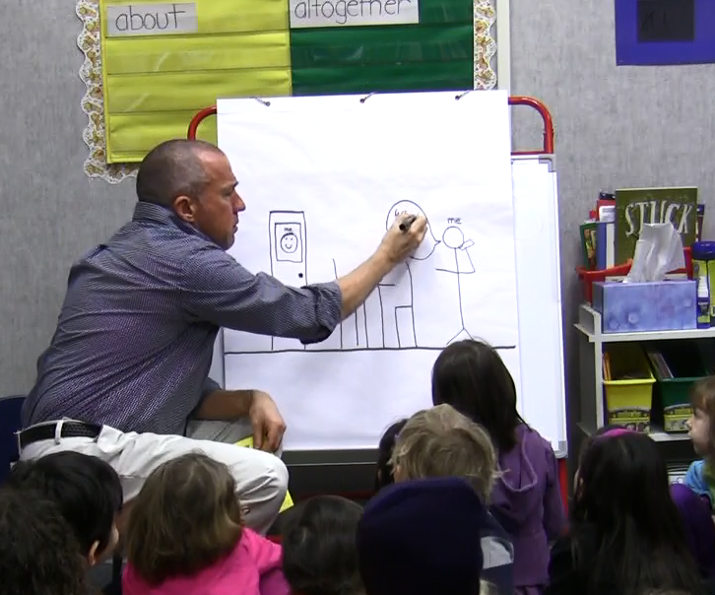

Literacy: Learning how stories work
Telling about a memory
What happened?
Who was there?
Where did it happen?
How did you feel?
What did you say?
Notes:
Everett Public Schools is using an aligned instructional writing strategy that develops student writing from PreK to 3rd grade.
If your child has attended a ECEAP, Head Start or community preschool and childcare program that is a partner in this work, the materials and strategies will be familiar to them. The writing instruction focuses on the elements of a personal story and the child’s ability to communicate their stories through pictures and writing.

Slide 14
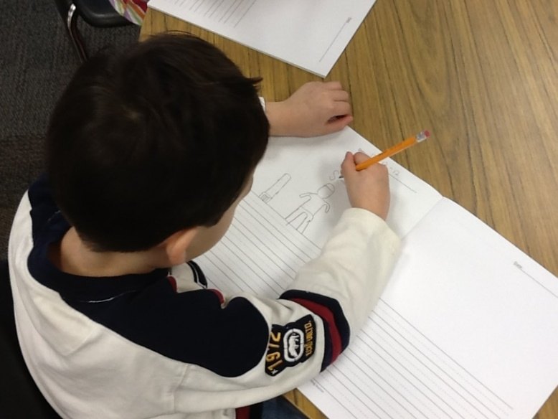
Literacy: Beginning to write
Telling and drawing one’s own stories
Sounding out and writing letters and words
Using writing in a variety of ways
  Labeling
  Expressing opinions
  Creating lists
  Journaling
Notes:
Children will learn letter sounds and how to sound out and write words.
They‘ll get a chance to write labels on their pictures, to express their opinion through writing, to make lists, to draw and write in their journal and to make drawings and write about what they are learning in science.

Slide 15
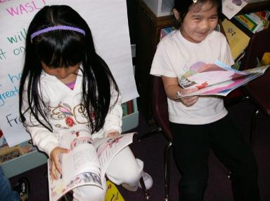
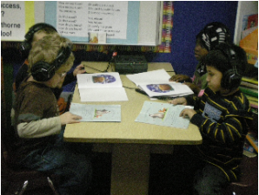
Literacy: Beginning to read
Phonemic awareness
Phonics
Sight words
Shared reading
Small flexible groups
Independent practice
Notes:
There will be lots of opportunities to read and hear stories in kindergarten.
Individual schools – add information on literacy instruction strategies used

Slide 16
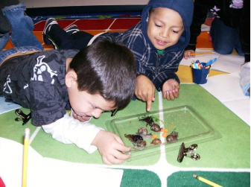
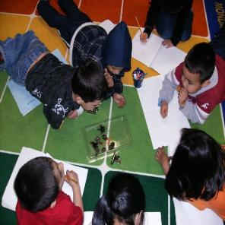
Science
Learn about
  Life science
  Physical science
Apply
  Next Generation Science Standards practices and crosscutting concepts
Participate in STEM engineering challenges
  Ask questions
  Observe
  Gather information
  Design
  Test
  Compare possible solutions
Notes:
Science is another really cool part of the day! They’ll get to learn about life Science through investigation of animal life and physical science by exploring ways balls move on flat surfaces, ramps and much more. The application of the Next Generation Science Standards & Science and Engineering practices such as asking questions, developing models, engaging in investigations, analyzing data, using mathematical thinking and constructing scientific explanations. Students will also have opportunity to actively engage in various STEM engineering challenges which incorporate literacy and math skills around the engineering design process. This is a fun engaging and interactive way to make sense of science content.

Slide 17
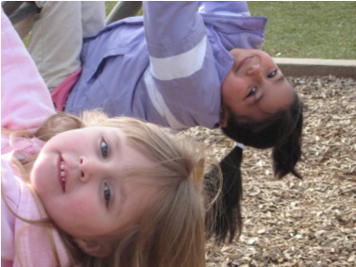
Recess
Notes:
Going outside for recess is a great time of the day! Children will get to run, play with friends, and use the playground equipment.
It’s also a time to relax, a time to learn how to play with others and develop friendships. Teachers will help children know where to play and how to get to and from the playground. Please dress your child appropriately for the weather. While there is an undercover area, students will be encouraged to play in areas of their choice.

Slide 18





Specialists
Notes:
Throughout the week your child will have an opportunity for specials: Music, Library, PE, Art and Technology.
Individual school information:
Frequency

Slide 19

Supporting your child’s success
Notes:
Here are some things you can do to support a smooth transition and make kindergarten a successful experience for your child – click to next slide

Slide 20

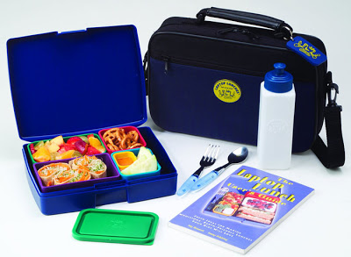
Creating independence
Independently use the bathroom
Put on, zip & button coat
Blow own nose
Wash hands
Open food & lunch containers
Clean up small spills
Put away materials
Ask for help
Notes:
It’s important to know how to take care of oneself. You will probably want to practice these skills with your child before they come to kindergarten.

Slide 21

Family involvement
Support your child’s learning in all areas
Make attendance a priority
Come to school and family events
Participate in WaKIDS family meeting and parent teacher conferences
Help with class projects/work
Volunteer
Join PTA or Natural Leaders
Notes:
Families are children’s first teachers. As children start school you continue to have the most important role. Schools and parents are partners in supporting children’s learning and growth. We invite you to work with us as a team for your child’s success.
Individual school information:
Coming to family events (around reading, math, science – some just for fun together)
Coming to Parent-Teacher Conference
Opportunity to let the teacher know more about your child; after all you know your child best
Learn about what children do in classroom and how your child is progressing
Ask questions
Volunteering – in the classroom, at home (cut out materials), or for events at school
PTA – Book fair, Carnival, Grounds Clean-Up

Slide 22
Everett Ready August 2021
A Transition into Kindergarten...
Monday, August 23 through Friday, August 27
At your child’s elementary school
Half-day: 3 hours per day in the morning
Transportation provided (if applicable)
  bus routes/stop will be sent in early August
Family meeting date & time will be sent in early August

Slide 23
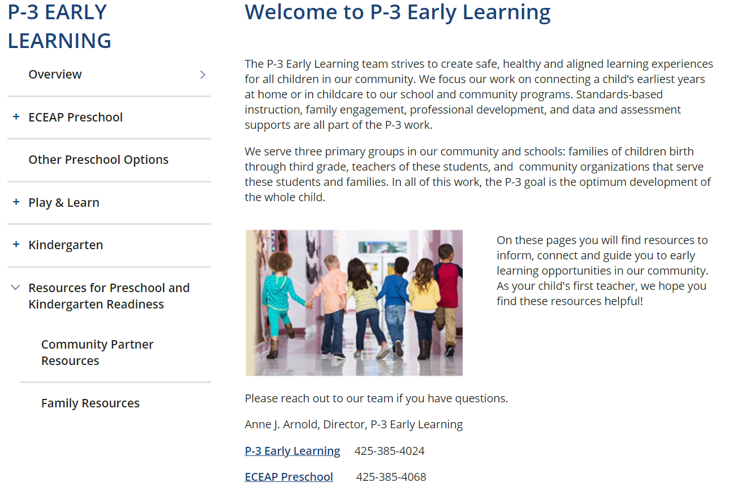
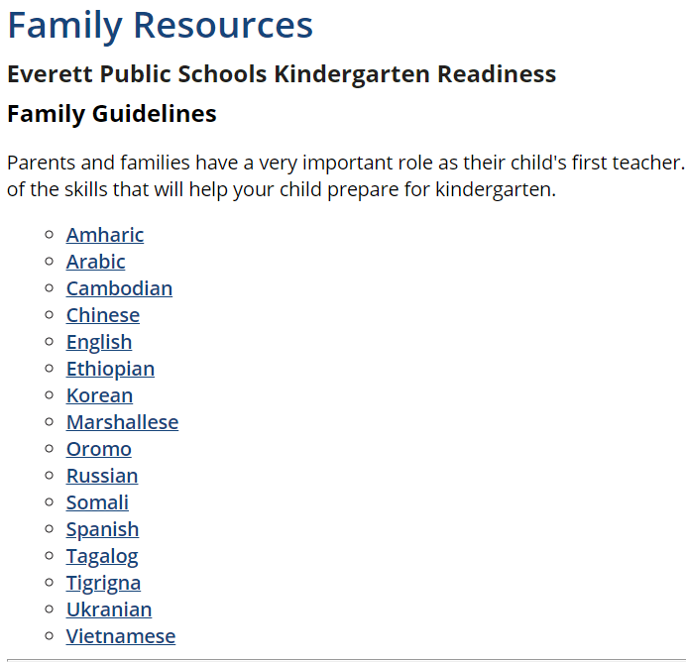
Visit the district P-3 Early Learning website https://www.everettsd.org/Page/5967
Notes:
Our Early Learning site has lots of information for you. You can access it by hovering over the program tab then clicking on P-3 Early Learning.
On the website you will find Pre-school and kindergarten readiness information. Drop down Parent resources
Kindergarten Readiness Guidelines are available in many languages

Slide 24
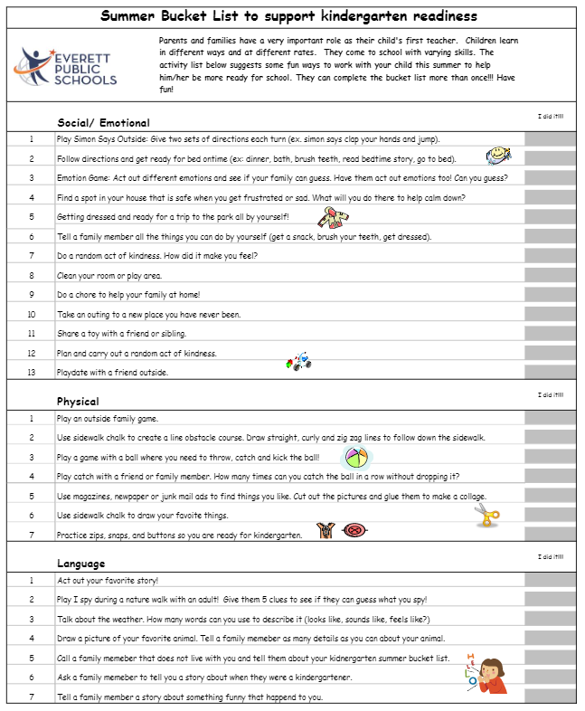
Summer Bucket List
Kindergarten Readiness
Notes:
Our Early Learning Team developed a Kindergarten Readiness Summer Bucket list aligned to the Kindergarten Readiness document.
Parents and families have a very important role as their child's first teacher. Children learn in different ways and at different rates. They come to school with varying skills. The activity list below suggests some fun ways to work with your child this summer to help him/her be more ready for school. They can complete the bucket list more than once!!! Have fun!

Slide 25

Before the first day
Develop a home and bedtime routine
Help your child learn their personal information
Get supplies ready and labeled
Visit the school playground over the summer
Practice drop off and pick up procedures
Notes:
Attendance – regular, daily and on-time
All children start school at different skill levels – teachers are trained to address this; they may ask you to help support your child at home

Slide 26
First day for parents
Schools put in your own information – see notes below for topic ideas
Notes:
Schools fill in the information of how their first day will work: what is the most important information a parent may need.
Examples of information to share:
Where do/can parents say goodbye?
Is there a coffee group they can go to socialize or learn information about kindergarten?
Are parents allowed to go into the classroom with their child?
Where can parents pay for lunches?
How do parents find out their child’s student ID number?
Where will parents pick up their student at the end of the day?
Can my child ride the bus on the first day of school?
Do I have to put my child on the bus? Do I have to meet my child at the bus stop at the end of the day?
If I drop my child off at school can they ride the bus home?
How do I update my phone number, address, emergency contact information, etc.?
Talk about breakfast and lunch on first day.
Provide info on first day packet and contents.

Slide 27
Additional support
If you have concerns about your child’s development or readiness for kindergarten, please contact:
  Your School Principal
  Special Services
    425-385-5250
  Early Learning Department
    425-385-4024
    425-385-4068

Slide 28

Questions?

Slide 29
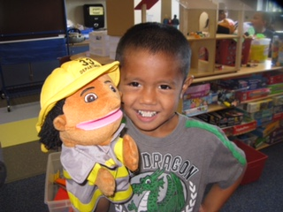
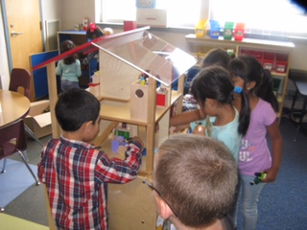
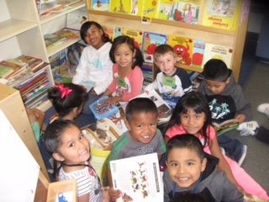
Thank you

