Slide 1
Choosing 8th Grade Classes

Slide 2
Required courses for all 8th grade students:
2 semesters of English 2 semesters of Mathematics 2 semesters of Science 2 semesters of Social Studies 1 semester of Physical Education 1 semester of Visual and/or Performing arts 2 semesters of other electives (total of 3 total elective semesters)

Slide 3
BUILDING MODIFICATION NEEDED
Slides 4 and 5 are from the course catalog, please remove any classes that are not offered in your building before sharing with students.
This is a hidden slide.
It does not show when doing a slideshow.

Slide 4
Required - Core Classes
Subject | Semesters | Course Choices
Required Courses
English | Year long | English 8
 | Year long (1.0 high school credits) | Pre-AP English 1*
Mathematics | Year long | Math 8
 | Year long (1.0 high school credits) | Algebraic Concepts* Geometry in Application*
Science | Year long | Science 8
 | Year long (1.0 high school credits) | Coordinated Science*
Social Studies | Year long | History 8
Physical Education | One semester | Physical Education – Foundational 8
You have choices in:
English
Math
and
Science
*choices have additional requirements.

Slide 5
Elective Classes
Subject | Semesters | Course Choices
Elective Courses
Performing Arts | Year long | Band I Band II Band III
 |  | Choir I Choir II Choir III
 |  | Chamber Orchestra Intermezzo Orchestra Prelude Orchestra
 | One semester | General Music
Visual Arts | One semester | Art 8
 | Year long | Art 8
Physical Education Electives | One semester | Lifetime PE Team Sports
STEM and CTE Electives | One semester (.5 high school credits) | Exploring Graphic Arts* Digital Manufacturing (CAD)* Robotics Tech I* Robotics Tech II*
Other Electives | Year long | Avid 8
 | Year long (1.0 high school credits) | Spanish 1
 | One semester | Leadership 8 PE Peer Coach
One semester of Performing or Visual Arts is required
Three total semesters of Electives
Year long courses are two semesters.
*choices have additional requirements.
Notes:
Buildings, Please plan to personalize this slide based on the course offerings in your school. There may be courses reflected on this slide that you do not have available in your school. Please feel free to delete. The table is from the Course Catalog in Docushare (https://docushare.everett.k12.wa.us/docushare/dsweb/Get/Document-127921/Course%20Catalogue%20MS%207th%20grade%20updated%202.24.23.docx)

Slide 6
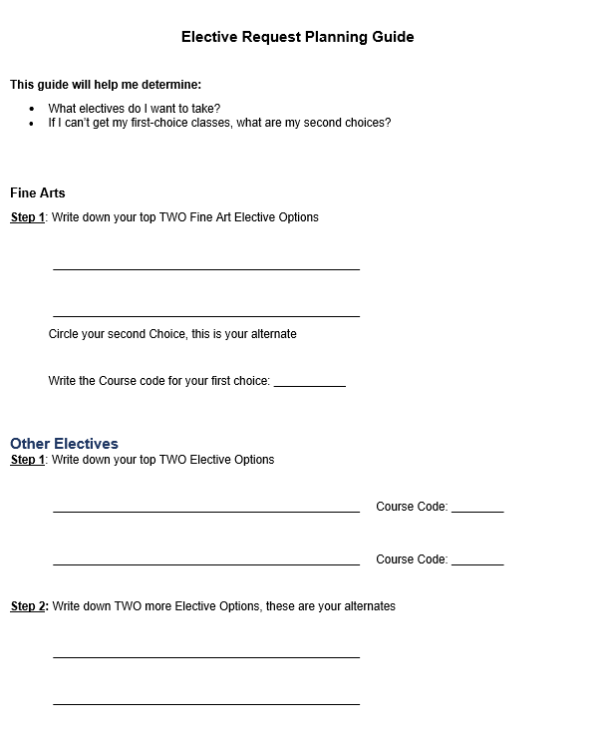
Before we put our choices into HAC
We need to pick out course we want to take
What Electives do I want to take?
Complete the Elective Request Planning Guide
  Use the Course catalog to help with your selection

Slide 7
What Core Classes Do I want to Take?
Core classes are Required but you do have choice for the following courses
  English
  Math
We highly recommend taking Honors English
If you are hardworking and enjoy math, Accelerated Math is a great choice

Slide 8
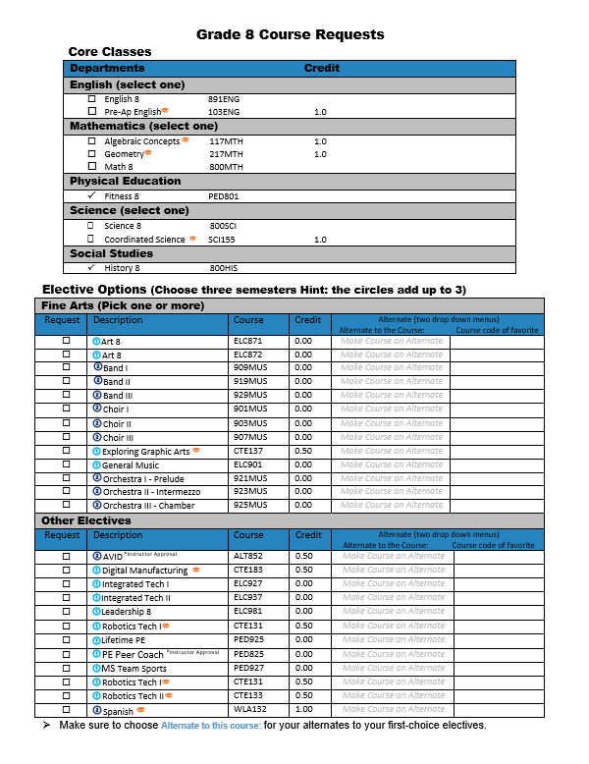
Check your English and Math Choices

Slide 9
Check your TOP 2 Fine Art Electives
Check your TOP 4 Elective Options

Slide 10
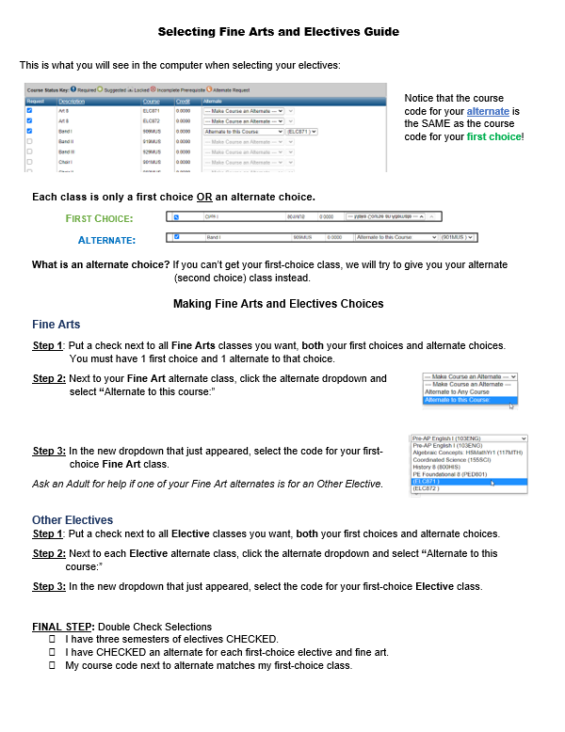
What is the difference between First Choice and Alternate Elective Options?

Slide 11
Circle your Alternate options
Write the course code of your first-choice electives next to each alternate, in the last column
Use your elective request planning guide to help

Slide 12
When you get into the Home Access Center,
Use this handout to help with the steps

Slide 13
Now Let's Enter our Requests into the Home Access Center...

Slide 14

How to log into HAC from Chromebooks
8th Grade

Slide 15
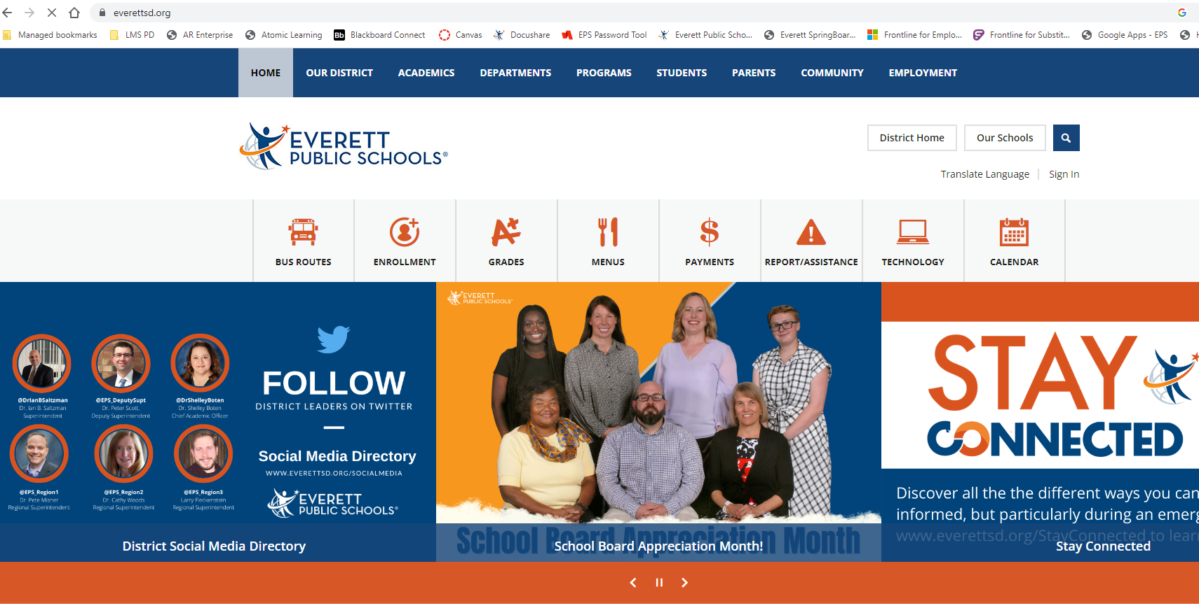
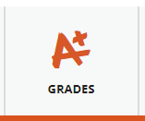
How to login to Home Access Center (HAC)?
Go to: Everettsd.org
Click on: Grades & more

Slide 16
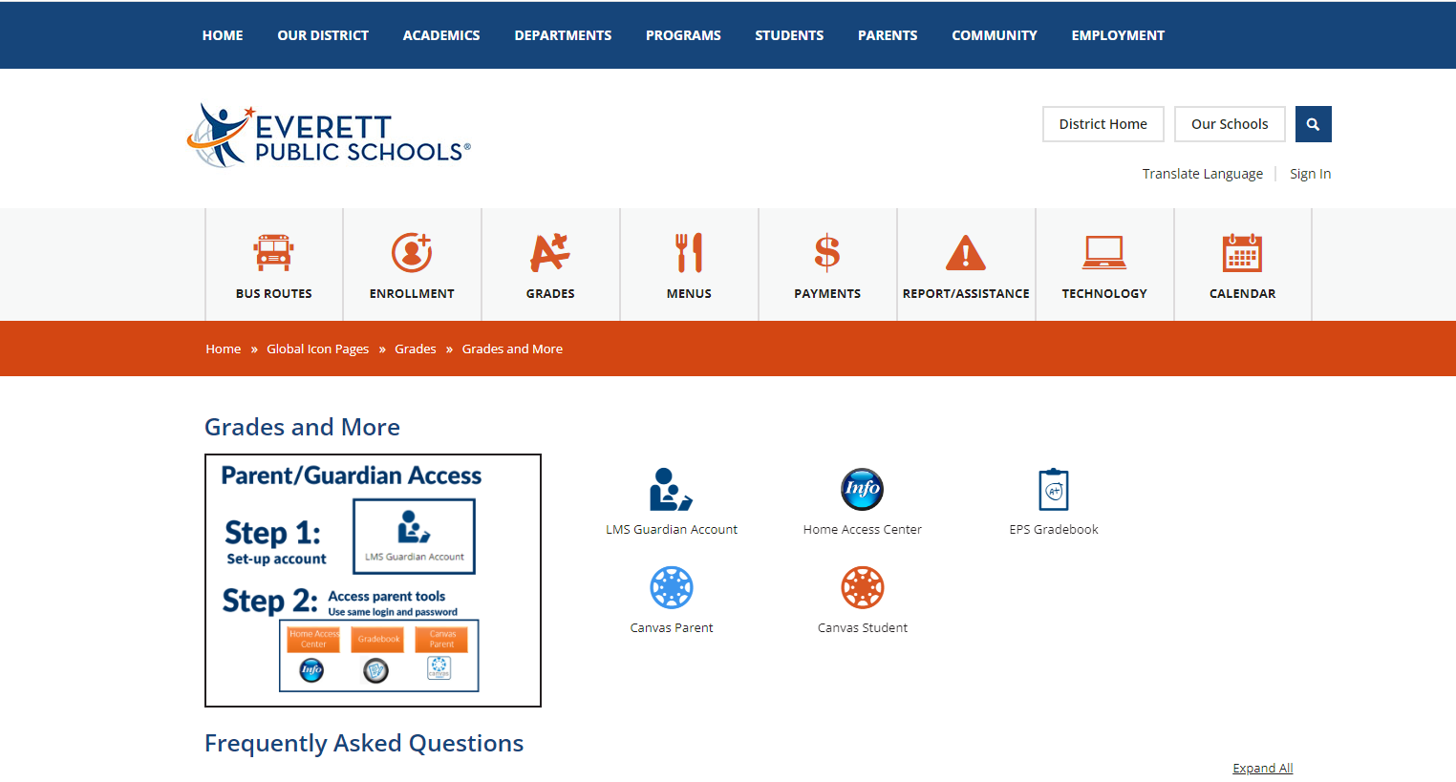
Click on Home Access Center

Slide 17
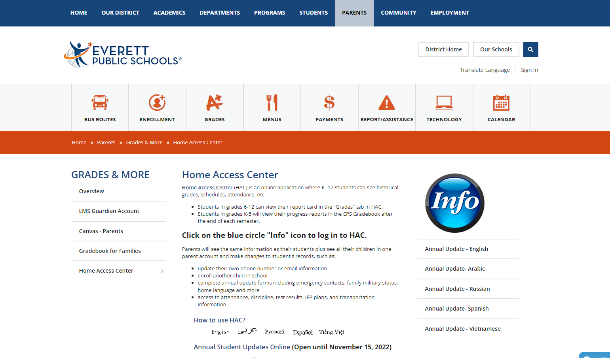
Click the large blue circle titled "Info"

Slide 18
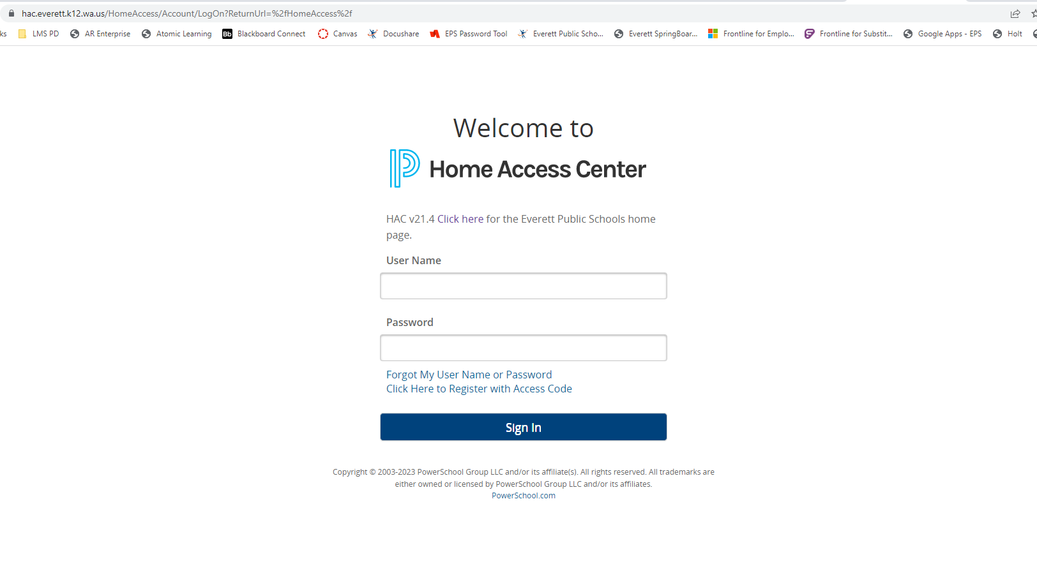
Login Using Your Computer Login and Password

Slide 19
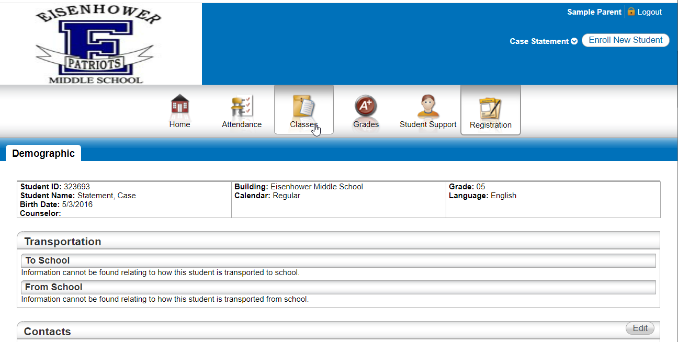
Click "Classes"

Slide 20
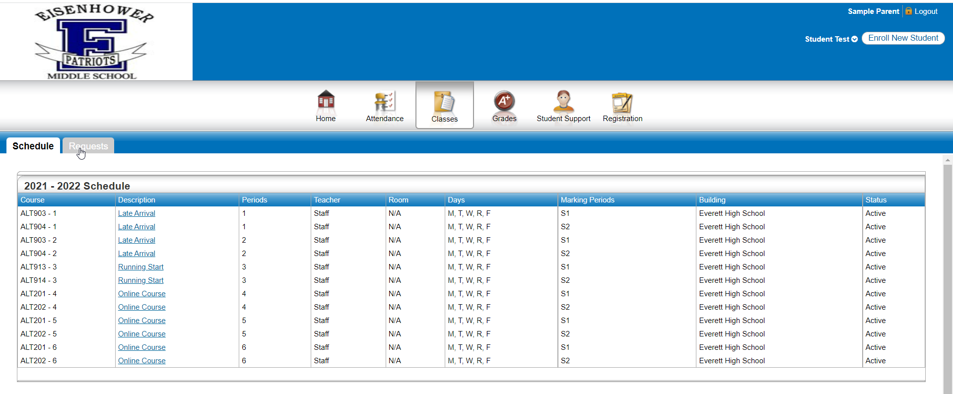
Click "Requests"

Slide 21
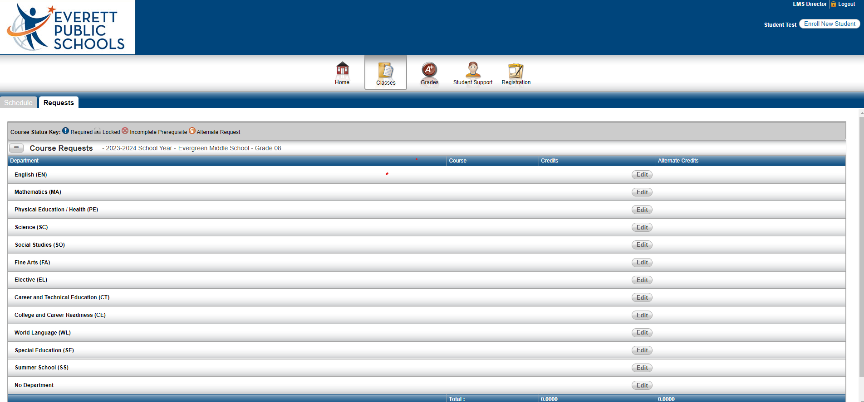
Click "Edit" to Add or Edit your English Course Requests
English (EN)

Slide 22
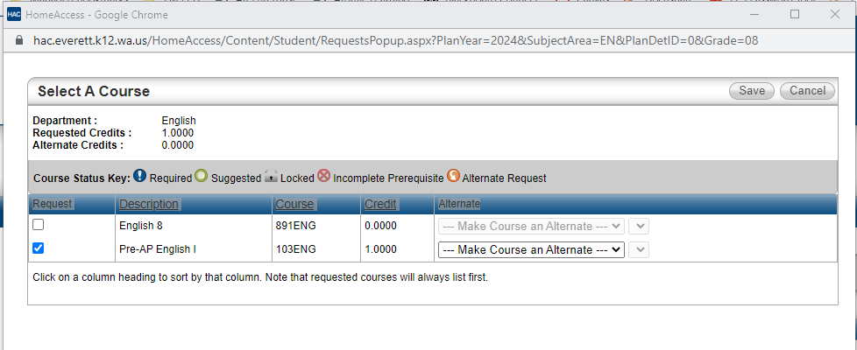
Check English
Then Click Save.

Slide 23
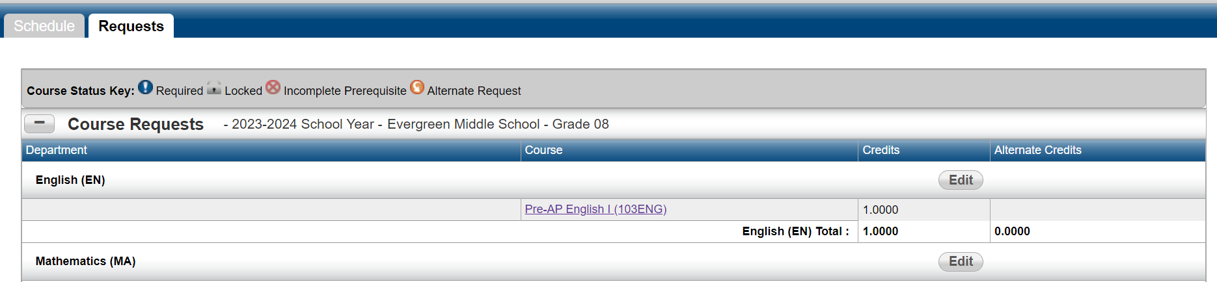
Click "Edit" to Select your Math Course Request
Mathematics (MA)

Slide 24
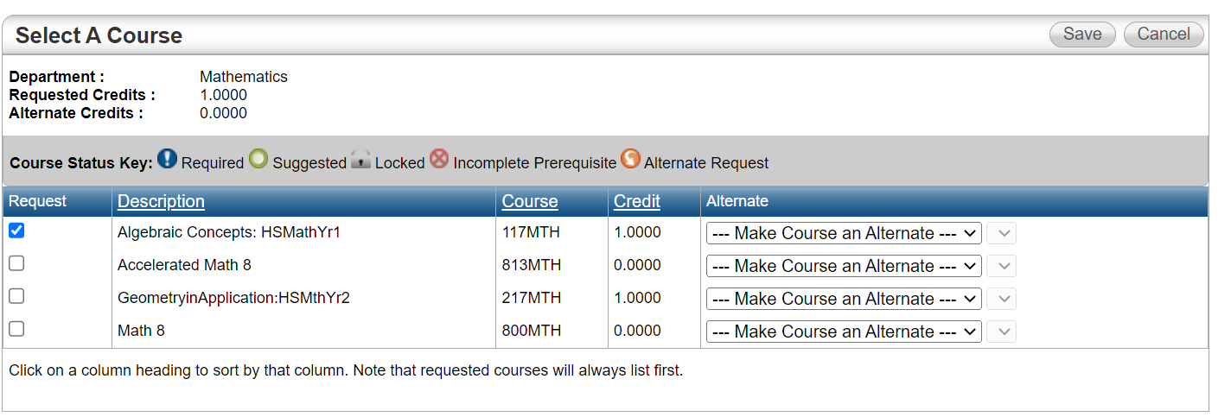
Check Math
Then Click Save.

Slide 25
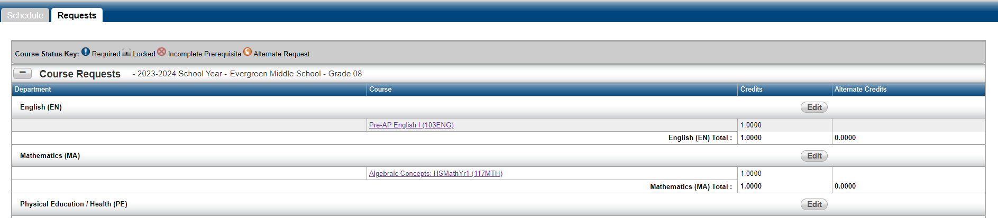
Click "Edit" to Select your Physical
Education/Health (PE)
Course Requests
Physical Education/Health (PE)

Slide 26
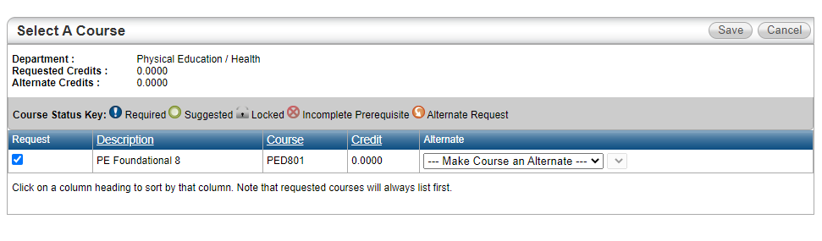
Check (PE Foundational 8)
Then Click Save.

Slide 27
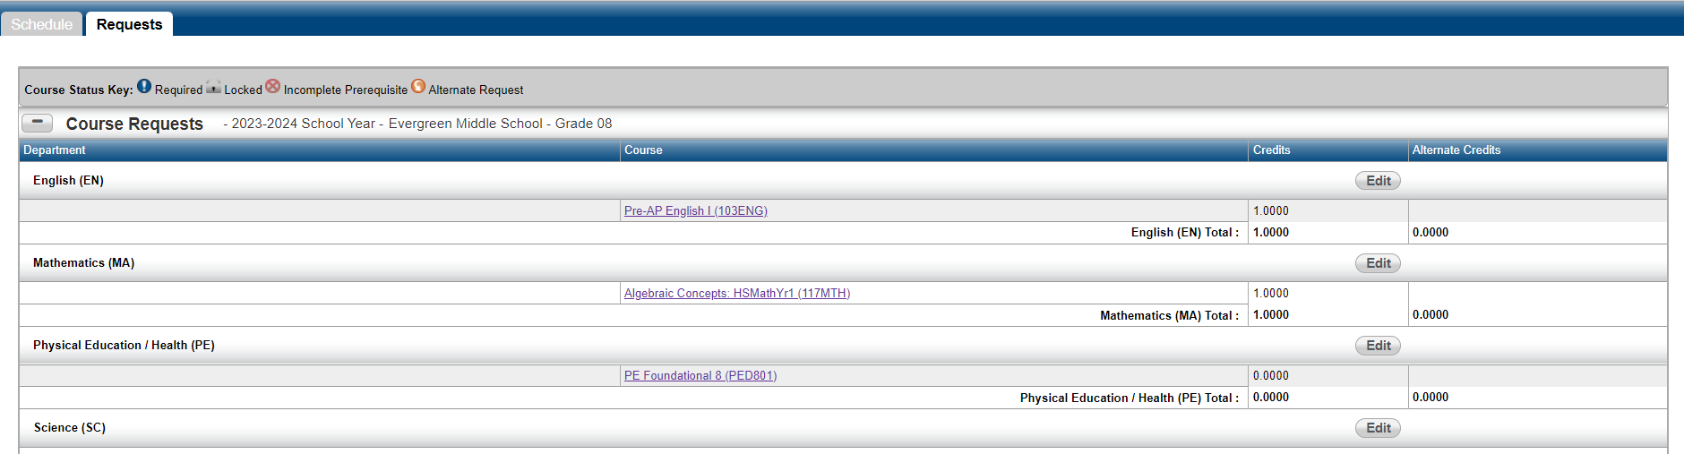
Click "Edit" to Select your Science
Course Request
Science (SC)

Slide 28
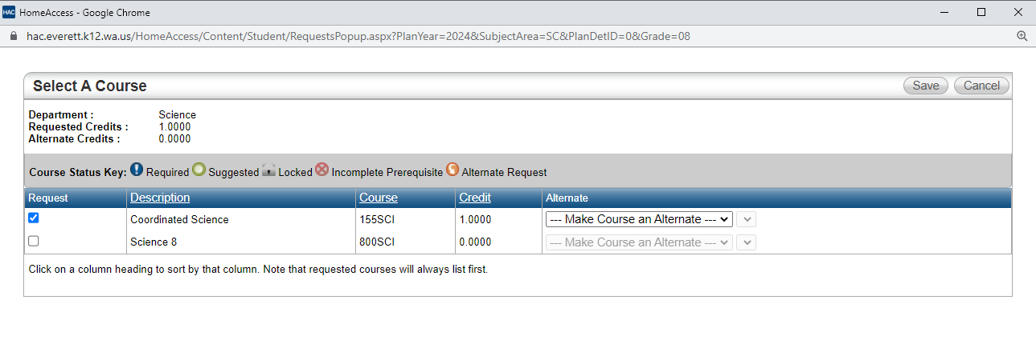
Check Science
Then Click Save.

Slide 29
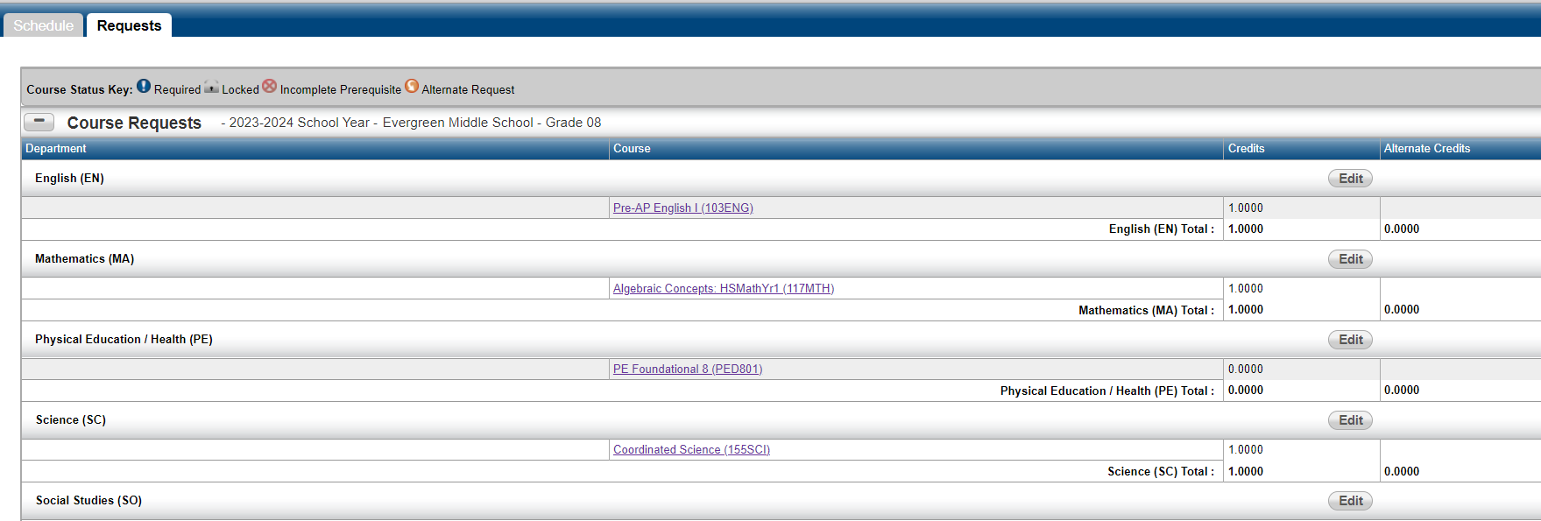
Click "Edit" to Select your Social Studies
Course Request
Social Studies (SO)

Slide 30
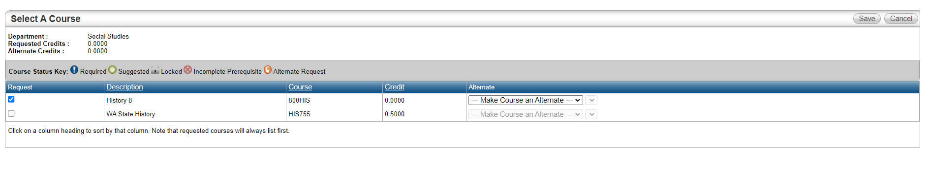
Check History 8
Then Click Save.
Only WA State History if you failed WA State History or if you have NEVER taken WA State History

Slide 31
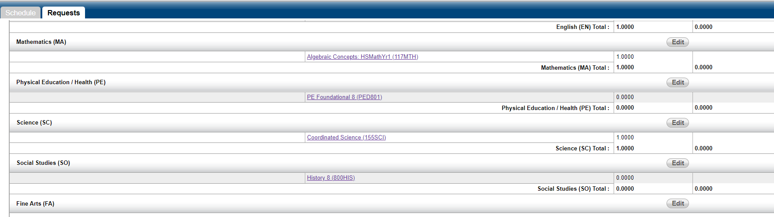
Click "Edit" to Select your Fine Arts
Course Requests
Fine Arts (FA)

Slide 32
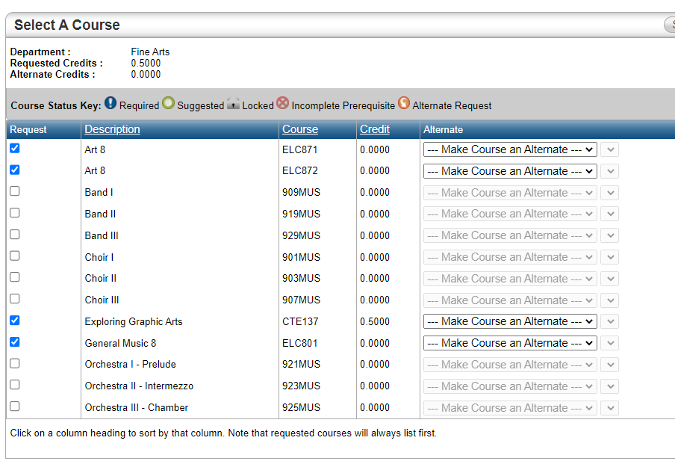
How to Select Fine Arts Classes
Place a check next to BOTH Fine arts classes you want:
First choice and Alternate

Slide 33
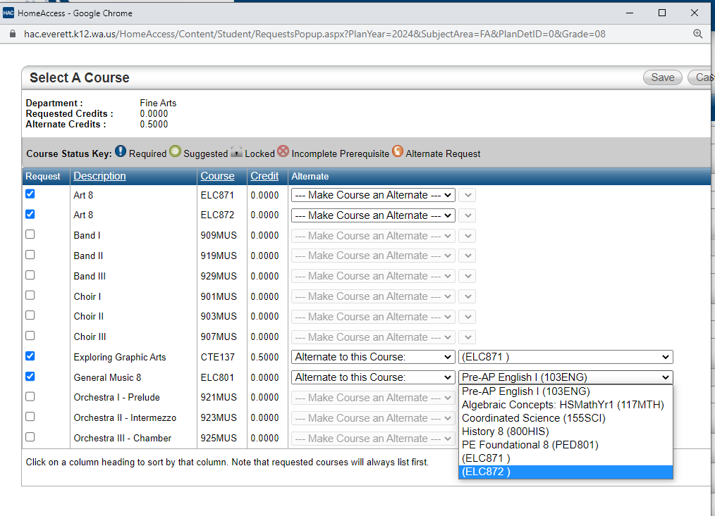





How to Select Fine Arts Classes
Go to the Alternate column and change drop-down to:
“Alternate to this course:”
for your Second Choice

Slide 34
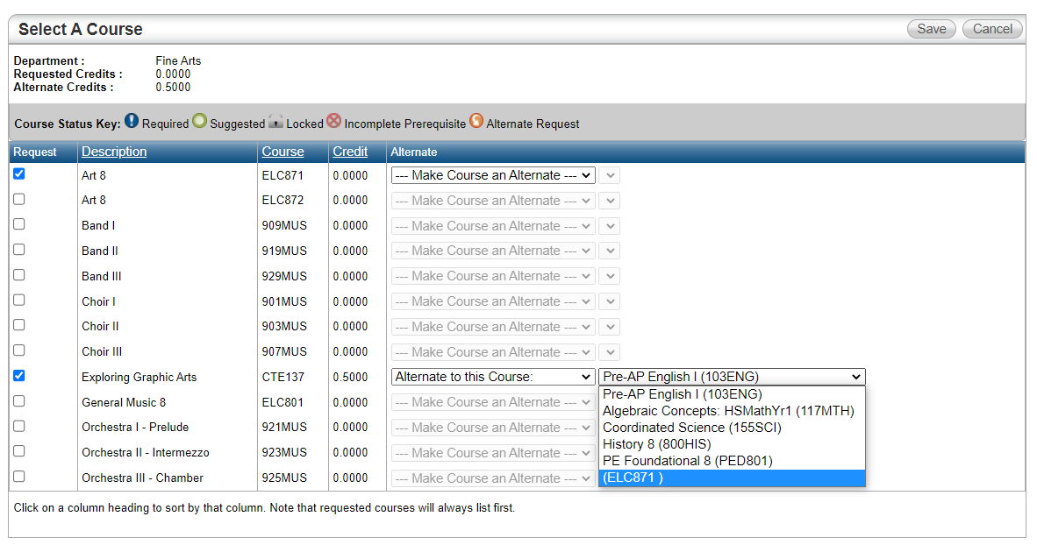



How to Select Fine Arts Classes
Then Click Save.
In the new dropdown, choose the course code for your first choice Fine Arts class.
Click save.
First Choice
Second Choice

Slide 35
How to Select Fine Arts Classes
Check your work!
Do you have a first-choice fine arts AND an alternate?
Does your alternate have an ORANGE circle with an arrow?

Slide 36
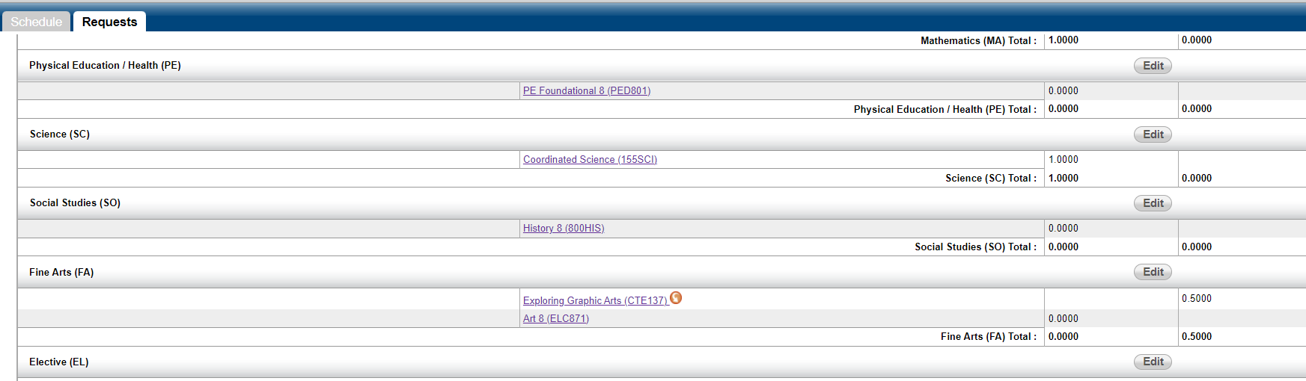
Click "Edit" to Select your Elective
Course Requests
Elective (EL)

Slide 37
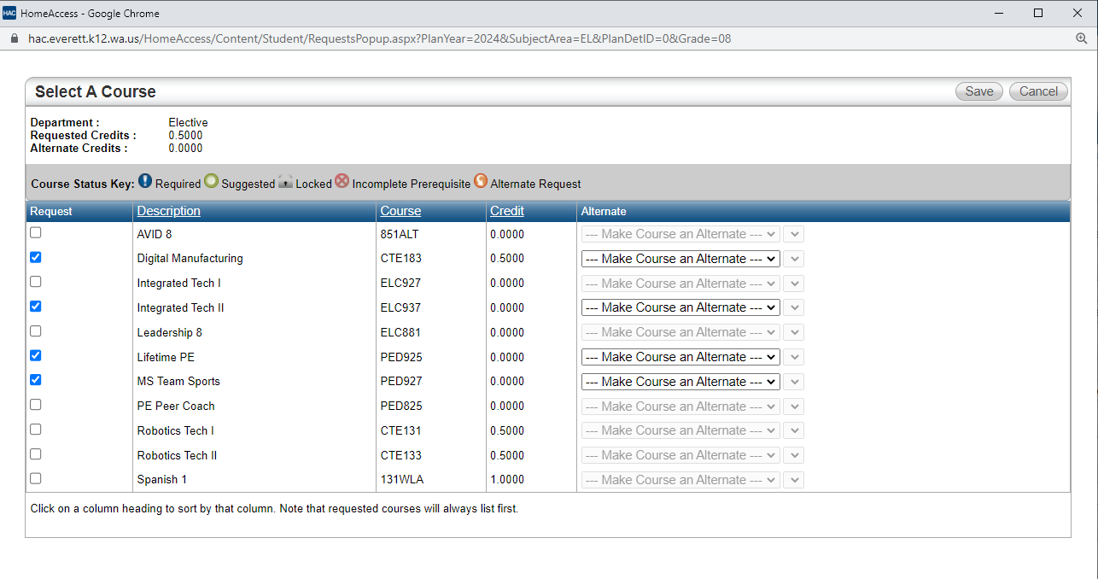
How to Select Elective Classes
Place a check next to ALL Elective classes you want:
First choice and Alternate choices

Slide 38
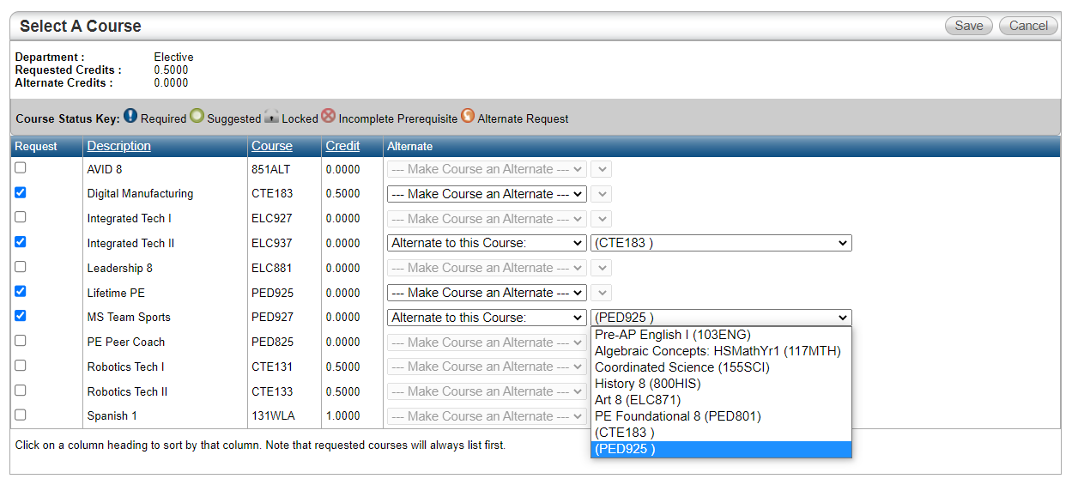






How to Select Elective Classes
Go to the Alternate column and change drop-down to:
“Alternate to this course:”
for ALL your Second Choices

Slide 39




How to Select Elective Classes
Then Click Save.
In the new dropdown, choose the course code for each first-choice Elective class.
Click save.
DO NOT LEAVE A CORE CLASS IN YOUR ALTERNATE DROPDOWN
First Choice
Second Choice
First Choice
Second Choice

Slide 40
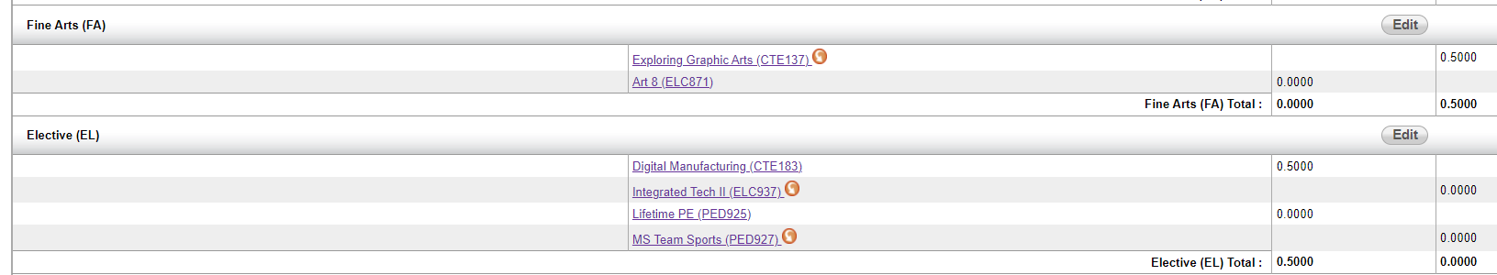
How to Select Elective Classes
First Choice was single semester fine arts
Check your work!
Do you have two first-choice Electives AND and two alternates?
Do your alternates have ORANGE circles with an arrow?

Slide 41
How to Select Elective Classes
Check your work!
Do you have a first-choice Elective AND an alternate?
Does your alternate have an ORANGE circle with an arrow?

Slide 42
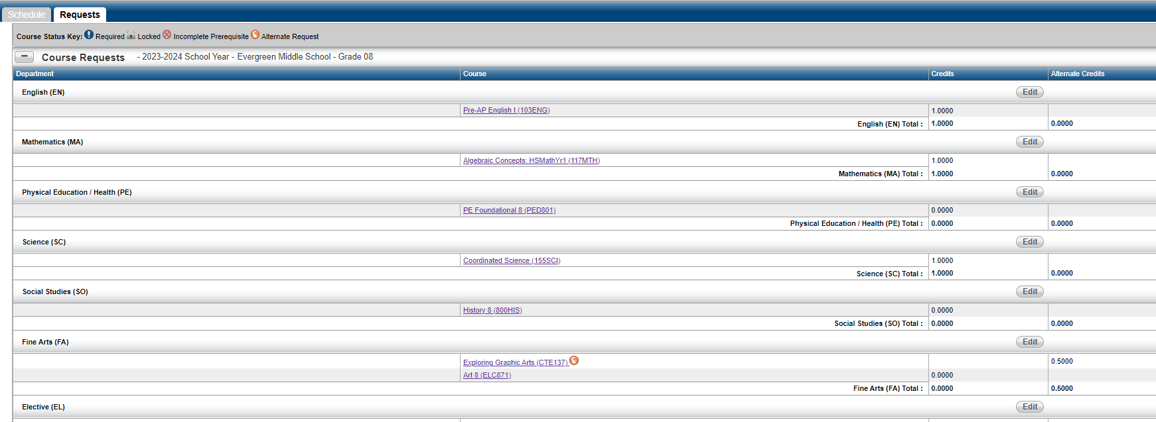
You’re Done!
Look your class requests
Do you have requests in ALL these areas?

Slide 43

How To VIDEO:
https://youtu.be/i82JRqW_Vdk
Notes:
https://youtu.be/i82JRqW_Vdk

Slide 44
Resources for School Staff using this PowerPoint
8th Grade Course Request Sheet with Worksheets – Word format
8th Grade Course Catalog – Word Format
8th Grade Walkthrough Video
Parent HAC Course Review Video
What if I want a Fine Art as an alternate to an Other Elective?
  Instructions – Word format
If links don’t work – contact your principal for the newest resources.
This is a hidden slide.
It does not show when doing a slideshow.

