Slide 1



SAFETY AT JHS
2022-2023

Slide 2

OBJECTIVES
Develop a “safety” conscious mind
Keep classroom doors LOCKED and SHUT at all times
Backpacks ready to go before school starts
Be familiar with all safety drills
October 6—Reunification Drill at the CRC

Slide 3


WHY?
Physical/Emotional Safety lead to students being able to be successful at school
With the prevalence of active assailants we need to be prepared!

Slide 4
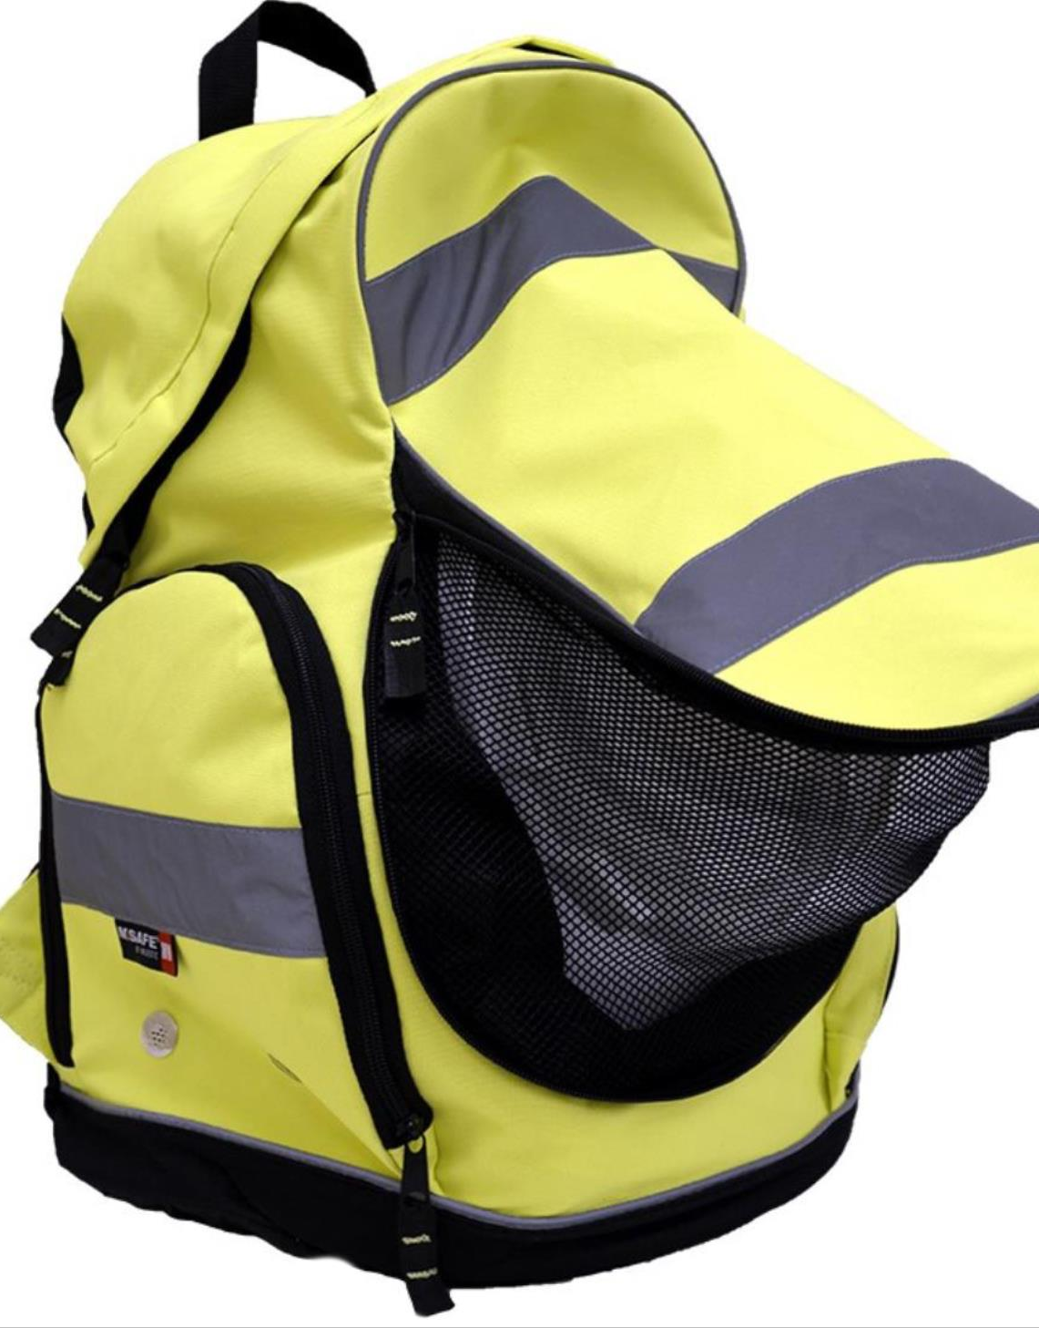
GO THROUGH BACKPACKS!
Turn in the yellow sheet when done
RAVE 911
Field line up chart/Tennis court chart for evacuations.

Slide 5

Think “safety” everywhere you go, every day!
“Your body won’t go where your mind has never been”

Slide 6

REVIEW OF OUR DRILLS
EVACUATION
YELLOW BACKPACK, YARD STICK, LOCK DOOR, ATTENDANCE
EARTHQUAKE
DROP, COVER AND HOLD, EVACUATE
SHELTER IN PLACE
CLOSE ALL WINDOWS, SEAL UNDER THE DOOR, KEEP TEACHING
“STRANGER DANGER”-alert the office

Slide 7

THERE WILL BE SOME UNANNOUNCED DRILLS!

Slide 8
THE DIFFERENCE BETWEEN
LOCKOUT AND LOCKDOWN
If there is a threat in the community but NOT near the school.
Admin/Security gives the command to lockout.
Normal Operations
  No one out and no one in
  Portables are the exception
If there is a threat in the community NEAR the school.
Admin/ will give the command to lockdown.
Staff check the halls for students and get them in to nearby classrooms. Lock the doors, cover windows, turn off all lights and have students sit out of sight silently (no cell phones). Wait for more instructions.

Slide 9

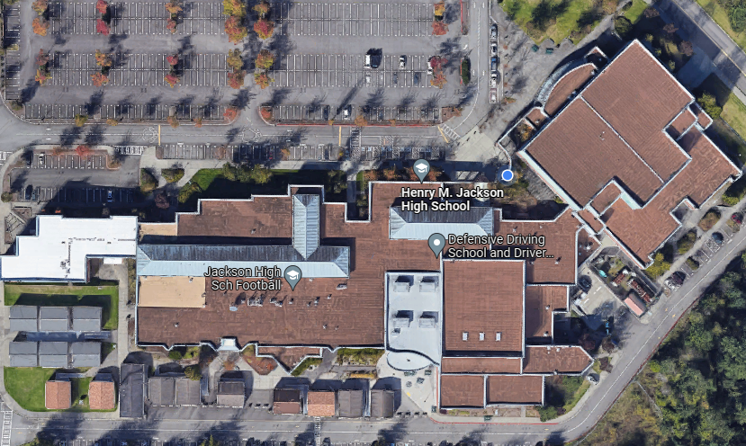
RUN/HIDE/FIGHT
THREAT IS INSIDE OF THE SCHOOL (ARMED INTRUDER)
  PARENT
  STUDENT
  STAFF MEMBER
  OUTSIDE THREAT THAT MADE ITS WAY INTO THE SCHOOL
IN RUN/HIDE/FIGHT NO ALL-CLEAR WILL BE GIVEN
DEPENDANT ON LOCATION OF THREAT

Slide 10
RUN/HIDE/FIGHT
YOUR DECISION WILL BE BASED ON YOUR KNOWLEDGE OF WHERE YOU ARE IN RELATION TO THE ANNOUNCED THREAT LOCATION
EVERYONE IS DIFFERENT AND WILL REACT DIFFERENTLY (STAFF AND STUDENTS ALIKE)
NO ONE WILL EVER ASK YOU, OR EXPECT YOU, TO DO SOMETHING THAT WILL ENDANGER YOUR LIFE OR THE LIVES OF YOUR STUDENTS
AN ANNOUNCEMENT OVER PA WILL INFORM RUN/HIDE/FIGHT
  ANYONE IN THE BUILDING CAN ANNOUNCE THIS
  RAVE 911 IN USE
  EVERY COP WITHIN A 50 MILE RADIUS WILL COME TO SUPPORT

Slide 11
RUN
KNOWLEDGE OF WHERE YOU ARE IN RELATION TO THE AGGRESSOR
SAFEST AND FASTEST WAY OUT OF THE BUILDING AND AWAY FROM THE SCHOOL
IN A PERFECT WORLD, YOU WILL BE ABLE TO GET YOU AND YOUR STUDENTS OUT IN A LOCATION TOGETHER (THIS IS NOT THE EXPECTATION, JUST GET OUT)

Slide 12
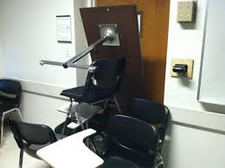
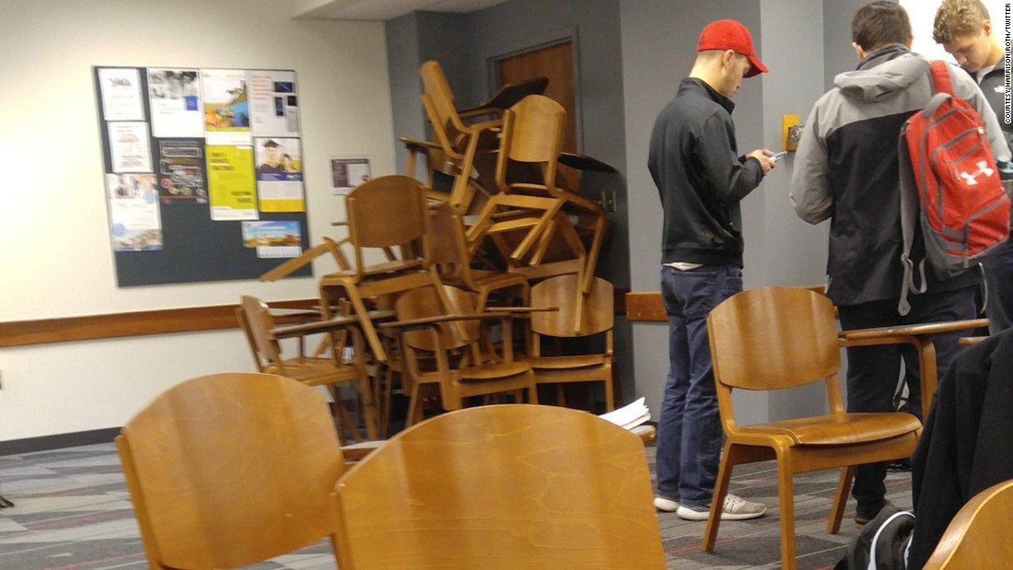
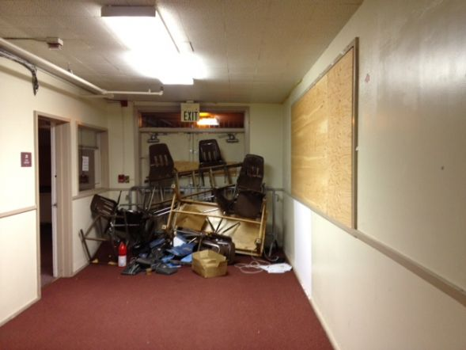
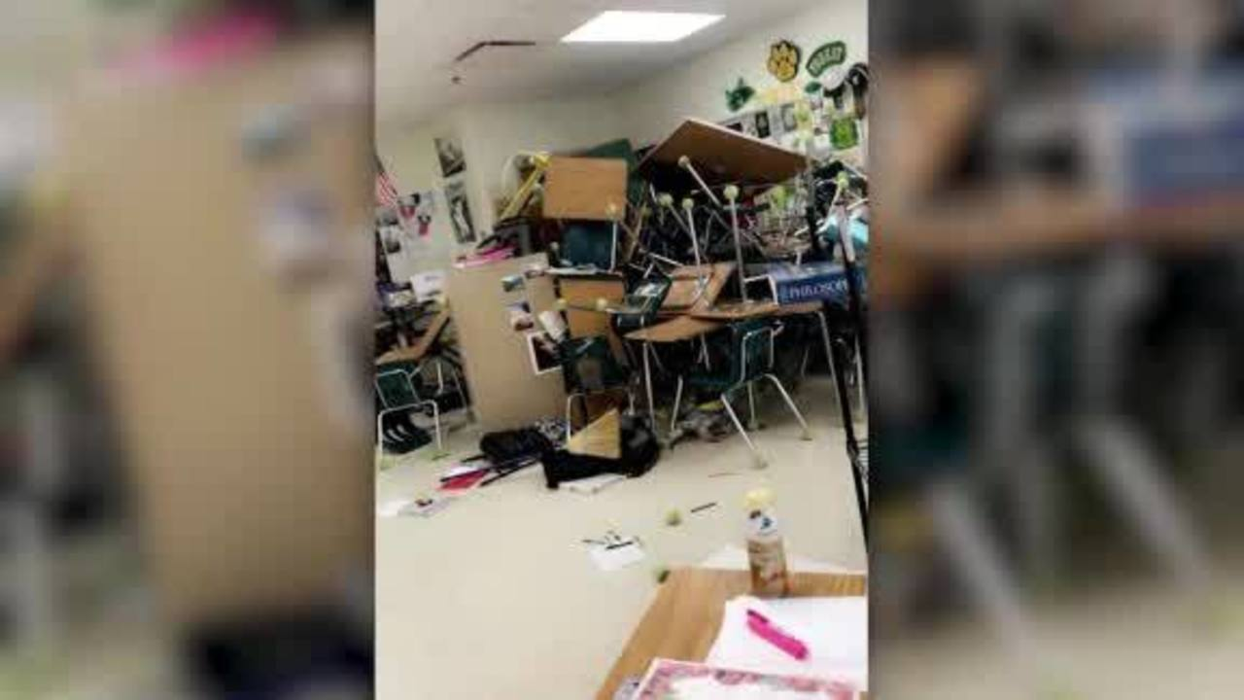
HIDE
KNOWLEDGE OF WHERE YOU ARE IN RELATION TO THE AGGRESSOR
IF YOU HAVE DECIDED YOU ARE TOO CLOSE TO THE THREAT, BARRICADE YOUR DOOR AND FIND ANYTHING TO FIGHT WITH (TABLE LEGS, STAPLERS, DESK DRAWERS)

Slide 13
FIGHT
THERE IS NO WAY I CAN EXPLAIN THIS TO YOU OTHER THAN…
AS STAFF AND ADULTS, WE ARE GUARDIANS OF OUR SCHOOL
PRESERVATION OF LIFE IS PARAMOUNT AND WE FIND THE SAFEST COURSE OF ACTION WHEN WE RESPOND
YOU CAN PREAPRE BY GOING THROUGH THE FOLLOWING SCENARIOS IN A RUN/HIDE/FIGHT DRILL ON THE NEXT SLIDE

Slide 14
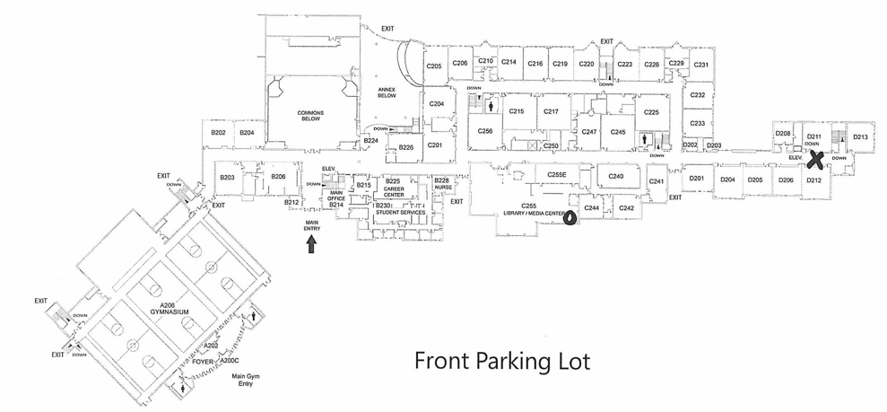
SCENARIO EXAMPLE
You are in the library during 2nd period.
There is a report of gunfire in the hallway of upper D unit.
WHICH RESPONSE WOULD GIVE YOU THE BEST CHANCE OF SURVIVING?
CRITICAL THINKING- LET THEM WALK THROUGH SCENARIOS AND GUIDE THE DISCUSSION TO THE SAFEST RESPONSE.
ALWAYS TIE IT BACK TO SAFETY- NOT BEING A HERO

Slide 15
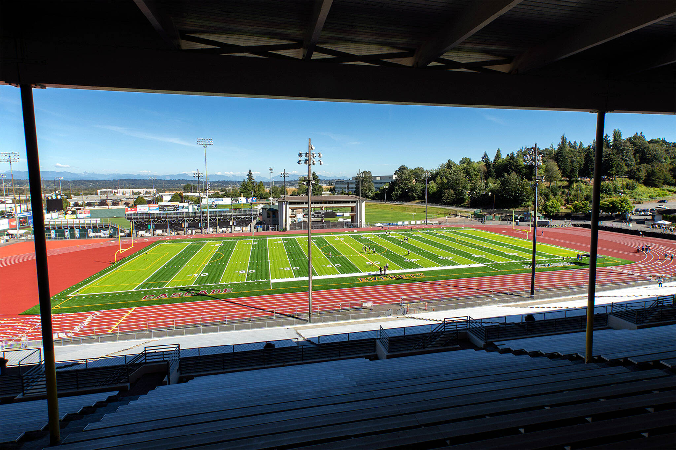
REUNIFICATION DRILL – OCT. 6
JACKSON HIGH WAS CHOSEN TO PARTICIPATE FIRST!!!!!!!
125 students including some students with special needs
35 + volunteers
Buses leave at 9:30am and return at 11:30am
CRC Workers will be there simulating the check in process, plus special services (nurse, counseling, etc.)
THANK YOU FOR BEING MEMBERS OF THE BEST SAFETY STAFF OF EPS!

Slide 16

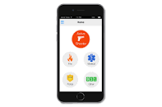
RAVE 911
1. Sign up if you don’t already have an account
2. See Jennifer Larson for help if you need it!

Slide 17

QUESTIONS?

