Slide 1
RUN, HIDE, FIGHT
How to decide what to do in case of a threat at school

Slide 2

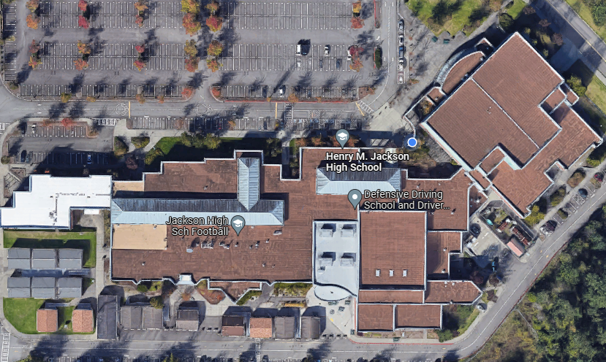
RUN/HIDE/FIGHT
THREAT IS INSIDE OF THE SCHOOL (ARMED INTRUDER)
  PARENT
  STUDENT
  STAFF MEMBER
  OUTSIDE THREAT THAT MADE ITS WAY INTO THE SCHOOL
IN RUN/HIDE/FIGHT NO ALL-CLEAR WILL BE GIVEN
DEPENDANT ON LOCATION OF THREAT

Slide 3
RUN/HIDE/FIGHT
YOUR DECISION WILL BE BASED ON YOUR KNOWLEDGE OF WHERE YOU ARE IN RELATION TO THE ANNOUNCED THREAT LOCATION
EVERYONE IS DIFFERENT AND WILL REACT DIFFERENTLY (STAFF AND STUDENTS ALIKE)
NO ONE WILL EVER ASK YOU, OR EXPECT YOU, TO DO SOMETHING THAT WILL ENDANGER YOUR LIFE OR THE LIVES OF YOUR STUDENTS
AN ANNOUNCEMENT OVER PA WILL INFORM RUN/HIDE/FIGHT
  ANYONE IN THE BUILDING CAN ANNOUNCE THIS
  RAVE 911 IN USE
  EVERY COP WITHIN A 50 MILE RADIUS WILL COME TO SUPPORT

Slide 4
RUN
KNOWLEDGE OF WHERE YOU ARE IN RELATION TO THE AGGRESSOR
SAFEST AND FASTEST WAY OUT OF THE BUILDING AND AWAY FROM THE SCHOOL
IN A PERFECT WORLD, YOU WILL BE ABLE TO GET YOU AND YOUR STUDENTS OUT IN A LOCATION TOGETHER (THIS IS NOT THE EXPECTATION, JUST GET OUT)

Slide 5
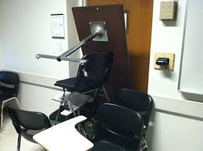
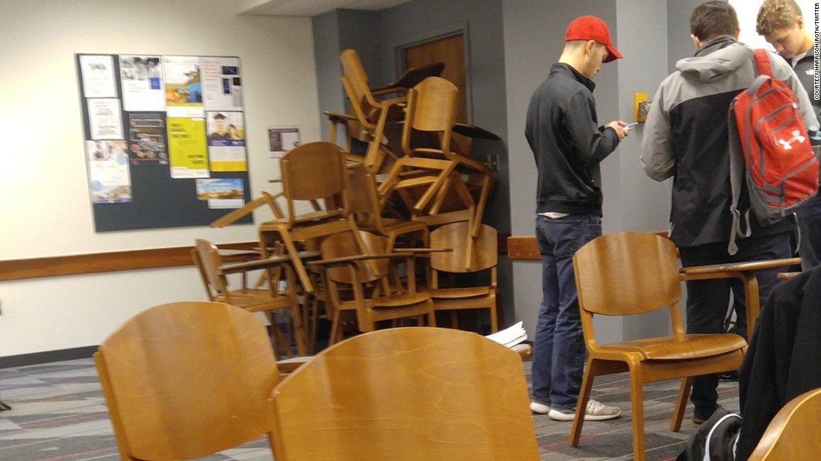
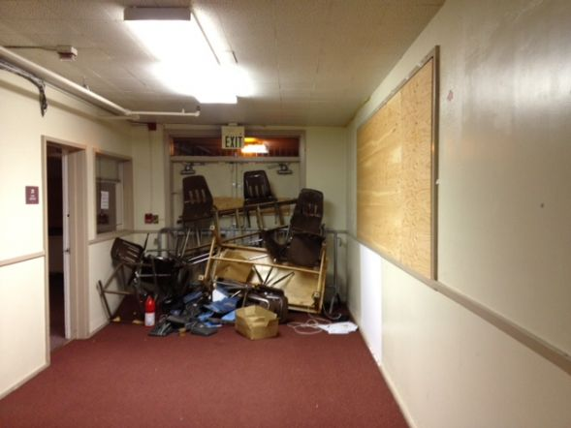
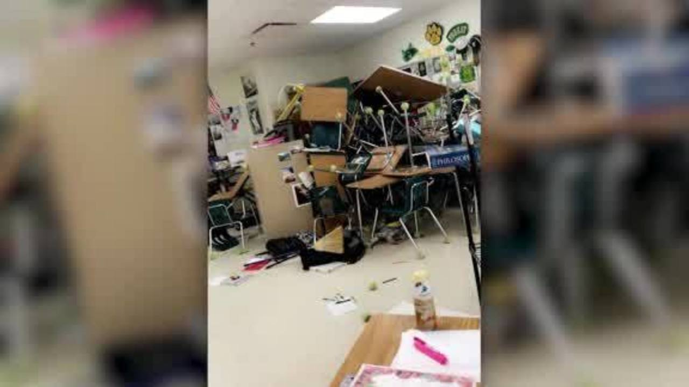
HIDE
KNOWLEDGE OF WHERE YOU ARE IN RELATION TO THE AGGRESSOR
IF YOU HAVE DECIDED YOU ARE TOO CLOSE TO THE THREAT, BARRICADE YOUR DOOR AND FIND ANYTHING TO FIGHT WITH (TABLE LEGS, STAPLERS, DESK DRAWERS)

Slide 6
FIGHT
THERE IS NO WAY I CAN EXPLAIN THIS TO YOU OTHER THAN…
AS STAFF AND ADULTS, WE ARE GUARDIANS OF OUR SCHOOL
PRESERVATION OF LIFE IS PARAMOUNT AND WE FIND THE SAFEST COURSE OF ACTION WHEN WE RESPOND
YOU CAN PREAPRE BY GOING THROUGH THE FOLLOWING SCENARIOS IN A RUN/HIDE/FIGHT DRILL ON THE NEXT SLIDE

Slide 7
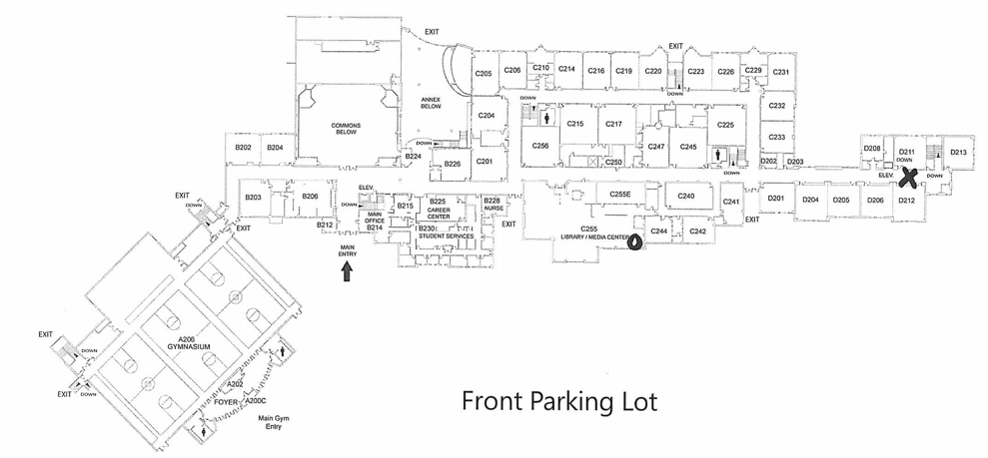
SCENARIO EXAMPLE
You are in the library during 2nd period.
There is a report of gunfire in the hallway of upper D unit.
WHICH RESPONSE WOULD GIVE YOU THE BEST CHANCE OF SURVIVING?
CRITICAL THINKING- LET THEM WALK THROUGH SCENARIOS AND GUIDE THE DISCUSSION TO THE SAFEST RESPONSE.
ALWAYS TIE IT BACK TO SAFETY- NOT BEING A HERO

