Slide 1
Best Practices in Selecting State Assessment
Supports and Accommodations
Everett Public Schools
Special Services and Assessment & Research
10/12/22

Slide 2
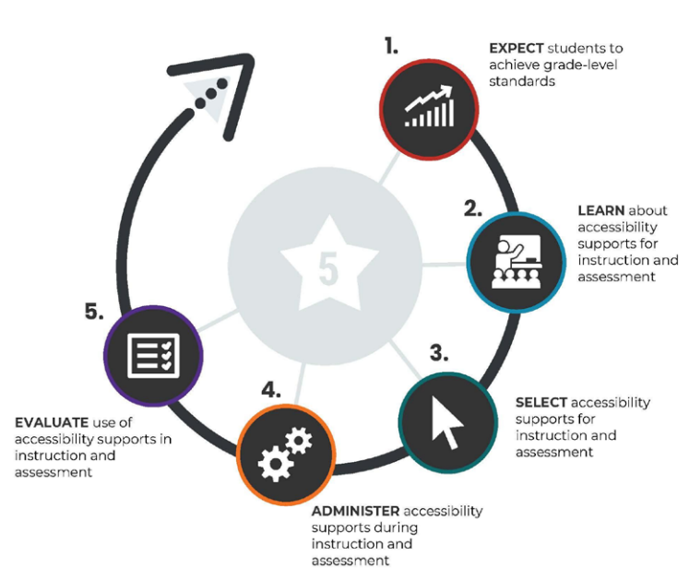
5-Step Decision Making
Notice that the CCSSO diagram separately indicates supports for classroom use versus assessment use.
Notes:
Council of Chief State School Officers

Slide 3

Supports and Accommodations: Key Concepts
Accuracy
Barriers
Cycle
Tools enable us to get an accurate picture of what students know
Tools correspond to specific disabilities and allow for more equitable access
Students are provided practice and feedback opportunities to identify appropriate tools
Key Questions
What are the student’s specific instructional and assessment needs?
How does facilitating the student’s access to curriculum, instruction and assessment support the goal of developing independence?
Is there a universal feature the student should not have?
Does the student need any designated supports or accommodations?
Notes:
Align the colors based on the colored graphic organizer

Slide 4

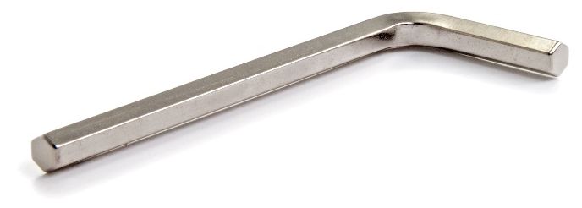


More is not more.

Slide 5


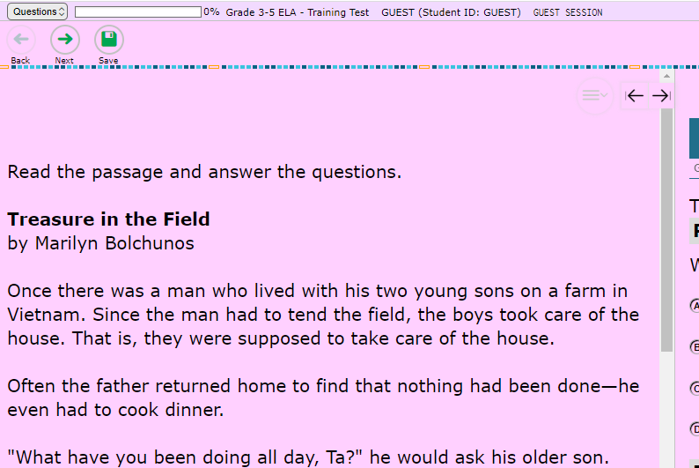

Embedded vs. Non
Embedded
Non-Embedded
Nautilus
Color Contrast

Slide 6





Tools and Support Types
Universal Tools
Test accessibility supports which provide access to all students automatically.
Designated Supports
Supports that mitigate a specific adult-identified barrier for any student who needs it
Highlighter
Breaks as needed
English glossary
world language glossary
color contrast

Slide 7


Tools and Supports Types
Universal Tools
Test accessibility supports which provide access to all students automatically.
Designated Supports
Supports that mitigate a specific adult-identified barrier for any student who needs it
Highlighter
Breaks as needed
English glossary
Accommodations
Supports that increase accessibility for students with specific barriers which the tool documented in their IEP or 504 plans mitigates.
closed captioning
braille

Slide 8
Choosing Accommodations Thoughtfully
  Some accommodations (marked with a lightning bolt) fundamentally change the assessment. For example, a reading test you listen to is now a listening test, preventing the student from demonstrating some skills.
Criteria 1: Documented Disability via IEP or 504
Does the student have a documented disability that pertains to the accommodation?
If yes, continue. If no, do not choose accommodation.
Criteria 2: Familiarity with Recommended Accommodation
Is the support utilized regularly as a classroom accommodation and during class assessment?
If yes, continue. If no, do not choose accommodation.
Criteria 3: Equitable Access to the State Assessment
Does the student need the accommodation to access the assessment?
Will the accommodation provide equitable access to the assessment, comparable to students without the specific disability noted in Criteria 1?
If yes, proceed with the accommodation.
If no, do not choose accommodation.
Notes:
Notes:
Left Column – any student can have this
Right column – only for IEP/504 students

Slide 9
Smarter Balanced Assessment and WA Comprehensive Assessment of Science
SBA ELA & Mathematics (online): grades 3-8, and 10
WCAS (online): grades 5, 8, and 11

Slide 10
Where to learn about SBA/WCAS Tools, Supports, and Accommodations
SBA/WCAS supports manual: Guidelines on Tools, Supports, and Accommodations for State Assessments (GTSA)
Guidelines on Selection: The Council of Chief State School Officers (CCSSO) Accessibility Manual - How to Select, Administer, and Evaluate Use of Accessibility Supports for Instruction and Assessment of All Students
Ways to see tools in action:
  Videos from California Assessment of Student Performance and Progress (CAASPP)
  Practice tests (instructions)

Slide 11
SBA/WCAS Dropdown Selection Options in Special Programs
See GTSA for information on all tools and supports, including those that are not included in IEP/504 dropdown boxes.

Slide 12


ATTENTION ISSUES
Noise Buffers
SBA; WCAS
Non-Embedded Designated Support
Description: Students use noise buffers (i.e. headphones)to block external sounds.
Recommended for Students with:
attention difficulties (distracted by external noises)
Separate Setting (Small Group)
SBA; WCAS
Non-Embedded Designated Support
Description: Any alteration of test setting
Note:
Recommended for Students with:
attention difficulties (easily distracted or may distract others)
Scribe
Read Aloud (human reader)
Read Aloud- Student (whisper phone)
Simplified Directions
Frequent breaks

Slide 13
Streamline
SBA; WCAS
Embedded Designated Support
ATTENTION ISSUES
Description: Displays the items below the stimuli instead of side by side. Video clip
Note:
Students often find Streamline Interface challenging to use– students must be given an opportunity to practice using this accommodation extensively.
Appears automatically when “zoom test level with streamline” or “Translations (dual language) Test Spanish” are coded.
Recommended for Students with:
specific learning and/or reading disabilities
Regular Screen: Streamline:
Passage
Question 1
Passage
Question 2
Question 1
Question 2
Question 3
Question 3

Slide 14
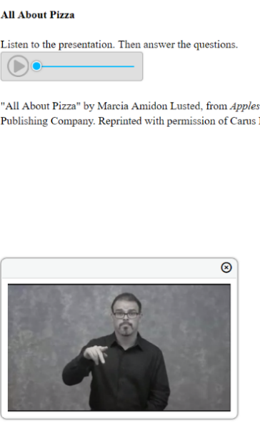
HEARING IMPAIRMENT
ASL Video
SBA
Embedded Accommodation
Description: Test content is translated into ASL displayed in a video. ASL human signer and the signed test content are viewed on the same screen. Video clip
Recommended for Students with:
hearing impairments, who use ASL as their primary form of communication
ASL (Human Signer)
WCAS
Non-Embedded Accommodation
Description: Test content is translated into ASL by a human signer.
Recommended for Students with:
hearing impairments, who use ASL as their primary form of communication

Slide 15
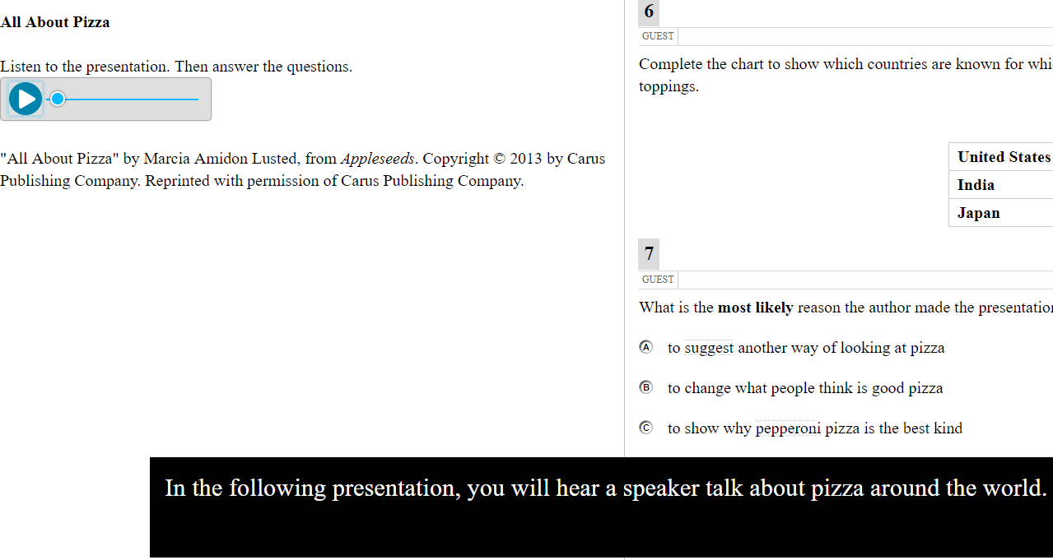
HEARING IMPAIREMENT
Closed Captioning
Math and ELA CAT (Listening)
Embedded Accommodation
Description: Printed text that appears on the computer screen as audio materials are presented. Video clip
Note:
If you choose closed captioning and ASL video, the closed captioning will appear and may block the ASL video.
Recommended for Students with: hearing impairments.

Slide 16
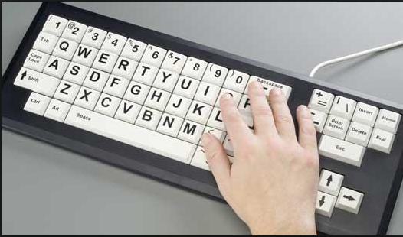
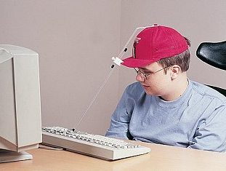
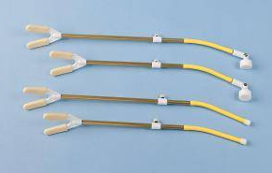
Alternate Response Options
SBA; WCAS
Non-Embedded Accommodation
PHYSICAL
Description: Alternate response options include but are not limited to adapted keyboards, large keyboards, StickyKeys, MouseKeys, FilterKeys, adapted mouse, touch screen, head wand, and switches.
Recommended for Students with:
physical disabilities (including both fine motor and gross motor skills)

Slide 17
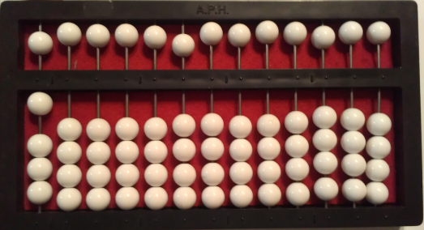
VISUAL IMPAIRMENT
Abacus
SBA
Non-Embedded Accommodation
Description: This tool may be used in place of scratch paper for students who typically use an abacus.
Note:
Rekenrek are also permitted.
Student must be familiar with an abacus and use it regularly.
Recommended for Students with:
visual impairments
Braille
SBA; WCAS
Non-Embedded Accommodation
Description: Test provided in braille format.
Note:
Paper braille as well as online test braille options, and braille tools available.
Recommended for Students with:
visual impairments (who can read text via braille well)

Slide 18
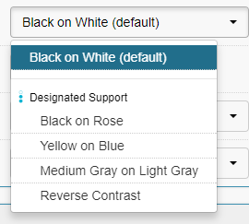
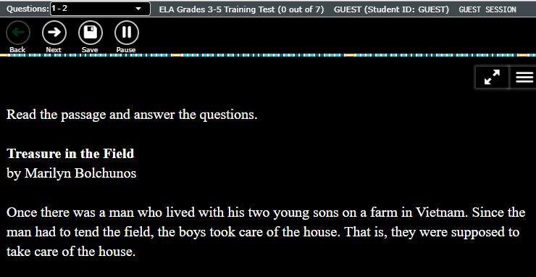
Color Contrast
SBA; WCAS
Embedded Designated Support
VISUAL IMPAIRMENT
Description: Enables staff to select alternate background and font color, based on student need. Student cannot adjust the color scheme. Video clip
Note:
  Staff member must sit with student to select desired color scheme.
  When box is checked in IEP/504, the color scheme will be changed to medium grey on dark grey (see below). If the student needs a different color scheme you must have a school coordinator code it manually in TIDE.
Recommended for Students with:
  attention difficulties
  visual impairments or other print disabilities (including learning disabilities)
Sample:
Notes:
Notes:
Staff member must sit with student to select desired color contrast before the testing.

Slide 19
VISUAL IMPAIRMENT
Magnification Assistive Tech
SBA; WCAS
Non-Embedded Designated Support
Description: Non-embedded magnification software, or physical magnifier.
Note:
Special Services will also code for Permissive Mode, which is required for outside software to work when the Secure Browser is open.
Recommended for Students with:
visual impairments or other print disabilities (including learning disabilities)
Zoom 3x
SBA; WCAS
Embedded Universal Tool
Description: Set whole test to default to 3x zoom
Note:
Will require significant scrolling
Students can select to increase the text and graphics using the Zoom Out and Zoom In by up to 3x.
An additional embedded zoom tool is available for hand coding: “Zoom test level with streamline”. It allows zooming 5x-20x, but changes the screen composition.
Recommended for Students with:
visual impairments or other print disabilities (including learning disabilities)
Notes:
Notes:
A5: Zoom – This is embedded support . The images and font size is magnified but not the other button.
B1: Magnification Assistive Tech – Non-embedded support. The entire screen can be magnified.

Slide 20
VISUAL IMPAIRMENT
Print on Demand
ELA CAT
Embedded Accommodation
Description: Students can push the print on demand button to request to print everything on their screen at any given time.
Note:
Students must have a specific need for viewing part of the test in print.
Only students coded with this accommodation have a print on demand button.
Teacher must approve request and have access to a printer in the room.
A very small percentage of students should need this accommodation.
Recommended for Students with:
visual impairments

Slide 21
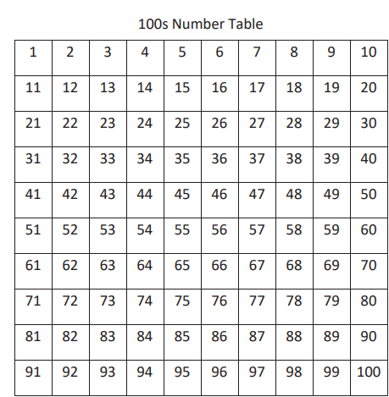
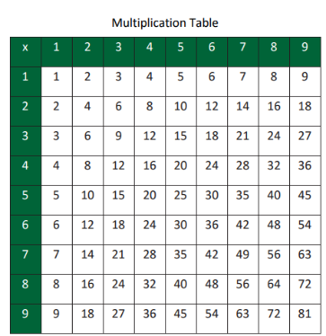
OTHER
100s Table
Math SBA
Non-Embedded Accommodation
Description: A table listing numbers from 1–100 from WCAP Portal.
Note:
Must be the Smarter Balanced provided table.
Recommended for Students with:
visual processing difficulties
spatial perception difficulties
Multiplication table
Math SBA
Non-Embedded Accommodation
Description: A single digit (1–9) multiplication table from WCAP Portal.
Note:
Must be the Smarter Balanced provided table.
Recommended for Students with:
documented and persistent calculation disability (i.e., dyscalculia).

Slide 22


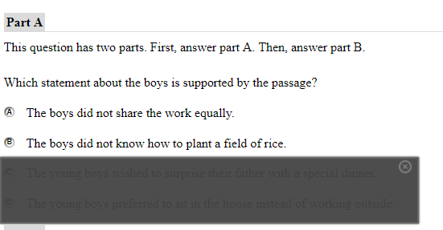
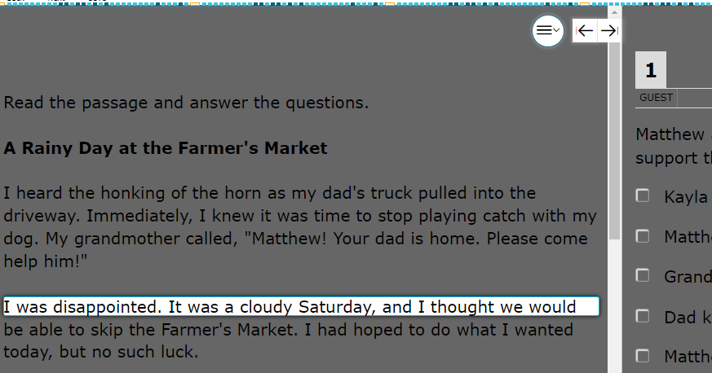
OTHER
Masking
SBA; WCAS
Embedded Designated Support
Description: Masking allows students to draw boxes over the screen to cover and reveal content as needed. Video clip
Recommended for Students with:
attention difficulties
print disabilities (including learning disabilities)
visual impairments
Hybrid Masking Tool
SBA; WCAS
Embedded Designated Support
Description: Alters line reader to show only a single line of text, while loosely obscuring the rest of the screen.
Recommended for Students with:
attention difficulties
print disabilities (including learning disabilities)
visual impairments

Slide 23
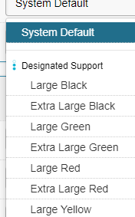
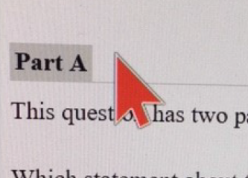
OTHER
Medical Supports
SBA; WCAS
Embedded Designated Support
Description: Allows student access to medical devices, which may include a cell phone. The device can only be used for medical purposes during testing
Note:
The student will require close monitoring and separate setting.
It is important that the student understands the device rules, as accessing the device for non-medical use will invalidate their assessment.
Recommended for Students with:
(most commonly) glucose or seizure monitoring needs
Mouse Pointer
SBA; WCAS
Embedded Designated Support
Description: Change the size or color of the mouse pointer.
Note: Code in IEP/504 only if you want extra large, black.
Code manually for any other mouse selection.
Recommended for Students with:
attention difficulties
print disabilities (including learning disabilities)
visual impairments

Slide 24
Word Prediction
SBA; WCAS
Embedded Accommodation
OTHER
Description: Student uses button in test to allow students to begin writing a word and choose from a list of words that have been predicted from word frequency and syntax rules.
Recommended for Students with:
significant and ongoing use of word prediction software in the classroom
significant documented motor or orthopedic impairments
moderate to severe learning disabilities that prevent students from recalling, processing, or expressing written language

Slide 25
Simplified Test Directions
SBA; WCAS
Non-Embedded Designated Support
OTHER
Description: A student’s normal 1:1 support ( must be proctor trained and Simplified Test Direction trained) paraphrases the test directions read from the Test Administrator Script.
Note:
All students may receive Technical Assistance from their proctors on how to use the Secure Browser– including logging in.
Requires special permission.
Simplified Test Directions:
  Applies only to the “say” instructions in the TA Script
  Teachers must be trained on State Guidelines
  1:1 only-- a single proctor with a single student for the duration of the test.
  Cannot include defining words or concepts.
  Cannot include anything from the student screen.
  Cannot prompt or influence student responses.
  Cannot be made up at the moment; proctors must be familiar with and practiced in reading and simplifying the “say” instructions. Writing down the simplified directions ahead of time is encouraged.
Recommended for Students with:
regular classroom accommodation: read aloud test instructions

Slide 26
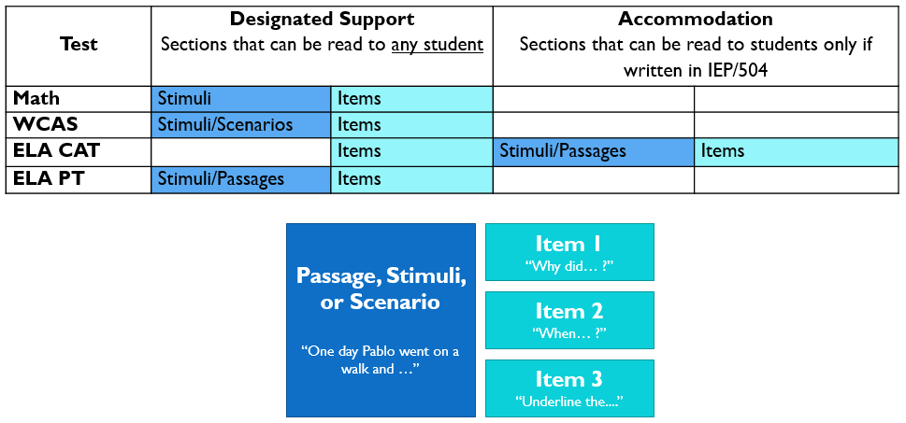
What is covered by Text-to-Speech and
Read Aloud (Human Reader)
OTHER
Can the student understand computer speech? If yes, select TTS.
Remember Read Aloud is a 1:1 support.
Notes:
Notes:
Left Column – any student can have this
Right column – only for IEP/504 students

Slide 27
Read Aloud at Two Levels
OTHER
Read-Aloud Designated Support
All subjects except reading
Description: Trained and qualified human reader reads aloud appropriate sections of the assessment to the student.
Note:
Does not include ELA CAT reading passages/stimuli.
Must be provided in 1:1 setting.
Recommended for Students with:
visual impairments
reading struggles that impact accessing the assessment
Read-Aloud Accommodation
All subjects including reading
Description: Trained and qualified human reader reads aloud all sections of the assessment to the student.
Note:
Must be provided in 1:1 setting.
Requires an IEP/504.
Only 1-2% of IEP/504 students should be using this accommodation.
Recommended for Students with:
Physical or visual impairments that prevent students from being able to access reading passages in any other way (i.e. a blind student who does not read braille)
Notes:
Notes:
B3: Read-Aloud (Oral) - Non-Embedded Designated Support = Reading skill is not being assessed.
D9: Read-Aloud (Oral) ELA CAT Passages/Stimuli -Non-Embedded Accommodation = Reading skill is being assessed. The student has no means of reading the text because of his/her impairment i.e. blind

Slide 28
Text-to-Speech at Two Levels
OTHER
Text-to-Speech Designated Support
All subjects except reading
Description: Computer reader reads aloud appropriate sections of the assessment to the student.
Note:
Does not include ELA CAT reading passages/stimuli.
Requires headphones.
Students can control speed and volume.
New for ‘20-’21: will read back constructed responses
Recommended for Students with:
visual impairments
reading struggles that impact accessing the assessment
Text-to-Speech Accommodation
All subjects including reading
Description: Computer reader reads aloud all sections of the assessment to the student.
Note:
Requires an IEP/504.
Requires headphones.
Students can control speed and volume.
Only 1-2% of IEP/504 students should be using this accommodation.
New for ‘20-’21: will read back constructed responses
Recommended for Students with:
Physical or visual impairments that prevent students from being able to access reading passages in any other way (i.e. a blind student who does not read braille)
Notes:
Notes:
A4: Text-to-Speech - Embedded Designated Support = Reading skill is not being assessed.
C4: Text-to-Speech ELA CAT Passages/Stimuli - Embedded Accommodation = Reading skill is being assessed. The student has no means of reading the text because of his/her impairment i.e. blind

Slide 29
Scribe at Two Levels
OTHER
Scribe Designated Support
All subjects except the full write
Description: Students dictate responses to appropriate items to a trained and qualified Scribe who records responses verbatim.
Note:
Requires 1:1 proctoring
Recommended for Students with:
motor or processing difficulties (i.e. dyslexia)
Scribe Accommodation
All subjects including the full write
Description: Students dictate responses to any or all items to a trained and qualified Scribe who records responses verbatim.
Note:
Requires 1:1 proctoring
Recommended for Students with:
significant documented motor or processing difficulties (i.e. dyslexia) and use a scribe regularly in the classroom, because it is the only way to demonstrate composition skills.
Recent injury that prevents typing or writing comfortably. Must submit an Incident Report and hand code in TIDE for students with temporary injuries.
Notes:
Notes:
B4: Scribe - Non-Embedded Designated Support: Student has difficulty writing responses and in this assessment he is not being tested/assessed for his writing skill for example for composing an essay.
D10: Scribe - ELA PT Segment 2 (Full Write) - Non-Embedded Accommodation: = The student is being assessed for his writing skills. It is impossible for student to write or compose an essay.

Slide 30
Speech-to-Text (Voice Recognition)
SBA; WCAS
Embedded Accommodation
OTHER
Description: Student uses embedded voice recognition button in the test to allow students to use their voice to dictate responses.
Note:
Students using Chrome extensions or Microsoft accessibility tools (native software/freeware) would use this.
Students who command their computer operation should be coded for Voice Command.
Recommended for Students with:
significant documented motor or processing difficulties (i.e. dyslexia), use it regularly in the classroom, because it is the only way to demonstrate composition skills

Slide 31
Voice Command
SBA; WCAS
Non-Embedded Accommodation
OTHER
Description: Student uses non-embedded voice recognition software to allow students to speak commands to their computer, as well as dictate responses.
Note:
Dragon Speak Naturally is recommended
Very uncommon– if the student does not command the computer by dictation, code for Speech-to-Text (embedded).
Recommended for Students with:
significant documented motor or processing difficulties (i.e. dyslexia), use it regularly in the classroom as it is the best way to control their computer.

Slide 32
English proficiency test supports and accommodations
WIDA Screener
WIDA ACCESS
WIDA Alternate ACCESS

Slide 33
WIDA Basics
WIDA Screener
All students in K-12 who may qualify for Title III or Multilingual Learner services will be screened for program qualification using WIDA Screener.
WIDA ACCESS
All ML qualifying students K-12 will be tested annually to determine progress and ongoing program eligibility.
  WIDA ACCESS for Kindergarten
  WIDA ACCESS Online (1-12)
  WIDA Alternate ACCESS (for students with significant cognitive disabilities)

Slide 34
Understanding WIDA Administrative Considerations
WIDA has more flexible administrative practice than SBA/WCAS. Most designated supports and universal tools available for SBA/WCAS are available for WIDA, but do not require coding, these are called “administrative considerations”. For example:
  Alternate response options
  Separate setting
  Amplification
  Noise buffers
  Color contrast/overlay
  Magnification

Slide 35
WIDA Accommodations
Accommodations to Code in IEP/504 Plans
Extended speaking test response time
Paper/pencil: standard or large print
Manual control of item audio
Repeat item audio
In-person human reader
Repeat in-person human reader
Scribe
ASL Interpreter (test directions)
Paper braille
SBA/WCAS tools and settings lists will be provided to WIDA coordinators to plan administration.
However, WIDA coordinators may need to chat with you about how to best administer the assessment for your students.

Slide 36
WIDA Dropdown Selection Options in Special Programs
See Accessibility and Accommodations Manual for information on all tools and supports, including those that are not included in IEP/504 dropdown boxes.

Slide 37
Audio Control
AUDIO WIDA
WIDA assessments are automatically read aloud by a recorded human reader. This audio plays 1 time when the student arrives on the page.
Manual Audio Control
Description: Allows the student to control when the audio is played by clicking a button.
Recommended for Students with:
Attention/behavior related disabilities
Processing disorders
Hearing related disabilities
Repeat Item Audio
Description: Student is provided a button to play audio again, an unlimited number of times in all domains except listening (which allows a single repetition only).
Recommended for Students with:
Attention/behavior related disabilities
Processing disorders
Hearing related disabilities

Slide 38
In-person Human Reader
AUDIO WIDA
Nearly everything on screen is automatically read aloud by a recorded human reader. This audio plays 1 time when the student arrives on the page.
In-person Human Reader
Description: Specially trained adult reads aloud the portions of the test that are not already read by the recorded reader:
Listening answer options
Writing test prompt materials
Text included in graphics.
Note:
Requires 1:1 with specially trained reader.
Recommended for Students with:
Attention/behavior related disabilities
Processing disorders
Hearing related disabilities
Repeat In-person Human Reader
Description: Allows the student to request repetition of the human read text as many additional times as needed in speaking and writing. Listening does not allow repetition.
Note:
Requires 1:1 with specially trained reader.
Recommended for Students with:
Attention/behavior related disabilities
Processing disorders
Hearing related disabilities

Slide 39
Paper/Pencil Test: standard Size or Large Print (with district approval)
VISUAL WIDA
Standard or Large Print
Description: Students will take paper tests fully administered by specially trained proctors.
Note:
Consider using adaptive tech to magnify or otherwise adapt online test.
Requires district approval
Requires 1:1 proctoring
Requires special training
Shorter window
Recommended for Students with:
significant need for a paper test that cannot be resolved by any other accommodations or administrative considerations
Braille
Description: Students will receive a full braille set of materials and can braille responses
Note:
Student must be fluent braille user
Requires district approval
Requires 1:1 proctoring
Requires special training
Shorter window
Recommended for Students with:
significant need for a braille test that cannot be resolved by any other accommodations or administrative considerations
Notes:
Notes:
B4: Scribe - Non-Embedded Designated Support: Student has difficulty writing responses and in this assessment he is not being tested/assessed for his writing skill for example for composing an essay.
D10: Scribe - ELA PT Segment 2 (Full Write) - Non-Embedded Accommodation: = The student is being assessed for his writing skills. It is impossible for student to write or compose an essay.

Slide 40
OTHER WIDA
Scribe
Description: Specially trained adult types dictated writing responses into the test system.
Note:
Most students can click to select their own answers using various accessibility supports as needed. If the student needs a scribe to drive the computer, contact Assessment & Research.
Recommended for Students with:
motor or processing difficulties (i.e. dyslexia) and who use a scribe regularly in the classroom and on assessments
recent injury that prevents typing. Principal must submit an Incident Report to request emergency scribe coding.
Extended Speaking Response Time
Description: Students will receive twice the standard recording time to record speaking responses.
Note:
This refers specifically to the window wherein the student can speak to have it recorded.
Recommended for Students with:
Cognitive, language processing, physical or communication disabilities which causes them to need additional processing time for spoken language.
Notes:
Notes:
B4: Scribe - Non-Embedded Designated Support: Student has difficulty writing responses and in this assessment he is not being tested/assessed for his writing skill for example for composing an essay.
D10: Scribe - ELA PT Segment 2 (Full Write) - Non-Embedded Accommodation: = The student is being assessed for his writing skills. It is impossible for student to write or compose an essay.

Slide 41
OTHER WIDA
ASL Interpreter
Description: Specially trained adult who is fluent in ASL (or another signed system) interprets the directions and practice items, but not the actual test items.
Note:
No test content may be interpreted.
Contact Quiana Hennigan directly for coding.
Student must be a strong signer.
Recommended for Students with:
hearing disabilities who are strong signers
Notes:
Notes:
B4: Scribe - Non-Embedded Designated Support: Student has difficulty writing responses and in this assessment he is not being tested/assessed for his writing skill for example for composing an essay.
D10: Scribe - ELA PT Segment 2 (Full Write) - Non-Embedded Accommodation: = The student is being assessed for his writing skills. It is impossible for student to write or compose an essay.

