Slide 1


Ukrainian student association club
Presentation by Viktoriia Nahorna

Slide 2
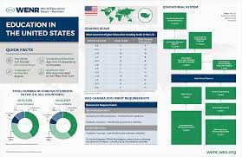
Why school need this club?
This club cans support Ukrainian student and shows they not alone in new county .American school system is very different with Ukrainian system. In this club we can explain how it work. Other culture student , who join our club, can learn more about Ukrainian culture.

Slide 3

What can you do in this club?
Give support
Communication with student your nationality
Give help with understanding US school system
Watch movie
Drawing
Ukraine history
Play game
Walk with your new friends
Ukrainian food
Ukrainian song

Slide 4

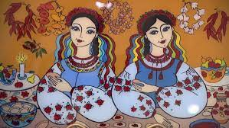
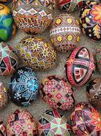
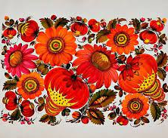
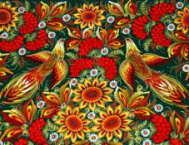
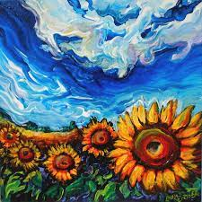
Drawing
Ukraine is art country . In this club you can try make some pictures in specific Ukrainian style.

Slide 5
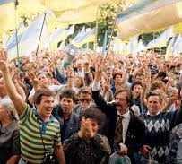
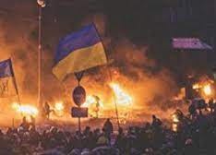
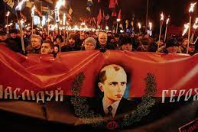
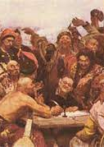
Ukraine history
People , who don’t know anything about Ukrainian history, can learn a lot of interesting information .
Ukrainian people , who already Know something , can discus about some historical moments.

Slide 6
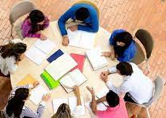
Help with homework to each other.
A lot of kids , who immigrate from other county, can have problem with understanding school material .Our club can help you .Club members can help you understand your homework because most of them already had this lesson or have this now. If you join our club , You will have less questions like:
What is mean?
How correct spelled this worlds?
How connect with people in lesson , where you don’t have people who speak the seme language?

Slide 7
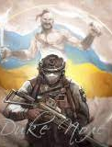
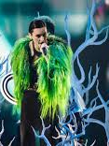
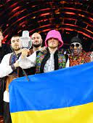
Ukrainian song
Song is important part of country because it is this county people voice .

Slide 8

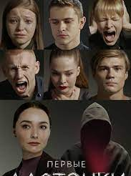




Watch movie (most time we prefer Ukrainian films)
We have two way how do it:
1)We can watch movie in Ukrainian language with English sub titer.
2)We can watch movie in English language with Ukrainian sub titer.(It can help understand more American slang)

Slide 9
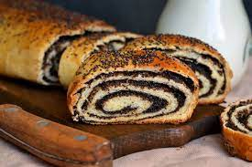
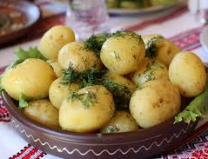
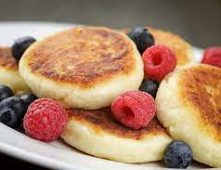
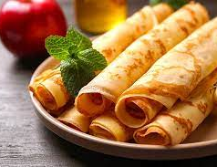
Ukrainian food
Ukraine is county who have a lot of different dishes and all of them different but special for all people. We plan a have a few days , when club members will bring their favorite food and we think most of this food will be Ukrainian.

Slide 10
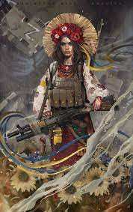
Thank you for attention

