Slide 1
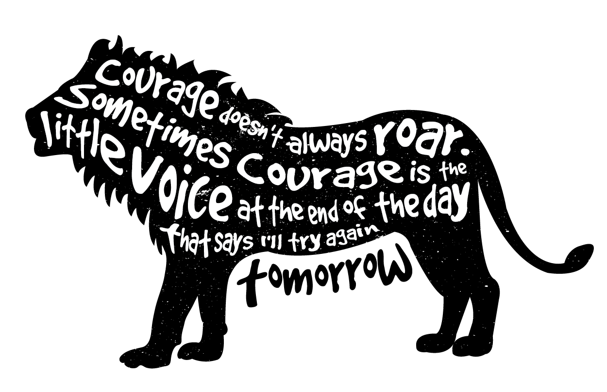
Define and consider: What do I NEED, to feel (or to be) courageous in today’s conversation?

Slide 2
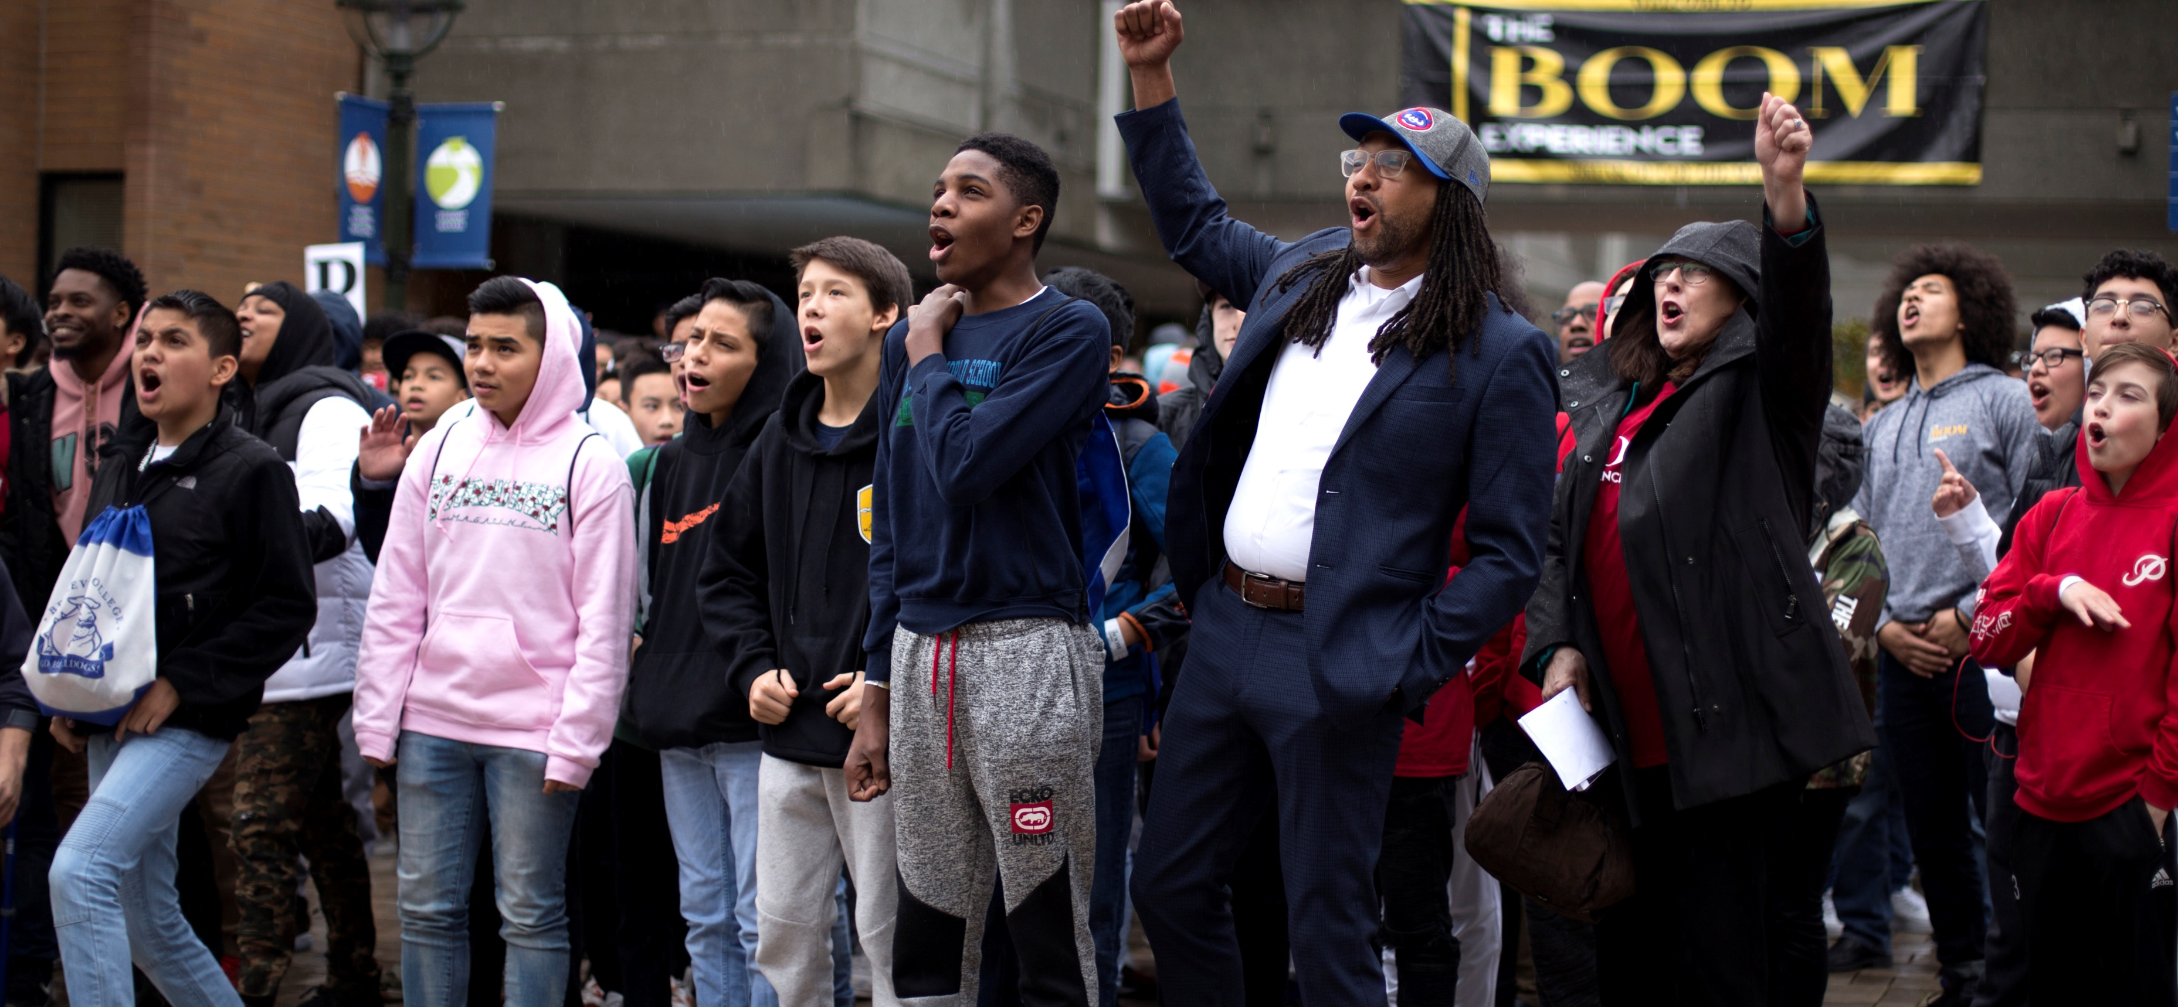
SHOMARI JONES
EQUITY AND ORGANIZATION TRANSFORMATION LEADER

Slide 3

Culturally Responsive Teaching
employing effective practices related to Culturally Responsive Teaching. This work aligns with our ongoing efforts to create an inclusive and welcoming school culture in which each student feels a deep sense of belonging
Beginning the journey
Understanding and having a shared definition of DEI terminology
Small group breakout session activity.
Q&A

Slide 4
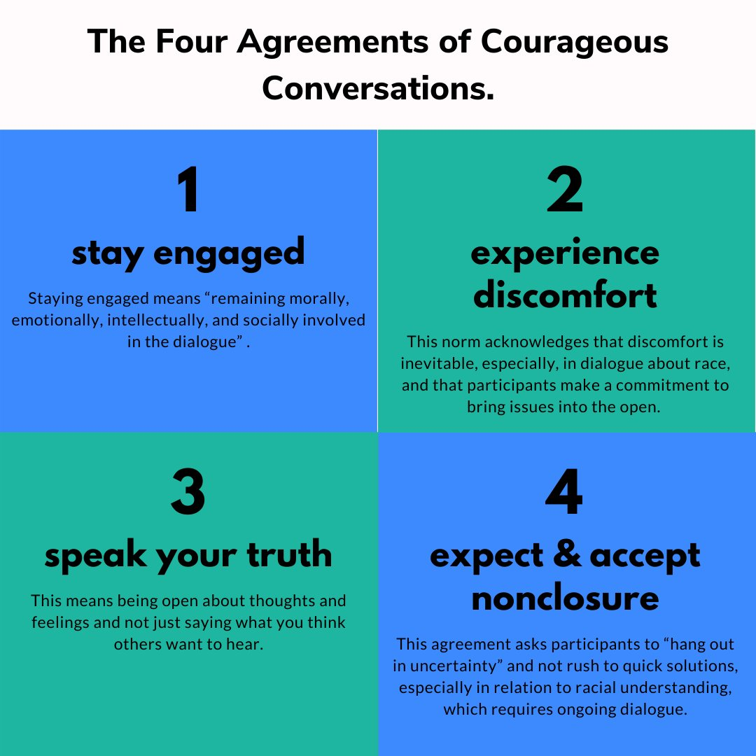


Slide 5
Equitable Practices

Slide 6


Slide 7
WHAT IS YOUR PERSONAL EXPERIENCE OF BELONGING (Positive or Negative) AND HOW DOES THAT INFLUENCE HOW YOU SERVE STUDENTS IN YOUR BUILDING.

Slide 8


Mindful Inquiry:
How it works:
  Speaker shares thoughts on the topic of focus without interruption (2 min)
  Listener completely focuses on the speaker and resists the urge to share his/her own ideas, even ones that are affirming
  Listener processes information/prepares to share summary (30 seconds)
  Listener summarizes, asks questions or seeks clarity,
  Speaker may respond during this time (2 min)
Listener can say:
  What I heard you say was…
  Tell me more about what you meant by…
Tell me more about what you meant by…
What I heard you say was…
Notes:
Shomari

Slide 9

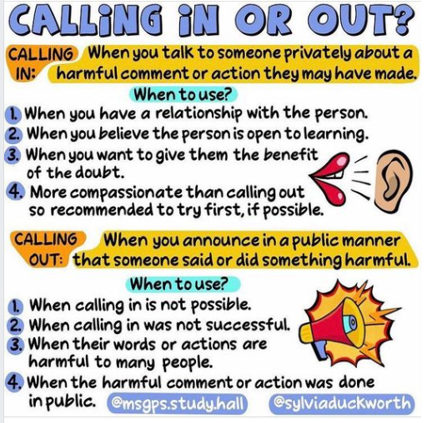

Slide 10
DIVERSITY
EQUITY
INCLUSION
The state of having a group with different identifiers or characteristics.
The quality of being fair or impartial.
The state of being when all people in a diverse group are valued, leveraged, and welcomed within a given setting.
Differences in identity include: race, gender, sexuality, age, disability, religion, class, caregiver status, veteran status, etc.
Equity recognizes that advantages and barriers exist, and that, as a result, we all don’t all start from the same place.
“Diversity is being asked to the party. Inclusion is being asked to dance.”

Slide 11
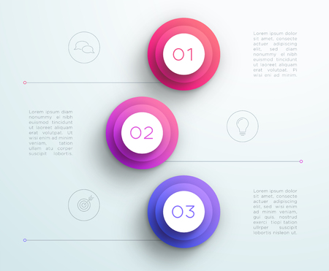
What are 3 things you believe will create a more equitable environment for our students?

Slide 12
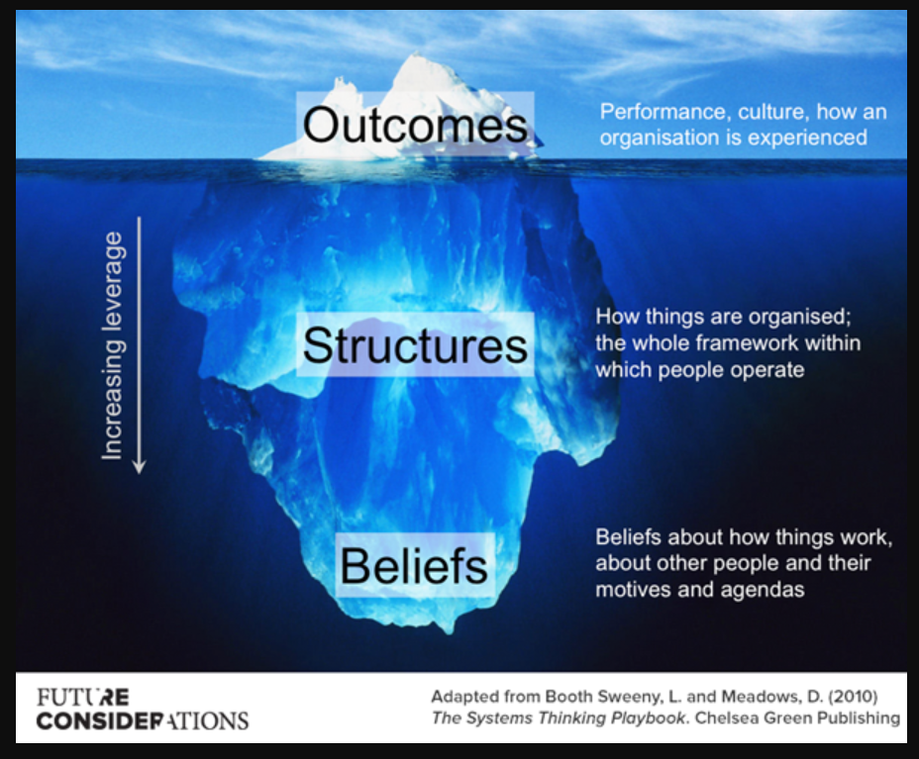

Slide 13
Students with a high sense of belonging are happier, healthier, and more engaged learners... and less likely to skip school, abuse substances, have emotional distress, or be involved in fighting or bullying behavior.

Slide 14
SENSE OF BELONGING
Be an Active Listener
Encourage faculty and staff to share their experiences—and then be an active listener.
We can cultivate belonging through the power of telling our own story and receiving others’ stories, both personal and collective
Storytelling is a vehicle for forming and changing community.
Foster Supportive Spaces
Intentionally created spaces can cultivate belonging, allowing for the mutual exchange of authenticity and vulnerability.
Share Your Authentic Self
While it can be risky to put our authentic selves out there and address the feeling of being othered, it is through this process that we and others can truly grow.
Continue To Engage
Continue engaging in these discussions, and to actively pursue further reading and learning on the subject.

Slide 15
Categorization leads to the creation of an “in group” and an “out group.”
in-group
out-group
People like us.
People not like us.
Neurologically, we’re more likely judge harsher, not get to know, and not humanize people in our out-group.

Slide 16
It is always there, and will always be trying to influence you.
Accept that bias is second nature, but keep in mind that it’s second nature.

Slide 17
Pay attention!
Question your first impressions and leave room for that first impression to be changed.
Become a scientist of your own behavior.

Slide 18
https://www.facebook.com/NCStateCED/videos/why-is-it-important-for-students-to-feel-a-sense-of-belonging-at-school-ask-the-/139781581677478/?_rdr

Slide 19
WHERE WILL YOU BEGIN THIS YEAR?

Slide 20
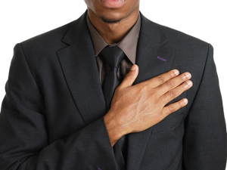
I PLEDGE…

Slide 21
Homework
What area in your life do you want to water and nourish this year, so you can show up for yourself and be impactful in your work/relationship/caring for a parent/whatever your focus is?

Slide 22
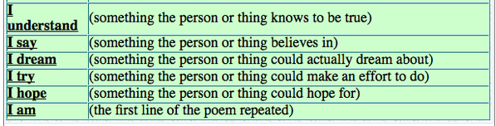


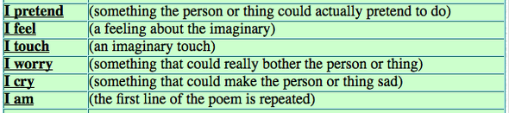
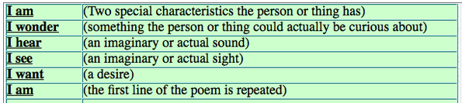
Poetic Justice: If you Knew me…
I Understand… | (Something you know to be true)
I Say… | (Something you believe in)
I Dream… | (Something you could or DO actually dream about)
I Try… | (Something you could or DO make an effort to do )
I Hope… | (Something you could or DO hope for)
I AM… | (NOT SIMPLY YOUR NAME)

