Slide 1

September 2, 2021

Slide 2
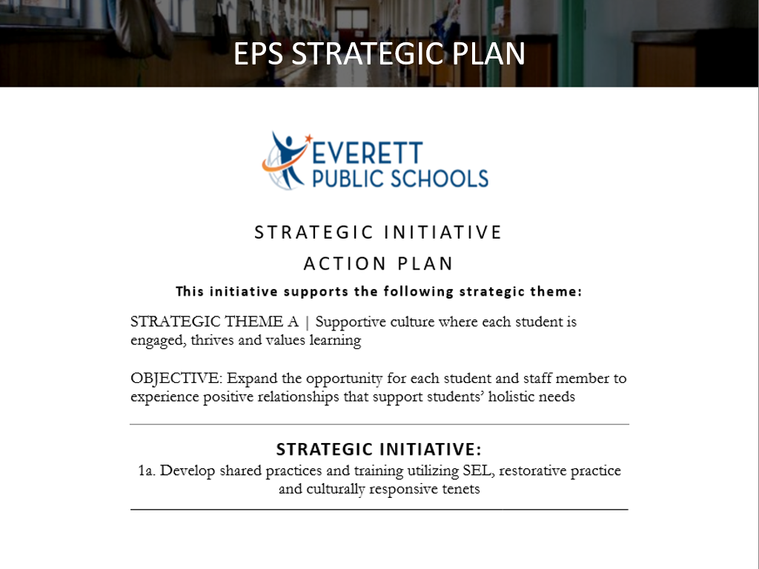
Notes:
Points to touch on:
-Here to introduce a new SEL Program being implemented district wide
-Emphasize this is core goal for district strategic plan to improve the district for EVERYONE
-Creating shared language and culture to support students and staff

Slide 3
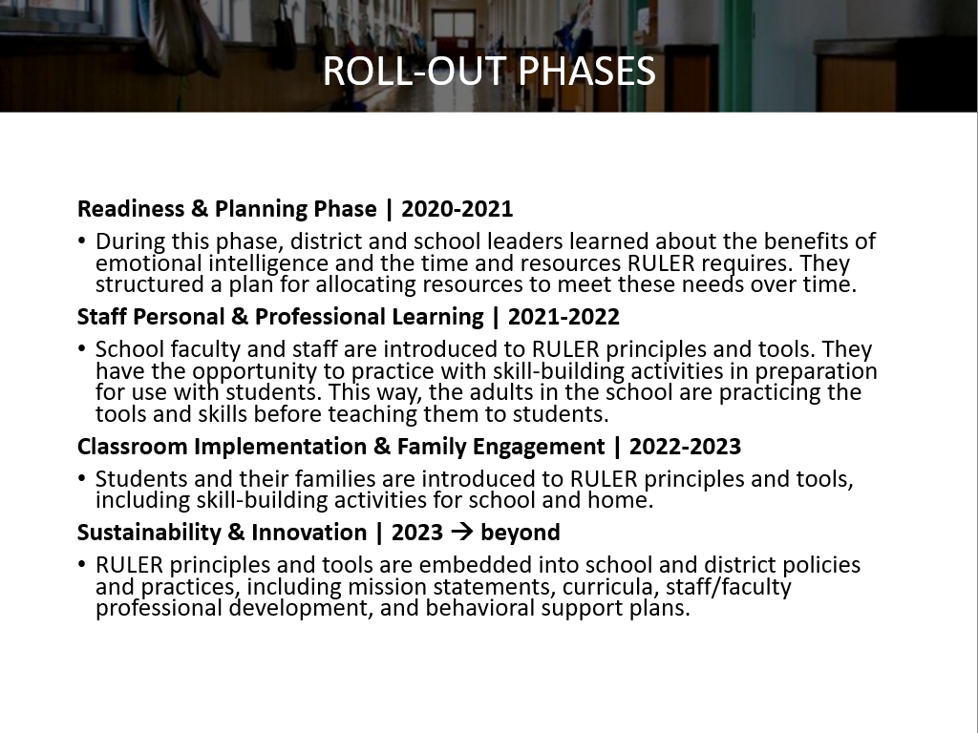
Notes:
Points to touch on:
-We (HMJHS) were trained during 2020-2021 school year on RULER. We learned about SEL, how RULER supports SEL for students AND staff, and how to plan for successful implementation.
-2021-2022 is devoted ENTIRELY to educating ALL staff on RULER and helping our adult community feel comfortable within our school culture. Additionally, we want staff to have true buy-in with this as not just a passing initiative, but as something that is supportive for adults as well as students.
-After this year, the goal is to roll this out school-wide to students and eventually families, community members, and all stakeholders to HMJHS.

Slide 4

Notes:
https://youtu.be/YUkAF8oPYtw

Slide 5
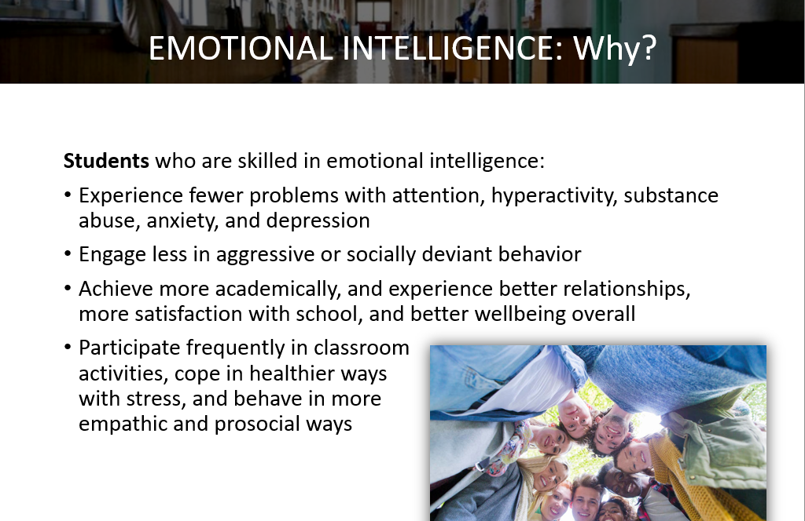
Notes:
Points to touch on:
-SEL learning and intelligence is important for all. It also connects to success in all areas of life.
-When we are better equipped to understand the manifestation of different emotions, we can communicate, support, and interact more efficiently with fellow adults AND our students.
-

Slide 6
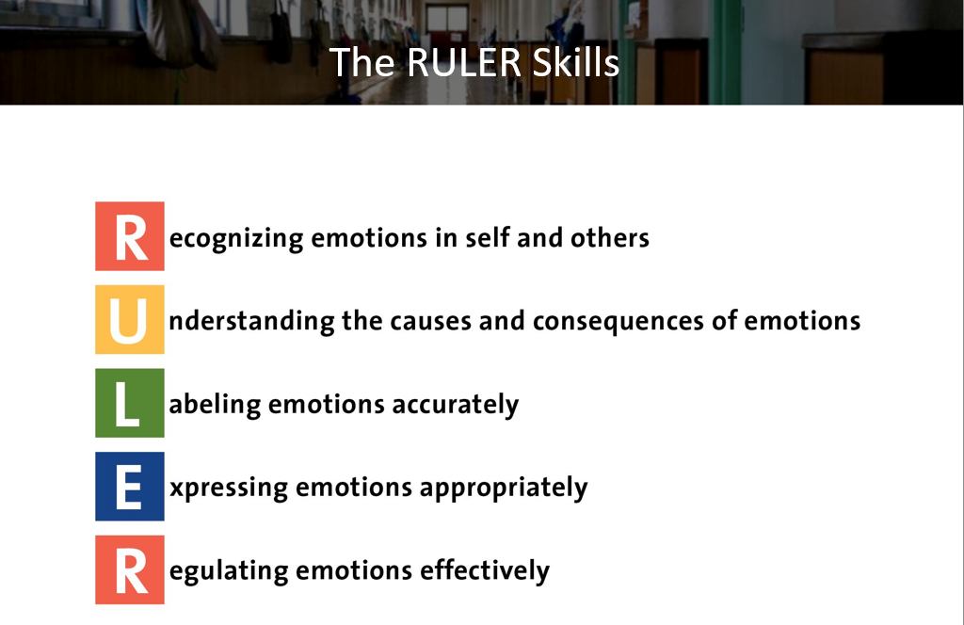

Slide 7
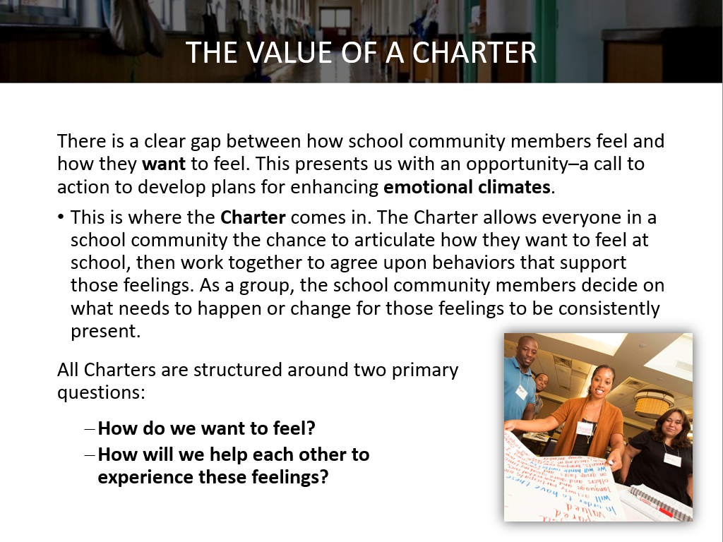
Notes:
Points to touch on:
-There is a gap between how school community members feel and how they WANT to feel – with this, we are called to enhance our emotional climate.
-Charter – Core RULER activity - community members work together to decide what needs to happen or change for emotional support to be consistently present
-2 main questions

Slide 8
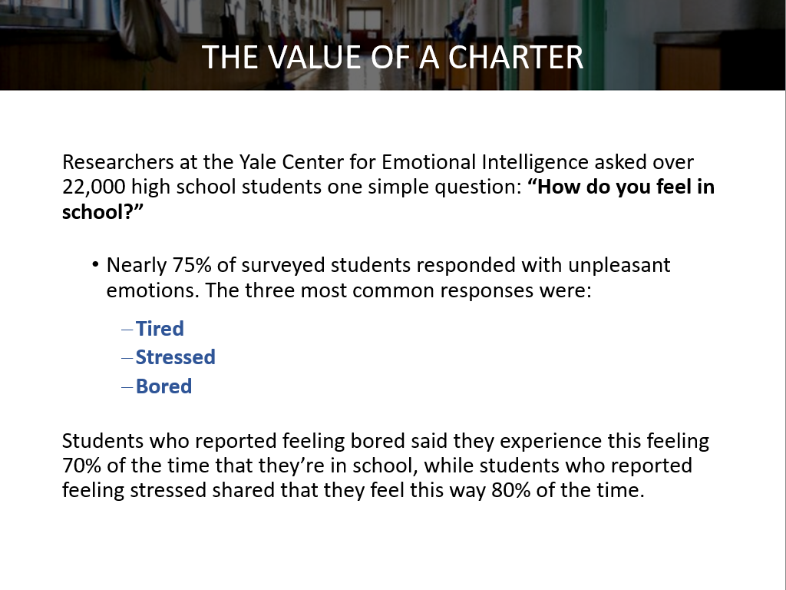

Slide 9
Developing a Charter
Step 1: How do you want to feel?
  List 3-5 feeling you want to experience each day while at school (HMJHS)
    What specific emotions would you like to experience each day?
    Do some words have similar meanings? If so, group them together and choose the distinct words that best represent your feelings

Slide 10
Developing a Charter
Step 2: Consolidate your answers
  In small groups, combine lists to create a shared list of 5-8 feeling words
    Are there words that are similar? If so, group them together and determine which one(s) are most important to include
  This process would continue (combining groups and their words) until the whole team (school) has developed a final list of 5-8 words.

Slide 11
Developing a Charter
Step 3: How will we help each other experience these feelings?
  Each group (small groups as before) identifies 1-3 specific and observable behaviors for EACH feeling
    This process would continue (combining groups and specific and observable behaviors) until the whole team (school) has developed a final list of 1-3 behaviors for each previously identified feeling.
  For each feeling, agree upon what specific and observable behavior YOU can/will be able to engage in on a daily/weekly basis.

Slide 12
Developing a Charter
Step 4: Share the Charter
  Once complete, print, sign, and Charter somewhere visible so it can be referred to and revisited as needed.
  Designate a Charter committee who will be responsible for creating, sharing, and maintaining the charter.
Step 5: Discuss keeping the Charter alive
  The Charter is a living document and should be kept ALIVE!!

