Slide 1
PCAD
2/9/2022
(Re) Building Community
Notes:
Pass paper as participants enter
Slides 1-3: 5 minutes
Jenn introduce us,other will pass out FN paper, Jenn have participants fill in the EQ. Expectation is to take notes as we work today, pausing to allow you to put down ideas (modeling use of FN)

Slide 2
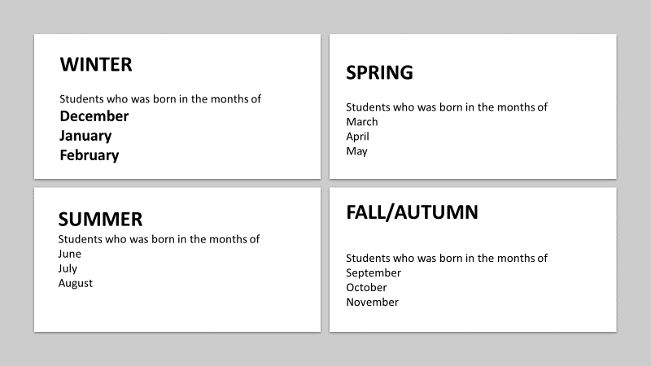
Who am I? and Seasonal Groups
Notes:
Rose

Slide 3
Would you rather? Acrostic Poem
Vote on your feet:
Prepare a few Would You Rather statements
Acrostic Poem
Have students shout out seven letters and avoid using less commonly used letters such as Q,X, and Z. Group the letters into two groups.
Have students create poems using the letter provided as the first letter of each line.
Notes:
Chiu-Hsin

Slide 4
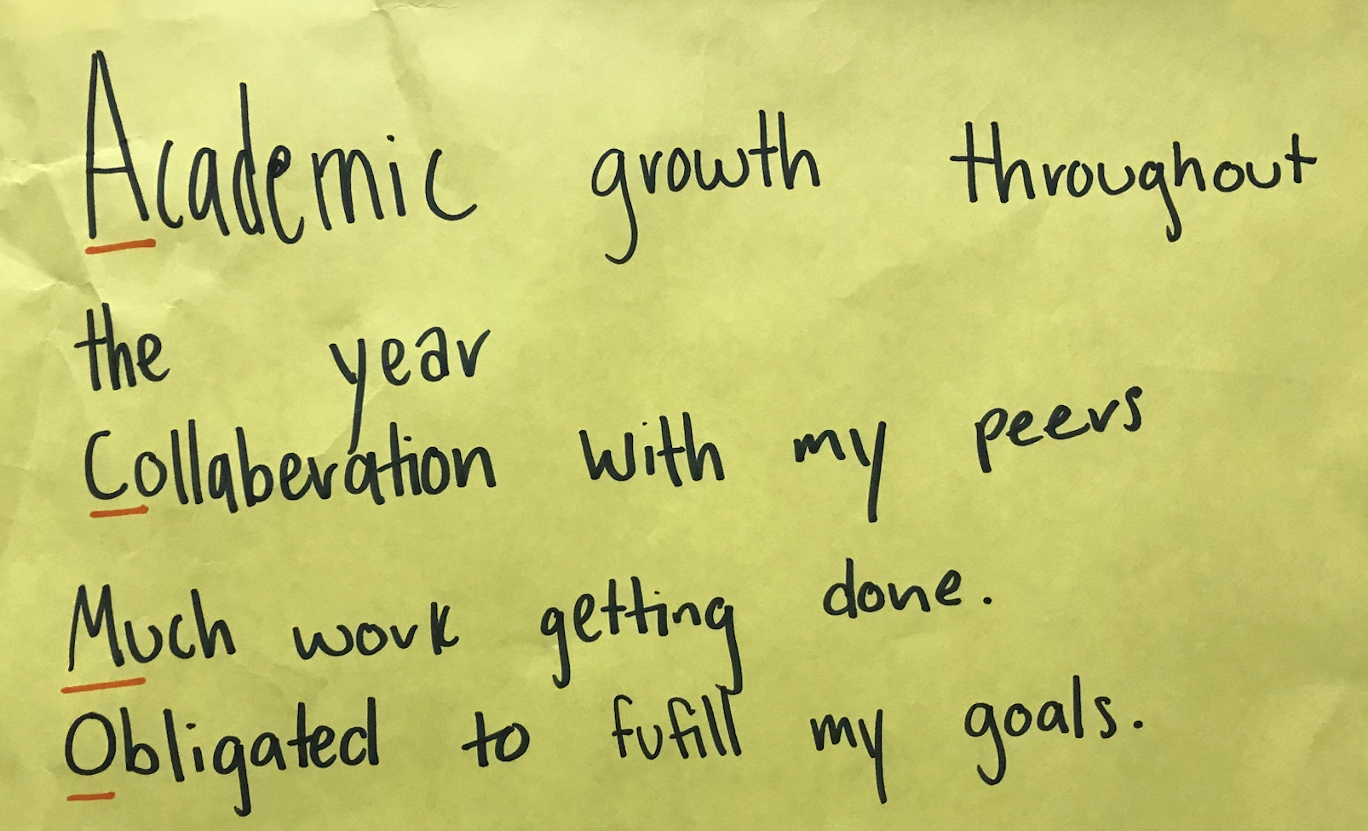
Would you rather? Acrostic Poem
Connect the poem to the course content students are learning.
No rhyming or poetic protocols needed
Two stanzas
Notes:
Chiu-Hsin

Slide 5
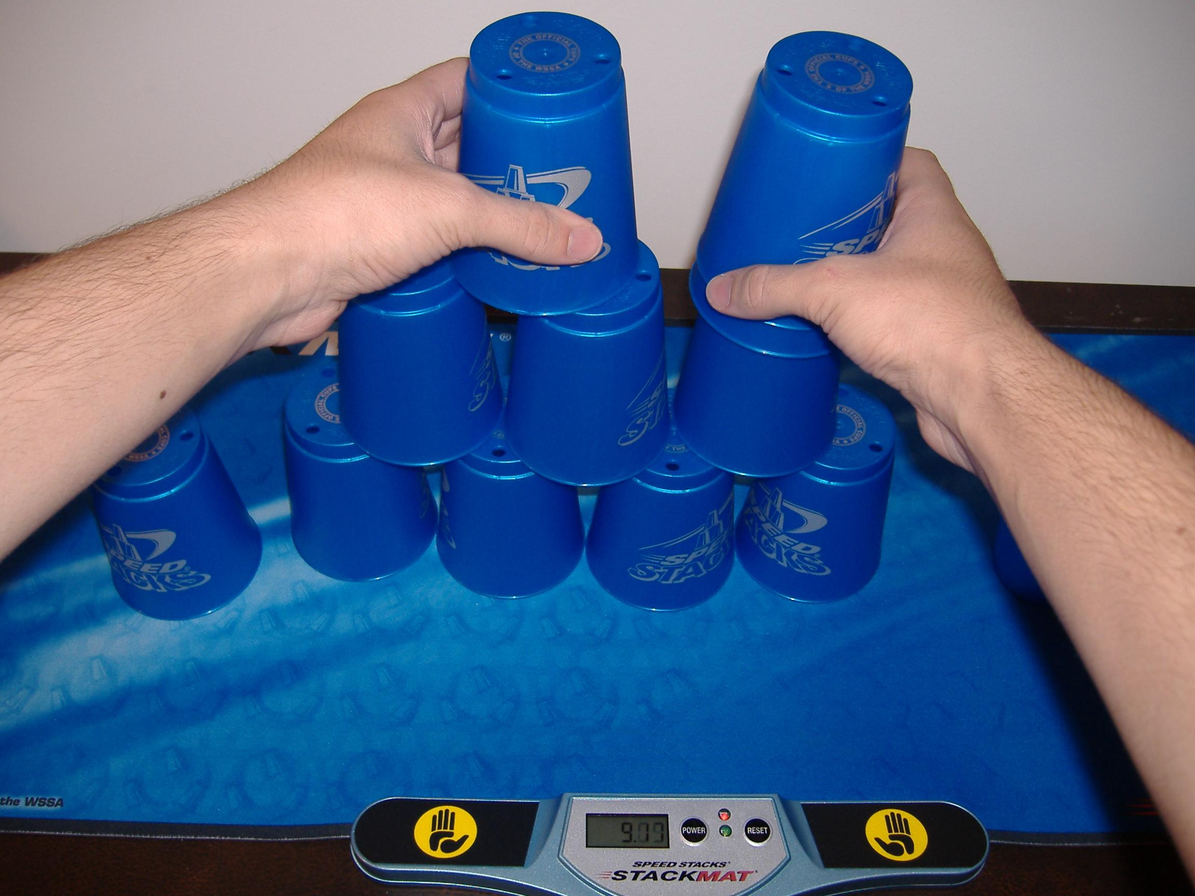
Challenge by Teams
Attendance points
Group Brainstorm (most ideas, most unique ideas)
“Engineering” or “Minute to Win It” activities
Prizes each week/month for winners
Notes:
Gail

Slide 6
Other Ideas from PCAD Attendees
“Cocktail Party” as personalities within a lesson. (This idea came from Bridget Shee, who uses it for history, but could also be fun for an English or language class!)
Variation on “Would you rather” - create a spectrum of agree/disagree and then fold the line for discussion. (This idea came from another group, but I believe I heard it came from Lance - I could see it work well for a wide range of classes!)

