Slide 1
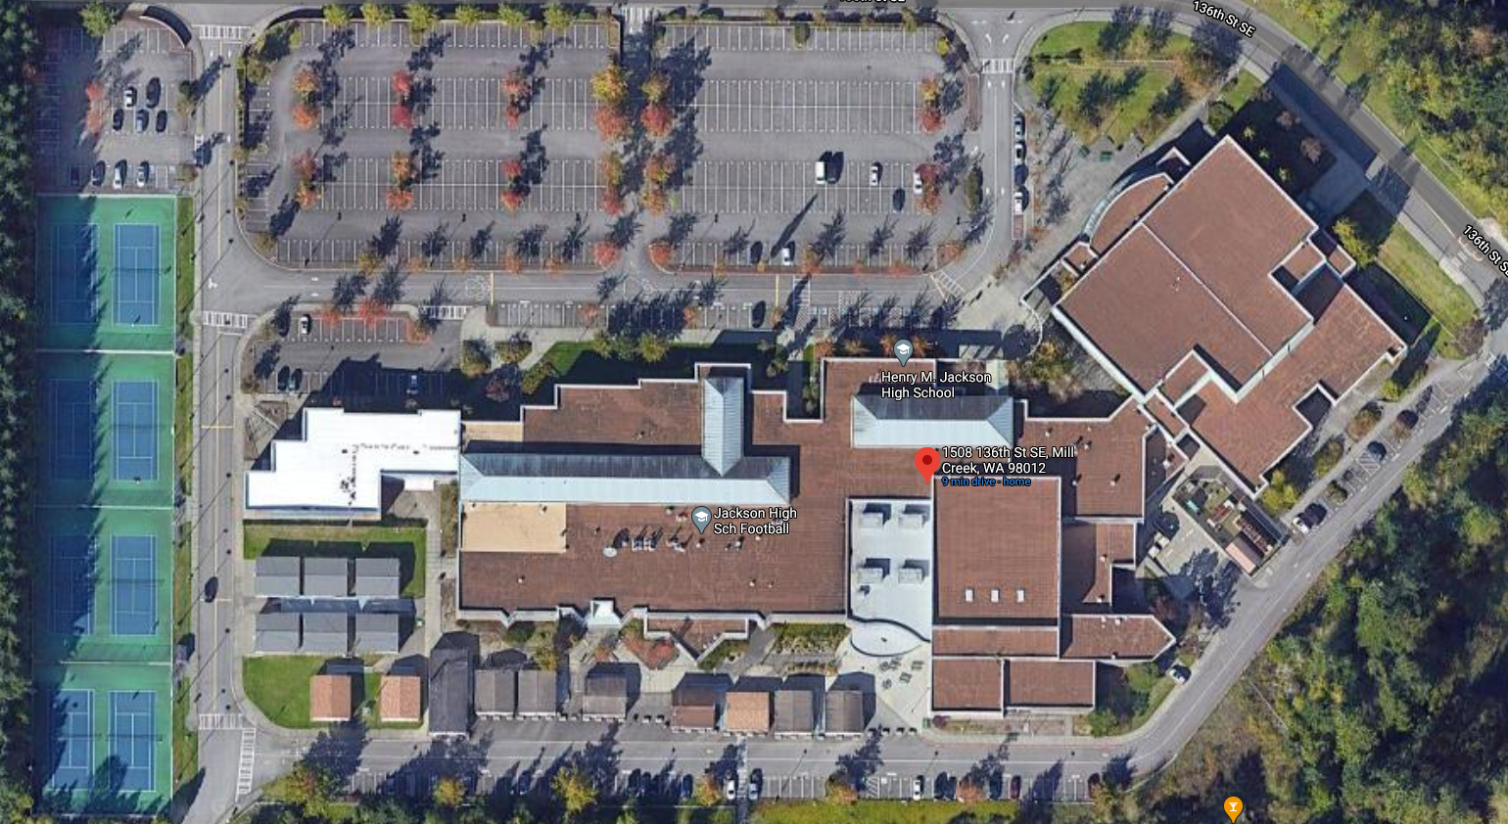
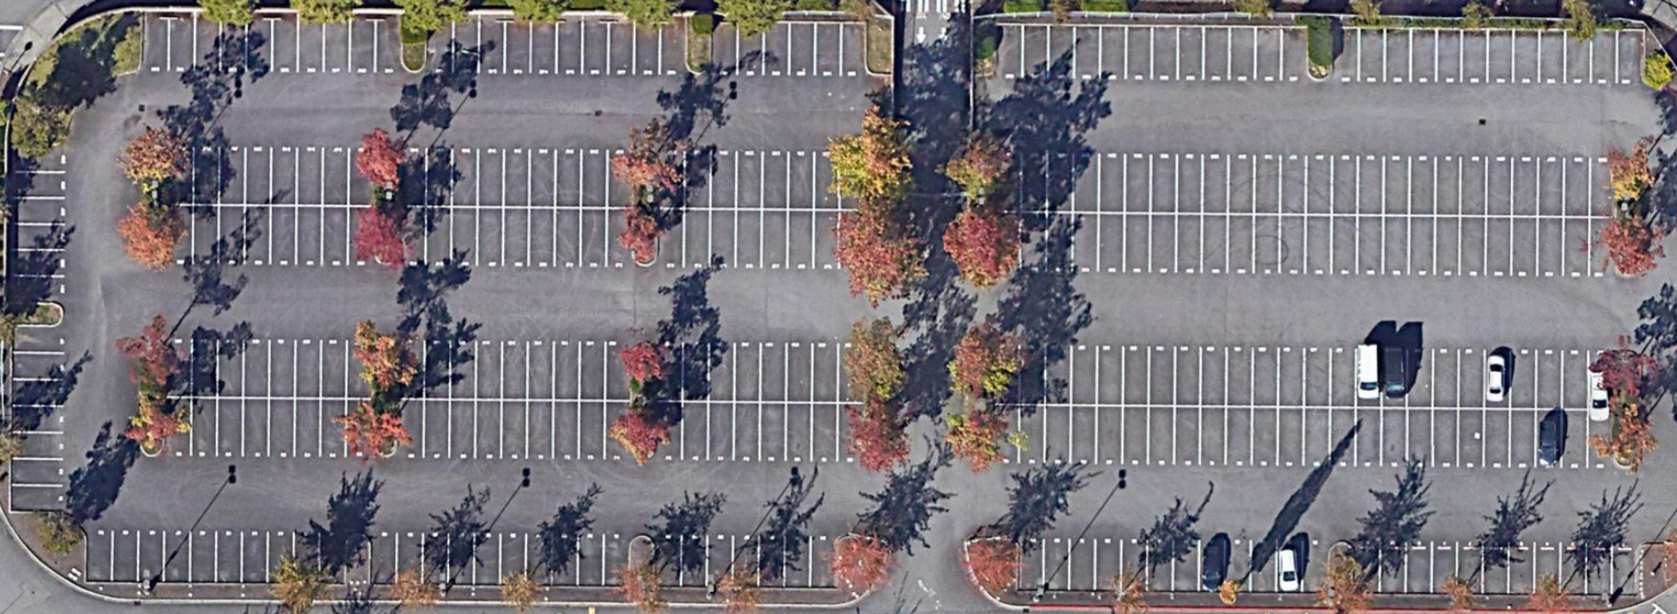
MAIN LOT
260 - 285
286 - 309
253 - 229
228 - 205
254 - 259
156 - 180
181 - 204
155 - 131
130 - 107
51 - 57
58 - 82
83 - 106
50 - 24
23 - 1

Slide 2
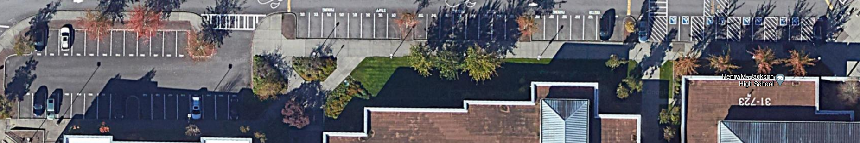
FRONT OF SCHOOL PARKING
PARKING BY D WING ENTRANCE
570 - 594
558 - 569
557 - 542

Slide 3
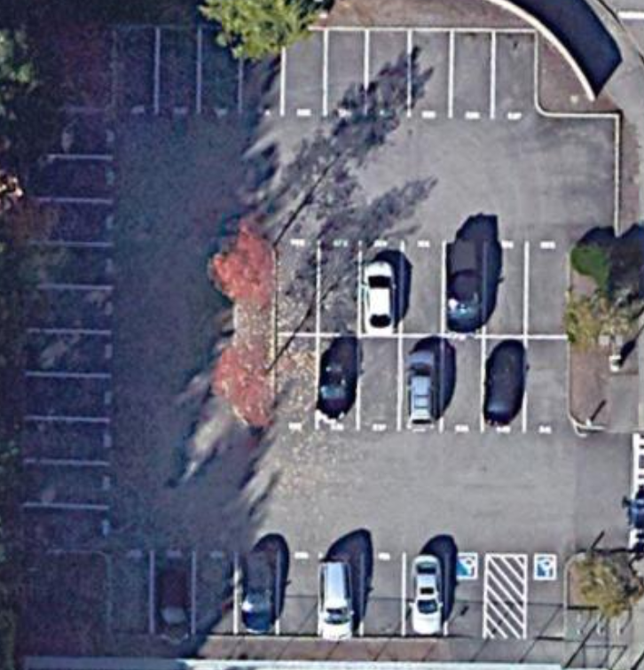
518 - 527
PARKING BY TENNIS COURTS
534 - 528
508 - 517
535 - 541
507 - 500

Slide 4
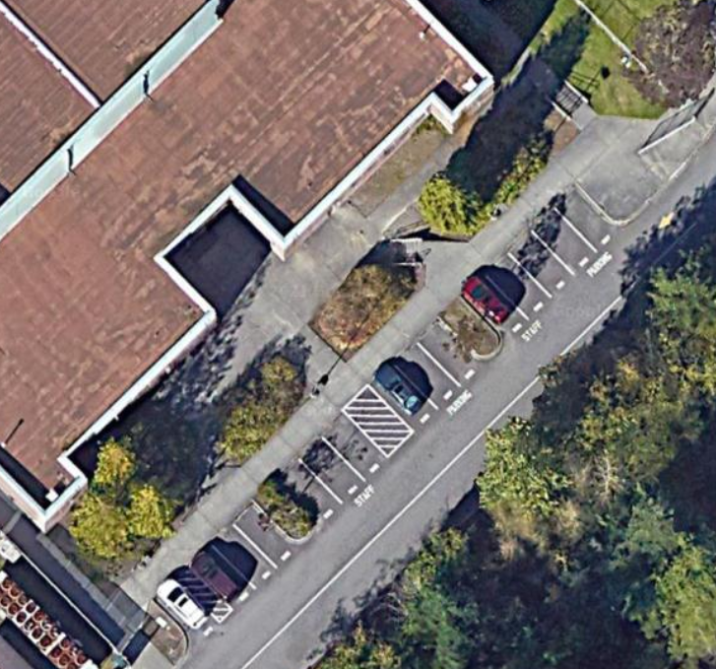
BUS LOOP ENTRANCE
679 - 693

Slide 5
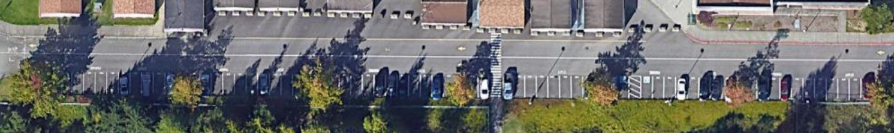
BUS LOOP (BACK OF SCHOOL PARKING BETWEEN HMS AND JHS)
616 – 678

