Slide 1


Survey Coordinator Toolkit
Administering Surveys with Panorama Education

Slide 2

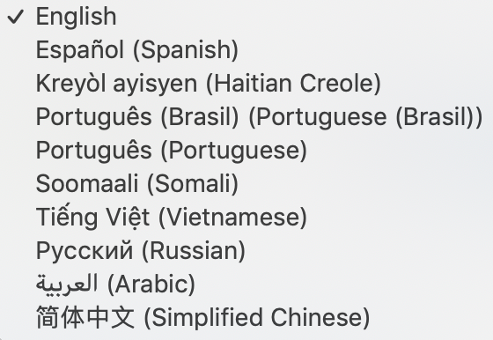
What are we surveying students?
Click below to see sample surveys:
3-5 SEL
6-12 SEL
SEL Survey:
Self-Management
Social Awareness
Growth Mindset
Emotion Regulation
Teacher Student Relationships
Sense of Belonging
Cultural Awareness and Action (6-12)
Student SEL Translations
SAMPLE SURVEYS

Slide 3
How will students take the survey?
Students will take the survey during class. Please plan to allocate one class period to this effort.
Students will go to: surveys.panoramaed.com/everett
Students will enter their student ID number as their access code. Students will then see a list of the survey(s) they need to take.
TAKING THE SURVEY
Students will hit the blue “Submit” button to enter their survey. If they do not hit this, their responses will not be saved

Slide 4
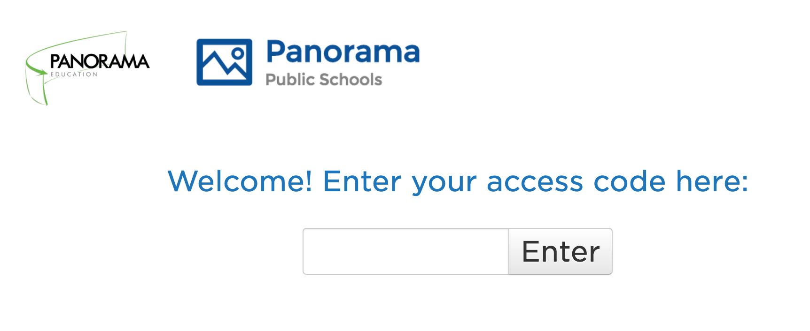
Student Survey Log In
surveys.panoramaed.com/everett

Slide 5
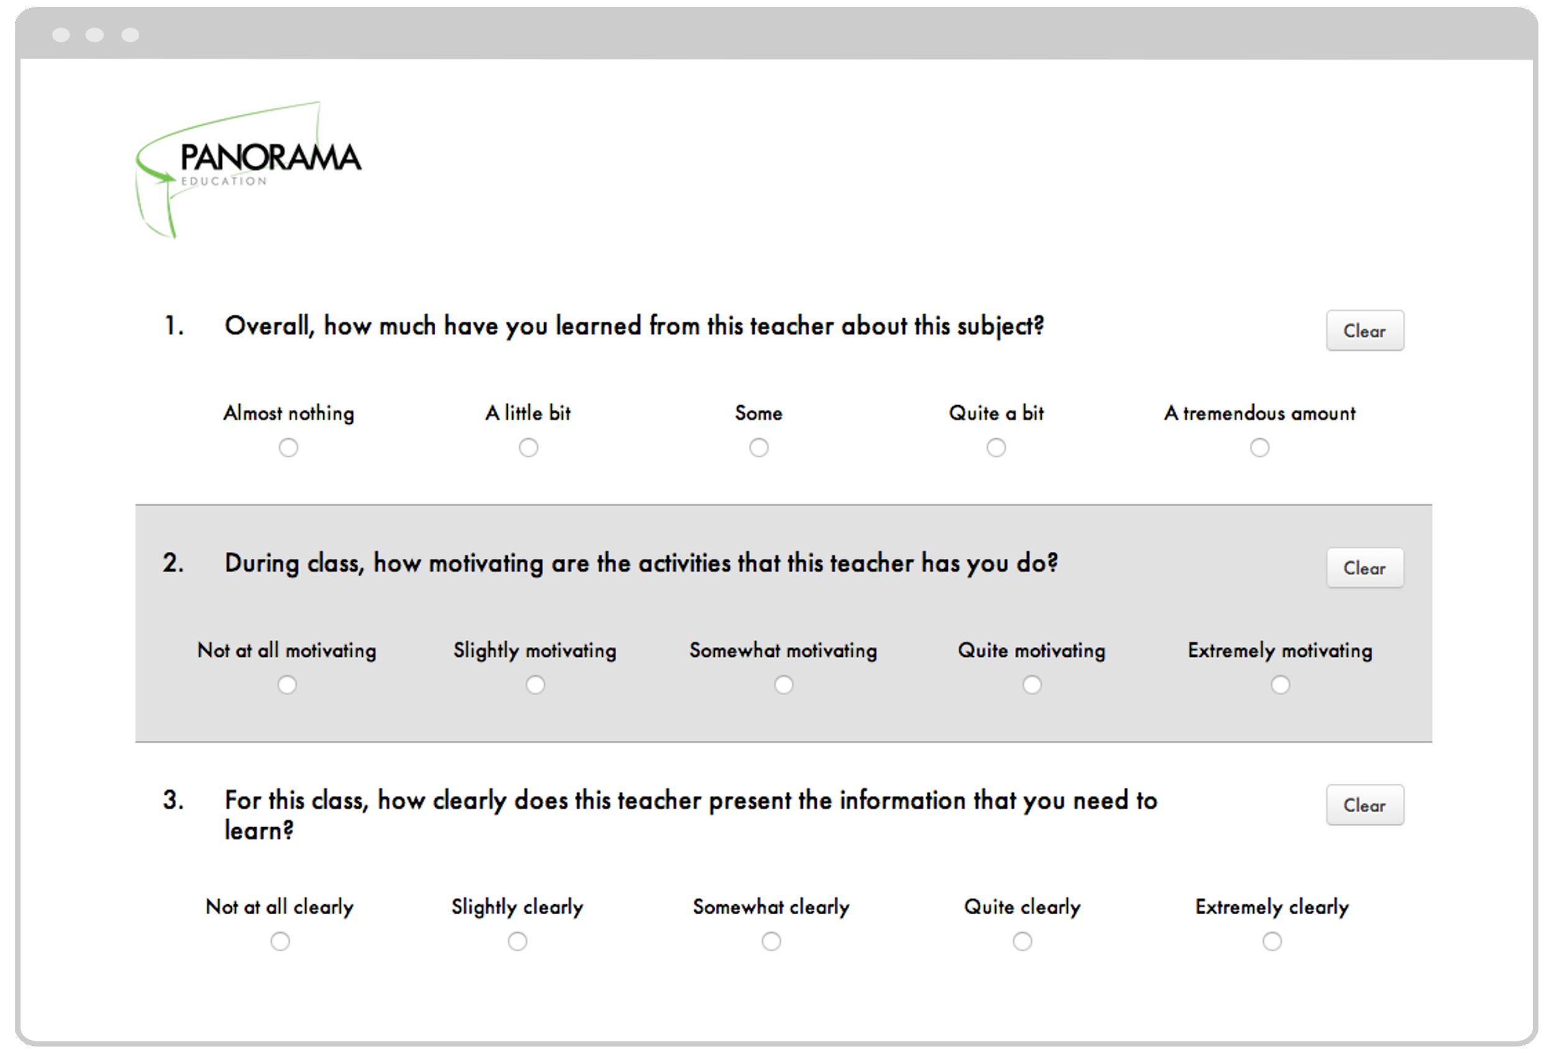

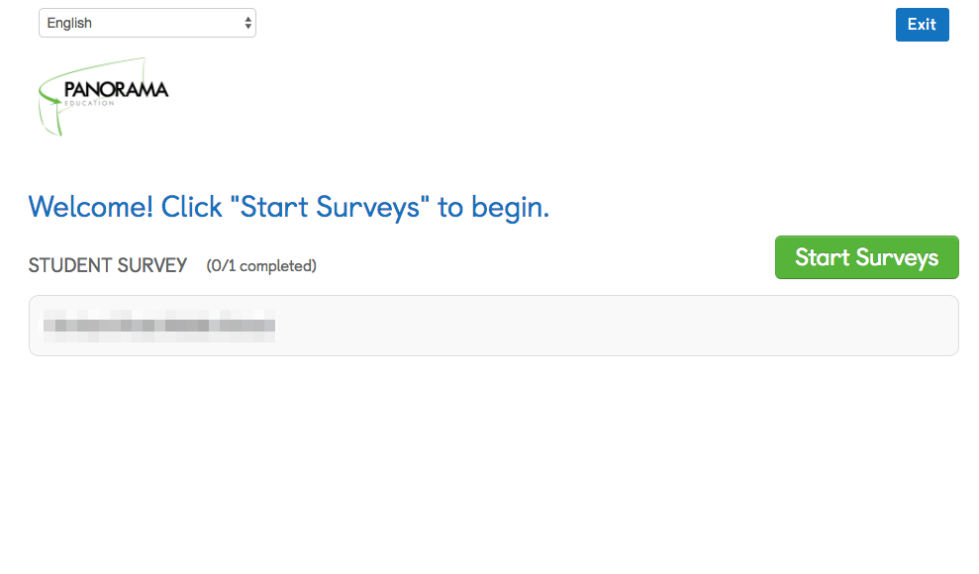
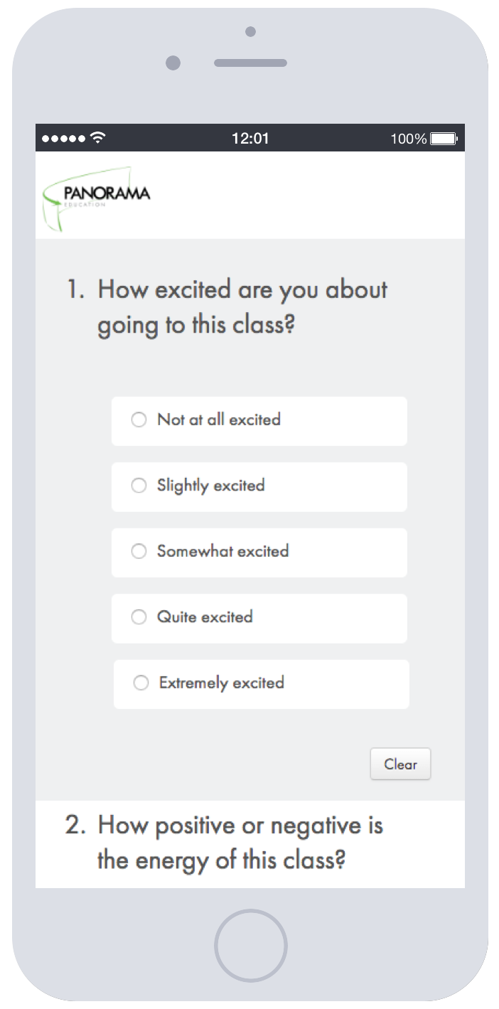
Survey Taking Experience
Students can access other languages here
Or here

Slide 6
How do I support students taking the survey?
The resources below provide detailed information about how to support students taking the survey.
Detailed Proctor Guide for Student Surveys
(best for synchronous surveys live with a teacher)
  English (in person)
  English (distance learning)
  Spanish
  Everett Student Survey Taking Slides
RESOURCES
Brief Videos outlining Student Survey Taking in English and Spanish
(best for asynchronous surveys as independent assignments; need to make sure students know survey url and their student ID)
  English Video Direct Link
  Spanish Video Direct Link
Mini Vocabulary Lessons
  English
  English & Spanish

Slide 7
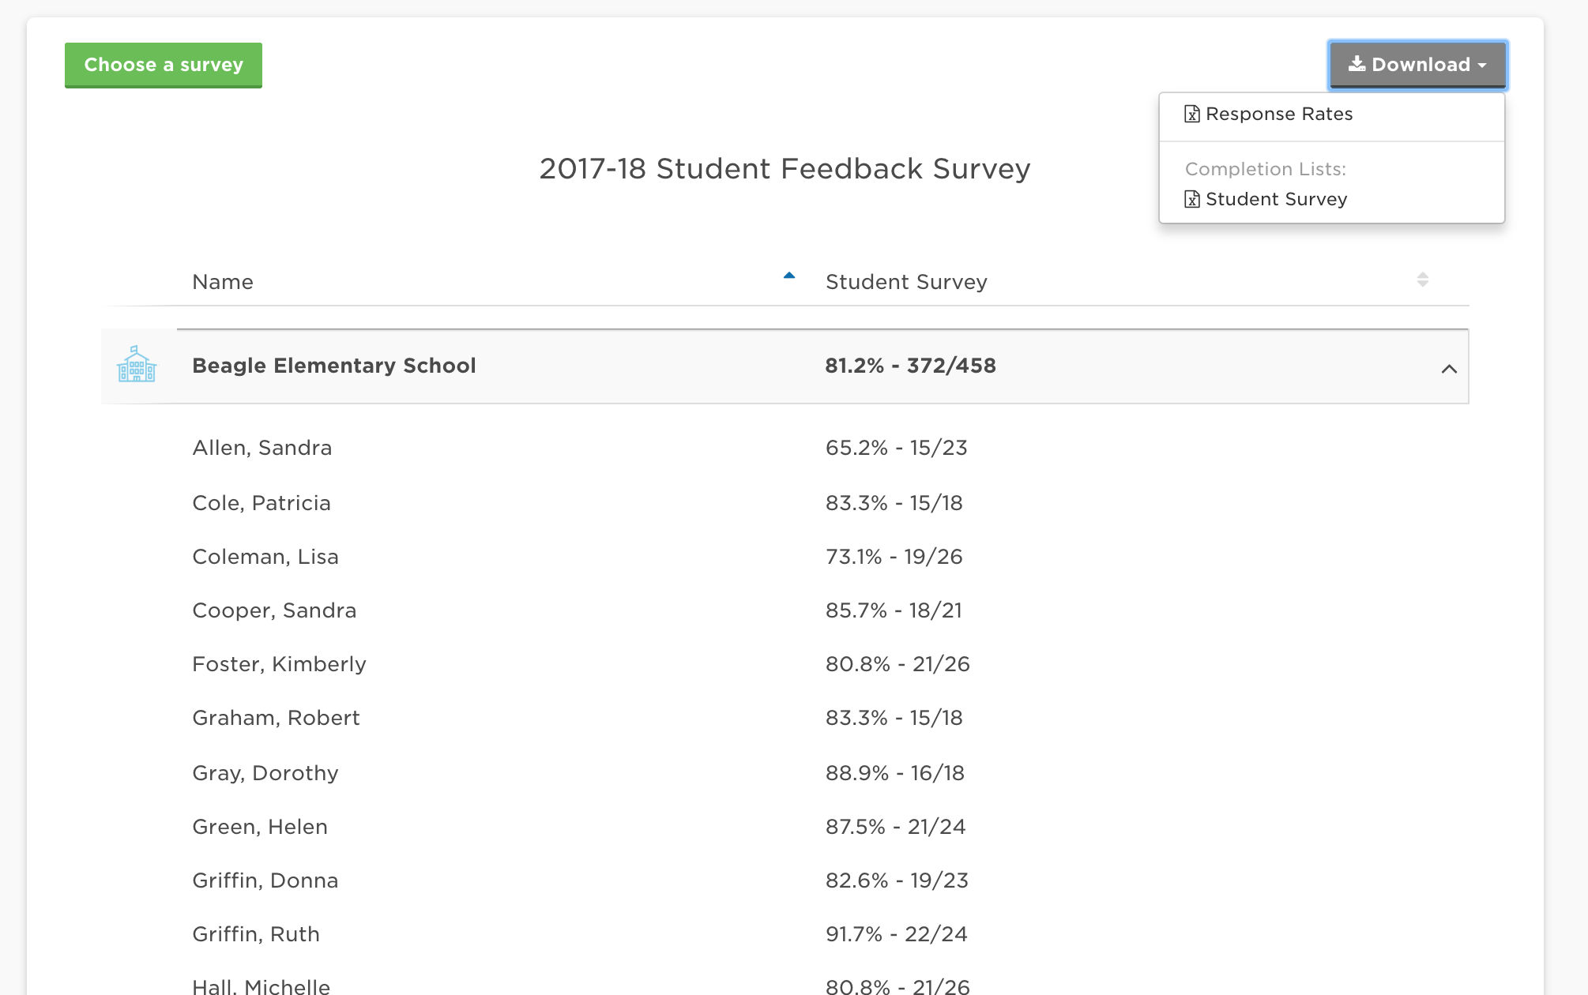
How do I track response rates?
Below are brief descriptions of how to track student response rates. You can log in to access the response rates at secure.panoramaed.com/everett
Go to secure.panoramaed.com/everett
Use the Response Rates Dashboard to track how many students have completed the survey online.
Download Completion Lists to see who has/hasn’t submitted a survey, and encourage specific students to participate!

Slide 8
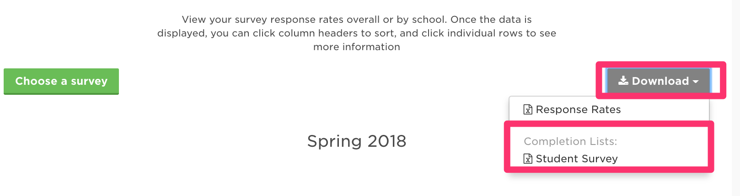
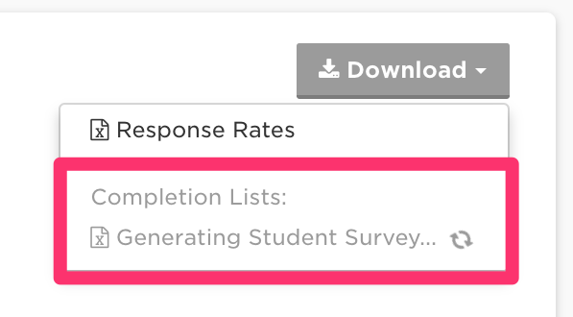
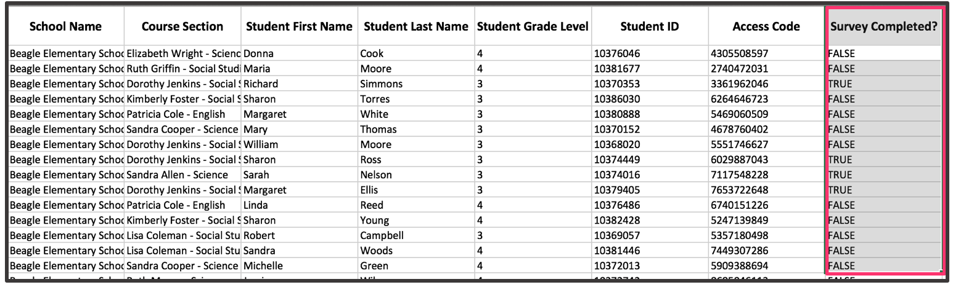
How do I Access Completion Lists? (for student surveys)
Step 1: Log in to Panorama
Step 2: Click on “Response Rates”
Step 3: Click “Download” button
Step 4: Select which completion list to download (for example, Student Culture/Climate Survey)
Step 5: Wait for file to download (may take a minute or so!)
Step 6: Open file from downloads folder
Step 7: Filter Column “Survey Completed” for ‘FALSE’

Slide 9
Frequently Asked Questions
What devices can surveys be taken on?
Panorama surveys can be taken on any device with an internet browser, including laptops, Chromebooks, tablets, iPads, and smartphones.
What accommodations should we give students to take this survey?
We recommend giving students the same accommodations they would have in the classroom. At a minimum, teachers should provide the same accommodations for students with disabilities or English Language Learners that they are eligible for when taking state or district assessments.

Slide 10
What if I have future questions?
Don’t hesitate to reach out with any questions or concerns!
Panorama Support Desk Email:
support+everett@panoramaed.com

