Slide 1
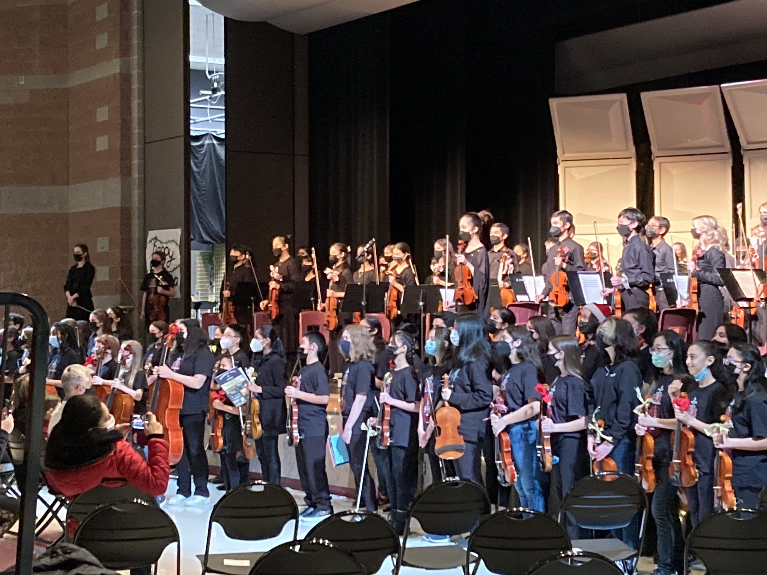

MIDDLE SCHOOL REDESIGN
UPDATE
February 2023

Slide 2
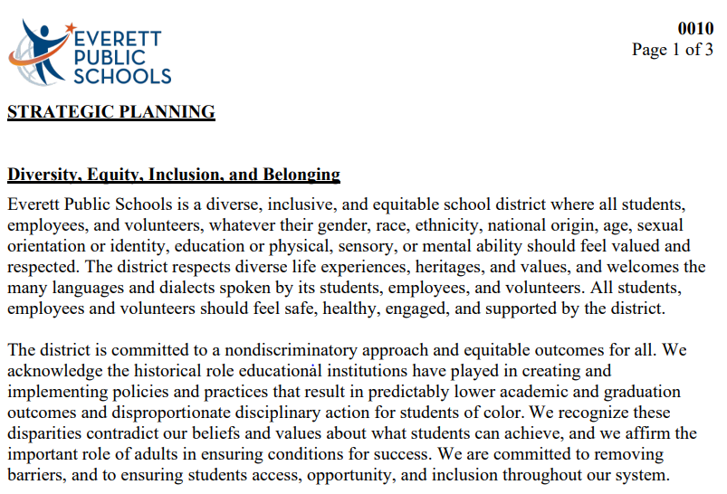
WHY A REDESIGN
Notes:
Larry (1 min.)

Slide 3
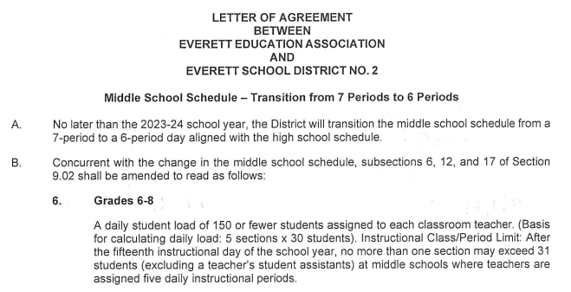
WHY A REDESIGN?
Notes:
Larry (1 min.)

Slide 4
MIDDLE SCHOOL REDESIGN TEAM
Anthony Anderson- Director STEM
Hayden Baker- CTE
Matt Bennett- Principal
Callie Berg- English
Jana Eggers- Counselor
Larry Fleckenstein- Regional Supt.
Wilnic Gideon- Principal
Claire Grosvenor- Science
Jared Kink- EEA President
Heather Paddock- Principal
Bailey Ryan- History
Camlynn Tafa- EEA Secretary
Michele Waddel- Principal
Laura Wellington- Principal
Notes:
Larry (1 min.)

Slide 5
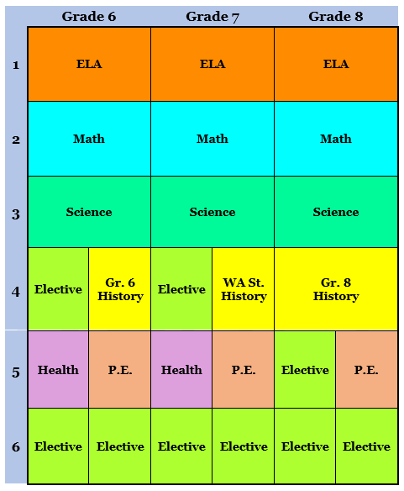

MIDDLE SCHOOL DESIGN
Notes:
Larry (2 min.)

Slide 6
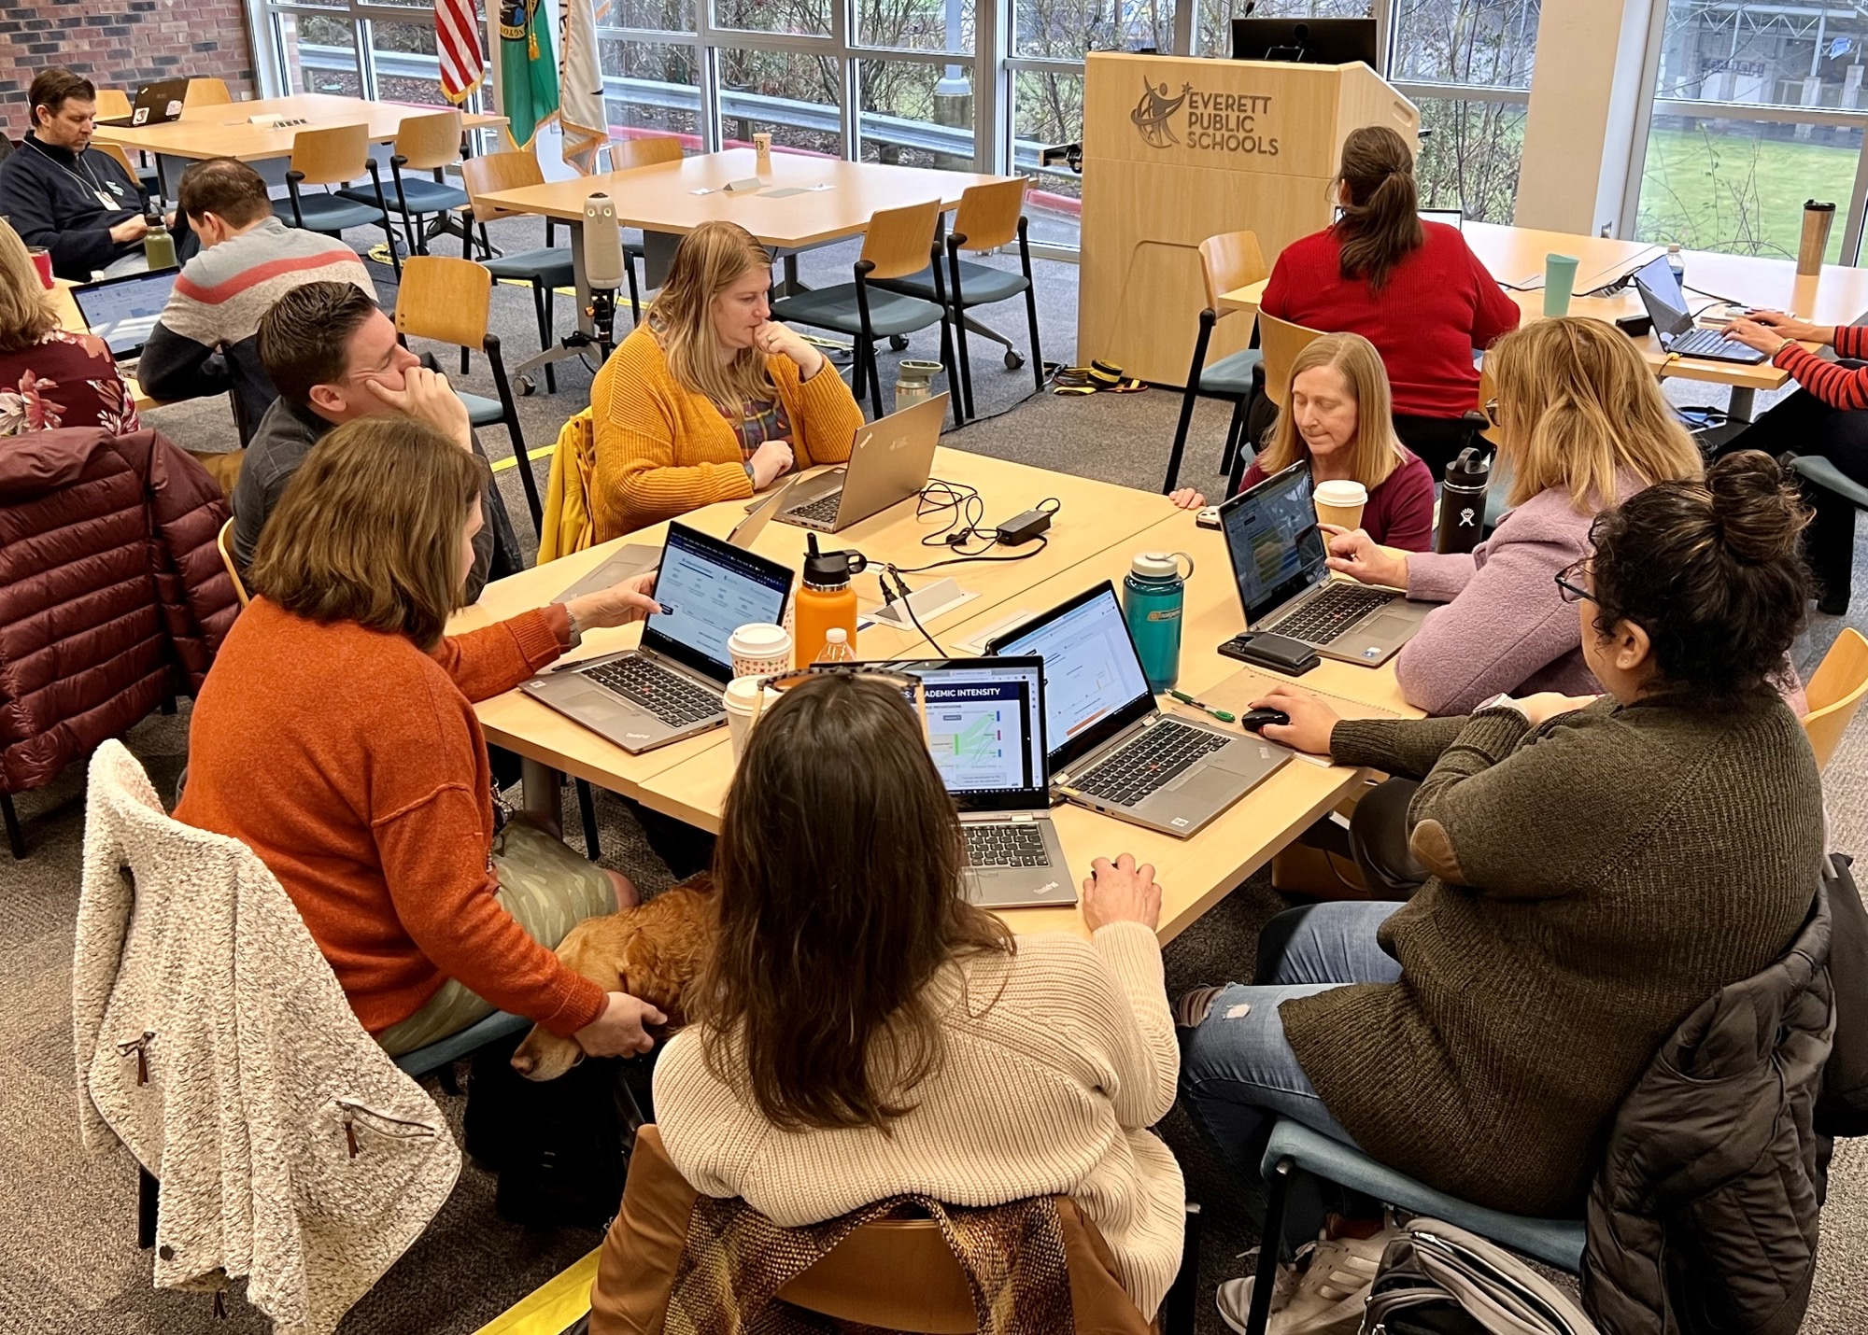
ENGAGING EPS STAFF
14 middle school redesign team members (teachers, principals, district, and EEA leaders)
Parent engagement event June 2022 on middle school redesign schedule draft
48 middle school teacher participants on ELA, Health/PE, History, Visual Arts, STEM/CTE committees
15 middle school counselors and 5 principals gave input on course registration
LITS, Academics, Student Support Services, Special Services, Human Resource and Finance Departments involved
100+ staff have had direct involvement in the middle school redesign process

Slide 7
STRATEGIC PERFORMANCE MEASURES
As a result of this work, over the next five years we should see measurable improvement in (but not limited to):
Middle School
Closing the gap between student groups participating and performing in advanced courses in middle and high school
Student participation in middle school advanced pathway courses
Students grades 7-8 earning 2.0 or more high school credits prior to 9th grade
High School
Increased participation in the high school STEM Choice Pathways
Increased percentage of 9th grade students on-track
Improved academic intensity, college readiness, and career readiness measures
Reduction of students failing courses in grades 9-12
Increase in students meeting College Academic Distribution Requirements (CADRs)
Notes:
Larry (1 min.)

Slide 8
NEXT STEPS
February
Principals implement communication plan for staff, students, and families about the middle school redesign structure
Our staff position interest survey opens 2/10
Finalized materials for middle school student registration sent to principals 2/24
Our staff position interest survey closes 2/28
March
Staffing workbooks provided to principals early March
Conversations with staff as needed regarding position interest survey responses
Students make course selections for 2023-24
April
Student course selections cleaned up; master scheduling begins April 17
Notes:
Larry (1 min.)

Slide 9
MASTER SCHEDULE TIMELINE
High-level milestone deliverables or activities | Brief description of work | Expected completion date
Student course selections for 2023-24 entered into home access center (HAC) by April 14 | Schedules as they are set prior to summer break are provided to regional offices | April 14, 2023
Middle School Principals & APs Meeting (CRC) | Master schedule workshop #1 | April 19, 2023
Secondary administrators develop iterative drafts of master schedules with monthly progress checks | District levels and regional meetings progress monitor master schedule development, provide feedback and support | June 2, 2023
Secondary schools publish master schedule drafts for staff prior to last student day | Staff assignments and locations as they are set prior to summer break are shared with teachers | June 21, 2023
Secondary master schedule drafts sent to Regional Superintendents | Schedules as they are set prior to summer break are provided to regional offices | June 30, 2023

Slide 10
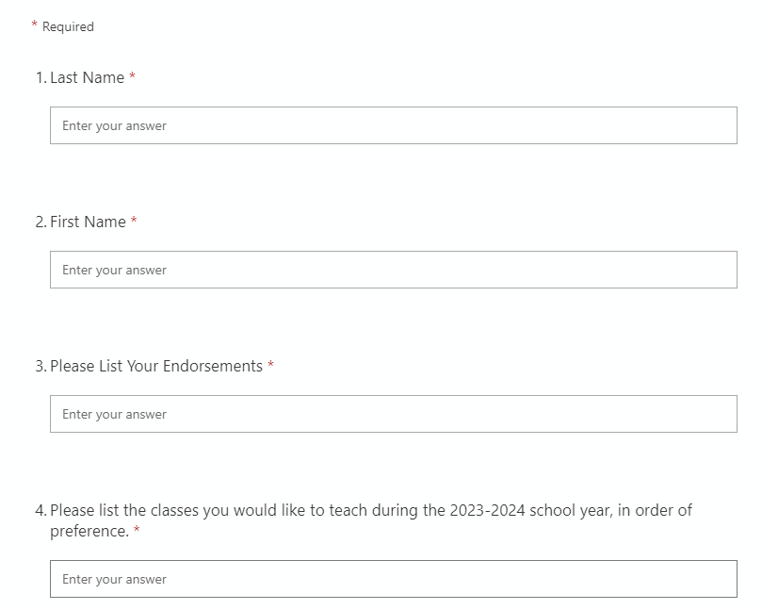
STAFF POSITION INTEREST SURVEY
February
Staff position interest survey (e-form) opens Feb. 10 and closes on Feb. 28
INSERT QR CODE TO YOUR SCHOOL’S COPY STAFF POSITION INTEREST SURVEY
HERE
Notes:
Larry (1 min.)

Slide 11
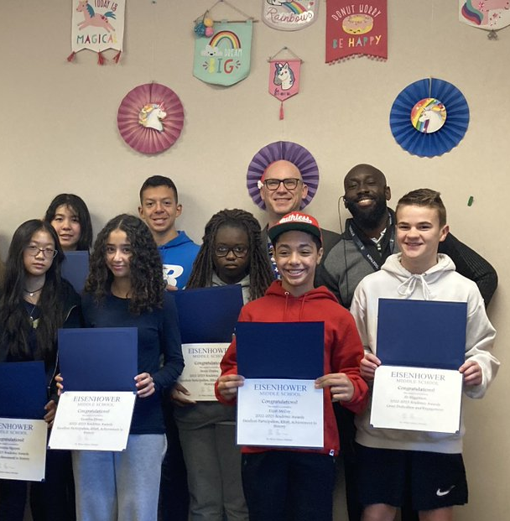

Questions?
Notes:
All (5 min.)

