Slide 1
JHS Inclusive Practices
Marisa Cundy, Katie Senouillet, Joe Rue & Sechin Tower

Slide 2

Programs and support at JHS
Resource- Katie Thomson & Orla Korten (Math), Steve Black & Michaelle Frank (English), Joe Rue (History/Science)
Achieve/Resource- Susan Walker & Andrea Gackle
Extended Resource- Kaye Smith
Life Skills- Marisa Cundy
Transition (18-21)- Katie Senouillet
Notes:
Joe
Need descriptions of each but note that it is not a one size fits all.

Slide 3
Related Service Providers & Paraeducators
Related Service Providers
Ginger Alonzo, Josh Krueger, Stephanie Vincent (School Psychologist)
Rebecca Wynne & Charlotte Richardson (SLP)
Tracy Hartley (PT)
Brenda Felder (Success coordinator)
Bonnie Karim (special education secretary)
What is the role of a paraeducator in general education class?
Support and implement the students IEP program in the general education classroom under guidance of the general education teacher
Some paras are assigned to support individual students who have specific needs on a one to one basis.
There to ensure inclusion into all activities is taking place in a way that meets the needs of the student.
Notes:
Joe

Slide 4
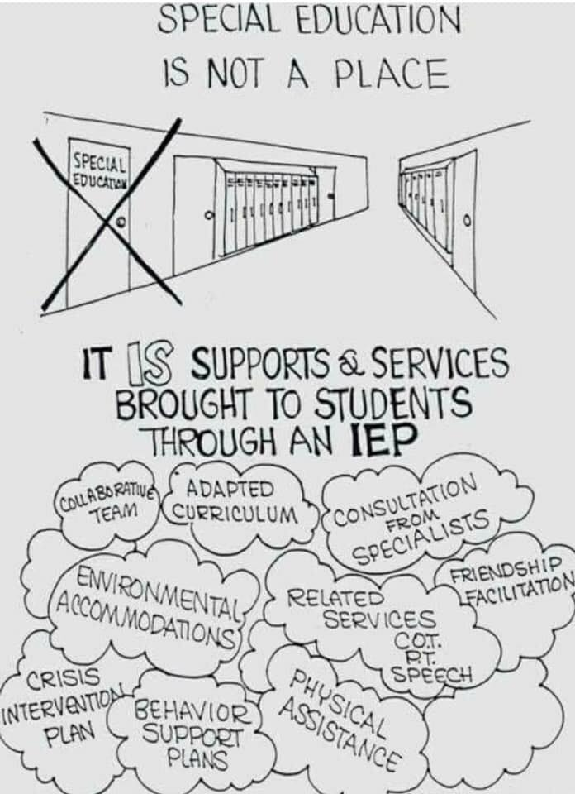
All the Lingo….
➢ FAPE: Free Appropriate Public Education
All students with disabilities have a right to a free appropriate public education. The federal law that gives these rights is the Individuals with Disabilities Education Act (IDEA).
➢ LRE: Least Restrictive Environment
Students who qualify for special education services should be in the same classrooms as their same aged peers as much as possible.
➢ IEP: Individualized Education Program
A written education plan designed to meet a student's learning needs.
➢ FBA: Functional Behavior Assessment
A functional behavior assessment (FBA) is a type of evaluation used to determine the cause (or “function”) of behavior before developing an intervention(s).
➢ BIP: Behavior Intervention Plan
A plan incorporated into a student’s IEP, if determined necessary by the IEP team, for the student to receive FAPE. This plan includes (at a minimum): the pattern of behavior, the instructional or environmental conditions, the positive behavioral interventions and supports and the skills that will be taught to the student to replace the behavior.
Notes:
Katie

Slide 5
What is an IEP Case Manager??
A special education case manager is the person responsible for overseeing all aspects of a student’s IEP program and services.
They are a certificated teacher with an endorsement in Special Education or a Certificated Specialist (SLP, OT, PT etc.)
Monitors the student’s IEP (including FBA and BIP) and facilitates services
Communicates with parents, teachers and services providers
Collects IEP related data and reviews/re-writes annual IEP
Reports IEP progress quarterly in Special Programs
Review and use HSBO annually to develop the student’s Transition Plan
Connect families with outside agencies
Review and monitor graduation pathways (in collaboration with counselors)
Notes:
Katie

Slide 6
Accommodations vs. Modifications
An accommodation changes HOW a student learns. A modification changes WHAT a student is taught or expected to learn.
Notes:
Marisa
Pull up/pass out example of an IEP at a glance and go through it, explaining what each component means

Slide 7
Examples of accommodations and modifications
Examples of accommodations;
*Teacher provides notes/outlines
*allows type-written work
*allows printed work
*provides a peer notetaker,
* provides highlighted text,
* allows the use of spell-checker,
*Daily agenda checks between home/school,
* Preferential seating,
ability to leave room without permission
*behavior reward system
* Extended time on assignments,
*shortened assignments,
*simplification of directions
*Tests read aloud to student,
*verbal response
*multiple -choice response
*word banks provided f or f ill in the blank questions
Examples of modifications
*Reduction of homework
reduction of class work -Omitting story problems, using specialized/alternative curricula written at lower level
*simplified vocabulary and concepts
*alternative reading books at independent reading level
*Tests are written at lower level of understanding
*preview tests provided as study guide
*picture supports are provided
*pass/fail grading
LINK to video

Slide 8
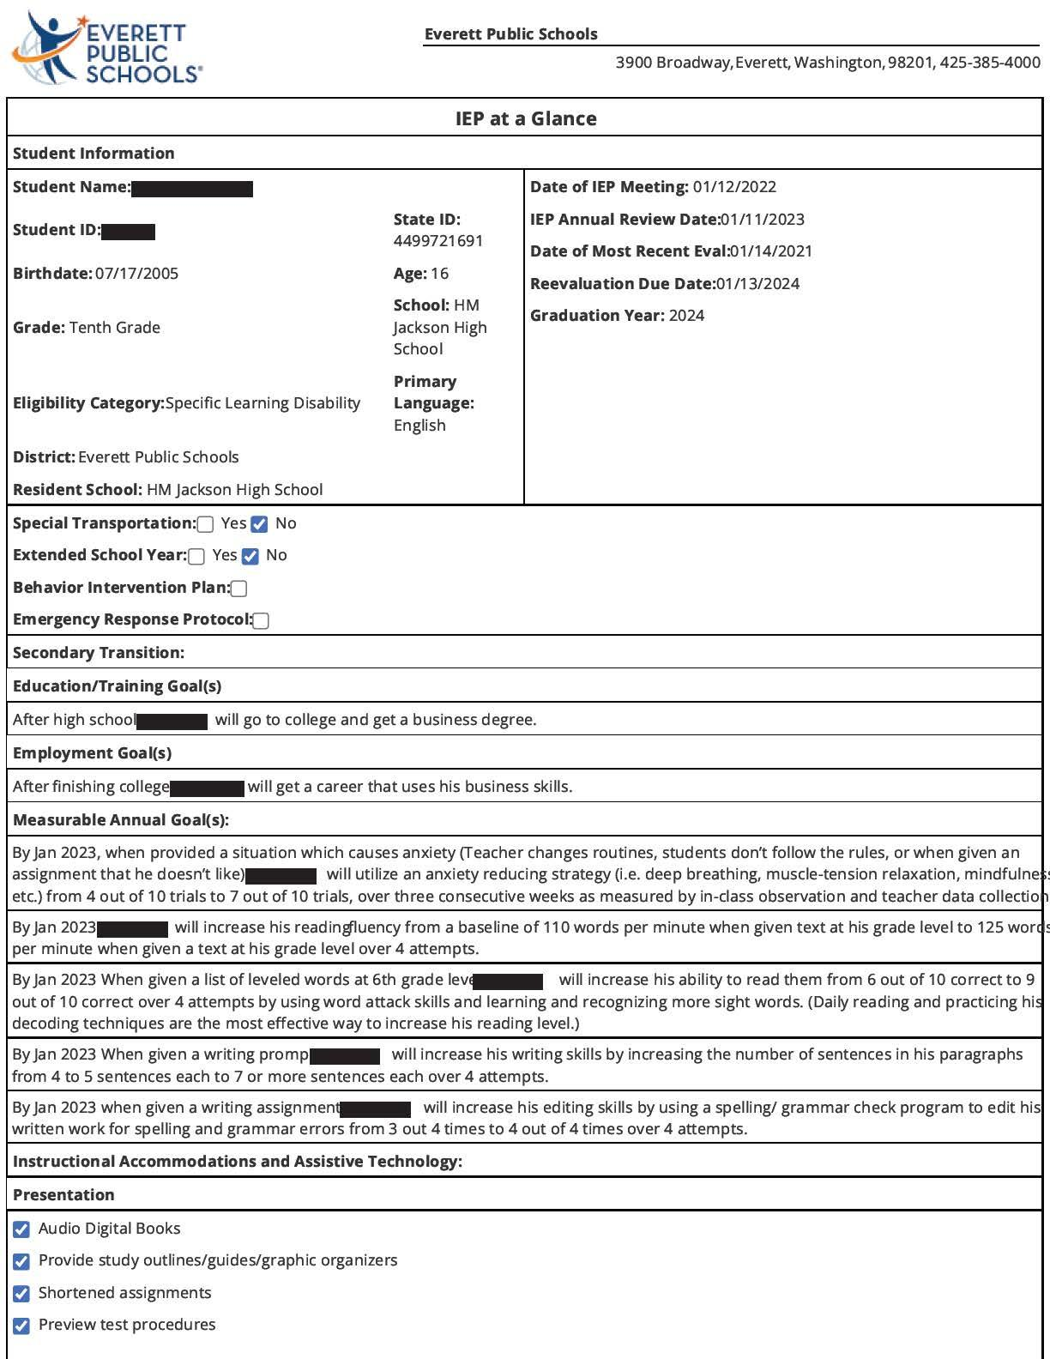
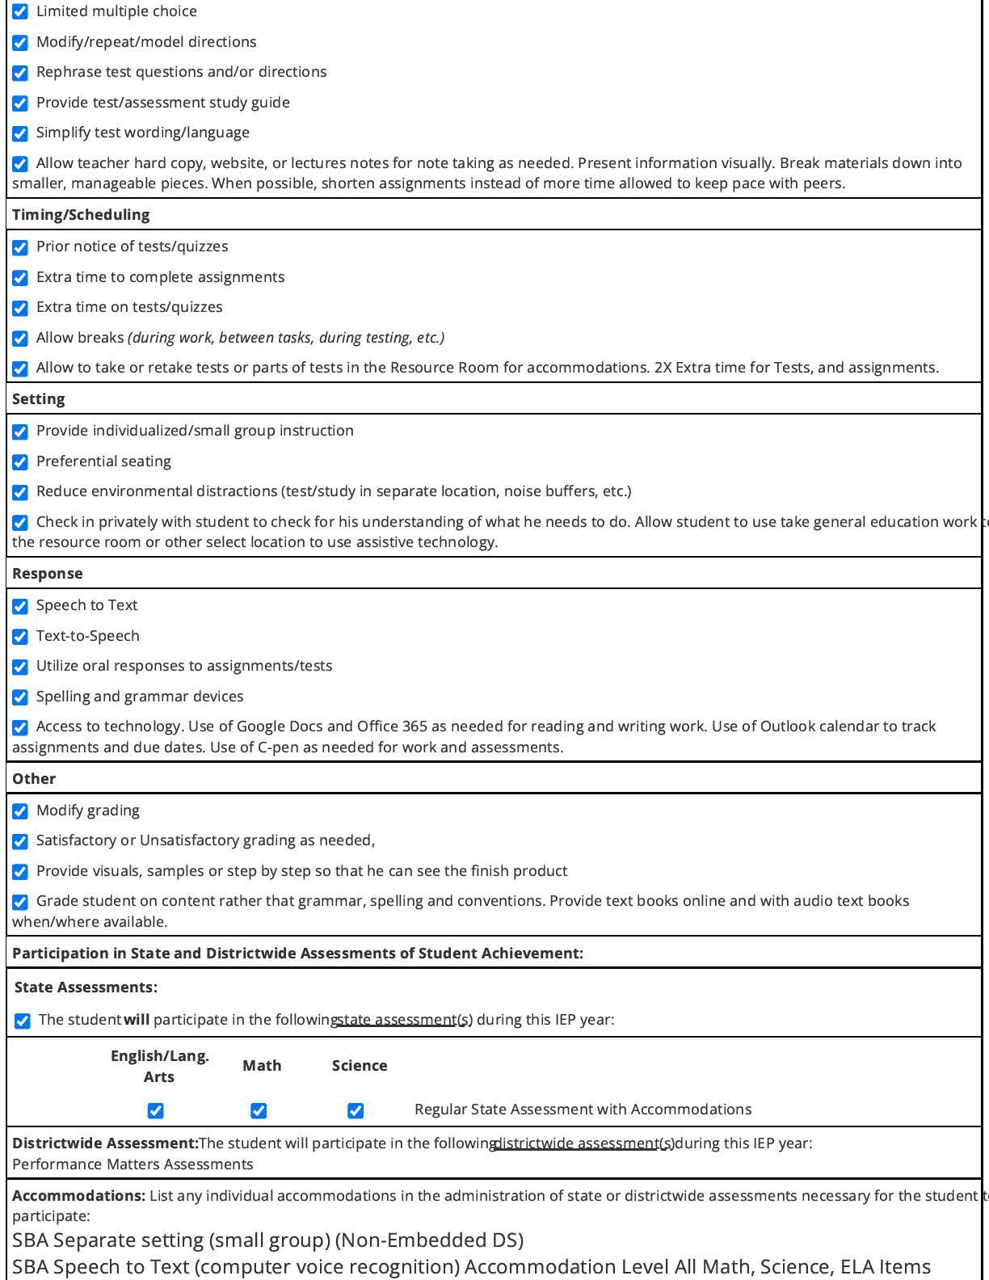
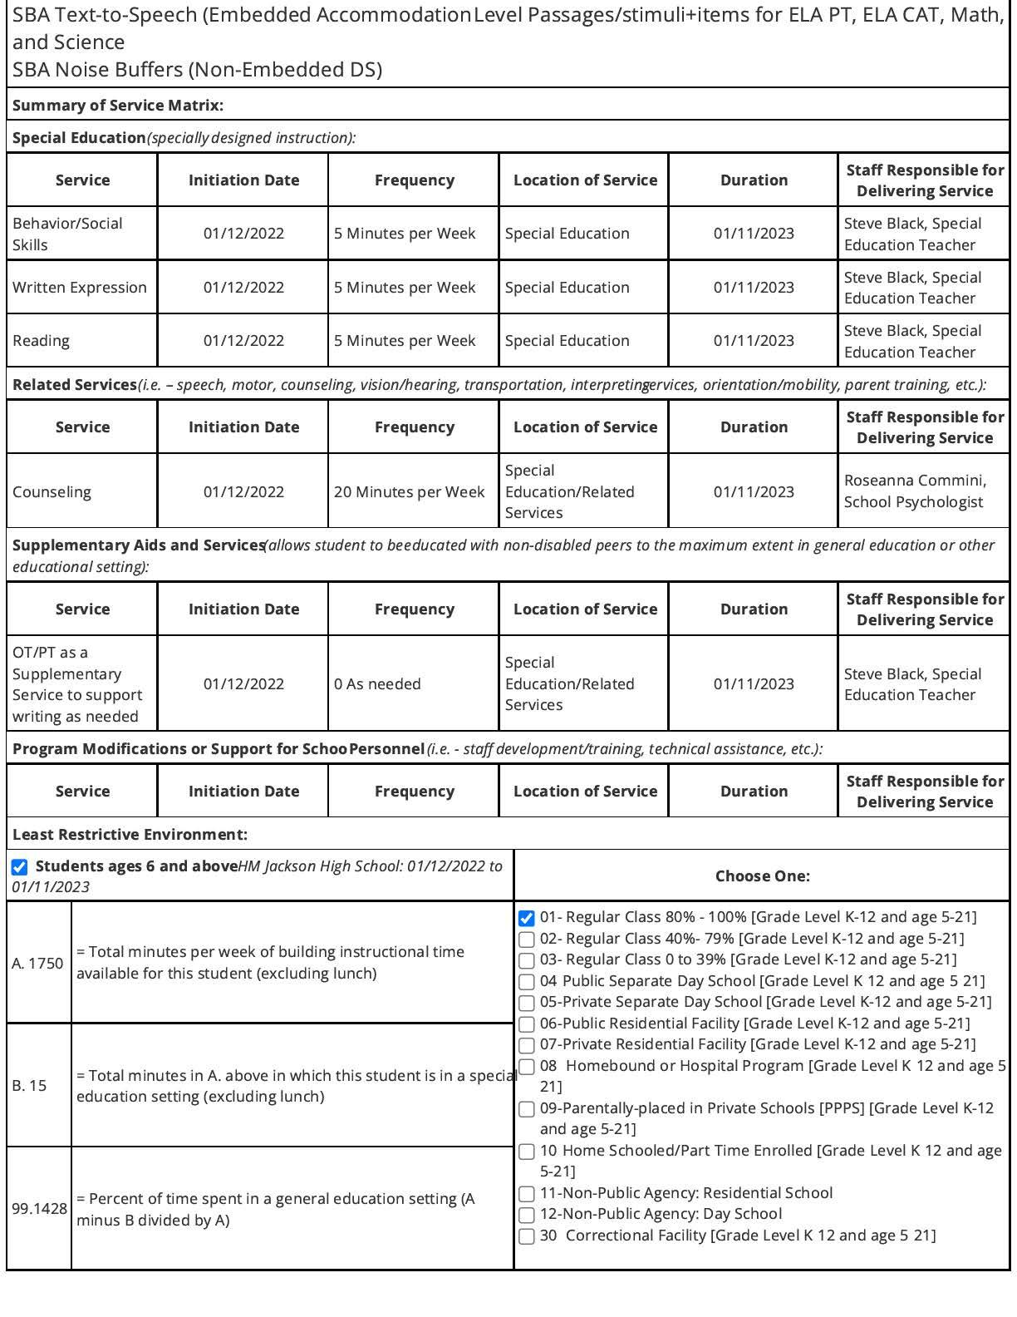
Important aspects of the IEP
IEP at a Glance
Teachers can find:
Case Manager
Student information,
Student goals,
Accommodations and modifications
Notes:
Review the printed copy of an IEP at a glance

Slide 9
Inclusive practices, how can this look in your space?
When you’re designing activities, lessons, etc. recognize the difference between students and use that to ensure that all the students in your class can access the content and participate in a meaningful way.
Notes:
Joe
Give us some examples of inclusive practices in your classroom
Where you have them seated in class
How you group students
Using multiple modalities when teaching/assessing

Slide 10
What do the data say?
​ | ELA​ | MATH​
Spring 2019​ | 77%​ | 49%​
Fall 2021​
Spring 2022​ | ​
Notes:
Sechin

Slide 11
What do the data say?
​ | ELA​ | MATH​
Spring 2019​ | 77%​ | 49%​
Fall 2021​ | 74%​ | 46%​
Spring 2022​ | ​
Notes:
Sechin

Slide 12
What do the data say?
​ | ELA​ | MATH​
Spring 2019​ | 77%​ | 49%​
Fall 2021​ | 74%​ | 46%​
Spring 2022​ | 86%​ | 53%​
Notes:
Sechin

Slide 13
What do the data say?
​ | ELA​ | MATH​
Spring 2019​ | 77%​ | 49%​
Fall 2021​ | 74%​ | 46%​
Spring 2022​ | 86%​ | 53%​
Higher than State and District average!
Big improvement– especially after pandemic!
Notes:
Sechin

Slide 14

​ | ELA​ | MATH​
Spring 2019​ | 77%​ | 49%​
Fall 2021​ | 74%​ | 46%​
Spring 2022​ | 86%​ | 53%​
Higher than State and District average!
Big improvement– especially after pandemic!
Notes:
Sechin

Slide 15
Table talk: What do you see here?
Students​ | ELA ​ meet standard​ | Math ​ meet standard​
Overall | 86% | 53%
Served by special Services​ | 32%​ | 11% ​
Received multiple ​ language ​ services​ | 10%​ | 6%​
Latinx​ ​ | 52%​ | 24%​
Navigating Poverty​ ​ | 51%​ | 17%​
Notes:
Sechin

Slide 16
Students Served by​​ | 3rd Grade​​ | 6th Grade​​ | 10th Grade​​
Multiple Language Services​​ | 39% ​​ | 13%​​ | 3%​​
Special Services​​ | 40%​​ | 12%​​ | 5%​​
Notes:
Sechin

Slide 17
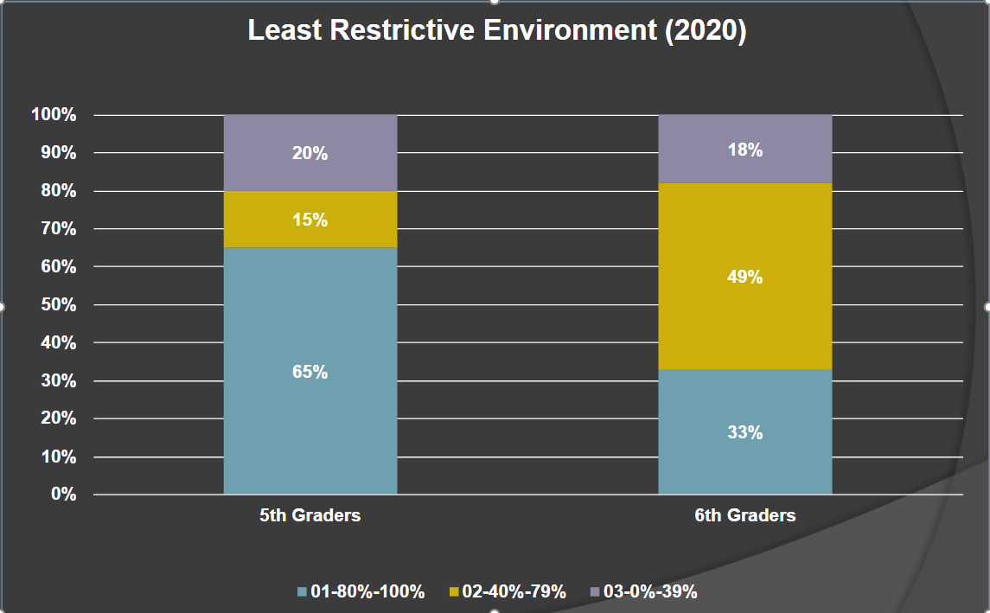
Least Restrictive Environment
Notes:
Sechin

Slide 18
Students Served by​​ | 3rd Grade​​ | 6th Grade​​ | 10th Grade​​
Multiple Language Services​​ | 39% ​​ | 13%​​ | 3%​​
Special Services​​ | 40%​​ | 12%​​ | 5%​​

Slide 19
Co-teaching
What it is
Implemented by two professionals with equivalent licensure but different areas of expertise as a way to ensure that students with disabilities have the same curriculum access and rigorous academic standards as other students
There are many models of co-teaching
Service delivery option
Equity and Social Justice Strategy
What it is not
A class identified to overload with kids who have IEPs
A special education class
A class with a different curriculum
LINK to video
Notes:
Joe introduce and explain your background and experience with co-teaching

Slide 20
Who is co-teaching what?
Algebra 1- Orla Korten & Deb Faber
Chemistry- Orla Korten & Travis Birse
World & US History- Joe Rue & Steve Johnson
Bio/Biotech- Brandon Gallaher, Andrea Gackle, Joe Rue, Ahnya Redman, Susan Walker
Ethnic Studies- Susan Walker & Judy Baker
YAY!
Notes:
Joe
44/50 in inclusion
We are learning and behavior specialists not content specialists

