Slide 1


SWITCH:
How to Change Things When Change is Hard
Notes:
Shelley & Peter

Slide 2
Learning Targets: As a team…
We will build our understanding of change management through the ‘big ideas’ in the book Switch

Slide 3


Direct the Driver
Motivate the Elephant
Shape the Path
Notes:
(1 min) Peter

Slide 4
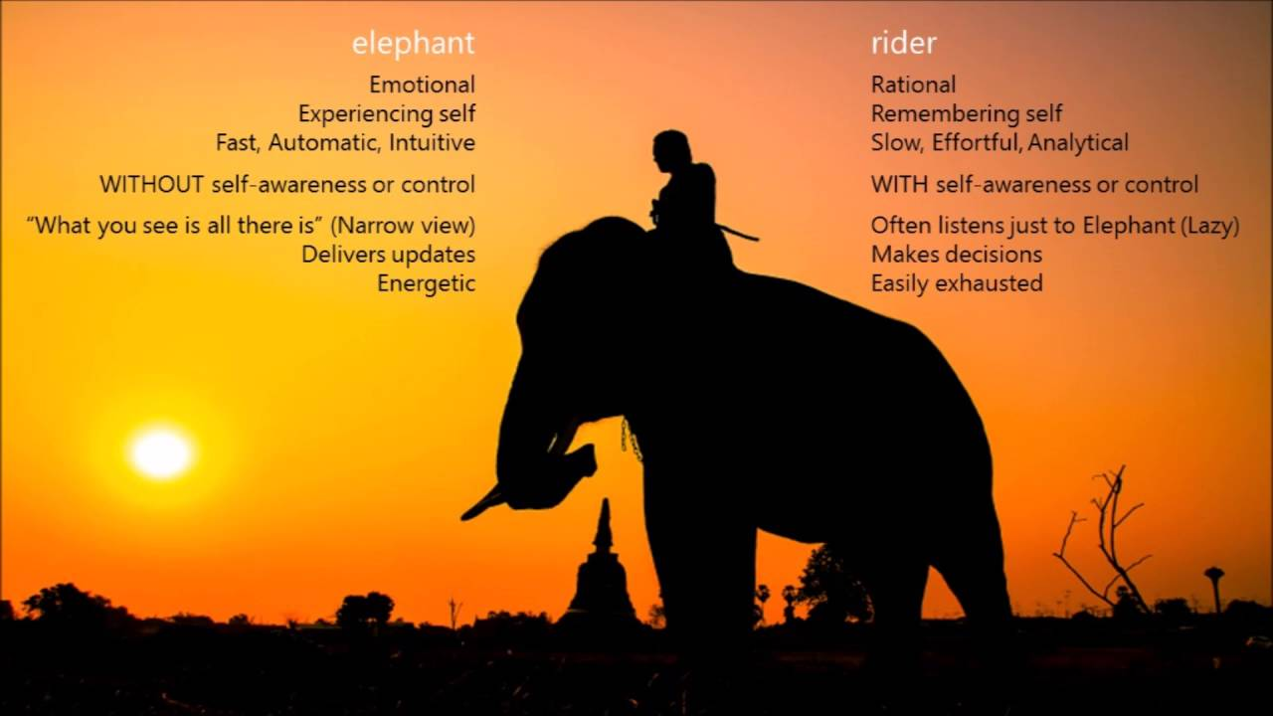
Notes:
Change can happen when both elephants and riders move together; the challenge is for the rider to learn how to engage the elephant and appeal to its emotions.

Slide 5
Direct the Driver: What looks like resistance is often lack of clarity.
Motivate the Elephant: what looks like laziness is often exhaustion. The Rider can’t get his way by force for very long.
Shape the Path: What looks like a people problem is often a situation problem.
Notes:
Left/Right brain

Slide 6

Clarity of change
Direct the Rider: What looks like resistance is often lack of clarity.
(1% milk p.15)
Notes:
(5 min) Shelley
Set up the context of the show- Moira (mom) is working on making her “family recipe” (not really hers, it was the housekeeper’s) with her son David, Moira is not very clear on how to make these enchiladas, and she is trying to coach David through this process.

Slide 7



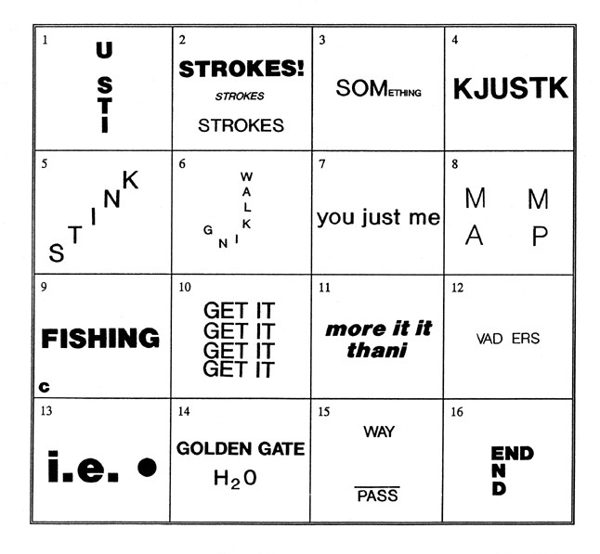
Clarity of change
Motivate the Elephant: What looks like laziness is often exhaustion. The Rider can’t get his way by force for very long.
        (Taste study p. 9)
Notes:
(5 min) Shelley
Set up the context of the show- Moira (mom) is working on making her “family recipe” (not really hers, it was the housekeeper’s) with her son David, Moira is not very clear on how to make these enchiladas, and she is trying to coach David through this process.

Slide 8

Shape the Path: What looks like a people problem is often a situation problem.
(Popcorn study P.1)
Notes:
Stale Popcorn
Bottomless- Large bucket/ Medium bucket
People with the large bucket ate 173 more calories or 21 extra handfuls.

Slide 9
Direct the Rider
Clarity of Change
What are we expecting people to do?
Motivate the Elephant
Desired Outcomes
Why would people want to go there?
Shape the Path
Ease of Change
Can we simply make it easier for people to change?
Notes:
(3 min) Peter

Slide 10
Application
Identify a problem of practice
  Describe the issue and the need for a "switch"
Identify barriers to success
  Clarity
  Exhaustion (Force)
  Situation Problem
Identify strategies
  Direct the rider
  Motivate the elephant
  Shape the path
Notes:
(10 min) Peter Share out

