Slide 1

Access Your High School & Beyond Plan Survey
This Photo by Unknown Author is licensed under CC BY-SA

Slide 2




Log in to Naviance…
Click Students from school website
1
Click Naviance button
2
Log in with district ID# and password
3

Slide 3
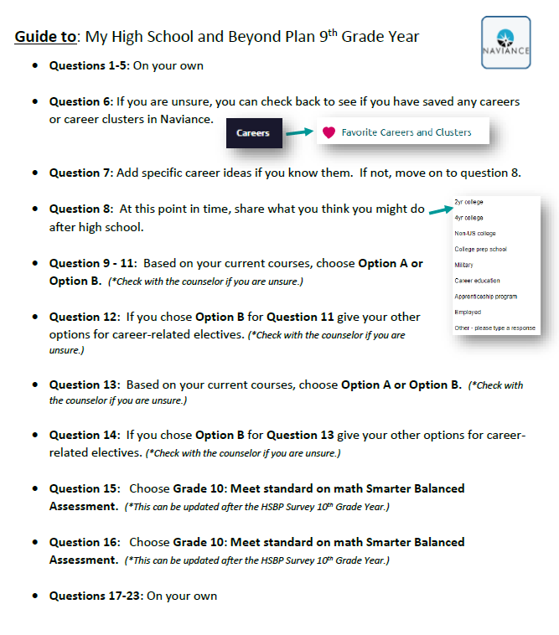
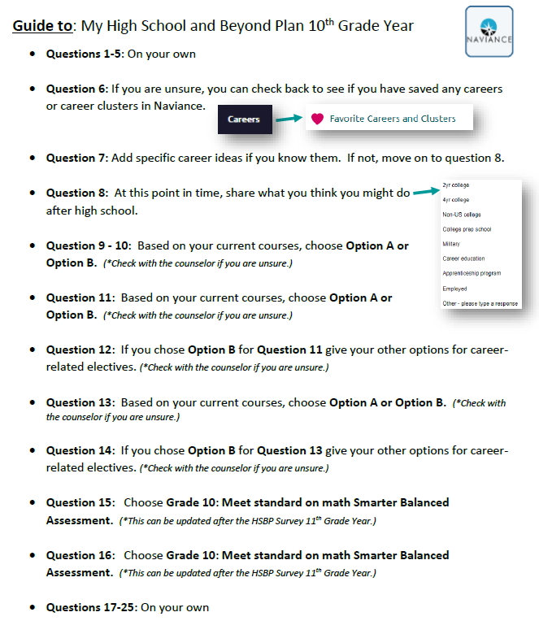
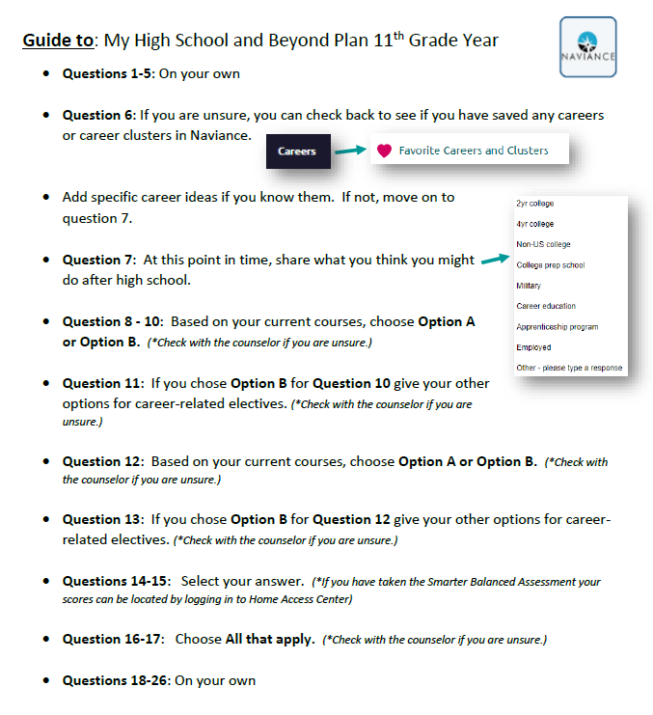
Survey instructions
Please ask your teacher for a copy of the survey instructions based on your grade level.

Slide 4
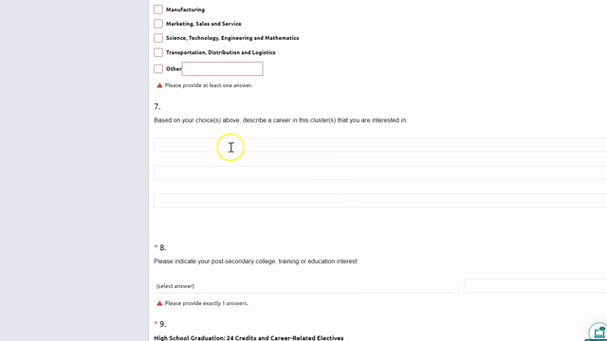
HSBP survey 9th-11th Gr. Video

Slide 5
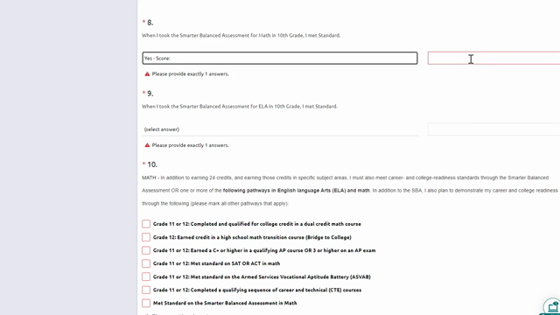
HSBP survey 12th Gr. Video

Slide 6
After the survey...what can I do?
9th Grade | 10th Grade | 11th Grade | 12th Grade
Required 9th Grade HSBP Tasks: In Naviance… Task 1: Click Self-Discovery Click Learning and Productivity inventory Task 2: Click Colleges Click SuperMatch to explore options | Required 10th Grade HSBP Tasks: In Naviance… Task 1: Click Self-Discovery Click StrengthsExplorer Task 2: Click About Me Click Resume Click + symbol to add items to resume | Required 11th Grade HSBP Tasks: In Naviance… Task 1: Click Self-Discovery Click Career Interest Profiler Task 2: Click Self-Discovery Click Skills Survey | Required 12th Grade HSBP Graduation Requirements: (Check student email for personal progress & how to videos) In Naviance… Click Planner Click Tasks & complete Career Interest Profiler Upload Completed Resume Financial Aid Survey Upload Documentation of Post-Secondary Plan HSBP SPRING Survey
Please ask your teacher for a copy of the survey instructions based on your grade level.

