Slide 1
Cover Letter
Naviance Student

Slide 2
Lesson Tasks
Students will understand the purpose of a cover letter.
Students will review sample cover letters and corresponding resumes.
Students will prepare a cover letter based on their resume and desired job

Slide 3
What is a cover letter?

Slide 4
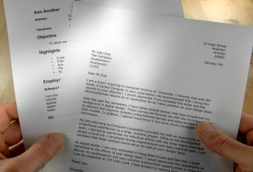
Purpose of a Cover Letter
A cover letter is a letter sent with your resume when applying for a job.
A cover letter…
Introduces you to potential employer
Explains why you are sending in your resume
Provides additional information about you

Slide 5
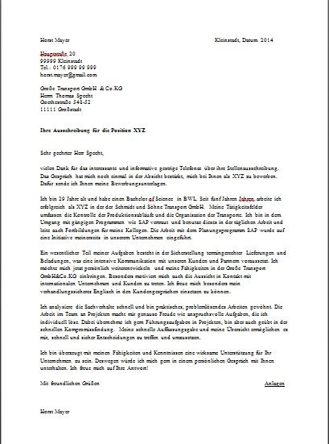
Who Sees Your Cover Letter?
A typical hiring manager does not read cover letter before the application
They generally spend 10 to 15 seconds scanning your
application
If they like what they see,
they will read more

Slide 6
What to Include…

Slide 7
Your Cover Letter Should…
focus on what the employer needs and point out how you will meet their needs
reflect your understanding of the company and the job you are applying for
tell your reasons for sending the letter, for example, desiring an interview

Slide 8
Cover letter format

Slide 9
Cover Letter Format Options
Block
Modified Block

Slide 10
Cover Letter Design
Open Punctuation - using few punctuation marks when writing
Dear Mr. Jones
Sincerely
Closed Punctuation - punctuation in which many commas, full stops, etc., are used
Dear Mr. Jones:
Sincerely,
No colon
No comma
Colon
Comma

Slide 11
The Body of the Letter
Your street address
Your city, state, zip code
Month, Day, Year
Mr./Ms./Dr. Name
Title
Name of company/organization
Company address
City, State, Zip code
Dear Mr./Ms./Dr. Last Name
Paragraph 1: Answers “Why am I writing?”
  Identify the position and the company
  Indicate how you learned about the position
  Request the employer’s consideration
  Introduce basic information about yourself
Paragraph 2: Answers “Who am I, and why should you hire me?”
  Contain a brief summary of your personal data and work experience.
  Relate your skills, experiences, and qualities that would benefit you in this position
Paragraph 3: Answers “What is my next step?”
  Refer the reader to your enclosed resume
  Reiterate your interest in the position
  Specify how you will follow up
Sincerely
Your signature
Your name
Enclosure: Resume for YOUR NAME
First paragraph – reason for writing
Second paragraph – point out qualifications
Third paragraph – call attention to resume, reiterate interest
*Click HERE to download an easy cover letter template!

Slide 12
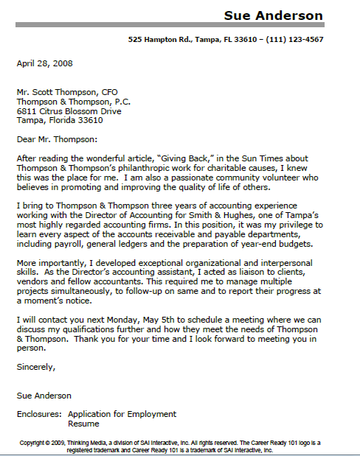
Sample Cover Letter

Slide 13
Cover Letter Tips

Slide 14
Cover Letter Tips
Be assertive – the first 20 words are the most important
Tell your story - how you can be of value to the employer
Use simple, straight forward language and grammar
Let your letter reflect your individuality
Send your letter to someone directly if possible
Spell letter recipient’s name correctly
Be friendly, not pushy

Slide 15
Don’t Forget to…
Use correct grammar & spelling
Do not use slang
Be brief, but cover the subject
Stick to the point of the letter
Proofread, proofread, proofread!
Ask for help if you need it
Strive for neatness and personality

Slide 16
Emailing Your Cover Letter
If you submit application, resume and cover letter electronically, submit each individual document as an attachment
Do not write cover letter in the email message
Usually, a Human Resources support person is responsible for processing applications before forwarding them to the hiring manager
The hiring manager might not see cover letter if it is in initial email message

Slide 17
Designing Your Cover Letter

Slide 18
Match Resume and Cover Letter
Matching your resume and cover letter creates a professional impression even before you get an interview!
Match the fonts – Use the same font for the body of your cover letter as you used in your resume
Match the formatting – Use the same style in your letter as you used in your resume.
For example, if you separate resume sections with horizontal lines use the same lines in the header/footer of your letter.
Match the information – Make sure your resume and cover letter information match. You don’t want to mention something in your cover letter that is not on your resume.

Slide 19
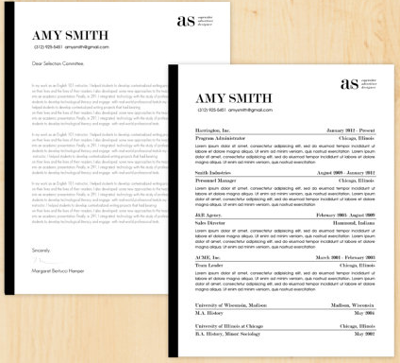
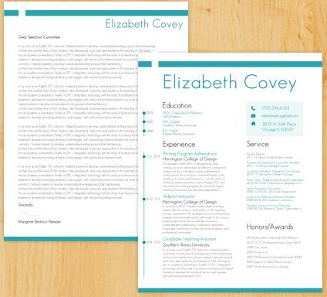
Matching Resumes and Cover Letters

Slide 20
Start with a Template
A template provides the basic structure to your cover letter.
Edit the template to include your personal information
Templates provide structure and reduce the amount of time you spend formatting the letter
Free Microsoft Word cover letter templates are available online to download and customize
*Click here to browse and download your cover letter template

Slide 21
Task Completion…

Slide 22



Log in to Naviance Student
Click Students from school website
Click Naviance button
Log in with district ID# and password
Naviance Student
Username: district ID#
Password: district password

Slide 23
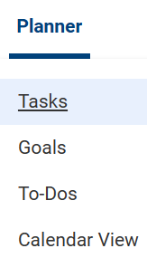

Complete the Task…
To complete the lesson task log into Naviance Student, click on Planner > Tasks.
Click the title of the task - Upload Completed Cover Letter
Click Browse… to locate your cover letter and upload.

