Slide 1
finding my way through the “noise”
Naviance Student

Slide 2
Lesson Tasks
Students will identify the “noise” they have around them in their daily lives.
Students will determine how the “noise” can impact their foundation.
Students will gain an understanding of how to shed the “noise” to focus on future career paths.

Slide 3
“noise”

Slide 4
What is “Noise?”
Becoming a high school senior can be overwhelming!
Each day you encounter many voices, pieces of advice, and expectations coming from well meaning family members, teachers, counselors, and society.
These voices tend to drown out your own voice and individual expression and can be referred to as “noise”.

Slide 5

Video: Shed The “Noise”
Click the link to watch the video
How to tune out bad advice – and listen to your own voice!
Adapted from Roadmap: The Get-It-Together Guide for Figuring Out What to Do with Your Life. By Gebhard, N., McAllister, B., & Marriner, M.

Slide 6
RoadTrip Nation

Slide 7

What is Roadtrip Nation?
In 2001 four friends, fresh out of college and unsure about what to do with their lives climbed aboard an old RV, painted it green, and traversed the country interviewing people who inspired them.
After many hours and miles they wanted to share their experience with more than themselves. Eventually they were able to turn their experience into a reality TV series beginning in 2004 when it first aired on PBS.
Since their first season, there have been 52 road trips, 1321 interviews and 10,947 videos.

Slide 8

Finding Your Own Road
Within Naviance Student you will find an interview archive of videos.
Each leader in the video describes their struggles, triumphs, and self-discovery as they explored their own roads and passions.

Slide 9



Log in to Naviance Student
Click Students from school website
Click Naviance button
Log in with district ID# and password
Naviance Student
Username: district ID#
Password: district password

Slide 10
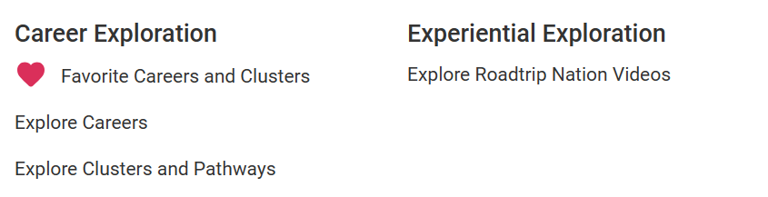

What’s Your Road?
You can customize your search of the interview archive.
Click on Careers> Explore Roadtrip Nation Videos.

Slide 11
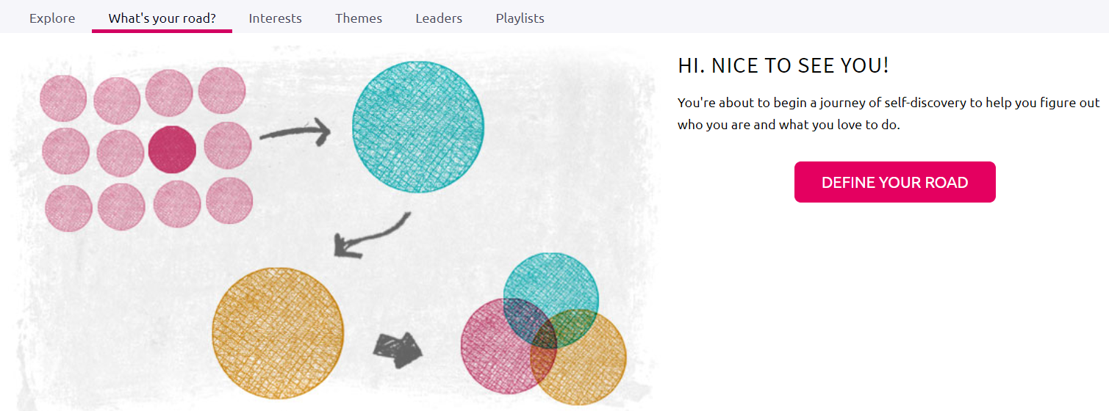
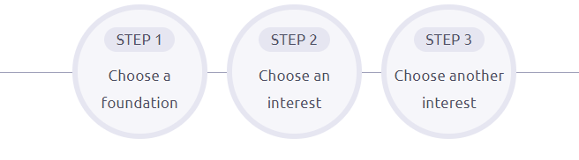
Define Your Road
When you click to Define Your Road, you will have an opportunity to choose a foundation and two interests helping you filter your video results.

Slide 12
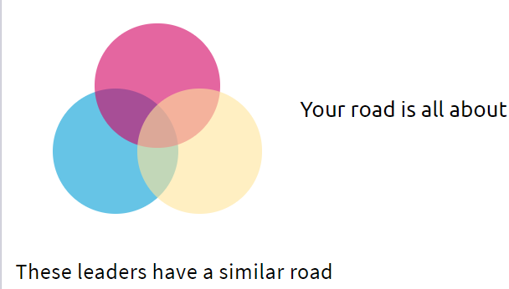

Your Road…
…
This process creates your Roadmap and provide you with videos of leaders with similar profiles.
Feel free to go through the process multiple times.
Just scroll down to the bottom of the page and click

Slide 13
Task Completion…

Slide 14

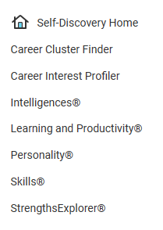
Personality Survey
To complete the task, log into Naviance Student and take the Personality survey which helps you identify your personality type by asking you to choose scenarios that are most like you in real life.
Click the Self-Discovery menu ​
​
Click the Personality survey

