Slide 1
Financial Aid
Naviance Student

Slide 2
Lesson Tasks
Identify the different types of financial aid options
Understand financial aid terms and the process for applying
Apply for financial aid via the FAFSA or WASFA
Learn about the process of accepting financial aid offers and next steps
Complete financial aid survey

Slide 3
Money for education & Training

Slide 4
Money for Post-Secondary Education
What does the word “college” really mean?
What are your biggest concerns about paying for college or any education or training classes after high school?
If you/your family is unable to pay for college, what other options are there to help you?
College is often used to describe any post-secondary education and training you receive. (Community College, University, Technical College, Training Program)

Slide 5

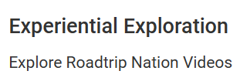
How did these Roadtrip Nation leaders pay for education?
Click Careers>Explore Roadtrip Nation Videos
Click Leaders
Click on the letter of the
person’s first name from this list to locate their interview.
List of Leaders
Ashley Hamilton-Ross | Gerard Baker
Bilal Bomani | John Legend
Charline Wright-Gipson | Luis Padilla
David Bader | Marshawn Evans
Dean Kamen | Todd McFarlane
Delfina Eberly | Soledad O’Brien
Deon Clark

Slide 6
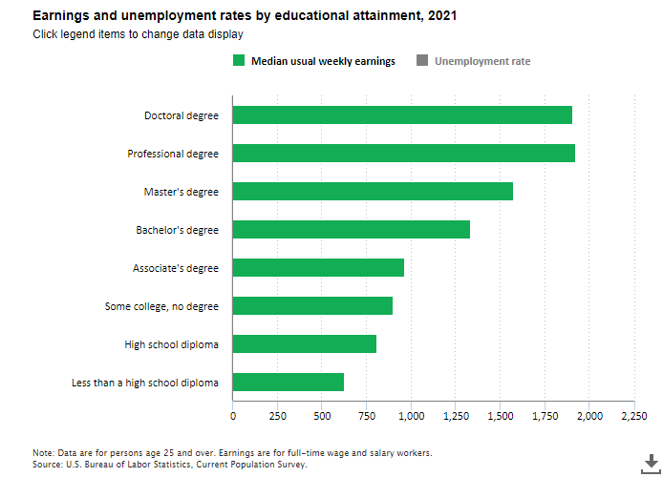
Learn More = Earn More!
Think about your career goals for the future and what type of education and/or training you may need.
Now look at your earning potential on average.
It pays to continue your education!!

Slide 7
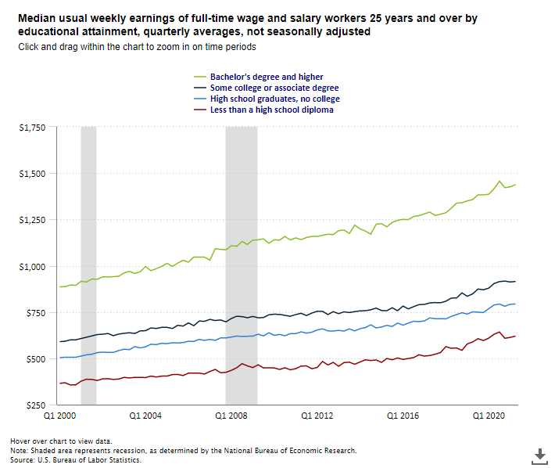
Education = Earning Potential
The chart focuses on the weekly earnings of full-time employees.

Slide 8
Benefits of Continued Education & Training
Research has shown that there are multiple ways value is added to your life when you continue to a post-secondary program after high school?
  Higher earning potential
  More job/promotion opportunities
  More employer-provided benefits
  More job satisfaction
  More on-the-job training opportunities
  Better working conditions
http://www.collegeatlas.org/earn-a-college-degree.html

Slide 9
Comparing Level of Education to Salary
Education Level | Lowest Median Earnings | Highest Unemployment Rate | Example Jobs at Education Level
No High School Diploma | $25,636/yearly $493/weekly | 8% | Fast Food Cook, Dishwasher, Hair Salon Shampooer
High School diploma | $35,256/yearly $678/weekly | 5.4% | Police or Sherriff Patrol Officers, Loan Officers
Associates Degree | $41,496/yearly $798/weekly | 4.3% | Dental Hygienists, Paralegal, Welding, Aviation Maintenance
Bachelor’s Degree | $59,124/yearly $860/weekly | 2.8% | Aerospace Engineer, Computer Info Systems Manager, Financial Analyst, Teacher
Master’s Degree | $69,732/yearly $1,341/weekly | 2.4% | Family Therapists, Physician Assistants, Business Administration
Professional Degree | $89,960/yearly $1,730/weekly | 1.5% | Doctors, Lawyers, Pharmacists
Doctoral Degree | $84,396/yearly $1,623/weekly | 1.7% | Physicists, Computer Research Scientists, College Professor
https://smartasset.com/retirement/the-average-salary-by-education-level

Slide 10
Financial Aid for students

Slide 11
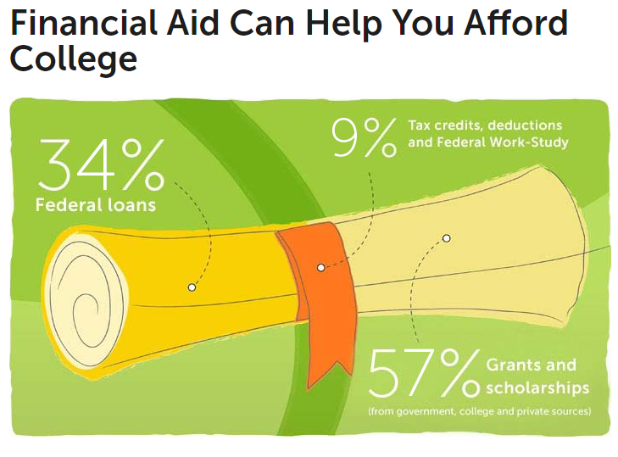
Money, Money, Money!
Financial aid is money that the federal and state government and other organizations give you or lend you to pay for college or training programs.
To qualify for financial aid, you have to apply.
https://bigfuture.collegeboard.org/pay-for-college/financial-aid-101/financial-aid-can-help-you-afford-college

Slide 12

Where does it come from?

Slide 13
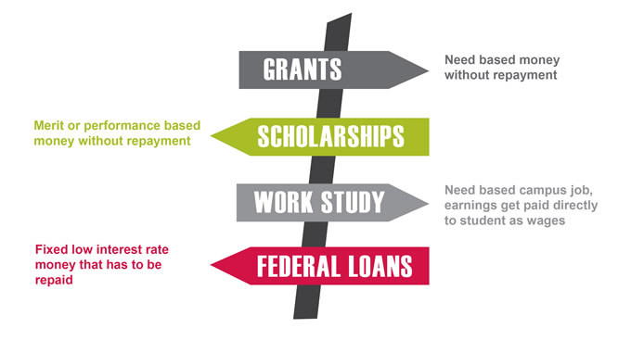
Financial Aid Types

Slide 14
Federal Pell Grant | Grant: Does not have to be repaid | Available exclusively to undergraduates; all eligible students will receive the Federal Pell grant amount they qualify for according to their FAFSA application | $5,920 Please see www.studentaid.ed.gov for updates
Federal Supplemental Educational Opportunity Grant | Grant: Does not have to be repaid | For undergraduates with exceptional financial need; priority is given to Federal Pell Grant recipients; funds depend on availability at school | $100 to $4,000
Federal Work-Study | Money is earned while attending school; does not have to be repaid | For undergraduate and graduate students; jobs can be on campus or off campus; students are paid at least federal minimum wage | No annual minimum or maximum award amounts
Subsidized Direct Stafford Loan | Loan: Must be repaid | Subsidized: U.S. Department of Education pays interest while borrower is in school and during grace and deferment periods; student must be at least a half-time student | Up to $5,500 depending on grade level and dependency status; visit https:// StudentAid.gov/sub-unsub for more information
Unsubsidized Direct Stafford Loan | Loan: Must be repaid | Unsubsidized: Borrower is responsible for interest during life of the loan; student must be at least a half-time; financial need is not a requirement | Up to $20,500 (less any subsidized amounts received for same period), depending on grade level and dependency status; visit https://StudentAid.gov/subunsub for more information
Direct Loan PLUS | Loan: Must be repaid | Available to parents of dependent undergraduate students who are enrolled at least half-time | Maximum amount is cost of attendance minus any other financial aid received; visit StudentAid.gov/plus for more information

Slide 15
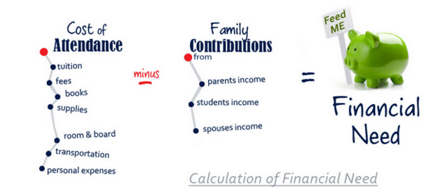
Financial Aid – Why?
Keep in mind that a college that charges a lot for tuition might offer you generous financial aid.
It might even be more affordable than colleges that charge lower tuition.
Each college you apply to will provide you with a financial aid offer.
Once you are notified from the colleges you’ve applied to, you will compare your financial aid offers to see which options are best for you.

Slide 16
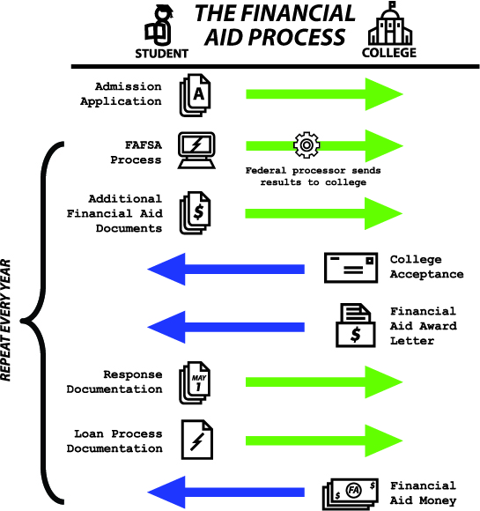
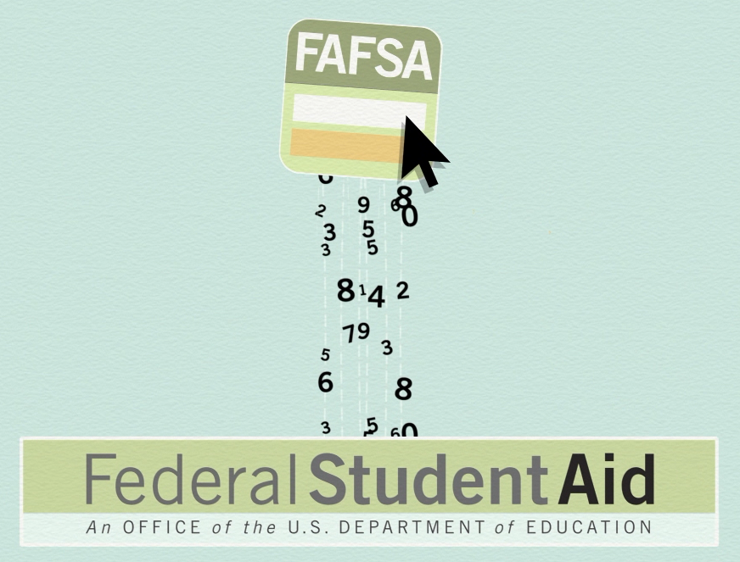
The Financial Aid Process
The financial aid process can seem a bit overwhelming at times.
Review the process to prepare for what comes next after you complete the FAFSA/WASFA.
To better understand the process after the application, click the link to watch the video.
Video: After the FAFSA

Slide 17
Financial Aid!
Typically beginning October 1st each year, students will be able to file the FAFSA or WASFA for the next school year. This year the form is being updated so it will be DECEMBER!
It allows you to complete your college applications and apply for financial aid at the same time.
It is best to submit your FAFSA or WASFA as close to when the form opens as possible!
Fill out the 2024-2025 application
Use 2022 tax information

Slide 18

Are You a College Bound Scholar?
The College Bound Scholarship is an early commitment of state financial aid to eligible students who…
Signed up in 7th or 8th grade
Fulfill the College Bound pledge
What do I get with the scholarship?
Once you file the FAFSA/WASFA as a senior the scholarship will pay the average tuition cost at a public college plus some fees and a small book allowance.
Where can I use it?
Public community and technical colleges
Public four-year colleges and universities
Independent colleges and universities
Private career colleges
http://www.readysetgrad.org/college/college-bound-scholarship-program

Slide 19
Applying for Financial Aid

Slide 20
Which Application Do You Complete?
In Washington, there are two different applications for financial aid, but you only need to file one.
You should apply for financial aid as soon as possible!
2023-2024 School Yr. – new federal app coming in December!
2024-2025 School Yr. – app opens on 10/1 so apply ASAP!
Do not wait until you are admitted to apply.
Your college may have additional financial aid forms for you to complete. Check their website or contact their financial aid office to find out.
FAFSA | WASFA
File the FAFSA (Free Application for Federal Student Aid) if you are a U.S. citizen or eligible non-citizen. | File the WASFA (Washington Application for State Financial Aid) if you are not eligible to complete the FAFSA due to immigration status and meet the eligibility criteria for one of the state aid programs that provide aid to non-citizens.

Slide 21
Getting Started…
FAFSA
Locate and memorize your Social Security Number
Go to the FAFSA (Free Application for Federal Student Aid) website.
WASFA
Go to the WASFA website to create a login
Under New User>Start A New WASFA click the button
Create a username and password called a FSA ID (Federal Student Aid ID)
Take a picture/write down of the final FSA ID screen with login information
Verify your email by logging into your inbox and clicking the link
Start your 2024-2025 FAFSA application
Create a username and password
Take a picture/write down your login information
Start your 2024-2025 WASFA application
Follow these important steps to begin your financial aid application.
*If you need additional help with the FAFSA/WASFA, please check with your teacher, counselor, or career specialist at your school.
*Use 2022 taxes

Slide 22
What do I do after I apply?

Slide 23
What’s Next?
Review your FAFSA / WASFA confirmation page | After you complete the FAFSA/WASFA form online and click “SUBMIT,” you’ll see a confirmation page. The confirmation page provides federal aid estimates based on the information you provided on your financial aid form. It’s important to know that these figures are truly estimates and assume the information you provided on the FAFSA/WASFA form is correct.
Apply for as many scholarships as you can | Many schools won’t be able to meet your full financial need, so applying for scholarships are a great way to fill the gap. Don’t wait until after you receive your financial aid offer to start applying for scholarships. There are thousands of scholarships out there, with deadlines all the time. Set a goal for yourself; for example, try to apply to one scholarship per week.
Be on the lookout for your aid offer(s) | The 2024-2025 FAFSA/WASFA is available in December Even if you submit it early, that doesn’t mean you’ll get an aid offer right away. Each school has a different schedule for awarding and paying out financial aid. *Remember that your school disburses your aid, not the FAFSA/WASFA* Contact your school’s financial aid office for details about when they send out aid offers.
Make corrections promptly if you need to | After your FAFSA/WASFA form has been processed you can go back and submit a correction to certain fields if you need to. This includes correcting a typo or adding another school to receive your FAFSA/WASFA information.

Slide 24
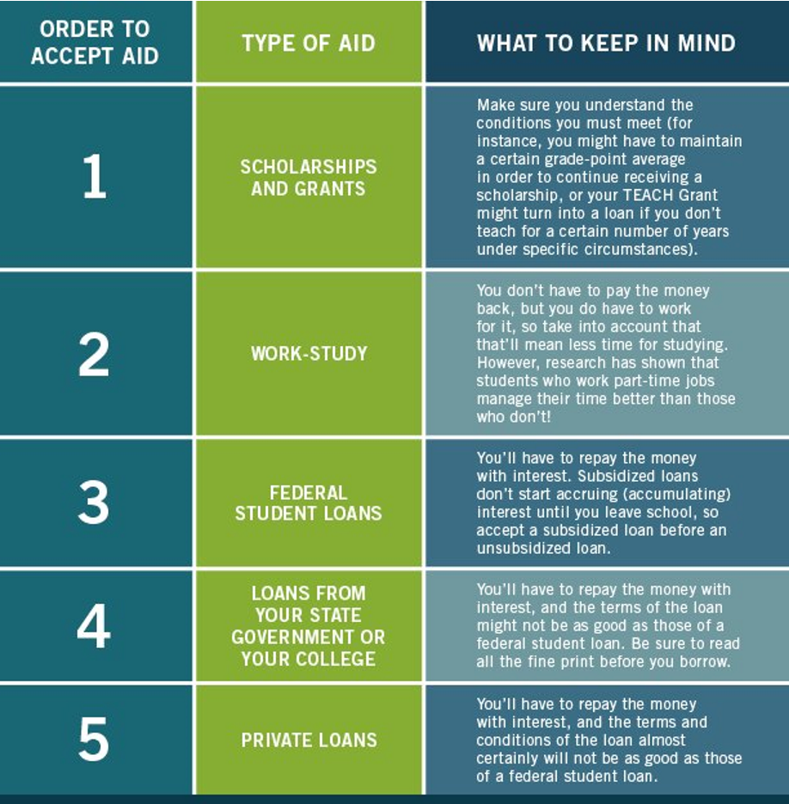
Order of Accepting Financial Aid

Slide 25
Task Completion…

Slide 26



Log in to Naviance Student
Click Students from school website
Click Naviance button
Log in with district ID# and password
Naviance Student
Username: district ID#
Password: district password

Slide 27
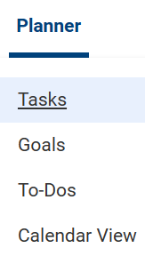


Complete the Task…
To complete the lesson task log into
Naviance Student, click Planner > Tasks.
Click the title of the task – Complete Financial Aid Survey
Then click the link to take this survey

