Slide 1
Scholarship applications
Naviance Student

Slide 2
Lesson Tasks
Save scholarships from Naviance Student Scholarship Search
Build a profile in the National Scholarship Search in Naviance Student and add scholarships to favorites
Apply for one school scholarship and upload application into Naviance Student
Explore additional resources to access scholarship opportunities

Slide 3
Scholarships –
Myths vs. Reality

Slide 4
What are Scholarships?
A scholarship is an amount of money awarded helping you further your education and you do not have to pay it back.
Scholarships are considered “gift aid.”
Scholarships come from many sources:
Government
Corporations
Colleges, universities, training programs
Organizations

Slide 5
Scholarship Myths vs. Reality
Scholarships are only for good grades and sports. | You have to write an essay to get a scholarship. | Scholarships that are small are not worth the effort of applying.
Many scholarships do not take grades or athletics into consideration and do not have a GPA requirement as part of their criteria. If scholarships consider your GPA as part of their application, the minimum might be 2.5 rather than a 4.0. | Not all scholarships require an essay. Reading the application criteria carefully is important. Essays are more about what you write than how eloquently it is written. It is more important to follow the instructions and directly address the essay question. | Remember that every dollar you receive in scholarships is one more you don’t have to pay back. If you win multiple scholarships that are worth smaller amounts, it adds up to a larger overall award. Scholarship money can help with additional college expenses like books, supplies, food etc.

Slide 6
Scholarship Myths vs. Reality
Scholarship competition is too intense. | Searching for scholarships takes too much time. | Scholarships are only for those with financial need.
The most important thing is to read all scholarship instructions and rules. Many times students don’t take the time to do everything correctly so they are not even considered. If you spend time searching, applying and win, think about how much money that would equal per hour if you worked? | Set aside time to search and apply for scholarships each week. Use tools inside Naviance Student and others where you can create a profile to narrow your search options, Reach each description and follow all instructions by scholarship provider so you don’t waste time applying. | There are a lot of scholarships not only focused on financial need. Scholarships are available based on your interest, talents, academics (known as “merit”), volunteering, and many other extra curricular activities. Often completing profiles like the National Scholarship Search can help.

Slide 7
Scholarships and Money

Slide 8



Log in to Naviance Student
Click Students from school website
Click Naviance button
Log in with district ID# and password
Naviance Student
Username: district ID#
Password: district password

Slide 9

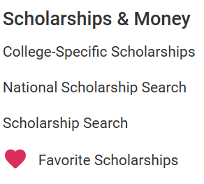
Scholarships in Naviance Student
There are tools to help you with your scholarship searching.
Click on Colleges to find:
Scholarship Search
National Scholarship Search

Slide 10
Scholarship Search

Slide 11

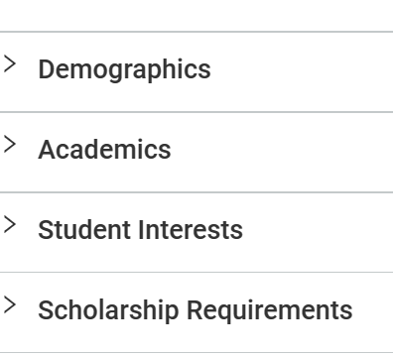
Scholarship List
The Scholarship Search list provides you with school specific, local and regional scholarships.
Using the Match and Filter, helps filter the type of scholarship by a variety of categories.
Scholarships in the Scholarship Search are updated regularly, so check back often!

Slide 12

Scholarship List Details
**Always check the due date!!
To read more details about a scholarship click the title.
In the scholarship details look for the link to a website for an online application or the link to download the application.
Check the Favorite button to remember the scholarship for later or to apply now.

Slide 13
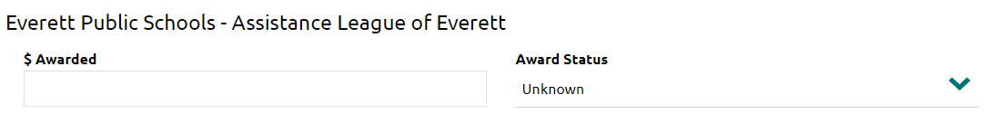
Updating Scholarships
As you are notified of your scholarships outcomes, you can report the Result and the amount of money Awarded in Naviance Student.
Unknown - you have not received notification of an award yet
Awarded - you received confirmation that you were awarded the scholarship
Denied - you received confirmation that you were not awarded the scholarship

Slide 14
National Scholarship search

Slide 15
National Scholarship Search
Click the link for Colleges>National Scholarship Search to create your profile.

Slide 16
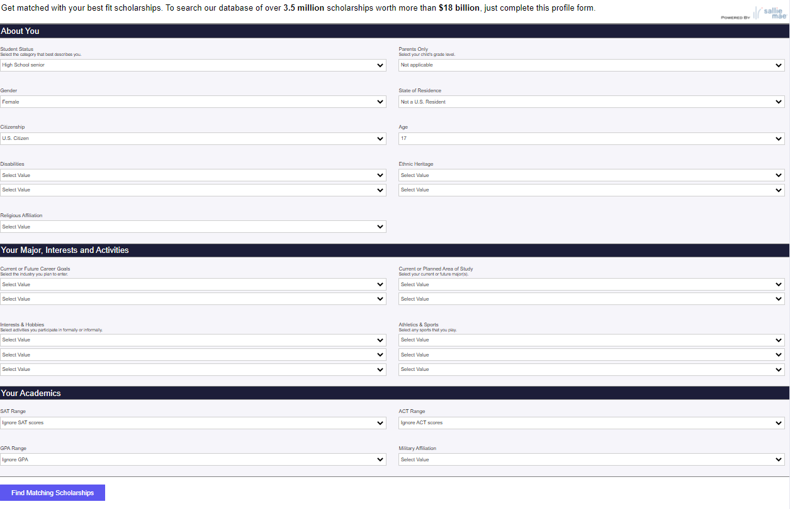
Building Your Profile
Complete as many parts of your profile as possible to and identify which scholarships match your profile.

Slide 17
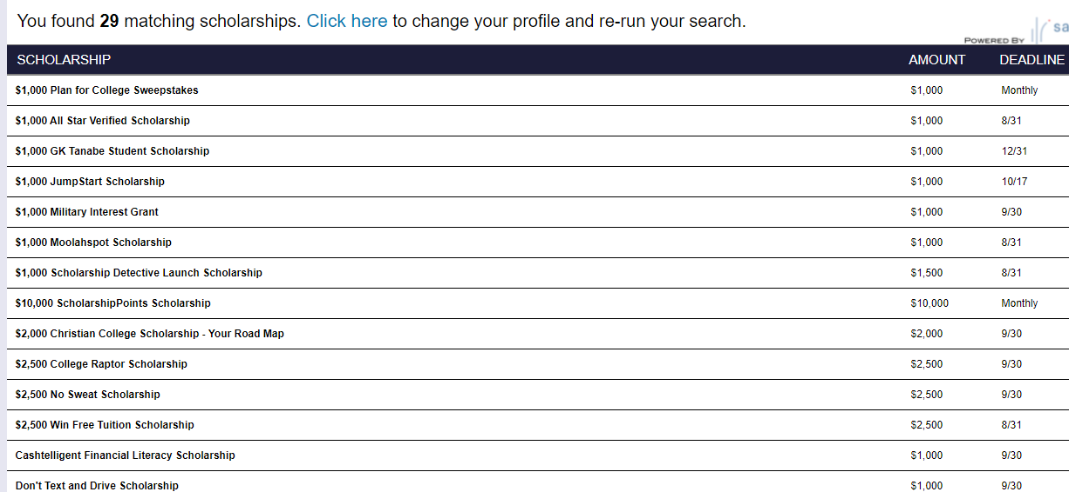
Your Scholarship Matches
Review your matches by clicking the scholarship titles linking you to the description and how to apply.
You can update your profile at any time.

Slide 18
Apply for School Scholarships

Slide 19
Scholarships at Your School
Each year, your high school posts their own scholarship applications in Naviance Student.
Your chances are greater at receiving a scholarship at your school because it is only out of your own senior class!
Your task is to apply for at least one of your own school’s scholarships and upload your application or documentation of applying to the task in Naviance Student.
*If the due date has passed for your school scholarship, choose another one off the Scholarship List.

Slide 20
Task Completion…

Slide 21
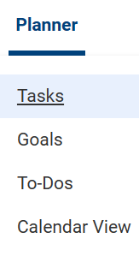

Complete the Task…
To complete the lesson task log into Naviance Student, click on Planner > Tasks.
Click the title of the task –
Upload Scholarship Application
Click Browse…
to locate your scholarship
documentation for upload.

