Slide 1
Making an impression – Interview Process
Naviance Student

Slide 2
Lesson Tasks
Discuss the fundamentals of interviewing
Answer common interview questions
Prepare for and participate in mock interview
Complete final community interview process and reflection

Slide 3
Interview Tips & Tricks

Slide 4
Preparing for the Interview
Your application and resume are the “opening act” for the interview
You will want to look good, act professionally and say the right things to make a good impression
Only the top applicants will be selected

Slide 5
Tips for Interview Preparation
Research the company before the interview Practice interviewing before you go Make sure you know how to get to the interview site Take two copies of your resume | Go to bed early the night before Dress your best Make sure you shower & look your best

Slide 6
Things to Avoid
Some typical nervous habits that you will want to avoid include:
Rubbing your nose Twirling your hair Blinking often Biting your nails Twisting your hands | Fidgeting Playing with jewelry Shaking your foot Scratching your head

Slide 7
Getting Off to a Good Start
Top tips for getting an interview off to a good start:
Arrive 15 minutes early Shake interviewer’s hand firmly Greet the interviewer by last name Smile & greet other people Stand until you are invited to sit Look the interviewer in the eye | Show enthusiasm & energy Use words appropriate to your audience Use your best posture Ask about the job Be prepared to talk about yourself

Slide 8
Getting off to a Good Start
You never know who will walk by or observe you while you are waiting
You will be more noticeable because you are a visitor
These occurrences provide you with an excellent opportunity to make a good impression
Things to remember:
  Stand tall and walk at the same pace as the interviewer
  No gum the entire time while you are at the interview site
  Smile or give a friendly nod to each person who makes eye contact with you
  Shake hands with any individuals you are introduced to you by the interviewer
  Take the lead from the interviewer regarding whether to stay quiet or talk

Slide 9
Interview Preparation

Slide 10
Questions and More Questions
Questions Asked of the Interviewee | Questions Asked of the Interviewer
To perform well at your interview, you need to be prepared for all different types of questions This will leave a good impression and increase your chances of being hired | An important part of doing well in an interview is to be prepared to ask questions yourself Asking good questions leaves a good impression and shows you are interested in the job

Slide 11
What are Your Character Traits?
Often employers will ask you to talk about your character traits in and interview.
Think of your answer ahead of time by looking at this list of top 10 traits considered by employers:
Attitude
Ability to do the work
Motivation & taking initiative
Ability to grow in the job
Self-confidence
Leadership skills
Social skills
Team skills
Compatibility
Communication skills

Slide 12
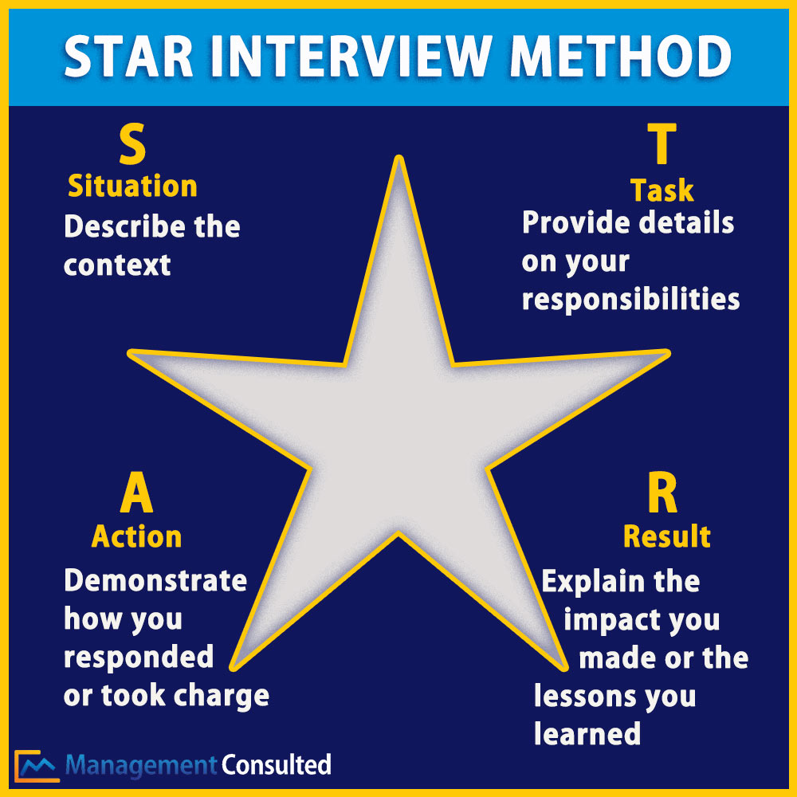
STAR Interview Method
Use the STAR method to help you remember how to respond to interview questions.

Slide 13
Ask about the Job
When you are in an interview, it can be difficult to remember what type of question to ask the interviewer…
Think of a few questions ahead of time and practice:
  “Will you describe the tasks & responsibilities of the job?”
  “What do you consider to be the top priorities of the person in this job?”
  “What personal characteristics or skills & abilities do you believe are the most important in this job?”

Slide 14
Responding Positively
When asked the question of your strengths & weaknesses, it is often difficult to think of an answer
This question allows you to point out your good points without exaggerating & state your weakness in a positive way
Example of stating a strength:
“I am very organized & pay close attention to details.”
Example of stating a weakness:
“Sometimes I get so caught up in my work that I forget what time it is. My supervisor reminds me take my lunch break.”

Slide 15
Mock Interview Preparation

Slide 16
Interview Practice
Interviewing well can take practice. You will have an opportunity to practice in class.
Review and Practice questions on the Common Interview Questions hand out
Conduct the mock interview with a peer or another volunteer
Interviewers use the Mock Interview Form from as a guide for asking questions and evaluating your resume

Slide 17
Task Completion…

Slide 18



Log in to Naviance Student
Click Students from school website
Click Naviance button
Log in with district ID# and password
Naviance Student
Username: district ID#
Password: district password

Slide 19
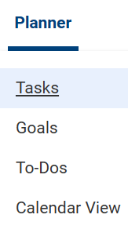
Complete the Task…
To complete the lesson task log into Naviance Student, click on Planner > Tasks.
Click the title of the task – Complete Job Interview Reflection to evaluate yourself on the mock interview.

