Slide 1
Career Exploration
Naviance Student

Slide 2
Lesson Tasks
Complete the Career Interest Profiler Assessment
(if previously completed, review and/or update your previous results)
Add careers to favorite careers and clusters list
Identify any updates to your post-secondary plan based on your college and career interests

Slide 3
How Do You Choose a Future Career?
How do you think someone chooses a career?
What careers do you think are in high demand?
What careers do you think will have the best employment outlook for the future?
What level of preparation do you need to consider to enter your desired career?

Slide 4
Career Exploration

Slide 5
What is the Career Interest Profiler?
The Career Interest Profiler is an assessment in Naviance Student that helps you identify your personality traits and how they fit within different careers.
Results are put into categories called Holland Code:
Realistic
Investigative
Artistic
Social
Enterprising, and Conventional
Results are then matched to potential career options
You can explore specific careers or career clusters/pathways (groups of careers)

Slide 6
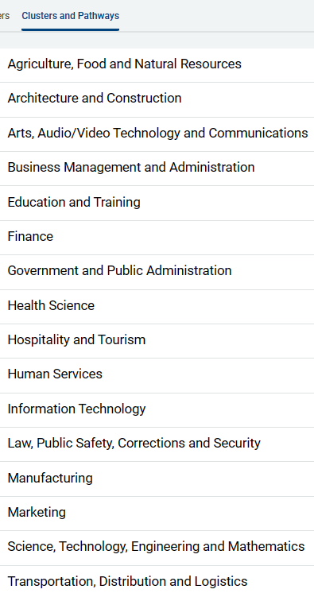
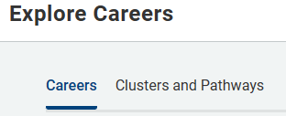
Exploring Options
Click Clusters and Pathways to get detailed information on groups of careers
Click Careers to get specific information about one career

Slide 7
Career Interest Profiler

Slide 8



Log in to Naviance Student
Click Students from school website
Click Naviance button
Log in with district ID# and password
Naviance Student
Username: district ID#
Password: district password

Slide 9
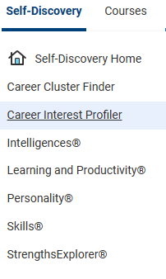

Access Your Career Interest Profiler
Click Self-Discovery > Career Interest Profiler
Click to begin.

Slide 10
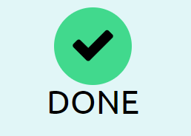
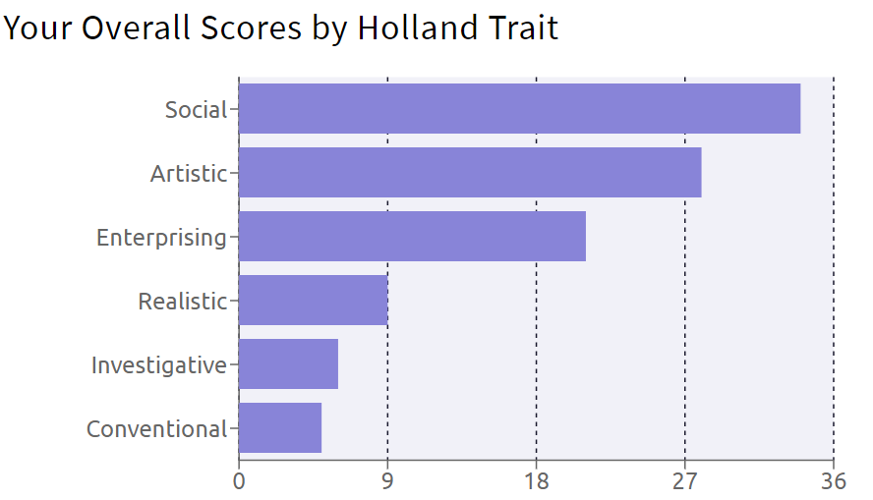
Career Interest Profiler Results
Your assessment results will map your interests to six categories of personalities called the Holland Code

Slide 11
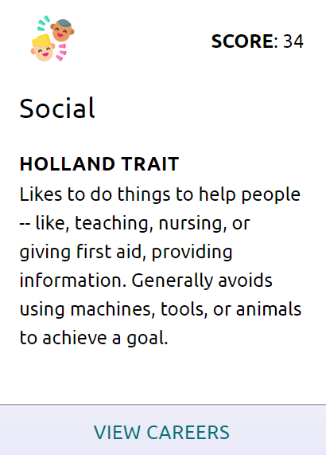
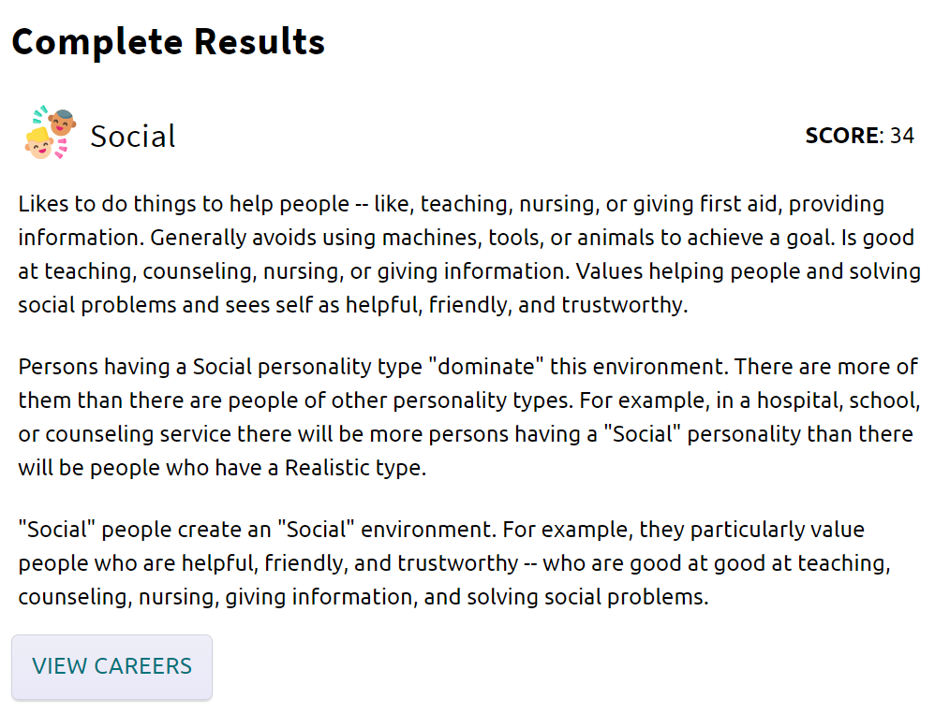
Career Interest Profiler Results
You can get more information about each trait and how it relates to future career interests.
Click View Careers to access detailed career information related to your personality.

Slide 12
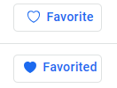

Saving Favorite Career Options
Click the heart icon to favorite Careers and career Clusters and Pathways to review later.

Slide 13
Task Completion…
21

Slide 14
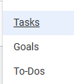

Complete the Lesson Task…
To complete the lesson, click Planner > Tasks.
Make sure that the Complete Career Interest Profiler is complete and you have favorited two Careers AND two Cluster and Pathways.
When done, both tasks should be listed under Tasks you’ve completed.

