Slide 1
LEARN Saves Lives:
Suicide Prevention Training
Learning Improvement Day
All-Staff Training
October 11, 2024
Notes:
Pre-training survey link: https://redcap.link/fis_learn_pre
Participant packet link: https://redcap.link/staff_docs
Welcome to today’s “LEARN Saves Lives Suicide Prevention Training”. This training was developed by Forefront Suicide Prevention, a Center of Excellence at the University of Washington’s School of Social Work.
As we get settled, please complete the pre-training survey if you haven’t already.
You can access the survey by scanning the QR code on the slide with your phone.
LEARN Training Implementation Tips
FACILITATOR NOTES: Italicized information includes tips for the instructor (e.g., reminders to keep the audience moving, animated slide, timing of activities etc.
ACTIVITY: These sections include additional audience engagement.

Slide 2
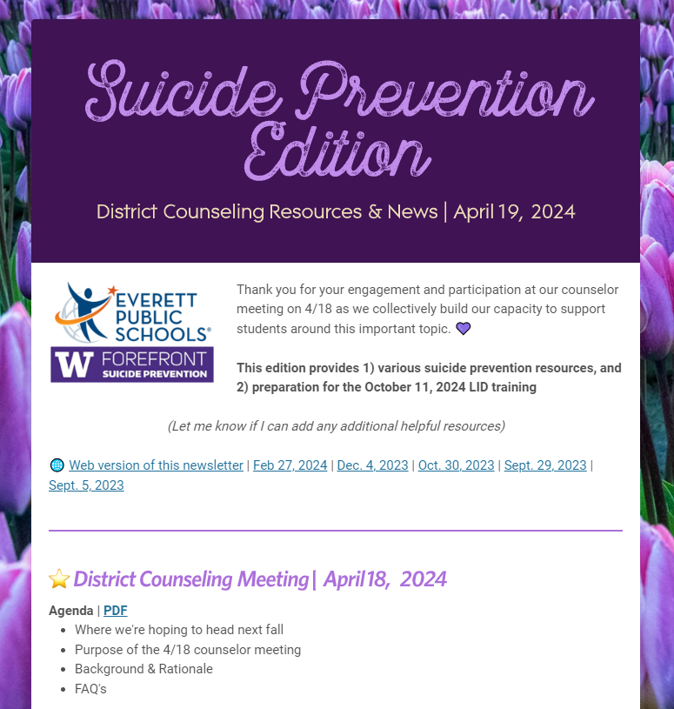
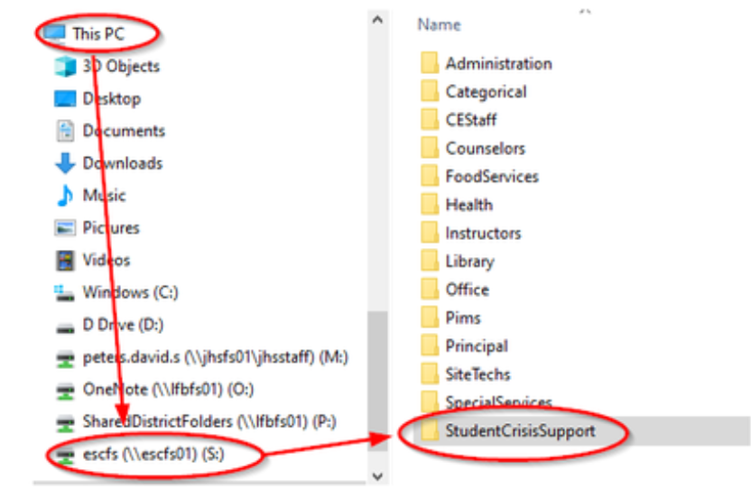
INFRASTRUCTURE
DEVELOPMENT
LEARN
Notes:
FOR IN-PERSON TRAINING ONLY - OTHERWISE SKIP
Let’s go through a bit of housekeeping before we begin the training today.
This training will take approximately [60-90] minutes
There will be one activity for you to practice the skills you’ll learn later.
If you have any additional questions, please don’t hesitate to ask.

Slide 3

OCT. 11 LID PLANNING
WHERE WE’RE HEADING THIS FALL
As part of the Learning Improvement Day agenda on October 11, 2024, the idea is that each school will divide their certificated and classified staff into classrooms of about 20 participants. A Forefront trainer will lead a LEARN training via Zoom webinar simultaneously across the district. Each room will have a trained staff member present in person to help with facilitation of this session.
BACKGROUND & RATIONALE
In Washington each year, school districts alternate annually between a professional learning focus on Diversity, Equity, & Inclusion (DEI) and Social & Emotional Learning (SEL). The 2024-25 school year will have an SEL emphasis. School Board Policy (2145) and Procedure (2145P) set expectations for suicide prevention training to be provided annually to help staff identify and respond to students at risk of suicide. Everett Public Schools is a cohort district with the University of Washington’s Forefront in the Schools suicide prevention program, and LEARN is the acronym for five steps to recognize signs of suicide and respond in a manner that can help save someone’s life.
LEARN
Notes:
FOR IN-PERSON TRAINING ONLY - OTHERWISE SKIP
Let’s go through a bit of housekeeping before we begin the training today.
This training will take approximately [60-90] minutes
There will be one activity for you to practice the skills you’ll learn later.
If you have any additional questions, please don’t hesitate to ask.

Slide 4

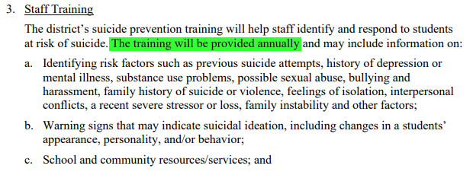
OCT. 11 LID PLANNING
LEARN
Notes:
FOR IN-PERSON TRAINING ONLY - OTHERWISE SKIP
Let’s go through a bit of housekeeping before we begin the training today.
This training will take approximately [60-90] minutes
There will be one activity for you to practice the skills you’ll learn later.
If you have any additional questions, please don’t hesitate to ask.

Slide 5




Forefront’s Mission
Forefront Suicide Prevention is a SSW Center of Excellence.
Our mission is to help people take action to prevent suicide in their communities.
Notes:
Forefront’s mission is to help people take action to prevent suicide in their communities. To that end, Forefront has provided suicide prevention training to nearly 70,000 professionals and community members across WA state, championed 11 state laws, and positioned our state as the first to require health professionals to have suicide prevention training.
Founded in 2013. We are a Center of Excellence, not considered a research center, but we think ourselves more of an action center. Our training programs are evidence-informed, but we’re working towards being able to classify our products as evidence-based as we pursue publications, and Zoe will talk more about that later.
Started by UW School of Social Work professors, Sue Eastgard, M.S.W., a national leader in youth suicide prevention, and Jennifer Stuber, Ph.D., a public health policy expert, to address suicide prevention at a public policy level.
Our early focus was on advocating for the first laws in the U.S. requiring that every behavioral health professional and health care provider in the state receive suicide prevention training, and we developed and delivered training programs statewide to meet these requirements.
In 2015, we founded Forefront in the Schools, a comprehensive, multi-year suicide prevention program that provides schools with a framework and tools to address youth suicide and suicidal behavior through an integrative approach. Over 50 schools have joined the program to date.
In 2015 we also launched Forefront Suicide Prevention LEARN®, our gatekeeper training.
In 2016, our work expanded to support a higher education task force formed by the state to improve suicide prevention programming in 2- and 4-year higher ed institutions across Washington.
In 2018, we started Safer Homes Suicide Aware, a program teaching practical skills and distributing free locking devices to help change public behavior on limiting unauthorized access to firearms and medications, which are the two most common means of suicide. Known as “lethal means safety”, this is one of only four interventions that is known to reduce suicide rates at population levels.

Slide 6
LEARN Training Room Needs
SECONDARY
BUILDINGS | TOTAL ROOMS | # OF COUNS | MAX PPL PER ROOM | MIN PPL PER ROOM
CHS | 5 | 6 | 24.3 | 18.2
EHS | 5 | 6 | 27.4 | 20.5
EIS | 3 | 3 | 23.4 | 17.5
EVG | 3 | 3 | 23.4 | 17.5
GMS | 3 | 3 | 24.5 | 18.4
HEA | 3 | 3 | 23.9 | 18.0
JHS | 7 | 7 | 23.0 | 17.3
NMS | 3 | 4 | 21.2 | 15.9
SHS | 2 | 2 | 18.4 | 13.8
LEARN
Notes:
FOR IN-PERSON TRAINING ONLY - OTHERWISE SKIP
Let’s go through a bit of housekeeping before we begin the training today.
This training will take approximately [60-90] minutes
There will be one activity for you to practice the skills you’ll learn later.
If you have any additional questions, please don’t hesitate to ask.

Slide 7
Thank you!
QUESTIONS?
Notes:
Thank you!
Now we’d like you to please complete our post training survey. You can access the survey by scanning the QR code on the screen or by going to https://redcap.link/fis_learn_post
Forefront uses this data for program improvement - including making sure that we are teaching you effectively. Forefront values anything that you can share.
If you are interested in learning more about Forefront Suicide Prevention, please:
Visit their website intheforefront.org
Connect with them on social media (Facebook, Twitter, and Instagram)
Email them at ffront@uw.edu

