Slide 1
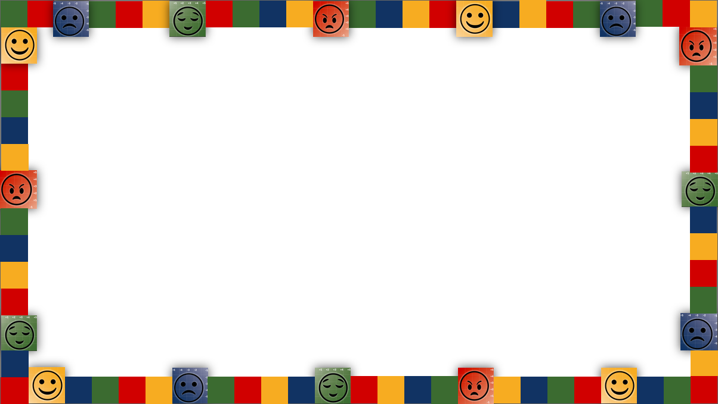


301: Brain Science of Emotions & Regulation
EPS Learns | August 22, 2024

Slide 2
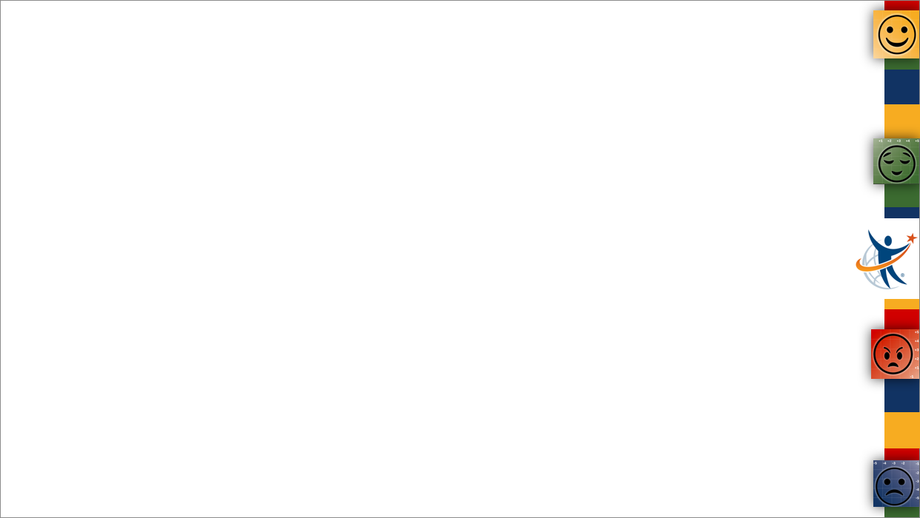
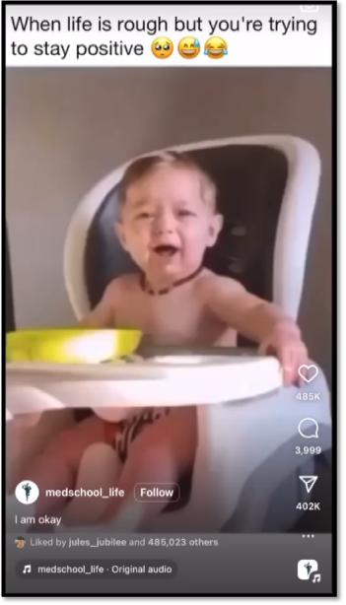
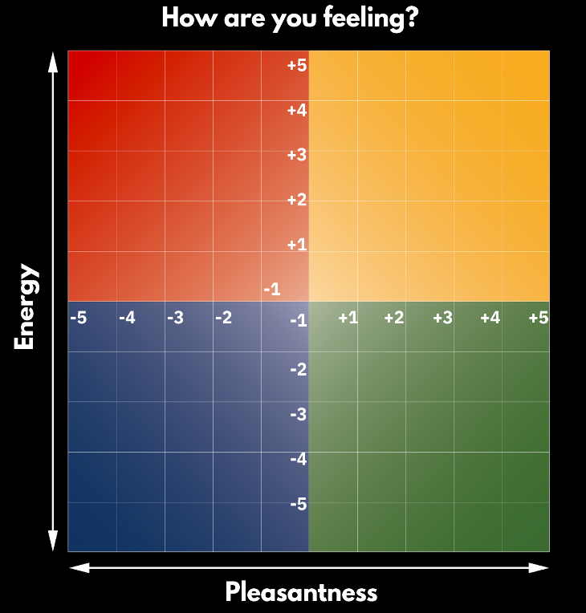




How are you feeling today?

Slide 3
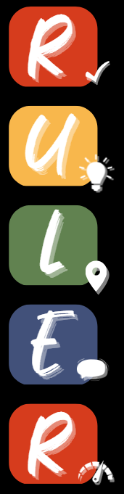
The RULER Skills
Recognizing emotions in ourselves and others
Understanding the causes and consequences of emotions
Labeling emotions accurately
Expressing emotions appropriately
Regulating emotions effectively

Slide 4

The Brain Science of Emotions

Slide 5
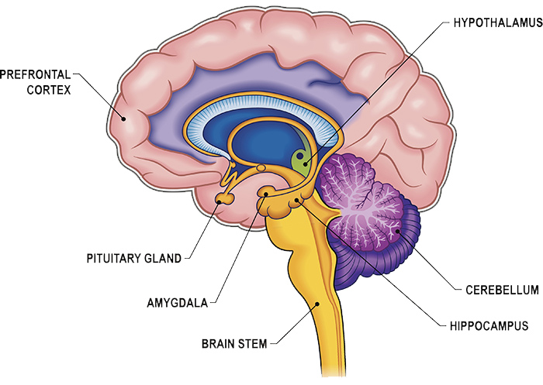
A Look Under the Hood
Attention
Concentration
Focus
Emotion Regulation
Reactivity
Learning
Episodic Memory
Understanding the Brain’s Threat & Stress Response

Slide 6
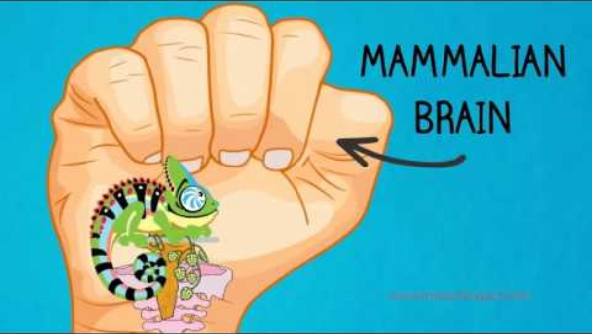
A Look Under the Hood
https://youtu.be/5CpRY9-MIHA?si=sQmZf8RmjCvZoDuH

Slide 7
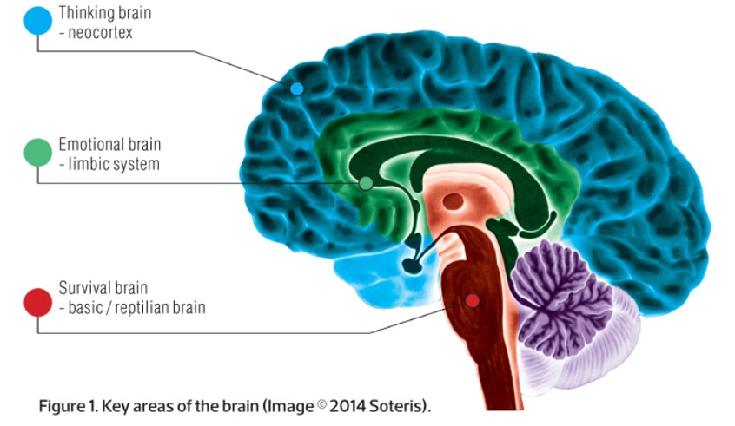
A Look Under the Hood

Slide 8
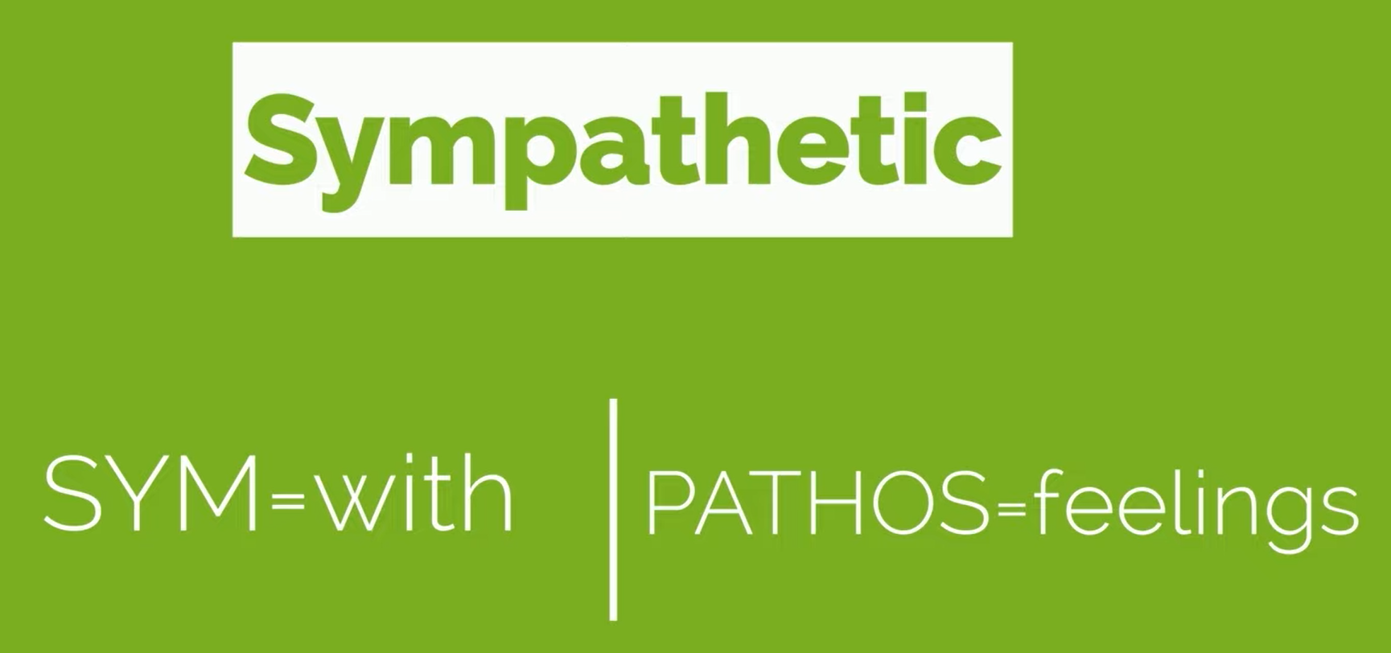


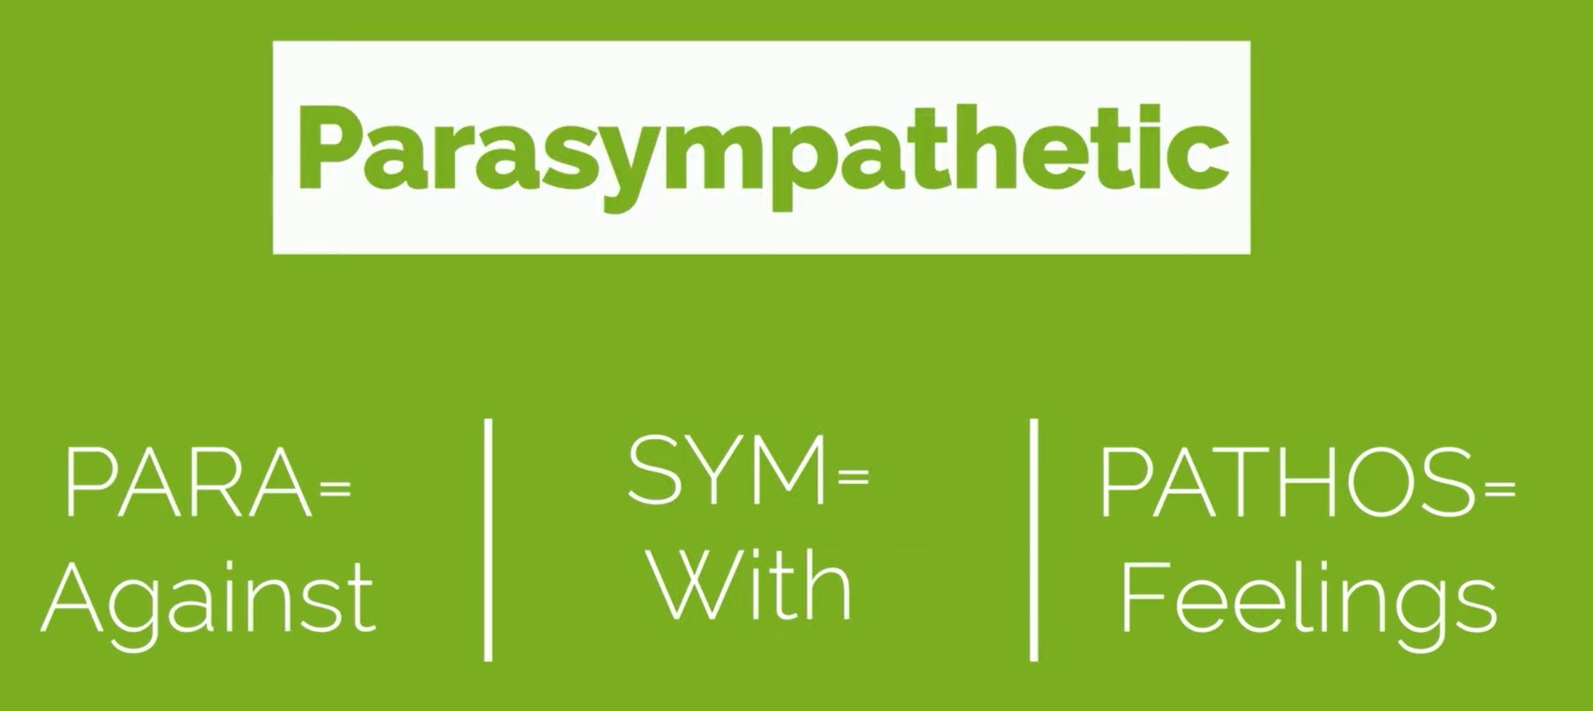
A Look Under the Hood
These two parts of our nervous system
have opposite but complementary roles

Slide 9
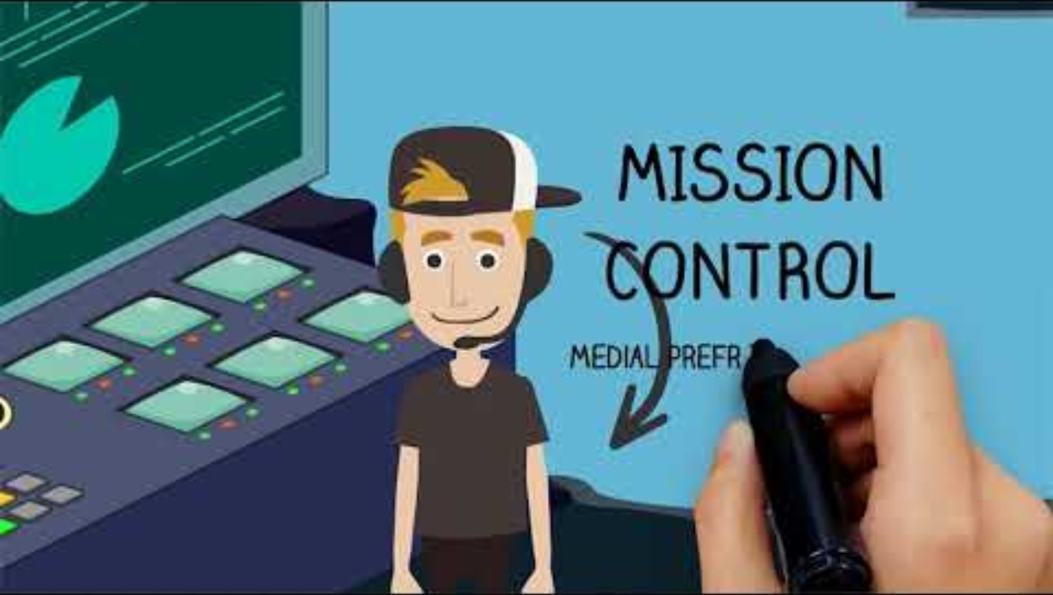
A Look Under the Hood
https://youtu.be/a-ddSEHRWVg?si=Pj7tCh3frU9zkOOu

Slide 10
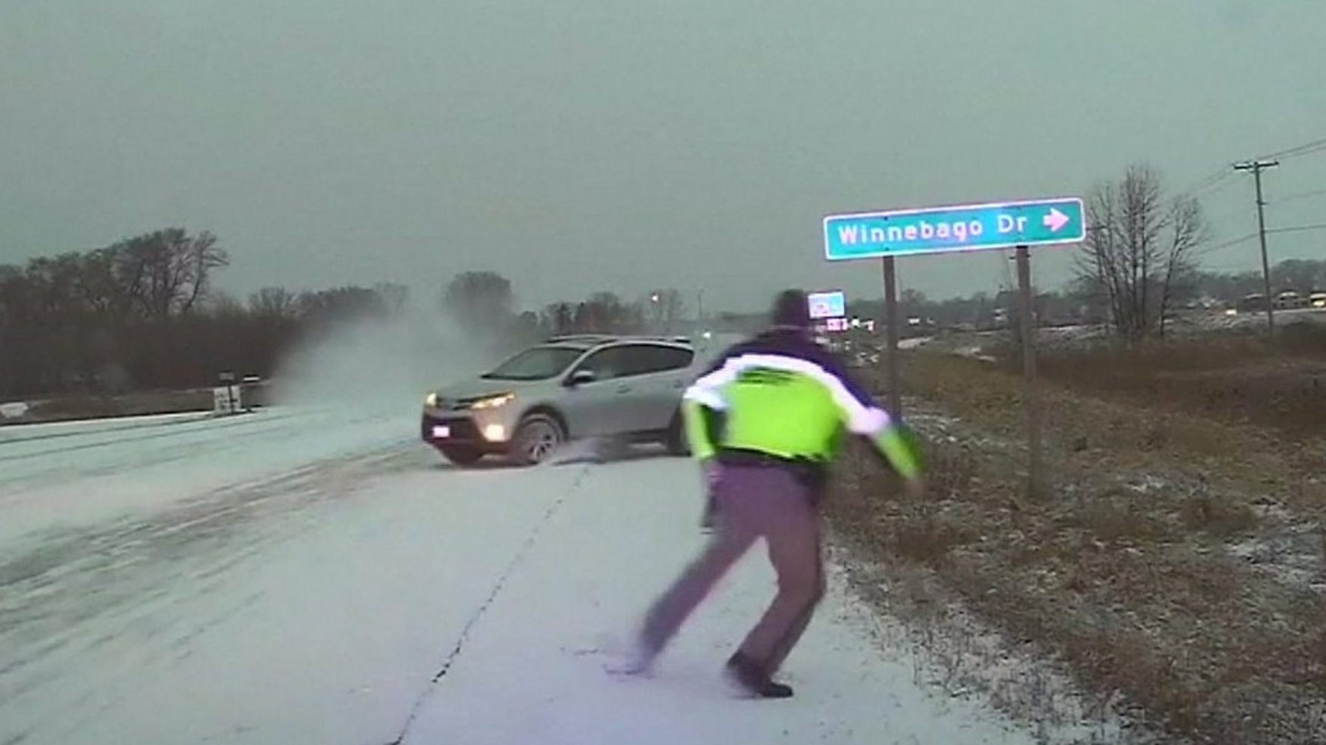
The Order of Brain Operations
The emotion brain responds to an event more quickly than the thinking brain.
-Daniel Goleman

Slide 11
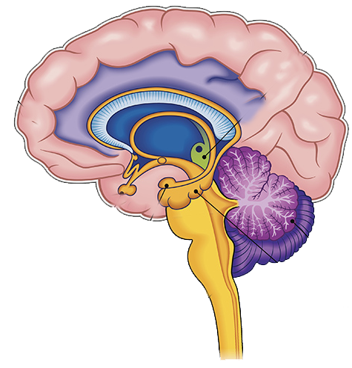
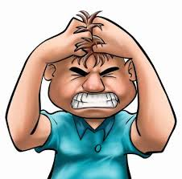
When Emotion Mind Takes Over
Prefrontal Cortex Shuts Down
No problem solving
No new learning
Rational Mind is Blocked
  Distorted thoughts occur
Impulse Control Decreases
  Can’t engage in non-mood-dependent behaviors
Limbic System Activates
Emotion Intensity Increases
Physiological Cues Activate
  Can’t regulate physiology
Can only focus on Emotion Cues

Slide 12
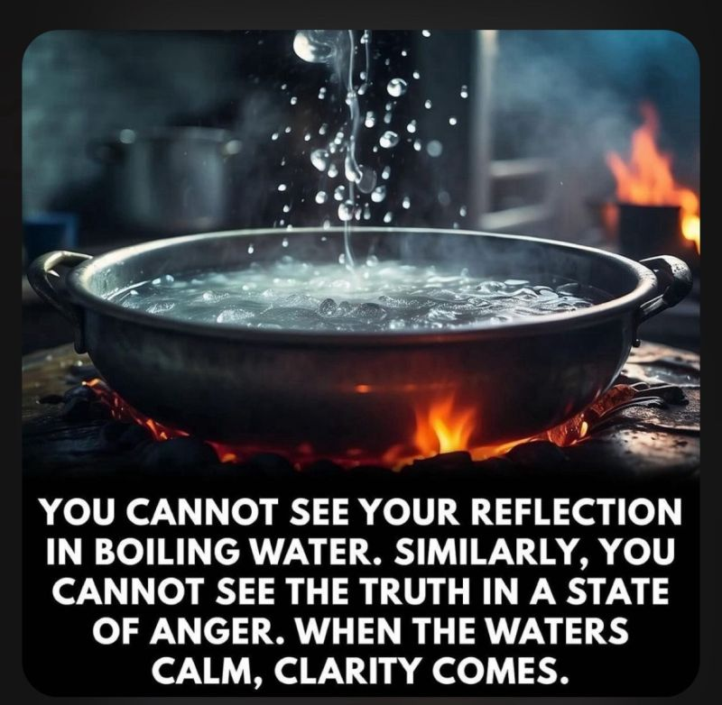
When Emotion Mind Takes Over

Slide 13
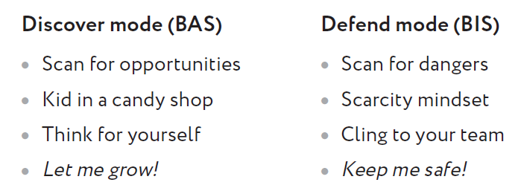
Discover Mode & Defend Mode
Two Basic Mindsets
Notes:
The behavioral activation system (or BAS) turns on when you detect opportunities, such as suddenly coming across a tree full of ripe cherries when you and your group are hungry.[ 5] You’re flooded with positive emotions and shared excitement, your mouths may begin to water, and everyone is ready to go! discover mode.[ 6] The behavioral inhibition system (BIS), in contrast, turns on when threats are detected, such as hearing a leopard roar nearby as you’re picking those cherries. You all stop what you are doing. Appetite is suppressed as your bodies flood with stress hormones and your thinking turns entirely to identifying the threat and finding ways to escape it. defend mode. For people with chronic anxiety, defend mode is chronically activated. The two systems together form a mechanism for quickly adapting to changing conditions, like a thermostat that can activate either a heating system or a cooling system as the temperature fluctuates. In humans (and other highly sociable mammals, such as dogs), the default setting is a major contributor to their individual personality. People (and dogs) who go through life in discover mode (except when directly threatened) are happier, more sociable, and more eager for new experiences. Conversely, people (and dogs) who are chronically in defend mode are more defensive and anxious, and they have only rare moments of perceived safety. They tend to see new situations, people, and ideas as potential threats, rather than as opportunities. Such chronic wariness was adaptive in some ancient environments, and may still be today for children raised in unstable and violent settings. But being stuck in defend mode is an obstacle to learning and growth in the physically safe environments that surround most children in developed nations today.

Slide 14
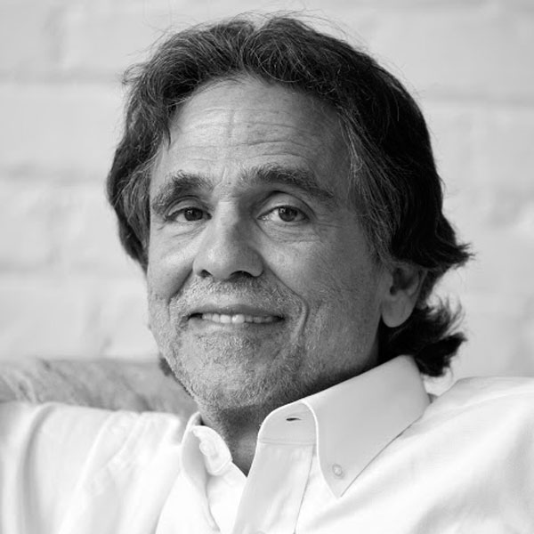
The Placebo Effect
Ted Kaptchuk
Professor of medicine at Harvard Medical School & director of the Harvard-wide Program in Placebo Studies
Notes:
Placebo = the effect of an inert substance… the effect of something that has no effect.
A way of quantifying and measuring everything that surrounds pills and procedures, mainstream or alternative. They’re about the rituals, the words, the engagement, the costumes/uniforms, the diplomas, and those special things you get when you go to a healer. They’re about how the drama of health care can alleviate symptoms and change the course of disease, even without pharmaceuticals. And placebos are not only about the imagination. They actually work through neuro-transmitters and brain circuitry that many important drugs recruit and hijack, mimicking what the body can already do – not the other way around.

Slide 15
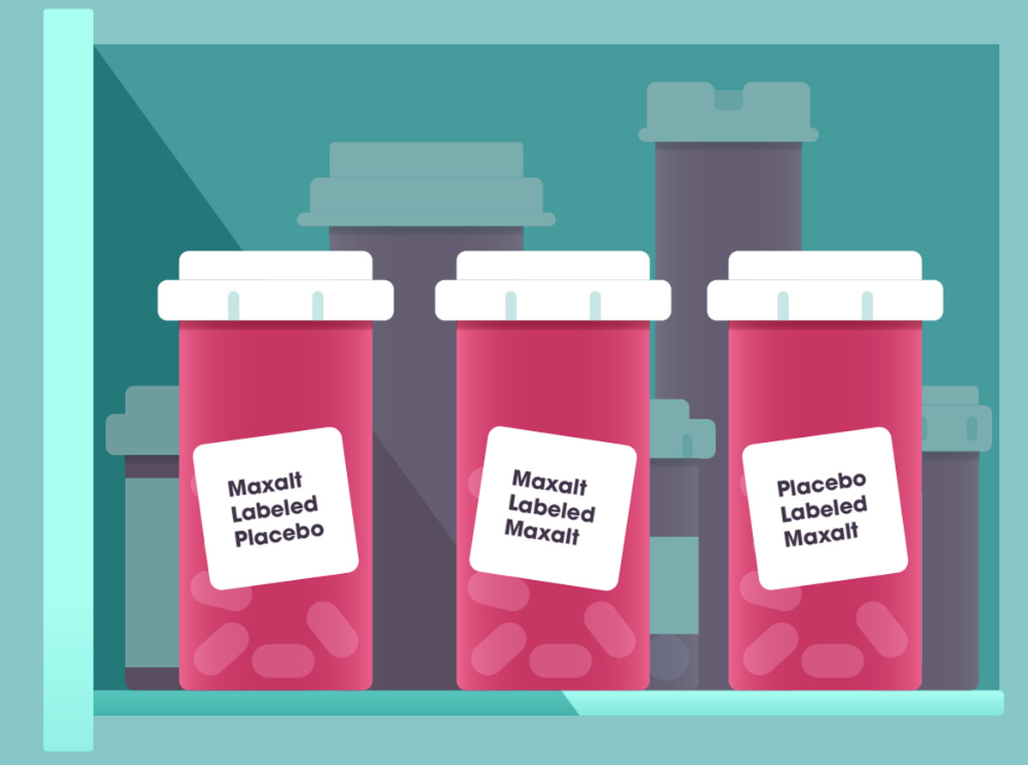
The Placebo Effect

Slide 16
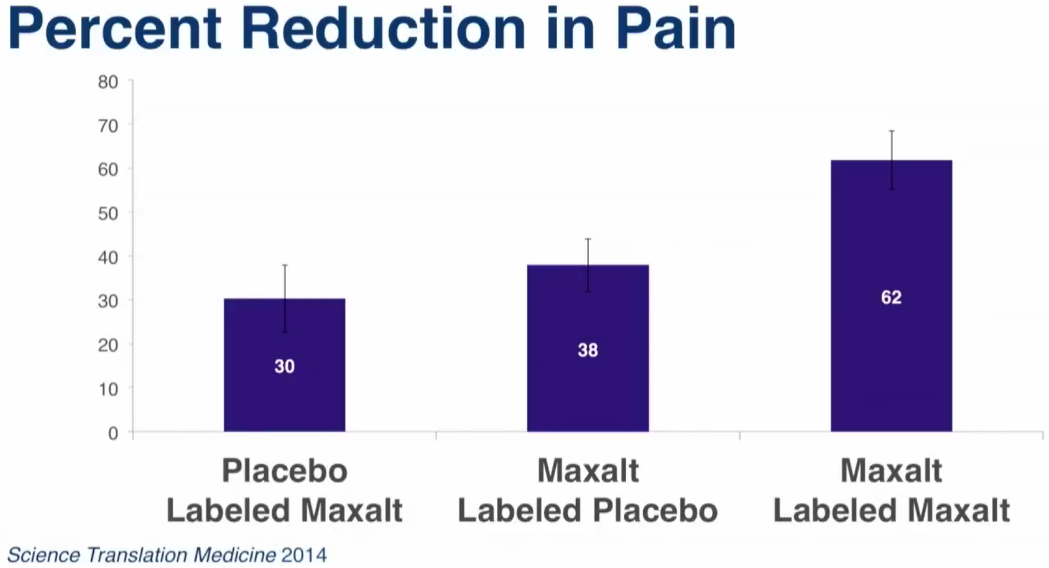
The Placebo Effect
Co-Regulation
Notes:
-Maxalt example-
The brain can function as a prediction machine. When a person is treated with the rituals, symbols, placebos, the pills – whether they have content or not – when you’re in pain, the brain releases endogenous opioids, cannabinoids, and/or prostaglandins. There’s a veritable pharmacy in each and everyone of us.
When researchers noticed that patients got better with placebos, they didn’t care – it was a nuisance. What they were committed to was a precise, pharmacological solution to the question of illness. Changed the art of medicine into the science of clinical care. Can’t do certain things. (ie. tumors & math skills). Value is that they make a good drug a better drug.

Slide 17
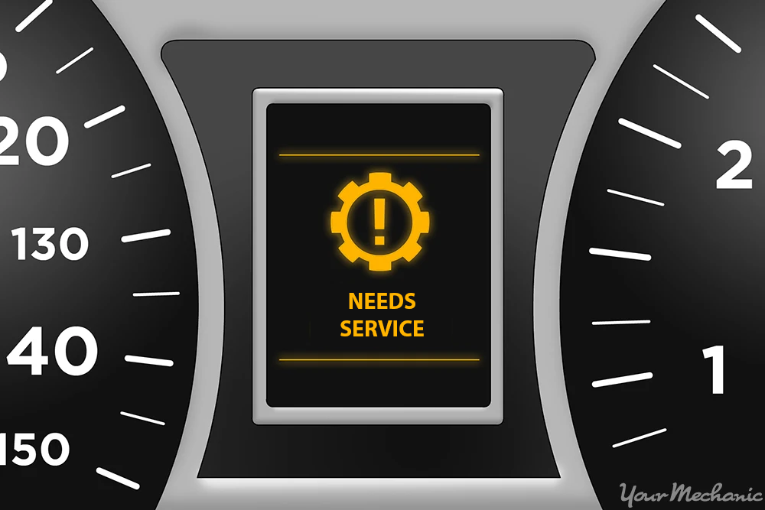
The Placebo Effect

Slide 18
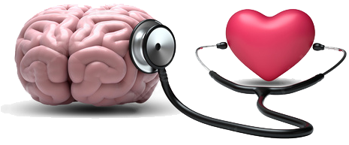
The Placebo Effect
Think of pain not as a direct effect of injury but more like the “NEEDS SERVICE” light on your car dashboard. It tells you something is wrong and needs addressing. Your body is saying: You need to stop what you’re doing and take care of this. Care. It’s central to the placebo effect.
It’s why placebos work even when we know they’re placebos. When someone cares for us, the more attention they give us, the more competent they seem, the better tools they use, the more time they spend with us, the more our bodies notice. And then your body can tell you a new story: ‘Someone is caring for us.
I don’t need to shout at you with pain anymore. We’re safe now.’ And it turns the “NEEDS SERVICE” light off.
-Eric Barker, “Plays Well with Others”

Slide 19
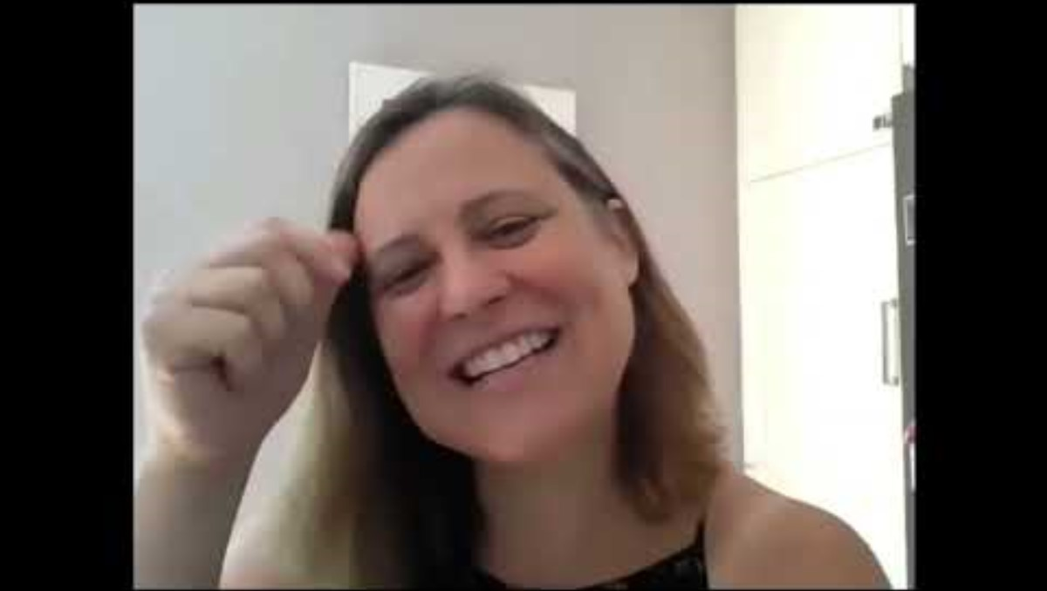
The Placebo Effect | Becky Kitzman’s Story
https://youtu.be/sHMJXcUJdNw

Slide 20

The Power of Relationships in Learning
https://youtu.be/kzvm1m8zq5g?si=QyMrDStN9lRl7ClF

Slide 21
Relationships Matter
Some statements from the video…
  Strong relationships are central to the learning process.
  When students have experiences of closeness, consistency, and trust, oxytocin is released.
  When we think about a relationship, we’re not just talking about being nice to a child, we’re talking about a child having an experience of attunement and trust strong enough to release the hormone oxytocin.
  The purpose of my morning greeting is to connect with them and to just make sure I’m seeing them as humans.
  Emotions and learning are completely connected.

Slide 22
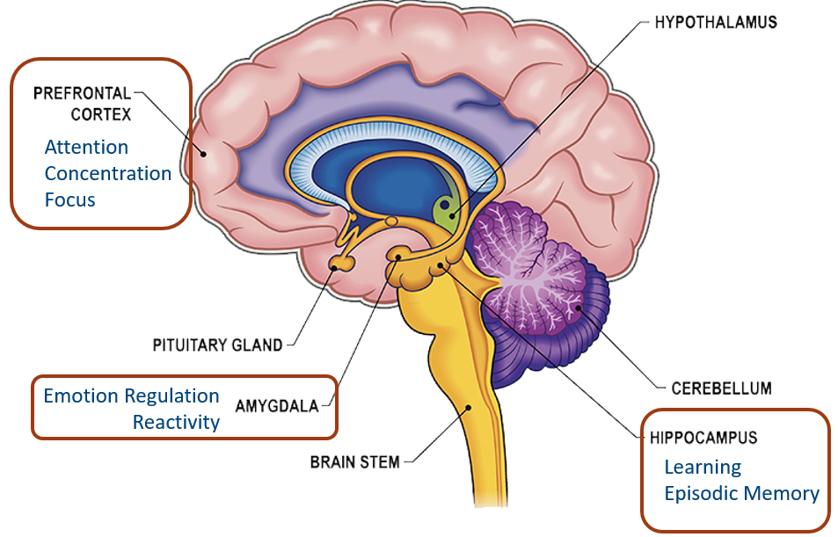
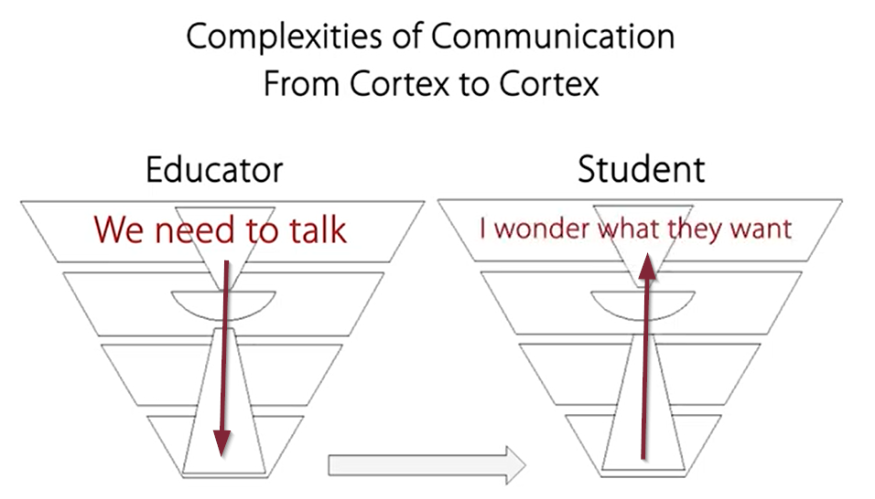
Understand the Brain & Begin with Relationships!

Slide 23
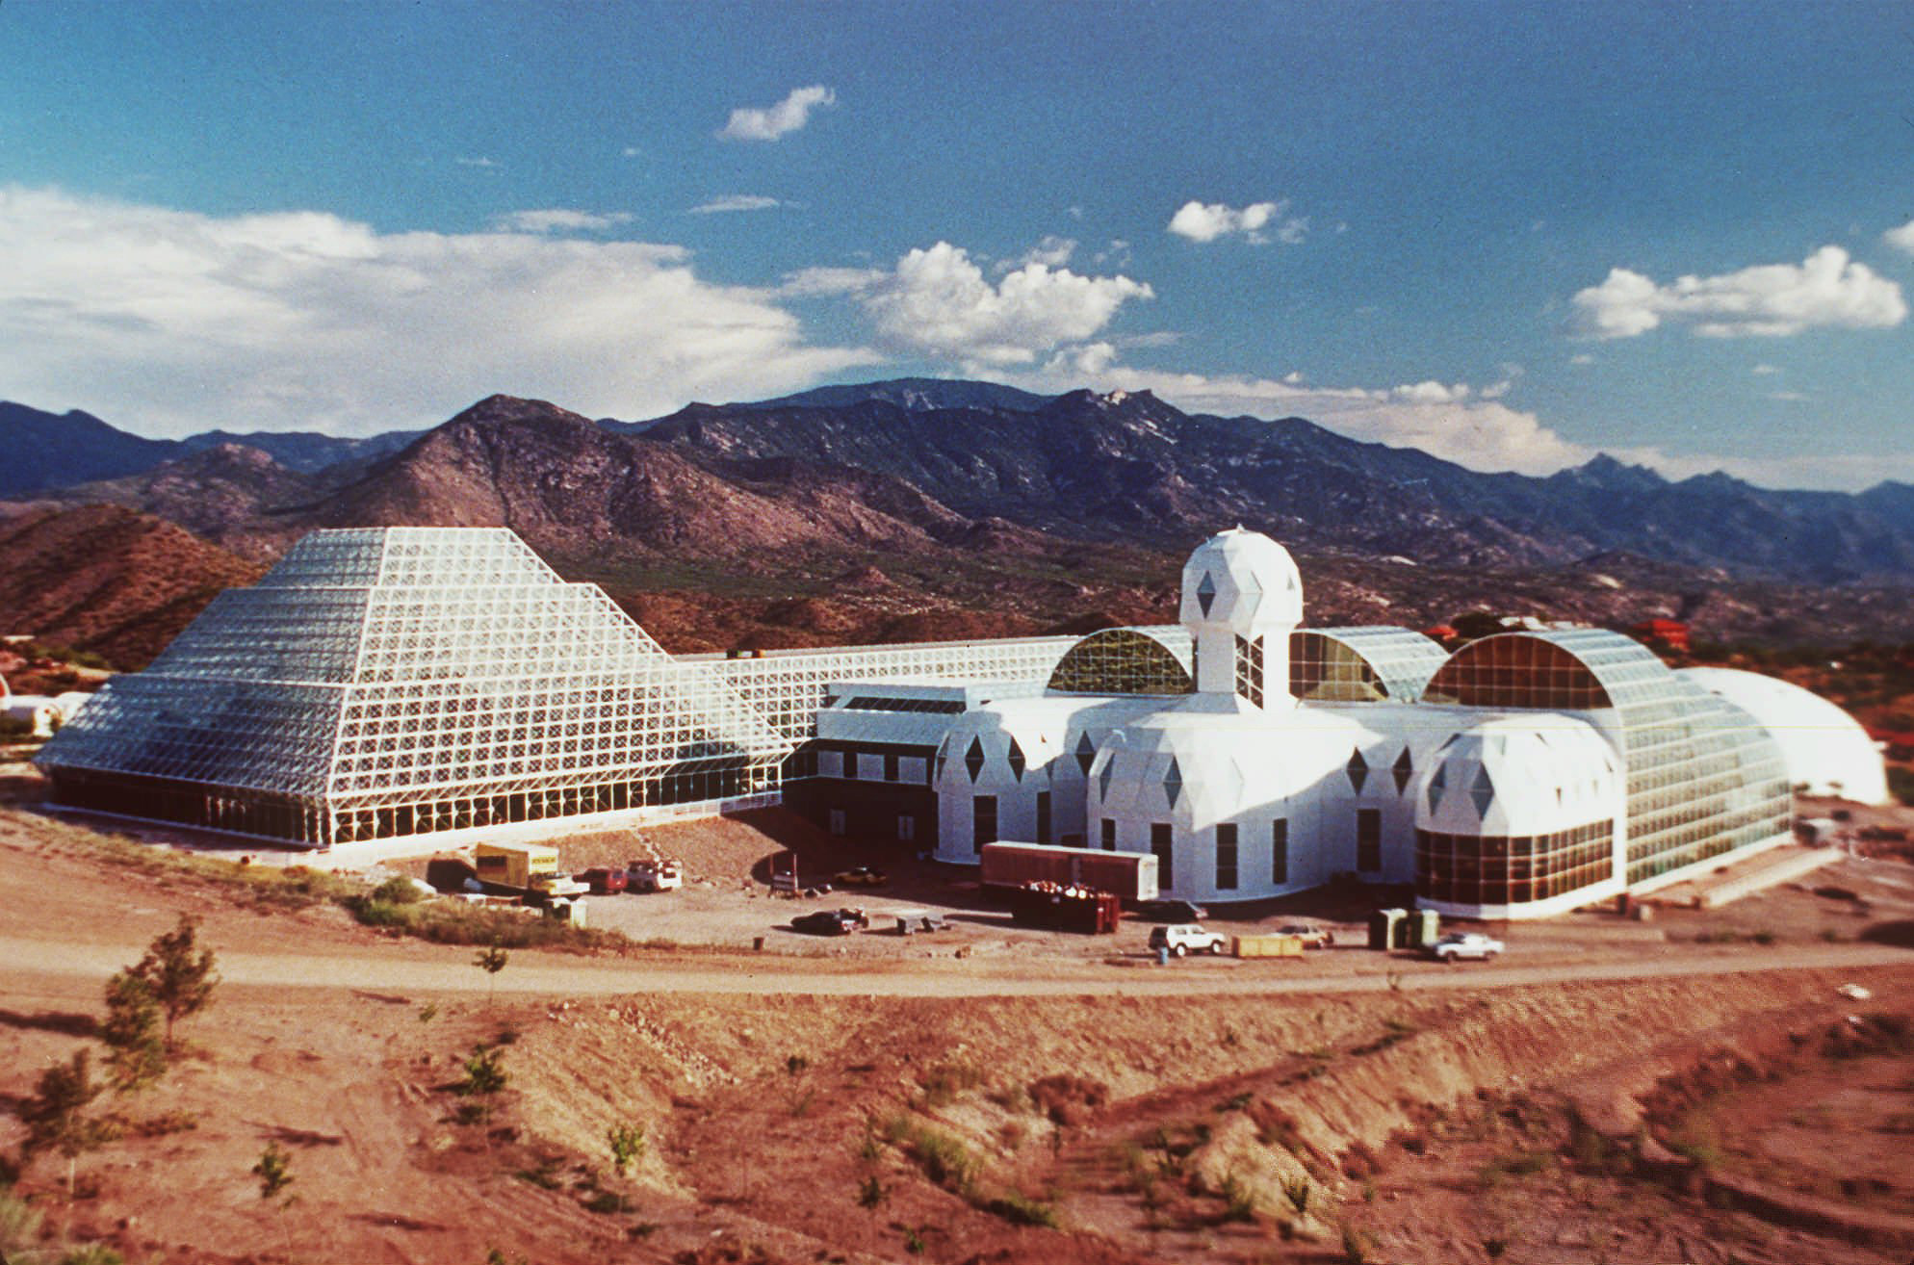
Antifragility
Biosphere 2, scientific research facility located in Oracle, Arizona, U.S., designed to emulate Earth’s environment (Biosphere 1) that was perhaps best known for two missions conducted in the early 1990s in which crews of 8 were sealed inside the enclosure to study survivability. The driving force for these studies was to assess whether humans were capable of building and living in self-sustaining colonies in outer space.
Notes:
“In the late 1980s, a grand experiment was launched in the Arizona desert. Biosphere 2 was (and still is) the largest attempt to build a closed artificial ecosystem, as a prelude to (someday) building self-sustaining ecosystems in outer space. Biosphere 2 was designed to support eight people, who would attempt to live within it for several years. All of the oxygen they breathed, the water they drank, and the food they ate was to be generated within the facility. That goal was never reached. The complexity of biological interactions among species and social interactions among humans proved to be too much, but a great deal was learned from the multiple failures. For instance, many of the trees they planted to create a rain-forest ecosystem grew rapidly but then fell over before reaching maturity. The designers had not realized that young trees need wind to grow properly. When the wind blows, it bends the tree, which tugs at the roots on the windward side and compresses the wood on the other side. In response, the root system expands to provide a firmer anchor where it is needed, and the compressed wood cells change their structure to become stronger and firmer. This altered cell structure is called reaction wood, or sometimes stress wood. Trees that are exposed to strong winds early in life become trees that can withstand even stronger winds when full grown. Conversely, trees that are raised in a protected greenhouse sometimes fall over from their own weight before they reach maturity. Stress wood is a perfect metaphor for children, who also need to experience frequent stressors in order to become strong adults.”
— The Anxious Generation: How the Great Rewiring of Childhood Is Causing an Epidemic of Mental Illness by Jonathan Haidt

Slide 24


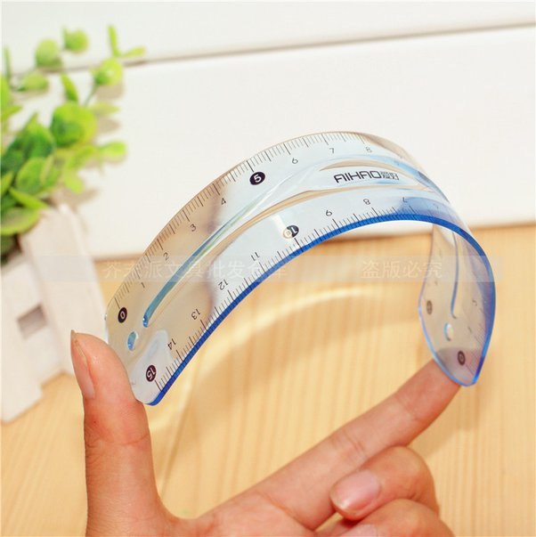
Antifragility
Fragile
Antifragile
Resilient
Notes:
Nassim Taleb in his 2012 book, Antifragile: Things That Gain from Disorder. Taleb noted that some things, like wineglasses, are fragile. We protect fragile things from shocks and threats because we know they cannot withstand even a gentle challenge, such as being knocked over on a dinner table. Other things are resilient, such as a plastic cup, which can withstand being knocked off the table. But resilient objects don’t get better from getting dropped; they merely don’t get worse. Taleb coined the word “antifragile” to describe things that actually need to get knocked over now and then in order to become strong. It’s the same dynamic for what has been called the psychological immune system[ 12]—the ability of a child to handle, process, and get past frustrations, minor accidents, teasing, exclusion, perceived injustices, and normal conflicts without falling prey to hours or days of inner turmoil. There is no way to live with other humans without conflicts and deprivations. As the Stoics and Buddhists taught long ago, happiness cannot be reached by eliminating all “triggers” from life; rather, happiness comes from learning to deprive external events of the power to trigger negative emotions in you. Well-intentioned parents who try to raise their children in a bubble of satisfaction, protected from frustration, consequences, and negative emotions, may be harming their children. They may be blocking the development of competence, self-control, frustration tolerance, and emotional self-management. Several studies find that such “coddling” or “helicopter parenting” is correlated with later anxiety disorders, low self-efficacy (which is the inner confidence that one can do what is needed to reach one’s goals), and difficulty adjusting to college. Children are intrinsically antifragile, which is why overprotected children are more likely to become adolescents who are stuck in defend mode. In defend mode, they’re likely to learn less, have fewer close friends, be more anxious, and experience more pain from ordinary conversations and conflicts.

Slide 25

Anti-Phobic Effects
Norwegian Researchers, Ellen Sandstetter and Lief Cannair 2010…
“Thrilling experiences have anti-phobic effects. Phobias are concentrated around a few animals and situations that kill almost nobody (such as snakes – even tiny ones, tightly enclosed spaces, the dark, public speaking, and heights). Conversely, very few people develop phobias to things that kill many modern people, including cars, opioids, knives, guns, and junk food…. Kids who fall out of trees often turn into the adults who are least afraid of climbing trees.”
Notes:
Exposure, experience, and mastery = fear recedes. Discover mode & Defend mode. More competence = more intrigue. Fear turns into thrill and triumph (worm under rock – delight and disgust… “he did it!” Less likely to be afraid in the future.

Slide 26
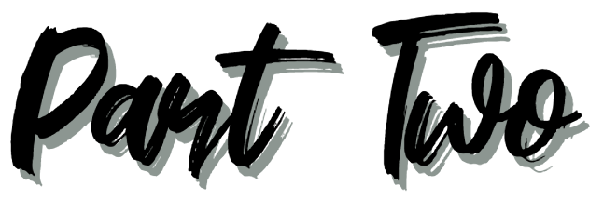
Emotion Regulation

Slide 27

Regulating Emotion
Regulating emotion is managing our emotions by developing thought or action strategies to reach a specific emotional goal.
Our emotional goals generally fall into the following areas, which we can remember with the acronym, PRIME:
  Prevent an unwanted emotion – like anxiety before a test
  Reduce an unwanted emotion – like anger when we are in an escalated conversation with someone
  Initiate a new emotion – like inspiration to be creative
  Maintain an existing emotion – like remaining calm in a stressful situation
  Enhance or increase a desirable emotion – like joy while at a celebration

Slide 28
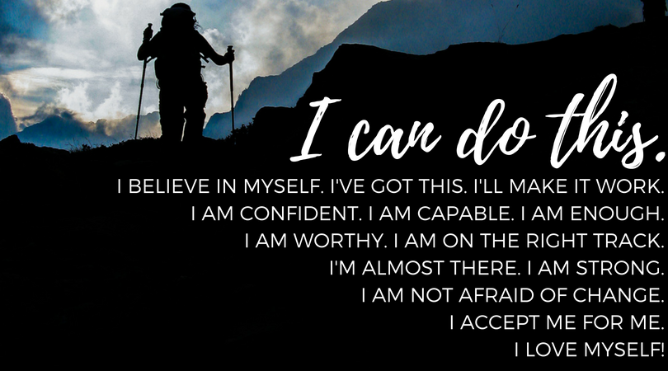
Regulating Emotion
Once we have selected a PRIME goal, we can choose strategies that will help us reach that goal.
Regulation strategies include:
THOUGHT STRATEGIES (things we think about)
ACTION STRATEGIES (things we can do)

Slide 29
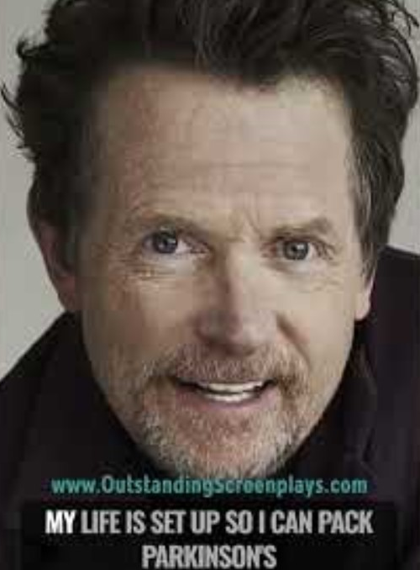
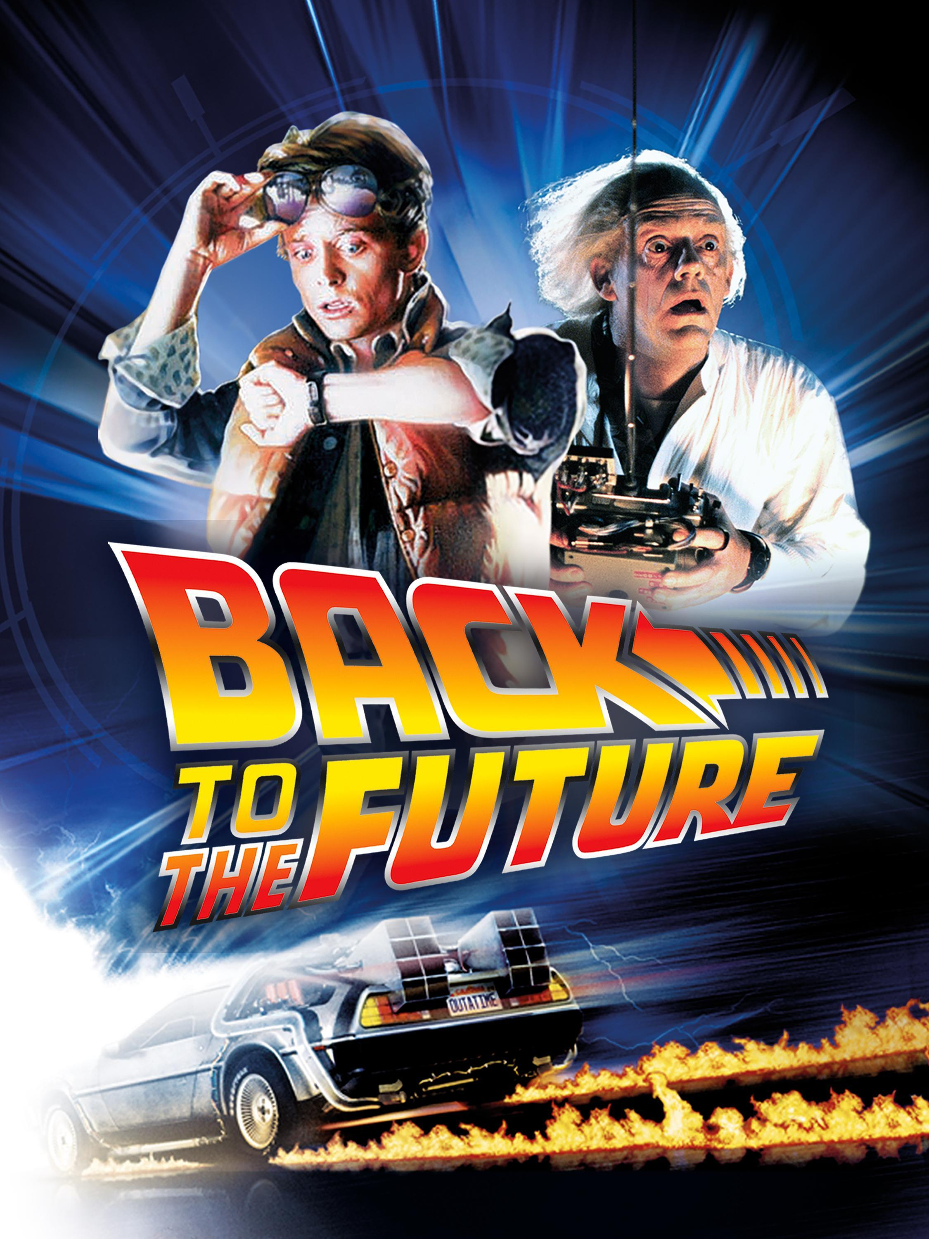
Thought Strategies
Michael J. Fox

Slide 30
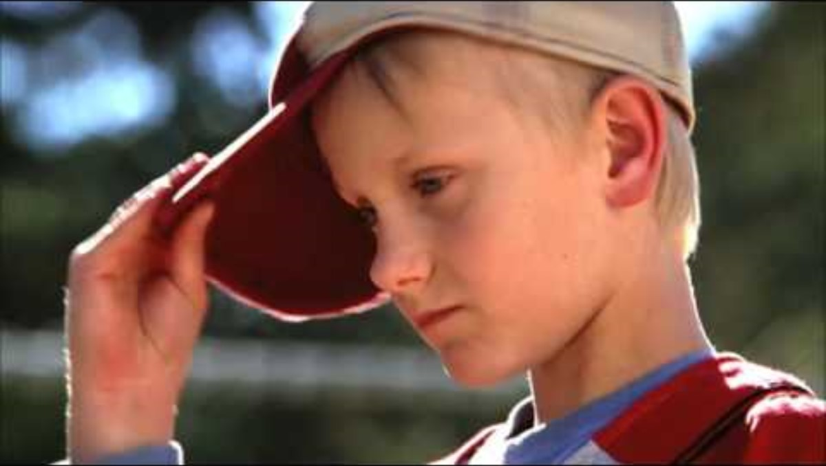
Thought Strategies

Slide 31
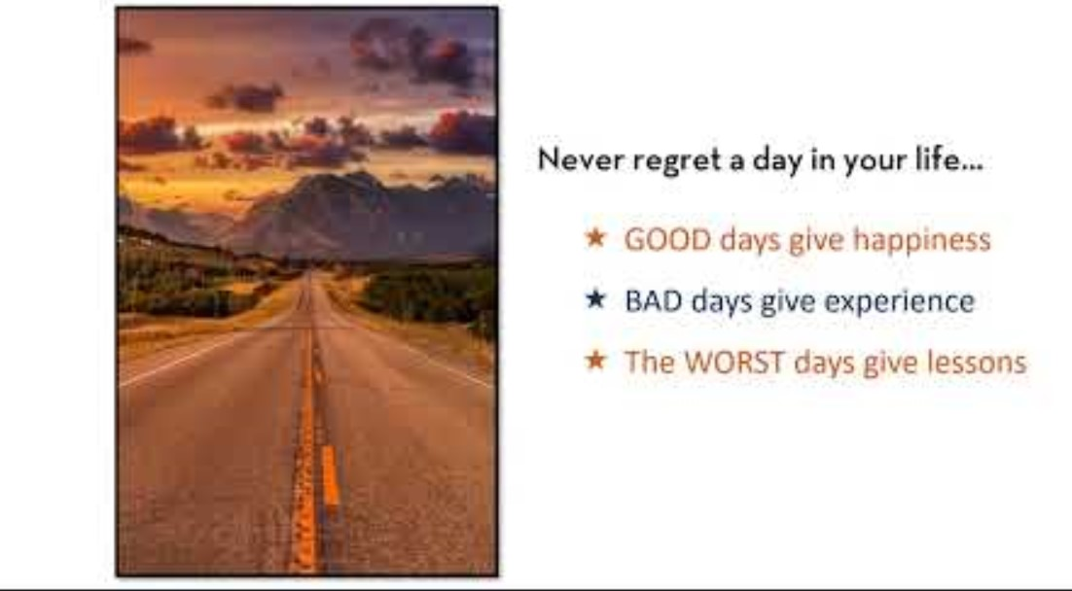
Thought Strategies

Slide 32
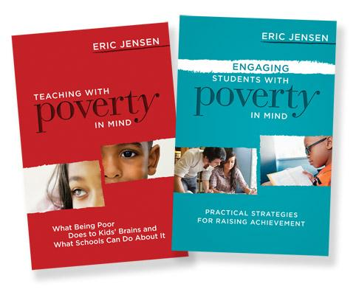
Action Strategies
There is often a direct correlation between the amount of
Stress and/or Anxiety we feel
we feel and the amount of
Control
that we perceive we have

Slide 33
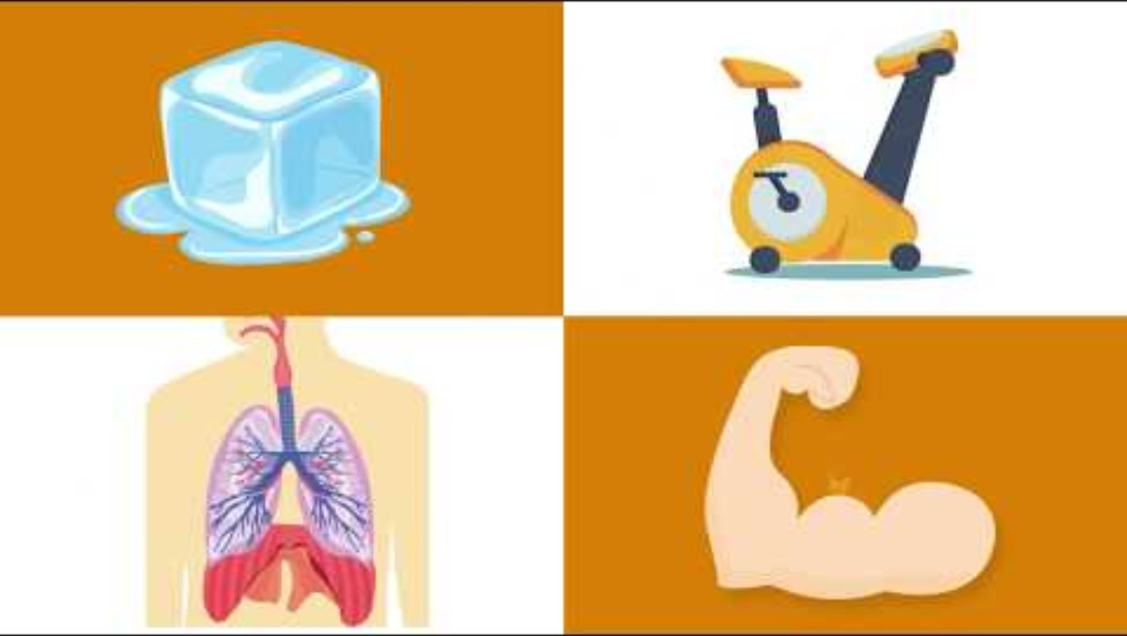
Action Strategies

Slide 34
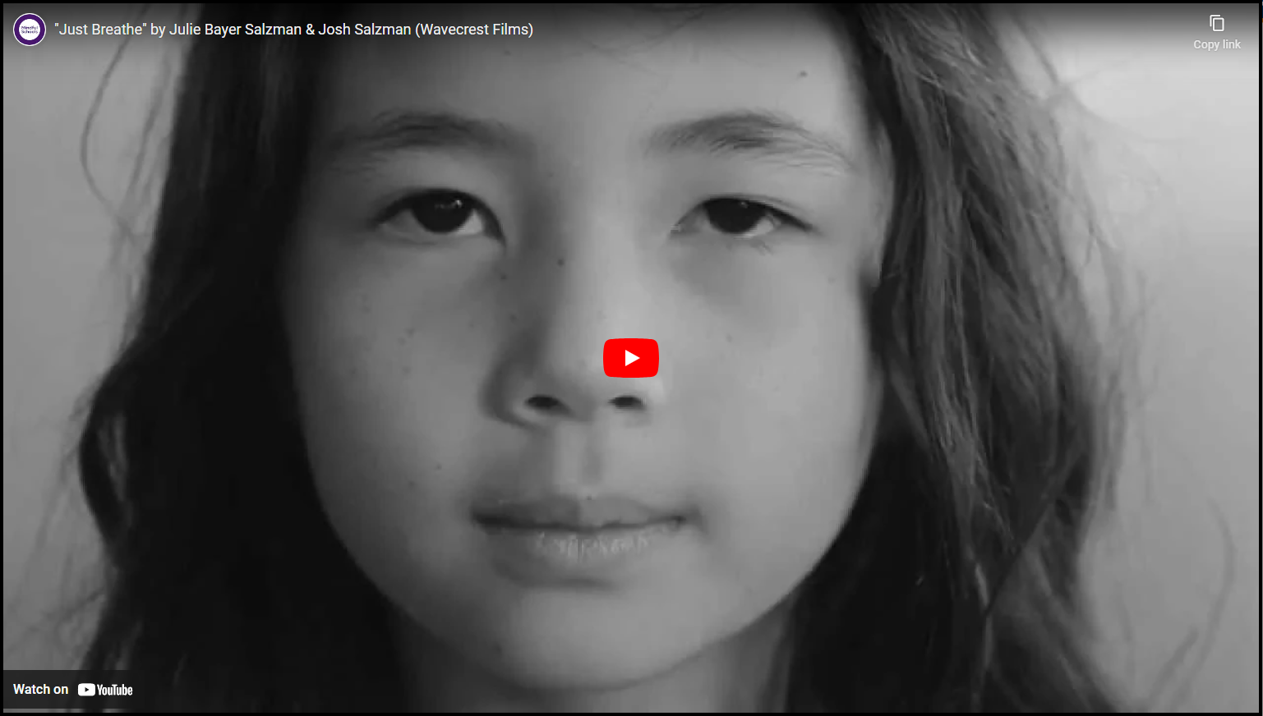
Action Strategies
https://youtu.be/RVA2N6tX2cg?si=julyen-tniKdSu3x

Slide 35
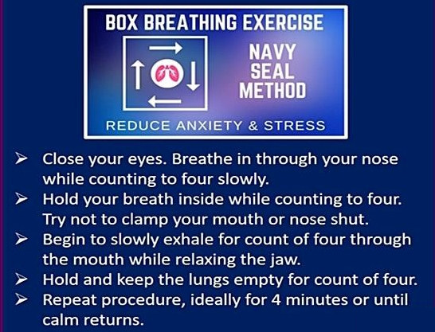

Action Strategies
The Benefits of Breathing Techniques & Awareness
Anxiety due to fear of the unknown
Dwelling on memories of negative experiences

Slide 36

Action Strategies

Slide 37
Barriers to Emotion Regulation
Personal
Fatigue (e.g., emotional labor)
Stress (about everything)
High expectations of others
A lack of trust
Need for control
Prior baggage
No education in
emotional intelligence
Relational
Other's impatience (with me)
Other's negativity
Lack of support from others
Feeling disrespected
Environmental
Work/home demands & struggles
Economics
Unpredictability (COVID)
Societal division/War
Feeling confined
Time in the day
Cultural
Differences in display rules
Family expectations
Unwritten rules for expression
The values connected to certain emotions

Slide 38
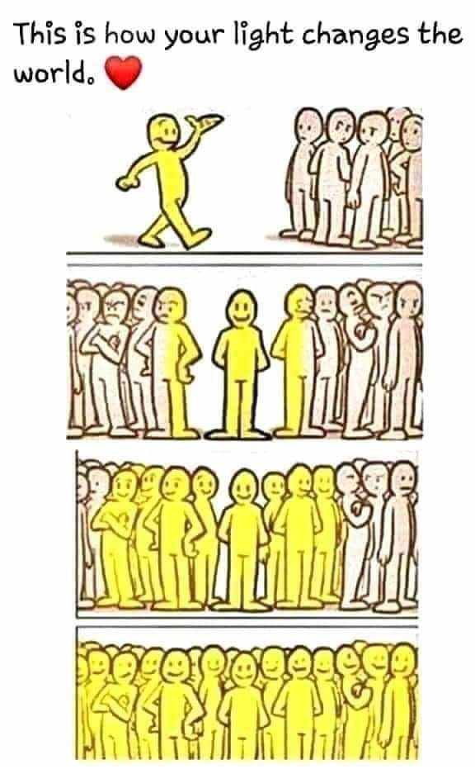
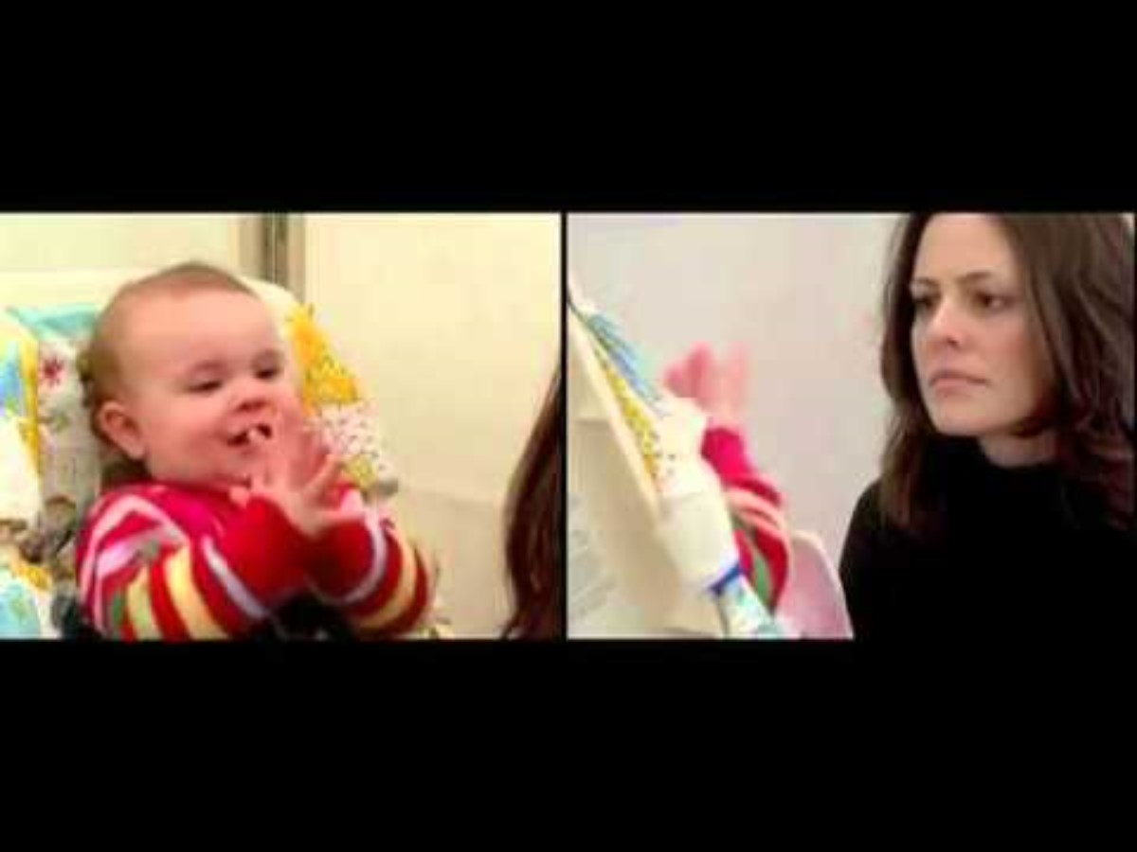
Co-Regulation

Slide 39

Co-Regulation

Slide 40

Co-Regulation

Slide 41

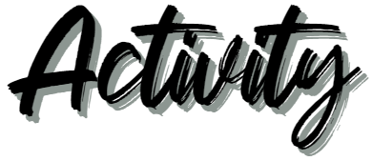
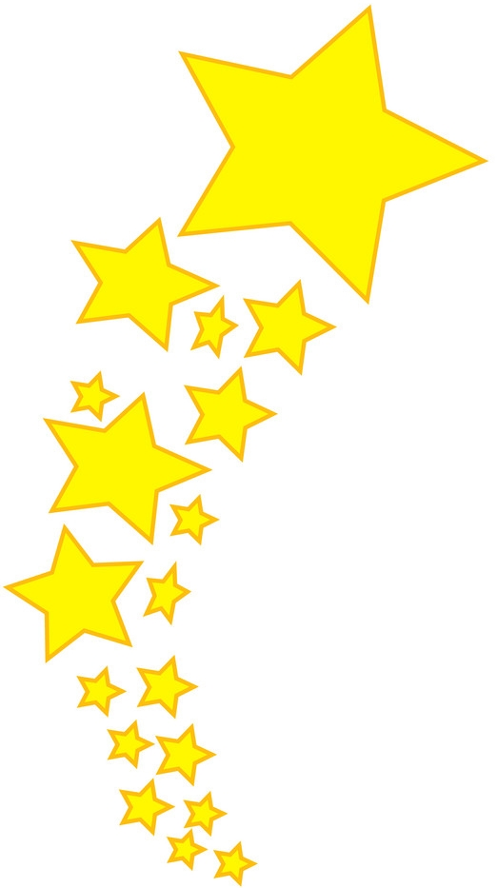
“PRIME”
  Prevent an unwanted emotion
Large group sharing…
Are there examples of emotions that would always be considered unwanted?
What are some examples of contexts where what are commonly considered “negative” emotions might be desirable?
Share with your small group…
Identify an unwanted emotion in a specific context.
Think of at least one thought strategy and action strategy that could be used to prevent this emotion.

Slide 42

“PRIME”
  Reduce an unwanted emotion
Large group sharing…
What might be a situation where it may be more beneficial to reduce an existing emotion rather than initiate a new one?
Share with your small group…
Think of at least one thought strategy and action strategy that could be used to reduce an unwanted emotion.

Slide 43

“PRIME”
  Initiate a new emotion
Large group sharing…
Changing from one emotion to another can often be a result of external influences. What are some examples?
What are some common situations where people purposely take steps to initiate new emotions (in either healthy or unhealthy ways)?
Share with your small group…
Identify a situation where you might want to change from an existing emotion to another specific emotion.
Think of at least one healthy thought strategy and action strategy that could be used to initiate this emotion.

Slide 44

“PRIME”
  Maintain an existing emotion
Large group sharing…
Can you think of a situation in which you might want to continue with a current emotion, but there are factors that make it difficult to do?
Share with your small group…
With an example in mind, what might be some thought or action strategies that could be used to maintain this emotion.

Slide 45

“PRIME”
  Enhance a desirable emotion
Large group sharing…
Are there examples of emotions that would always be considered desirable?
What are some examples of contexts where what are commonly considered “positive” emotions might not be beneficial or productive?
Share with your small group…
Identify a desirable emotion in a specific context.
Think of at least one thought strategy and action strategy that could be used to enhance or increase this emotion.

Slide 46
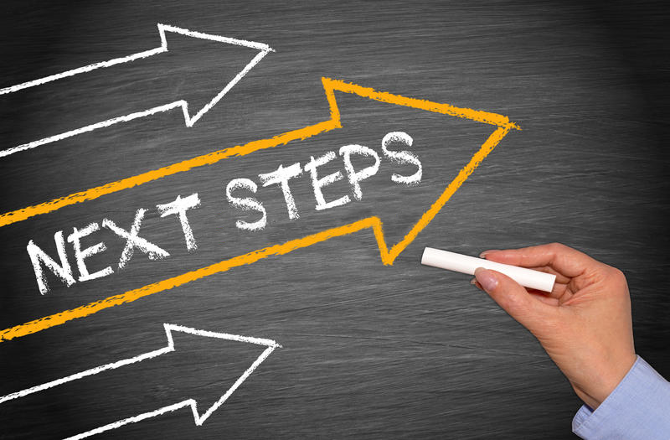
Feedback, Needs, & Ideas

Slide 47
