Slide 1

CTE
AMBASSADORS

Slide 2
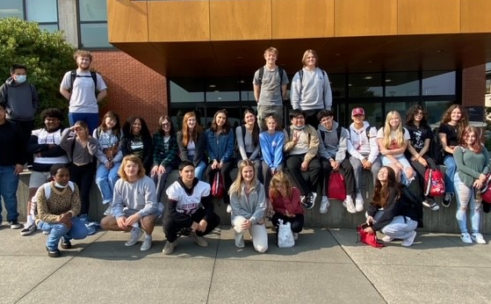
Agenda
Introductions
Why CTE Ambassadors
Meet each other
What do you know Kahoot!
Break time
Training time!
What are our programs?
RPG Time
Mission Statement

Slide 3

Land Acknowledgement & Pledge
We acknowledge the original inhabitants of this area, the sduhubš* people, and their successors, the Tulalip Tribes.
Since time immemorial, they have hunted, fished, gathered on, and taken care of these lands and waters.
We respect their sovereignty, their right to self-determination, and honor their sacred spiritual connection with the land and water. In Everett Public Schools, we strive to create equitable outcomes and build a culture of inclusive belonging for all students, teachers, staff, and community.
*(Lushootseed pronunciation of sduhubš: sdoh-HOHBSH)

Slide 4

Land Acknowledgement & Pledge
I pledge allegiance to the flag of the United State of America and to the republic for which it stands; one nation under god, indivisible, with liberty and justice for all.

Slide 5
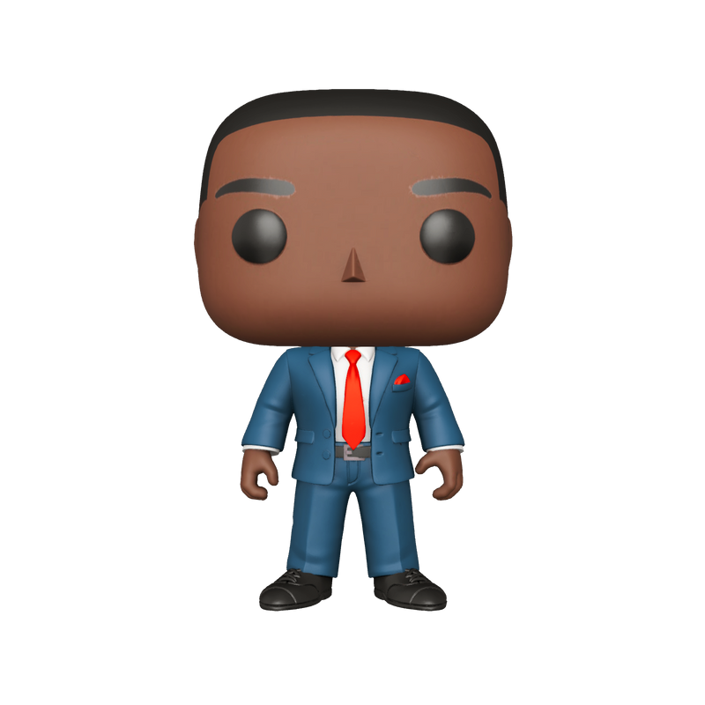
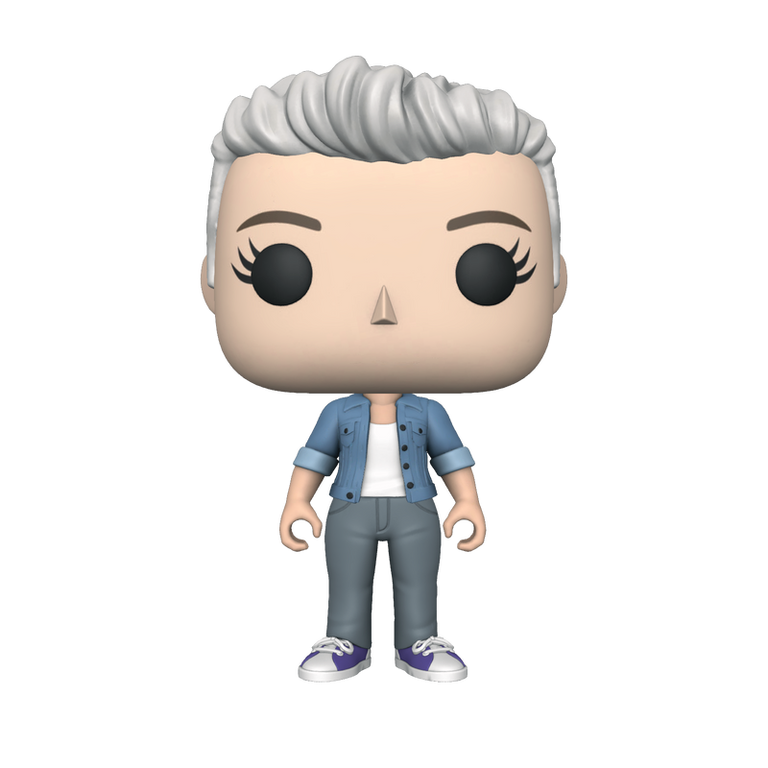
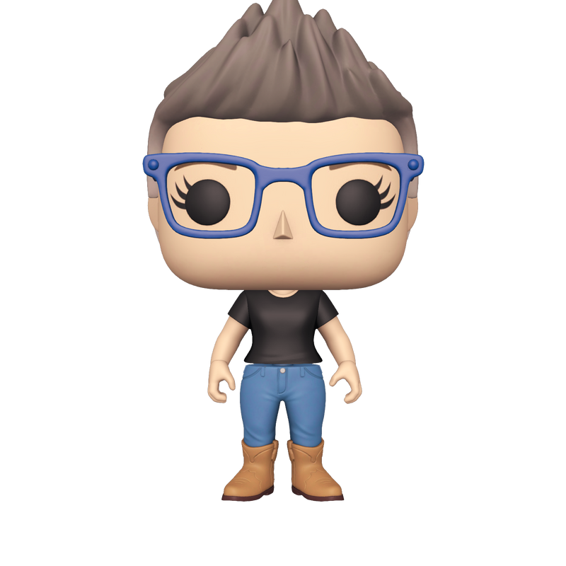
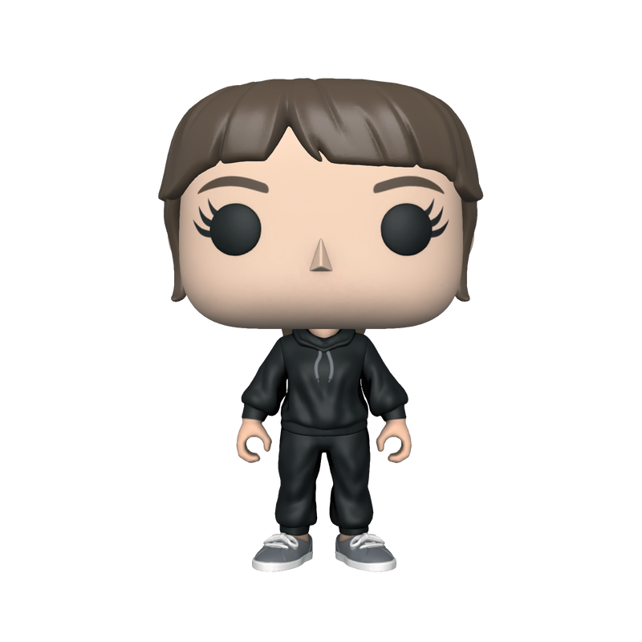
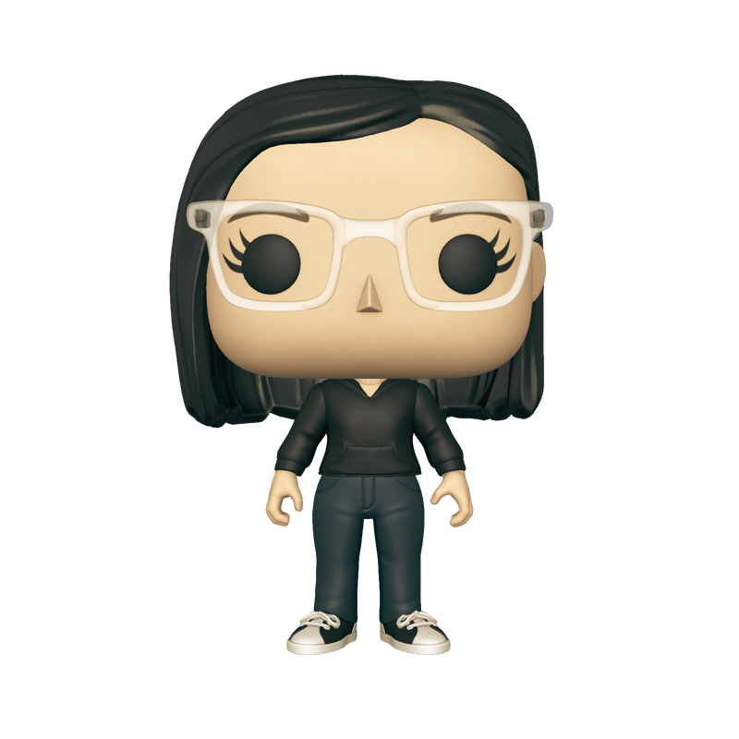
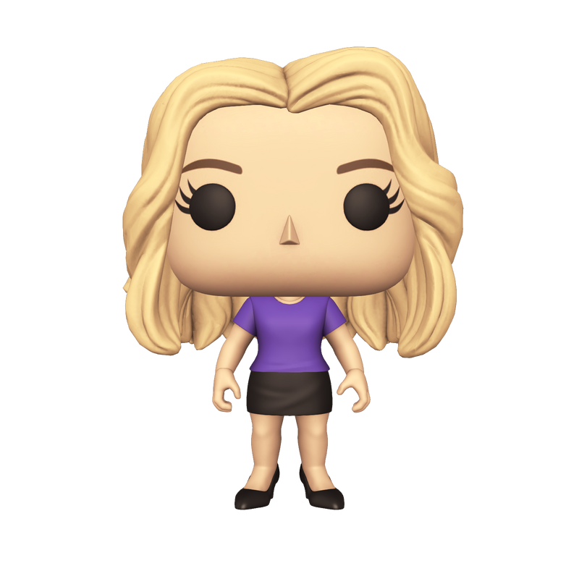
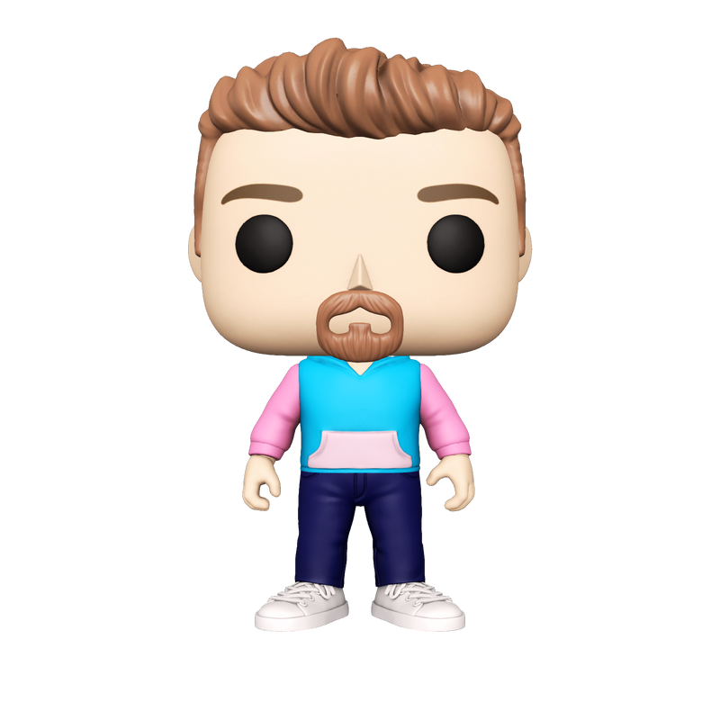
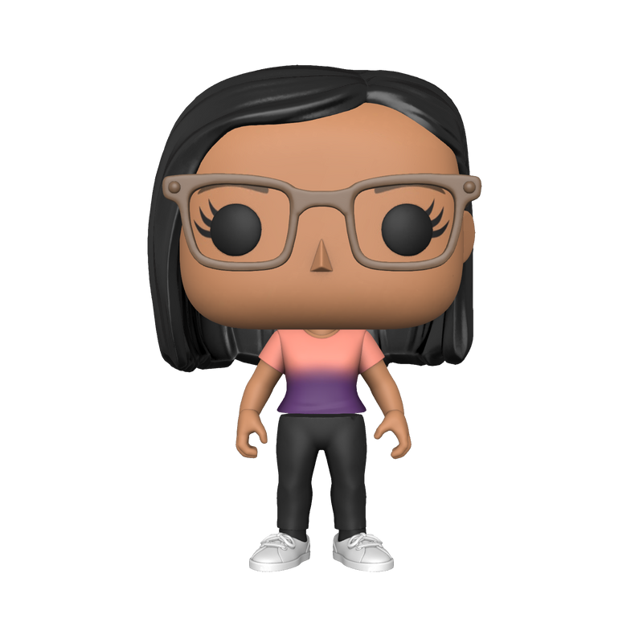
INTRODUCTIONS
Anthony Anderson
Bree Youngberg
Shama Desarda
Director
Work-based Learning Coord.
CTE Admin Assistant
Sara Scott
CTE Field Tech
Kyle Hendrickson
CTE Field Tech
Jodi Jacobs
CTE Program Facilitator
Danielle DeLuca
CTE Program Facilitator
Susan McCoard
CTE Coord.

Slide 6
INTRODUCTIONS
Who you’ll see the most!
Susan McCoard
CTE Ambassador Coordinator
Danielle DeLuca
Jodi Jacobs
Bree Youngberg
Anthony Anderson

Slide 7
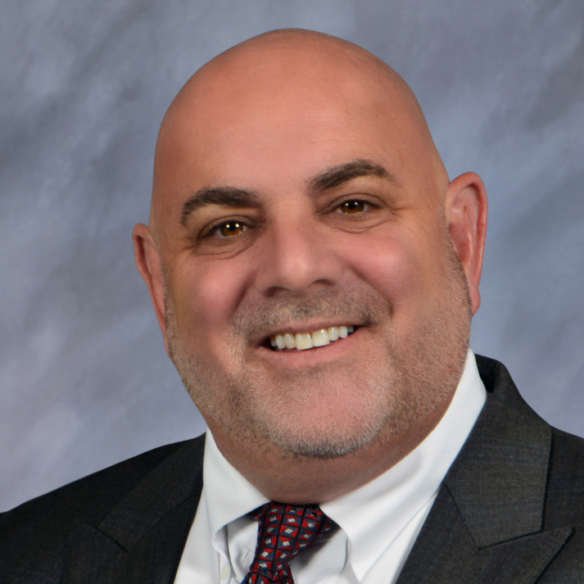
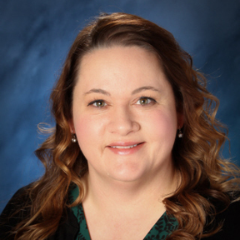
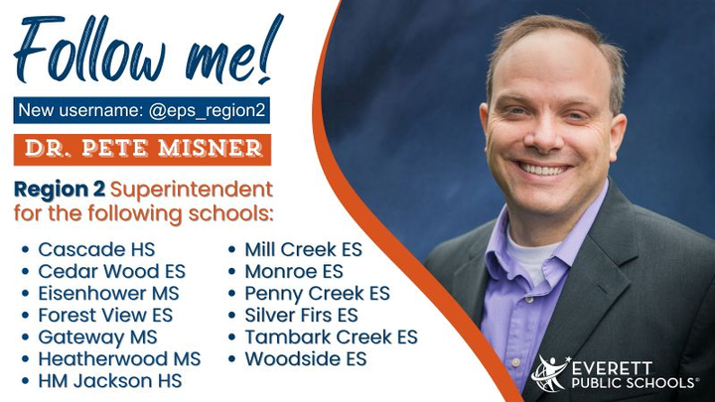
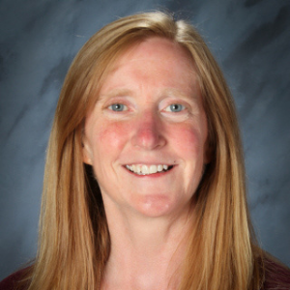
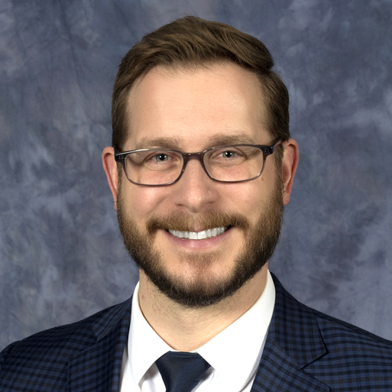
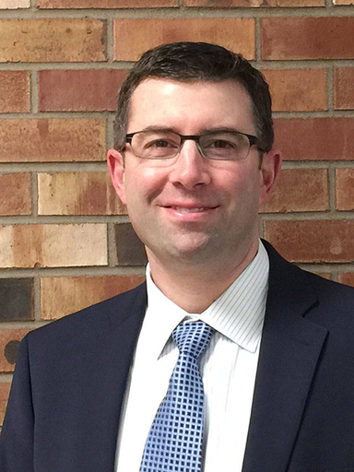
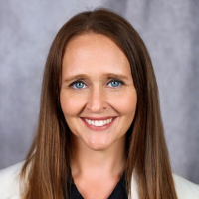
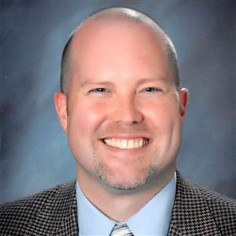
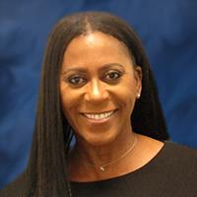
INTRODUCTIONS
Who you’ll meet!
IAN SALTZMAN
EVERETT
SUPERINTENDENT
SHELLEY BOTEN
CHIEF
ACADEMIC OFFICER
PETE MISNER
REGIONAL
SUPERITENDENT
CATHY WOODS
REGIONAL
SUPERINTENDENT
LARRY FLECKENSTEIN
CHEIF
OPERATING OFFICER
PETER SCOTT
DEPUTY
SUPERINTENDENT
HARMONY WEINBERG
DIRECTOR OF
COMMUNICATIONS
CHAD GOLDEN
ASSISTANT SUPER.
OF HUMAN RESOURCES
JOI ODOM-GRANT
DIRECTOR OF DIVERSITY,
EQUITY, AND INCLUSION

Slide 8
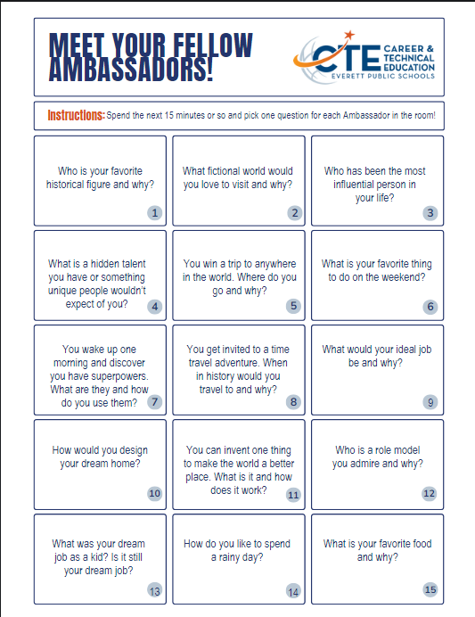
INTRODUCTIONS
Who are you?

Slide 9






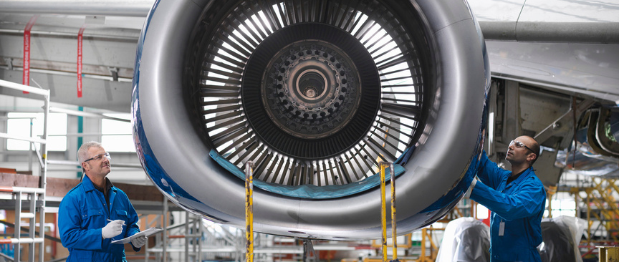


WHY AMBASSADORS?

Slide 10
Why Ambassadors?
THIS
IS
WHY!
Have you ever heard about an opportunity in your school that you would have enjoyed if you’d only learned about it sooner?
Who do you find you prefer to listen to when they’re talking about opportunities in high school? Adults or fellow students?
Has your parent ever asked you “Hey! I saw this opportunity on the Facebook and I think you should look at it!” and then they forward you a screenshot from Facebook that’s missing half the link but also you don’t use Facebook anyway because you’re not an old person?

Slide 11
KAHOOT TIME!
Please find your group, determine a great team name and decide who will be in charge of the Kahoot for your group!
Group 1
Group 2
Group 3
Group 4
Soumya
Charlie
Ravindu
Anthony
Winston
Min Sang
Olawumi
Rachel
Trina
Keely
Vignesh
Juan
Oliver
Natasha
Akhila
Annabelle

Slide 12
OUR PROGRAMS

Slide 13







CTE Programs of Study

Slide 14



CTE BENEFITS
There are three main items that set CTE program apart from other courses:
CTE Programs are all reviewed by people working in the related industry to make sure what we’re teaching matches the working world. This includes technology, apps, machines, etc.
All CTE Programs have CTSOs or CTE Clubs that offer opportunities for leadership, competitions and even chances for travel! Some of these are:
FBLA, FFA, FCCLA, WCTSMA, TSA, SkillsUSA, DECA, Thespians, Mock Trial
ALL CTE Programs lead to courses which HAVE to offer either Dual Credit / College Credit or Industry Certificates like First Aid, Nursing Assistant Certified, Drone Certification, Boeing CorePlus, Paraprofessional Certification, and more!

Slide 15


CTE BENEFITS
Other things to know!
CTE courses are often equivalency courses, meaning it counts for two kinds of credit.
For example, Accounting counts as a math credit AND a CTE Credit. Biology in the Environment is a Science credit and a CTE Credit.
We have four Signature programs available for all students even thought they’re limited to one building. Automotive is at Cascade, Healthcare Academy is at Everett, CorePlus Aerospace Manufacturing is at Cascade, and NJROTC is at Everett.
Transportation is provided to and from the school!
Many CTE classes offer what’s called CTE Dual Credit, meaning you earn College Credit WHILE TAKING your high school CTE Course and you don’t have to take an AP Exam to earn that credit (though you do have to fill out some paperwork).

Slide 16
CTE Programs of Study
In your table groups, look through the Programs of Study pages in your packet and discuss:
What is something you’re surprised to learn is CTE?
How many CTE classes have you already taken?
If you were going to talk someone into taking your favorite CTE Class, what would you tell them besides “I LOVED THIS CLASS”?

Slide 17

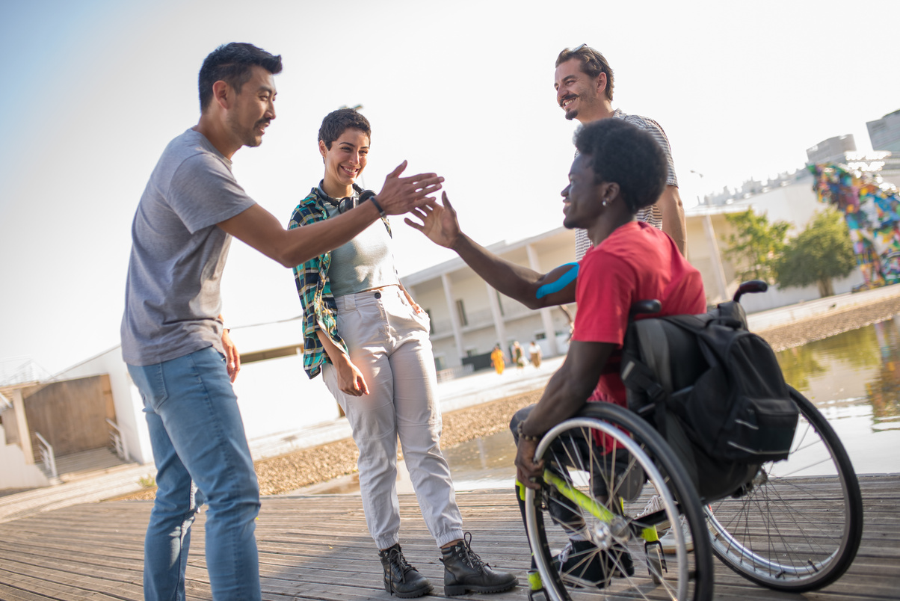
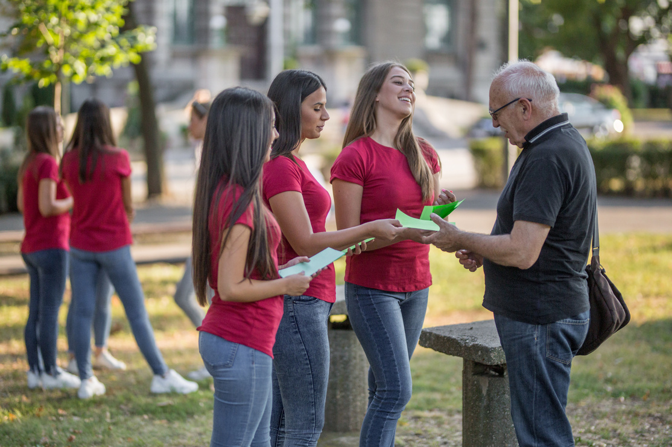
ENGAGEMENT
COME AWAY
FROM THE WALL
GREET PEOPLE LIKE YOU KNOW THEM
NEVER GO
EMPTY
HANDED

Slide 18
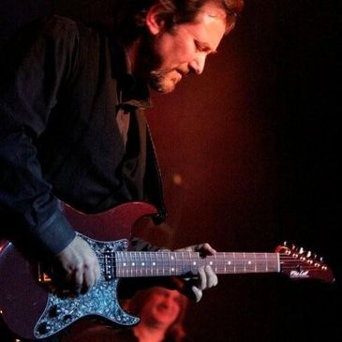
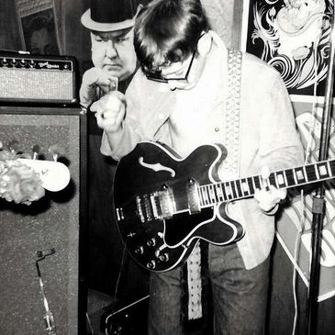
COME AWAY FROM THE WALL
In the wise words of guitarist
Leonard Berman,
“If you walk into the McDonalds and just stand there, nobody is going to just hand you a burger and fries.”
Part of being approachable and getting people to want to engage with you is getting out of the chair, getting away from the wall, getting out from behind the table and approaching people.

Slide 19
TALK TO THEM LIKE YOU KNOW THEM
Embrace the Awkward
Talk About What THEY Know
People Remember Compliments
Students and adults at any event are feeling just as awkward as you might feel walking up to them.
Do it anyway!
Think about any time you were stuck in a presentation, and someone was talking about a topic you had NO frame of reference for.
Try to use layman's terms and limit acronyms.
Point out awesome shoes, a shirt with a favorite fandom, band merch, etc.
Whatever is going to make a connection goes a LONG way.
Be EXCITED About What You’re Telling Them
I don’t mean like a super happy person walking around Disneyland in their costume, but if you don’t look like you care, neither will anyone else.

Slide 20

NEVER GO EMPTY HANDED
  Bring SOMETHING with you!
  Even if someone isn’t in the mood to talk to you, you can hand them a flyer. Adults LOVE flyers.
  It gives you something to refer to
  while talking to folks.
  When in doubt, point them to the website or tell them to email CTE@everettsd.org!

Slide 21
RPG Time!
Find your Kahoot groups, read your scenario and prepare a quick skit on how you would act this out in real life!
Group 1
Group 2
Group 3
Group 4
You are in the hallway at school and you hear someone talking about how much they love working on cars but is upset their school doesn’t have an auto program. What would you do?
Your little brother is getting ready for 9th grade registration. He is really interested in a career in business and wants to pursue that. What kind of advice can you give him?
You are at a career night at your high school and a parent asks you if the Healthcare Careers class is really teaching current careers or if it’s the same stuff they learned 30 years ago. What can you tell them?
You are at the grocery store and the person in front of you is talking about how kids these days don’t learn anything to help them in the real world. What can you tell him about CTE Programs to change his mind?
* Please don’t actually engage with strangers unless you feel safe to do so.

Slide 22
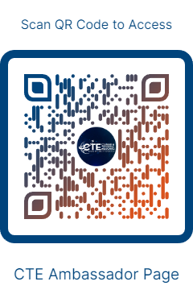
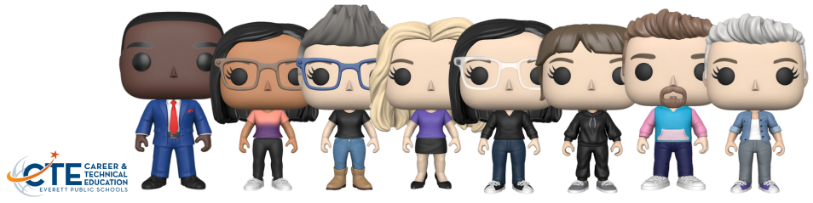
Thank You!
We look forward to working with you this year.
Please scan the code on the right and take the
CTE Ambassador Survey!
Notes:
Anthony

