Slide 1

How to Take Online Student Surveys

Slide 2
To better support you, your school and teachers would like to ask you some questions about your school and about yourself.
We would like to learn more about you! These surveys will help your teachers and schools provide you with the best education possible.
Only your teachers and school leaders will be able to see your responses, and these responses will not be used as class grades.
We want you to respond honestly—there are no right or wrong answers!
Your voice is important, so thank you for sharing about your thoughts and experiences.
Notes:
Today, you are being asked to reflect on yourself and your school in general. To do this, you’ll be asked to fill out two surveys that focus on helping you and your teachers learn more about how they can best support you. This survey will ask about your skills in life and in school, which are important for your school and teachers to understand so they can best support you in all aspects of school.
[ PAUSE FOR 5 SECONDS, say “STOP” PAUSE FOR ANOTHER 5 SECONDS AND GO TO NEXT SLIDE]
Please listen carefully while I give you some important directions.
[ PAUSE FOR 5 SECONDS, say “STOP” PAUSE FOR ANOTHER 5 SECONDS AND GO TO NEXT SLIDE]

Slide 3
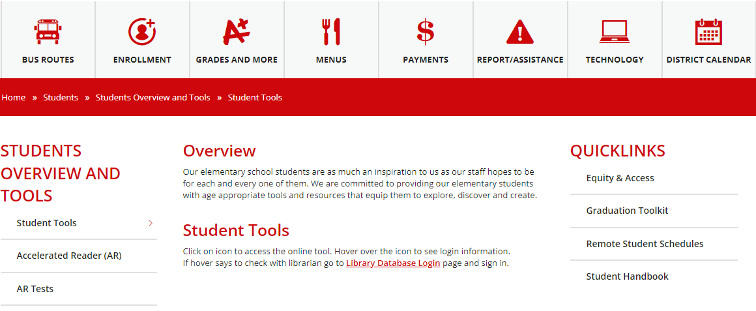

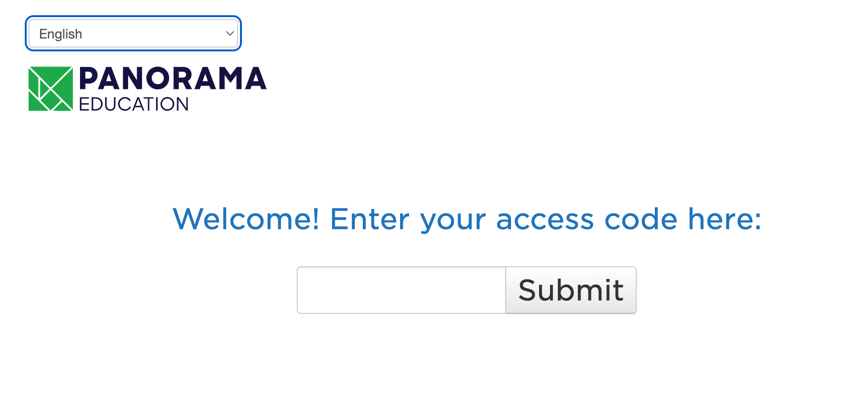
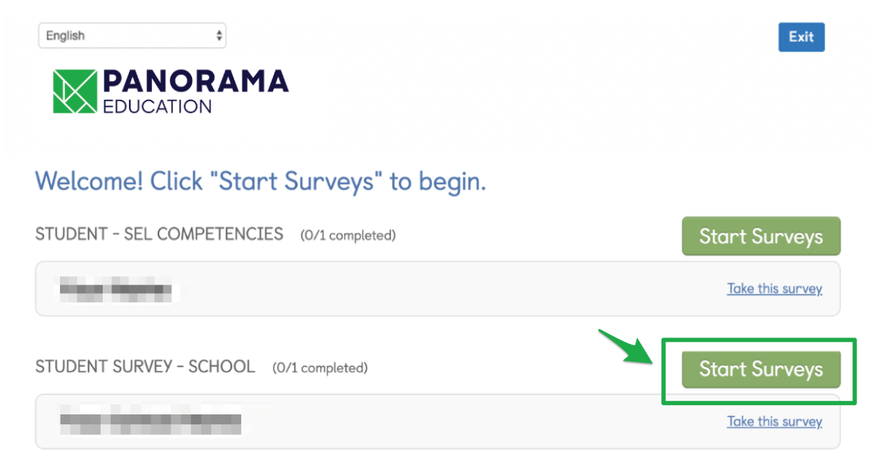
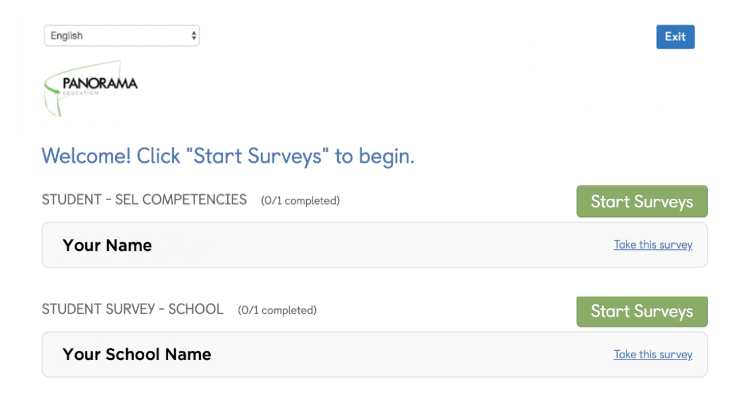

To access your surveys:
Go to your school’s Quicklinks
Step 1
Step 4
Please make sure you are completely finished and click at the bottom of the page.
You will not be able to change your selections once your have submitted your answers.
Step 2
Step 5
Enter your access code, which is your student ID and click Submit.
*If you need to translate the survey, click the drop-down menu in the top left corner.
You will now start your second survey.
Click on the other “Start Surveys” button to begin.
Step 3
Step 6
Double Check:
Make sure this is your own name and your school's name. We want to make sure you are taking the right survey and click Start Survey.
Please make sure you are completely finished and click at the bottom of the page.
You will not be able to change your selections once your have submitted your answers.
Notes:
To access the survey, please open your web browser now. Type the website address on the board (point to URL) into your address bar and load the page. Raise your hand if your page does not load and you need help finding the website.
[ PAUSE FOR 5 SECONDS, say “STOP” PAUSE FOR ANOTHER 5 SECONDS AND GO TO NEXT SLIDE]

Slide 4

When you have finished taking all your surveys, you will see this screen indicating you are all done!
Notes:
When you see a final “Thank you” screen, it means you are done. Once you have completed your survey, you may read or work silently until all of your classmates have finished.
[ PAUSE FOR 5 SECONDS, say “STOP” PAUSE FOR ANOTHER 5 SECONDS AND GO TO NEXT SLIDE]

Slide 5
Congratulations, you are done!
Thank you for your feedback!
Notes:
Congratulations, you are done! Thank you for your feedback!

