Slide 1

6th Grade Transition Meetings
Collective WE assisting our students with a smooth transition to Middle School

Slide 2
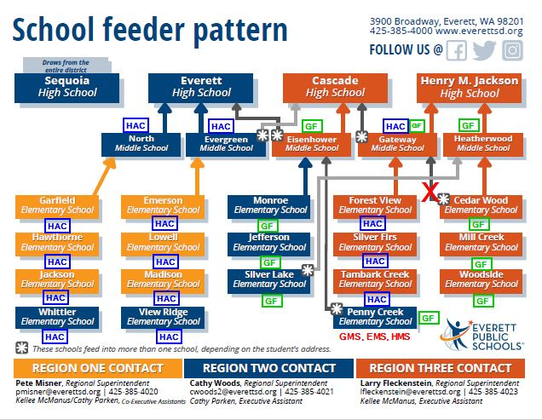
Confirm the Plan
Confirming 6th Grade Registration Plan

Slide 3
Before Meeting with 5th graders
Step 1: Set up HAC
Step 2: Communicate with Feeder schools
Principals
Elementary counselors
5th Grade Students
Step 3: Compile all necessary resources
Step 4: Train staff
Counselors-ES & MS
5th Grade Teachers
2024-25 Course Request Tracking.xlsx
Other Steps
Registrars

Slide 4


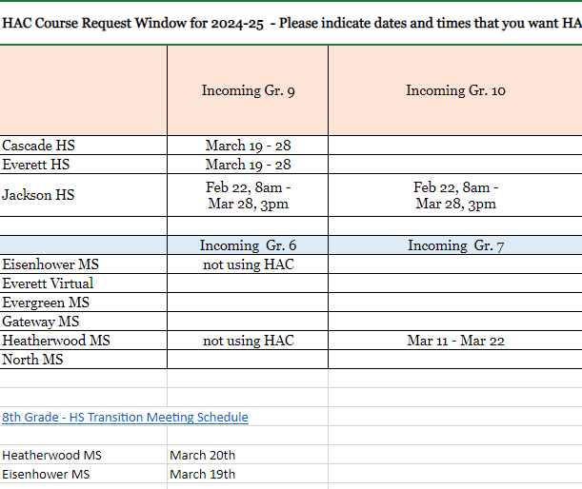
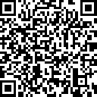
Opening HAC
Schools determine HAC Course Request availability window
Open = Building wide
2024-25 Course Request Tracking.xlsx

Slide 5


Draft Roles
Middle School Counselors
5th Grade Teachers & Elementary Counselors
Communicate the process
Communicate the schedule
Visit classrooms, after initial conversation with 5th grade teachers/ES Counselors
  Walk through request selection
  Use ppt., video, and handouts to help
Review Course Catalog
  Page 3, Page 19-Checklist/pre-work
  Pages 20-27
    Answering questions for students on different course options
Watch: Entering Course Requests in HAC with students prior to the MS. Counselor Visit
Support Students during MS Counselor visit

Slide 6
Timeline of Events
MS communicates with feeder schools
Visiting Schedule
Resources
ES Counselors/5th Grade Teachers review Resources
ES Counselors/5th Grade Teachers go over the process with students
Watch the HAC Video
Map out course selection in course catalog
MS Counselors visit 5th Grade Classrooms
Students enter requests in HAC
ES OM's send connect ed reminding parents to review HAC
ES Counselors/Teachers Support
1
2
3
4
5

Slide 7
Timeline of Events
ES OM's run cognos reports "Next Year Course Selections Review – 5th Grade"
MS Registrars run students w/o requests and students missing requests reports and shares with OM's and 5th grade teachers/ES Counselors
ES Counselors/Teacher help students complete missing requests in HAC.
5th Grade Teachers double check requests with Guardians during conferences
Any changes are interofficed or scanned and set to MS
MS Registrars/Counselors finalize requests and begin MS
6
7
8
9
10

Slide 8
Timeline of Events
MS communicates with feeder schools
  Visiting Schedule​
    Provide Resources​
ES Counselors/5th Grade Teachers review Resources​
ES Counselors/5th Grade Teachers go over the process with students​
    Watch the HAC Video​
    Map out course selection in course catalog​
MS Counselors visit 5th Grade Classrooms​
    Students enter requests in HAC​
    ES Counselors/Teachers Support​
ES OM's send connect ed reminding parents to review HAC​
MS Registrars run students w/o requests and students missing requests reports and shares with OM's and 5th grade teachers/ES Counselors​
ES Counselors/Teacher complete missing requests ​
ES OM's run cognos reports​ "Next Year Course Selections Review – 5th Grade"
5th Grade Teachers double check requests with Guardians during conferences​
  Any changes are interofficed or scanned and set to MS​
MS Registrars/Counselors finalize requests and begin MS
1
2
3
4
5
8
6
7
9
10

Slide 9
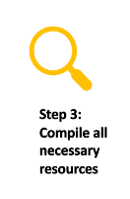

Training Resources
1. Videos
2. Lesson Plan
3. Resources
Handbook
Sample mass communication
4. Zoom Sessions
5. Individual Help sessions
6. Other
Next Week:
Principal Packet
Direct Email to Counselors

Slide 10

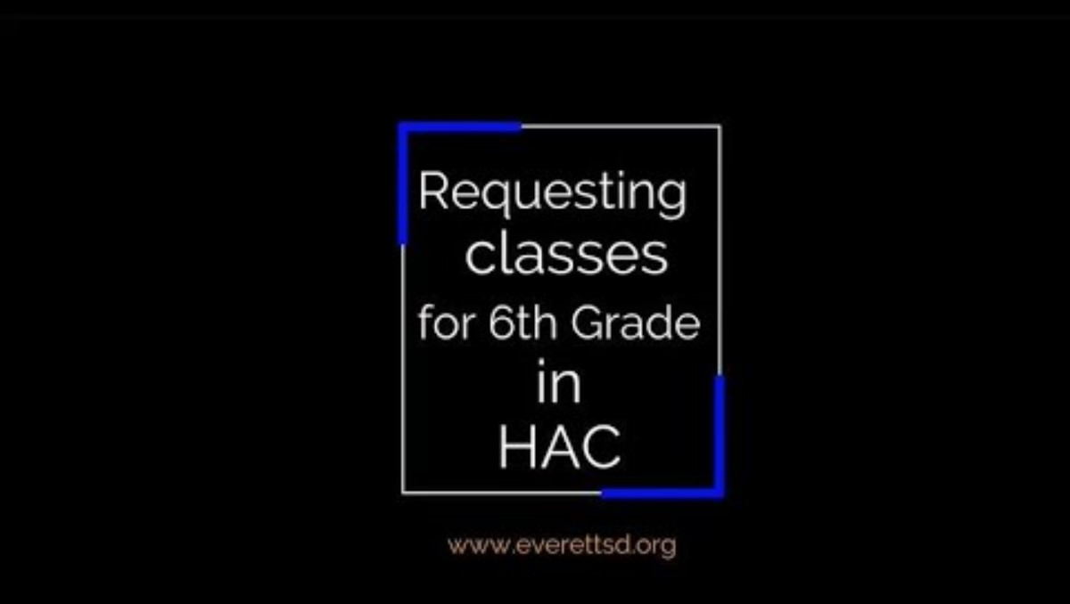

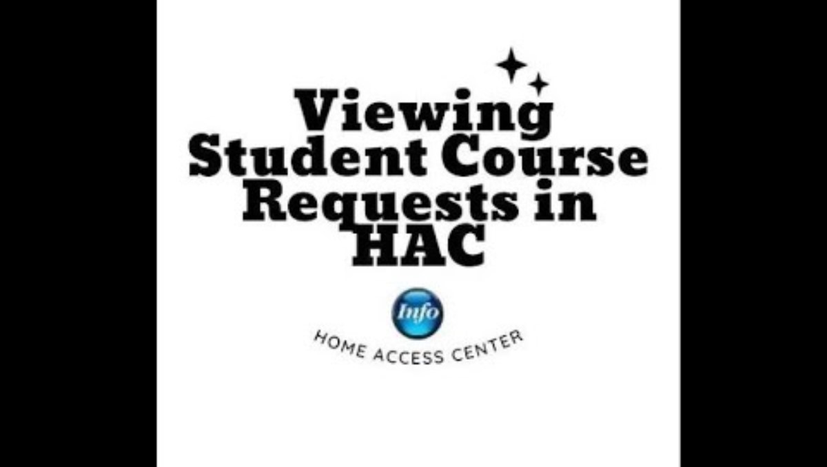
Students Registering for Classes https://youtu.be/BtNsRfuD26s
Parents reviewing Student course Selections
  1 minute version
    https://youtu.be/JOsG0tmheXo
  1.5 minute version
    https://youtu.be/AZlf0EeftPI
Short/Fast Longer Version
Version

Slide 11

20230120_HACCourseRequestsForStudents.pptx
PPT Entering Requests in HAC
Do you want it updated to reflect preloaded REQUIRED Electives?

Slide 12
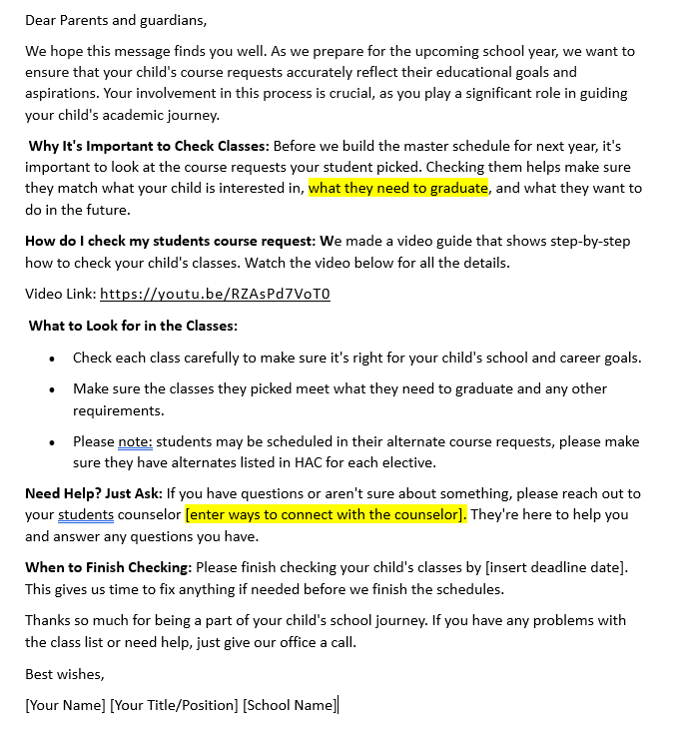
Guardian Communication Resources
Shortened Version
After counselors meet with students and students register for courses in HAC, we recommend that you send home a connect ed call to guardians: Possible wording for connect ed:
Today your students selected their course request for next year. We would encourage you to go onto the Home Access Center to view their selections. Here is a video to show you how to look at your student’s course requests for next year. https://youtu.be/0HdsG7jQ6CA
If you would like changes to your student’s course requests, please email their counselor at______________.
For more: Parent Communication after student course requests.docx
Draft Blackboard Connect Message to Families

Slide 13
Guardian Communication Resources
Possible Social Media Posts
Parents and students, it's time to ensure your course requests for next year align with your goals and aspirations! Check out our step-by-step video guide to review your selections: VIDEO LINK HERE #Education #StudentSuccess #CourseRequests
Don't forget to review your course requests for next year before the deadline! It's crucial to make sure they match your interests and graduation requirements. Need help? Reach out to your counselor for assistance. #AcademicPlanning #StudentSupport
Planning for the future starts now! Make sure your course selections reflect your academic and career goals. Double-check them today and ensure you have alternate course requests listed in HAC. #FutureReady #AcademicSuccess #CourseSelection
For more: Parent Communication after student course requests.docx

Slide 14
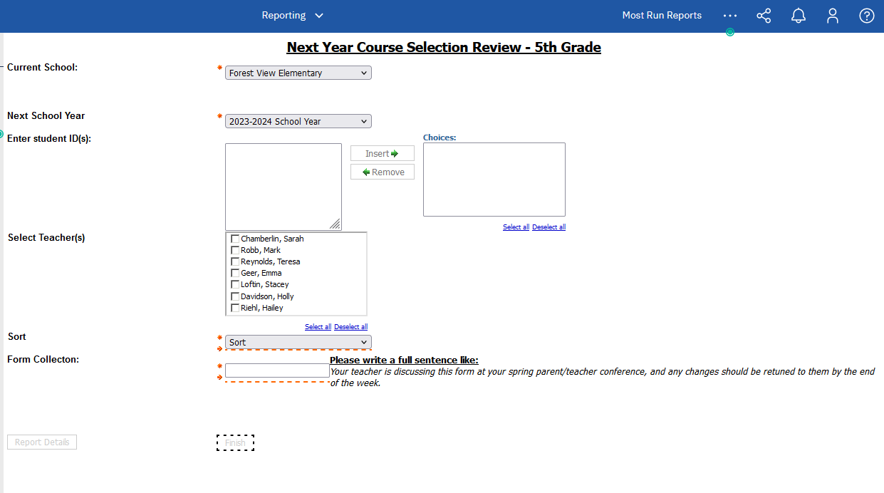
Sending home a paper version of student course requests
OM's and OA's can run in Cognos
  "Next Year Course Selection Review – 5th Grade"
5th Grade Teachers can review with parents and students during conference week
  If changes are requested, interoffice or scan and email
    the Verification Form to the Middle School Registrar/Counselor

Slide 15
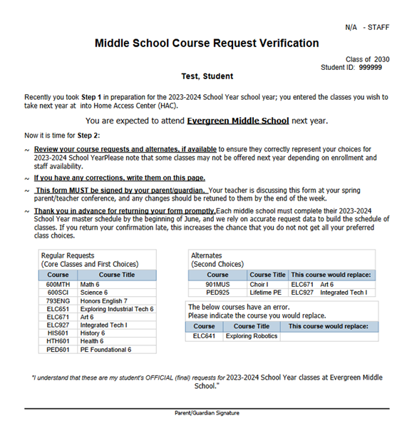
Sending home a paper version of student course requests

Slide 16

Will be updated after receiving feedback from this meeting

Slide 17
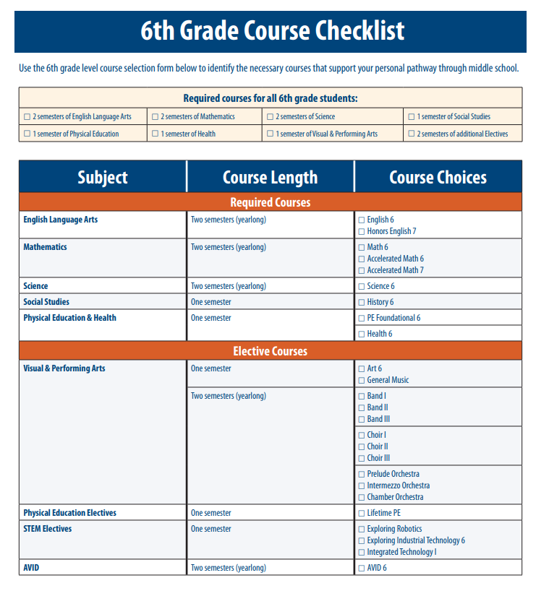

Resources
Course Catalog Resources:
Middle School Course Catalog 2024-25
Middle School Course Catalog Highlights
Elective Landscapes 2024.docx

Slide 18
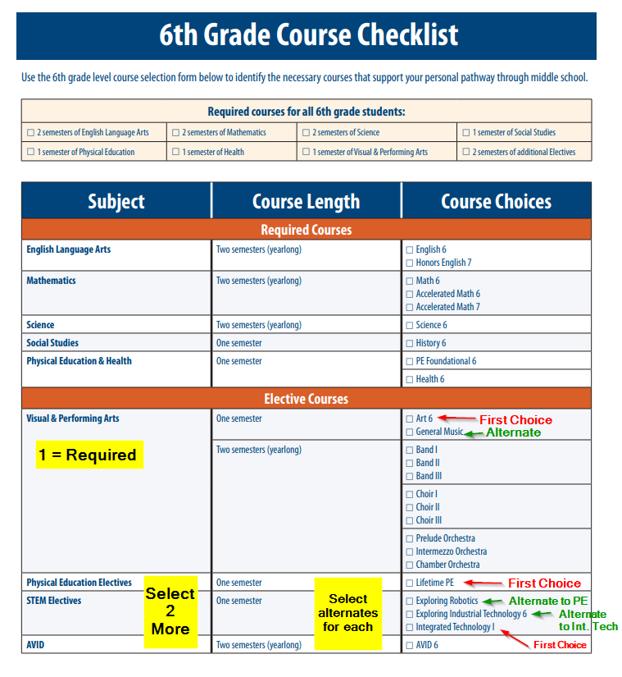
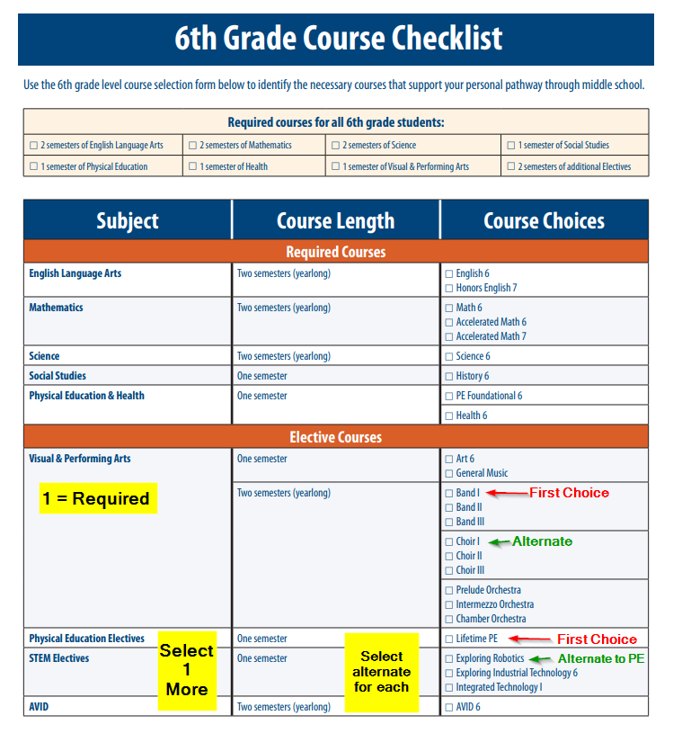
Choice Options
Electives: 1.5 Credits Only

Slide 19
Choice Options
Electives: 1.5 Credits Only

Slide 20
Ideas for our team
Brainstorm:
Our Ideas
Course Catalog-overview of courses
Pages 20-27
  Answering questions for students on different course options

Slide 21
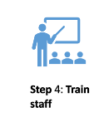
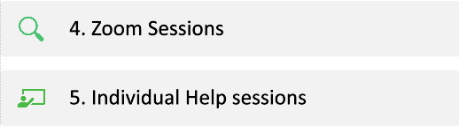
Zoom Training Ideas for our teachers
25 minutes before the start of the school day
25 minutes after the school day
More than one option
Recorded resources available as well
Does the plan work?
Does the timing work?
What's missing?

Slide 22
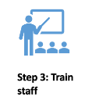
Proposed Zoom Dates
Tuesday, March 5, 8:50 – 9:15 am
Tuesday, March 5, 2:50 – 3:15 pm
Tuesday, March 5, 3:30– 3:55 pm
Wednesday, March 6, 8:05 – 8:30 am
Thursday, March 7, 8:50 – 9:15 am
Friday, March 8, 1:35 – 2:00 pm
Tuesday, March 12, 8:50 – 9:15 am
Tuesday, March 12, 2:50 – 3:15 pm
Tuesday, March 12, 3:30– 3:55 pm
Wednesday, March 13, 8:05 – 8:30 am
Wednesday, March 13, 2:50 – 3: 15 pm
Thursday, March 14, 3:30– 3:55 pm
Friday, March 15, 2:15 – 2: 40 pm
Does the plan work?
Does the timing work?
What's missing?

Slide 23



Registrar Course Requests Training
Thursday, February 29
2:30 – 4 pm at CRC
Registrar Scheduling Check-in
Friday, March 22
3 – 4 pm at CRC
Registrar Scheduling Training
Tuesday, April 16
2:30 – 4 pm at CRC
The LMS data team offers Office Hours – Click here to schedule time.
Don’t forget the Helpful resources in the SIS Documentation Portal.

Slide 24

5th Grade Transition Timeline
MS Counselors/Admin Communicate with their Feeder Schools on the upcoming work
Resources are Provided
Course Catalog
How To PowerPoint
OTHER
Elementary School Teacher and Counselor look through the resources
ES Teacher and Counselor
Walk students through the process

Slide 25
Elementary School Staff Timeline Suggestions
In advance:
Watch the How-to Video: LINK
Examine the MS Course Catalog
  Pages 3-27
    Three-Year Planner (p. 3)

Slide 26
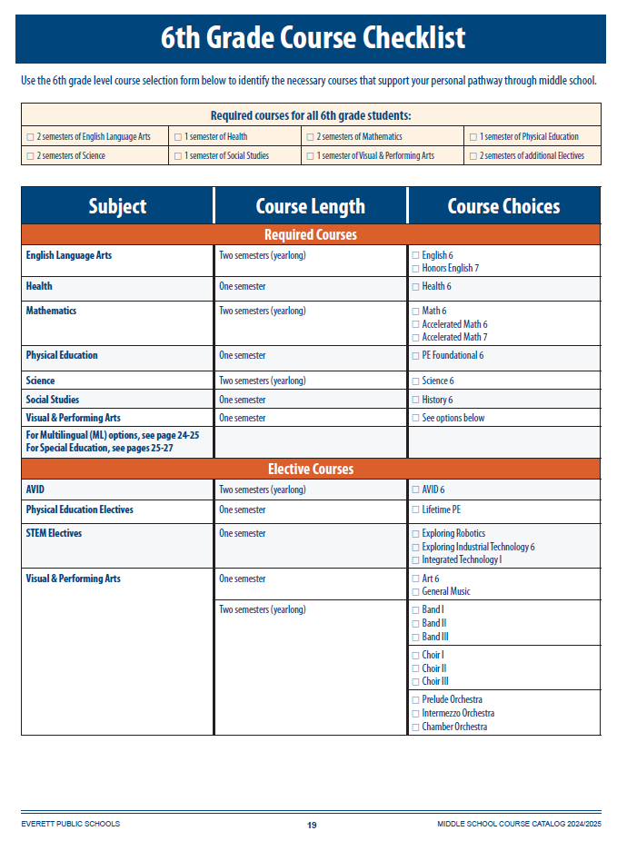
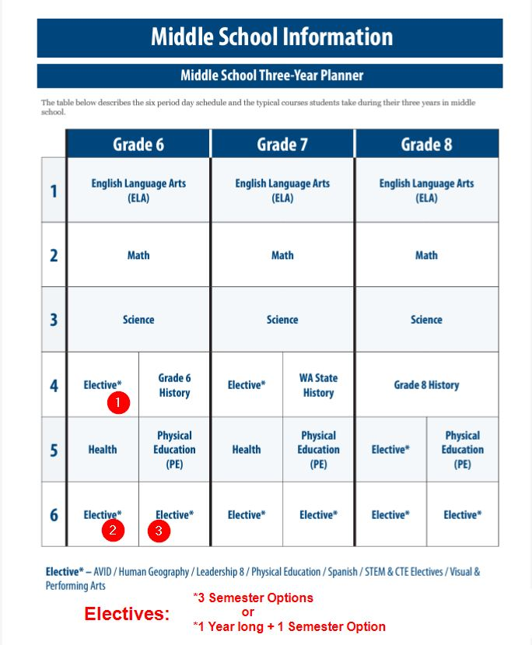
Course Catalog Highlighted Resources

Slide 27
Request Sheets?
What do you have?
Does this meet all needs?

Slide 28
Course Request Preparation
Preload
The Following Required Classes
  Health
  Foundational PE
  Required History for specific grade levels
  English & Math
  Removal of Barriers-Choice
Do NOT Preload
(unless it's coteach or ML Course)

Slide 29

What's Missing?
Type Ideas Here

Slide 30



Based on your Feedback.. Updates are...

