Slide 1
Exploring Post-Secondary Options
Naviance Student

Slide 2
Lesson Tasks
Learn key post-secondary terms to help with researching options after high school
Use SuperMatch and Washington Career Bridge to explore for university, college, and training programs that might be the right “fit” for your future
Add two colleges with your desired programs to your Colleges I’m Thinking About list

Slide 3
Life After high school

Slide 4
Ready for What Comes Next?
Often well-meaning people ask “what are you doing after high school” as soon as you start your senior year.
This can be stressful and the important thing to remember is to find the right FIT for you!
As you go through your senior year, use the figure out what you want to do and develop your PLAN for after high school graduation.
Notes:
https://app.schooltube.com/video/aebdc8ded8634e20b73e/Success%20in%20the%20New%20Economy

Slide 5
Glossary for Post-Secondary Terms
Certificate of Completion — Awarded in many technical and career fields and designed to prepare graduates for employment. Typically programs are one year in length and can lead to an associate degree.
Associate Degree — A two-year college degree awarded at a community or technical college upon completion of coursework (i.e. Associate of Arts; Associate of Science).
Bachelor Degree — A four-year college degree at a university, college, also offered at some two-year colleges. Awarded upon completion of all coursework. (i.e. Bachelor of Arts; Bachelor of Science).

Slide 6
Glossary for Post-Secondary Terms
Open Admission — An admission policy that accepts students without regard to the criteria of grade point average and/or test scores.
Regular Admission — The application process that requires application materials to be submitted no later than the specified deadline. Admission responses are usually received in March.
Early Action — An admission plan used primarily in highly selective colleges. Under Early Action, you follow an accelerated application process and usually apply by November 1. You will be notified of a decision by mid-December, but, if you are accepted, you do not have to let the institution know of your decision until May 1.
Early Decision — An admission plan well-qualified applicants who are definitely committed to their choice of college. Applicants will be notified of their acceptance or refusal in December. Acceptance under Early Decision requires you to withdraw applications at other colleges.

Slide 7
Finding the right Fit

Slide 8

















Post-Secondary College & University Options
Public Colleges | Private Colleges
Funded by local and state governments Usually offer lower tuition rates than private colleges for in-state residents | Funded primarily by tuition, fees, and other private sources Private donations can fund generous financial aid packages for students
Liberal Arts Colleges & Universities | For Profit Colleges
Offer a broad base of courses in liberal arts Literature, history, languages, math, life sciences Most are private offering four-year programs | Businesses that offer a variety of degree programs Typically prepare you for specific career Tend to have higher costs and not all credits transfer
Special Focus Colleges | Specialized Mission Colleges
Focused on a specific interest or student population | HBCUs – Historically black colleges and universities HSIs – Hispanic-serving institutions Offer programs, services and activities targeted toward underrepresented students

Slide 9

Guaranteed Admissions Program (GAP)
Everett Public Schools is a participating institution in the following guaranteed admissions programs, or GAP:
The Guaranteed Admission Program with Washington four-year, public institutions
The Automatic Admission Partnership with Pacific Lutheran University
The Guaranteed Admission Program with Saint Martin's University
      Central Washington University
      Eastern Washington University
      The Evergreen State College
      Pacific Lutheran University
      Saint Martin's University
      University of Washington Tacoma
      Washington State University
      Western Washington University

Slide 10
Guaranteed Admissions Program (GAP)
To qualify for the Guaranteed Admissions Program, a student must have:
A minimum cumulative GPA of 3.0 (GPA of 3.3 for Pacific Lutheran University)
Completed necessary College Academic Distribution Requirements (CADR) courses in high school (typically mirrors high school grad requirements)
Completed the Family Educational Rights and Privacy Act (FERPA) Form (which is included in the student handbook, the enrollment form, or annual student information update) and provided permission to share high school student information with colleges.
If all of these are true or the student is on track to meet these criteria by high school graduation, GAP guarantees the student will be admitted to all participating institutions.

Slide 11










Community & Technical College Options
Community Colleges | Technical Colleges
Two-year colleges Open access, affordable, no SAT/ACT requirement Earn an associate degree and/or transfer to four-year college Some offer bachelor degree programs Often programs partner with industry to prepare for workforce | Two-year colleges Open access, affordable, no SAT/ACT requirement Earn an associate degree, certificate of completion or transfer to four-year college Commonly offer programs focused on career pathways Partner with industry to prepare for workforce

Slide 12
Training & Certificate Options
Internships | Apprenticeships | Military | Employment
An intern is a student undergoing supervised practical training. Real-life applications of the skills students learn in school. An internship is a way to “try on a job” before deciding on a career. | Training program where you earn wages while learning a skilled profession in a specific field. Supervised by a trade professional Includes classroom studies and on-the-job training Earn a salary while you learn about your trade | Educational opportunities Up to 90% tuition assistance for college courses Technical training in over 200 skill areas G.I. Bill-Tuition for any school | Entering the workforce after graduation Paid positions either full time or part time.

Slide 13
Find Your fit

Slide 14
SuperMatch Search
SuperMatch allows you to search for post-secondary opportunities based on your interests.
By selecting different criteria, a list of options are generated.
There are thousands of choices from culinary and military to technical colleges and four –year universities.
Select your preferences and see what you find!

Slide 15



Log in to Naviance Student
Click Students from school website
Click Naviance button
Log in with district ID# and password
Naviance Student
Username: district ID#
Password: district password

Slide 16
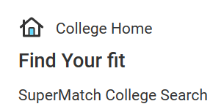


SuperMatch
Click on Colleges > SuperMatch College Search
Remember that many technical, trade, and apprenticeship options are also at colleges in your community!

Slide 17
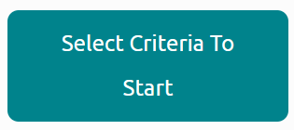
Find Your Best Fit
To get started…click the Select Criteria To Start button and customize your search based on your preferences

Slide 18
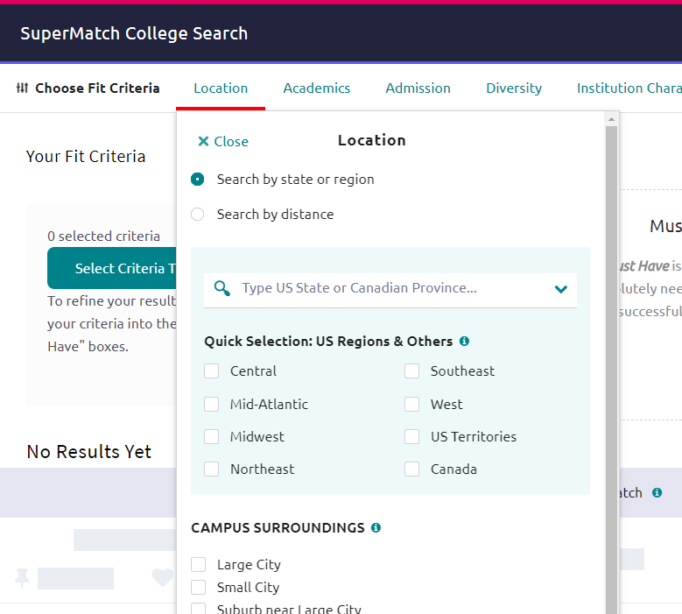
More Search Options
Each criteria will have lists of options to refine your search
You can rate the importance by selecting, Kinda, Very and Must Have (the more information your provide, the more accurate your search will be)

Slide 19
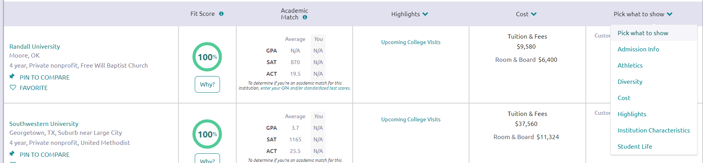
Check out a “Match”
When you finish selecting your criteria, click on the name of the college and check out the information.

Slide 20
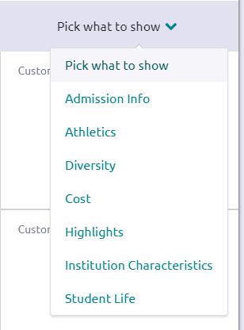
Explore the Information
Admission Info - acceptance rate and application fee
Athletics - Division and sports
Diversity - male/female, out of state, international, minorities
Cost - tuition and fees
Highlights – upcoming college visits to your school
Institution Characteristics - undergrad size, graduation rate, retention rate
Student Life - Greek life, student clubs, offerings
By clicking on the University name you can find additional information.

Slide 21
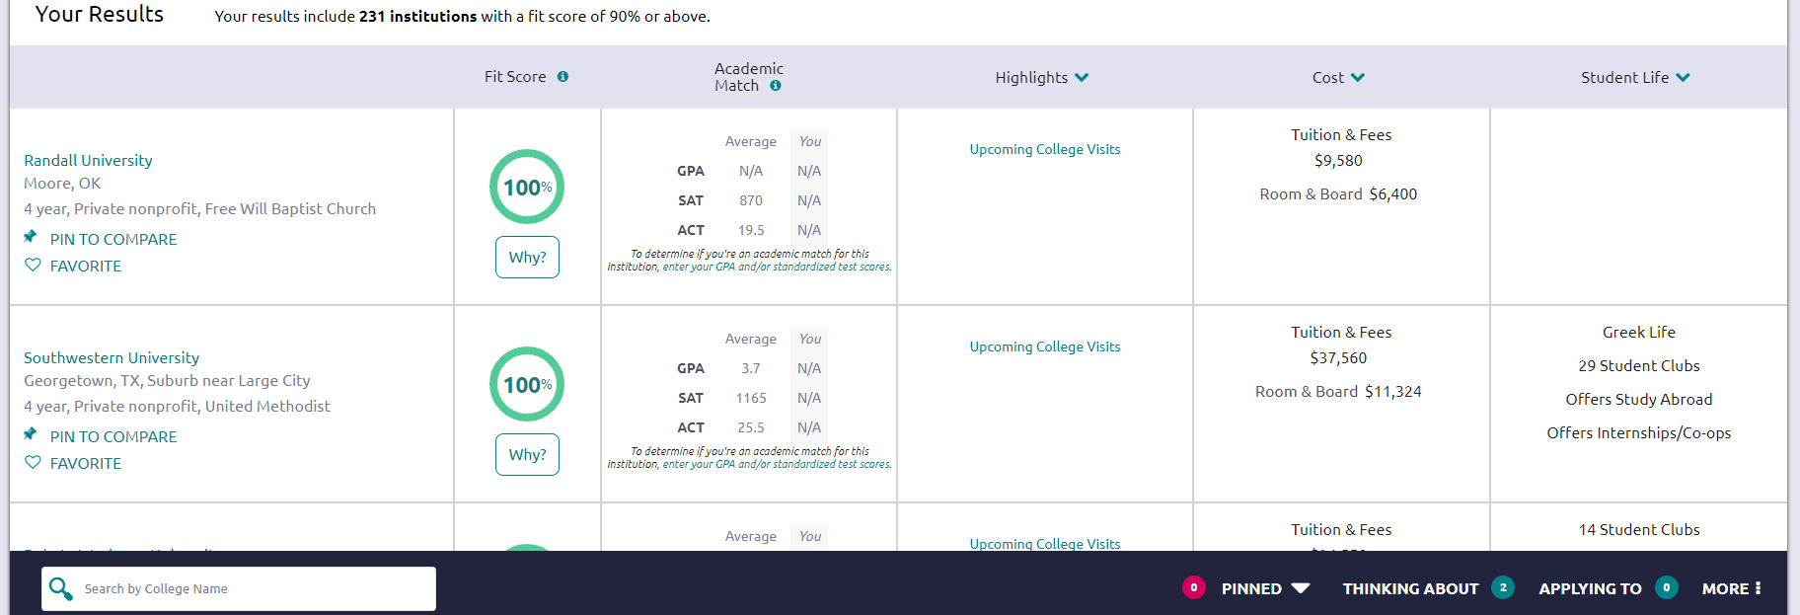
Add to Your Favorites
Once you have identified a college or program of interest, click the heart to add to your Colleges I’m thinking about list.

Slide 22


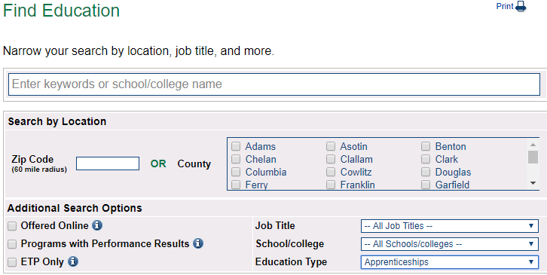
Not Seeing Your Future Option?
Check out Washington Career Bridge!
(careerbridge.wa.gov)
Click Find Education
Type the job title or search by location or search by education type such as apprenticeships.

Slide 23
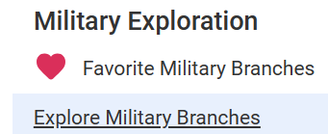

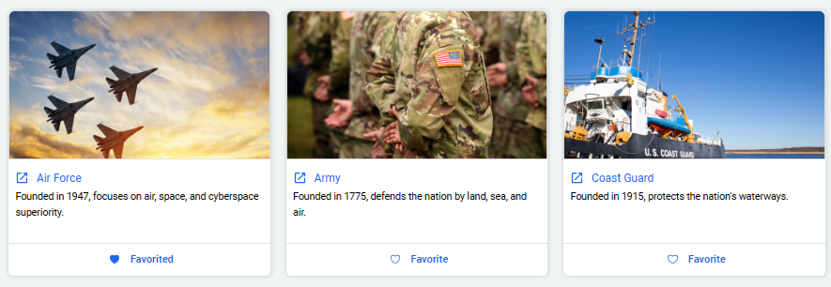
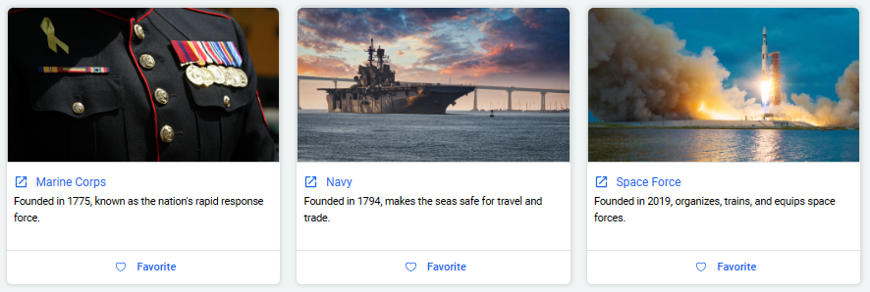
Interested in the Military?
Within the college search options, you can access military colleges/programs.
If you are interested in the military right after high school, check out the resources in Naviance.

Slide 24
Task Completion…

Slide 25
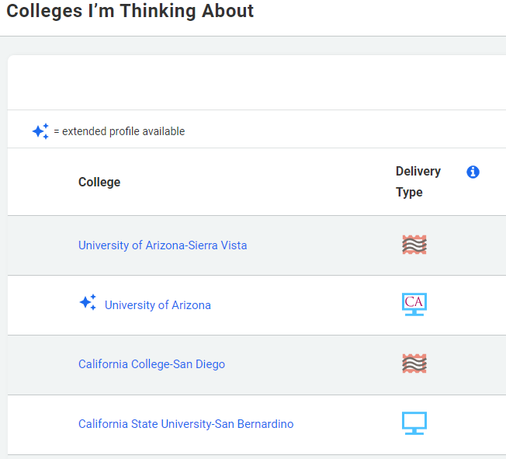
Complete the Task…
To complete the lesson, make sure you have added a minimum of two college and/or programs to your Colleges I’m thinking about list.

