Slide 1
Post-Secondary Application Process
Naviance Student

Slide 2
Lesson Tasks
Learn about the different college application types
Submit a transcript request to your registrar for submitted applications
Complete a college application and upload confirmation of the submission

Slide 3
Application Process

Slide 4
Application Process in Naviance Student
In Naviance Student you can…
Research college and training program options
Directly access admission sites
Request transcripts and other school documents to be sent with your application

Slide 5
Streamline the Application Process
Step 1: Use tools in Naviance Student to explore college and training program options.
Step 2: Add college and training programs to your Colleges I’m thinking about list
Step 3: Determine which colleges and/or programs you plan send applications to
Step 4: Check application delivery types in Naviance Student to understand how each college/training program expects you to apply
Step 5: Move the names of colleges/training programs where you plan to submit applications to your Colleges I’m applying to list and request your transcripts be sent by your school
Step 6: Complete your application(s)
Step 7: Continue to check status of your transcript and other school documents in Naviance Student
Step 8: Update your application results on your Colleges I’m applying to list

Slide 6
Creating your list

Slide 7


Colleges I’m Thinking About List
As you use the different search tools, you will be able to “favorite” colleges to your Colleges I’m thinking about list

Slide 8

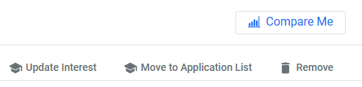
Building Your List
As you continue your research you will be able to add/remove colleges/training programs from your list, update your interest and decide if you want to move to application list.

Slide 9
Application delivery Types

Slide 10
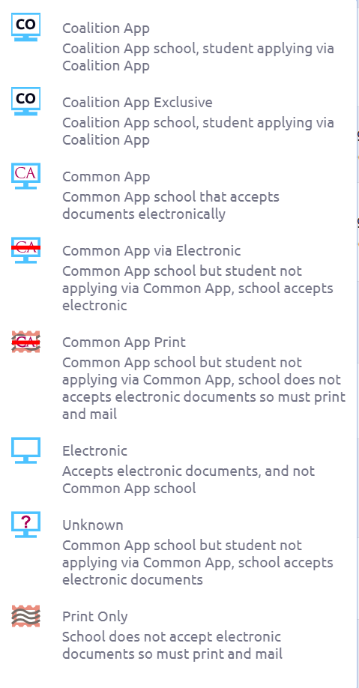
College Application Delivery Types
These icons will be next to your applications and indicates how your high school will send your application materials through Naviance Student.
Documents like your transcript is sent based on what each college/training program prefers.

Slide 11
Common App
These icons indicate that the submission of the application will go through Naviance Student through Common App.

Slide 12
Electronic
When you see the Electronic icon, you will be able to submit your application online through the college website.
You can access the college website admissions page by clicking the Apply online button.

Slide 13
Print Only
The Print Only icon means your school registrar will send your transcript by postal mail.
You can access the college website admissions page through Naviance Student and still complete the application online.

Slide 14
Common App via Electronic
The Common App via Electronic icon indicates that documents can be submitted either through Common App or Directly to the Institution electronically.

Slide 15
Ready to Apply?

Slide 16


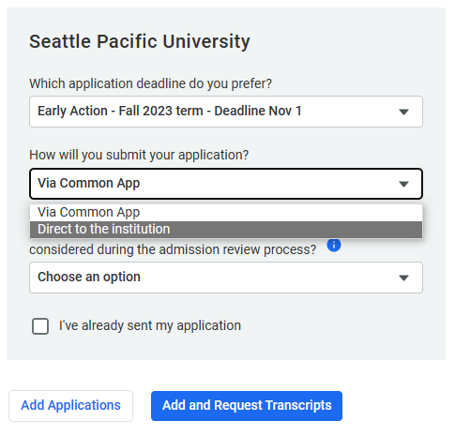
Colleges I’m Applying to List
The Colleges I’m applying to list is where you move the colleges when you plan to submit applications.
1.
Click the box next to the college name from the Colleges I’m thinking about list.
Click Move to Application
List
Select how you will submit your application, then click
Add and Request Transcripts
2.
3.

Slide 17
Requesting Transcripts Reminder
You do not need to request your transcript for every college/training program on your list.
Only request a transcript for that college/training program if you submit an application.
All college transcript requests must go through Naviance Student.

Slide 18
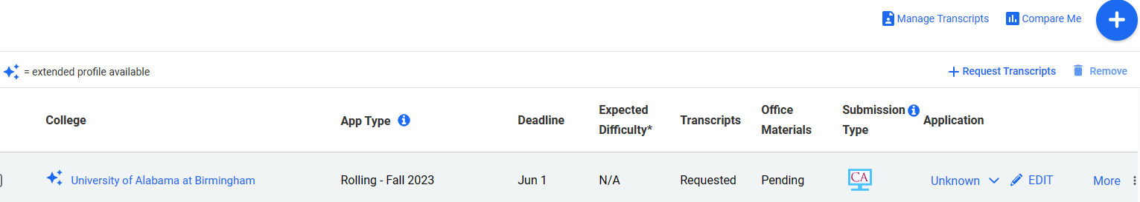
Viewing Your Colleges I’m Applying to List
Remove an application if you decide not to apply
Manage transcript requests
Track progress of application materials
It is very important to keep this list up to date and current.
Information on this page informs your school counselor and registrar where documents need to be sent.
Edit your application status

Slide 19
Do You need a recommendation?

Slide 20
Teacher & Counselor Recommendations
Throughout the application process you may need to submit a recommendation letter from a teachers or your counselor.
Examples:
Common App college applications
Scholarship applications
NCAA/NAIA athletics

Slide 21
The Brag Sheet Survey
A “brag sheet” is exactly that.
A format for you to talk about yourself and your accomplishments.
Teachers and staff can then use the information to write you the most complete recommendation possible.
The Brag Sheet Survey is in Naviance Student and can be edited/amended at any time to keep the information current.

Slide 22
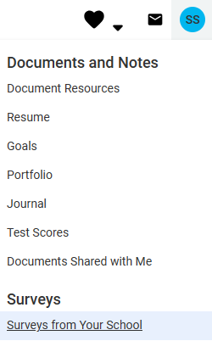

Access the Brag Sheet
In Naviance, click on your initials the
upper-right corner
Click Surveys> Surveys from Your School
Click the link to complete
the Brag Sheet Survey.
You can fill out the survey in parts. At the bottom, click
after each answer you complete.
*You can also type your answers on another document, then copy/paste into the survey

Slide 23
Common App Teacher and Counselor Recommendations
Most Common App colleges ask for letters of recommendation.
Please consider the following…
  Ask the teacher in person
  Make sure the brag sheet is complete
  Use Naviance Student to submit and track your requests to the teacher
  Teachers will need to upload/send their letter using Naviance Student
  Ask the teacher two weeks in advance to allow enough time. (*Remember you are probably not the only student requesting a letter!)

Slide 24
Submit, Save, & check back

Slide 25
Submit Your Application
When you submit an application, you will want to start checking your email account for confirmation and updates regularly.
Colleges and training programs will use the email you used in the application process to:
  Notify you if your application is complete, incomplete, or needs additional information
  Notify you of your application status
  Notify you when they receive your school transcript or other documentation
  Communicate with you about your financial aid award status

Slide 26


Save Your Communication
As you receive communication regarding your college/training program application, save it!
There may be times when you will need to refer back to the emails containing important information and due dates.
To save your emails click the star/flag next to the message or create a folder in your inbox for college/training program communication.

Slide 27
Check Back Often
Most colleges/training programs send decisions electronically through either an email or the application status link when you log into your account at that school and then follow up with a letter.
If you are accepted to multiple schools, you do not have to make your decision right away.
Take time to receive all information prior to making the choice that is right for you. The right “fit!”

Slide 28
Task Completion…

Slide 29



Log in to Naviance Student
Click Students from school website
Click Naviance button
Log in with district ID# and password
Naviance Student
Username: district ID#
Password: district password

Slide 30

Complete the Task…
You will complete this graduation requirement at the END OF YOUR SENIOR YEAR!
For CCRS, please complete the Brag Sheet Survey and click

Slide 31
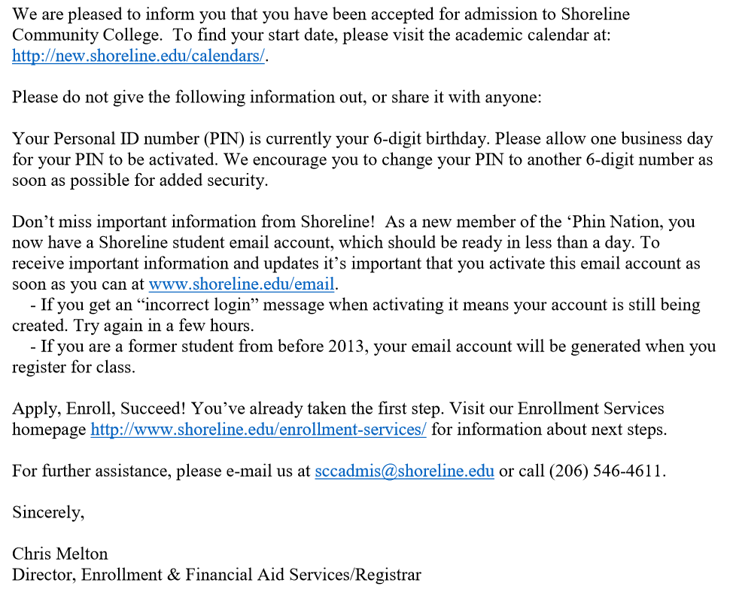
Upload Example 1

Slide 32
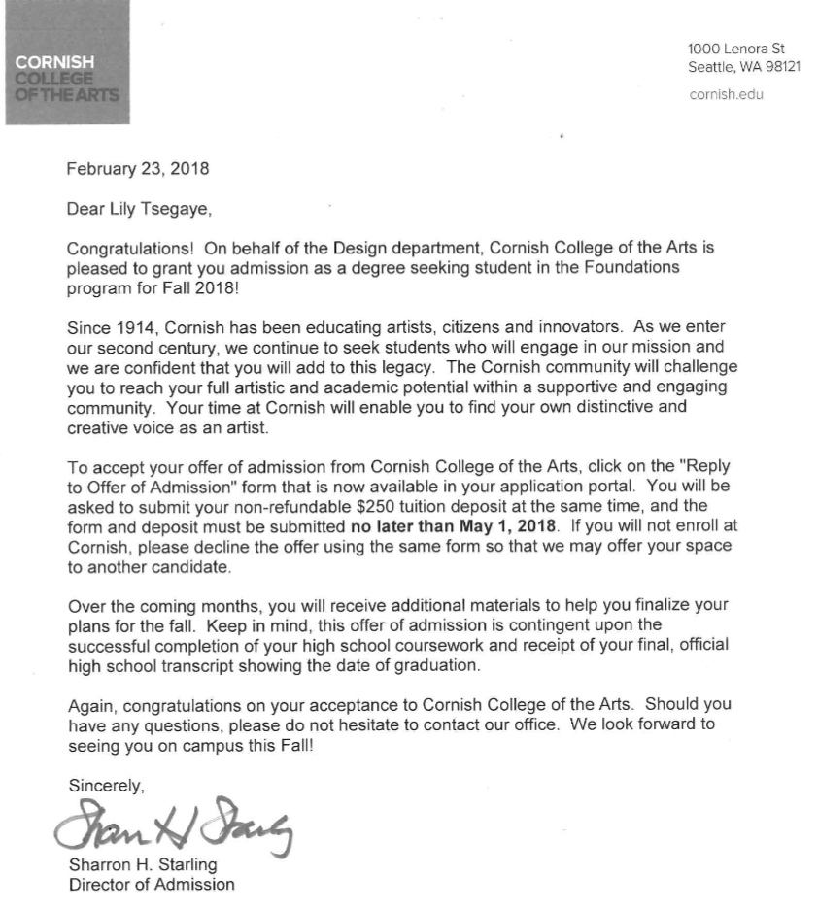
Upload Example 2

Slide 33
Upload Example 3
Provide a screenshot of your post-secondary plans:
 | Email communication (with employer, military recruiter, apprenticeship provider etc.)
 | Contact/other information about an option found on Washington Career Bridge
 | Other documentation of post-secondary opportunity

