Slide 1


Welcome to Kindergarten 2025-2026

Slide 2


Welcome to (school) Elementary
Thank you for joining us today!
Introductions:
Administration
Teachers
Specialists
PTA / Natural Leaders members (if present)
Notes:
Insert names of presenters, and a picture of your choosing. This is your welcome and thank you for coming page

Slide 3

Everett Ready
At EPS, Kindergarten begins with Everett Ready a transition-into-kindergarten program
Monday, August 18 to Thursday, August 21
Half-day: 3 hours / day - xx am to xx am/pm
Transportation provided for qualified students
(If student is enrolled and registered to attend Everett Ready by August 1)
Family meeting on August xx from xx to xx am/pm
Build relationships with teachers & peers
Become familiar with the school campus
Learn school routines
Explore
classroom materials
Feel safe & confident
For more information: www.everettsd.org/everettready
Notes:
School to update start / end time for daily 3 hours
In Everett Public Schools, kindergarten begins in August with Everett Ready.
One of the reasons it is important to enroll your student, online or in person, is to have access to our transition program for all students in August.
Transportation is provided id you live outside of a one miles radius from the school. AND if your student is enrolled before August.
Program benefits – students who participate in Everett Ready arrive at kindergarten in September, familiar with the school, knowing some of their classmates, and ready to learn!

Slide 4

WaKIDS - Washington Kindergarten Inventory of Developing Skills
WaKIDS’ Three Components
Family Connection Meeting
Welcomes you into the Washington K-12 system as partners in your child’s education through a family conference with your child’s teacher.
The meetings take place during the first 3 school days when grades 1-12 students are starting school.
This is an opportunity for you to get to know your child’s teacher, share information about your child, and ask questions.
Whole-Child Assessment
Helps kindergarten teachers learn about the skills and strengths of the children in their classrooms so they can meet the needs of each child.
Early Learning Collaboration
Aligns practices of early learning professionals and kindergarten teachers to support smooth transitions for children.
Notes:
After Everett Ready in August, students have another transition support called WAKIDS. This is a state-wide program that was implemented when we implemented full day kindergarten in Washington. State. There are 3 important Components to WaKIDS
Family Connection Meetings—held the first three days of school with families and the kindergarten teacher.
Whole child assessment—conducted the first seven weeks of school – observational assessment on six developmental areas (language, literacy, math, cognitive, social emotional and physical). The student data is shared with families at November family conferences
Early Learning Collaboration –Supports the alignment of early learning professional and kindergarten teachers to created seamless transitions from one program to another, providing professional learning opportunities, kindergarten transition reports from ECEAP and some of our preschool partners. The goal is to connect and collaborate to best support our young students.

Slide 5

WaKIDS
Notes:
Optional WaKIDS 4min Video: https://www.youtube.com/watch?time_continue=29&v=zO7JAHpqLyU​
​
​

Slide 6



Welcome to Kindergarten
First day of school (grades 1 to 12) – Wednesday, August 27, 2025
Family Connection Meetings for K Families
Wednesday, August 27 to Friday, August 29, 2025
Your student’s teacher will contact you to schedule your family meeting
First day of attendance for kindergarteners
Tuesday, September 2, 2025
visit www.everettsd.org to view 2024-2025 calendar
Notes:
Kindergarten dates
Note to families to check website in August for 2025-2026 school year calendar

Slide 7
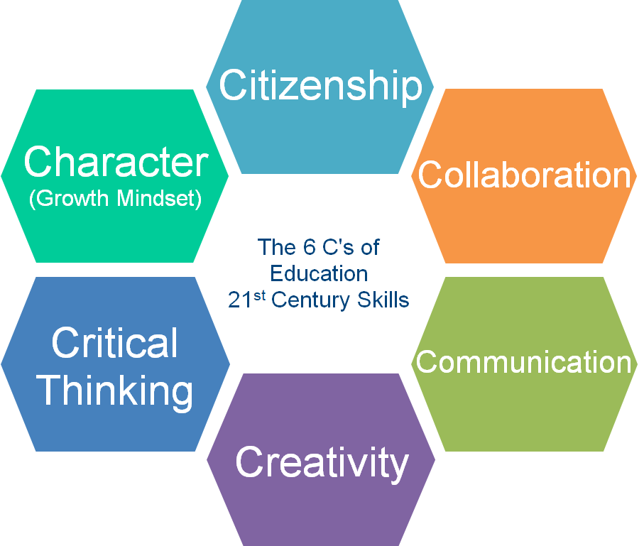
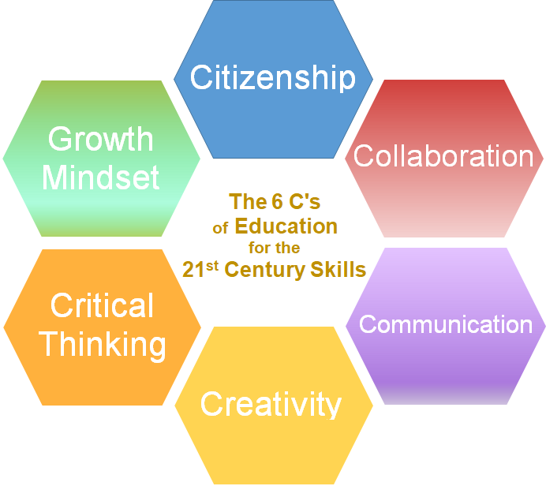
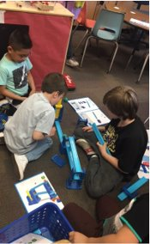

21st Century Skills
Notes:
These six over arching skills are embedded into all content areas.​
Individual schools add own information

Slide 8
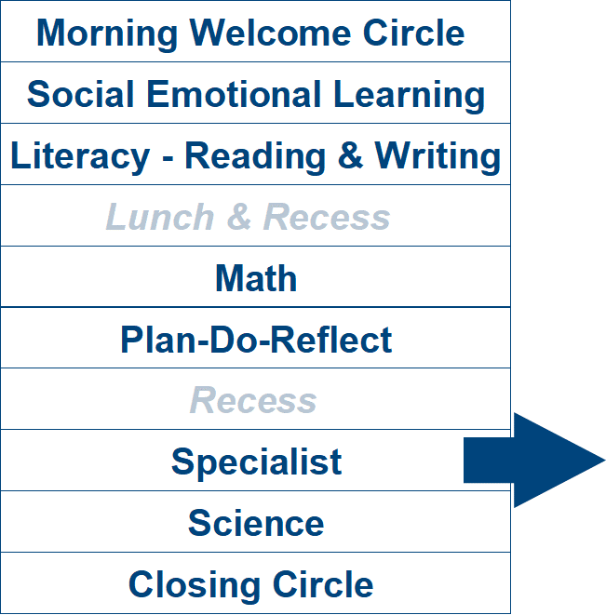
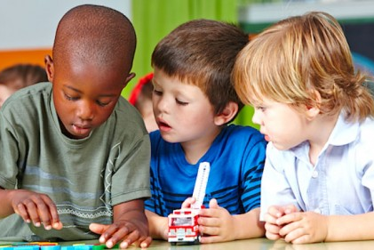
A Day in Kindergarten
Specialists may include:
Physical Education, Library, Music, Art, or STEM
(Science, Technology, Engineering, & Math)
Notes:
All kindergartners have a day that includes these components listed here:
Social Emotional Learning—we use a curriculum called Second Step that supports student learning around being a good friend, sharing, using words to ask for what we want
Literacy involves building foundational skills focused on letters and sounds to support early reading and writing. The math curriculum, Illustrative Mathematics, focuses on counting & cardinality understanding addition and subtraction, early concepts in place value, measurement and geometry. In Science we have two project -based kits, Animals two by two and Balls and Ramps. Specialists vary from day to day but can include any of those listed—music, art, PE, library, STEM (not all schools have all of these specialists)
Once families are enrolled in their school, there are opportunities to tour the school, meet the teachers and learn more about the day for your student. Usually that opportunity is scheduled for May and is called "Getting Ready for Kindergarten orientation". And of course, we encourage every kindergartners to attend Everett Ready in August.

Slide 9
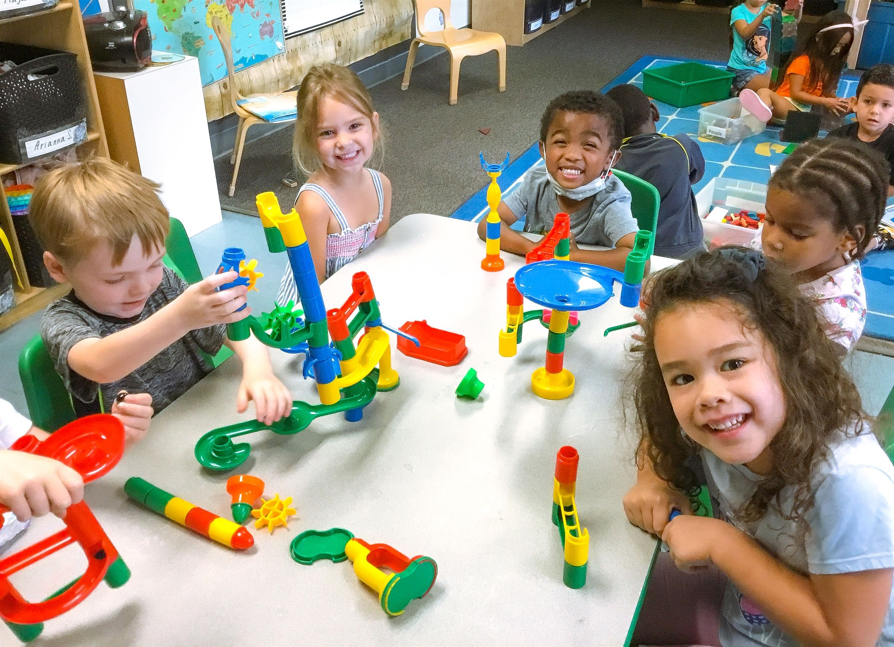
Plan – Do – Reflect (PDR)
PLAN
Choice with intention
DO
Develops competent thinkers, decision makers, & problem solvers
REFLECT
Remembering & reflecting with analysis
A model of play-based learning
A model of play-based learning
Enhances creativity, critical thinking & problem-solving
Contributes to the development of self-regulation & social skills
Promotes physical well-being & coordination
Encourages reading & writing
Enhances communication & collaboration
Develops character & citizenship
Notes:
Play is the work of children.....and Plan Do Reflect offers opportunities to play with thought and intentionality. Read slide.
Plan Do Reflect is a key component of the kindergarten day. Students choose from centers including: blocks, art, library, manipulatives, and dramatic play. Learning is embedded in all of the activities and students are encouraged to explore the materials, collaborate with their peers, engage in creative use of materials and learn to plan and reflect on their activities.
Benefits Of play include: Read slide

Slide 10

Second StepTM – Social Emotional Learning
The Second Step™ curriculum promotes self-regulation: the ability to monitor and manage emotions, thoughts, and behaviors.
It’s a key to school readiness that supports children’s ability to be successful in both academic and social situations.
Helps children focus their attention on learning when they might be distracted by others, upset by a problem, or excited about an upcoming event.
Increases the ability to self-regulate and helps children get along better, engage with teachers and their peers, and promoting positive social goals and values.
Notes:
Kindergarten is more than just academics. It’s also about learning how to get along with others and how to manage oneself in a group setting. ​
Individual schools add own information

Slide 11
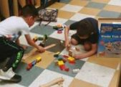
Illustrative Mathematics
The big ideas in kindergarten math include; representing and comparing whole numbers, initially with sets of objects; understanding and applying addition and subtraction; and describing shapes and space. More time in kindergarten is devoted to numbers than to other topics.​
​
The mathematical work for kindergarten is partitioned into 8 units:​
Math in Our World​
Numbers 1–10​
Flat Shapes All Around Us​
Understanding Addition and Subtraction​
Composing and Decomposing Numbers to 10​
Numbers 0-20​
Solid Shapes All Around Us​
Putting It All Together​

Slide 12
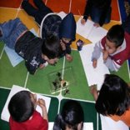
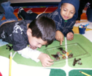
Science
Learn about​…
Life science​
Physical science​
Apply​…
Next Generation Science Standards practices and crosscutting concepts
Participate in STEM engineering challenges ​
Ask questions​
Observe​
Gather information​
Design​
Test ​
Compare possible solutions​
Notes:
Everett Public Schools is using an aligned instructional writing strategy that develops student writing from PreK to 5th grade. ​
​
If your child has attended a ECEAP, Head Start or community preschool and childcare program that is a partner in this work, the materials and strategies will be familiar to them. The writing instruction focuses on the elements of a personal story and the child’s ability to communicate their stories through pictures and writing.​
​

Slide 13
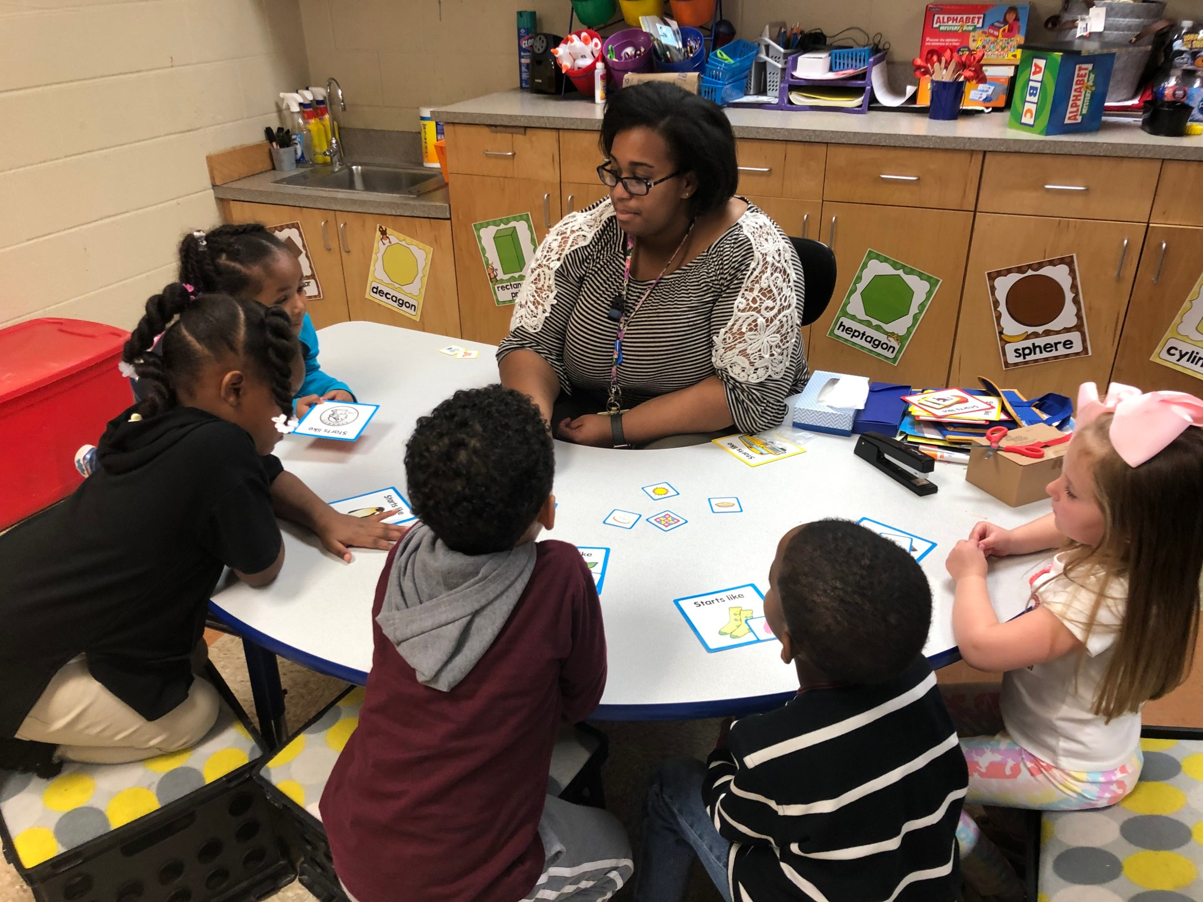
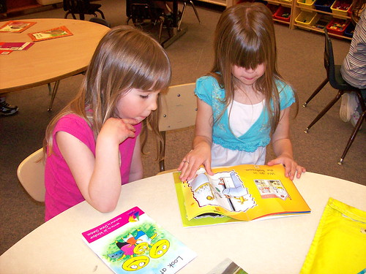
Reach for Reading
Reading Foundational Skills
Phonemic awareness​
Phonics​
Sight words​
Shared reading​
Small flexible groups​
Independent practice​

Slide 14
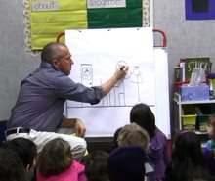


Writing Foundations
Learning how stories work
Telling about a memory​
What happened?​
Who was there? ​
Where did it happen?​
How did you feel?​
What did you say?​
Notes:
Everett Public Schools is using an aligned instructional writing strategy that develops student writing from PreK to 5th grade. ​
​
If your child has attended a ECEAP, Head Start or community preschool and childcare program that is a partner in this work, the materials and strategies will be familiar to them. The writing instruction focuses on the elements of a personal story and the child’s ability to communicate their stories through pictures and writing.​
​

Slide 15
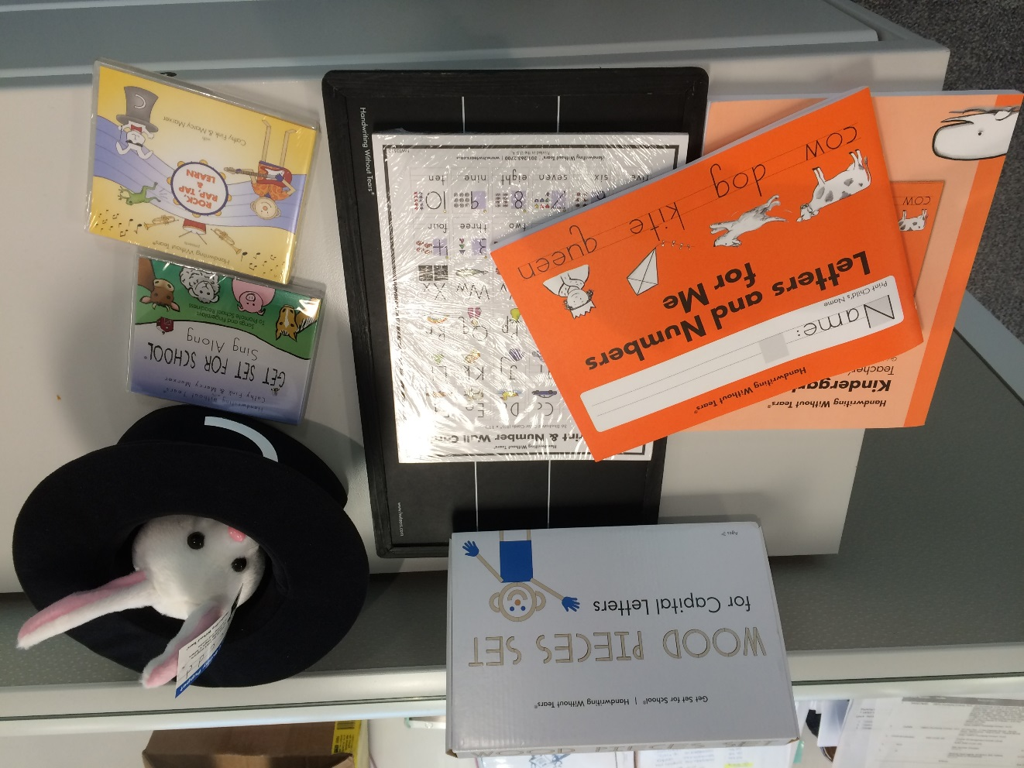
Handwriting Without Tears
Fine Motor Development
Pencil grip
Correct letter and number formation
Letter proportion and spacing
Building stamina for writing

Slide 16
Challenging Options
Learning Enrichment Achievement Program (LEAP)
Challenging Options provide accelerated and enriched academic opportunities for students in grades K-12.
There are two programs to serve students in the elementary schools: LEAP (Grades K-5) and the Highly Capable self-contained classrooms (Grades 2-5)
To be screened for LEAP in the fall, kindergarten families need to complete a referral form. Link to the form and deadline for submission will be available on www.everettsd.org/challengingoptions by the first day of school.
If, following the screening process, the student is identified for LEAP they are served in their general education classroom, with the same teacher, beginning in the second half of the school year.
For more information: www.everettsd.org/challengingoptions

Slide 17

Multilingual Learner (ML) Program
The program provides structured language acquisition instructions to students whose native language is not English and qualified Native American students
Students are assessed measuring their speaking, listening, reading, and writing skills. Scores indicate if support is required
ML services are available at all our schools

Slide 18
Dual Language Spanish Immersion Program
Notes:
EME / SLE to include information relevant to KK / a dual language teacher could speak to this slide in Spanish too.

Slide 19
Current Students (Preschool / Transitional Kindergarten)
If you have a student currently attending an EPS early learning program:
ECEAP Preschool, Developmental Preschool (DPK), or Transitional Kindergarten (TK), they are already EPS students and do not need to be re-enrolled. Before end of school year, your student’s teacher will send you forms to be completed and returned to your school for kindergarten:
Everett Ready Registration Form
Kindergarten Questionnaire
Kindergarten Transportation
Updated Certificate of Immunization
All forms are also available on website www.everettsd/kindergartenenrollment

Slide 20
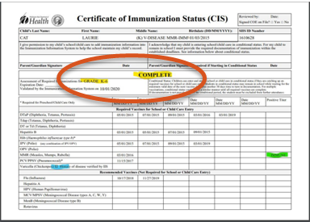

Immunization Status & Health History
IMPORTANT
Make sure that your child’s vaccination is completed before their 1st day of school attendance:
  Everett Ready - August 18
  or
  1st day of school – September 2
Complete / submit the ‘Annual Health History’ by mid-July, at the latest, if your child:
  has a life-threatening condition / a medical plan
  and
  will be attending Everett Ready.

Slide 21

Before / After School Care
EPS partners with the YMCA and the Boys and Girls Club to provide before and after school care at many of our schools.
There are also community childcare programs that transport students to and from schools for before and after school care.
At our school, the before and after school options are: ??
YMCA – visit https://www.ymca-snoco.org/programs/1044/school-age-care/?locations=-1
Boys & Girls – visit https://bgcsc.org/clubs/everett-club/childcare/
Notes:
Read Slide– School to update as relevant to the service available at school

Slide 22
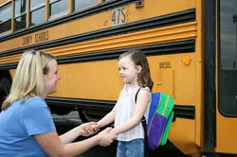
Transportation
Bus Transportation
Provided for students that reside outside a half-mile radius of the school
Designated bus stops located along routes in central locations
Routes are available on the district website prior to the start of school
Route information is communicated to families via automated phone call and email prior to start of school
All students have assigned seats with kindergartners in front of bus
For additional information & forms: www.everettsd.org/transportation - www.everettsd.org/busroutes
Notes:
You can find frequently asked questions on our website at www.everettsd.org/busroutes

Slide 23
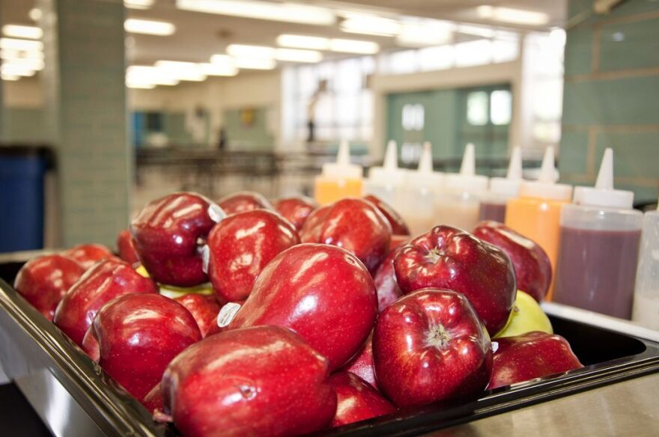
Food and Nutrition Services
Students:
may bring breakfast and/or lunch from home
may purchase* either a hot or cold meal at school
Families can set up an online account for school meals*
School meals are prepared to be free of these allergens: peanuts, tree nuts, shellfish and pork. If your student has other allergies, you can submit a Special Dietary Accommodation Request form.
*Free and reduced meals are available. Meals provided at Community Eligibility Provision (CEP) sites are offered at no charge to families.
For additional information & forms: https://www.everettsd.org/foodservices
Notes:
Our Food and Nutrition Department offers nutritious and delicious meals that include seasonal fresh fruits and vegetables, scratch-made whole grain foods and lean proteins, with vegetarian and gluten free options too.
Students:
May bring breakfast and/or lunch from home (students can eat breakfast at home and do not need to eat breakfast at school. It is optional)
May purchase* either a hot or cold meal at school
Families can set up an online account for school meals*
School meals are prepared to free of these allergens: peanuts, tree nuts, shellfish and pork. If your student has other allergies, you can submit a Special Dietary Accommodation Request form.
*Free and reduced meals are available. Meals provided at Community Eligibility Provision (CEP) sites are offered at no charge to families.
Confirm if CEP school / If not advise of meals at a cost – however, if family qualify for F&R, form to be submitted

Slide 24

Family Involvement
Ways to support your child’s learning
​
Make attendance a priority​
Come to school and family events​
Participate in WaKIDS family meeting and parent teacher conferences ​
Help with class projects/work​
Volunteer​
Join PTA or Natural Leaders​
Being involved in your student's school sends a positive message about the importance of education!
Notes:
Families are children’s first teachers. As children start school you continue to have the most important role. Schools and parents are partners in supporting children’s learning and growth. We invite you to work with us as a team for your child’s success.​
​
Individual school information:​
Coming to family events (around reading, math, science – some just for fun together)​
Coming to Parent-Teacher Conference​
Opportunity to let the teacher know more about your child; after all you know your child best​
Learn about what children do in classroom and how your child is progressing ​
Ask questions​
Volunteering – in the classroom, at home (cut out materials), or for events at school​
PTA – Book fair, Carnival, Grounds Clean-Up​
​

Slide 25


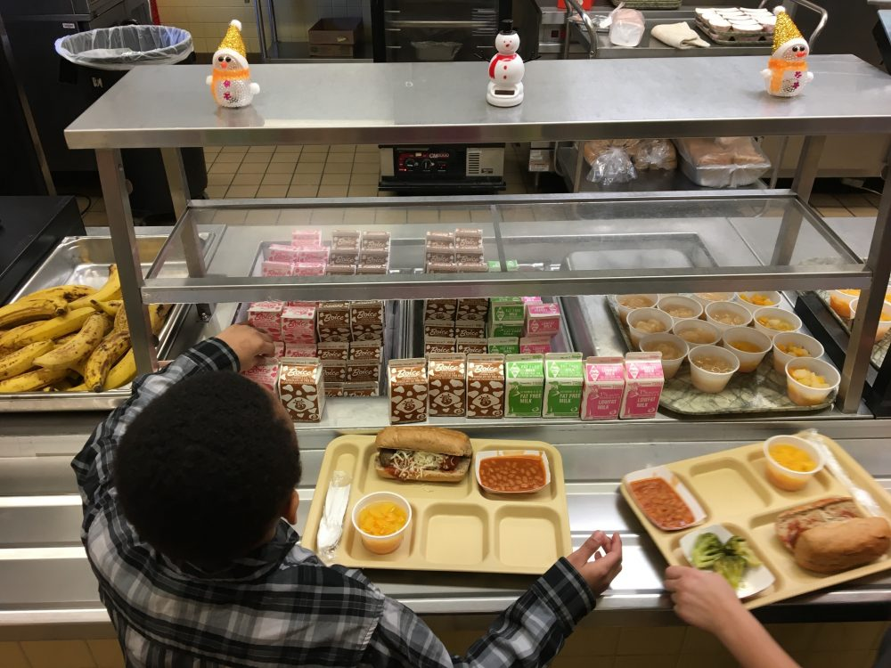
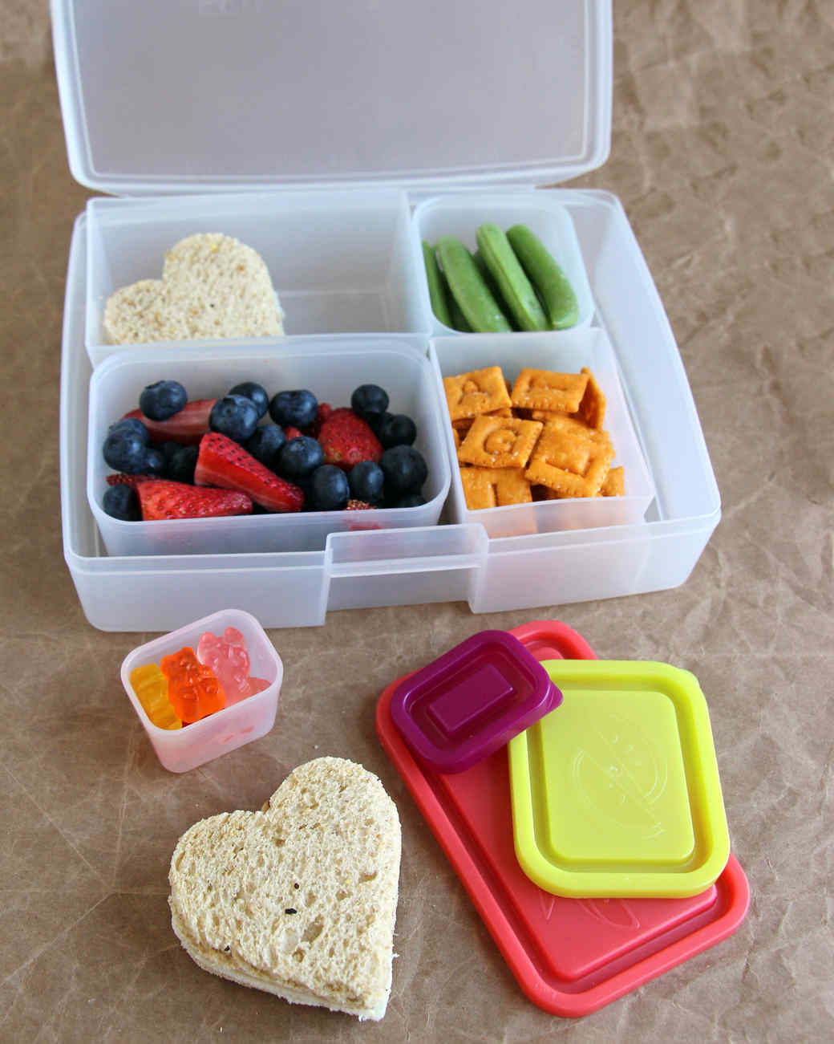
Creating Independence
Independently use the bathroom​
Put on, zip, and button coat​
Blow own nose​
Wash hands​
Open food & lunch containers​
Clean up small spills​
Put away materials​
Ask for help​

Slide 26
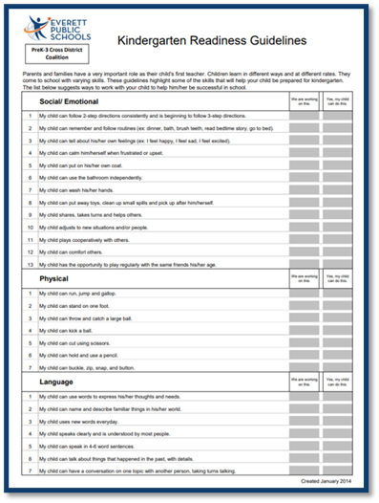
Kindergarten Readiness Guidelines
Parents and families have a very important role as their child's first teacher.
These guidelines, available in multiple languages, highlight some of the skills that will help your child prepare for kindergarten.
www.everettsd.org/kindergarten
Notes:
Kindergarten Readiness Guidelines link
https://www.everettsd.org/Page/38584
Available in kit

Slide 27
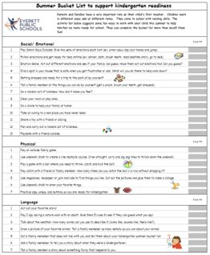


Summer Activity Kit
Kindergarten Readiness Guidelines​
Summer Bucket list to support Kindergarten readiness ​
“Kindergarten Here I Come” book
Bookmark (reading and math strategies)
Notes:
Families that attend a spring, building level, getting ready for kindergarten event will receive a Kindergarten Summer Kit.
Kindergarten Readiness Guidelines, Summer Bucket list, math calendar?, book, bookmark with reading and math strategies. Review with families the contents of summer support.
Our Early Learning Team developed a Kindergarten Readiness Summer Bucket list aligned to the Kindergarten Readiness document. ​
Parents and families have a very important role as their child's first teacher. Children learn in different ways and at different rates. They come to school with varying skills. The activity list below suggests some fun ways to work with your child this summer to help him/her be more ready for school. They can complete the bucket list more than once!!! Have fun! ​

Slide 28
Getting Ready for Kindergarten
Plan to attend Everett Ready
  Monday, August 18 to Thursday, August 21 (3 hours in the morning)
  www.everettsd.org/everettready
Develop a home and bedtime routine​
Help your child learn their personal information​ (first and last name)
Get supplies ready and labeled ​(listed on school’s website)
Visit the school playground over the summer​
Practice drop off and pick up procedures​
Notes:
​
Parents and families have a very important role as their child's first teacher. Children learn in different ways and at different rates. They come to school with varying skills. The activity list below suggests some fun ways to work with your child this summer to help him/her be more ready for school. They can complete the bucket list more than once!!! Have fun! ​

Slide 29
Kindergarten School Supplies
Students are asked to bring the following supplies at the start of school year:
​
Notes:
​optional for schools to add their supply list (referred to on the previous slide prompting families to check their school’s website

Slide 30

Additional Support
If you have concerns about your child’s development or readiness for kindergarten, please contact:​
Your School Principal​ (NAME?)
Special Services​ - 425-385-5250​

Slide 31




Communications
ParentSquare keeps you updated through an app, text, email, and voice messages. You will receive an email in August from ParentSquare to activate your account. We encourage you to also download the app. This is the best way to stay engaged with your student's teacher and school. This is how you will receive emergency messages, absences, school and district information, and more.
Social media is a great way to keep informed about school and district events and happenings. The district and schools have various social media accounts. Visit our social media directory on the website to find the ones you want to follow. (Departments/Communication/Social Media Directory)
Notes:
We are excited to have you join Everett Public Schools. Here are ways to stay connected and informed of the events, news, school announcements, etc.
.

Slide 32
PTA / Natural Leaders
Notes:
Optional slide – might be included if your PTA / Natural Leaders are present / involved in this event
This is an opportunity to inform families about these groups, purpose, how to join, … as well as volunteering
I

Slide 33


ECEAP – Early Learning Programs for your Younger Child
Early Childhood Education & Assistance Program (ECEAP) is a FREE preschool program serving 3 and 4 year old students and located at seven locations across EPS: Cedar Wood, Jackson, Hawthorne, Lowell, Madison, Silver Lake and Silver Firs Elementary Schools.
ECEAP supports student learning and the whole family through these services:
Preschool education
Family services
Health & nutrition services
www.everettsd.org/eceap
Notes:
Share with families the District preschool opportunities – Even if not offered at this site, inform families about ECEAP program for their 3 / 4 year old kids

Slide 34





Play & Learn – Early Learning Programs for your Younger Child
Play and Learn is a school-year program for children birth through 5 years and their parents or caregivers. Together they engage in play-based learning that enhances brain development and supports school readiness.
Play and learn is currently serving families Monday through Friday from 10:30 to 12:00 at Mill Creek City Hall North, Evergreen Branch of the Everett Public Library, Sequoia High School Gym and Lively Environmental Center.
Visit website www.everettsd.org/playandlearn for more information.
Notes:
Share with families this early learning opportunity in Everett Public Schools.

Slide 35
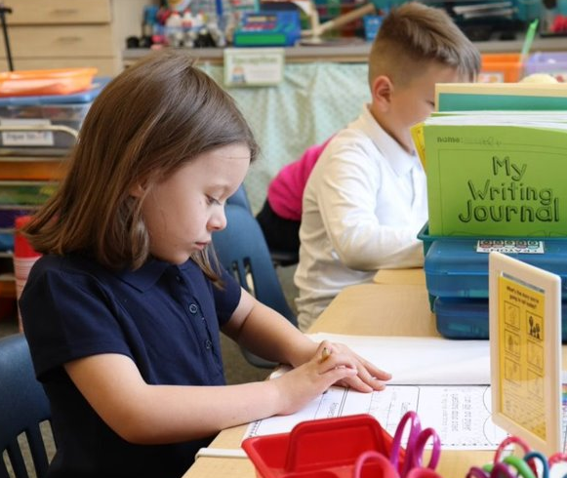

THANK
YOU!
.

