Slide 1

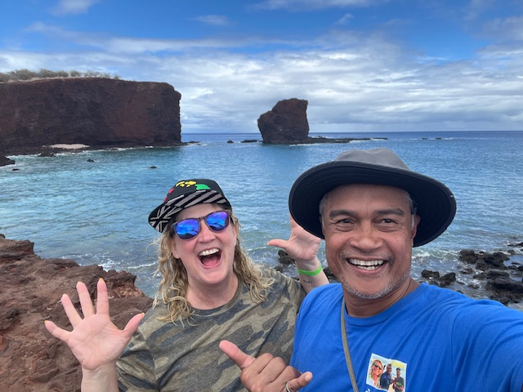

Slide 2
Working in Everett for the past 30 years as an elementary counselor has given me great pride. What an awesome place to support kids and families! With more and more on our plates, I wanted to remind you all to keep a healthy work/life balance. It is OK to say no, ask for help, set healthy boundaries, and question expectations. Doing these things have kept my passion for elementary counseling alive as well as kept me somewhat sane.
It has been a pleasure to work beside and sometimes with so many dedicated counselors. My next chapter will be filled with travel, reggae music, and ire vibes. With many great memories I say goodbye –
Rhonda

Slide 3

Counselor Training

Slide 4
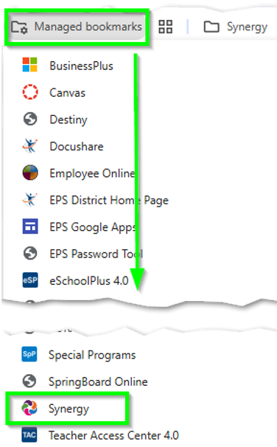
Accessing Synergy

Slide 5
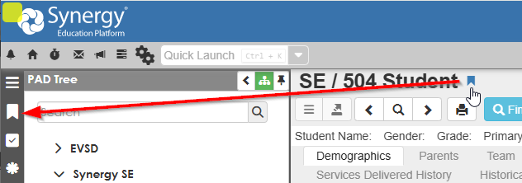
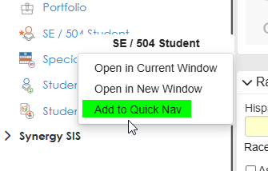
Bookmark a Screen

Slide 6
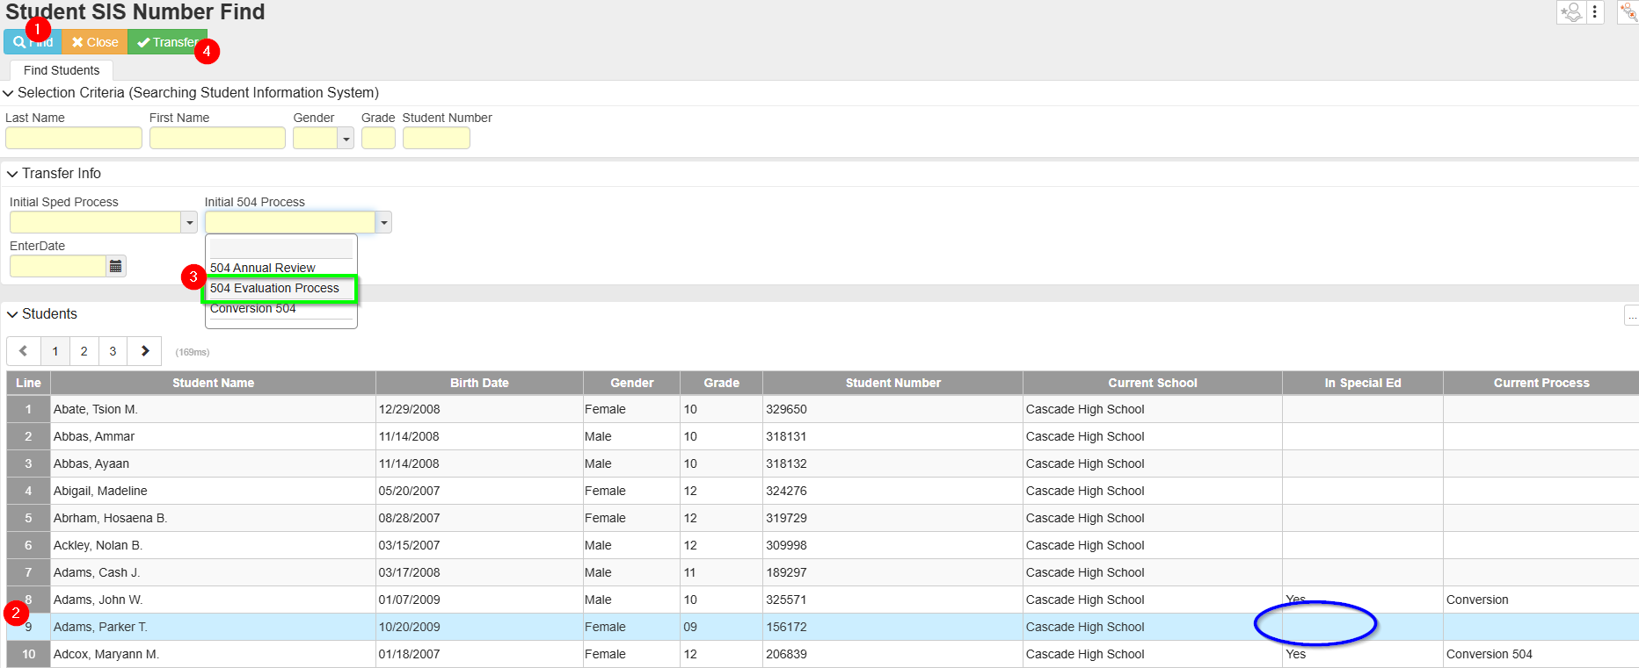
Adding a student to SE

Slide 7
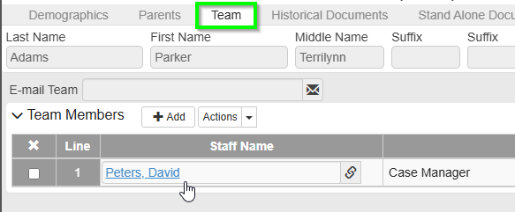
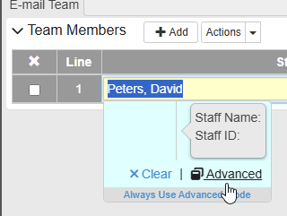
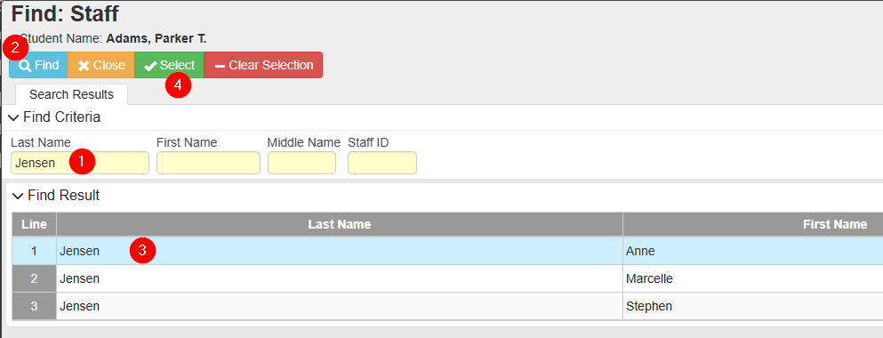
Case manager

Slide 8
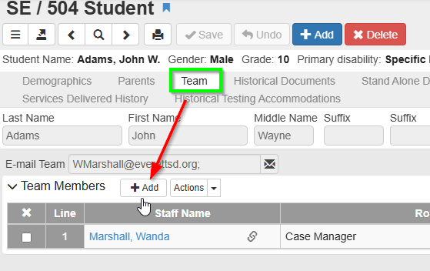
Add team member

Slide 9
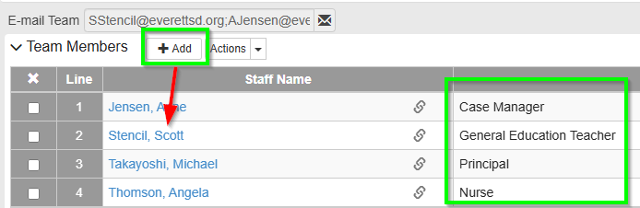
Team members

Slide 10
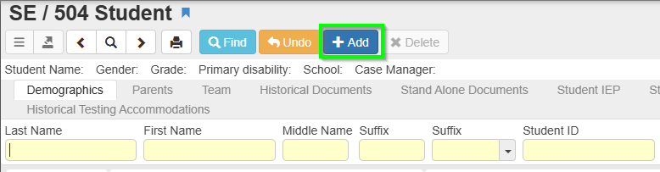
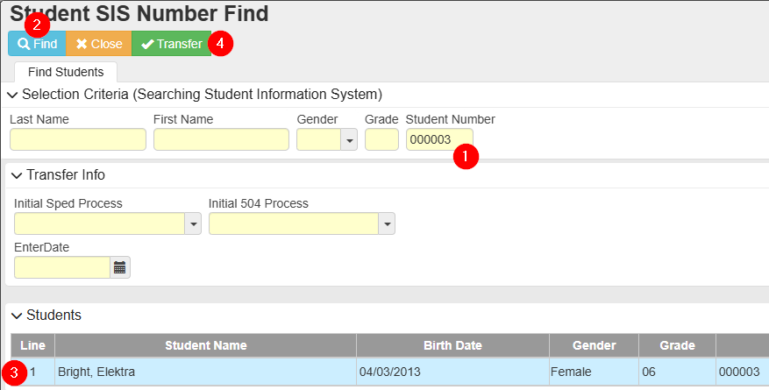
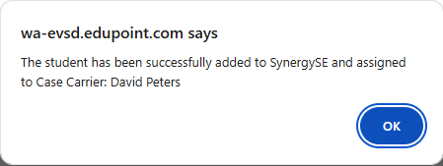
Adding a student to 504

Slide 11
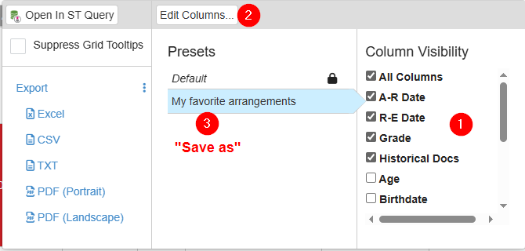
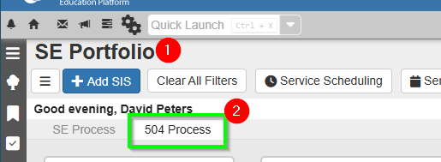
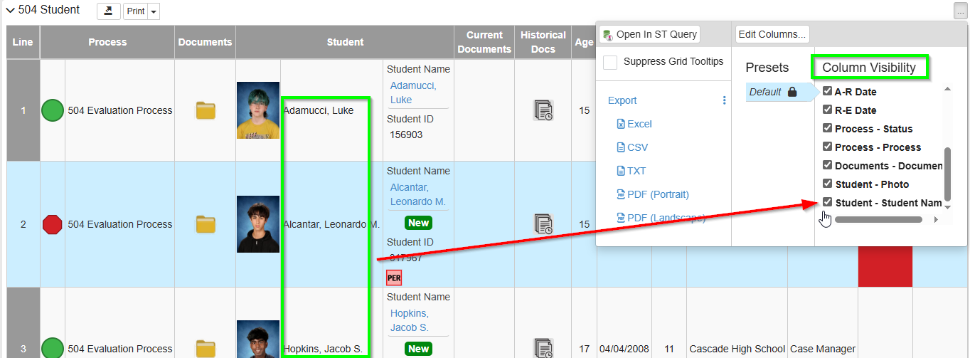
Adding from Portfolio

Slide 12
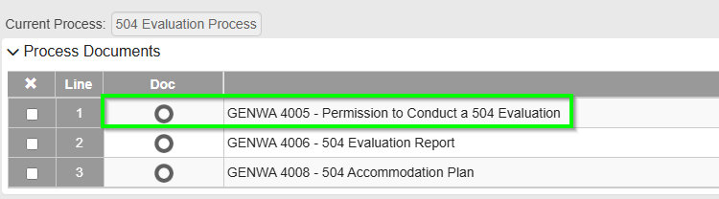
Consent Form

Slide 13
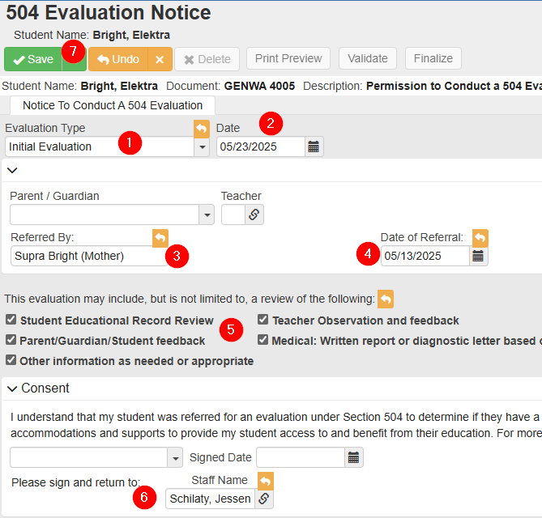
Consent Form

Slide 14
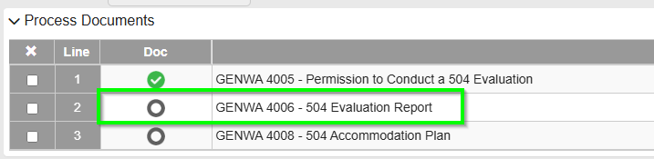
Evaluation Report

Slide 15
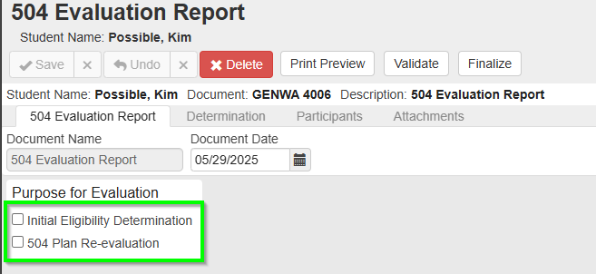
Eval Purpose

Slide 16
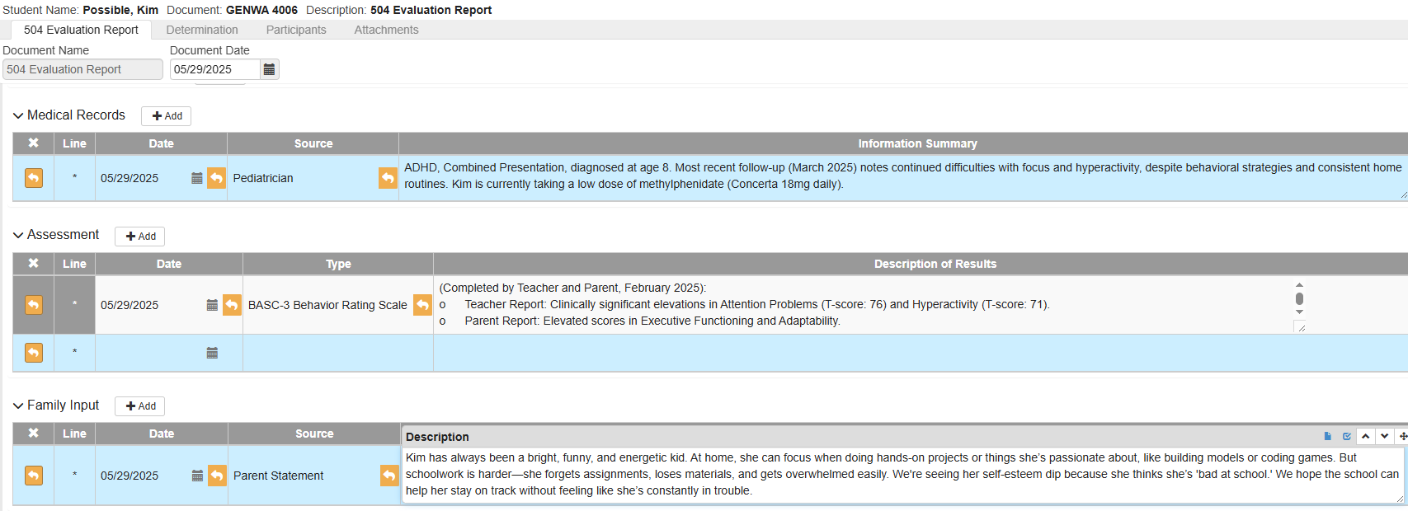
Evaluation Data

Slide 17
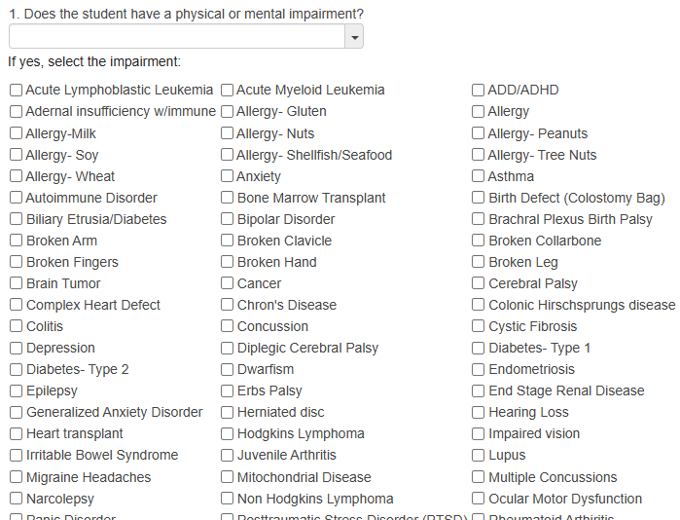
Question #1

Slide 18
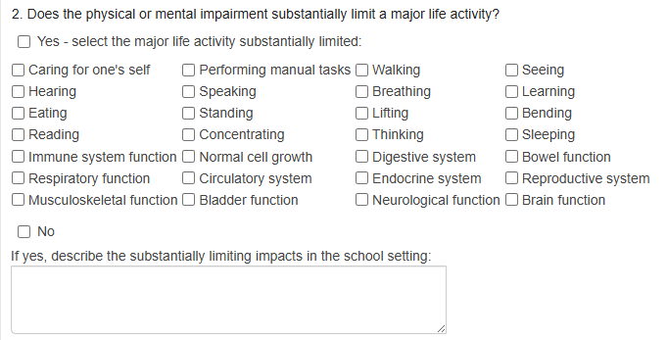
Question #2

Slide 19
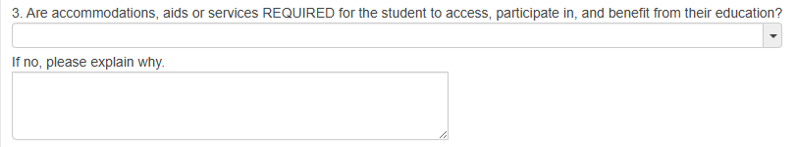
Question #3

Slide 20
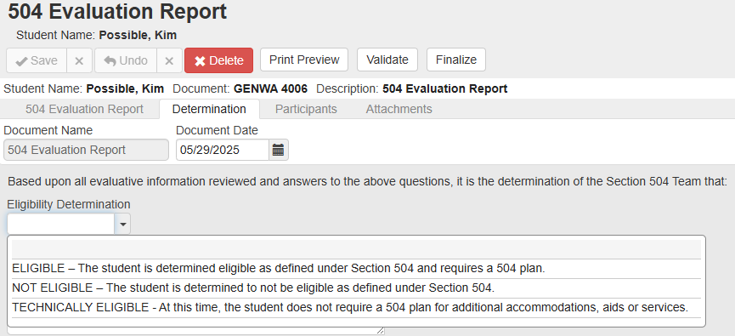
Determination

Slide 21
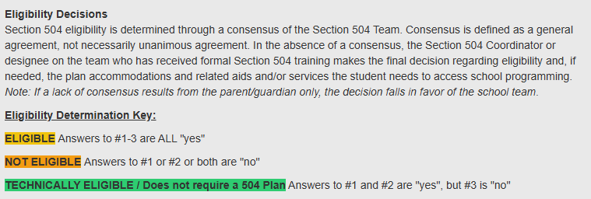
Determination

Slide 22
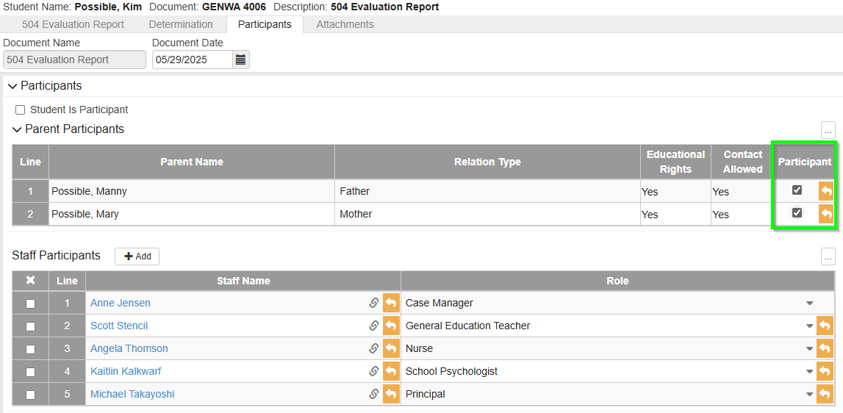
Participants

Slide 23
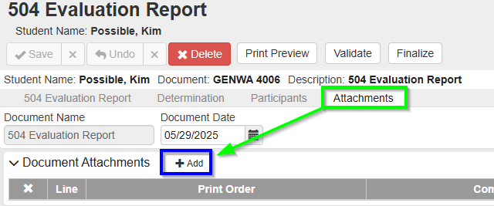
Attachments

Slide 24
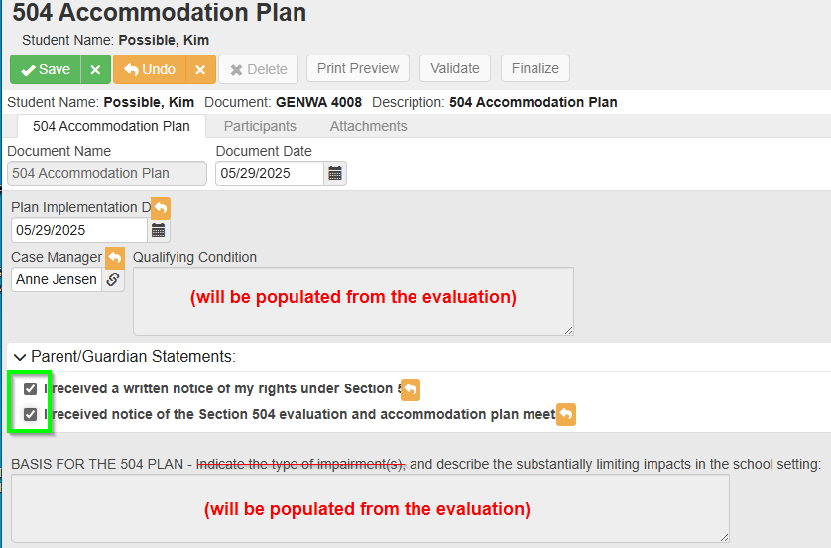
Accommodation Plan

Slide 25
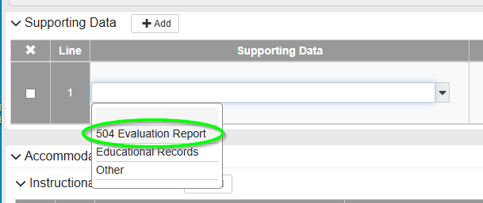
Accommodation Plan

Slide 26
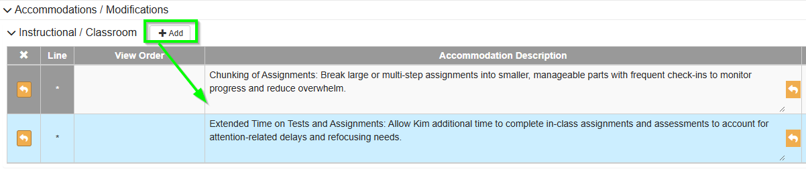
Accommodation Plan

Slide 27
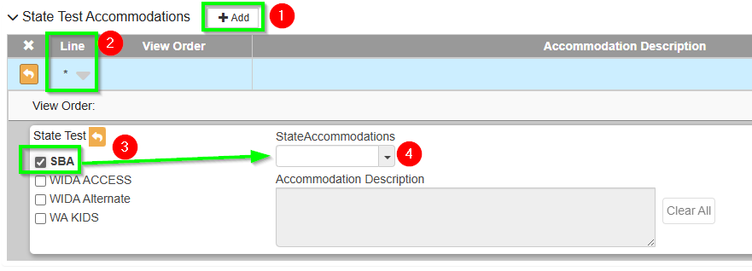
State Test Accommodations

Slide 28
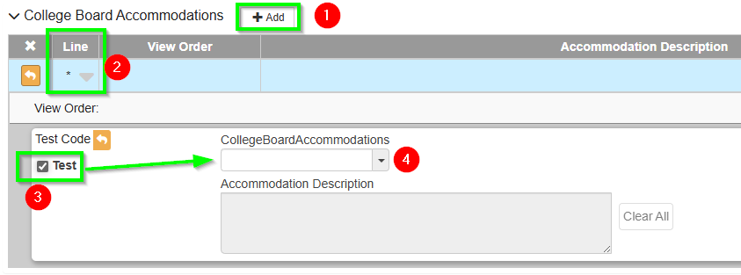
College Board Test Accommodations
(AP, SAT, PSAT, ACT)

Slide 29
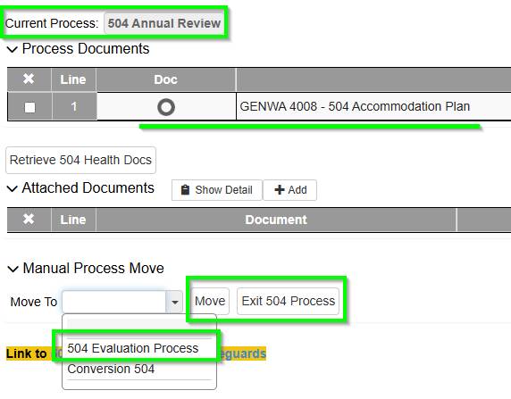
Current Process

Slide 30
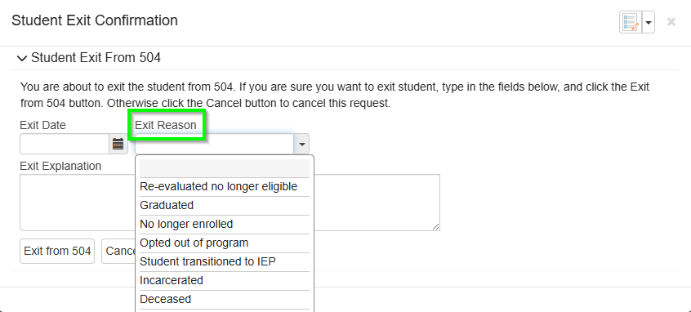
Exiting a 504

Slide 31
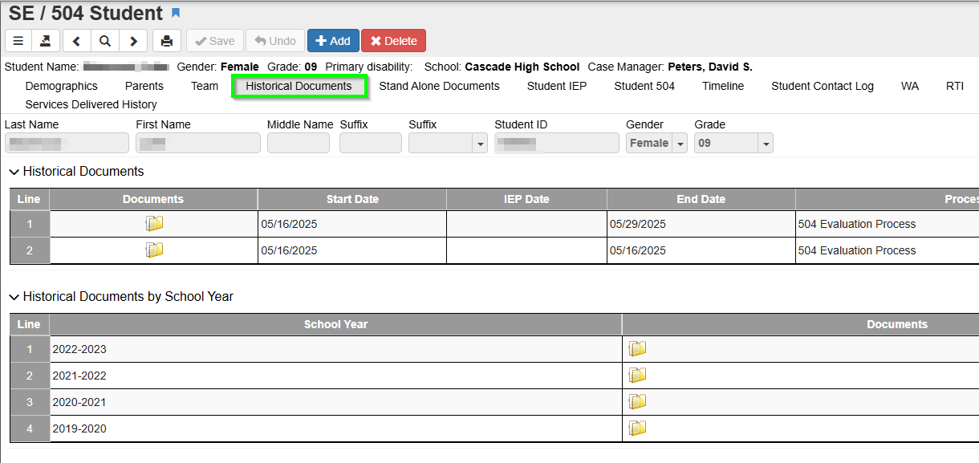
Historical Documents

Slide 32
xxxx

