Slide 1


Greetings
Everett Public School Counselors
Everett Community College does not discriminate based on, but not limited to, race, color, national origin, citizenship, ethnicity, language, culture, age, sex, gender identity or expression, sexual orientation, pregnancy or parental status, marital status, actual or perceived disability, use of service animal, economic status, military or veteran status, spirituality or religion, or genetic information in its programs, activities, or employment. Contact the following people with inquiries or complaints regarding discrimination, Title IX compliance, or Americans with Disabilities Act compliance: Equal Opportunity Director: EqualOpportunity@everettcc.edu, 425-388-9271; ADA Coordinator: ADAcoordinator@everettcc.edu, 425-388-9232; Title IX Coordinator: TitleIXCoordinator@everettcc.edu, 425-388-9271. All offices are located in Olympus Hall 111, 2000 Tower St. Everett, WA 98201. For more information, visit the Equal Opportunity and Title IX website: EverettCC.edu/EqualOpportunity
Notes:
Next Slide: Introduction – introduce yourself!

Slide 2
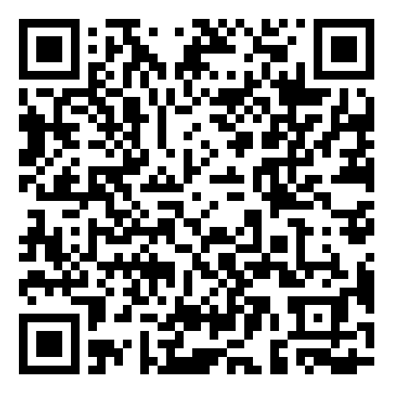
Russell Dorsey
Outreach & Recruitment
Connect with us to schedule a:
College and Career Fairs
Career Center Visits
Class Room Visits
EvCC Campus Visits
The Outreach team is flexible and we will tailor our visits to meet your needs. Available for either in-person or virtual info sessions.
outreach@everettcc.edu
Notes:
Introduction! Introduce yourself and the upcoming video slide:
Next Slide: video: Success in the New Economy

Slide 3

Admissions | Highly Accessible
Open Access
%100 Acceptance Rate
No Entrance Exams
No Application Fee
High School Completion/GED Programs
Course Placement
High School Transcript
SAT/PSAT/ACT (Standardized Test Results)
Directed Self Placement
Accuplacer Assessment
Notes:
Next Slide: Answer a Question; Win a Prize! (Big Prize)
Question: What year was EvCC established?
Answer: 1941

Slide 4









ACADEMIC PATHWAYS
Manufacturing
& Aerospace
Arts
Business
Exploratory
Healthcare
Humanities
Social Science, Education,
& Public Safety
STEM
Transitional Studies
www.EverettCC.edu/Pathways
Notes:
Everett Community College’s pathways are designed to help you succeed.
Pathways are groups of related degrees and certificates. Each pathway has a team of academic advisors who will work with you to create a plan for your education.
Students with a clear path are more likely to achieve their academic goals. Starting Fall 2018, all new students will select a pathway before registering for classes.
Each pathway has a support team who will work with you throughout your educational journey at EvCC.
Not sure where to begin?
Start with the Exploratory pathway. This pathway is designed to help you clarify your interests and life goals during your first quarter. If you are uncertain about which pathway to choose, starting here will give you one quarter to explore your options. You will choose a suitable pathway before you move into your second quarter.
Next Slide: Mechatronics Video

Slide 5
Pathway Considerations
Transfer Degree Options
Pathways of Degrees that prepare
for transferring to a university.
Professional / Technical Options
Pathways of short-term certificates or degree training programs
that lead directly into the workforce.

Slide 6
Pathway Considerations
Transfer Degree Options
Associate in Arts and Sciences - Direct Transfer Agreement: The designated transfer degree, accepted by many institutions in Washington and Oregon.
Associate of Science: Designed for transfer to selected Washington universities in science majors
Associate in Business - DTA: Designed for transfer to Washington institutions for business and accounting majors
Associate in Applied Science - Transfer: Computer Information Systems
Associate in Technical Arts: Offered in a wide variety of professional, technical and occupational fields
Associate in Fine Arts: Interdisciplinary program including visual, studio and performing arts
Associate in General Studies: Combines a variety of courses selected by the student
Bachelor of Applied Science - Accounting
For a list of articulation/transfer agreements with other colleges and universities refer to our Articulation Guide.

Slide 7

Pathway Considerations
Professional / Technical Options
Aerospace Composite Technician
Aerospace Design CATIA V5
Aerospace Fabrication and Welding
Aviation Maintenance Technology
Manufacturing Pre-Employment
Mechatronics
Precision Machining
Engineering Technology
Welding and Fabrication
Manufacturing
& Aerospace

Slide 8

Pathway Considerations
Professional / Technical Options
Emergency Medical Technician
Medical Assistant
Medical Spanish Interpreter
Nursing
Phlebotomy
Criminal Justice
Fire Science
Project Management
Healthcare
&
Service Industry

Slide 9
Pathway Considerations
Professional / Technical Options
Arts
Graphic & Web Design
Education
Early Childhood Education
Information Technology
Information Technology Program
Computer Support Specialist
Systems Specialist
Engineering Technology
Cyber Security

Slide 10

Pathway Considerations
Professional / Technical Options
Accounting
Business
  Marketing
  Administration
Business Technology
Cosmetology
Healthcare Risk Management
Medical Administrative Support
Medical Billing Specialist
Medical Coding
​Medical Receptionist
Business
&
Applied Technology

Slide 11

COURSE PLACEMENT
Most new students are required to get English and math placement before registering for classes. Proper placement ensures you are in the right classes to be successful.
Placement is how we find out your current level of reading, writing and math knowledge and skills. This information helps us find the best classes for you.
Many of our classes will have a math and/or English prerequisite.
Visit our Course Placement page to learn about the different placement options and see which option is the best for you. If you have any questions about course placement, please email placement@everettcc.edu.

Slide 12
PLACEMENT FORM
IT’S FREE & YOU CAN EASILY SUBMIT ONLINE
GREAT OPTION IF:
You attended a Washington State High School in the last 5 years
-OR-
You have completed classes or a placement test at another college
-OR-
You have Smarter Balanced (SBA) or AP Exam scores
-OR-
You took the PSAT, SAT, or ACT test

Slide 13
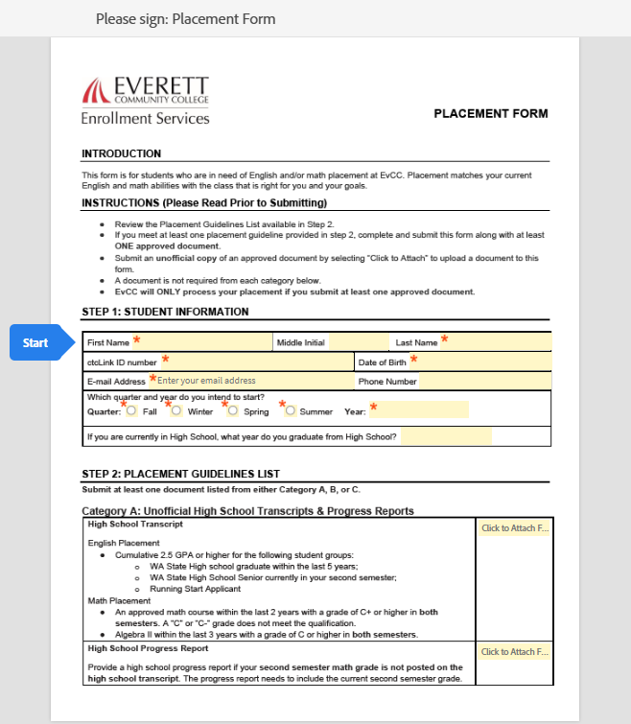
PLACEMENT FORM

Slide 14
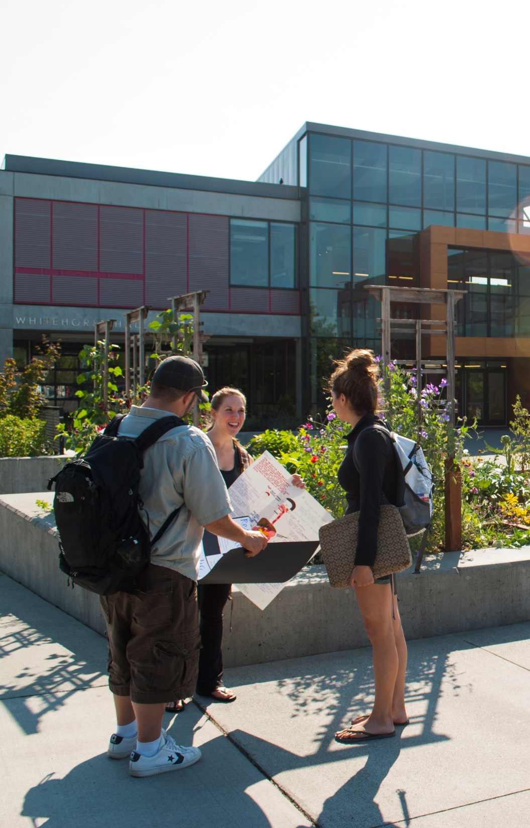
DIRECTED SELF PLACEMENT
ENGLISH ASSESSMENT
THINGS TO KNOW ABOUT THE DIRECTED SELF PLACEMENT
Directed Self Placement helps assess confidence in reading, writing, and revision.
Students self assess readiness to study English
It usually takes students about one hour to complete. However, it is not timed
The Holistic Assessment rubrik helps to select most successful English Placement
You cannot fail!

Slide 15
ACCUPLACER
MATH ASSESSMENT
THINGS TO KNOW ABOUT THE ACCUPLACER:
It costs $33.70
We have three testing options available.
  Accuplacer via Zoom
  Accuplacer via Drop-In In-Person
  Accuplacer via Pre-paid In-Person appointments
It usually takes students about 1 ½ - 2 hours to complete. However, it is not timed, so make sure to plan for what you think you will need
You cannot fail! The Accuplacer is just a tool to help you figure out which classes are the best match for your skill set
You will get your results immediately

Slide 16



Tuition & Fees | First Year
(Based on in-state tuition rates; 2024-2025 Academic Year)
$4,725 + No Enrollment Fee + No Application Fee | $14,263 + $347 Enrollment Fee + $80 Application Fee | $13,372 + $200 Enrollment Fee + $50 Application Fee | $54,285 + $500 Enrollment “Deposit” + $55 Application Fee

Slide 17

Ways to Pay for College
Financial Aid
2025-2026 Academic Year Priority Processing Dates:
Fall 2025 June 6, 2025
Winter 2026 November 7th, 2025
Spring 2026 February 13th, 2026
Benefits of Meeting the Priority Processing Date:
Tuition Postponement Hold: If you meet the priority processing date, you may be eligible for a tuition postponement hold, allowing you to remain registered for your classes while your financial aid is processed.

Slide 18
Ways to Pay for College
What Happens if You Miss the Priority Date?
Don’t worry—you can still apply for financial aid! However:
Late Files: Applications completed after the priority date may not be reviewed until after the quarter begins.
Planning Ahead: Be prepared to cover your educational expenses upfront while your aid is being reviewed.
Retroactive Aid: If you qualify for grant aid, it will be applied retroactively for the quarter(s) you were eligible.

Slide 19
Ways to Pay for College
There are many other ways to help fund your education! Some examples include:
  Scholarships
  Veterans’ Funding
  Workforce Funding
  Payment Plan
  Tuition Reimbursement
Learn more at:
EverettCC.edu/WaysToPay

Slide 20
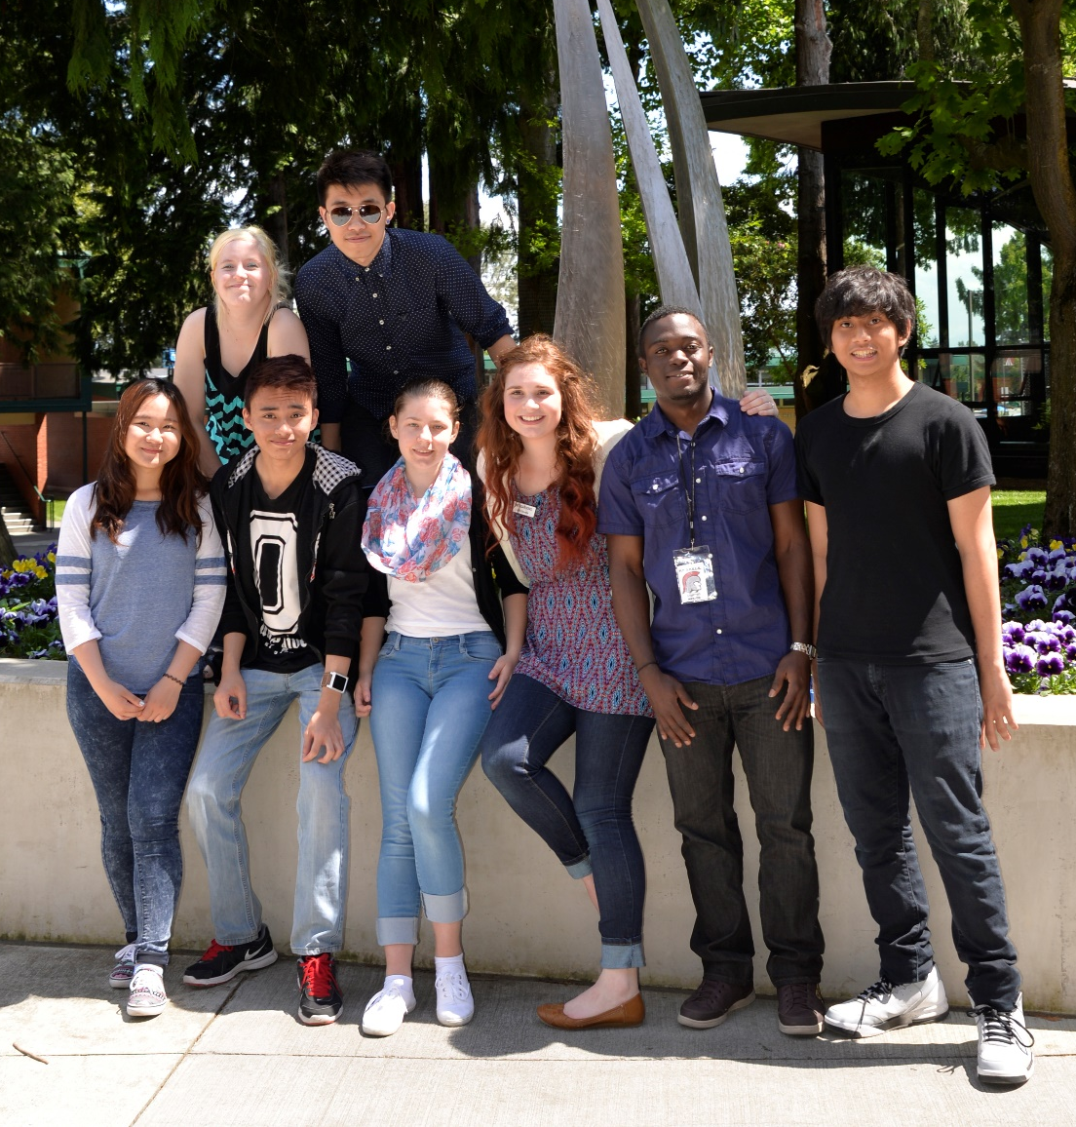
Student LIFE
16,500+
Students enrolled in EvCC, part-time and full time.
50+
Student clubs, leadership organizations, and student government.
FREE
Access to Chromebooks and WiFi Hotspots for eligible students
Virtual
Access to all Student Services
Notes:
At EvCC, we have it all! Amazing academic programs, a plethora of student services, helpful staff, sports, clubs, etc.
Clubs vary by interests, whether cultural, academic or hobby related (swing dance, travel abroad, society of physicists, Hawaiian club)
Next Slide: Prize Question

Slide 21
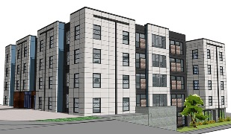
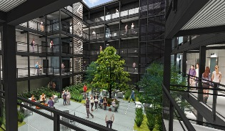
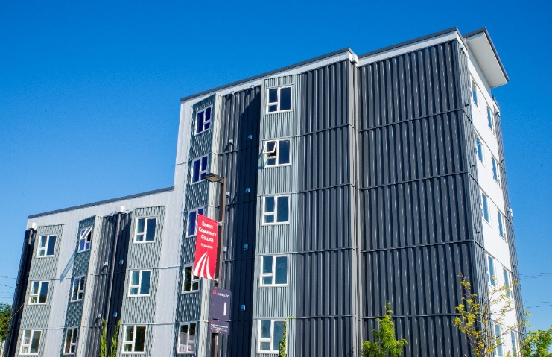
Student Housing
Cedar Hall & Mountain View
Open year round (including breaks and holidays)
One payment covers: water, electricity, garbage, wireless internet, and a fully furnished room
Exclusive activities for on-campus residents (including evenings, weekends, and holidays)
Student Resident Assistants throughout each hall who are there to help, share valuable information, and create a sense of community

Slide 22
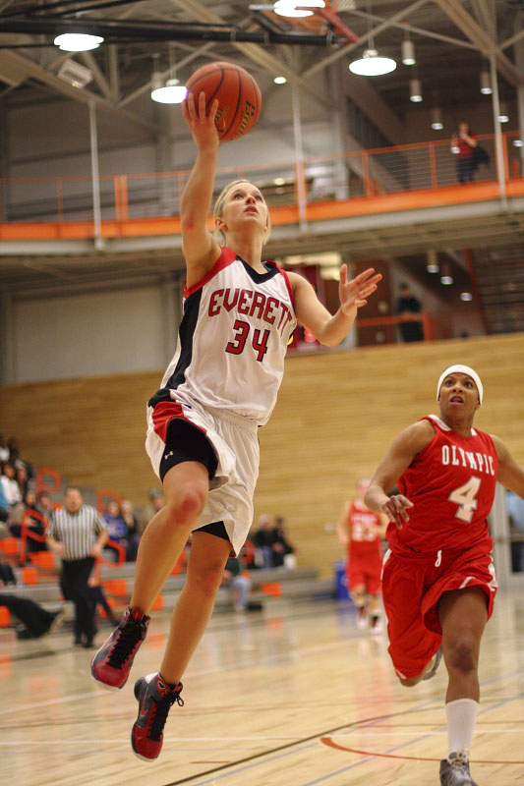
Trojan Athletics
More than 170 student athletes compete for Everett Community College across 11 different men’s and women’s varsity sport programs.
Varsity Teams:
  Baseball
  Basketball
  Cross County
  Soccer
  Softball
  Track & Field
  Volleyball
EverettCC.edu/Athletics

Slide 23
Student Resources
Technology Services (Tech Hub)
Pathway Coaches
Tutoring Center
Writing Center
Diversity & Equity Center
Advising Center
Counseling and Student Success
EvCC Bookstore
Enrollment Services
Financial Aid
Learn more at: everettcc.edu/students/online/

Slide 24
Center for Disability Services
Everett Community College is committed to providing equal opportunity for students with disabilities.
By providing reasonable accommodations based on an individual's need for services, CDS assists students in pursuing their goals at Everett Community College. Many of these accommodations are to assist students with their academic programs.
Students may be eligible for accommodations if they have a physical, mental, psychological or sensory barrier that limits one or more major life activities.

Slide 25
TRiO Student Support Services
TRiO empowers first-generation, low-income students, and students with disabilities to navigate opportunities and barriers in order to author their authentic dreams. TRiO cultivates personal growth, academic progress, and community development through a social justice lens.
TRiO offers the following free services to participants:
  Personalized one-on-one academic planning and goal setting
  Transfer advising
  Major choice and career advising
  Tutoring for specified courses
  Visits to local 4-year colleges and universities
  Scholarship and financial aid resources
  Cultural and Educational Events

Slide 26
MESA
(Math, Engineering, Science Achievement)
The MESA Program at EvCC provides resources and extra support to students who want to transfer to four‐year colleges or universities in pursuit of STEM based degrees.
The goal of MESA is to increase the number of higher education degrees in STEM acknowledging the gaps still seen with historically underrepresented community college students. Undocumented students are welcome to apply.
To join, students must be pursuing their first bachelor’s degree. The MESA Program provides a variety of services such as the use of the MESA center for studying, borrowing textbooks, academic and professional development workshops, university trips, and field trips.
MESA Student Support Services
  Transfer planning
  Academic excellence workshops
  Industry field trips to local companies
  Dedicated study space

Slide 27
The Everett University Center
Universities Include:
  Eastern Washington University
  UW - Bothell
  WSU – Everett
  Western Washington University
First, earn your 2-year associates degree at EvCC.
Next, earn your bachelors or even a masters degree at 1 of 4 universities at the Everett University Center!

Slide 28
Tuition & Fees | First Year
(Based on 15 credits per quarter; 2022-2023 Academic Year)
$4,600 + No Enrollment Fee + No Application Fee | $12,076 + $347 Enrollment Fee + $80 Application Fee | $12,416 + $200 Enrollment Fee + $50 Application Fee | $51,324 + $500 Enrollment “Deposit” + $55 Application Fee

Slide 29
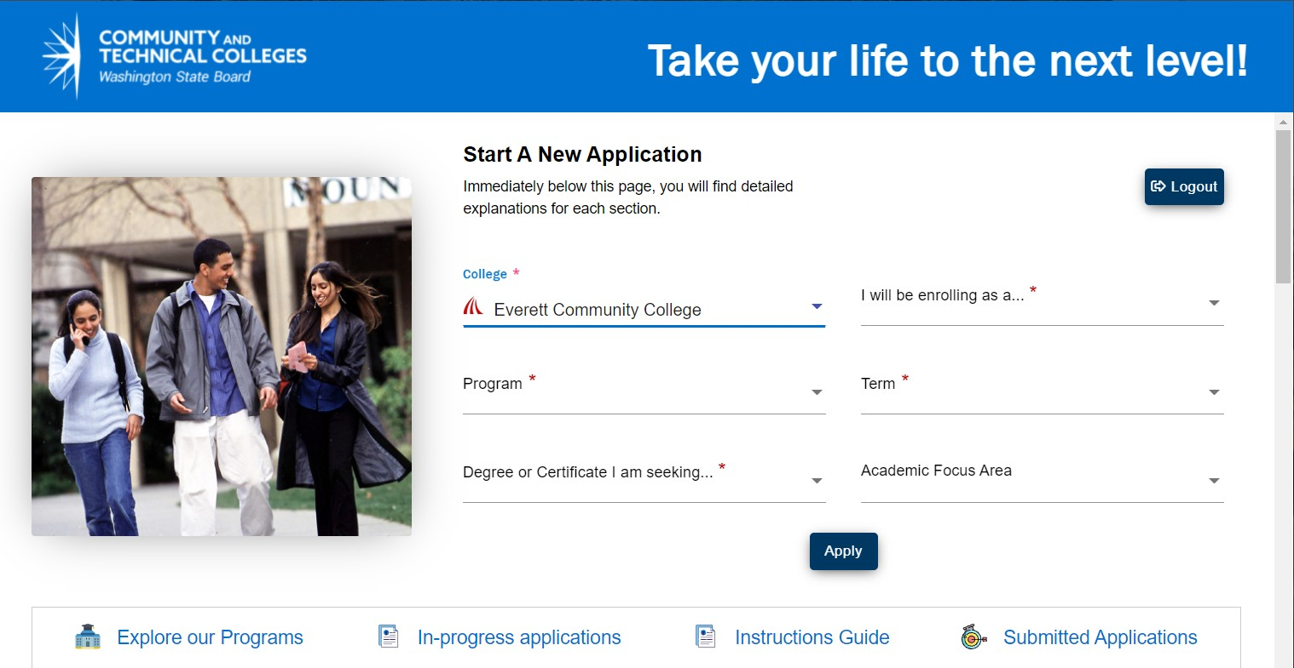
Steps for Applying
Explore the Educational Pathways to find the best fit for you.
Create a User Name and Password for the Online Application Account Portal (OOAP).
Begin the OOAP Application by selecting intended start date, Program of Interest, and Degree or Certificate of choice.
Complete the OOAP by filling in the needed personal information.
Acceptance letters are emailed to applicants in 3-5 business day. Acceptance Letters include the Student’s ctcLink ID (Student ID) and steps to activate their ctcLink Account.

Slide 30

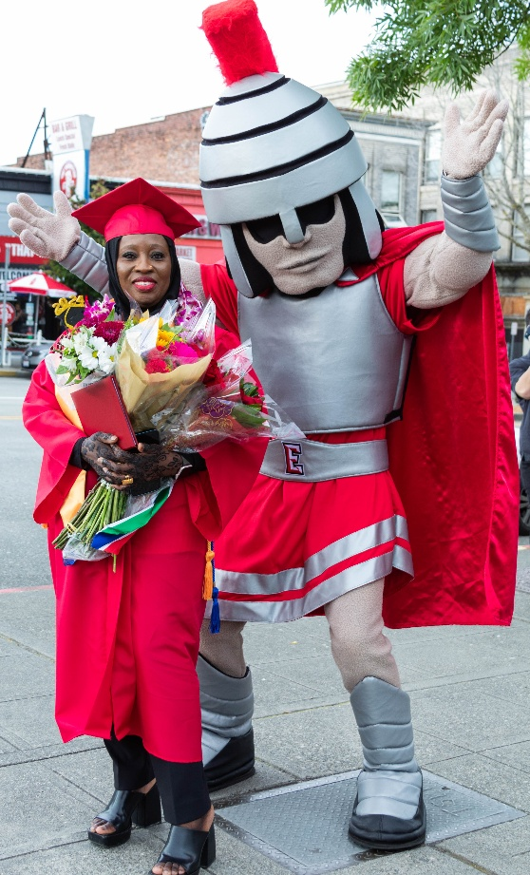

Steps after Applying
Orientation is recommended
Determine Class Placement
  Placement Form, Directed Self, or Accuplacer
Meet with Entry Advising
  Drop-in appointments | In-Person & Virtual
Register for Classes…
Graduate!!!

Slide 31
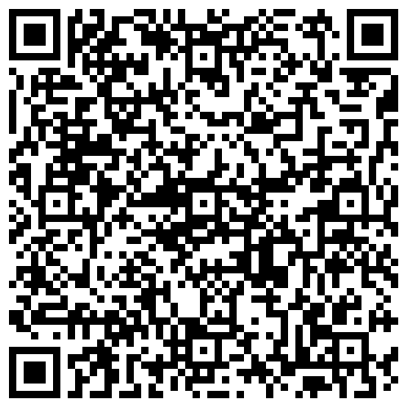
Questions?
Everett Community College does not discriminate based on, but not limited to, race, color, national origin, citizenship, ethnicity, language, culture, age, sex, gender identity or expression, sexual orientation, pregnancy or parental status, marital status, actual or perceived disability, use of service animal, economic status, military or veteran status, spirituality or religion, or genetic information.
Notes:
Next Slide: Connect with us!

Slide 32
Connect with us to schedule a:
College and Career Fairs
Career Center Visits
Class Room Visits
EvCC Campus Visits
The Outreach team is flexible and we will tailor our visits to meet your needs. Available for either in-person or virtual info sessions.
outreach@everettcc.edu
Everett Community College does not discriminate based on, but not limited to, race, color, national origin, citizenship, ethnicity, language, culture, age, sex, gender identity or expression, sexual orientation, pregnancy or parental status, marital status, actual or perceived disability, use of service animal, economic status, military or veteran status, spirituality or religion, or genetic information.
Notes:
Next Slide: Connect with us!

