Slide 1


Student and Staff Supports Overview/Review
STAFF EXTENSION – Tuesday, January 21st, 2025

Slide 2
AGENDA
BEHAVIORAL SUPPORTS
Attendance
Discipline – Cell Phones
ACADEMIC & SOCIAL EMOTIONAL SUPPORTS
Academic Intervention & Graduation
Student Support Advocate
RULER
MTSS – PEER SUPPORTS
Peer Tutoring

Slide 3

BEHAVIORAL SUPPORTS
Kristina Monten
&
Erik Heinz

Slide 4
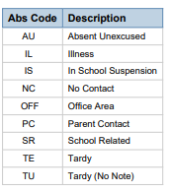
JHS Attendance/ENGAGEMENT Matters!
OSPI/District Policies (BECCA)
JHS Policies/Absence Codes
Standard Practice
Targeted Interventions/Supports

Slide 5

Attendance Process
School must communicate unexcused absences to students and parent/guardians; calls go out daily
Letter sent for BECCA Meeting when three days of unexcused absences are reached
Next: When seven or more unexcused absences in a month or 15 unexcused absences in a school year are reached a letter is sent
School is then required to file a petition with juvenile court

Slide 6

Root Causes & Interventions for Absences / OSPI Website
OSPI believes that educators have a great opportunity to get curious about why students aren’t attending, to provide effective and tailored interventions that address the root cause.
Chronic absenteeism is a signal to educators and parents that a student may be experiencing barriers to attending or engaging in school. These underlying barriers or root causes must be understood to effectively support the student and family to attend and engage.
The root cause of student absences can come from one or several of these contexts:
  School (e.g. school environment does not feel welcoming)
  Classroom (e.g. curriculum does not feel relevant)
  Community (e.g. unsafe walking routes)
  Family (e.g. unreliable transportation)
  Student (e.g. motivation, anxiety)
Attendance Works offers a worksheet to use with individual students on Understanding the Root Causes of Student Absences, that can help them to understand the reasons that a student may miss school.

Slide 7
For questions about Attendance Support
Admin Support | Kristina R. Monten 425-385-7020 kmonten@everettsd.org
Counselor Alphas
A—BE ..... Rebecca Medendorp rmedendorp@everettsd.org
BF—E ...... Jonathan Gerig jgerig@everettsd.org
F-I ....... Alfred Cain acain@everettsd.org
J—L ....... Sarah Williams swilliams@everettsd.org
M-PE ...... Paul Turner pturner@everettsd.org
PH-ST .... John Lerner jlerner@everettsd.org
SU—Z ..... Leiann Gregg lgregg@everettsd.org
Support Staff
Graduation Success Coordinator Janet Britt jbritt@everettsd.org
*ML Graduation Success Coordinator Maria Rey mreyrivera@everettsd.org
*ML Graduation Success Coordinator Mariela Hernandez mhernandezbartolomei@everettsd.org
Special Services Success Coordinator Holly Bryan hbryan@everettsd.org
*Student Support Advocate Claudia Childers cchilders@everettsd.org
Intervention Specialist Michael Keiss mkeiss@everettsd.org
*Spanish Speaking - Hablo Español
SUPPORTS
Parent Meetings
BECCA Meetings
WARNs Assessment
BECCA Attendance Packet
CEB (Community Engagement Board) Meeting
Court Petitions
Referrals
Interventions
Supports
Partnerships
Coaches/Advisors
JHS Staff
HOW CAN WE HELP

Slide 8
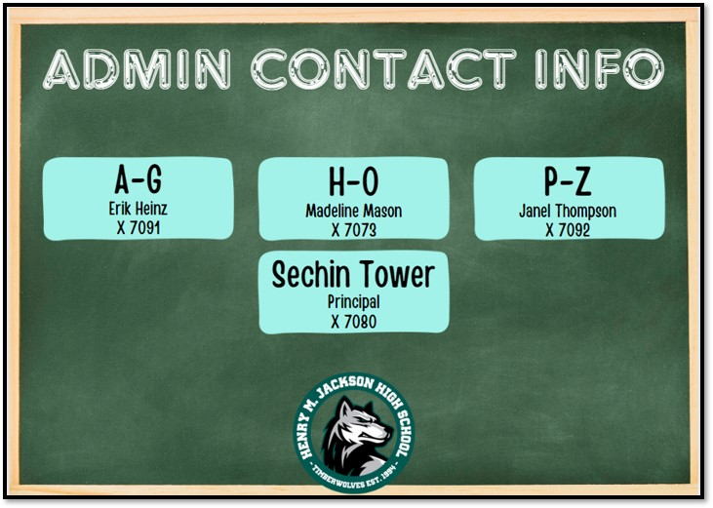

Discipline/Referrals
*For general discipline – email admin alpha with incident, student name, and any previous action taken (parent contact, etc.)
  Admin will follow up with you, sometimes include admin support (Kristina, Mason Siddick), Lori Wirtz, counselor and any other relevant stakeholders.
*For attendance, email admin alpha, counselor and Kristina
*For immediate assistance, please call main office (x7000) or Admin for admin or security support

Slide 9

Cell Phones
1st Infraction: Warning, phone put away, reminder of student expectations.
2nd Infraction: Cell phone will be placed in a designated area chosen by the teacher for the remainder of the class period; teacher will email home and administrator to document 2nd offense.
3rd Infraction: Phone will be confiscated and taken down to the office, where student can pick up at the end of the day. Teacher will contact home and administrator (to document offense). Admin conference with student required.
4th Infraction: Phone will be confiscated and taken down to office where parent must pick up. Teacher will write a referral to administrator who will contact home and document offense. Behavior contract will be written for student and documented.
5th Infraction: Repeat of Step 4 and student will be assigned lunch detention(s).
6th Infraction: Repeat of Step 5 (PED misuse/disruption is a Type One offense where classroom exclusion is not allowed. I cannot find a step above that that would allow for classroom exclusion/ISS/STS).
When contacting admin on any number of infractions, please include Jen Larson, Lori Wirtz, and either Kristina or Mason. This is to ensure that we document accordingly in eSchools

Slide 10

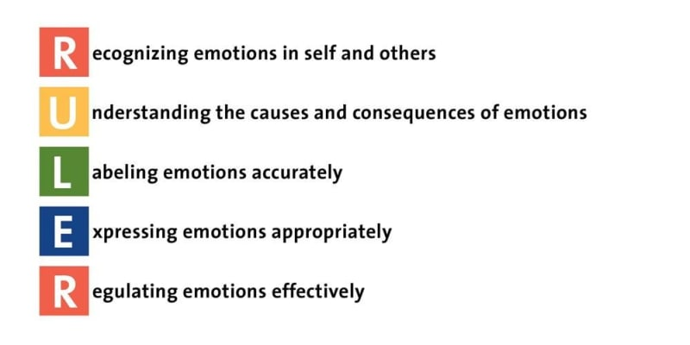
ACADEMIC & SOCIAL EMOTIONAL SUPPORTS
Janet Britt, Claudia Childers, and Ruler team (Travis birse & kyle Pihl)

Slide 11

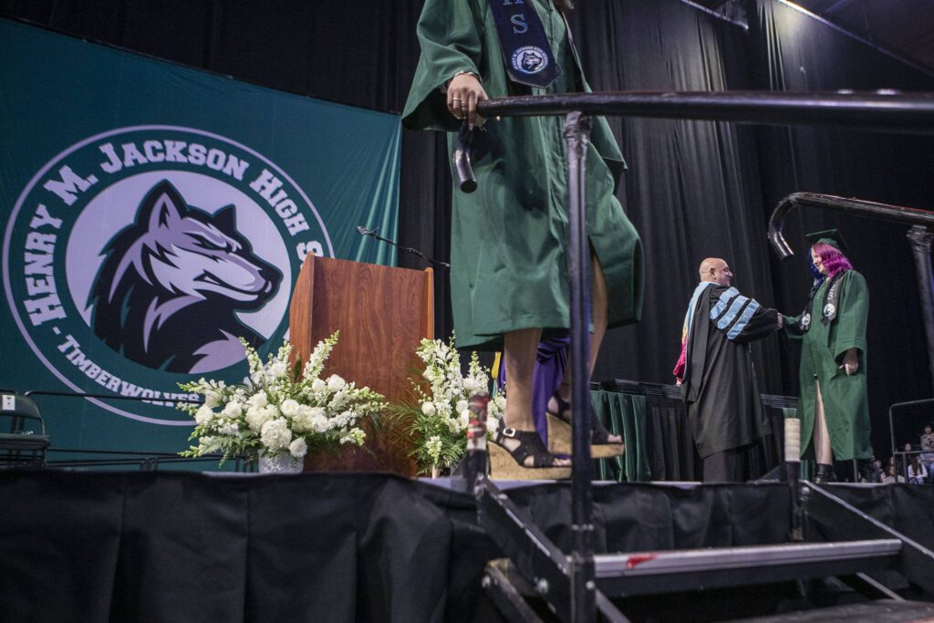
ACADEMIC INTERVENTION & GRADUATION
OSPI Data for School Year 2024​
% of students graduated within 4 Years​
Washington State: 82.8​
Everett School District: 95.2​
JHS: 98.3​
CHS: 94.6​
EHS: 93.5​
Random Other Schools​
West Seattle High School: 90.0​
Ellensburg High School: 89.8​
Pullman High School: 93.3​
Port Townsend High School: 88.2
Graduation Requirements​
Subject Area Credits​
High School Beyond Plan​
Pathway​
​
Academic Interventions​
Classroom & Instructor Supports​
Family Support/Resources/Awareness​
School-Provided Opportunities & Supports

Slide 12

School Provided Opportunities & Supports
High School Credit in Middle School​
Planning and Outreach​
Tutoring / Homework Help / External Resources​
One-on-One Support for Grad Tasks / Critical Assignments ​
Personal Coaching​
Summer School Referrals ​
ALE Referrals​
Credit Recovery Opportunities​
Competency Credit Opportunities​
Assessment Credit Opportunities

Slide 13

Student Support Advocate
Claudia Childers ext. 7150
My office is located in the counseling office
5 SSA's in District
  2 middle schools ( Evergreen & North)
  3 high schools ( JHS, EHS and CHS)
KIT/McKinney BPP
Resources
Did you know?
All students are welcome to meet with me for any reason (no scheduled appointment needed)
Referrals : ALL Staff , including KIT, and parents
A student can also self-refer
  Collaboration
Mental health/emotional support/trusted adult
Frequently encourage students to seek out counselor, complete homework, and go to class
CONTRACT: “Within the Multi-Tiered System of Support (MTSS) structure, Student Support Advocates operate primarily at the Tier 2 and Tier 3 levels of support.”
MTSS: Tier 2 is small group, standardized interventions that target academic, social, emotional, and behavioral needs using validated programs to support students identified as at-risk. Tier 3 is intensive intervention that is intensified and individualized based on student need.

Slide 14


Slide 15
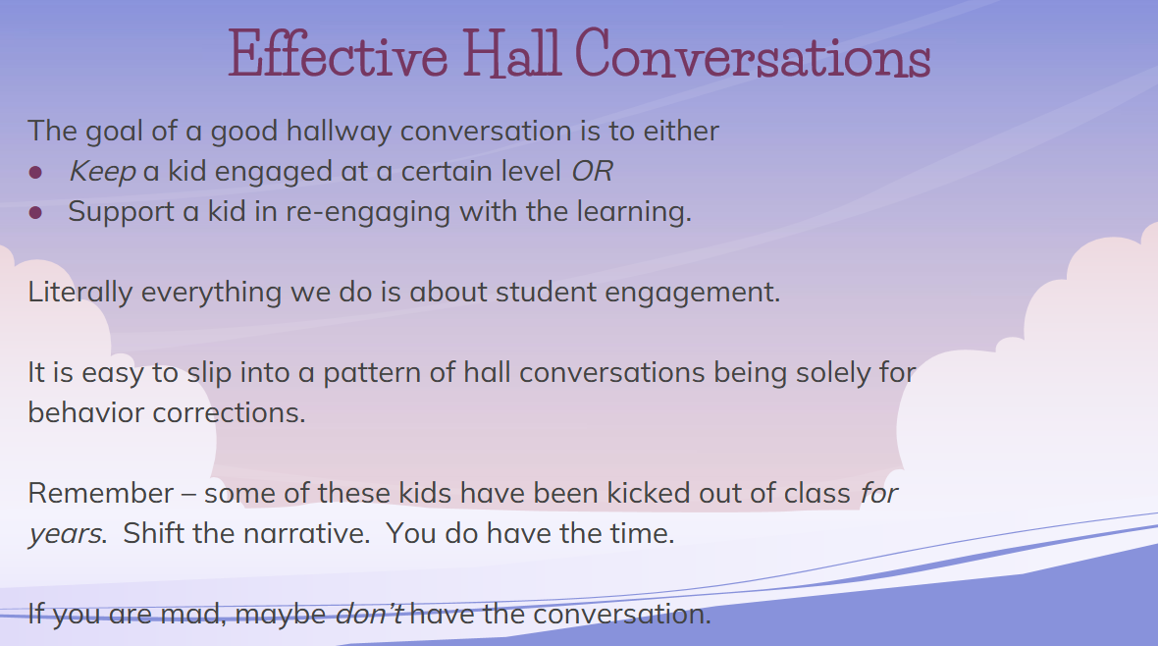

Slide 16
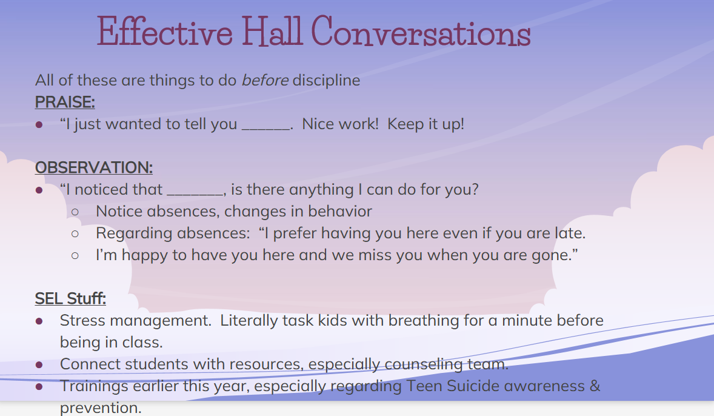

Slide 17

MTSS Next Steps – PEER SUPPORT
JANEL THOMPSON & THE MTSS TEAM

Slide 18

Empowering Students Through Peer Mediation
What is Peer Mediation?
- A conflict resolution program where trained students help peers and teachers address challenges and misunderstandings.
Why Peer Mediation?
- Promotes communication, empathy, and problem-solving skills.
- Provides a platform for student voice.
Our Vision:
- Reduce conflicts and foster a positive school culture.
How You Can Support:
- Encourage student participation and promote awareness.

Slide 19
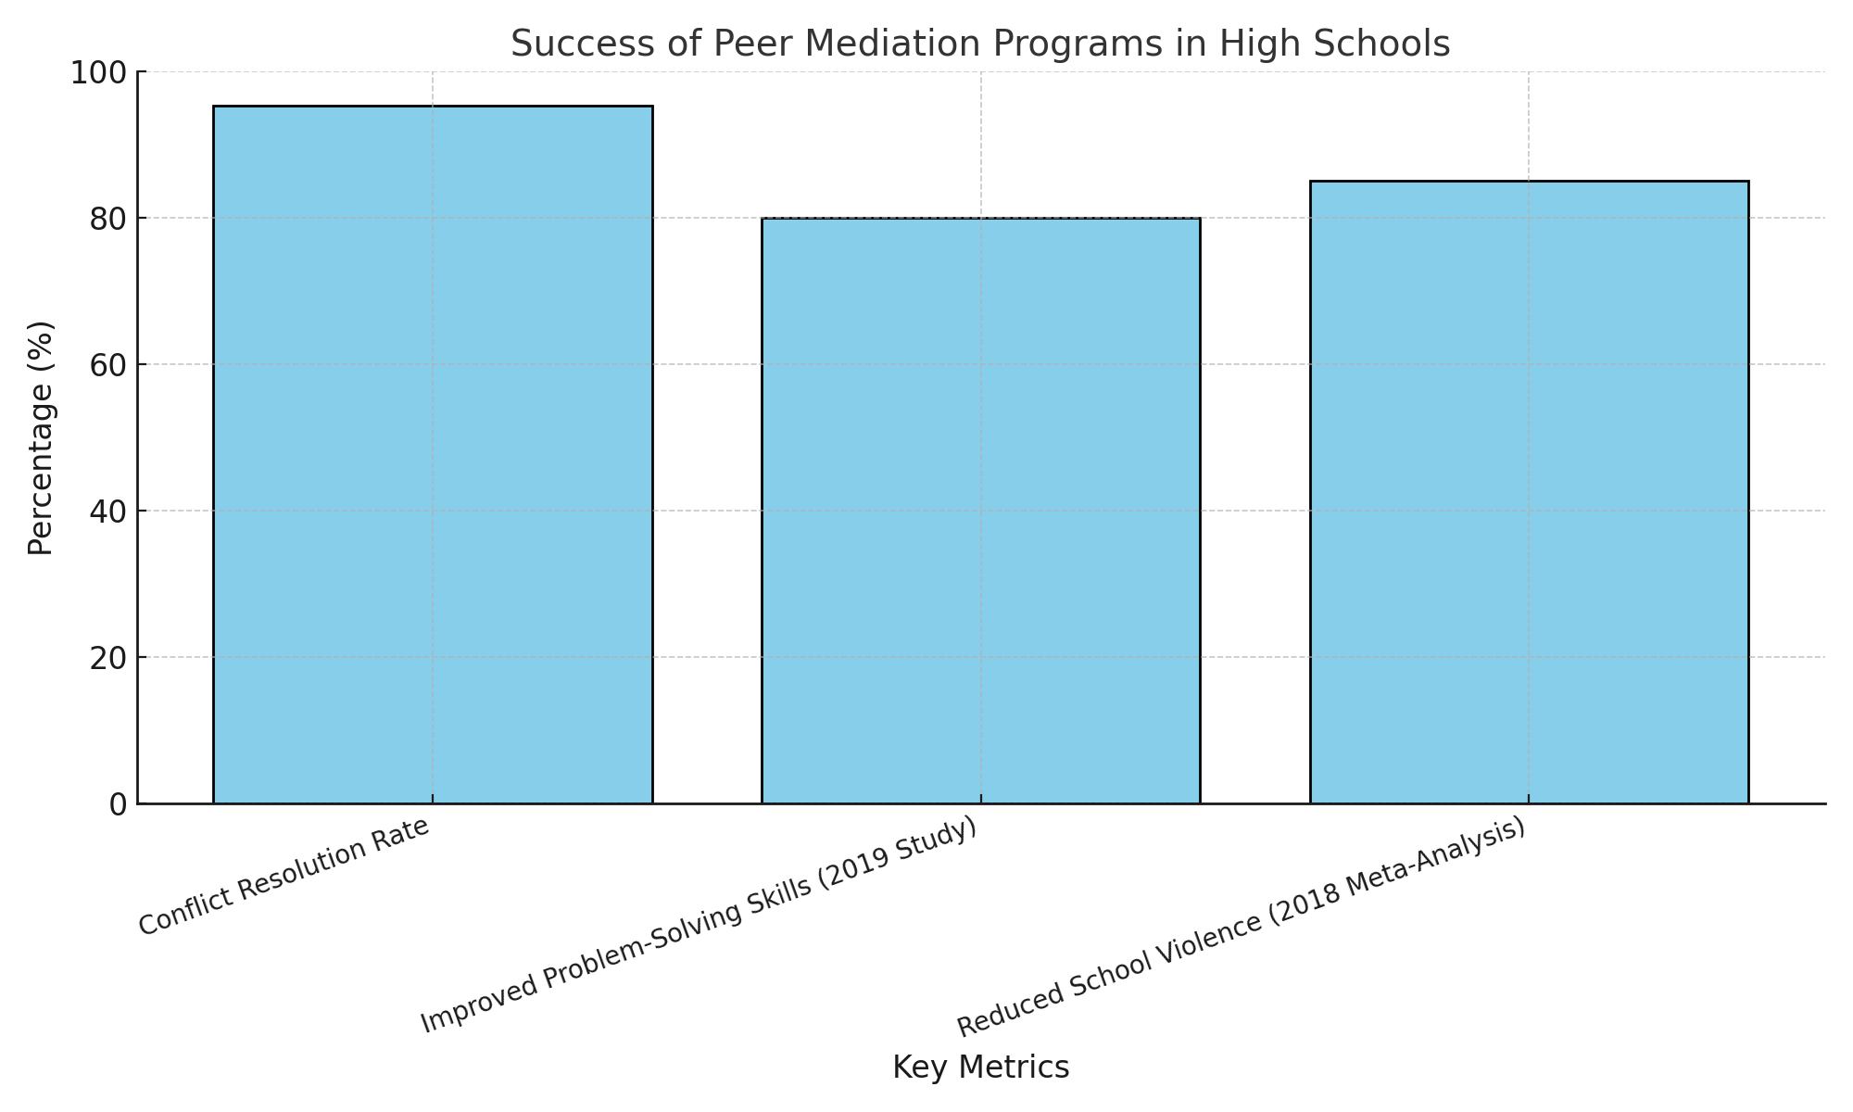
Success of Peer Mediation Programs in High Schools
Key Data:
- Conflict Resolution Rate: 95.31% of cases resolved successfully (Auburn University Study).
- Improved Problem-Solving Skills: Students gained conflict resolution and negotiation skills (2019 Study, International Journal of Instruction).
- Reduced School Violence: Programs reduced school violence and improved school climate (2018 Meta-Analysis).
Further Reading:
- 2019 Study on Negotiation Training: https://files.eric.ed.gov/fulltext/EJ1220189.pdf
- 2018 Meta-Analysis on Conflict Resolution: https://files.eric.ed.gov/fulltext/EJ1165110.pdf
- Auburn University Peer Mediation Evaluation: https://etd.auburn.edu/bitstream/handle/10415/1353/Ridley_Cami_49.pdf

Slide 20

Welcoming the Access Project
What is the Access Project?
- A program that identifies and removes barriers for student success.
Key Features:
- Triage system for student needs.
- Referrals to community resources.
- Poetry and therapy class offering.
Our Goal:
- Provide equitable access to support services for all students.

Slide 21
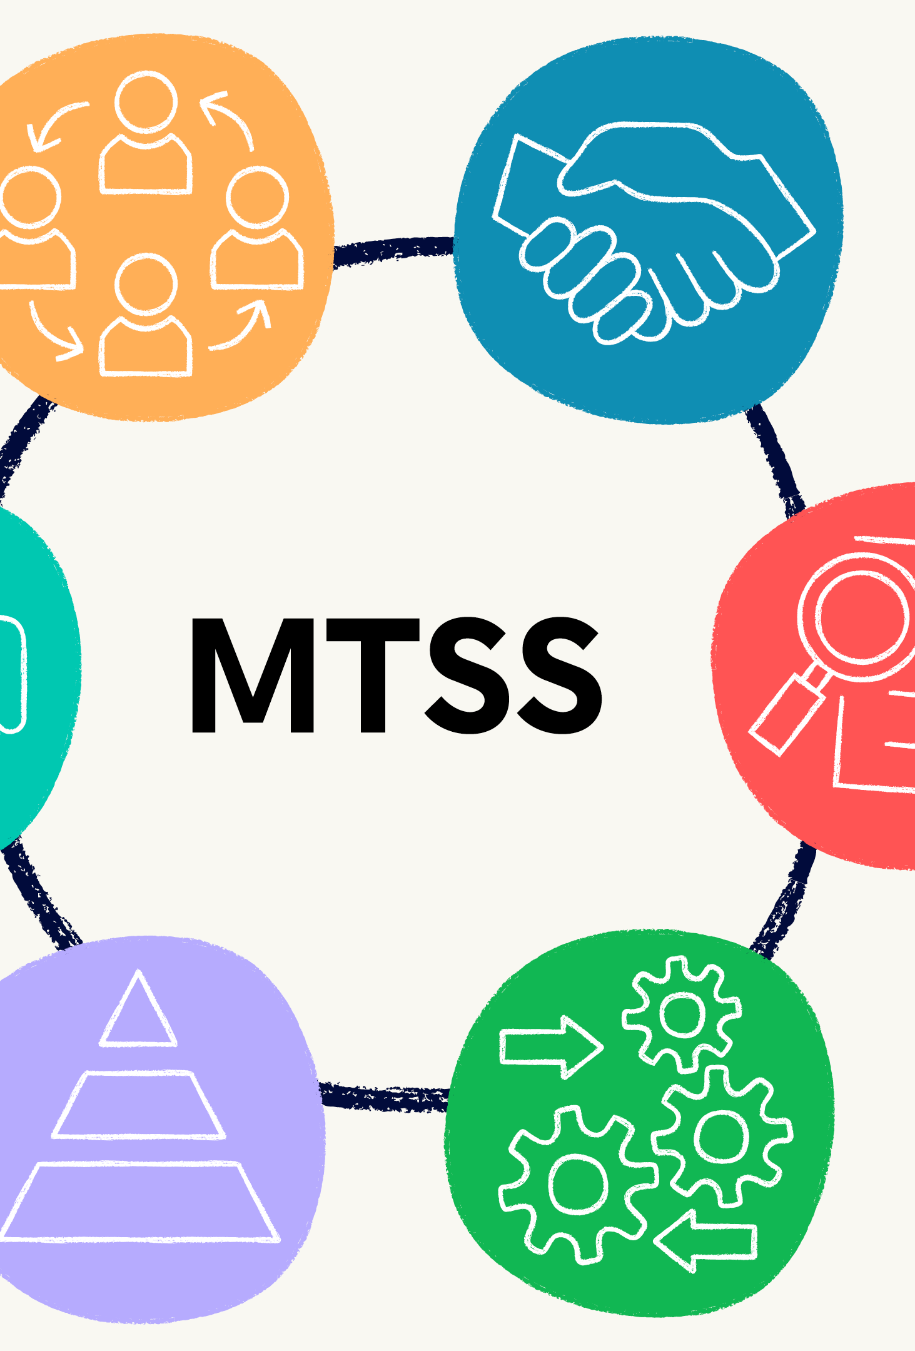
Building a Strong MTSS Framework
Where We Are:
- New MTSS team formed to improve academic, SEL, and behavioral interventions.
Your Role:
- Collaborate and share feedback to shape our framework.
Action Step:
- Complete the MTSS Feedback Google Form (link sent via email).
Upcoming Initiatives:
- Tiered supports tailored to classroom needs.
- Collaboration across departments for unified strategies.

Slide 22
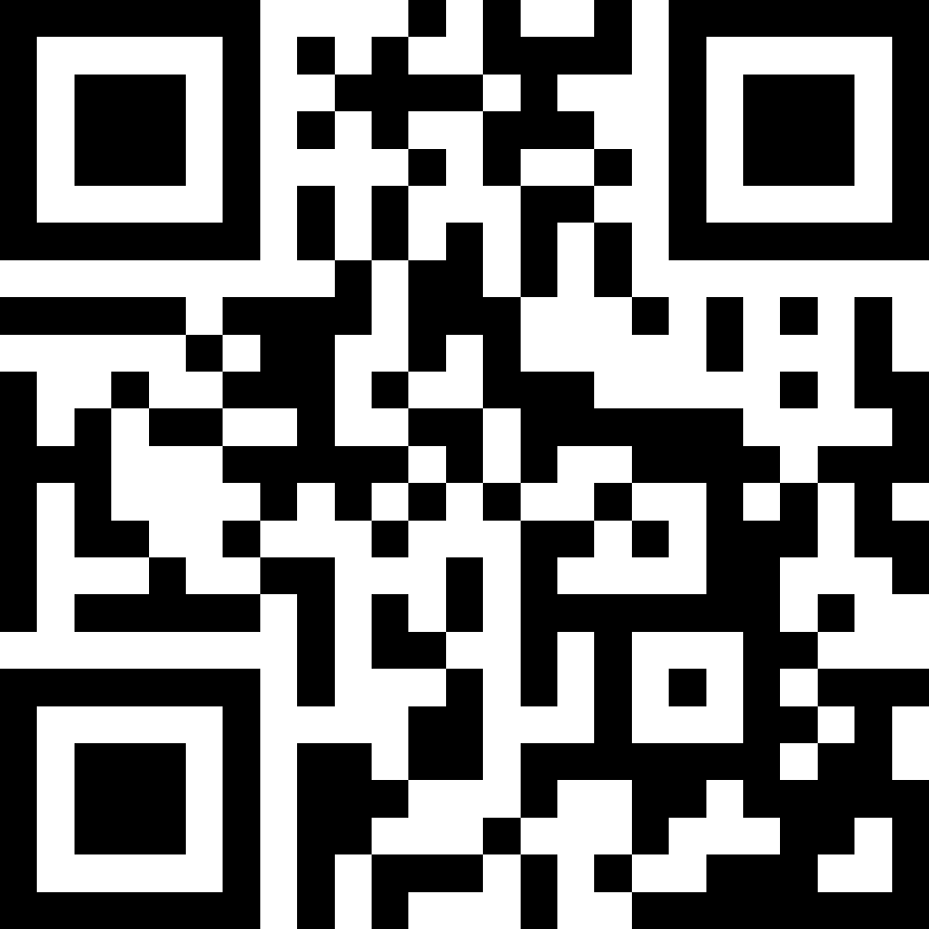

STAFF MTSS FEEDBACK
https://tinyurl.com/MTSSJackson

